Slide 1

C O M P E T I T I V E A D V A N T A G E. R E A L I Z E D.
GM Apprentice Validation Results:
Team Member Family - TMCB

Slide 2
Participant Sampling/Data Collection
Sampling procedures to target a representative set of participants
Standard data quality filters applied
Final matched sample = 139

Slide 3
Validation Sample Characteristics: Demographics (N = 139)
Race
  Caucasian 82%; African American 5.8%; Hispanic 2.9%; American Indian or Alaskan Native 2.2%; Other 1.4%; Not Reported 5.8%
Gender
  Male 84.9%; Female 11.5%; Not Reported 3.6%
Age
  Younger than 40 45.3%; 40 or Older 51.1%; Not Reported 3.6%
  Mean = 41.13 years; SD = 7.58 years

Slide 4
TMCB – Scoring Configuration
WSD Scales included:
    Adaptability
    Locus of Control
    Self-Efficacy
    Work Quality

Slide 5
WSD – Performance Composite Correlations (N = 139)
 | Overall Performance | Ability-related Performance | Motivation-related Performance | Interpersonal Performance | Bottom-line Performance
WSD Overall Score | .31 (.25)** | .23 (.18)* | .34 (.27)** | .33 (.26)** | .24 (.19)*
Note: Values in parentheses represent validity coefficients uncorrected for criterion unreliability.
* Denotes significance at the .05 level; **Denotes significance at the .01 level.

Slide 6
WSD – Competency Correlations (N = 137 - 139)
 | Applied Learning | Collaboration | Communication
WSD Overall Score | .26 (.21)** | .31 (.24)** | .33 (.26)**
 | Continuous Learning | Quality Orientation | Safety Awareness
WSD Overall Score | .38 (.30)** | .31 (.25)** | .31 (.25)**
 | Technical Skill | Work Standards | Technical Knowledge
WSD Overall Score | .21 (.16)* | .23 (.18)* | .13
Note: Values in parentheses represent validity coefficients uncorrected for criterion unreliability.
* Denotes significance at the .05 level; **Denotes significance at the .01 level.

Slide 7
WSD – Bottom-Line Correlations (N = 127-139)
 | Attendance | Speed to Performance | Avoid Misuse of Time
WSD Overall Score | .31 (.25)** | .21 (.17)* | .25 (.20)**
 | Advance through Program | Troubleshoot Equipment | Enter Receive on Computer
WSD Overall Score | .27 (.21)** | .13 | .06
Note: Values in parentheses represent validity coefficients uncorrected for criterion unreliability.
* Denotes significance at the .05 level; **Denotes significance at the .01 level.

Slide 8
WSD – Attitudinal Criteria Correlations (N = 134)
 | Engagement | Retention Likelihood
WSD Overall Score | .49 (.47)** | .34 (.32)**
Note: Values in parentheses represent validity coefficients uncorrected for criterion unreliability.
* Denotes significance at the .05 level; **Denotes significance at the .01 level.

Slide 9

US Department of Labor Guidelines for Interpreting Validity Coefficients
Validity Coefficient Value | Interpretation
Above .35 | Very beneficial
.21 - .35 | Likely to be useful
.11 - .20 | Depends on circumstances
Below .11 | Unlikely to be useful
.31 w/
Overall Perf
  TESTING AND ASSESSMENT: AN EMPLOYER’S GUIDE TO GOOD PRACTICES
  U.S. Department of Labor Employment and Training Administration, 2000

Slide 10
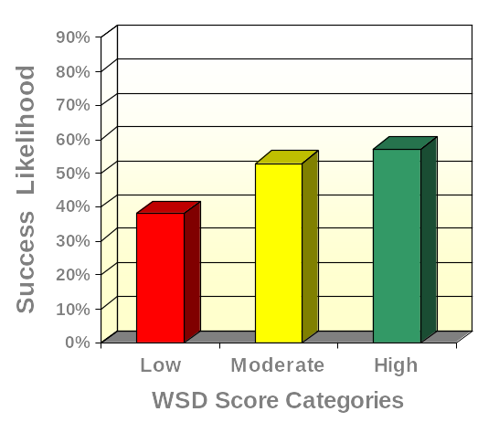
WSD and Overall Performance
(N = 139)
High Scorers
2.2 times more likely to succeed
than Low Scorers

Slide 11

WSD and Can-do Performance
(N = 139)
High Scorers
2.2 times more likely to succeed
than Low Scorers

Slide 12
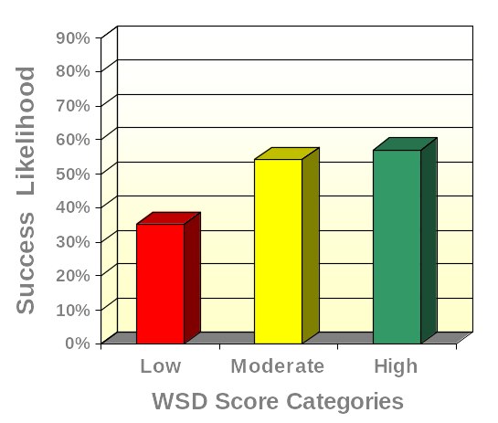
WSD and Will-do Performance
(N = 139)
High Scorers
2.4 times more likely to succeed
than Low Scorers

Slide 13
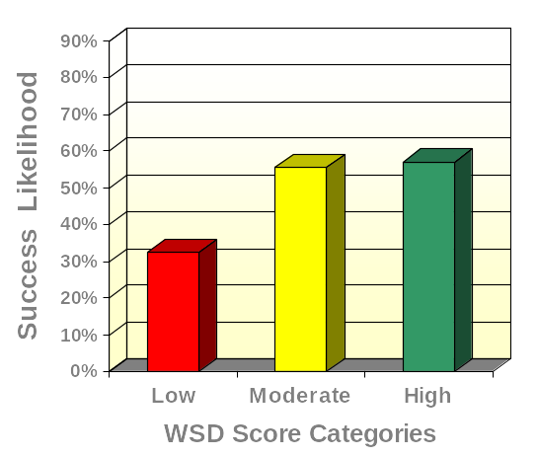
WSD and Interpersonal Performance (N = 139)
High Scorers
2.8 times more likely to succeed
than Low Scorers

Slide 14
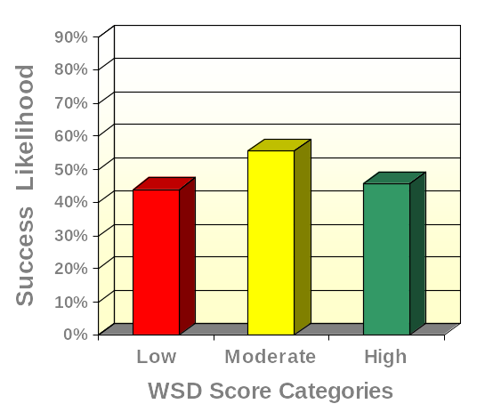
WSD and Bottom-line Performance (N = 139)
High Scorers
1.1 times more likely to succeed
than Low Scorers

Slide 15
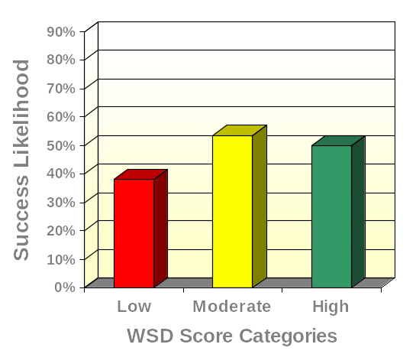
WSD and Applied Learning
(N = 137)
High Scorers
1.6 times more likely to succeed
than Low Scorers

Slide 16
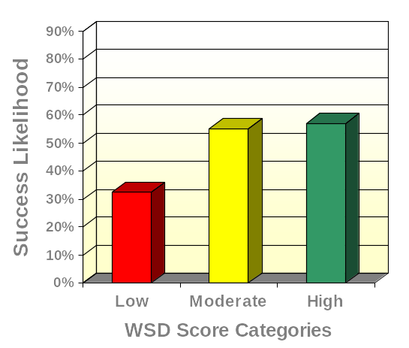
WSD and Collaboration
(N = 138)
High Scorers
2.8 times more likely to succeed
than Low Scorers

Slide 17
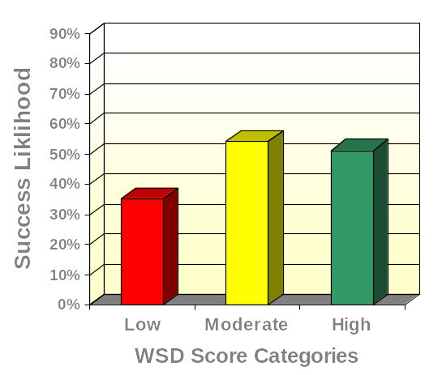
WSD and Communication
(N = 139)
High Scorers
1.9 times more likely to succeed
than Low Scorers

Slide 18
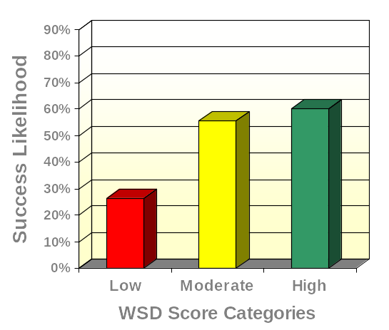
WSD and Continuous Learning (N = 139)
High Scorers
4.2 times more likely to succeed than Low Scorers

Slide 19
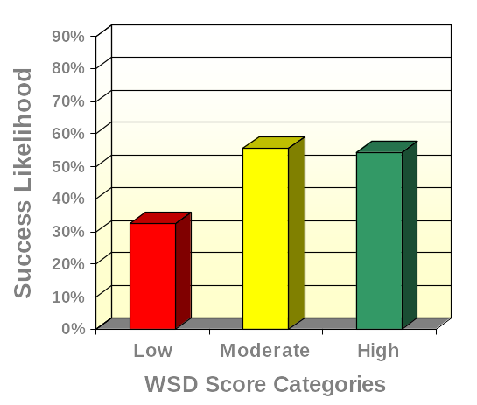
WSD and Quality Orientation
(N = 139)
High Scorers
2.5 times more likely to succeed than Low Scorers

Slide 20
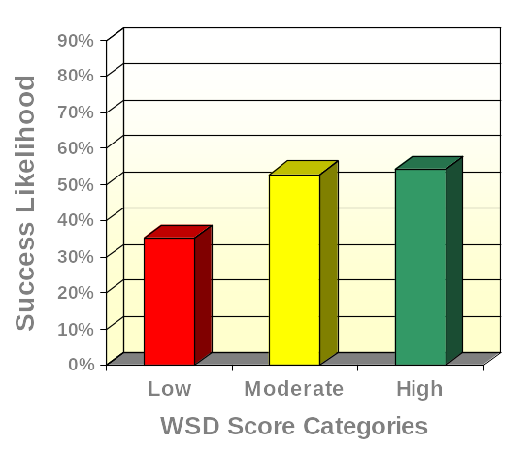
WSD and Safety Awareness
(N = 139)
High Scorers
2.2 times more likely to succeed than Low Scorers

Slide 21
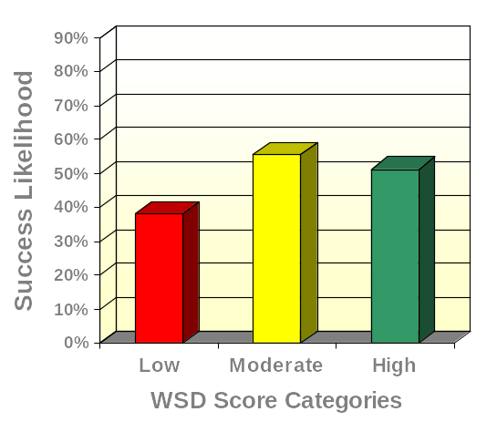
WSD and Technical Skill
(N = 139)
High Scorers
1.7 times more likely to succeed than Low Scorers

Slide 22
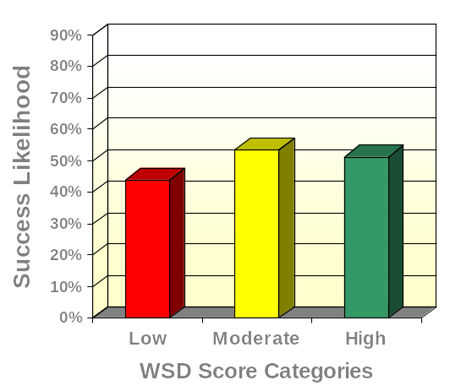
WSD and Work Standards
(N = 138)
High Scorers
1.3 times more likely to succeed than Low Scorers

Slide 23
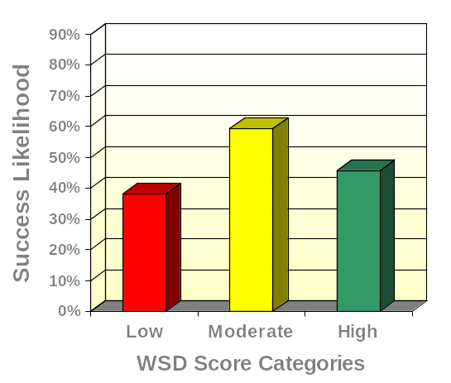
WSD and Technical Knowledge
(N = 138)
High Scorers
1.4 times more likely to succeed than Low Scorers

Slide 24
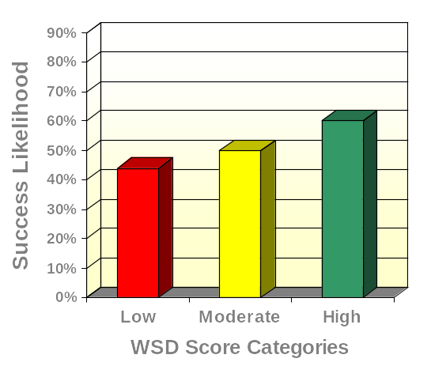
WSD and Attendance (N = 137)
High Scorers
1.9 times more likely to succeed than Low Scorers

Slide 25
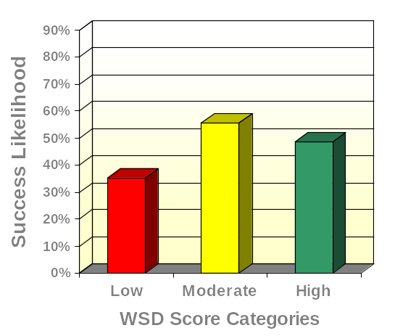
WSD and Speed to Performance (N = 139)
High Scorers
1.7 times more likely to succeed than Low Scorers

Slide 26
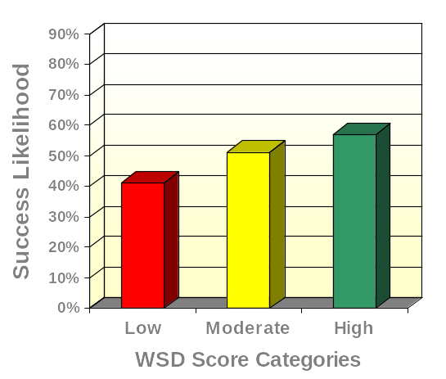
WSD and Avoiding Misuse of Time (N = 139)
High Scorers
1.9 times more likely to succeed than Low Scorers

Slide 27
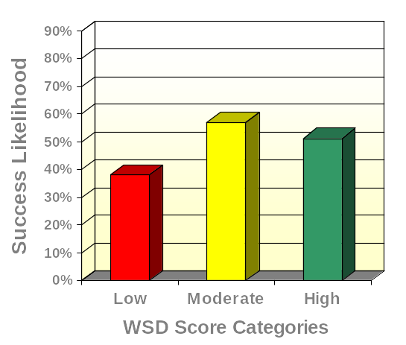
WSD and Advance through Program (N = 139)
High Scorers
1.7 times more likely to succeed than Low Scorers

Slide 28
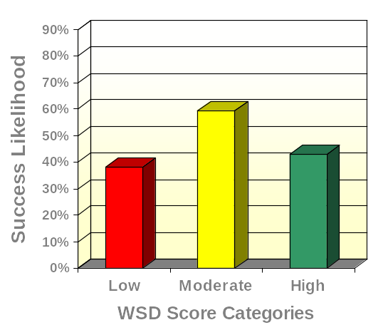
WSD and Troubleshoot Equipment (N = 138)
High Scorers
1.2 times more likely to succeed than Low Scorers

Slide 29
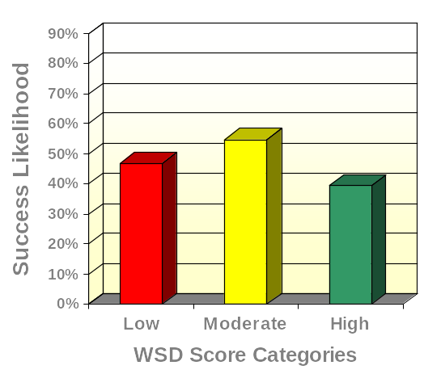
WSD and Enter Receive on Computer (N = 127)
High Scorers
.7 times more likely to succeed than Low Scorers

Slide 30
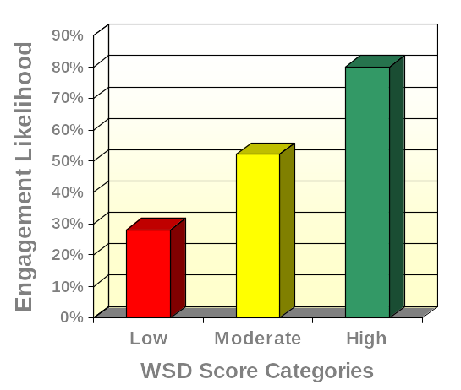
WSD and Engagement (N = 134)
High Scorers
10.2 times more likely to be engaged than Low Scorers

Slide 31
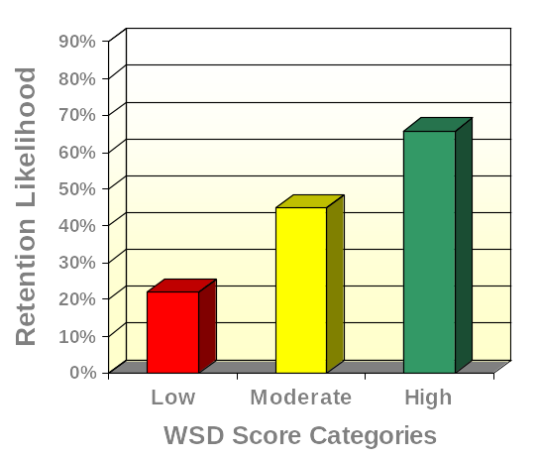
WSD and Retention Likelihood
(N = 134)
High Scorers
6.8 times more likely to report a high Intent to Stay than Low Scorers

