Slide 1

C O M P E T I T I V E A D V A N T A G E. R E A L I Z E D.
Westinghouse Validation Results:
Leader Job Family - LII

Slide 2
Participant Sampling/Data Collection
Extensive sampling procedures to obtain a representative set of participants
Standard data quality filters applied; few cases screened out
Final matched sample = 87

Slide 3
Validation Sample Characteristics: Demographics (N = 87)
Race
  White 66.7%; African American 12.67%; Hispanic 2.3%; Asian 1.1%; Native Hawaiian or Other Pacific Islander 1.1%; Other 2.3%; Not Reported 13.8%
Gender
  Male 81.6%; Female 5.7%; Not Reported 12.6%
Age
  Younger than 40 8.0%; 40 or Older 70.1%; Not Reported 21.8%
  Mean = 48.75; SD = 6.69

Slide 4
LII – Scoring Configuration
Factor scoring:
    Drives for Success 2
    Engages People 1
    Inspires Confidence 4
    Learning Agility 2
    Shows Discipline 1
    Sustains Positive Outlook 5
4 scales were dropped from scoring:
    WRJ: Situational Judgment & Delegation
    WSD (Drives for Success): Achievement Orientation
    BE: Initiative

Slide 5
LII – Performance Composite Correlations (N = 87)
 | Overall Performance | Ability-related Performance | Motivation-related Performance | Interpersonal Performance | Leadership Performance
LII Overall Score | .40 (.32)*** | .33 (.26)*** | .36 (.29)*** | .32 (.26)*** | .42 (.33)***
Note: Values in parentheses represent validity coefficients uncorrected for criterion unreliability.
** Denotes significance at the .05 level; ***Denotes significance at the .01 level.

Slide 6
LII – Competency Correlations (N = 87)
 | Work Standards | Coaching | Decision Making
LII Overall Score | .36 (.29)*** | .37 (.29)*** | .33 (.26)***
 | Communication | Managing Conflict | Leadership Disposition
LII Overall Score | .24 (.19)** | .37 (.29)*** | .43 (.34)***
Note: Values in parentheses represent validity coefficients uncorrected for criterion unreliability.
** Denotes significance at the .05 level; *** Denotes significance at the .01 level.

Slide 7
LII – Bottom-Line/Business Driver Correlations (N = 84-87)
 | Turnover for Direct Reports | Operational Costs | Comply Security Regulations | Comply Safety Standards
LII Overall Score | .32 (.25)*** | .41 (.33)** | -.12 | -.18
 | Enforce Internal Controls | Customer Service Culture | Process Innovation | Drive Efficiency
LII Overall Score | .23 (.19)** | .18 (.14)* | .19 (.15)* | .11
 | Create Alignment | Engage Employees | Drive Performance
LII Overall Score | .23 (.18)** | .20 (.16)* | .24 (.19)**
Note: Values in parentheses represent validity coefficients uncorrected for criterion unreliability. *Denotes significance at the .10 level; ** Denotes significance at the .05 level; ***Denotes significant at the .01 level.

Slide 8
LII – Attitudinal Criteria Correlations (N = 76)
 | Engagement | Retention Likelihood
LII Overall Score | .44 (.42)*** | .15
Note: Values in parentheses represent validity coefficients
uncorrected for criterion unreliability.
** Denotes significance at the .05 level;
*** Denotes significance at the .01 level.

Slide 9
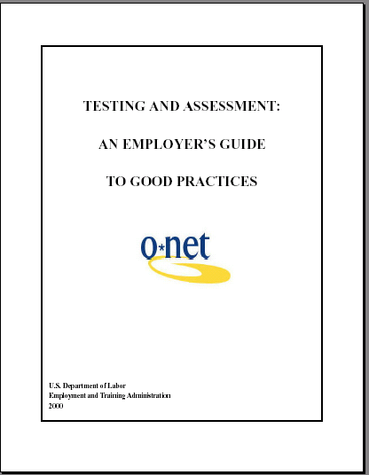
US Department of Labor Guidelines for Interpreting Validity Coefficients
Validity Coefficient Value | Interpretation
Above .35 | Very beneficial
.21 - .35 | Likely to be useful
.11 - .20 | Depends on circumstances
Below .11 | Unlikely to be useful
.40 w/
Overall Perf
  TESTING AND ASSESSMENT: AN EMPLOYER’S GUIDE TO GOOD PRACTICES
  U.S. Department of Labor Employment and Training Administration, 2000

Slide 10
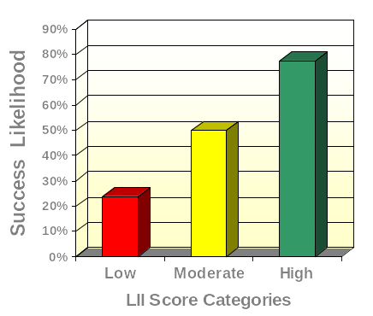
LII and Overall Performance
(N = 87)
High Scorers
10.9 times more likely to succeed
than Low Scorers

Slide 11
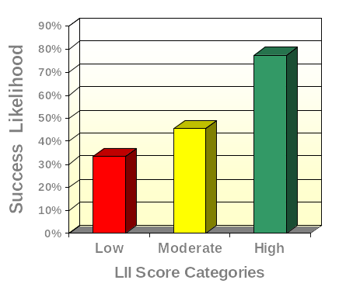
LII and Leadership Performance
(N = 87)
High Scorers
6.8 times more likely to succeed
than Low Scorers

Slide 12
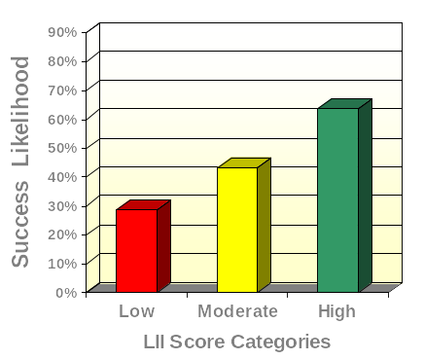
LII and Work Standards
(N = 87)
High Scorers
4.4 times more likely to succeed
than Low Scorers

Slide 13
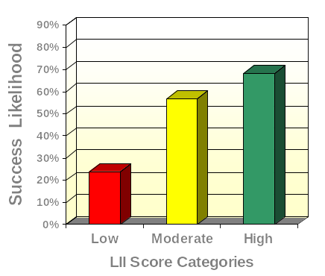
LII and Decision Making (N = 87)
High Scorers
6.9 times more likely to succeed
than Low Scorers

Slide 14
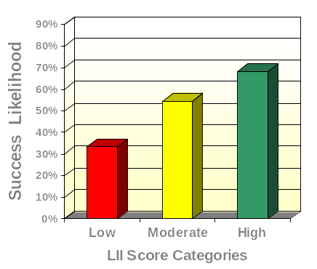
LII and Communication (N = 87)
High Scorers
4.3 times more likely to succeed
than Low Scorers

Slide 15
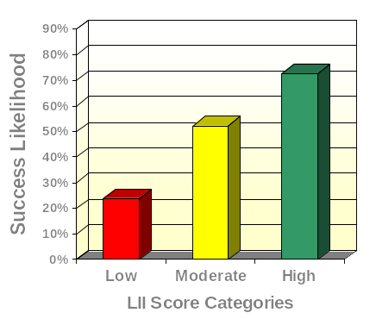
LII and Leadership Disposition
(N = 87)
High Scorers
8.5 times more likely to succeed
than Low Scorers

Slide 16
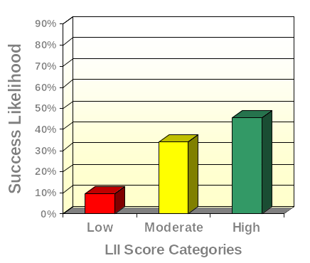
LII and Turnover for Direct Reports (N = 87)
High Scorers
7.9 times more likely to succeed
than Low Scorers

Slide 17
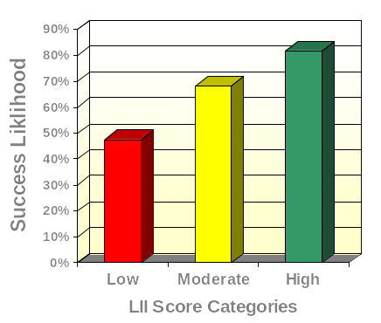
LII and Process Innovation (N = 87)
High Scorers
5.0 times more likely to succeed
than Low Scorers

Slide 18
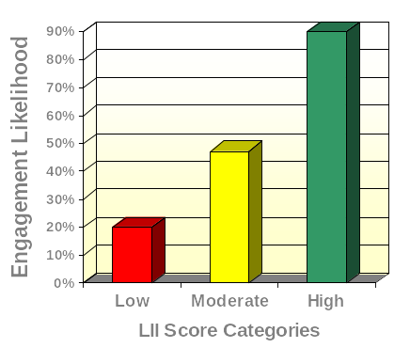
LII and Engagement (N = 76)
High Scorers
36.0 times more likely to be engaged
than Low Scorers

