Slide 1

C O M P E T I T I V E A D V A N T A G E. R E A L I Z E D.
Test Perceptions Across Cultures:
Construct Equivalence & Outcomes
Jill Budden, Ph.D.
Laurie Wasko, Ph.D.
Jeanne Makiney, Ph.D.
Development Dimensions International

Slide 2
Research Focus
Examine measurement invariance of test reactions/experience constructs between countries/region (U.S. and Asia).
Examine online test environment characteristics across countries/regions (U.S., Asia, Latin America)
Identify aspects of “culture” that influence the relationship between test reactions/experiences and test performance.
Notes:
Goal was to extend prior research showing some evidence that reactions vary by culture (Ryan et al, 1999; Salgado & Moscoso, 2003)
We focused on 3 areas:
Examined the comparability of the constructs (measurement invariance) between countries/regions
This step is key because different cultural frames-of-reference may impact comparisons between cultures
Investigated online test environment characteristics (e.g., environmental suitability, user-friendliness/efficiency) across countries.
Explored which aspects of “culture” influence test-taker reactions to/perceptions of an online testing environment, and which aspects affect the reactions to test performance relationship (i.e., we examined culture as a moderator).

Slide 3
Culture/Demographic/Environment Variables (potential moderators)
Country/Region
  U.S.
  Asia (e.g., Thailand, Hong Kong, Beijing, Shanghai)
  Latin America (e.g., Puerto Rico, Mexico)
Gender
Age
Education
  High School
  Post High School/ Technical/Vocational School
  BA/BS
  Master’s and above
Type of Test
  Entry (sales, team member)
  Leader (leader, professional)
Test-taking Location
  Home
  Public
  Proctored
Language (for Latin America only)
  English
  Spanish
Notes:
Reference the Culture/Demographic/Environment variables that were examined:
Country/Region - US, Asia region drawn from countries such as Thailand and Shanghai, and Latin America drawn from countries such as Puerto Rico and Mexico
Gender (US / Asia / Latin America)
Age (US / Asia / Latin America)
Education (Asia / Latin America) – not explored in US sample
Type of Test (Asia / Latin America) - not explored in US sample
Test-Taking Location (US / Asia / Latin America) – this variable focused on the physical location where the test was taken (home, public area like a library, or in a proctored/controlled environment)
Language (Latin America only) - not explored in US or Asia sample

Slide 4
Method: Sample Characteristics
U.S.
N = 358; k = 2
Entry-level (100.0%)
Male (78.2%)
Home (75.1%) vs. Proctored (0.0%) vs. Public (12.8%)
Age: M = 31.00
Asia
N = 1408; k = 7
Entry-level (70.7%)
Male (70.7%)
Home (60.9%) vs. Proctored (13.4%) vs. Public (6.3%)
Age: M = 29.86
Education: 77.6% college degree or above
Latin America
N = 388; k = 3
Entry-level (74.2%)
Male (40.0%)
Home (43.0%) vs. Proctored (7.5%) vs. Public (8.0%)
Age: M = 31.52
Education: 77.2% college degree or above
Spanish (80.4%) vs. English (19.6%)
Notes:
This slide shows an overview of the characteristics of the sample
For each country/region we combined samples from variety of clients – client sample N ranged from 11 to 371 and gathered test, environment, and demographic characteristics

Slide 5
Method: Measures
Leader or Entry level selection test
  Situational Judgment
  Personality
  Background Experience
Feedback Questionnaire
  Quality of the Testing Environment
  User-friendliness/ efficiency
  Perceived Content Validity
  Perceived Predictive Validity
  Previous On-line Job Search Experience
Notes:
Candidates taking a leader or entry level selection test were then asked to complete reactions questionnaire that contained items assessing reactions to the test, and to the testing process, as well as familiarity completing selection processes online.
Reactions assessed included:
Perceptions of the testing environment (level of distractions, etc.),
Perceptions of User-friendliness/efficiency of the process
perceptions of the content validity of the test (e.g., seeing a relationship between the test and what is required on the job)
Perceptions of the predictive validity of the test. (e.g., seeing a relationship between high performance on the test and good performance on the job)
Previous job search experience (familiarity completing the hiring processes online).

Slide 6
Analyses
Cross-Cultural (U.S. and Asia) Construct equivalence
  Examined using multi-group SEM
  Follow-up SEM analyses conducted to examine item mean level equivalence
Within country/region moderator analyses
  Examined impact of other cultural demographic factors (e.g., age, education, gender) on the relationship between test reactions and test performance
  Univariate GLM and follow-up simple effects analyses
Notes:
Direct comparisons of relationships across cultures require measures to exhibit equivalence across groups. Therefore, we first looked at cross cultural construct equivalence of the reactions factors. We followed this analysis with moderator analyses within each country/region to examine the impact of other cultural, demographic, and environmental factors on the relationship between test reactions and test performance

Slide 7
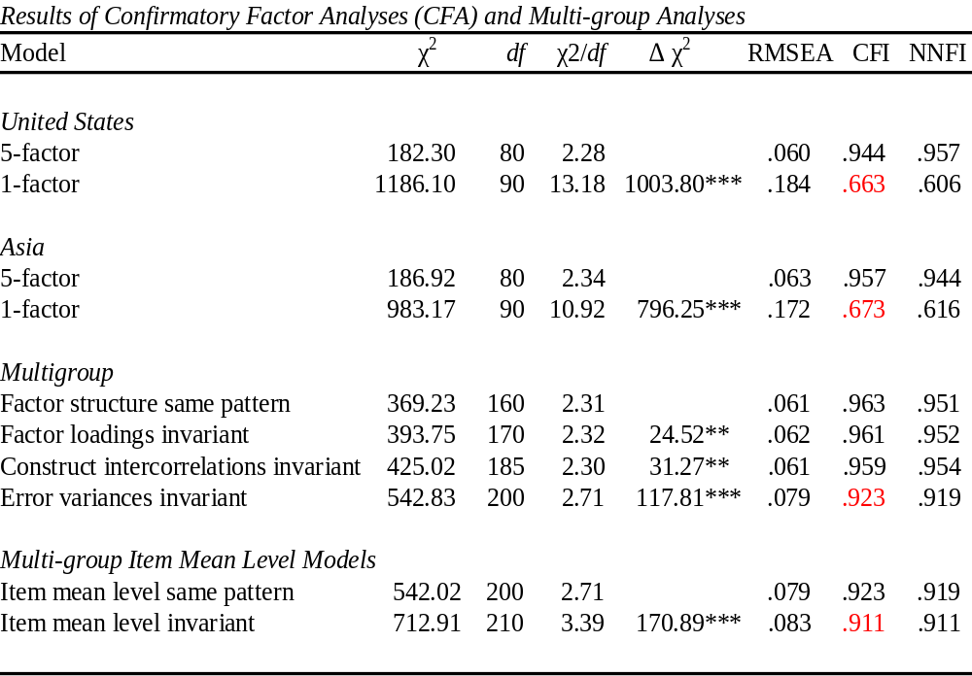
Notes:
Conducted multi-group SEM analysis using Lisrel 8.0 .
When looking at the majority of the fit indices, we found partial measurement invariance
The fit indices indicated the factor structures,factor loadings, and construct interrcorrelations were invariant
However, the error variances and item mean levels not equivalent
*******
Five factor model of facets of test reactions a better fit than one factor model of overall reactions –for both the US and Asia, fit statistics indicated better fit for 5 factor model than 1 factor model
Factor structures were equivalent (same pattern) – Multigroup 1st line of data – fit indices within acceptable limits
Factor loadings were equivalent (invariance) – multigroup 2nd line of data
Construct intercorrelations were equivalent (invariance) – Multigroup 3rd line of data
Error variances were not equivalent - Multigroup 4th line of data – fit indices declined
Item mean levels were not equivalent – Multigroup item mean level same pattern vs invariant – invariant showed lower fit
∆CFI greater than -.01 are highlighted in red

Slide 8
T-tests: Explore item mean level differences
U.S. had higher means on all items
U.S. and Asia were similar on:
  Perceived Content Validity d = .12.
U.S. scored higher than Asia on:
  Perceived Predictive Validity d = .35.
  Testing Environment, d = .26.
  User-Friendliness/Efficiency, d = .81.
  Previous Job Search Experience, d = .48.
Notes:
Because we found item mean levels were not equivalent, we explored this further.
Found us higher on all items / for perceived content validity US and Asia were similar / for the other facets, US had higher mean scores
Largest effects for US user friendliness and previous online job search experience

Slide 9
Test Reaction →Test Performance
Results Summary
 | Gender (U.S., A, L.A.) | Age (U.S., A, L.A.) | Educ. (A, L.A.) | Type of Test (A, L.A.) | Location (U.S., A, L.A.) | Lang. ( L.A.) | MAIN EFFECT
Testing Environment |  | A
User-friendliness/ Efficiency |  |  |  |  | U.S. |  | A / U.S.
Perceived Content Validity | A |  | A | A
Perceived Predictive Validity |  | L.A. |  |  |  |  | A / U.S.
Previous Job Search Experience | L.A. |  |  |  |  | L.A. | U.S.
Notes:
The next set of analyses was conducted to examine aspects of “culture” that influence the perceptions/reactions to performance relationship. Univariate GLM where Overall Test Score was the DV. Regressed Overall Test Score on the set of moderators, perceptions variables, and interactions between one potential moderator and all perceptions variables). This was conducted separately for each potential moderator within each country/region.
Education and Test-type were not examined in the US sample
Language only relevant to Latin America sample
Overall themes –
Perceived CV in Asia interacted with a number of demographic and environmental variables. Latin America Perceived predictive validity and previous job search experience interacted with a number of demographic and environmental variables
*****
RESULTS
US:
SIMPLE EFFECTS:
User-friendliness/Efficiency → Overall Test Score (Test-taking location = HOME) β = .06, ns (n = 269)
User-friendliness/Efficiency → Overall Test Score (Test-taking location = PUBLIC) β = .42, p < .01 (n = 46)
Interpretation: in the PUBLIC testing location, as user-friendliness reactions went up test score went up… Individuals who perceived the PUBLIC environment as less user-friendly/efficient may have artificially lower test scores…
****************************************
ASIA
SIMPLE EFFECTS:
Type of Test
Perceived Content Validity → Overall Test Score (Type of Test = TMCB) β = .09, p = .07 (n = 382)
Perceived Content Validity → Overall Test Score (Type of Test = LCB) β = .30, p < .001 (n = 118)
Perceived Content Validity → Overall Test Score (Type of Test = SCB) β = .09, p < .05 (n = 613)
Perceived Content Validity → Overall Test Score (Type of Test = PCB) β = .15, p < .01 (n = 295)
Interpretation: As Perceived Content Validity goes up, Overall Test Score goes up (this relationship is strongest for applicants taking Leader and Professional tests)… there is basically no relationship between Perceived Content Validity and Overall Test Score for applicants taking Sales and Team Member (entry-level) tests.
Gender
Perceived Content Validity → Overall Test Score (Gender = Male) β = .13, p < .001 (n = 995)
Perceived Content Validity → Overall Test Score (Gender = Female) β = .24, p < .001 (n = 395)
Interpretation: The relationship between Perceived Content Validity and Overall Test Score is stronger for Females.
Education
Perceived Content Validity → Overall Test Score (Education = no degree) β = -.43, ns (n = 3)
Perceived Content Validity → Overall Test Score (Education = High School) β = .36, p < .001 (n = 77)
Perceived Content Validity → Overall Test Score (Education = Post High school/Tech or Vocational school) β = -.05, ns (n = 230)
Perceived Content Validity → Overall Test Score (Education = BA or BS) β = .20, p < .001 (n = 865)
Perceived Content Validity → Overall Test Score (Education = Master & above) β = .16, p < .05 (n = 211)
Age
Mean age = 29.86
SD = 6.57
Test Environment → Overall Test Score (age = high) β = .05, ns
Test Environment → Overall Test Score (age = moderate) β = .12, p < .001
Test Environment → Overall Test Score (age = Low) β = .18, p < .001
****************************************
Latin America:
SIMPLE EFFECTS:
User-friendliness/Efficiency → Overall Test Score (Test-taking location = HOME) β = .06, ns (n = 269)
User-friendliness/Efficiency → Overall Test Score (Test-taking location = PUBLIC) β = .42, p < .01 (n = 46)
Interpretation: in the PUBLIC testing location, as user-friendliness reactions went up test score went up… Individuals who perceived the PUBLIC environment as less user-friendly/efficient may have artificially lower test scores…
****************************************

Slide 10
Test Environment →Test Performance
What Moderates?
↑
Asia
  Age F(1, 1004) = 3.91; p < .001.
    As age increased, the relationship between test environment and test performance increased

Slide 11
User Friendliness →Test Performance
What Moderates?
↑
United States
  Test-Taking Location F(2, 267) = 4.65; p < .05.
    Relationship found for Public testing location but not for Home

Slide 12
Perceived Cont. Val. →Test Performance
What Moderates?
↑
Asia
  Gender F(1, 1004) = 3.89; p < .10.
    Relationship was stronger for Females than for Males
  Education F(1, 1004) = 5.07; p < .05.
    No relationship for post high school/technical/vocational school
    Relationships for High School, BA/BS, and Master or above were significant
  Type of Test F(1, 1004) = 3.46; p < .10.
    Relationship was stronger for Leader and Professional test candidates than for entry-level candidates

Slide 13
Perceived Pred. Val. →Test Performance
What Moderates?
↑
Latin America
  Age F(1, 191) = 6.10; p < .05.
    As age increased, the relationship between perceived predictive validity and test performance increased

Slide 14
Prev. Online Job Search →Test Performance
What Moderates?
↑
Latin America
  Gender F(1, 191) = 6.95; p < .05.
    Relationship was strongest for Males
  Language F(1, 191) = 10.48;p < .01.
    Relationship was strongest for individuals taking the test in English

Slide 15
Main Effects:
Test Reaction →Test Performance
United States
  User-friendliness/efficiency (p < .05)
  Perceived Predictive Validity (p < .05)
  Previous Job Search Experience (p < .05)
Asia
  User-friendliness/efficiency (p < .05)
  Perceived Predictive Validity (p < .001)
Latin America
  No main effects
Notes:
All of the above are Main effects (positive relationships)
DV = Overall test performance
Asia (overall had lower usability scores).

Slide 16
Conclusions & Recommendations
Relationships between test reactions and Test Performance varied as a function of Culture (country/region and demographic variables)
Future research should further explore implications of these differences on the validity of test score inferences
Global rollouts of the same selection system should consider impact of differences in factors influencing the candidate’s experience (e.g., familiarity with online systems)
Notes:
The United States applicants had more favorable reactions to the employment testing process. Research has shown that test reactions are related to test performance. Hence, the finding that Asia applicants scored lower on test reactions has implications for selection system validity in Asia. That is, because of different experiences, frames of reference, and attitudes toward employment testing, assessment tools may have lowered validity in Asia versus the United States….
In Asia reactions to/perceptions of the test-taking experience are lower, and seem to have a fairly significant impact on Overall test scores:
ME for usability and perceived predictive validity (positive relationship – those who thought it was more user-friendly/efficient had higher test scores; those who thought that scores were representative of future job performance had higher scores.
Test score impacted by more than the applicant’s ability level

