Slide 1
001
HAND GESTURE DETECTION
SIGN LANGUAGE DETECTION
S I G N L A N G U A G E D E T E C T I O N

Slide 2

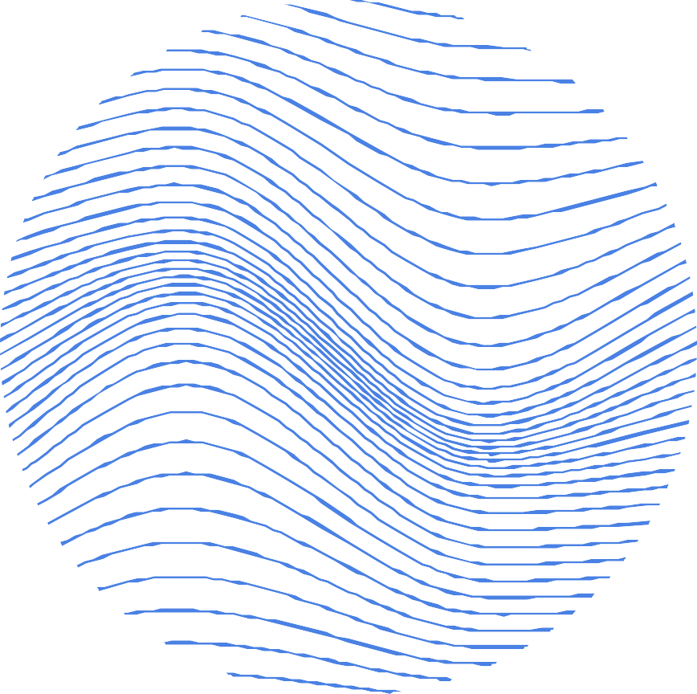
002
GROUP - 7
GROUP MEMBERS
JILL SHAH KHUSHEE VAKIL DHRUVI SHAH
- AU2040234
- AU2040242
- AU2040263
SIGN LANGUAGE DETECTION

Slide 3
INTRODUCTION
Hand gesture detection for sign language is a critical area of computer vision that aims to recognize and translate hand movements and positions into meaningful sign language. Sign language is an essential mode of communication for people with hearing impairments, and it allows them to communicate with others who do not understand sign language.
003
However, it can be a challenge for computer systems to interpret sign language since it involves recognizing hand gestures and movements in real-time. The primary objective of hand gesture detection is to develop an accurate and robust computer vision system capable of recognizing hand gestures and translating them into text or speech.
SIGN LANGUAGE DETECTION

Slide 4
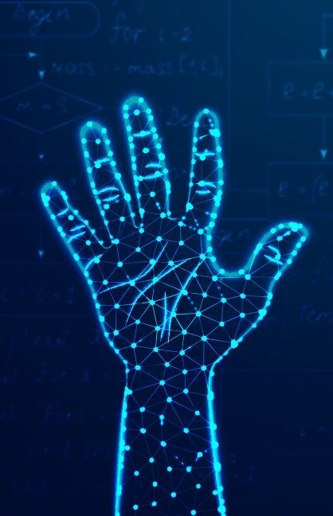
004
PROBLEM STATEMENT
Brief Introduction
The problem statement for hand gesture detection in sign language is to develop an automated system that can accurately recognize and translate hand gestures into text or speech in real-time. This system should be able to handle various hand gestures, recognize different hand positions, and adapt to different lighting conditions and backgrounds. Furthermore, the system should be reliable, efficient, and user- friendly, allowing people with hearing impairments to communicate with ease.
SIGN LANGUAGE DETECTION

Slide 5


005
WORK COMPLETED
In our project we are detecting the signed language using hand gestures. Till now we have completed the code in which our hand gets detected. This detects our hand along with the skeleton parts due to which it becomes easy for classifier to detect the shape of the hand. It also represents the name of the side which is being detected i.e right or left.
CURRENTLY WORKING ON
Currently we are working on how to train dataset so that it can recognize the specific alphabet in sign language and can display the relevant output.
EXISTING BODY OF WORK
SIGN LANGUAGE DETECTION

Slide 6




006
PROBLEMS BEING FACED
Occlusions and clutter: Hands can be partially occluded by other body parts, clothing, or objects, which can make it difficult to detect specific alphabets. Additionally, clutter in the background can interfere with the detection of hand gestures.
Lighting conditions: Lighting conditions can also affect the accuracy of hand gesture recognition systems. Poor lighting, shadows, and glare can make it difficult to accurately detect hand gestures.
Limited training data: Deep learning models used for hand gesture recognition require large amounts of training data. However, collecting and annotating large amounts of sign language data can be challenging and time-consuming, which can limit the availability of training data.
EXISTING BODY
OF WORK
SIGN LANGUAGE DETECTION

Slide 7
OUR APPROACH
007
Collect a sign language dataset: Collect a dataset of hand gesture images and videos for the sign language(s) you wish to recognize. The dataset should contain a wide variety of hand positions and movements, and it should be large enough to train your model.
Preprocess the data: Preprocess the dataset to improve its quality and prepare it for training. This could include resizing the images, normalizing the colors, and removing the background
Train a deep learning model: Develop a deep learning model that can recognize hand gestures in real-time. You can consider using CNNs or RNNs for this task. You may also use transfer learning to improve the model's accuracy and speed up training.
Evaluate the model: Evaluate the model's performance using a hold-out validation dataset. You can calculate metrics such as accuracy, precision, recall, and F1-score to determine the model's effectiveness.
SIGN LANGUAGE DETECTION

Slide 8
OUR APPROACH
008
Optimize the model: Optimize the model's hyperparameters, such as learning rate, batch size, and number of layers, to improve its performance.
Test the model: Test the model on a separate testing dataset to verify its performance. Ensure that the testing dataset contains a diverse set of images and videos, including challenging cases that may be difficult for the model to recognize.
Deploy the model: Deploy the model in a real-time setting and test its performance in different lighting conditions and backgrounds. You may need to make adjustments to the model or the hardware/software setup to improve its performance.
Monitor and improve the model: Monitor the model's performance in real-world scenarios and continuously improve it based on feedback from users or new sign language gestures.
SIGN LANGUAGE DETECTION

Slide 9
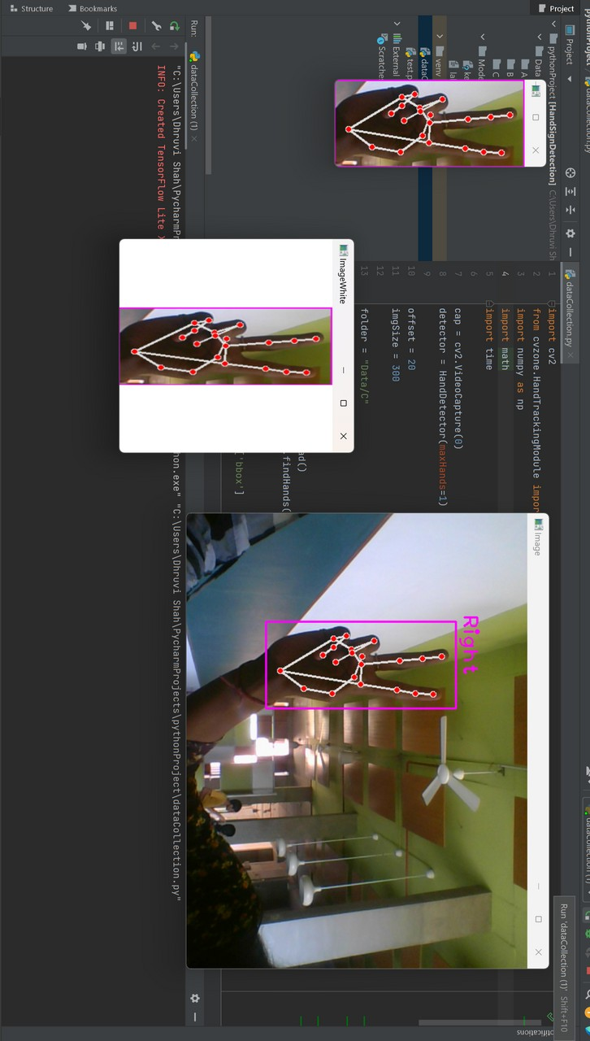
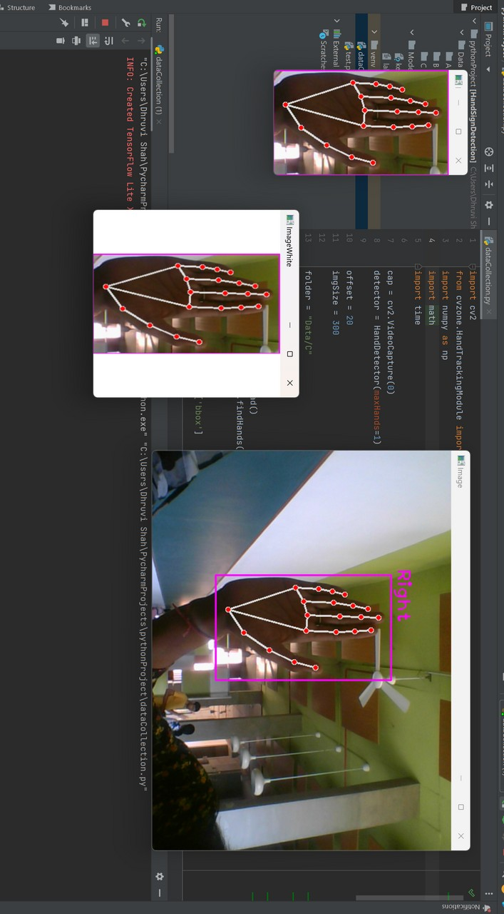
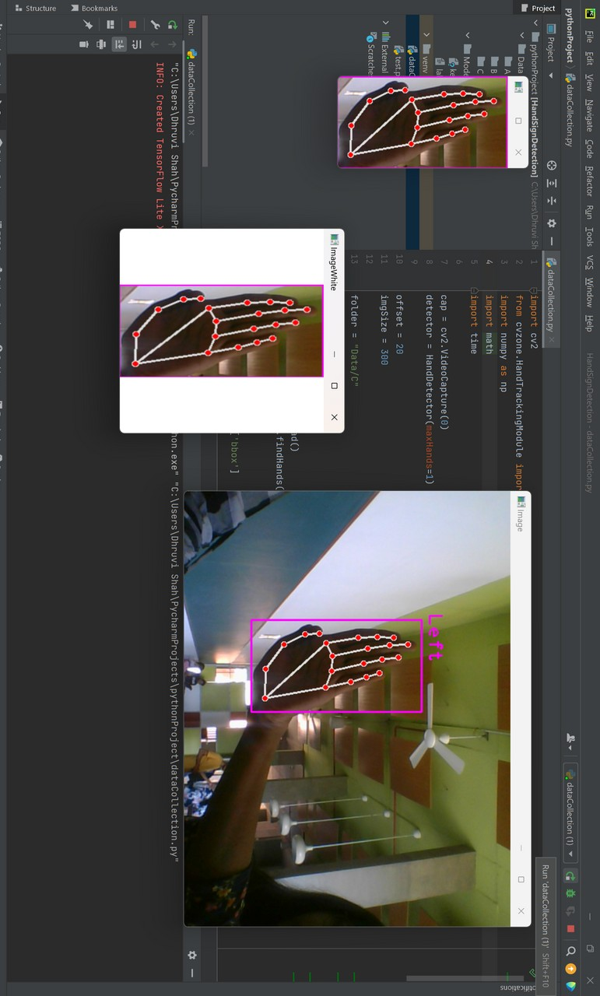
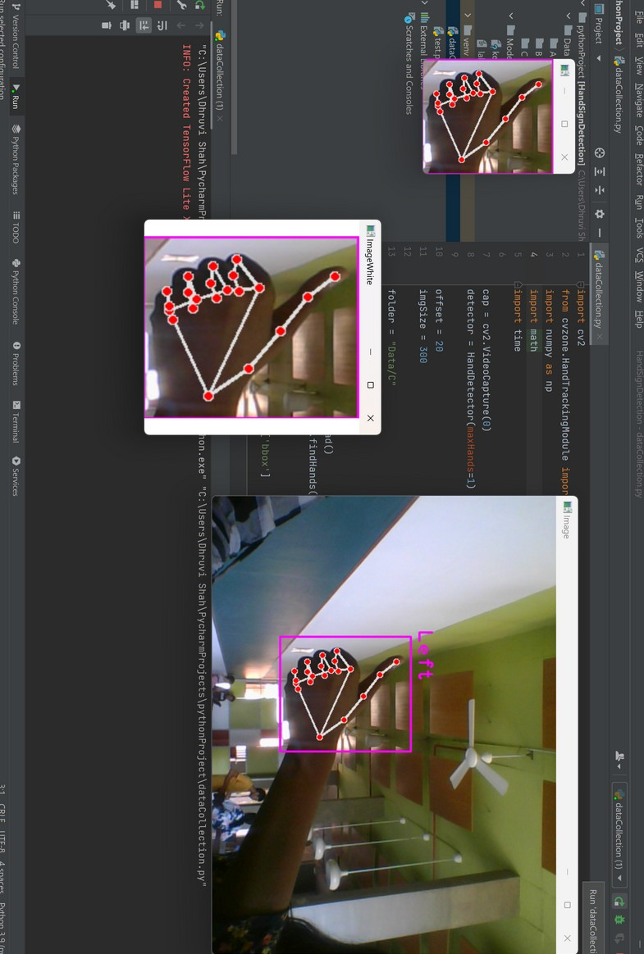
SIGN LANGUAGE DETECTION
INITIAL RESULTS
009

Slide 10





FUTURE WORK
010
ROLE OF EACH GROUP MEMBER
JILL SHAH - Organizing and cleaning data. KHUSHEE VAKIL - Collecting and cleaning data.
DHRUVI SHAH - Detecting hand
Training and testing of data is collectively done by all.
Once hands have been detected in sign language videos, the next step is to recognize the specific alphabets being made. Future work could focus on developing more accurate and robust algorithms for recognizing different sign language gestures.
SIGN LANGUAGE DETECTION

Slide 11





REFERENCES
Akash. (2018, April 22). Asl alphabet. Kaggle. Retrieved March 11, 2023, from https://www.kaggle.com/datasets/grassknoted/asl- alphabet
(2022). YouTube. Retrieved March 11, 2023, from https://youtu.be/wa2ARoUUdU8.
Hand sign detection (ASL). Computer Vision Zone. (2022, July 4). Retrieved March 11, 2023, from https://www.computervision.zone/courses/hand-sign-detection- asl/
SIGN LANGUAGE DETECTION

