Slide 1
Programming in Alice

Slide 2
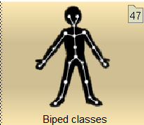
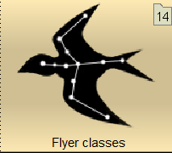
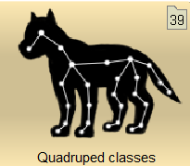
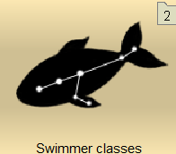
Joints

Slide 3
Programming
A Program
A program consists of objects which have:
Methods
Procedures
Functions
Properties
Can be predefined by the class, or added by you

Slide 4
Programming
Programming Constructs
Sequence (Do in order)
Conditional (Do something if a condition is true)
Iteration (Repetition e.g. count or while condition is true)
Concurrency (Do together)

Slide 5
Programming
Variables
A place to store something
Similar to algebra
Has:
A name – same rules as naming an object
A data type
Decimal Number
Whole Number
Text String
Defined Class

Slide 6
Programming
Keeping Score
Use a Text Model to display the score
Have a Scene property to hold the score
Add to it when the gamer scores
Use the SetValue method of the text model to display the score

Slide 7
Programming
Events
Scene Activation Event
Timer Event
Keyboard Event
Mouse Event
Position/Orientation Event

Slide 8
Programming
Mouse Events
addDefaultModelManipulation
addMouseClickOnObjectListener
addMouseClickOnScreenListener

Slide 9
Programming
Keyboard Events
addKeyPressListener
addArrowKeyPressListener
addNumberKeyPressListener
addObjectMoverFor

Slide 10
Programming
Position/Orientation Events
addCollisionStartListener
addCollisionEndListener
addProximityEnterListener
addProximityExitListener
addViewEnterListener
addViewExitListener
addOcclusionStartListener
addOcclusionEndListener
addPointOfViewChangeListener

Slide 11
Programming
Finding More Information
http://www.alice.org/resources/
How-to guides
Sample Programs
http://www.alice.org/forums/
Discussions
Help
Search for ‘Alice Programming’ on YouTube

