Slide 1
Exploring Alice
Introduction

Slide 2
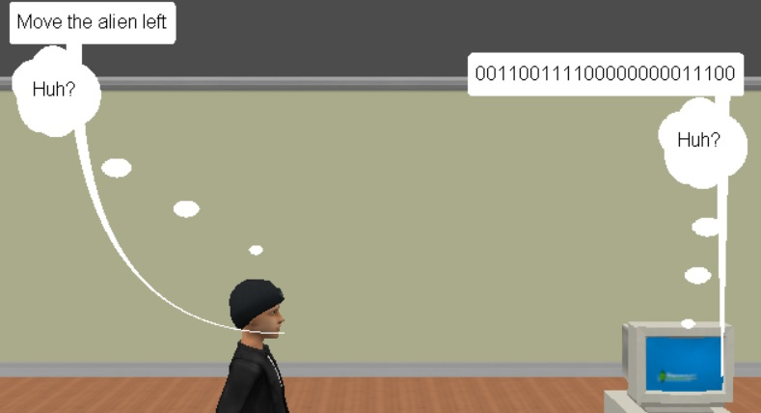
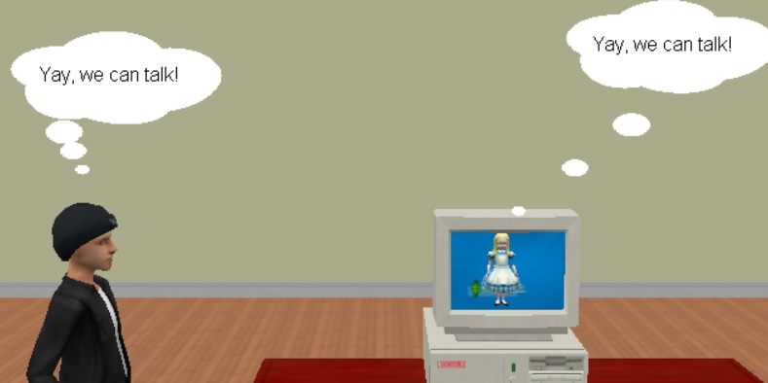
Introduction to Alice
What is Alice?
Alice is a programming language.
So what’s a programming language?
Computers only understand binary (0s and 1s)
This is hard for humans
We need an interpreter
Alice is the interpreter

Slide 3
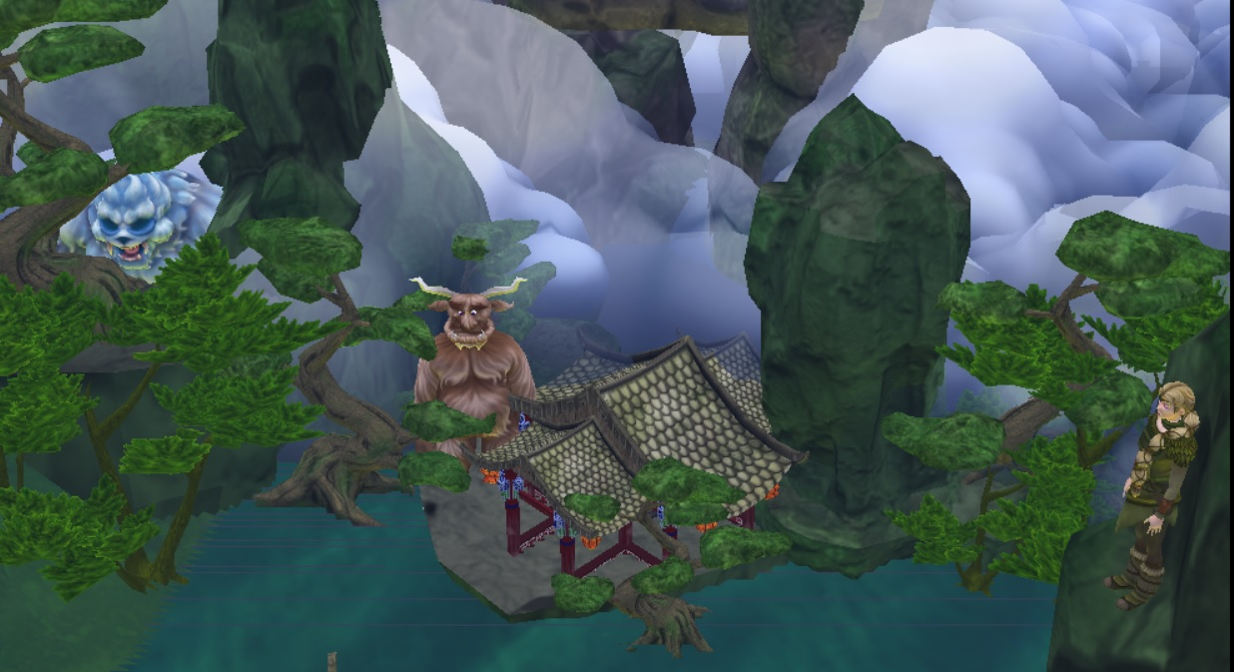
Alice Introduction
About Alice
- A fun and easy way to learn programming
- Created as a learning tool, so it may not do everything you want
- A great way to create animated stories and games, and bring your imagination to life
- Alice "worlds" are 3D - everything has height, width and depth
- Based on Java programming language
A World Created in Alice

Slide 4
Some Programming Words
Object - A thing that's a part of your program. For example, in a game, an object could be an alien, a child, an aeroplane or a tree.
Property - Something that an object has. For example, an alien may have a colour and a size; it also may have a head, a hand etc.
Method - A way of describing how something is done. There are two kinds of methods: procedures and functions. The difference will become clear later.
Class - A blueprint for creating similar objects.
Event - Something that happens. For example, the user clicks the mouse or presses a key on the keyboard.
Code - The instructions that make up a method.

Slide 5
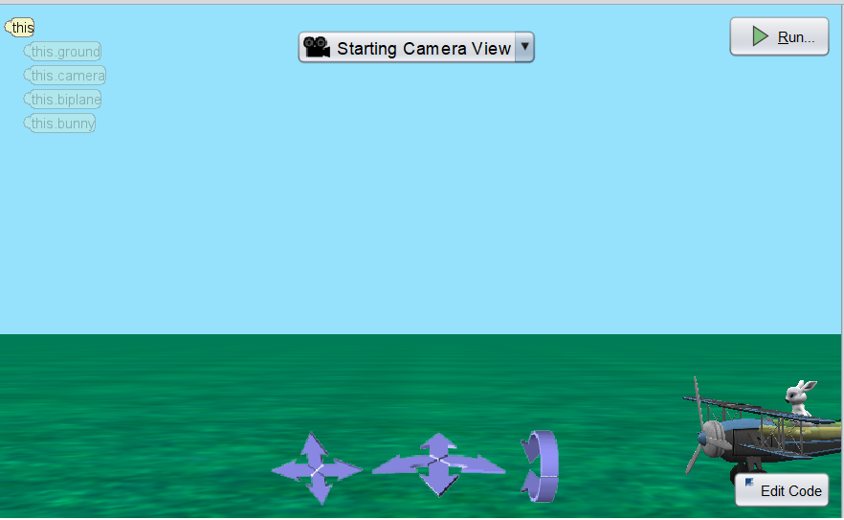
Intro to Scenes
Creating an Alice World
Creating a Scene
Two tasks:
Create a scene
Add some action
An Alice world has:
- A scene (the whole world)
A camera
The ground
Some objects

Slide 6
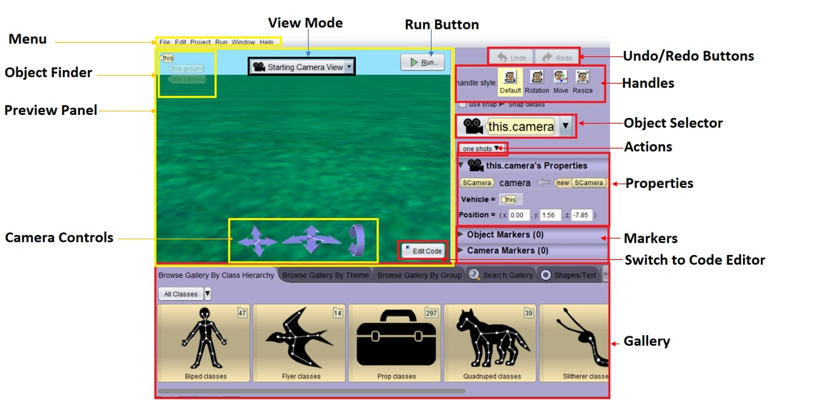
The Scene Editor
Intro Scene Editing

Slide 7
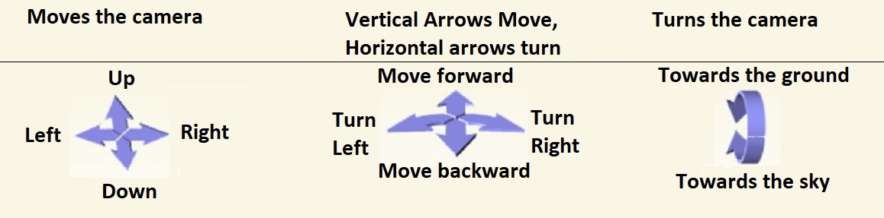
Camera Controls

Slide 8
Programming Words
More Programming Words
Method: A set of instructions for doing something.
Procedure: A method made up of a list of actions eg moving a character, make it say something.
Function: A method that gets some information eg get an aeroplane’s height above ground.
Parameter: A set of facts that limit how something can or must happen
Object-oriented: Everything is centred around objects. All methods belong to an object.

Slide 9
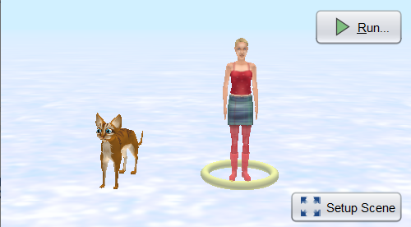
Planning
Planning Example
Kittycat says ‘Hello’
Suzie moves backwards in fright
Suzie says, ‘A talking cat??’
KittyCat says, ‘Yeah, I can also fly. Wanna come fly with me?’
Suzie turns to face KittyCat
KittyCat turns to face Suzie
Suzie says ‘Yeah!’
KittyCat jumps onto Suzie’s shoulder.
They fly away.

Slide 10
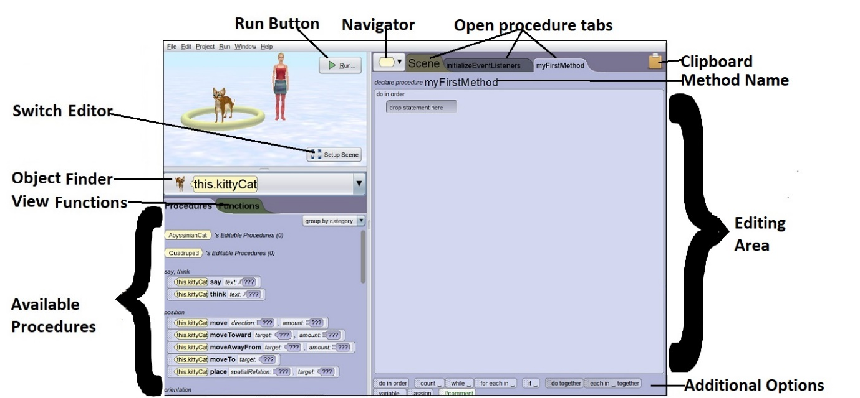
Code Editor
The Code Editor

Slide 11
Changes
Making Changes in Code Editor
Change a line: Click on the arrow next to the bit you want to change
Insert a line: Drag the new instruction in between the lines where you want it.
Move a line: Position on the grey area to the left; drag the instruction to the new place.
Delete a line: Right-click the grey area just to the left of the line; choose delete.
Duplicate a line: Right-click it; choose Copy to Clipboard; drag from clipboard to new place

Slide 12
Preview
Preview of Next Course
More about scene setting in 3-D
Moving sub-parts of an object, eg arms, legs and head.
Setting more than one scene in your world
Using text, billboards and shapes
Using repeated actions, conditional actions and do-together actions
Writing procedures, and importing procedures from other programs
Making programs interactive
Detecting collisions
Creating sound files with Audacity

