Slide 1
Cognitive Foundations of
Risk and Ambiguity Attitudes
Jilong Wu
Doctoral Public Defense · 2026

Slide 2
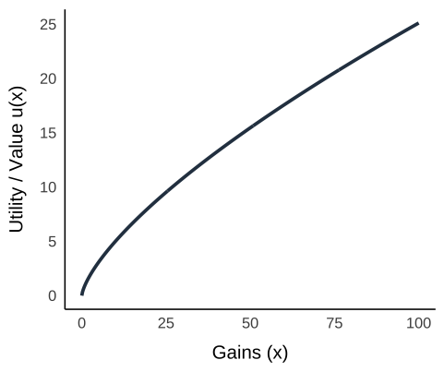
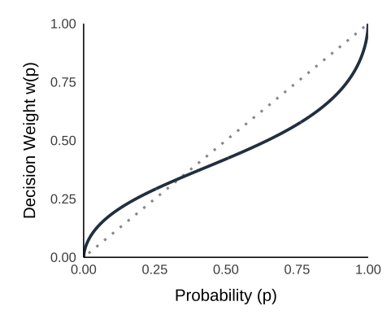
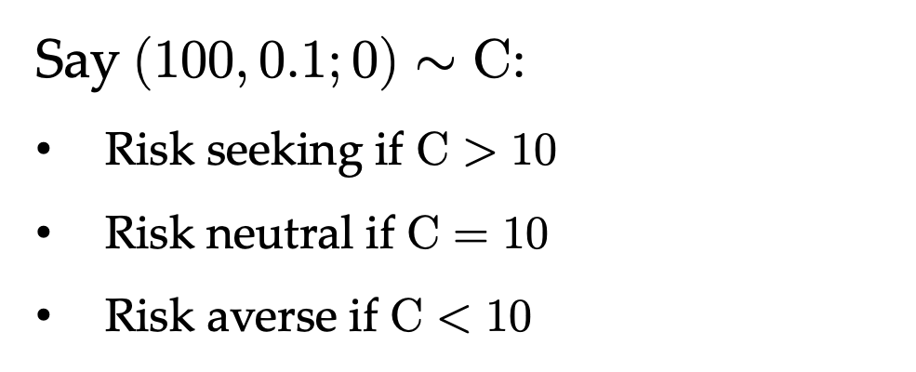
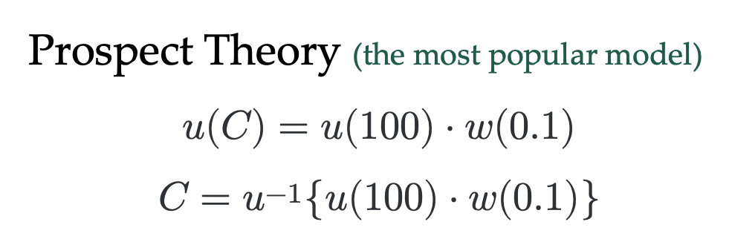
Background – Risk Behavior
Say $(100, 0.1;0)∼C$:
Risk seeking if $C>10$
Risk neutral if $C=10$
Risk averse if $C<10$
Prospect Theory (the most popular model)
$$u(C)=u(100)⋅w(0.1)$$
$$C=u^{−1}\{u(100)⋅w(0.1)\}$$

Slide 3
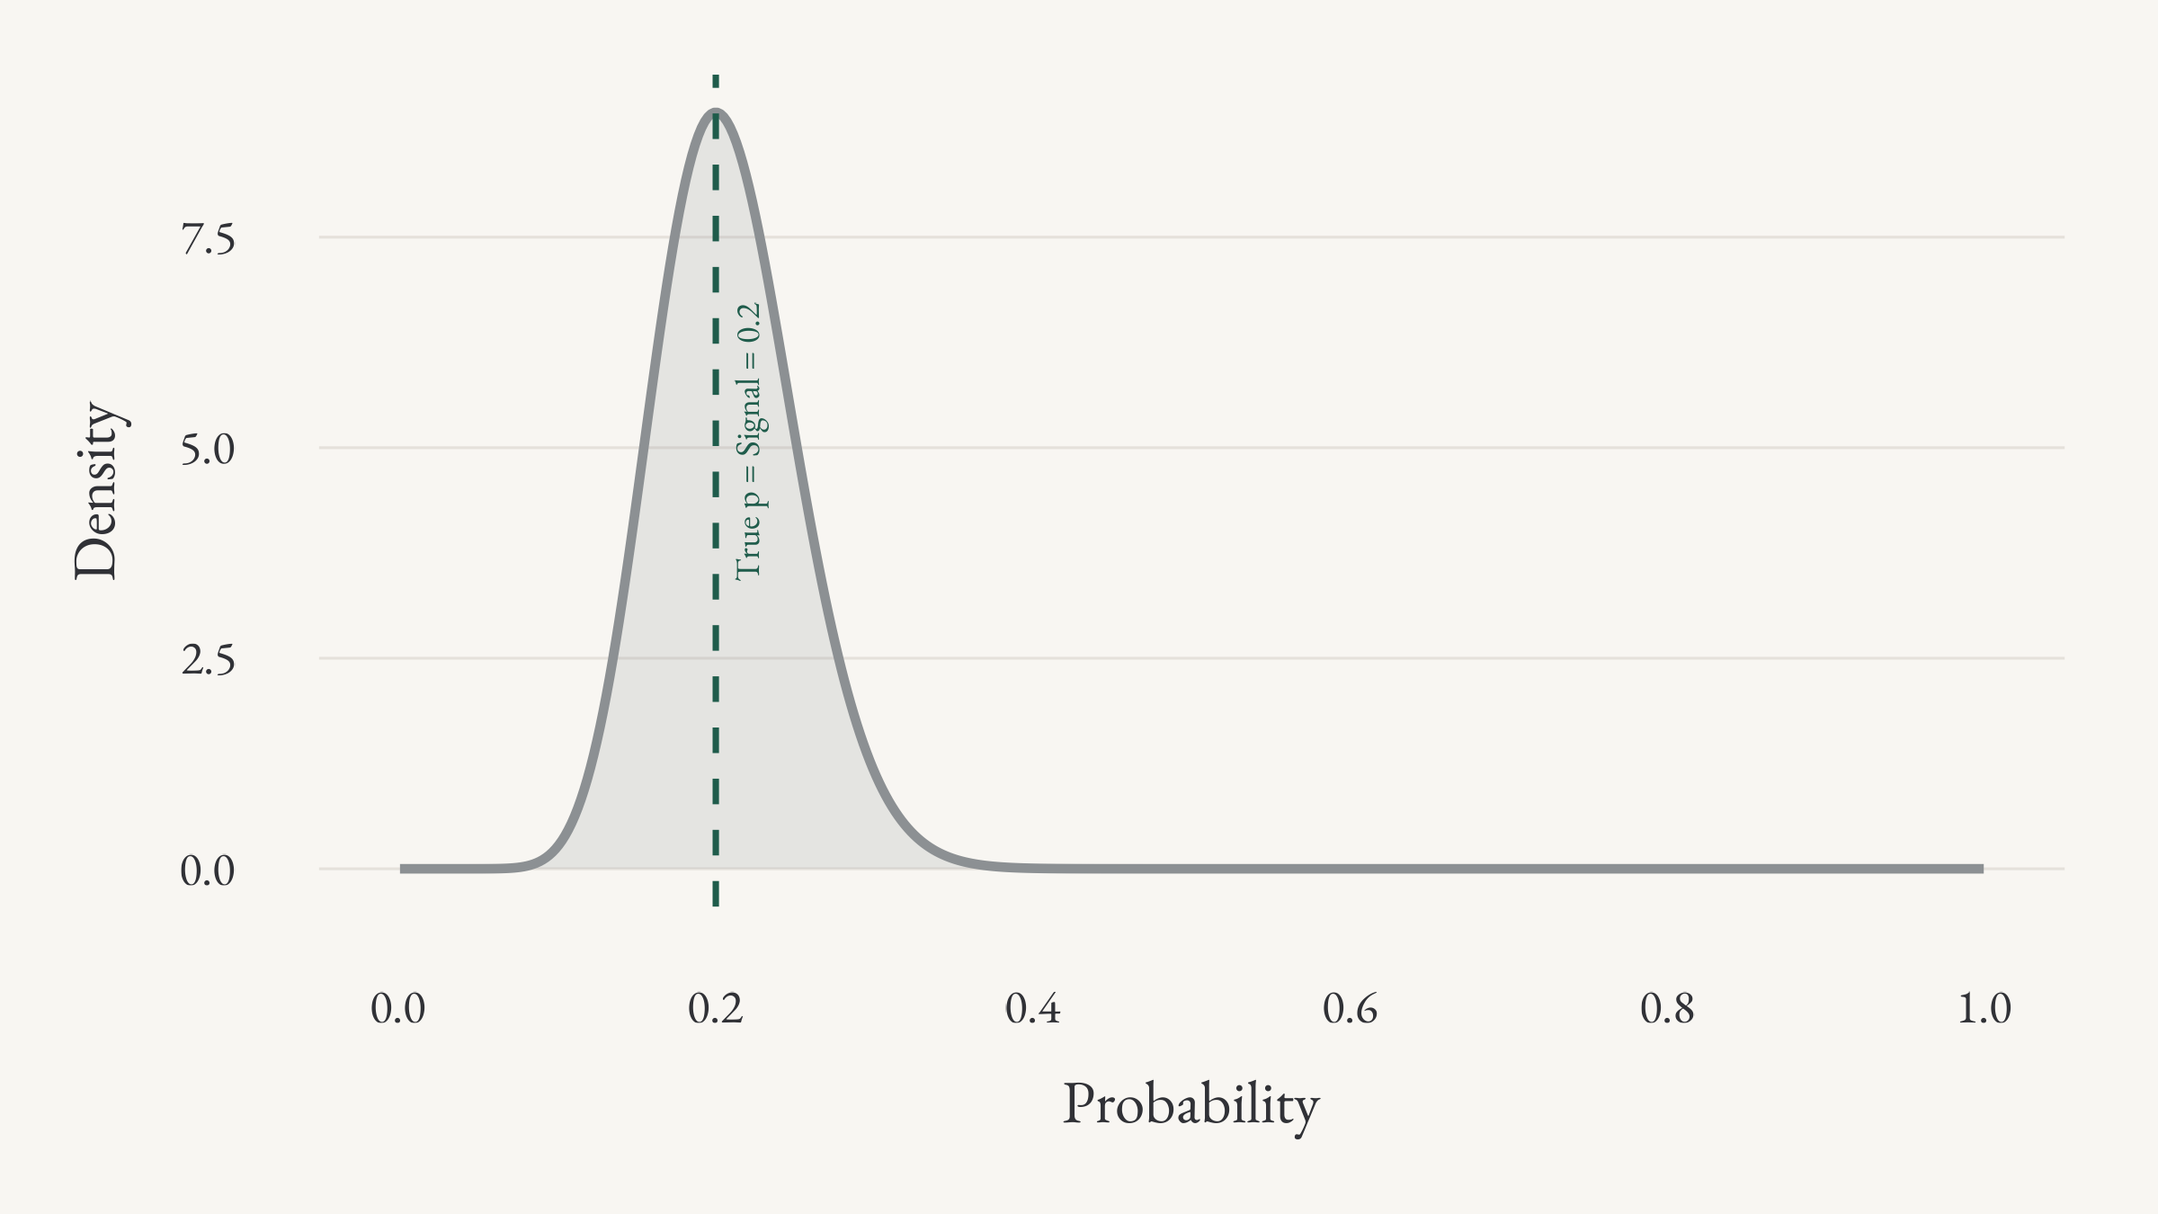
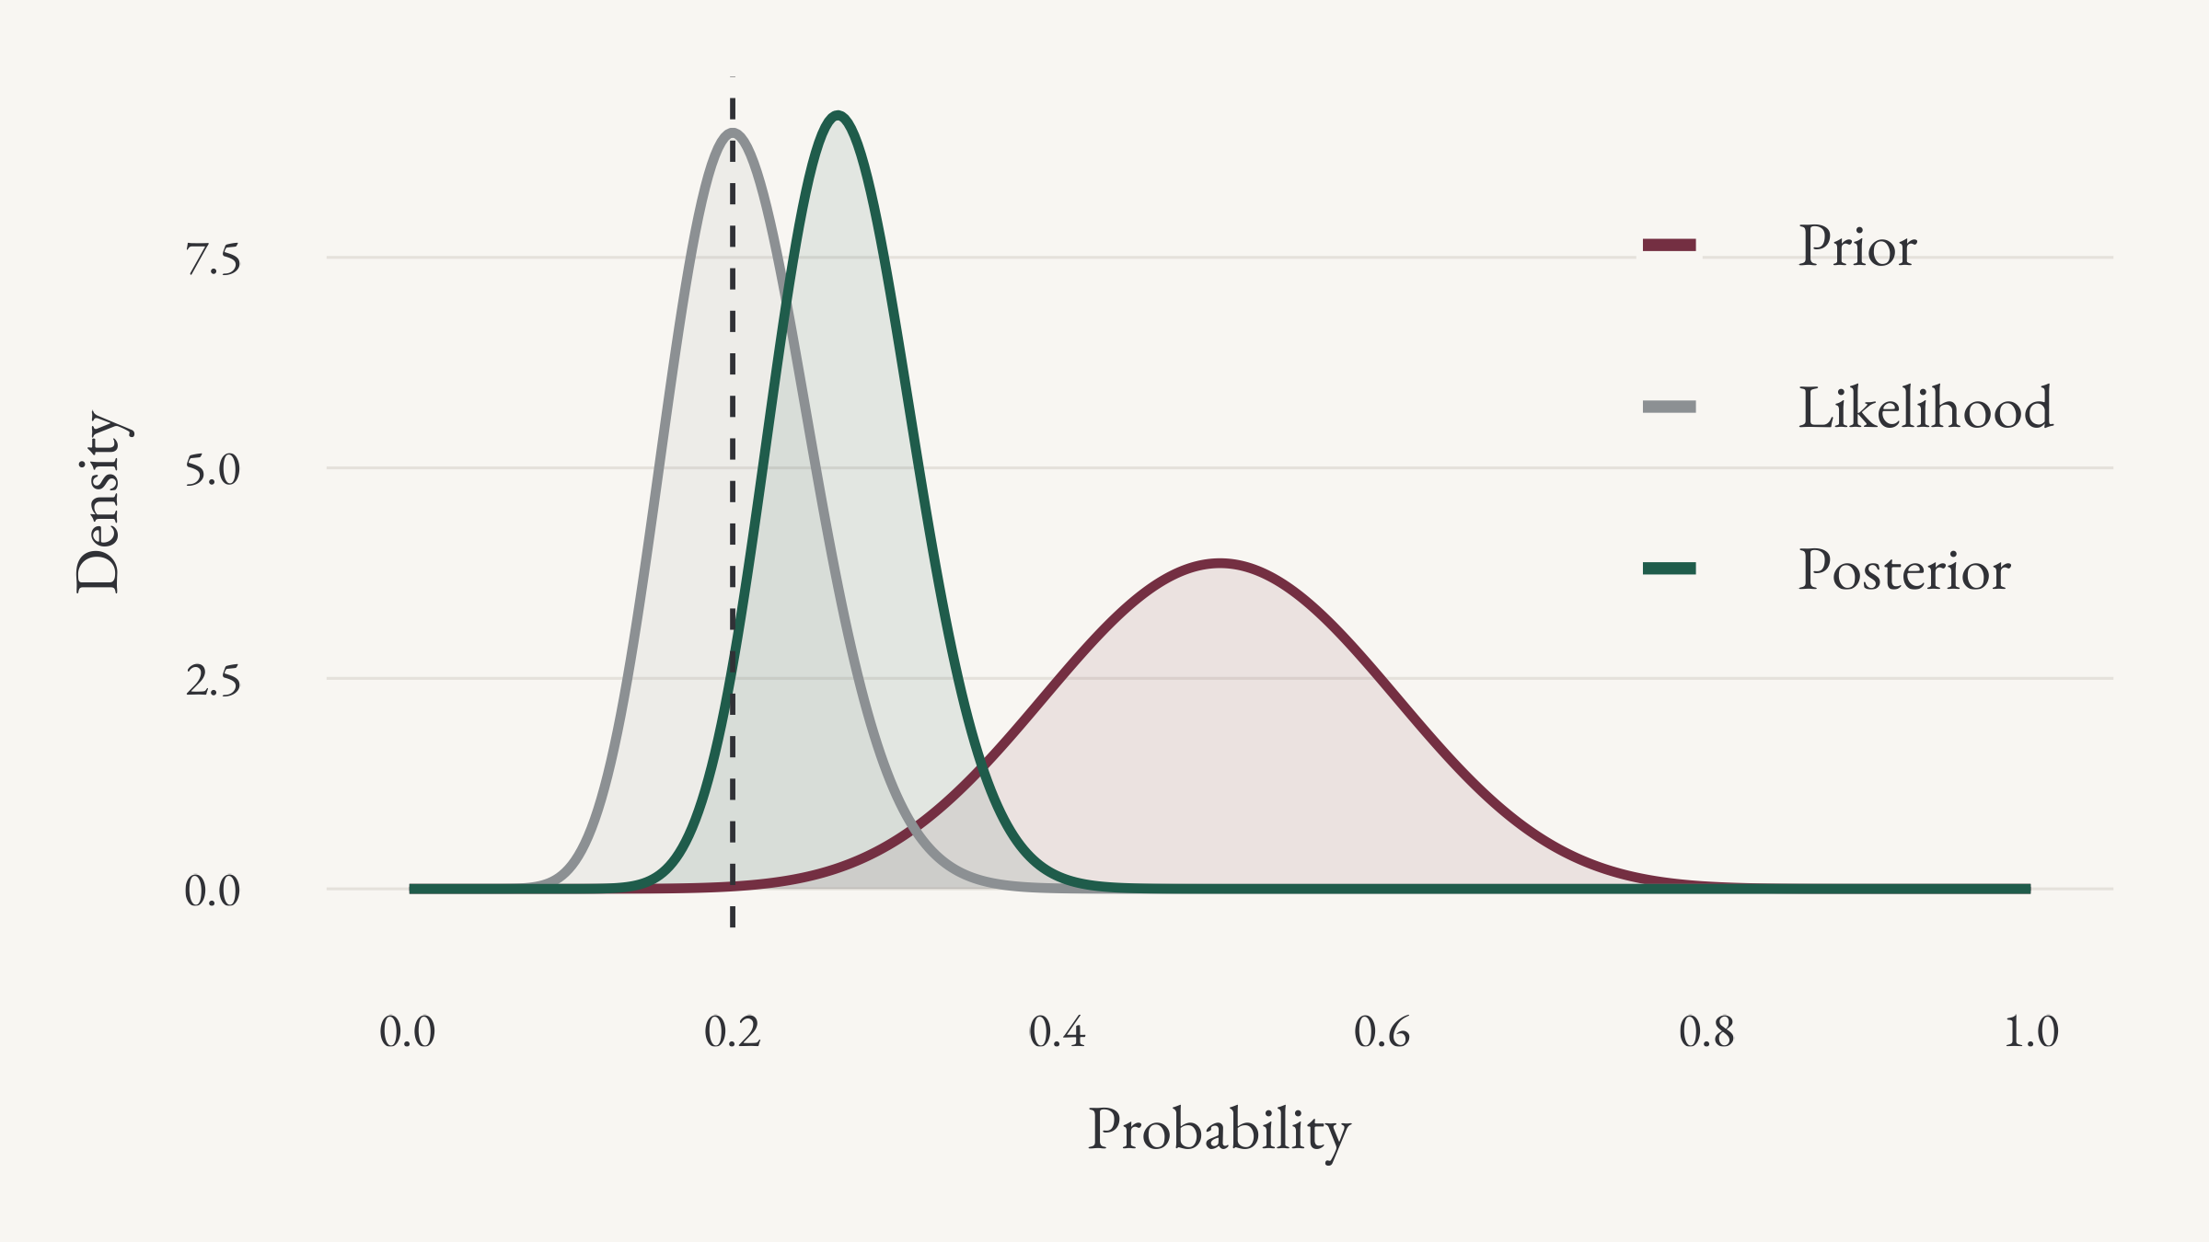
Background – Theory
The cognitive-noise model:
Human process numerical information in a fuzzy way (unlike traditional models).
No utility and probability weighting function is assumed.
It implies: PT parameters, fitted from choice data, should be intercorrelated and unstable.

Slide 4
Chapter 1
Meta-Analysis of Prospect Theory Parameters
Joint work with Taisuke Imai, Salvatore Nunnari, and Ferdinand Vieider

Slide 5
Chapter 1 – A Meta Analysis
Implementation:
812 estimates from 166 papers + Bayesian estimation.
Basic Findings:
People have a concave (convex) utility for gains (losses).
  Utility is more linear for gains than for losses.
People have an inverse S-shaped probability weighting function.
  No big difference between positive and negative outcomes.
Additional Findings:
Substantial heterogeneity across papers.
Much unexplained after controlling for study characteristics.
The strongest predictor: the elicitation method used.

Slide 6
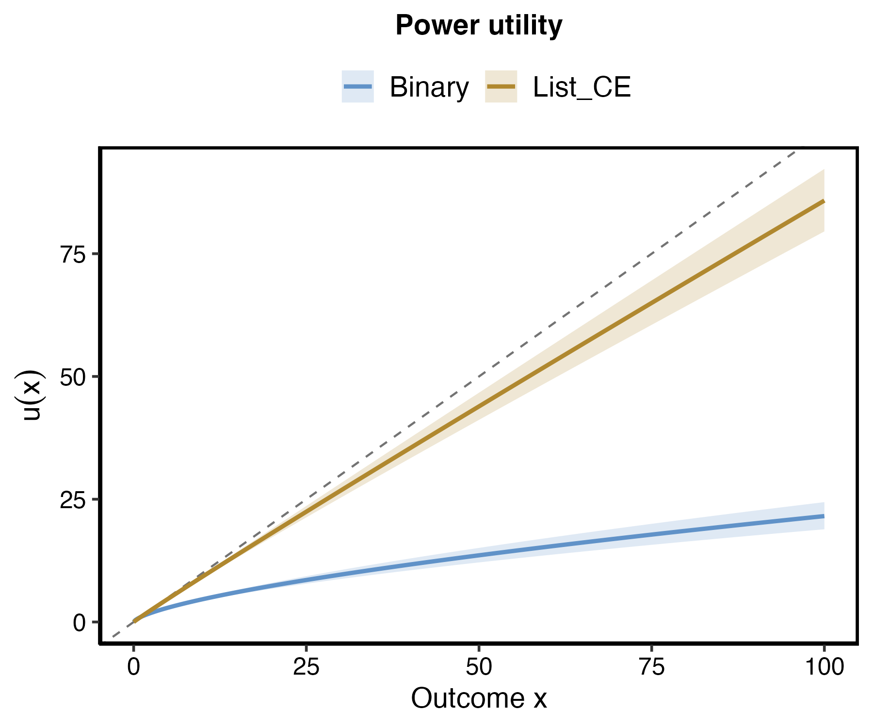
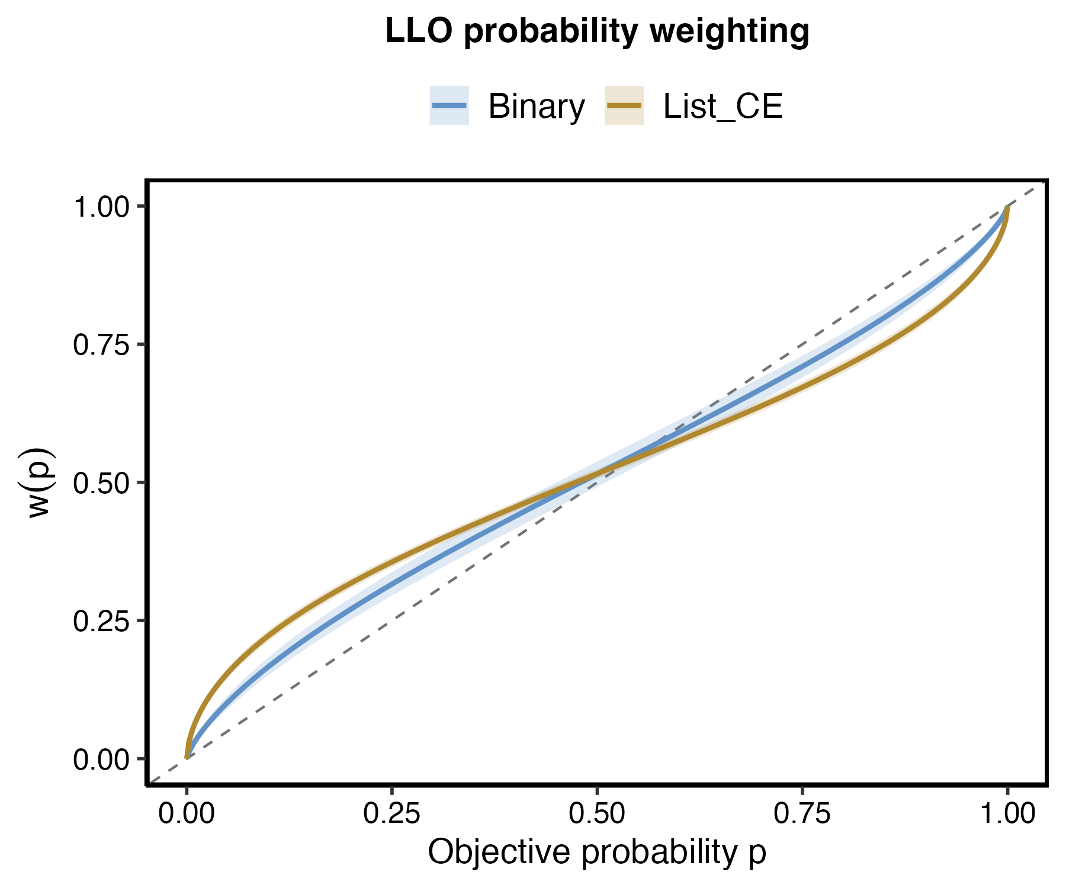
Chapter 1 – A Meta Analysis

Slide 7
Chapter 2
Cognitive Frictions and Canonical Patterns in Risk-Taking
Joint work with Ranoua Bouchouicha, Ryan Oprea, and Ferdinand Vieider

Slide 8
Chapter 2 – Empirical
To have a deeper understanding what the difference implies:
Filter those studies of Binary Choice and Choice List
Calculate the predictive CE of (100, 0.1) and (–100, 0.1).
Do meta-analysis on this predictive CE.

Slide 9
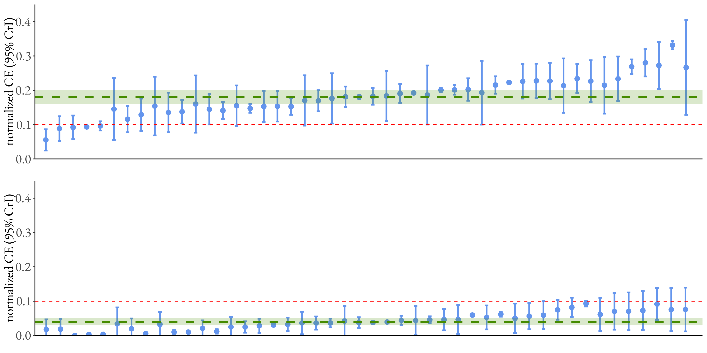
Chapter 2 – Empirical

Slide 10
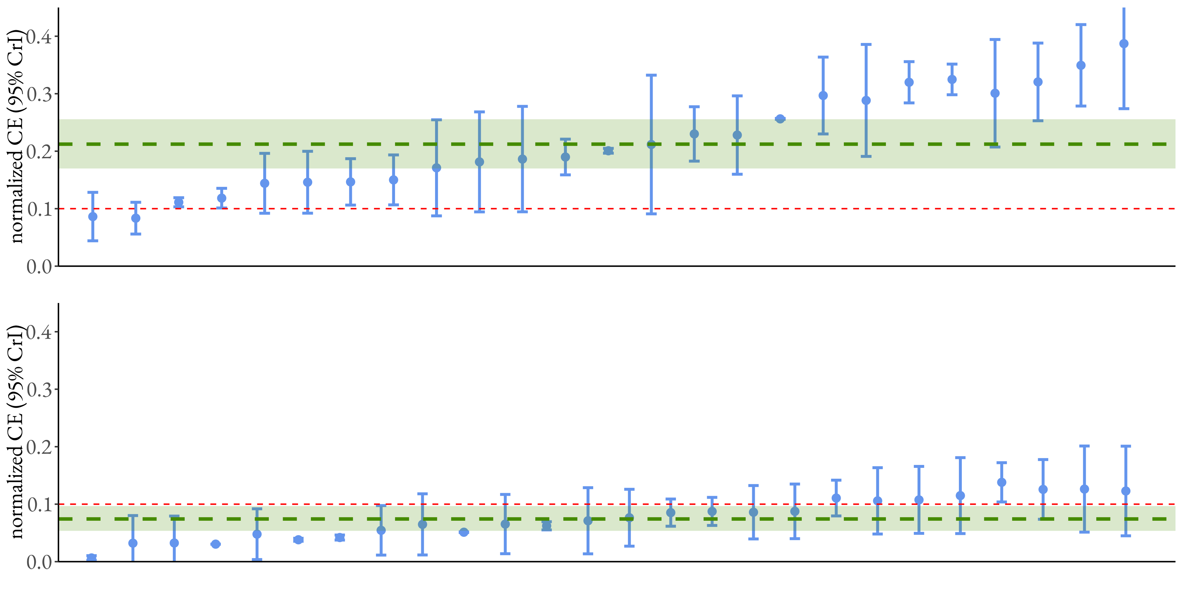
Chapter 2 – Empirical

Slide 11
Chapter 2 – Empirical
The Finding:
The fourfold pattern exists in Choice-list studies but not Binary-choice studies.
The limitation:
The difference found in meta-analysis is not causal!

Slide 12
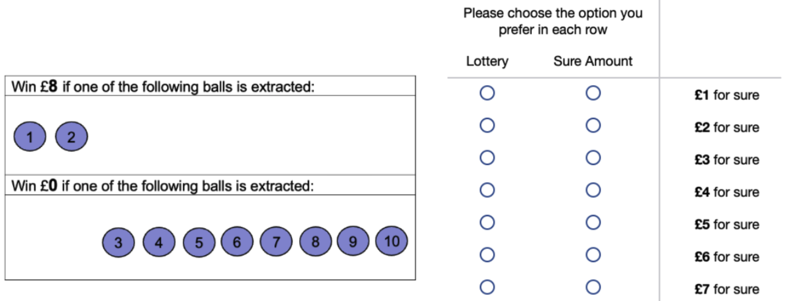
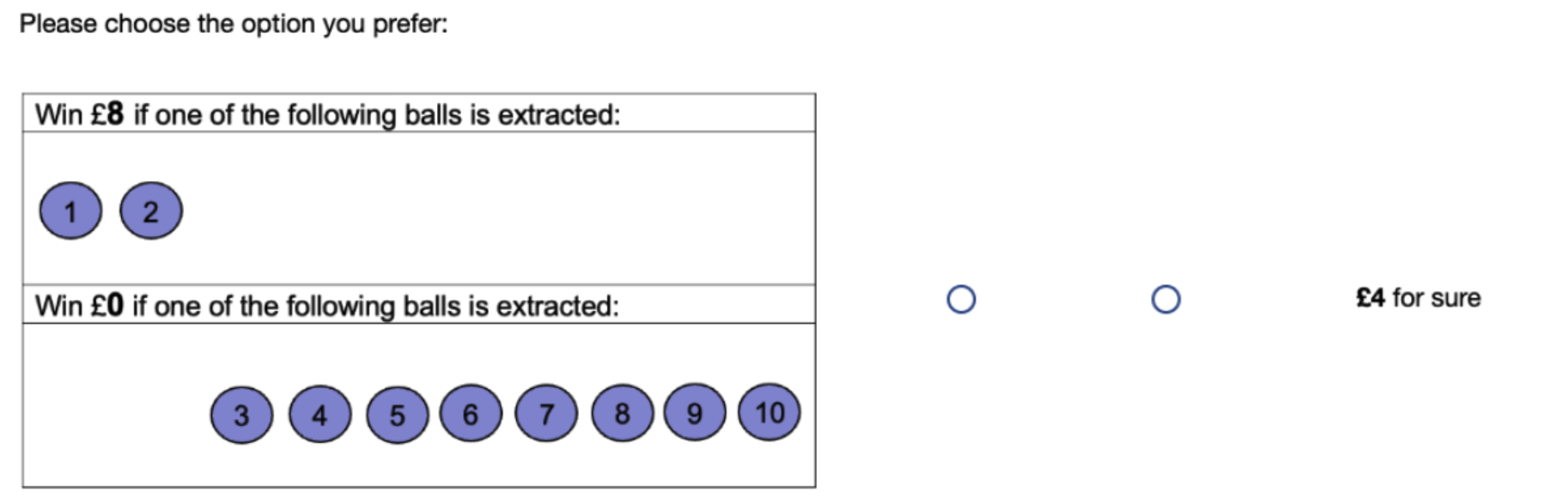
Chapter 2 – Empirical
The Finding:
The fourfold pattern exists in Choice-list studies but not Binary-choice studies.
The limitation:
The difference found in meta-analysis is not causal!
Solution:
Run experiment, remain all other factors same, except for the elicitation!
Experimental results echo with meta-analysis

Slide 13
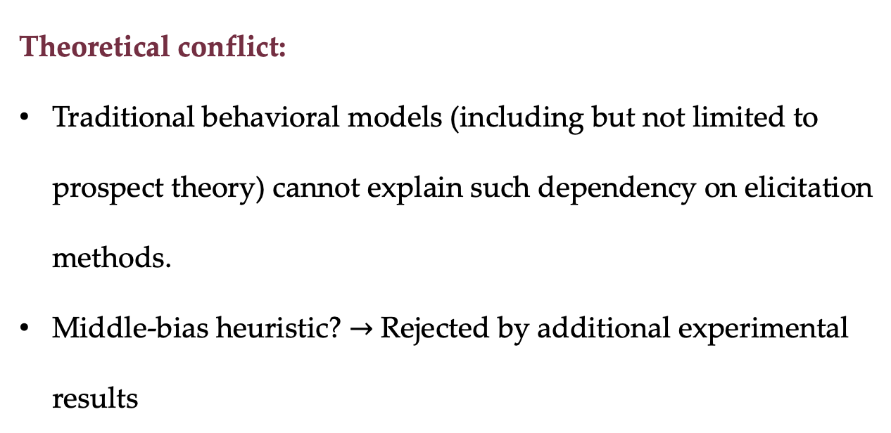
Chapter 2 – Theoretical
Theoretical conflict:
Traditional behavioral models (including but not limited to prospect theory) cannot explain such dependency on elicitation methods.
Middle-bias heuristic? $→$ Rejected by additional experimental results

Slide 14
Chapter 2 – Theoretical
Under two different elicitations:
Binary choice: DMs compare two options at the same time.
Choice list: DMs firstly evaluate the fixed option and then find the indifferent sure amount.
Unique Prediction:
The presence of list does not matter, as long as the separate evaluation exists.

Slide 15
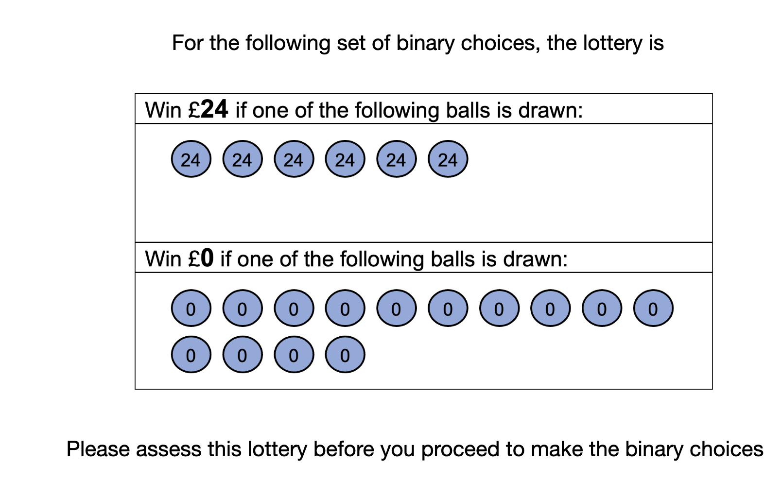
Chapter 2 – Experiment 2
Unique Prediction:
The presence of list does not matter, as long as the separate evaluation exists.
A new condition:
Binary choice + Initial lottery evaluation.
The finding:
Responses in this new condition is almost same to the choice-list condition.
A simple middle-bias heuristic is ruled out.

Slide 16
Chapter 3
Ambiguity Attitudes under Matching and Choice
Joint work with Yuchi Li

Slide 17
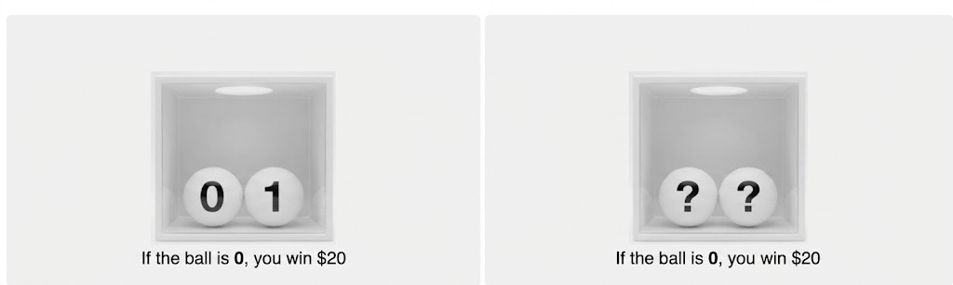
Chapter 3 – Ambiguity

Slide 18
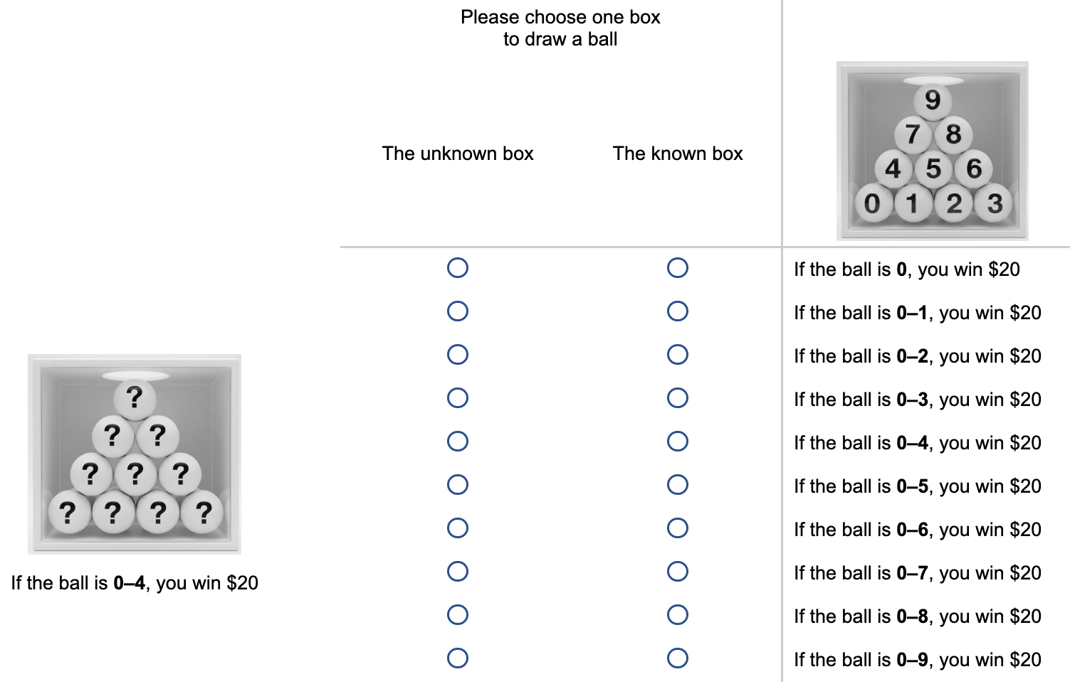
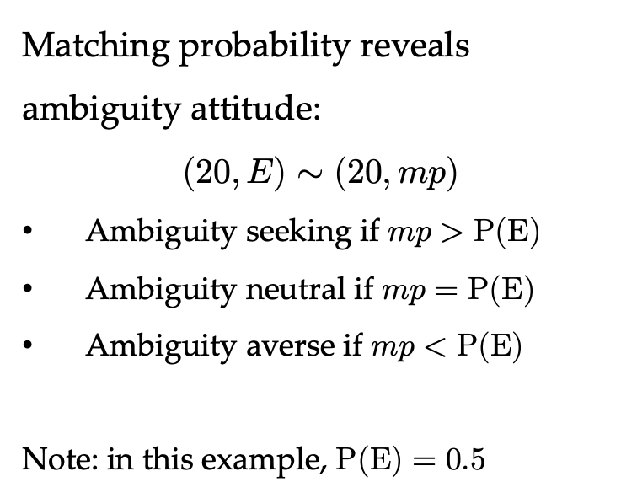
Chapter 3 – Ambiguity
Matching probability reveals ambiguity attitude:
$$(20, E)∼(20, mp)$$
Ambiguity seeking if $mp>P(E)$
Ambiguity neutral if $mp=P(E)$
Ambiguity averse if $mp<P(E)$
Note: in this example, $P(E)=0.5$

Slide 19
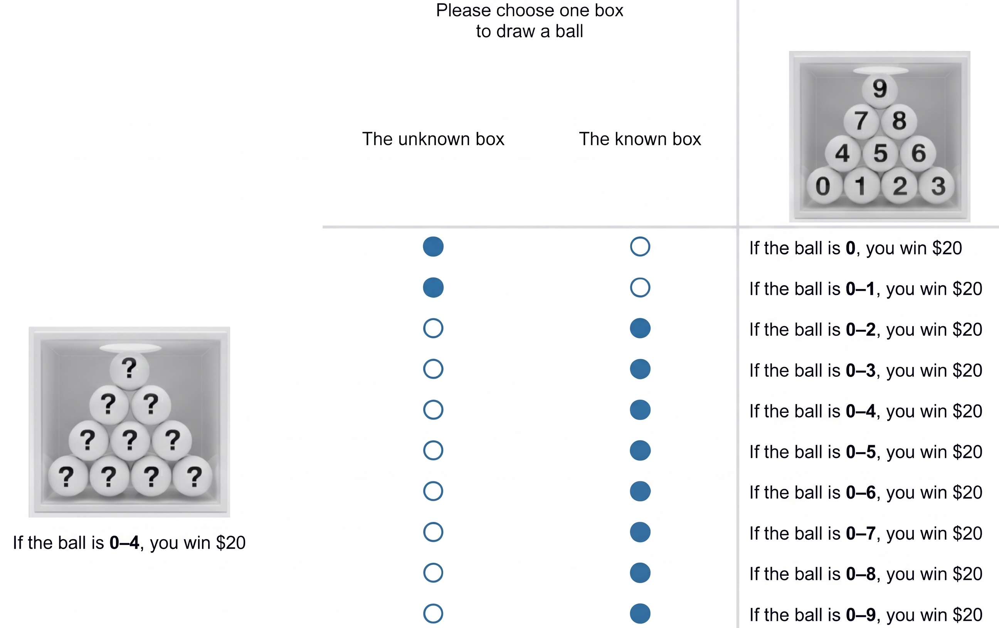
Chapter 3 – Ambiguity
This example indicates Ambiguity averse as $mp=0.25<P(E)=0.5$

Slide 20
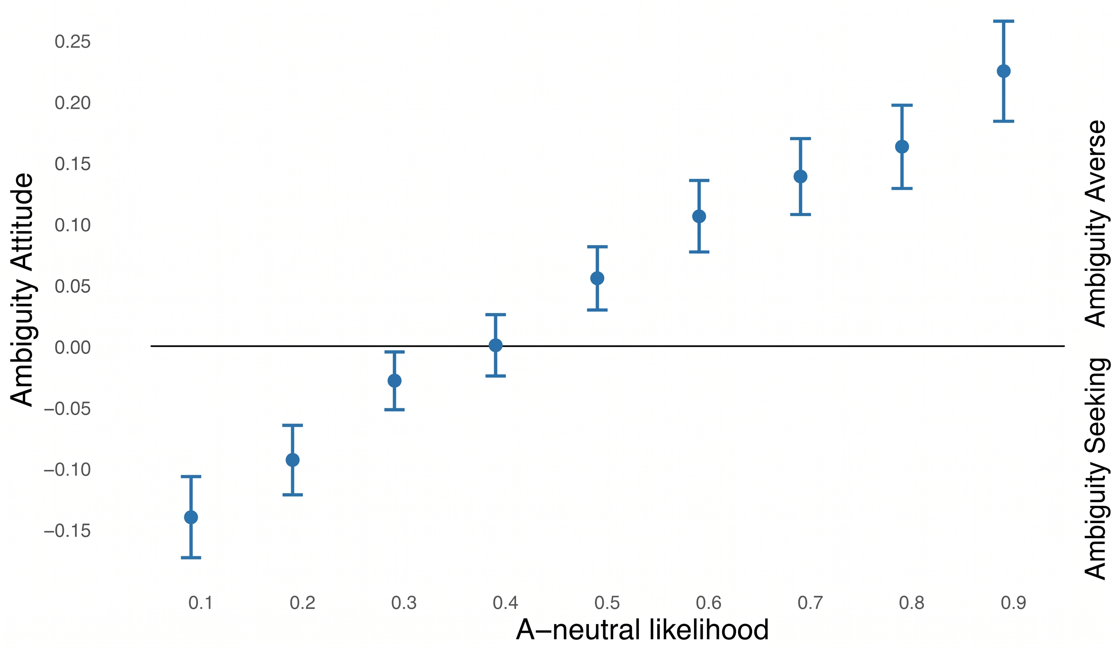
Chapter 3 – Ambiguity
The Finding:
Using choice lists, we got similar behavior pattern as in the literature.

Slide 21
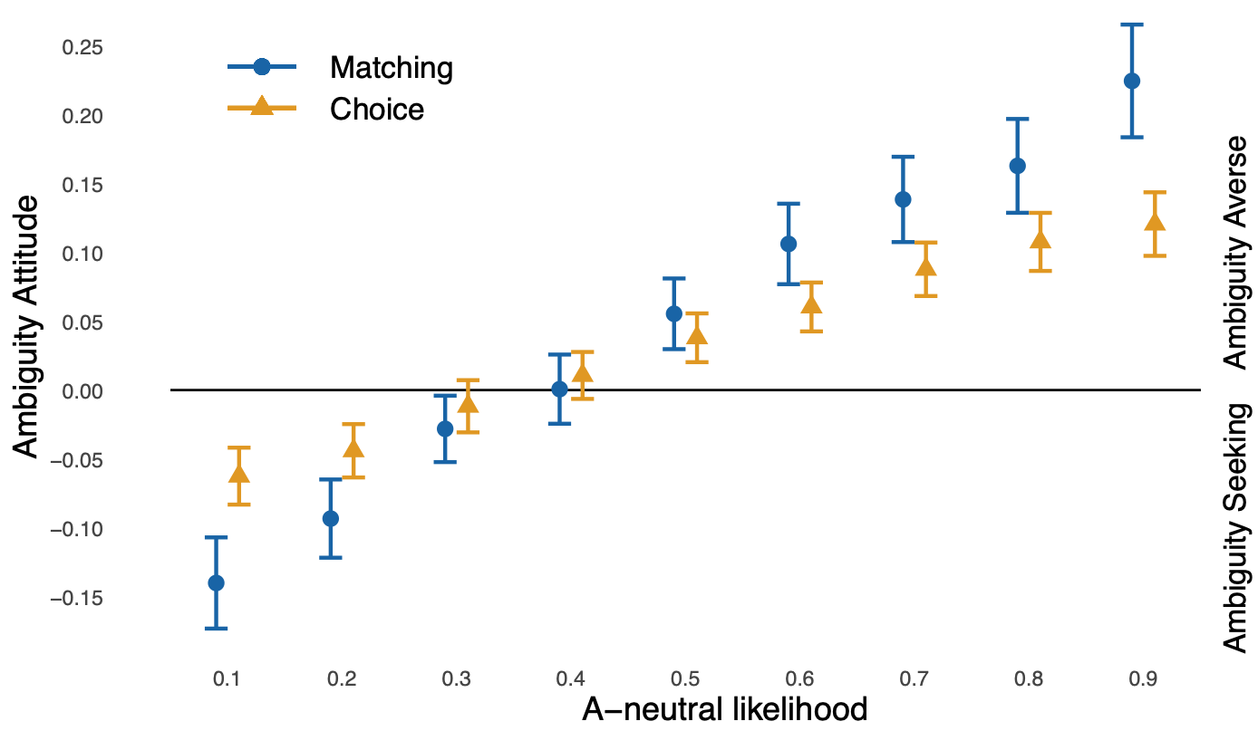
Chapter 3 – Ambiguity
The Finding:
Using choice lists, we got similar behavior pattern as in the literature.
Yet, when same choices are presented on separate pages, the pattern is much weaker.
Echoing last chapter:
Choice-list elicitation results in heavier cognitive noise, thereby stronger deviation from ambiguity neutrality.

Slide 22
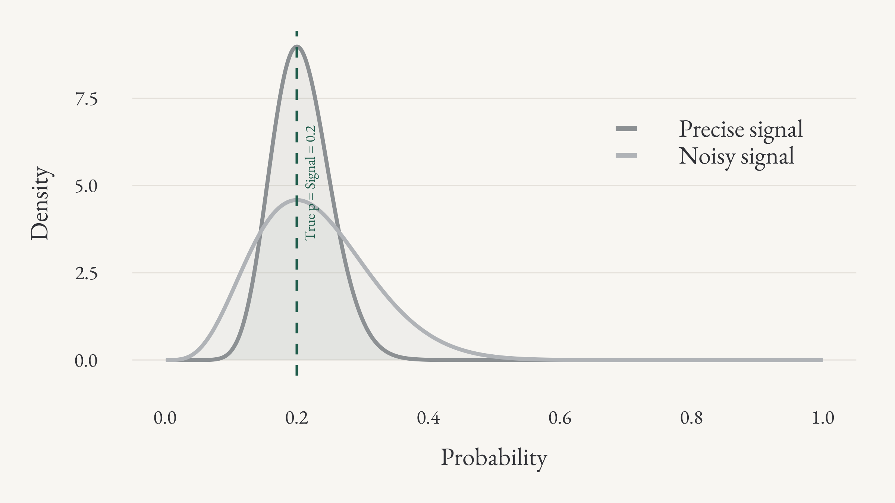
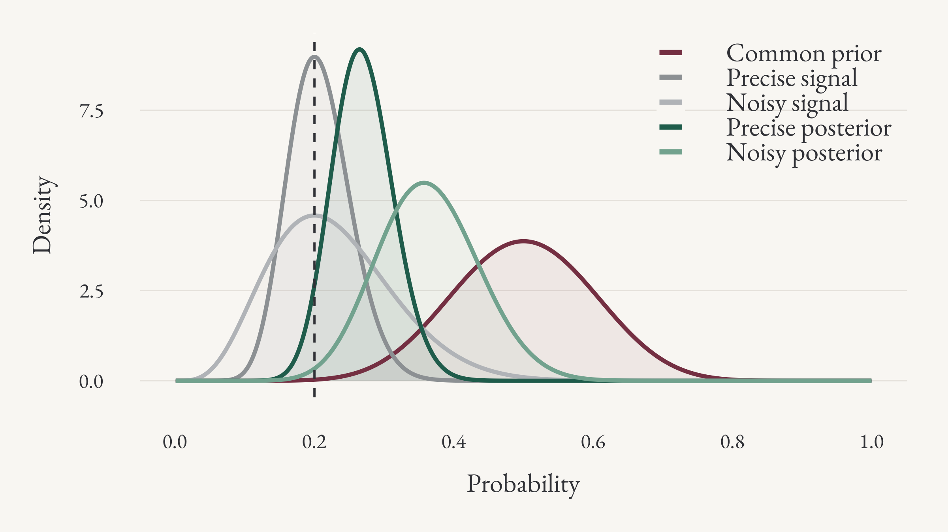
Chapter 3 – Ambiguity
The cognitive-noise model:
This cognitive framework provide a very intuitive account for ambiguity behavior.
Unknown probability is perceived more noisily, so its mental representation is closer to the prior.

Slide 23
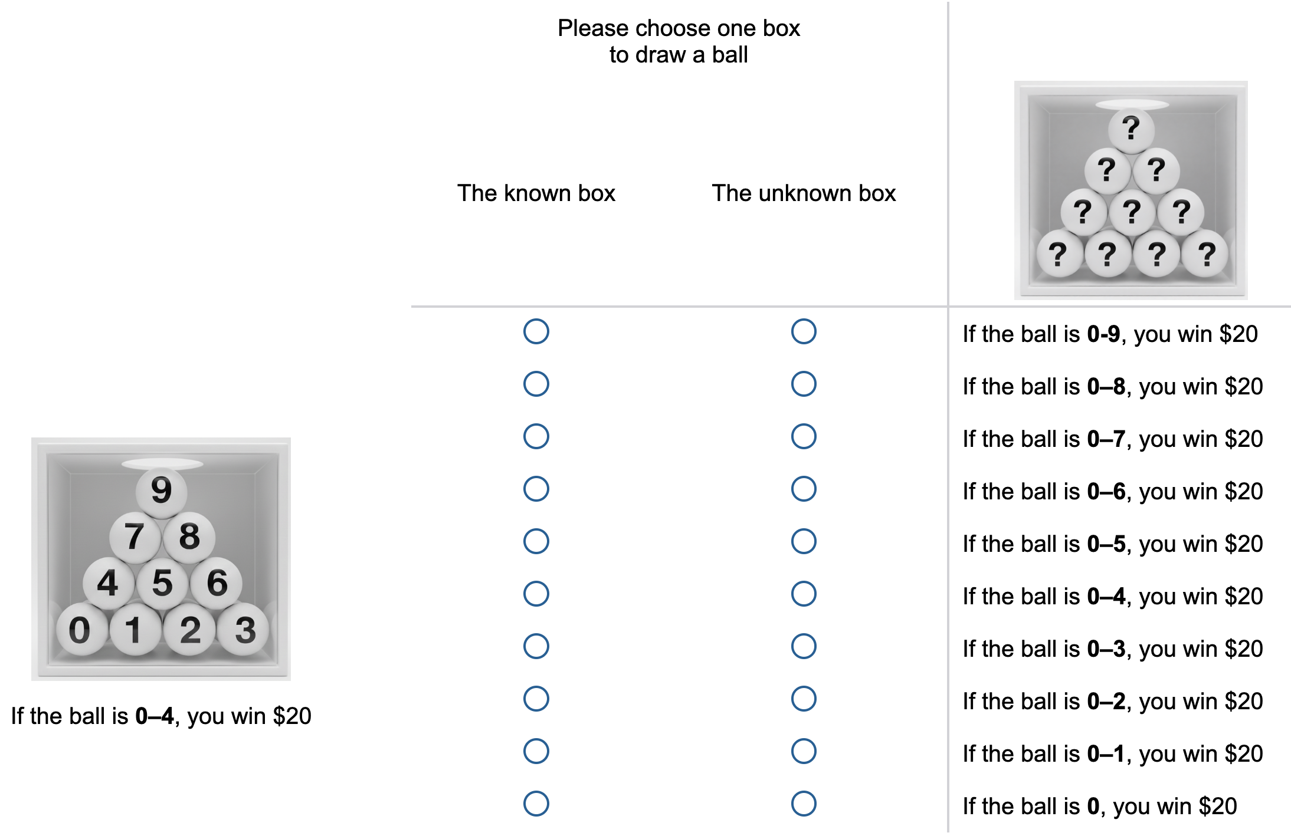
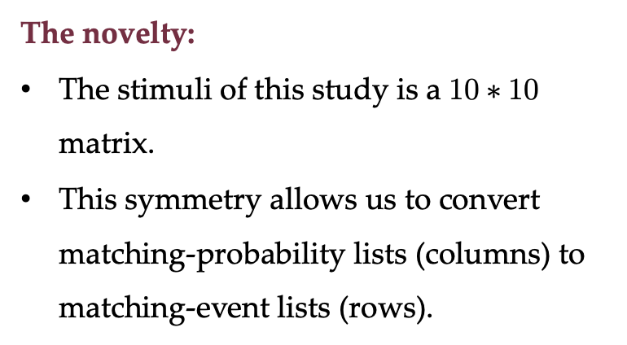
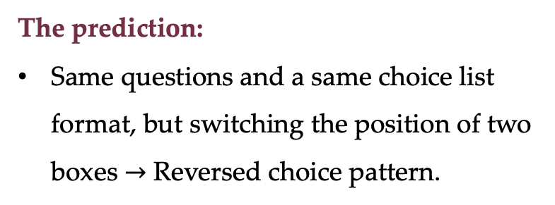
Chapter 3 – Ambiguity
The novelty:
The stimuli of this study is a $10∗10$ matrix.
This symmetry allows us to convert matching-probability lists (columns) to matching-event lists (rows).
The prediction:
Same questions and a same choice list format, but switching the position of two boxes $→$ Reversed choice pattern.

Slide 24
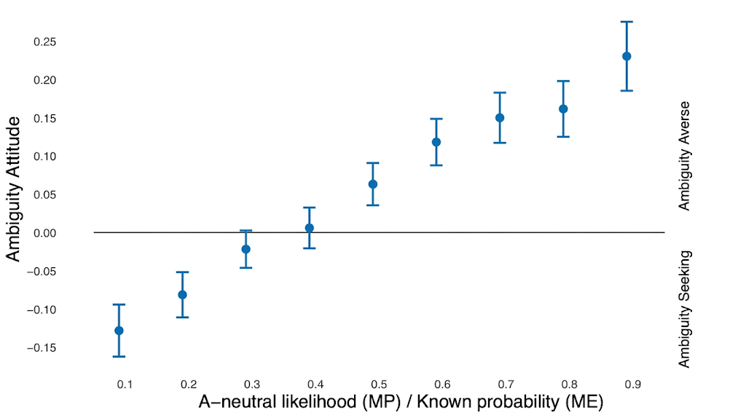
Chapter 3 – Ambiguity
The novelty:
The stimuli of this study is a $10∗10$ matrix.
This symmetry allows us to convert matching-probability lists (columns) to matching-event lists (rows).
The prediction:
Same questions and a same choice list format, but switching the position of two boxes $→$ Reversed choice pattern.

Slide 25
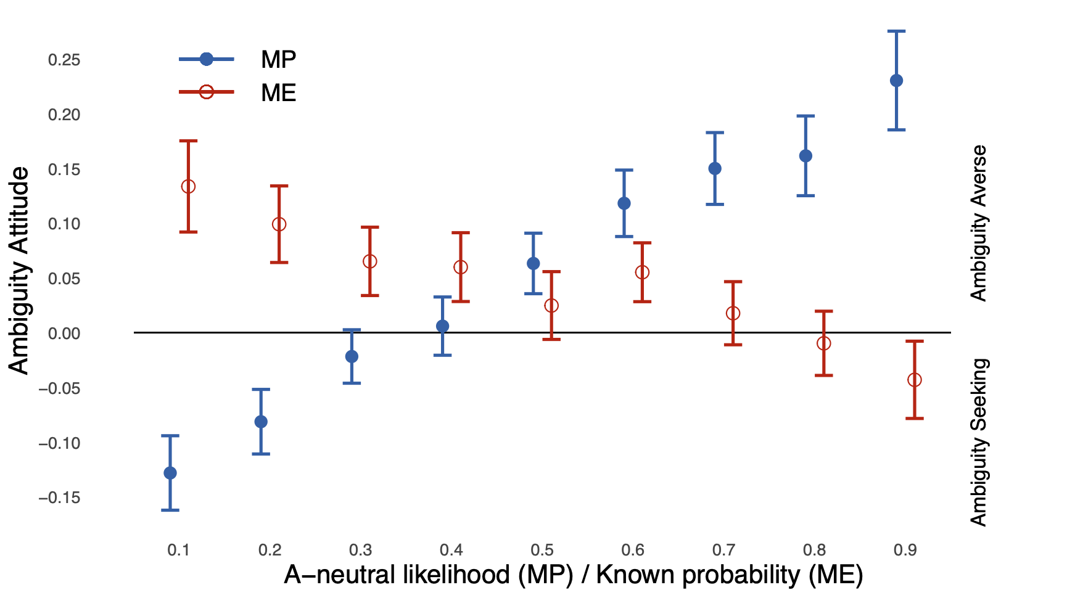
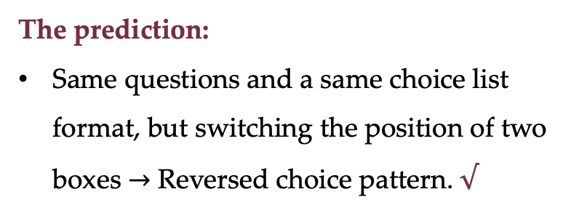
Chapter 3 – Ambiguity
The novelty:
The stimuli of this study is a $10∗10$ matrix.
This symmetry allows us to convert matching-probability lists (columns) to matching-event lists (rows).
The prediction:
Same questions and a same choice list format, but switching the position of two boxes $→$ Reversed choice pattern. $√$

Slide 26
Chapter 4
Training intensity and ambiguity attitude elicitation: Evidence from a matching-probability task
Solo work

Slide 27
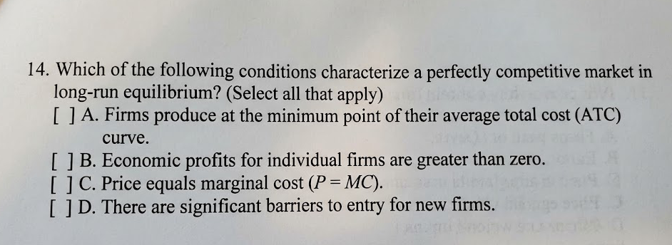

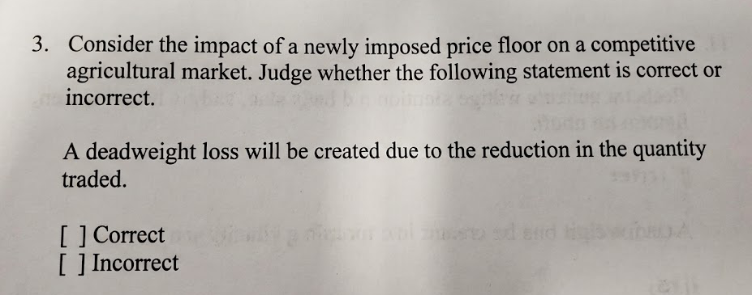
Chapter 4 – Training

Slide 28
Chapter 4 – Training
Research Questions:
If DMs are trained to be more familiar with the basic choices, does the choice-list method still leads to different responses than the binary-choice method?
Experimental treatment:
Sparse training: subjects only answer 5 binary choices before the MP task.
Extensive training: subjects answer all 100 binary choices before the MP task.

Slide 29
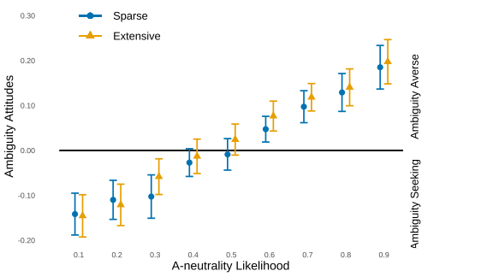
Chapter 4 – Training
The Finding:
Training extensity does not affect DMs’ responses in the main MP task.
The Implication:
The cognitive friction arising from the choice-list elicitation mechanism is very persistent.

Slide 30
Conclusion
Key message: the cognitive noise model provides a cognitive foundation of individual decision-making.
C1: The estimated parameter of prospect theory is unstable and depends on how we measure.
C2: The classic fourfold pattern only exists as the elicitation involves separate evaluation.
C3: The elicitation impact also holds in the domain of ambiguity, and it dominates.
C4: The elicitation impact remains, even after intensive training.

Slide 31
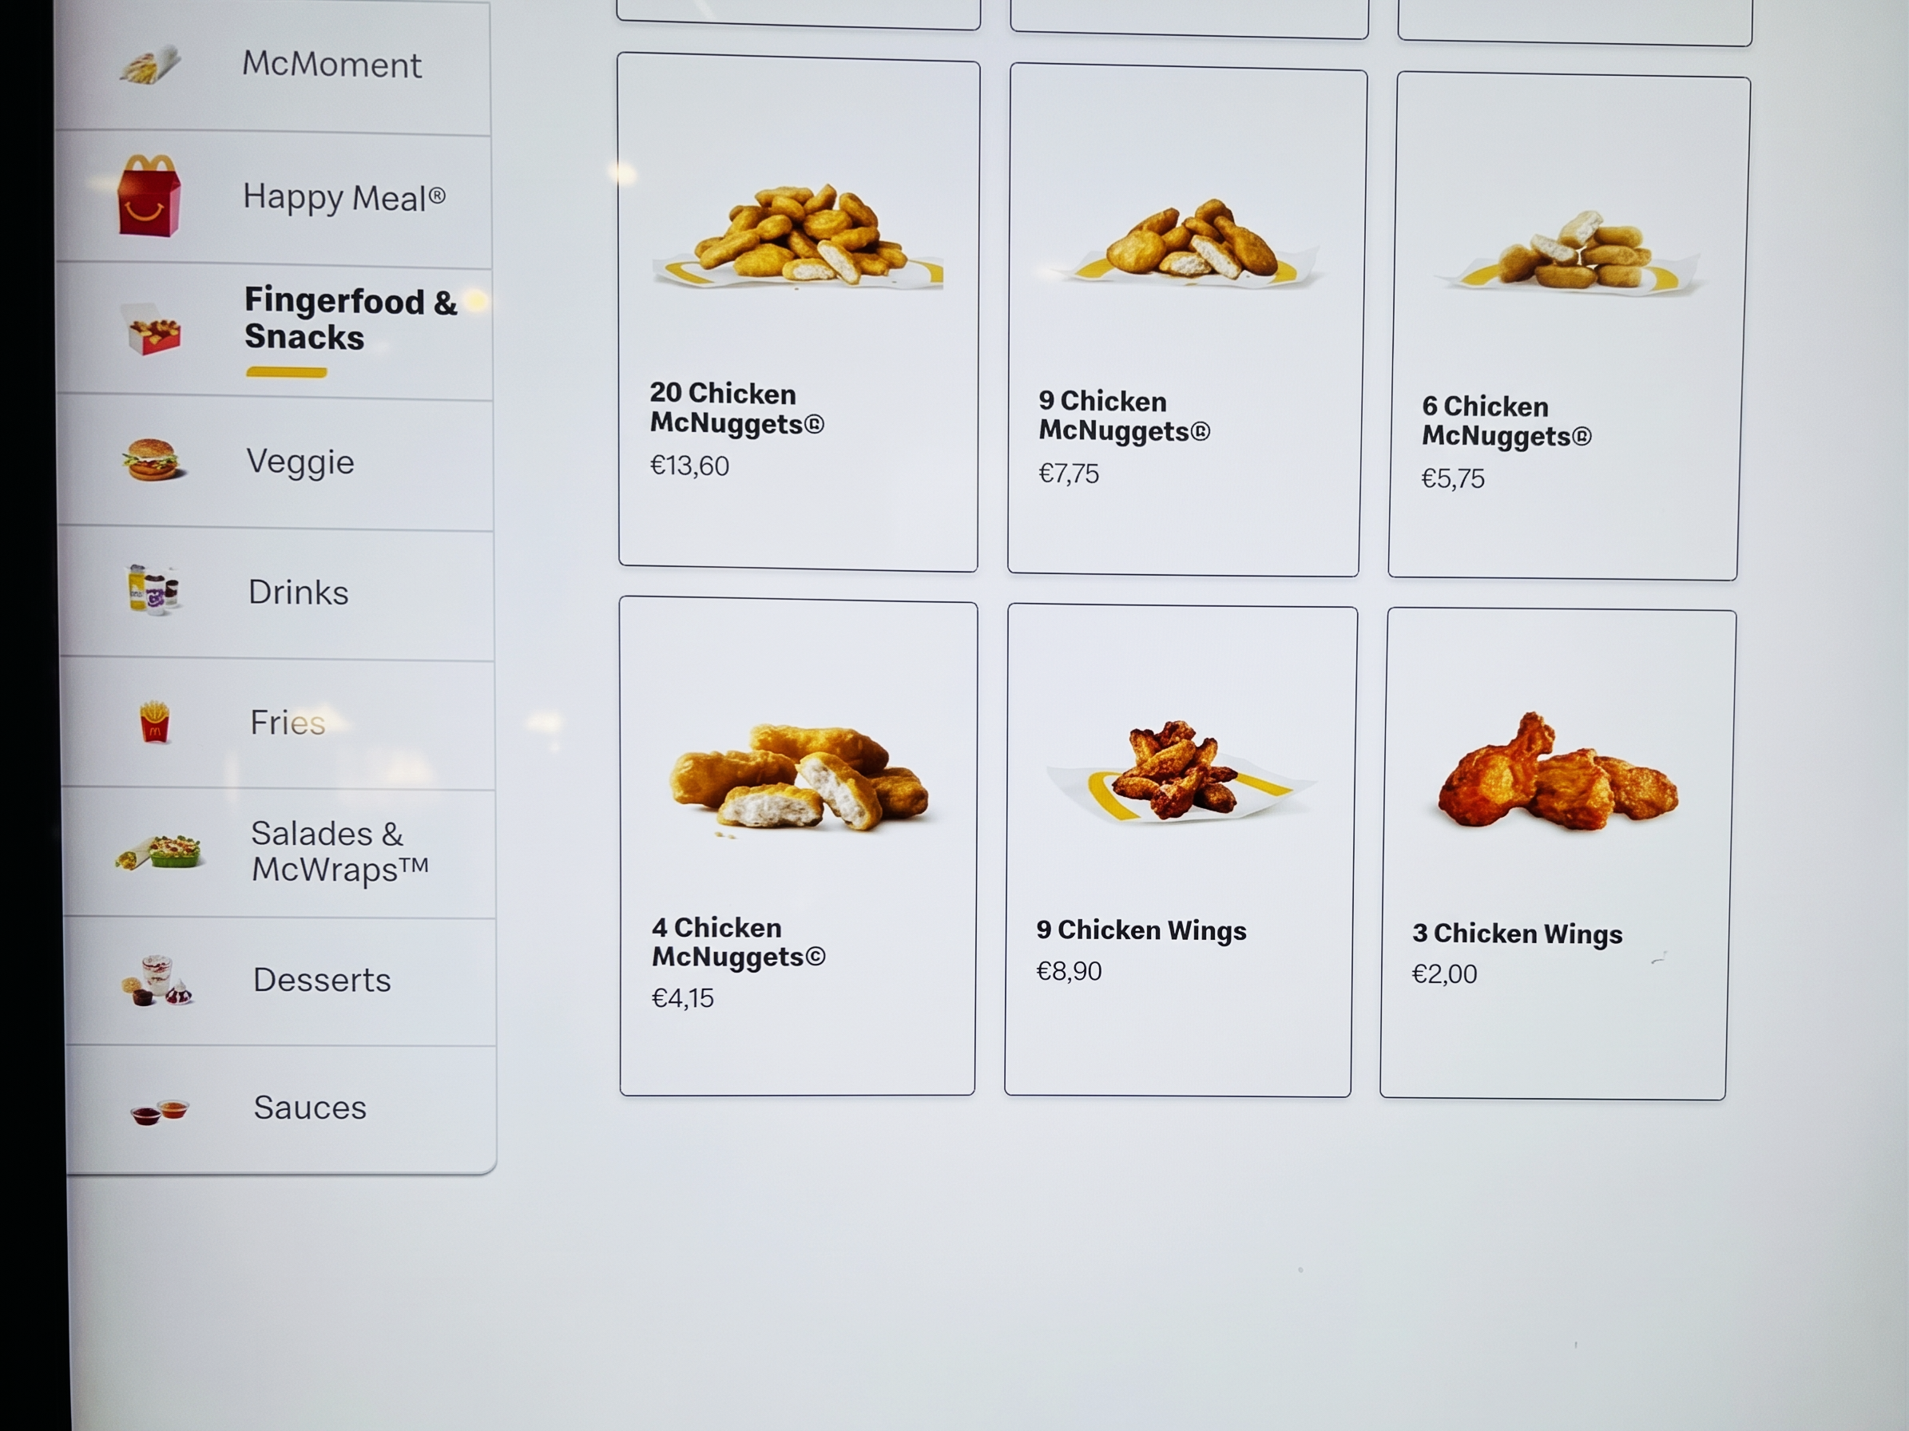
Discussion
Daily experience with cognitive noise.
Its consequences are prevalent.
Some irrelevant behavior may share same cognitive foundation.
Qiu, J., Wu, J., & Zhong, S. (2026). Cognitive frictions in decisions under risk: Evidence from (almost) degenerate lottery evaluation.

Slide 32
Discussion
Does “preference” exist?
Yes, but it would play the major role when the decision is at bigger stakes.
  e.g., when decide whether continue or not in the last round of Who Wants to Be A Millionaire.
For risky decisions of small stakes (e.g., those in lab), cognitive noise plays a bigger role.
Does cognitive noise matter beyond lab? Or, how to model cognitive noise in applied settings.
Though this literature currently focus on a lab setup, but some existing works:
  Azeredo da Silveira, R., Sung, Y., & Woodford, M. (2024). Optimally imprecise memory and biased forecasts. American Economic Review, 114(10), 3075-3118.
  Sung, Y. (2026). Macroeconomic expectations and cognitive noise. Conditionally accepted, American Economic Review.

Slide 33

Discussion
For a comprehensive discussion: Oprea, R. and Woodford, M. (2026) Behavioral Signatures of Cognitive Noise.
My personal views on the cognitive noise (complexity):
The cognitive friction from numerical information process.
The cognitive friction from task mechanism.
Two distinct sources, but may interact.
  Some works not included in this thesis. My research agenda.

