Slide 1
A Simple Test for Decisions under Risk
Jianying Qiu Jilong Wu Songfa Zhong
FUR 2026, Alicante
10th June 2026
Notes:
Thanks for having me here, reporting this joint work with Jianying from Radboud university, the nethelands; and songfa from Hongkong university of science and technology. As you can see from the title, this research is about individual decision making under risk.

Slide 2

Fourfold Pattern
Say Subject A feels$c∼\left(25, p;0\right)$
$c>25p→$ risk seeking
$c<25p→$ risk averse
An important finding — the fourfold pattern
Sparked some important models
Notes:
To study risky taking behavior, a common setup is the binary choice between a lottery and a sure amount. Say here, Subject A feel indifferent between a sure amount c and a two-outcome lottery that wins x with a chance of p; in this sense, we say the sure amount c is the certainty equivalent of the lottery;
If the certainty equivalent is larger than the expected value of the lottery, then we say this person is risk seeking for this lottery;
If the certainty equivalent is smaller than the expected value, then we say she is risk averse for this lottery;

Slide 3
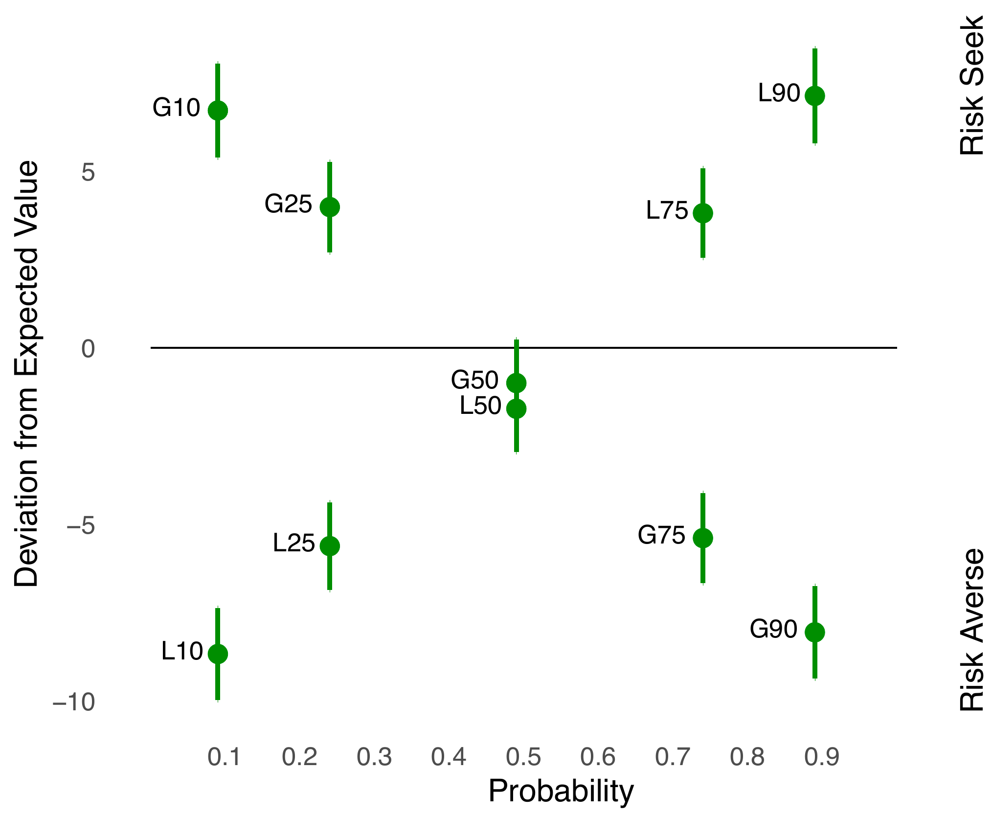
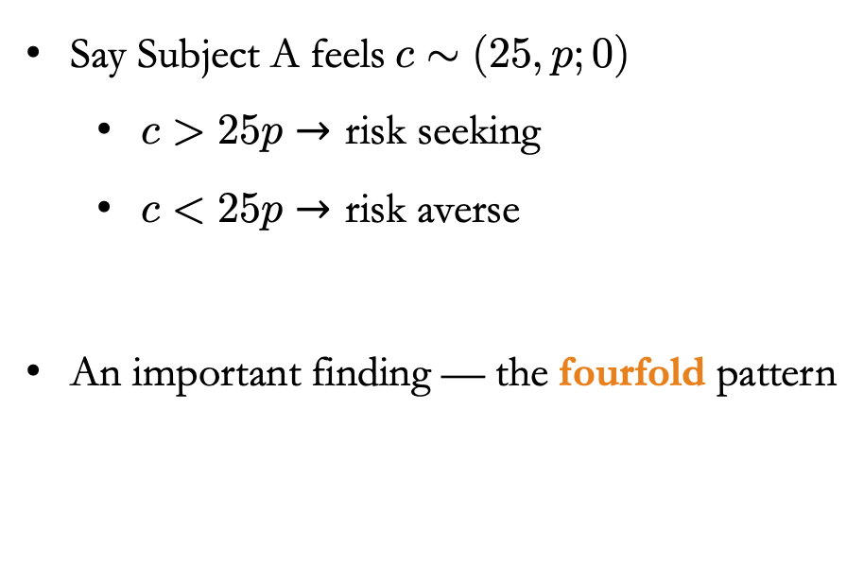
Fourfold Pattern
Say Subject A feels$c∼(25, p;0)$
$c>25p→$ risk seeking
$c<25p→$ risk averse
An important finding — the fourfold pattern
Sparked some important models
Risk Seeking
(G – gains; L – losses; 10 – 10%, etc.)
Notes:
Throughout those studies which elicit certainty equivalent, a common finding is that subjects‘ choice follow the fourfold pattern.
Specifically, subjects are risk seeking for small probability of gains and risk averse for gains when the winning probability becomes larger.
For losses, the pattern would be reversed: subjects would be risk averse for small probability of losses and they would be risk seeking when the losing probability become larger.

Slide 4
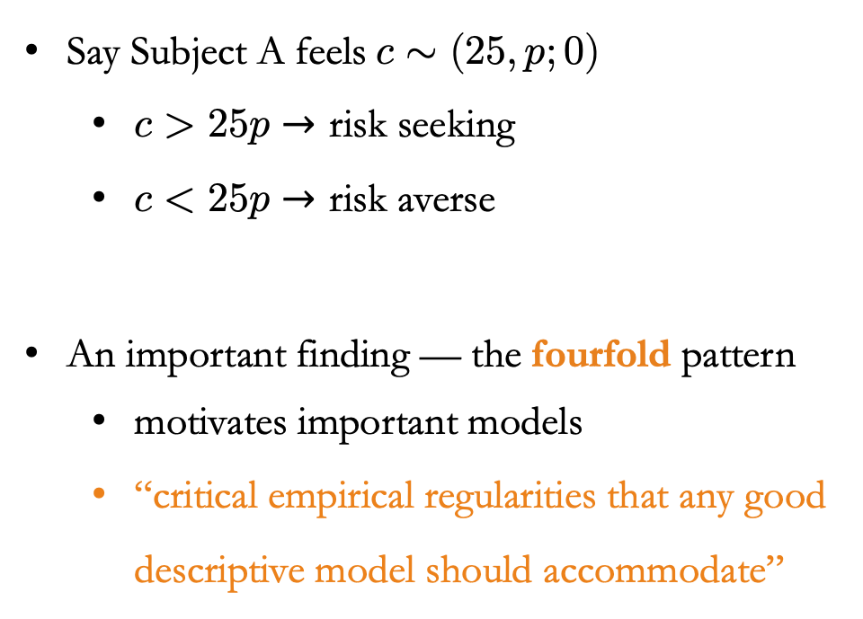
Fourfold Pattern
Say Subject A feels$c∼(25, p;0)$
$c>25p→$ risk seeking
$c<25p→$ risk averse
An important finding — the fourfold pattern
motivates important models
“critical empirical regularities that any good descriptive model should accommodate”
Risk Seeking
(G – gains; L – losses; 10 – 10%, etc.)
Notes:
This fourfold pattern is one of the most important empirical regularity for behavioral economics, and it motivates many classic models, including prospect theory;
Actually, some scholars even regard the fourfold pattern as “critical empirical regularities that any good descriptive model should accommodate”

Slide 5

A Simple Test
An observation: most models respect stochastic dominance:
(Almost) degenerate lottery evaluation (ADLE) test:
$\left(x, p;x\right)∼x$
$x−1<(x+ε, p;x−ε)<x+1, ε≪1$
Can DMs pass this simple test?
If not, does this test failure reveal any behavioral foundation of risk attitudes?
Notes:
In this paper, we want to test those models proposed to account for the fourfold pattern, based on a salient observation that most of them respect stochastic dominance.
To do so, we use the evaluation of those degenerate lottery as the test tool. For short, we call this test as the adel test.
Specifically, for a degenerate lottery, which pays you x with a chance of p; otherwise, it still pays you x; for this case, its valuation should be x. for the almost degenerate lottery, which vary the outcome x with a small amount of epsilon, the lottery’s valuation should also converge to x.

Slide 6
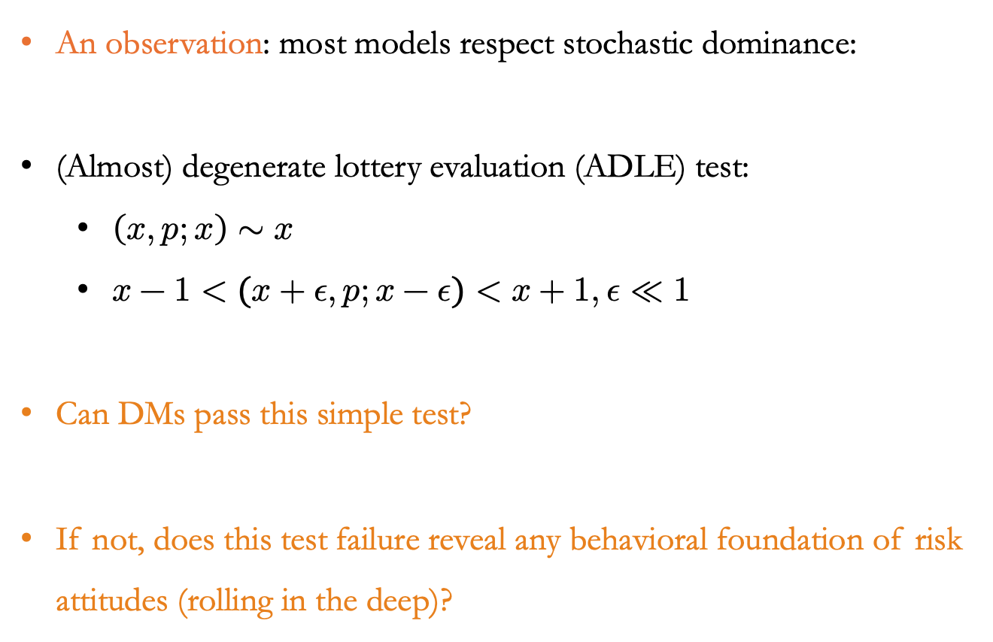
A Simple Test
An observation: most models respect stochastic dominance:
(Almost) degenerate lottery evaluation (ADLE) test:
$\left(x, p;x\right)∼x$
$x−1<(x+ε, p;x−ε)<x+1, ε≪1$
Can DMs pass this simple test?
If not, does this test failure reveal any behavioral foundation of risk attitudes (rolling in the deep)?
Notes:
With this study, we then mainly ask two questions: the first one is whether decision makers can pass this simple test; the second one is, if they do not, then whether and how such dominance violation relates to the fourfold pattern?

Slide 7
Experiment 1
Notes:
So, lets start with our first experiment.

Slide 8
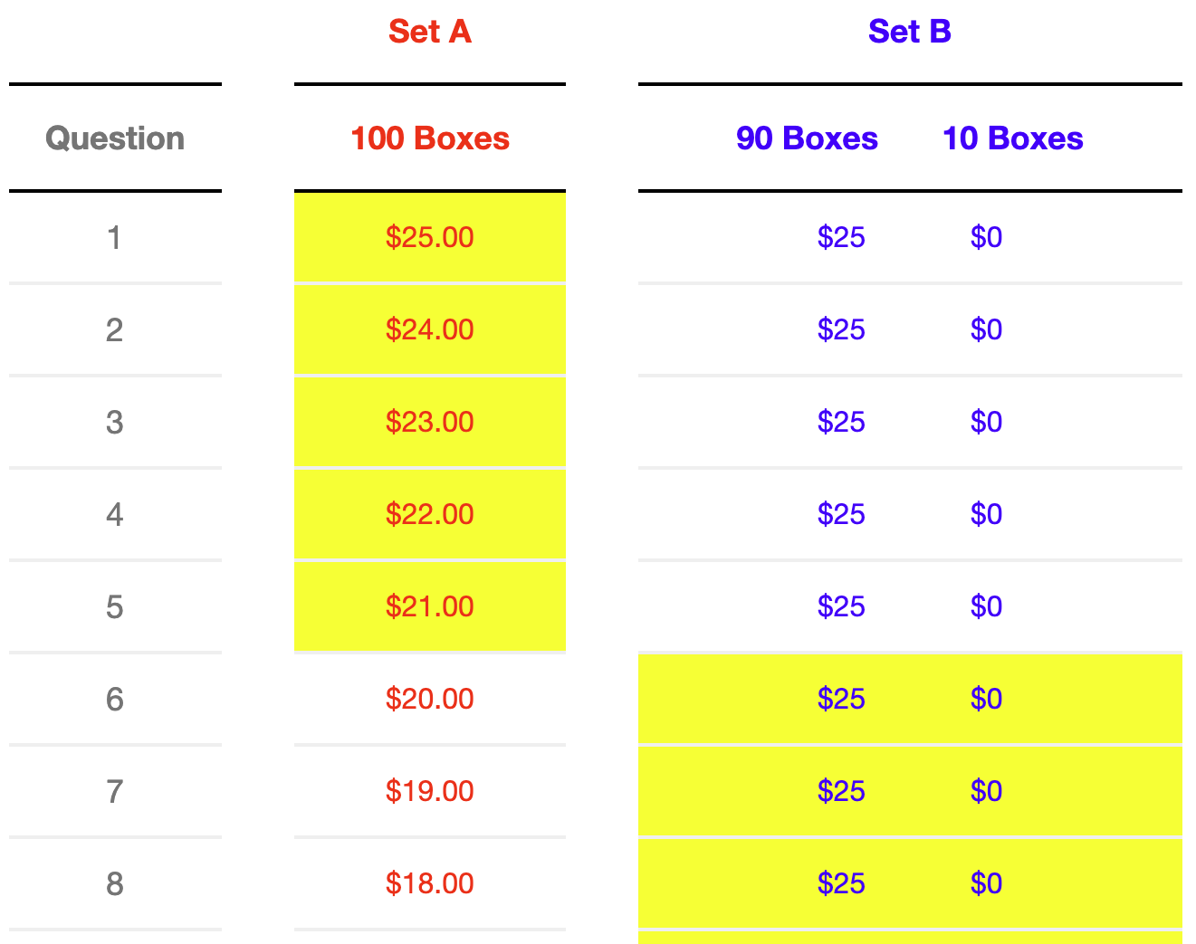
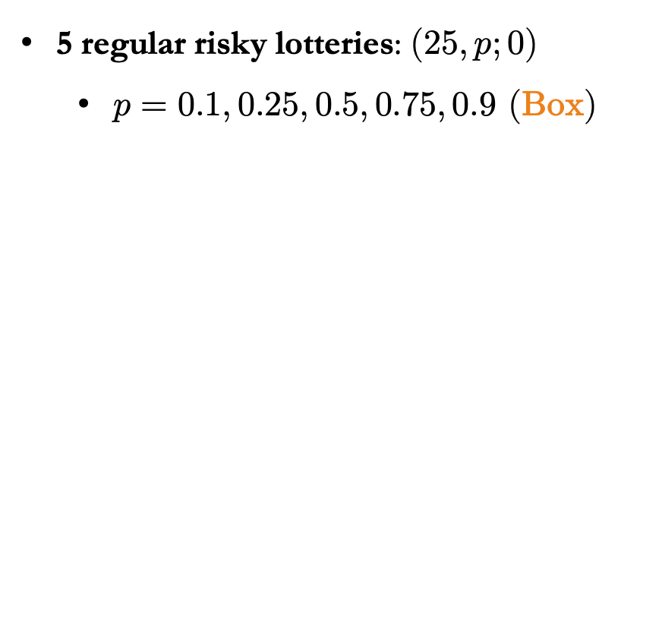
Experiment 1: Designs
5 regular risky lotteries: $(25, p;0)$
$p=0.1, 0.25, 0.5, 0.75, 0.9$ (Box)
4 test lotteries:
$(2.3, 0.1; 2.3)$and $(22.7, 0.9; 22.7)$
$(2.9, 0.1; 2.1)$and $(22.9, 0.9; 22.1)$
Loss domain: same lotteries as above, but with negative outcomes.
( risky lottery )
Notes:
To capture the fourfold pattern, we have five lotteries in the gain domain: a chance of p to win 25 dollars, and otherwise win 0; The probability increases from 10 percent to 90 percents, and it is represented by the proportion of boxes containing different amounts; to determine the outcome, one random box would be open.
To elicit certainty equivalents, our experiments use the multiple price lists, which is the most common way in this literature. So, the certainty equivalent is determined by the position where subjects switch from the sure amount option to the lottery option.

Slide 9
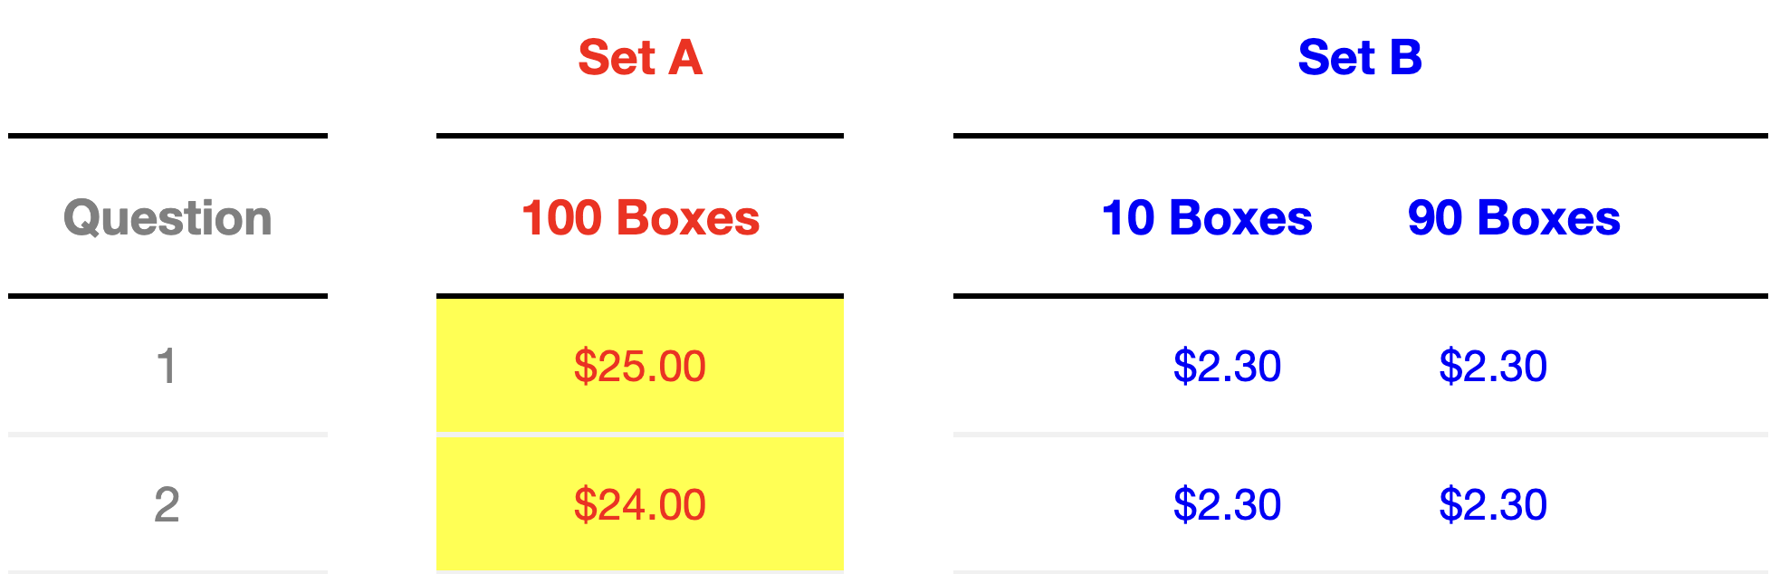
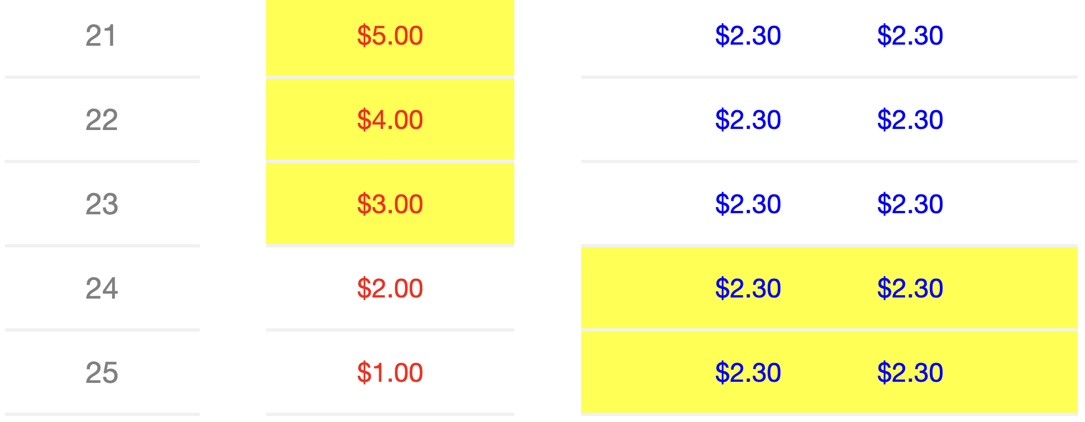
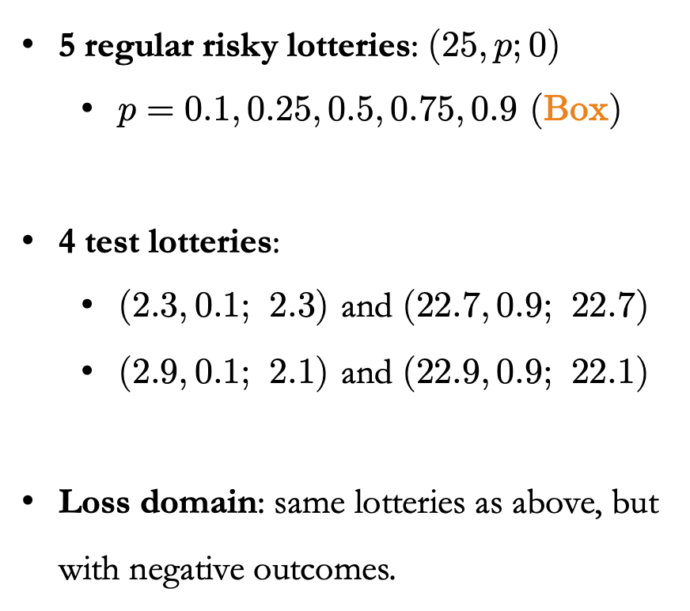
Experiment 1: Designs
5 regular risky lotteries: $(25, p;0)$
$p=0.1, 0.25, 0.5, 0.75, 0.9$ (Box)
4 test lotteries:
$(2.3, 0.1; 2.3)$and $(22.7, 0.9; 22.7)$
$(2.9, 0.1; 2.1)$and $(22.9, 0.9; 22.1)$
Loss domain: same lotteries as above, but with negative outcomes.
…
( A degenerate Test Task)
Notes:
In addition, we have four test lotteries that are degenerate or almost degenerate, and these lotteries have a objectively correct switching position.
Take the degenerate of 2.3 dollars for example. According to stochastic dominance, the subjects should switch when the sure amount option decreases from 3 dollars to 2 dollars.
We also have a counterpart set of lotteries in the loss domains. here, the lotteries are same as shown above, but the outcomes become negative.

Slide 10
Experiment 1: Implement
Instructions
Trainings with examples
Six comprehension questions (reward if correct on the first try)
Price lists task
Risky & test lottery (randomized)
Gains and losses (within-domain randomized)
End-survey questionnaire
150 Subjects (Prolific USA sample)
Notes:
As for implement, we have tried our best to make sure that subjects understand the decision task. We provide the instructions with daily language, some training questions with explanations, and six comprehension questions.
Subjects can only proceed until they answer all of them correctly. Besides, to encourage more attentions and efforts, we reward subject per comprehension question if they answer it correctly upon their first try.
Within the price list task, we put the risky and test lotteries together with a random order. On the other hand, we randomize the order of the positive part and the negative part.
At the end, we have a end-survey questionnaire for basic characteristics.
For this experiment, we have recruited 150 Prolific subjects from the representative USA population.

Slide 11
Experiment 1: Results
( Whole Sample)
(Subsamples by test performance)
Notes:
First, we have the fourfold pattern as what previous studies have.

Slide 12
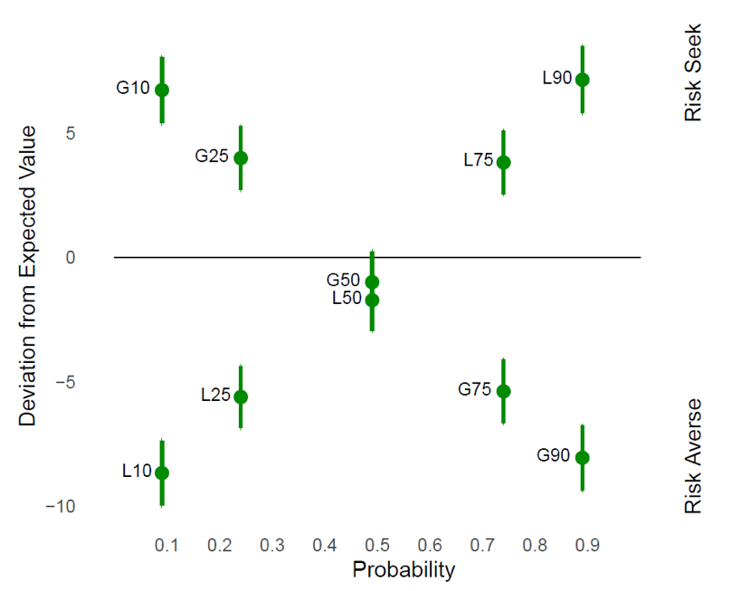
Experiment 1: Results
129 out of 150 failed at least once
110 failed three or more.
The fourfold pattern is significantly weaker among who passed the test than those who failed.
(Subsamples by test performance)
Notes:
Then, we first look at the test performance. Surprisingly, 129 subjects failed at least once out of the eight test lists. And this failure is not trivial as 110 failed at least three times.
Next, when we devide subjects into two groups based on their test performance, we find that people who failed the test have this classic fourfold pattern.

Slide 13
Experiment 1: Results
129 out of 150 failed at least once
110 failed three or more.
The fourfold pattern is significantly weaker among who passed the test than those who failed.
(Subsamples by test performance)
Notes:
Instead, for those people who passed the test, they tend to have a much weaker fourfold pattern.

Slide 14
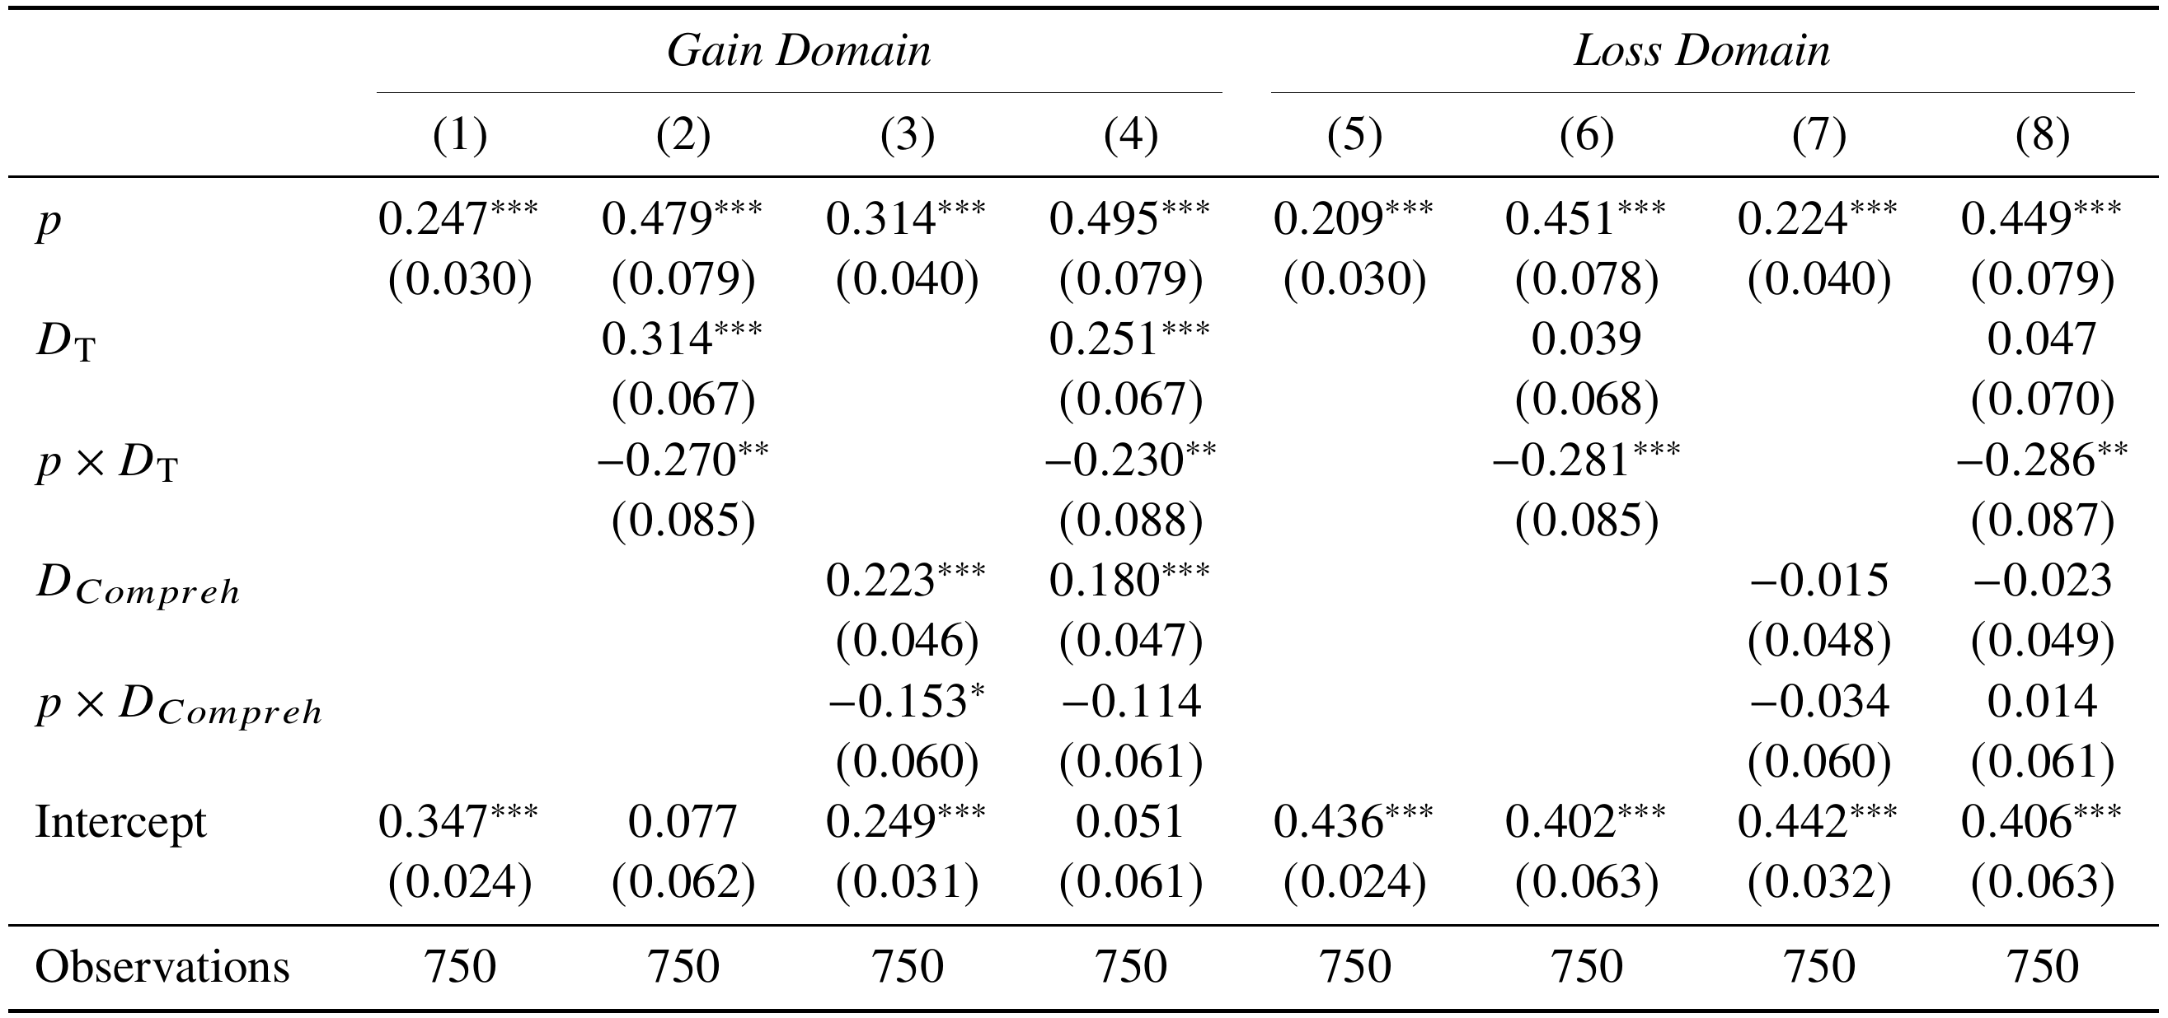
Experiment 1: Results
Mixed-effects model; Outcome: normalized absolute CE
Notes:
We have also done some parametric analysis. We regress the normalized certainty equivalents on the probabilities as well as the dummy variable indicating if the subject failed the test. So, from column 2 and column 6, we can see that people failed the test, they are more insensitive to likelihood change. This is inline with our nonparametric results.
The interesting part is that, this effect is robust to including participants comprehension check performance.

Slide 15
Experiment 2: Deterministic Mirrors
Notes:
So, clearly, many preference-based models could not explain our findings. As our test does not involve any lottery-specific factors, the test failure must be caused by more general ones, such as the complexity of the elicitation mechanism.
In recent years, there are more and more studies discussing the impacts of complexity on the formation of the fourfold pattern.
One important paper is the AER paper decision making under risk is decision making under complexity by ryan oprea.

Slide 16
Experiment 2: Designs
Expt. 1 + the deterministic mirror tasks (Oprea, 2024).
Same structure, but open ALL boxes rather than a random one.
Remain computational complex, but no risk anymore.
Our test lottery can be regarded a special case of this mirror task.
“You will be paid the value of all of the boxes from the Set you selected, added up and divided by 100.”
Notes:
On the basis of our first experiment, we include the deterministic mirror task as proposed by Ryan.
Specifically, a mirror entirely replicate the lottery structure, but now not only one random would be open, but all 100 boxes would be, and the payoff is determined by the average of all boxes’ amounts. In this sense, the mirror is deterministic, but it is indeed as complex as the lottery.
In particular, our test lottery can be regarded as a special case of this mirror task, but we go one step further by removing this layer of computation complexity.

Slide 17
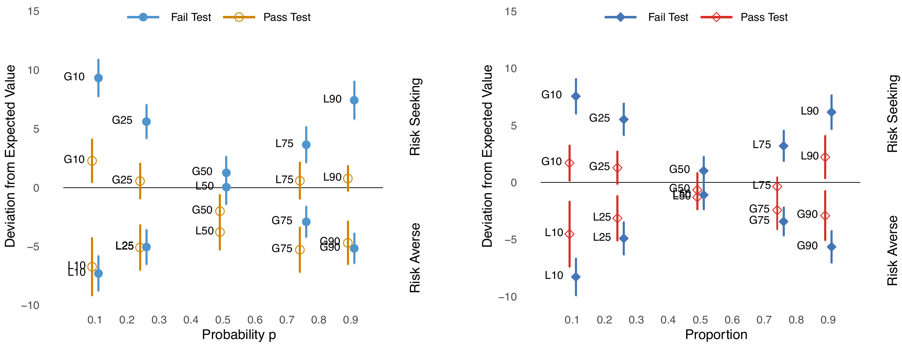
Experiment 2: Results
We replicate the key findings documented in Experiment 1
Lottery Task
Mirror Task
Notes:
So, first, we have replicated the first experiment’s findings that:
Those who passed our simple test have a much weaker fourfold pattern compared to those who failed the test.

Slide 18
Experiment 2: Results
We replicate the (alike) FF pattern in Mirror as well.
DMs who failed the test ALSO have a stronger (alike) FF pattern in Mirror as in Lottery.
Lottery Task
Mirror Task
Notes:
As for the mirror task, we also have this difference of the fourfold pattern. For those people who passed the simple test, the mirror anomaly documented by Ryan is much weaker. The main driving force is from those who failed our test.

Slide 19
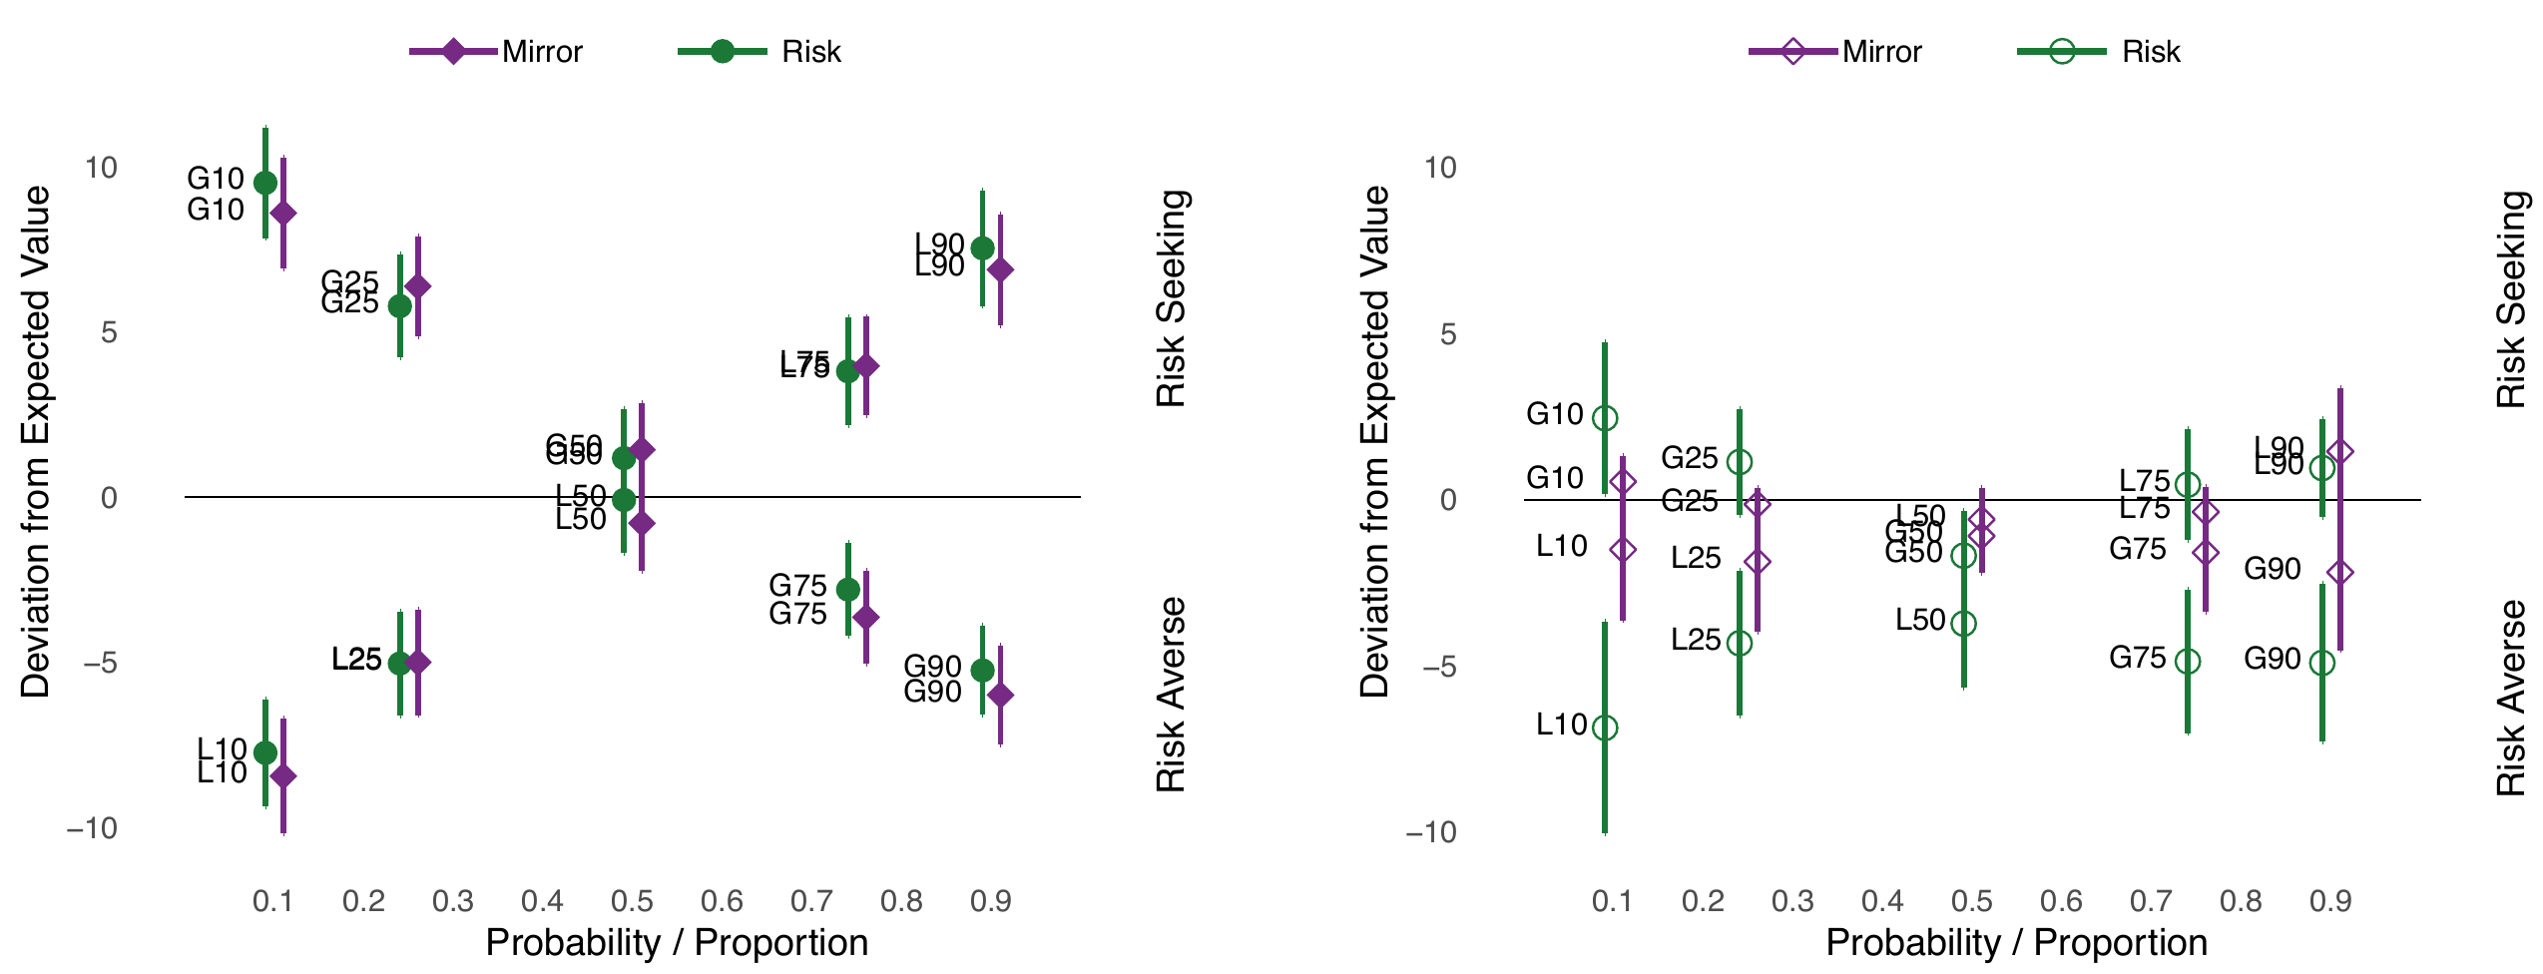
Experiment 2: Results
The valuation of each pair of lottery and mirror:
( Fail Test )
( Pass Test )
Notes:
We can also look at the data in another way by checking the correlation of responses in each pair of lottery and mirror.
In the left hand side, clearly, the correlation here is very strong and even the valuation of mirrors and lotteries are very close to each other, not significantly different.
Instead, for the right plot which represent those participants who passed our test, the correlation is not significant, while the difference is significant. Specifically, the mirror’s valuation is way closer to the expected value.

Slide 20
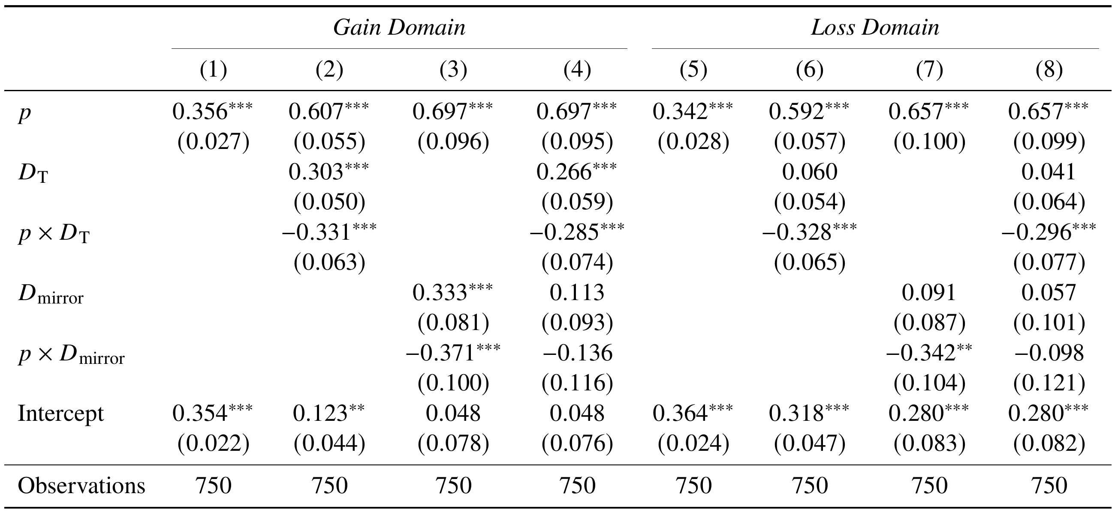
Experiment 2: Results
Mixed-effects model; Outcome: normalized absolute CE
Robust to replacing $D_{mirror}$ with the paired mirror’s valuation.
Notes:
Again, for the regression, we can say that people who failed the test, is more insensitivity to likelihood change and its very robust to controlling individual mirror task failure. Interestingly, as column 4 and 8 show, when we regress our test and mirror performance at the same time, the coefficients of mirror task performance is not significant anymore.

Slide 21
Experiment 3: Cognitive Uncertainty
Notes:
Another important paper regarding the role of cognition on fourfold pattern is the cognitive uncertainty by Enke and Graeber.

Slide 22
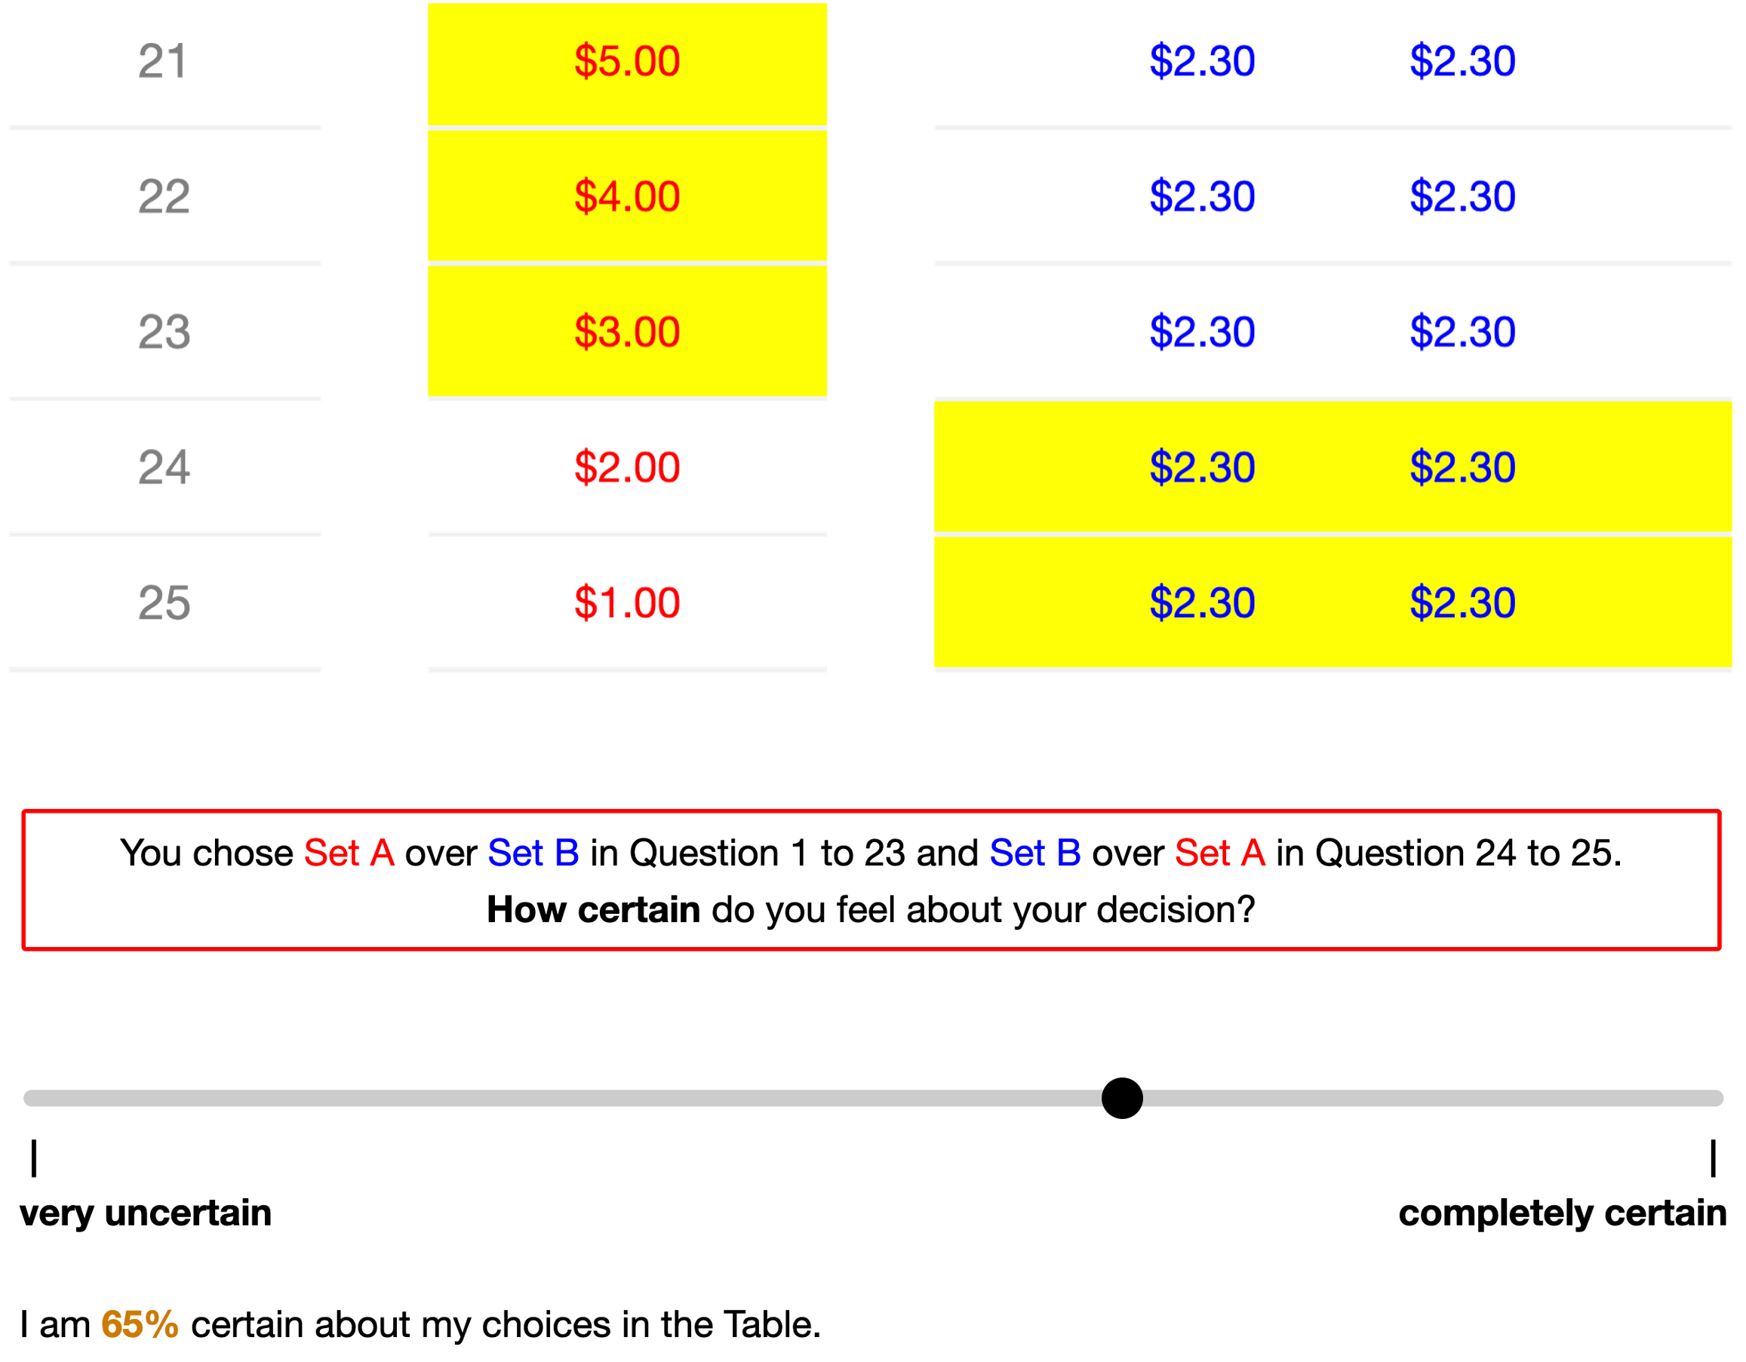
Experiment 3: Designs
Expt. 1 + the cognitive uncertainty measurement (Enke & Graeber, 2023).
After each valuation submission.
How much does subjective cognitive uncertainty measure overlap our test ?
Notes:
On the basis of our first experiment, we include the cognitive uncertainty measure. Specifically, after submitting the choice list responses, subjects need to report how certain do they feel about that decision.
For this measure, even though the original paper mainly discuss the perception and process of these lottery-specific information, in practice, it definitely will capture the uncertainty about the general decision environment.
So, we want to explore in this experiment, how much does our test overlap with their measure.

Slide 23
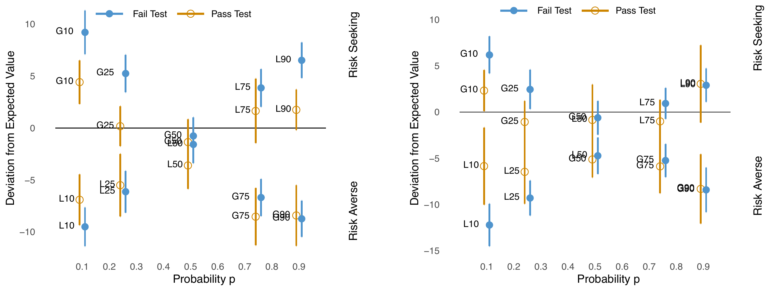
Experiment 3: Results
( High CU DMs )
( Low CU DMs )
Notes:
So, we divide the subjects based on their personal average of cognitive uncertainty. And it is clear that no matter whether the subjects have higher or lower cognitive uncertainty, the linkage between our test performance and the fourfold pattern exists in both subsamples.

Slide 24
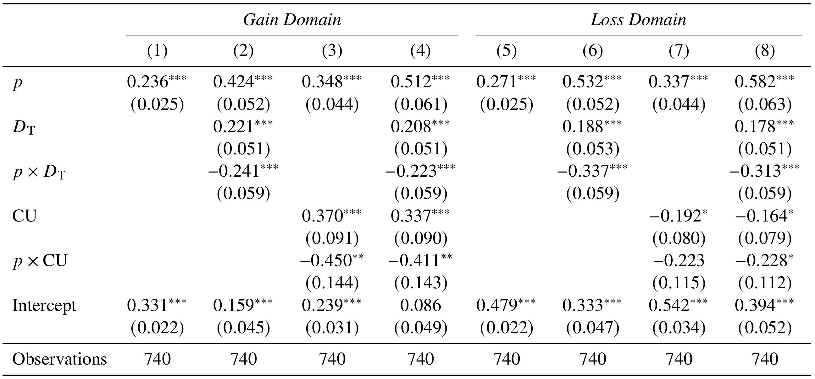
Experiment 3: Results
Notes:
Again, for the regression analysis, we can see that the main effects are robust after controlling the cognitive uncertainty measure.

Slide 25
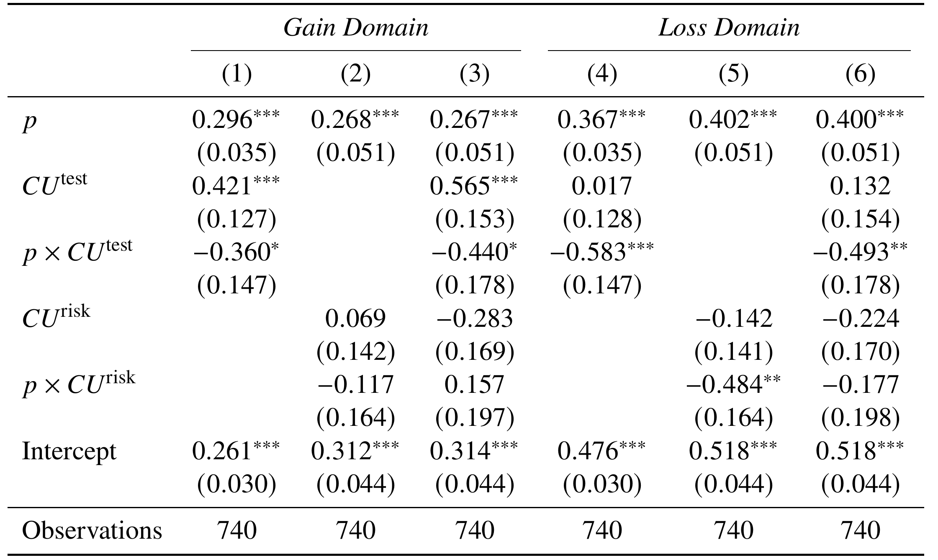
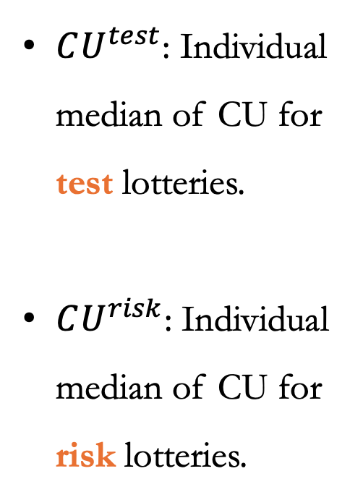
Experiment 3: Results
$CU^{test}$: Individual median of CU for test lotteries.
$CU^{risk}$: Individual median of CU for risk lotteries.
Notes:
We have also conducted the regression of certainty equivalents on two individual level cognitive uncertainty measure. The first one indicates the average uncertainty for those test lotteries; while the second one indicates the average uncertainty for those risk lotteries.
Clearly, only the cognitive uncertainty over test lotteries correlated with the likelihood insensitivity.

Slide 26
Experiment 4: Student Sample
Notes:
So, from the second and the third experiment, we can say something like: in this classic setup, the fourfold pattern are actually related to some more general factors, including but not limited to mechanism complexity, heuristics, or inattention.

Slide 27
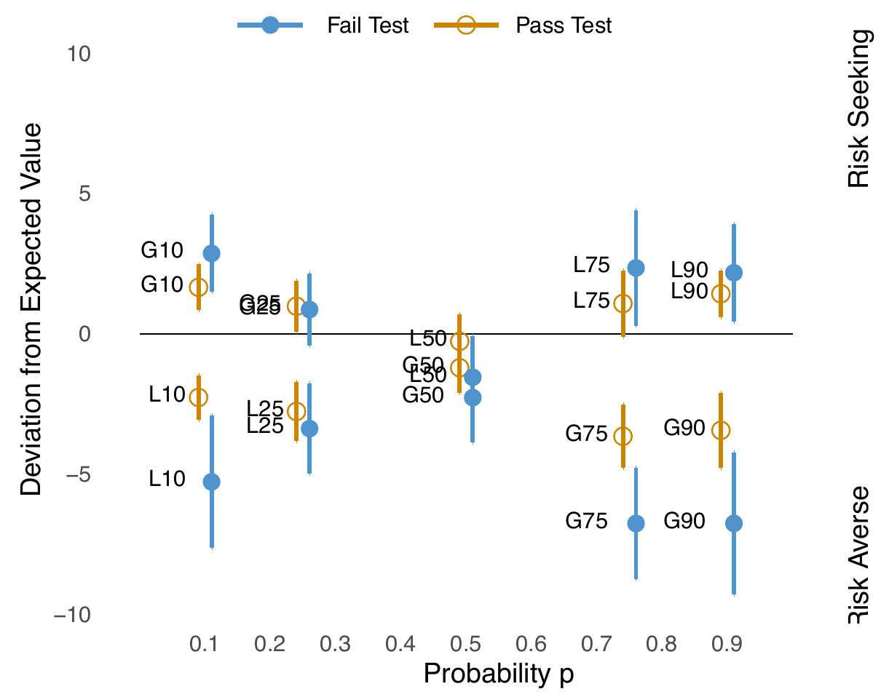
Experiment 4
Are the findings specific to this Prolific population?
Replicate Expt. 1 with university student sample.
Fewer DMs (29 / 81) failed the test, and many (18 / 29) only failed once.
The results are essentially same to that of Expt. 1.

Slide 28
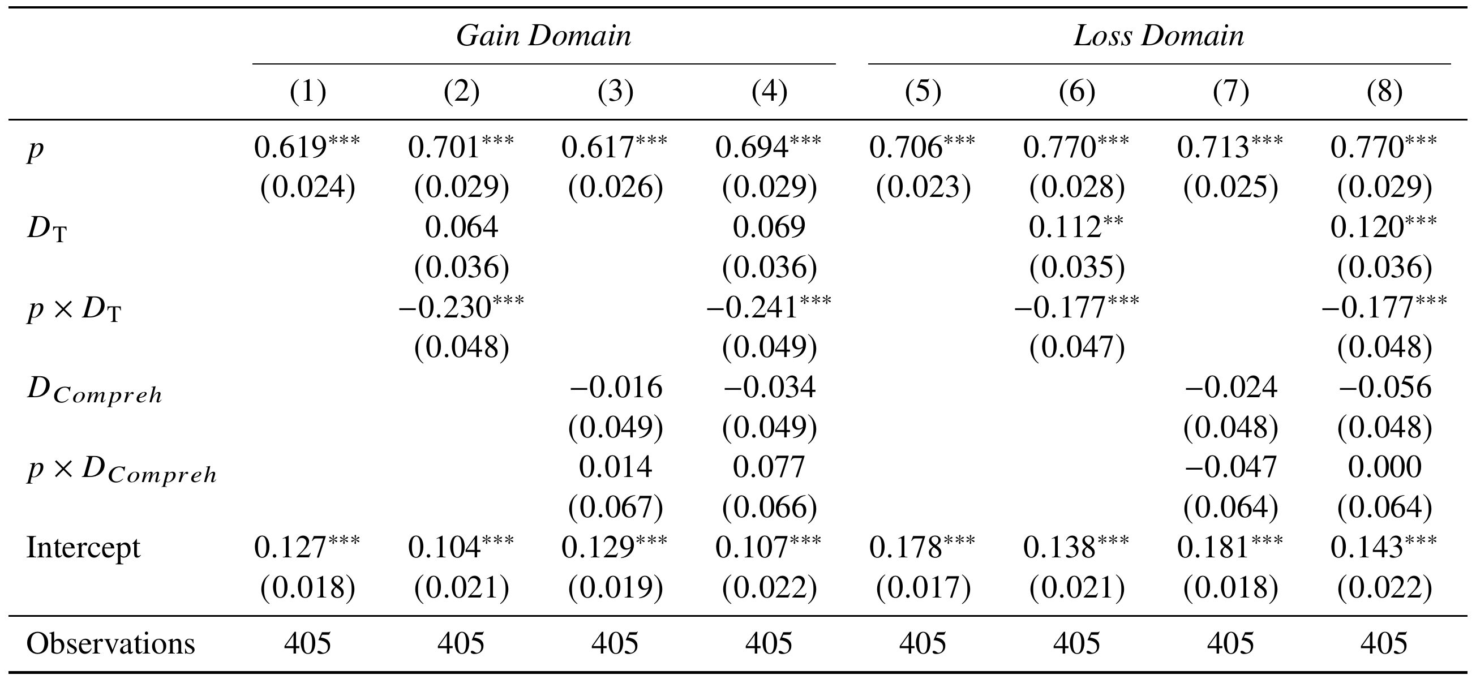
Experiment 4

Slide 29
Discussion

Slide 30
Discussion 1 / 3:
Previous studies emphasize lottery-specific cognitive frictions
The complexity of computing lottery values (Oprea 2024, Puri 2025)
Noisy perception of probabilities or payoffs (Woodford, 2020; Khaw et al., 2021; Frydman and Jin, 2021; Enke and Graber, 2023; Vieider, 2021;)
Our contribution: Highlight the importance of non–lottery-specific cognitive frictions (e.g. the complexity of price lists).

Slide 31
Discussion 2 / 3:
Empirical regularities are key inputs for developing preference-based models.
But not all observed behaviors are equally informative.
Our contribution: Our test helps clarify the scope of preference-based models.
For example, most leading models respect stochastic dominance.
When participants repeatedly fail simple tests, caution is needed to use their behavior to motivate such models.

Slide 32
Discussion 3 / 3:
Experimental studies often include:
clearer mechanism descriptions (Gonczarowski et al., 2023),
trainings to reduce misconceptions (Plott and Zeiler, 2005, 2007),
improving instructions (Freeman et al., 2018),
adopting characterization assessment method (Bernheim et al., 2025).
While these design features are helpful, their effects can be difficult to assess.
Our contribution: A convenient, and more direct and stringent assessment.

Slide 33
Thank you

Slide 34
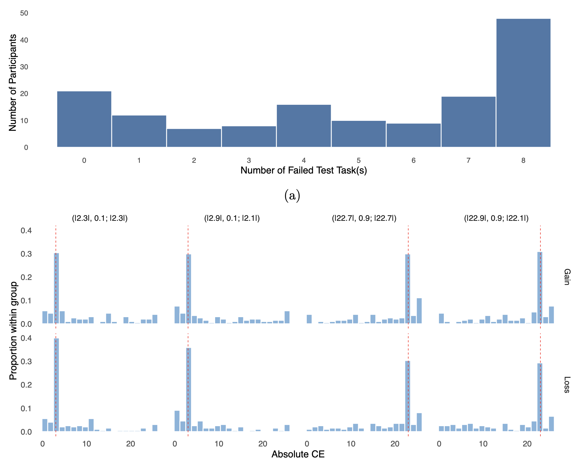
Other F & T:

