Slide 1
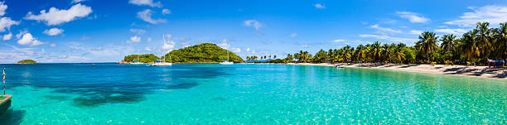





TI
Home
Lodging
Transportation
SEARCH
Find Something….
Dining
Activities
FAQ
Welcome To Taniti Island
Taniti is a small, tropical island in the Pacific. While the island has an area of less than 500 square miles, the terrain is varied and includes sandy and rocky beaches, a small but safe harbor, lush tropical rainforests, and a mountainous interior with a small, active volcano. Taniti has an indigenous population of about 20,000. Until a recent increase in tourism, most of the Tanitian economy was dominated by fishing or agriculture.
Dining
Lodging
Activities
Transportation
FAQs
SITE MAP
PRIVACY RIGHTS
CONTACT US
TERM of SERVICE
Images Provided By https://www.gettyimages.com/

Slide 2

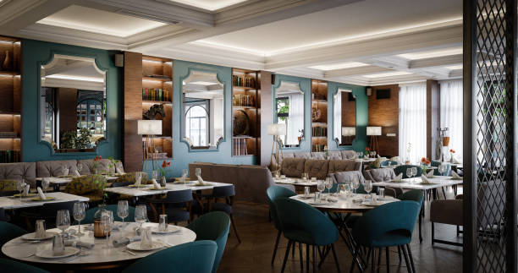

TI
Home
Lodging
Transportation
SEARCH
Find Something….
Dining
Activities
FAQ
Information for Dining
Taniti has two supermarkets, two smaller grocery stores, and one convenience store that is open 24 hours a day
Taniti currently has ten restaurants: five serve mostly local fish and rice, three serve American-style meals, and two serve Pan-Asian cuisine
Home
Lodging
Activities
Transportation
FAQs
SITE MAP
PRIVACY RIGHTS
CONTACT US
TERM of SERVICE
Images Provided By https://www.gettyimages.com/

Slide 3
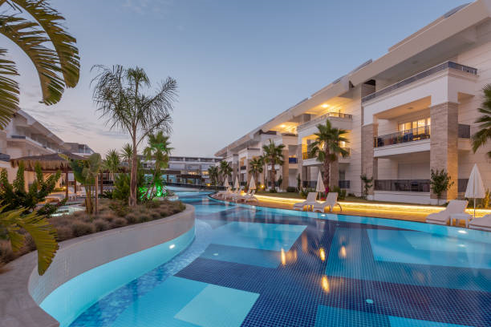
TI
Home
Lodging
Transportation
SEARCH
Find Something….
Dining
Activities
FAQ
Information for Lodging
Taniti has a wide variety of lodging that ranges from an inexpensive hostel to one large, four-star resort. There are many small, family-owned hotels and a growing number of bed and breakfasts. All types of lodging are strictly regulated and regularly inspected by the Tanitian government.
Home
Dining
Activities
Transportation
FAQs
SITE MAP
PRIVACY RIGHTS
CONTACT US
TERM of SERVICE
Images Provided By https://www.gettyimages.com/

Slide 4
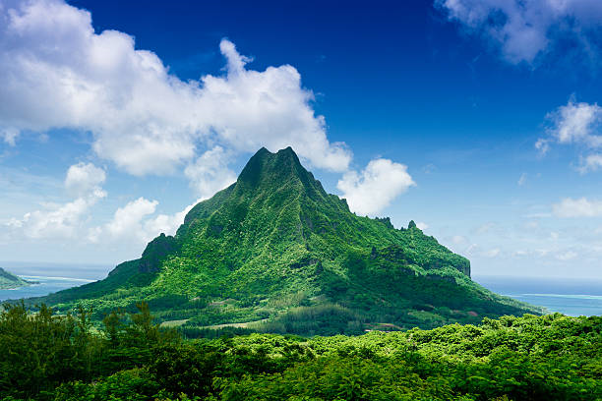
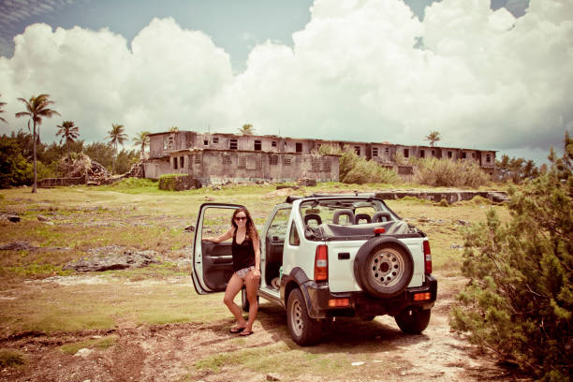
TI
Home
Lodging
Transportation
SEARCH
Find Something….
Dining
Activities
FAQ
Information for Activates
Most people visit Taniti to enjoy the beaches, explore the rainforest, and visit the volcano. However, there are other things to do, including visiting a local history museum, going on chartered fishing tours, snorkeling, zip-lining in the rainforest, visiting several pubs, including a microbrewery, dancing at a new dance club, seeing a movie, taking helicopter rides, playing at an arcade, visiting art galleries, and bowling. Also, a nine-hole golf course should be operational by next year. Many of these activities are in Merriton Landing, a rapidly developing area on the north side of Yellow Leaf Bay.
Most tourists spend most of their time in Taniti City, which boasts native architecture and nearby white, sandy beaches that encircle Yellow Leaf Bay. Most tourists spend most of their time in Taniti City, which boasts native architecture and nearby white, sandy beaches that encircle Yellow Leaf Bay.
Other popular activities include:
boat or bus tours of the island
hikes in the rainforest
visits to Taniti’s active volcano.
Home
Dining
Lodging
Transportation
FAQs
SITE MAP
PRIVACY RIGHTS
CONTACT US
TERM of SERVICE
Images Provided By https://www.gettyimages.com/

Slide 5



TI
Home
Lodging
Transportation
SEARCH
Find Something….
Dining
Activities
FAQ
Information for Transportation
Almost all visitors arrive in Taniti by air, though some arrive on a small cruise ship that docks in Yellow Leaf Bay for one night per week. Taniti is served by a small airport accommodating small jets and propeller planes. Taniti is in the process of expanding the airport so larger jets will be able to land on the island within the next few years.
Public buses serve Taniti City from 5 a.m. to 11 p.m. daily.
Private buses serve the rest of the island.
Taxis are available in Taniti City
Rental cars can be rented from a local rental agency near the airport.
Bikes and helmets are available to rent from several vendors (helmets are required by law).
Taniti City is flat and very walkable. Many tourists stay in the area surrounding Merriton Landing: this area is easy to explore on foot.
Home
Dining
Lodging
Activities
FAQs
SITE MAP
PRIVACY RIGHTS
CONTACT US
TERM of SERVICE
Images Provided By https://www.gettyimages.com/

Slide 6
TI
Home
Lodging
Transportation
SEARCH
Find Something….
Dining
Activities
FAQ
Frequently Requested Information
Power outlets are 120 volts (the same as in the United States).
Alcohol cannot be served or sold between midnight and 9:00 a.m.
The drinking age on Taniti is 18, and the drinking age is not strictly enforced.
Many younger Tanitians speak fluent English. Very little English is spoken in rural areas, especially by the older residents.
There is one hospital and several clinics. The hospital has many multilingual employees.
Violent crime is rare in Taniti, but as tourism increases, there are more reports of pickpocketing and other petty crimes.
Taniti enjoys many national holidays, and many tourist attractions and restaurants will be closed on holidays, so visitors should plan accordingly.
Taniti uses the U.S. dollar as its currency, but many businesses will also accept euros and yen. Several banks facilitate currency exchange, and many businesses accept major credit cards.
Home
Dining
Lodging
Activities
Transportation
SITE MAP
PRIVACY RIGHTS
CONTACT US
TERM of SERVICE
Images Provided By https://www.gettyimages.com/

