Slide 1
Boosted Decision Trees In Particle Physics
Presenter: James Shaddix

Slide 2
Plan
Develop the algorithm:
1. Decision Trees
2. Random Forests
3. Boosted Decision Tree
MiniBooNE Experiment

Slide 3
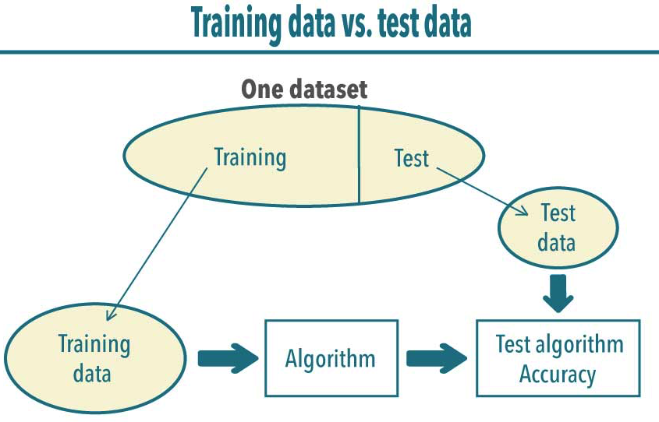
Decision Trees
Machine Learning
Algorithm
Supervised Learning
Algorithm
Solves Classification (Discrete) and
Regression
(Continuous) Problems
Day | Temp | Wind | Pressure | Rain
1 | 70 | 3 | 22 | no
2 | 20 | 5 | 35 | yes
3 | 50 | 7 | 40 | yes

Slide 4
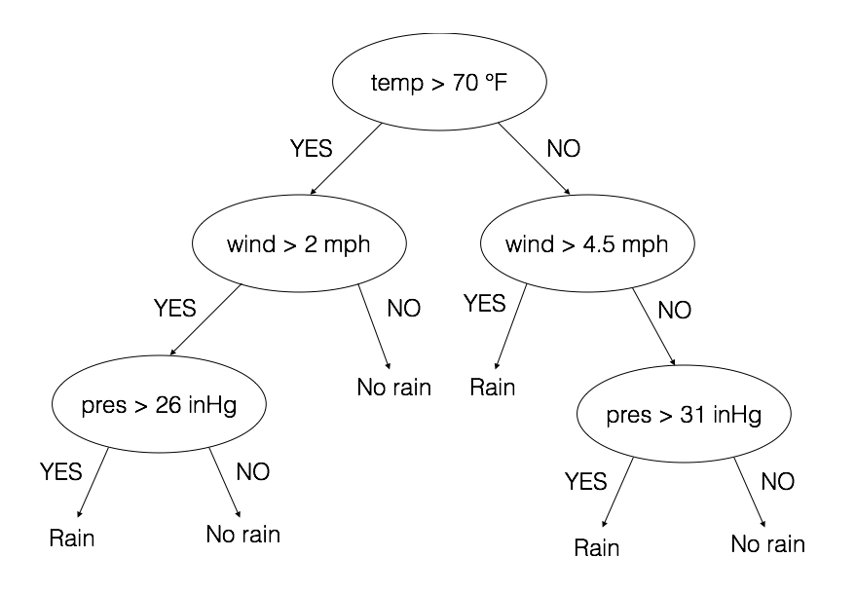
Will it Rain Tomorrow?
Nodes: 1.) Root Node 2.) Decision Node 3.) Leaf Node

Slide 5
Creating a Decision Tree:
Essential Question:
- What question should we ask at a node?
Algorithms: CART, C4.5,CHAID, MARS
- Greedy Algorithms
Cost Function:
- Information Gain: Metric for strength of the question

Slide 6
CART Algorithm
Determine Candidate questions
Day | Temp | Wind | Pressure | Rain
1 | 70 | 3 | 22 | no
2 | 20 | 5 | 35 | yes
3 | 50 | 7 | 40 | yes
Use Features as Boundary Values:
Is: (Temp >= 70) (Temp >= 20) (Temp >= 50)
Is: (Wind >= 3) (Wind >= 5) (Wind >= 7)
Is: (Pressure >= 22) (Pressure >= 35) (Pressure >= 40)
Gini Impurity: Metric For Measuring the purity of a Node

Slide 7
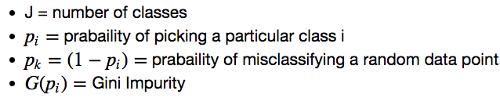




Gini Impurity and information Gain

Slide 8
Improving A Decision Tree
Problems:
1. Tends to overfit the data
2. Tends to have high variance
3. Results are biased towards classes that appear more often
Stopping Condition:
- Reduces chance of over fitting
- Uses Majority Vote
Pruning:
- Decrease the size of the tree
Reduces chance of over fitting
Reduced Error Pruning

Slide 9
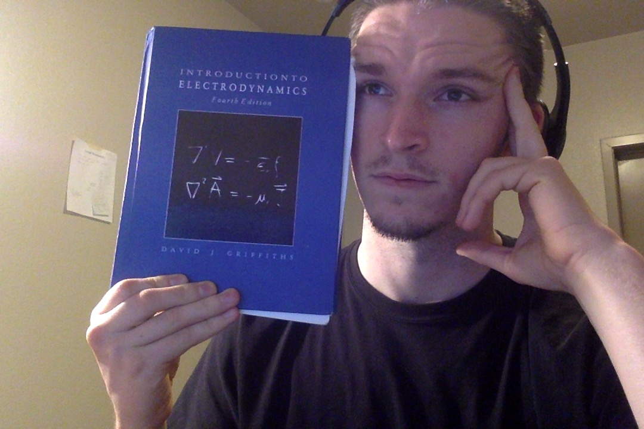

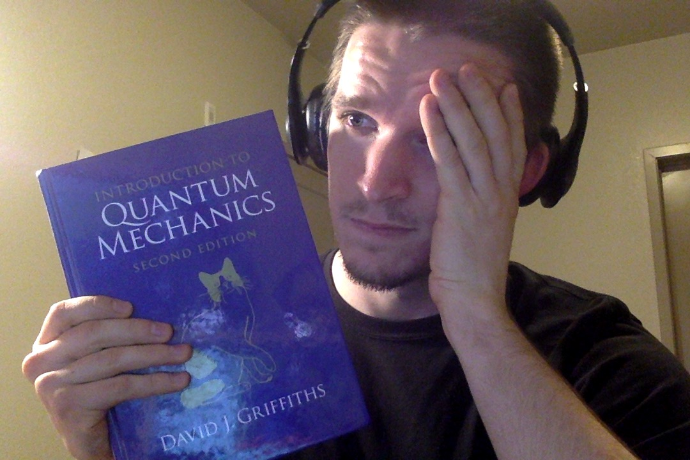
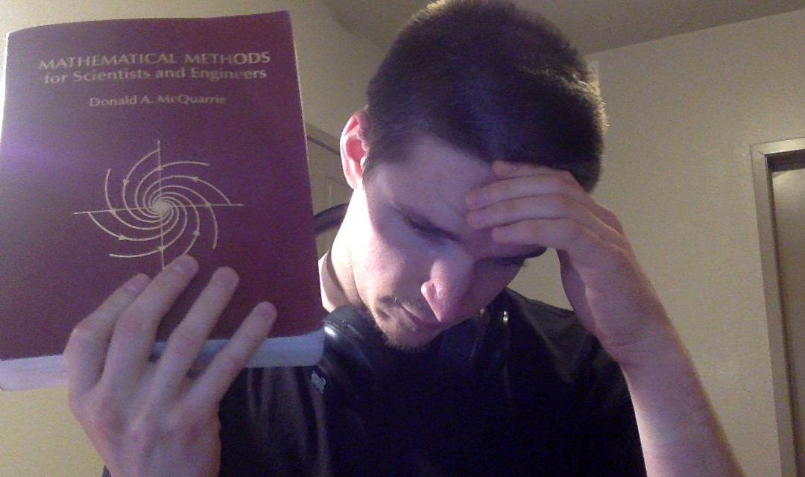
Random Forest
Ensemble Learning Algorithm
- Makes use of many decision trees (which are deterministic)
- Decreases Variance of our algorithm
Use Bagging to resample the data → instability
- Stratified Random Sampling
Different Features compose questions → instability
Weak Learners Strong Learner

Slide 10
Boosted Decision Trees with AdaBoosting
Reduces chance of over fitting our data.
How does it work?
Create decision trees that are weighted based on performance.
Assign weights to data points based on misclassifications.
Determine what data points to train on based on weights
- If data is classified correctly reduce the weight
- if data is classified incorrectly increase the weight

Slide 11
Mini BooNE
Experiment done at Fermi Lab
- studying neutrino interactions
Created a model using Monte Carlo samples.
Tested various classifying techniques:
(ANN) Artificial Neural Networks
Boosted Decision Trees
Boosted decision trees worked 20-80% better than ANN’s.
Training parameters: hit topology, timing of events, scintillation light, etc..

Slide 12
Questions?

