Slide 1
Baseline
Intervention
SAJE
GIAD
LELI

Slide 2
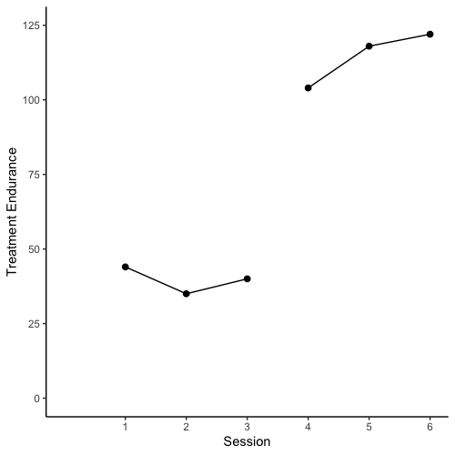
Baseline
Intervention
SAJE

Slide 3
Baseline
Intervention
SAJE
PND
Above line = 3
Phase N = 3
PND= 3/3 = 1

Slide 4
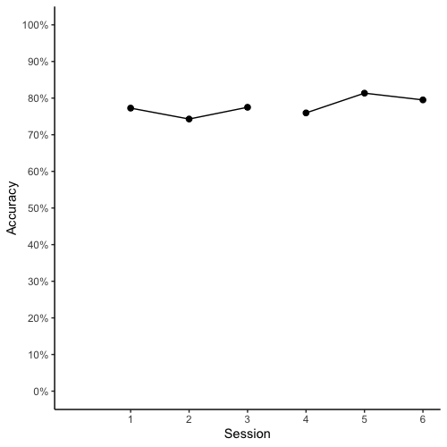
Baseline
Intervention
SAJE

Slide 5
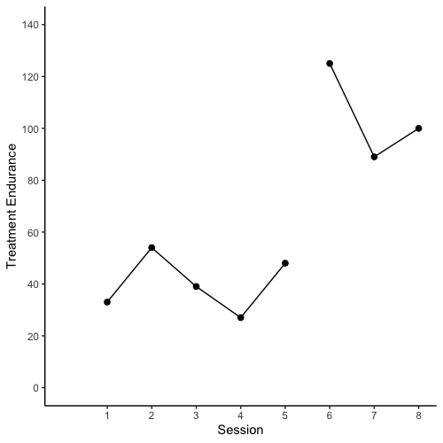
Baseline
Intervention
LELI

Slide 6
Baseline
Intervention
LELI
PND
Above line = 3
Phase N = 3
PND= 3/3 = 1

Slide 7
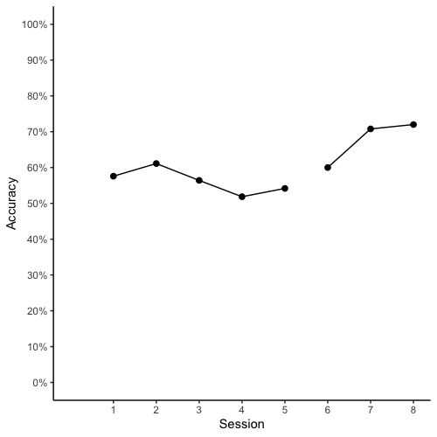
Baseline
Intervention
LELI

Slide 8
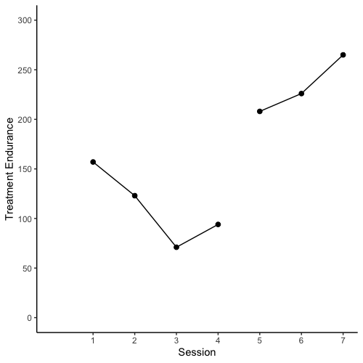
Baseline
Intervention
GIAD

Slide 9
Baseline
Intervention
GIAD
PND
Above line = 3
Phase N = 3
PND= 3/3 = 1

Slide 10
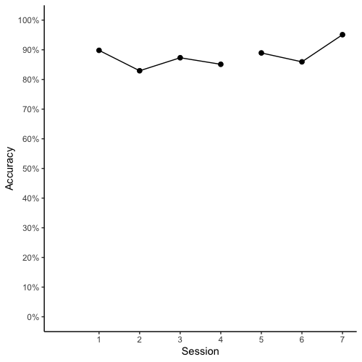
Baseline
Intervention
GIAD

Slide 11
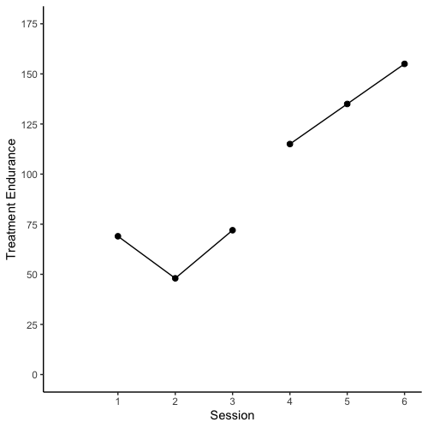
Baseline
Intervention
SAJE
PND
Above line = 3
Phase N = 3
PND= 3/3 = 1

Slide 12
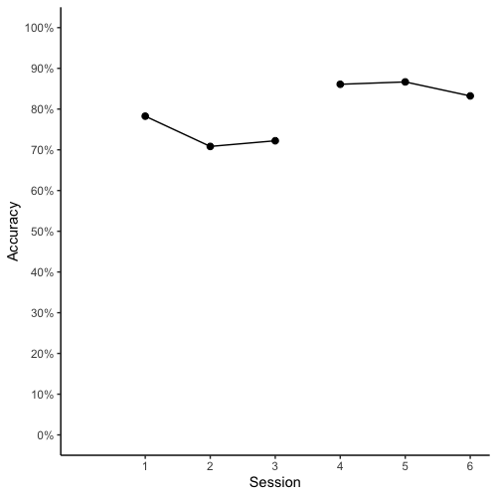
Baseline
Intervention
SAJE
PND
Above line = 3
Phase N = 3
PND= 3/3 = 1

Slide 13
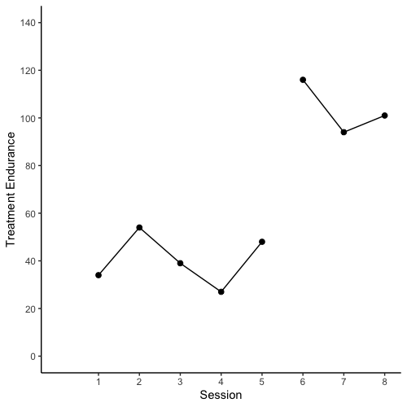
Baseline
Intervention
LELI
PND
Above line = 3
Phase N = 3
PND= 3/3 = 1

Slide 14
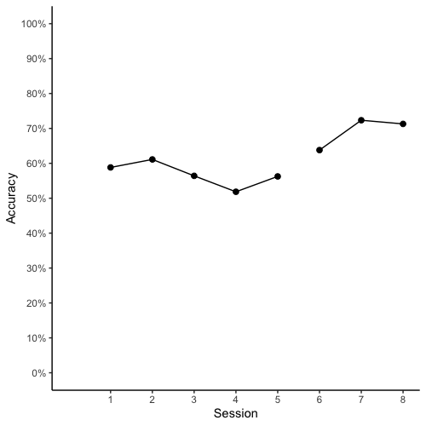
Baseline
Intervention
LELI
PND
Above line = 3
Phase N = 3
PND= 3/3 = 1

Slide 15

Baseline
Intervention
GIAD
PND
Above line = 3
Phase N = 3
PND= 3/3 = 1

Slide 16
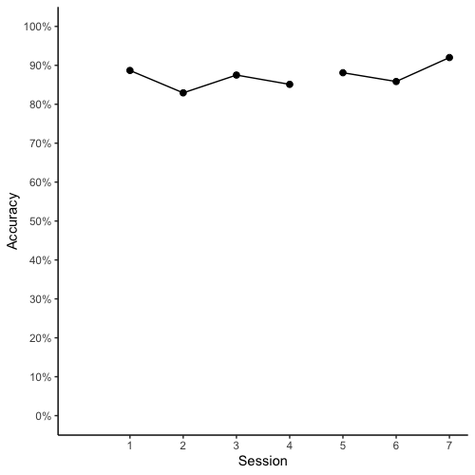
Baseline
Intervention
GIAD
PND
Above line = 1
Phase N = 3
PND= 1/3 = 0.33

Slide 17
Baseline
Intervention
AE

Slide 18
Baseline
Intervention
EI

Slide 19
Baseline
Intervention
IA

Slide 20
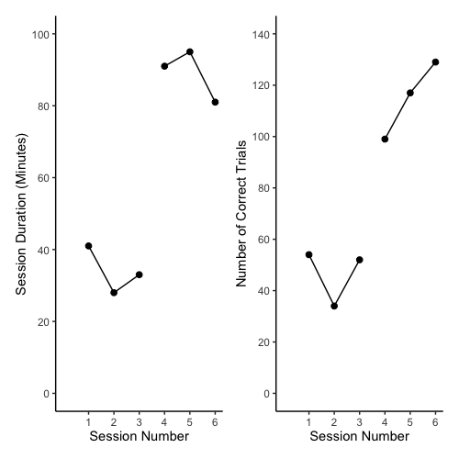
Baseline
Intervention
Baseline
Intervention
AE

Slide 21
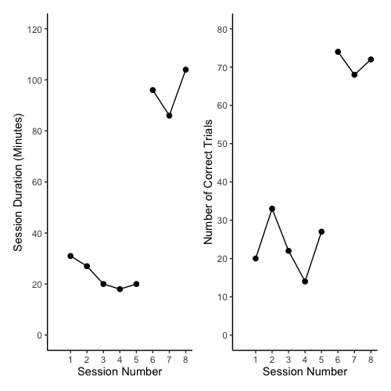
Baseline
Intervention
Baseline
Intervention
EI

Slide 22
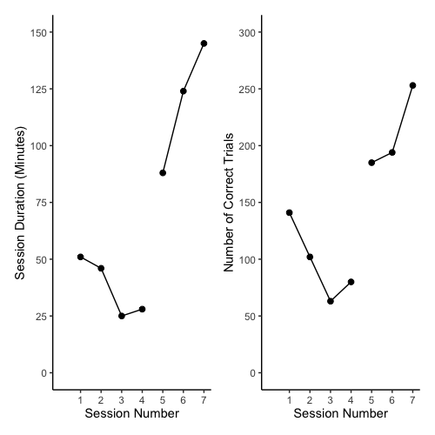
Baseline
Intervention
Baseline
Intervention
IA

Slide 23
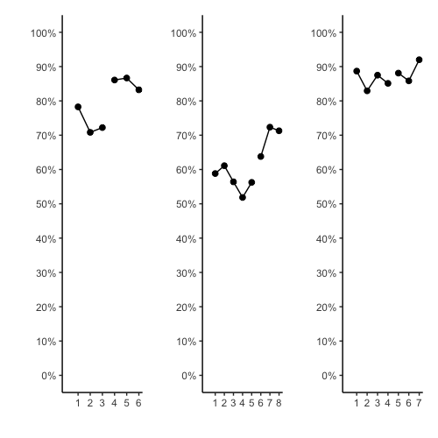
Baseline
Intervention
Baseline
Intervention
Baseline
Intervention
Accuracy
AE
EI
IA
Session

Slide 24
Baseline
Intervention
Baseline
Intervention
Baseline
Intervention
Accuracy
AE
EI
IA
PND
PND
PND
Above line = 3
Phase N = 3
PND= 3/3 = 1
Above line = 3
Phase N = 3
PND= 3/3 = 1
Above line = 1
Phase N = 3
PND= 1/3 = 0.33
Session

Slide 25
Accuracy
Session

Slide 26
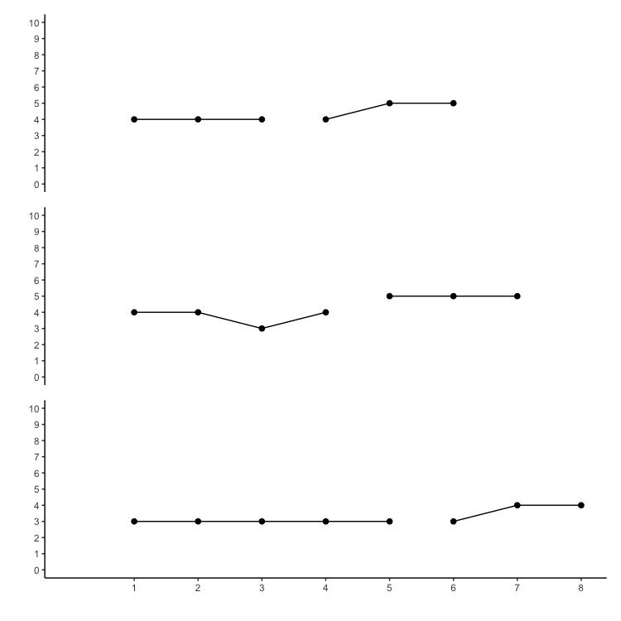
Baseline
Intervention
AE
Digit Span
EI
IA
Session

Slide 27
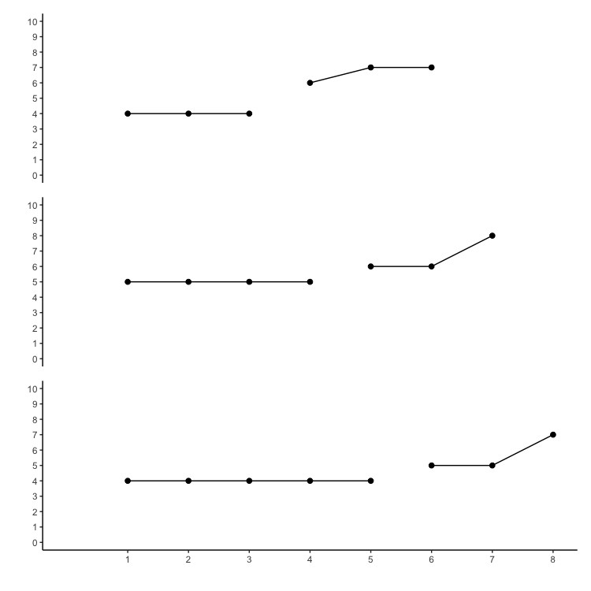
Baseline
Intervention
AE
Sentences
EI
IA
Session

