Slide 1
Baseline
Intervention
SAJE
GIAD
LELI

Slide 2
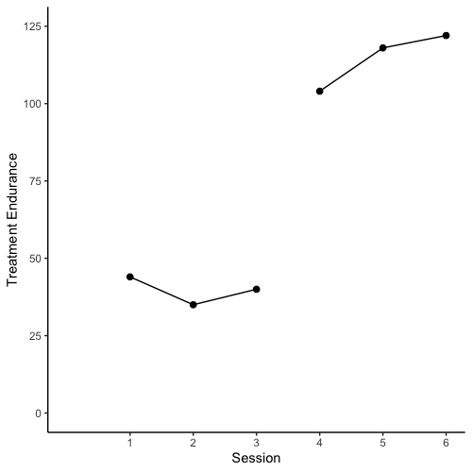
Baseline
Intervention
SAJE

Slide 3
Baseline
Intervention
SAJE
PND
Above line = 3
Phase N = 3
PND= 3/3 = 1

Slide 4
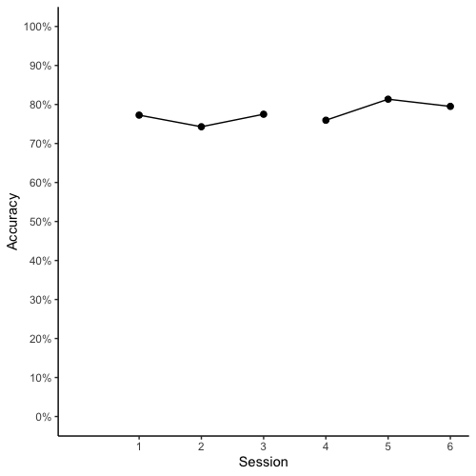
Baseline
Intervention
SAJE

Slide 5
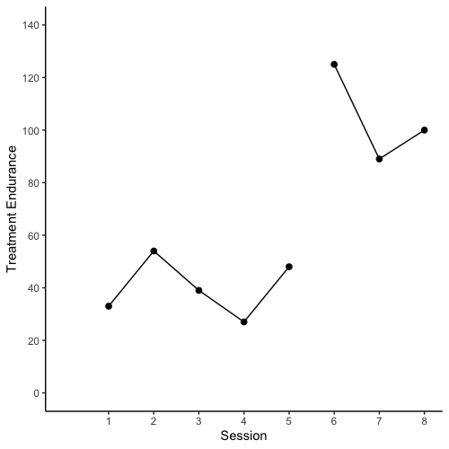
Baseline
Intervention
LELI

Slide 6
Baseline
Intervention
LELI
PND
Above line = 3
Phase N = 3
PND= 3/3 = 1

Slide 7
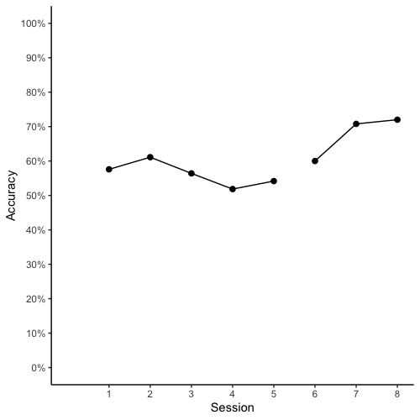
Baseline
Intervention
LELI

Slide 8
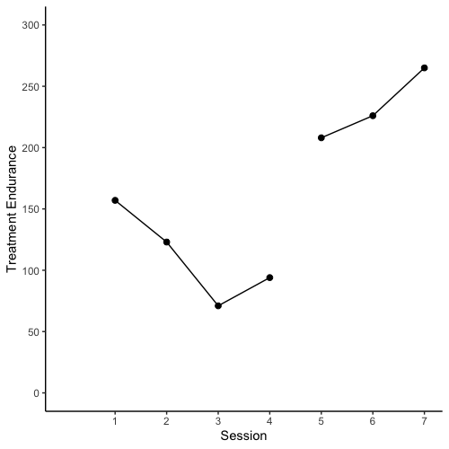
Baseline
Intervention
GIAD

Slide 9
Baseline
Intervention
GIAD
PND
Above line = 3
Phase N = 3
PND= 3/3 = 1

Slide 10
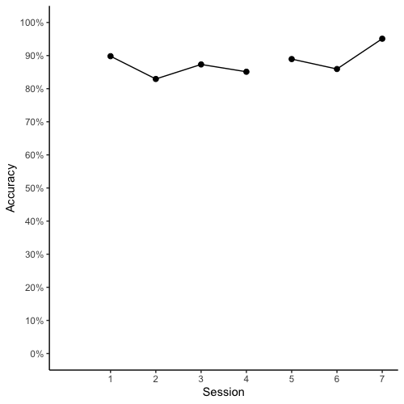
Baseline
Intervention
GIAD

Slide 11
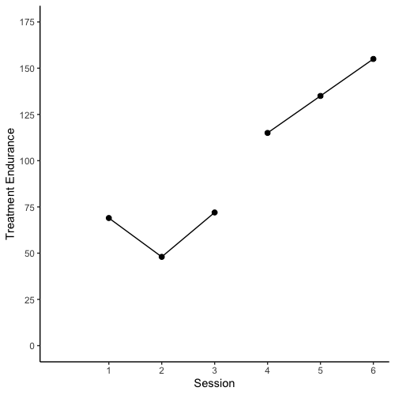
Baseline
Intervention
SAJE
PND
Above line = 3
Phase N = 3
PND= 3/3 = 1

Slide 12
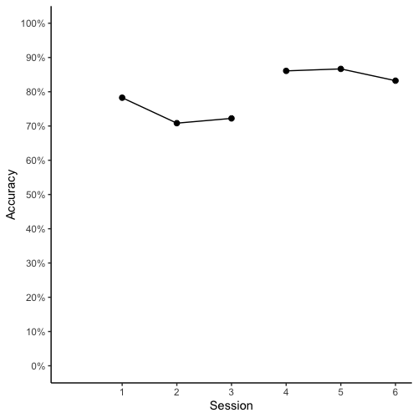
Baseline
Intervention
SAJE
PND
Above line = 3
Phase N = 3
PND= 3/3 = 1

Slide 13
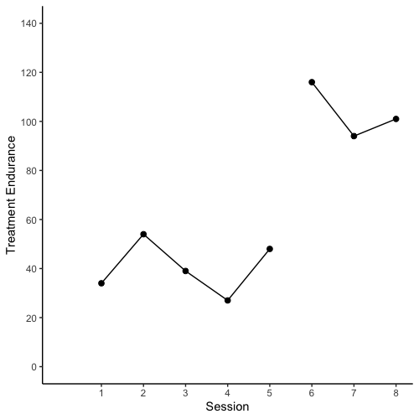
Baseline
Intervention
LELI
PND
Above line = 3
Phase N = 3
PND= 3/3 = 1

Slide 14
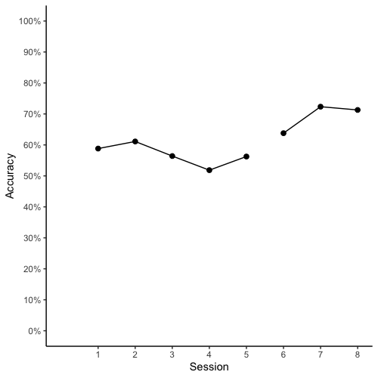
Baseline
Intervention
LELI
PND
Above line = 3
Phase N = 3
PND= 3/3 = 1

Slide 15

Baseline
Intervention
GIAD
PND
Above line = 3
Phase N = 3
PND= 3/3 = 1

Slide 16
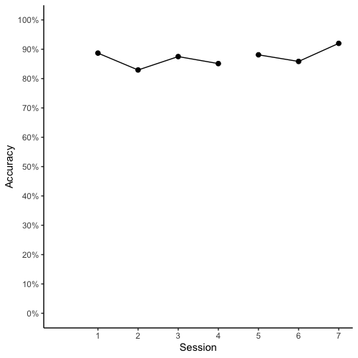
Baseline
Intervention
GIAD
PND
Above line = 1
Phase N = 3
PND= 1/3 = 0.33

