Slide 1
Baseline
Intervention
SAJE
GIAD
LELI

Slide 2
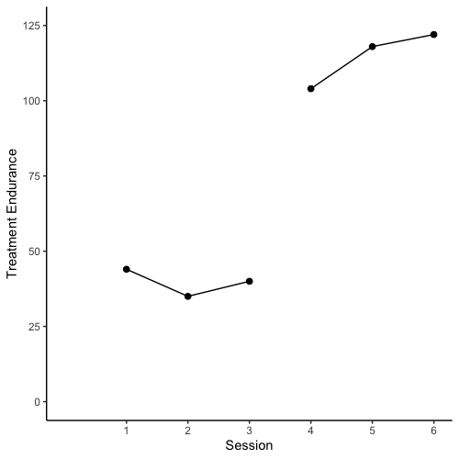
Baseline
Intervention
SAJE

Slide 3
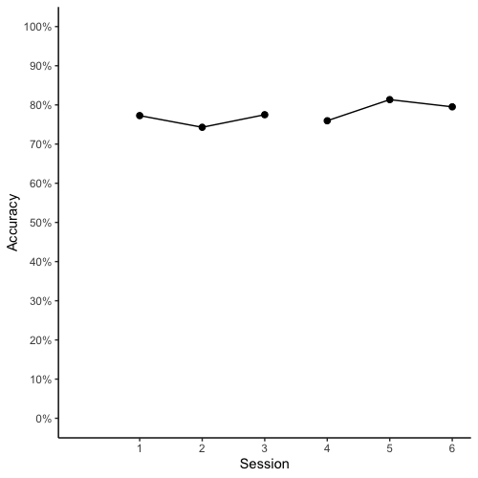
Baseline
Intervention
SAJE

Slide 4
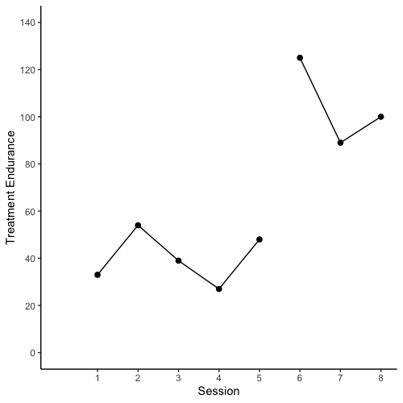
Baseline
Intervention
LELI

Slide 5
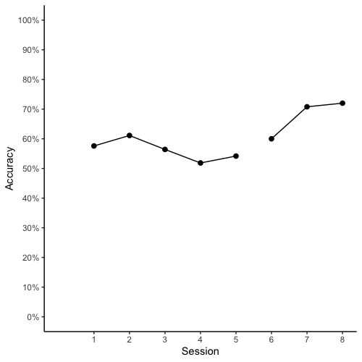
Baseline
Intervention
LELI

Slide 6
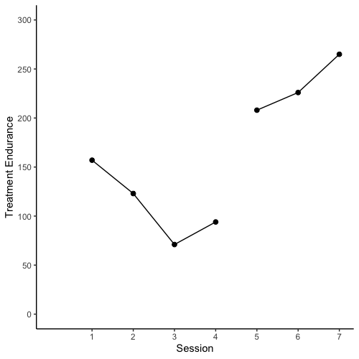
Baseline
Intervention
GIAD

Slide 7
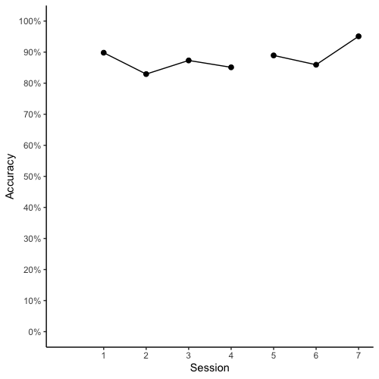
Baseline
Intervention
GIAD

