Slide 1
Out-of-Class Assignment #1: Designing an Assessment
Found on Canvas
Type your answers directly into document
Upload to Canvas when completed
This is an independent assignment
Use what you have learned through the class case study to answer the questions.
You can start now and gradually answer the questions as the material is covered in class.
This assignment is worth 25 points. Points for each question are noted on the assignment. On-time submission earns 2 points.
2 points are deducted for each day late.
DUE: April 22, 2021 by 5:00 pm

Slide 2
Clinical question
How significant is Matthew’s speech sound disorder?
How can we describe his speech sound disorder? What phonological patterns does he have in error? How intelligible is his speech?
What kindergarten phonological awareness skills does he have? Does he know his letter sounds? Can he identify the first sound in words? Can he blend/segment words?
What other factors may be contributing to his speech sound disorder? Hearing status? Oral motor skills? Overall Expressive Language Development Comprehension skills
What is the best treatment plan? What error patterns should be targeted first and what is Matthew’s baseline on those error patterns? What does the research say is the best approach for treating Matthew’s SSD? What are the family’s preferences concerning therapy?

Slide 3
Considerations for Choosing Assessment Tools:
Client’s chronological age
Client’s developmental level
Linguistic and cultural background
Clinical/Medical History
Client’s background and experiences
Talking with unfamiliar adults
School experience
Test taking behaviors
Looking at books/magazines
Pointing to pictures that “match what I say”
Describing pictures
Answering questions adults already know the answer to

Slide 4
Choosing Assessment Methods: How to answer your clinical questions
Informal Measures
Standardized Measures
Criterion-referenced
Norm-referenced
Standard score
Standard deviation
Percentile rank
Age Equivalency
Growth Scale Values
Notes:
The major purpose of standard scores is to place scores for any individual on any variable having any mean and standard deviation on the same standard scale so that comparisons can be made. Without some standard scale, comparisons across individuals and/or across variables would be difficult to make (Lomax,2001, p. 68). In other words, a standard score is another way to compare a student's performance to that of the standardization sample. A standard score (or scaled score) is calculated by taking the raw score and transforming it to a common scale. A standard score is based on a normal distribution with a mean and a standard deviation (see Figure 1). The black line at the center of the distribution represents the mean. The turquoise lines represent standard deviations.
On many standardized assessments the publishers base the standard score on a distribution with a mean of 100 and a standard deviation of 15. A score of 100 on such a test (e.g., WJIIIDRB) means that if the student scored in the middle of the distribution (Mercer & Pullen, 2009). A Standard Score of 85 indicates that the student scored one standard deviation below the mean of the normative sample. Figure 2 illustrates a normal distribution of test scores with a mean of 100 and a standard deviation of 15. The standard deviation is an indication of the variability of scores in a population (Mather & Jaffe, 2002).
The most common definition of a percentile is a number where a certain percentage of scores fall below that percentile. You might know that you scored 67 out of 90 on a test. But that figure has no real meaning unless you know what percentile you fall into. If you know that your score is in the 90th percentile, that means you scored better than 90% of people who took the test.
In statistics, the standard deviation (SD, also represented by the Greek letter sigma σ or the Latin letter s) is a measure that is used to quantify the amount of variation or dispersion of a set of data values.^{[1]} A low standard deviation indicates that the data points tend to be close to the mean (also called the expected value) of the set, while a high standard deviation indicates that the data points are spread out over a wider range of values.

Slide 5
Standard Scores and Standard Deviations
Percentages not percentiles
Don’t confuse them!

Slide 6
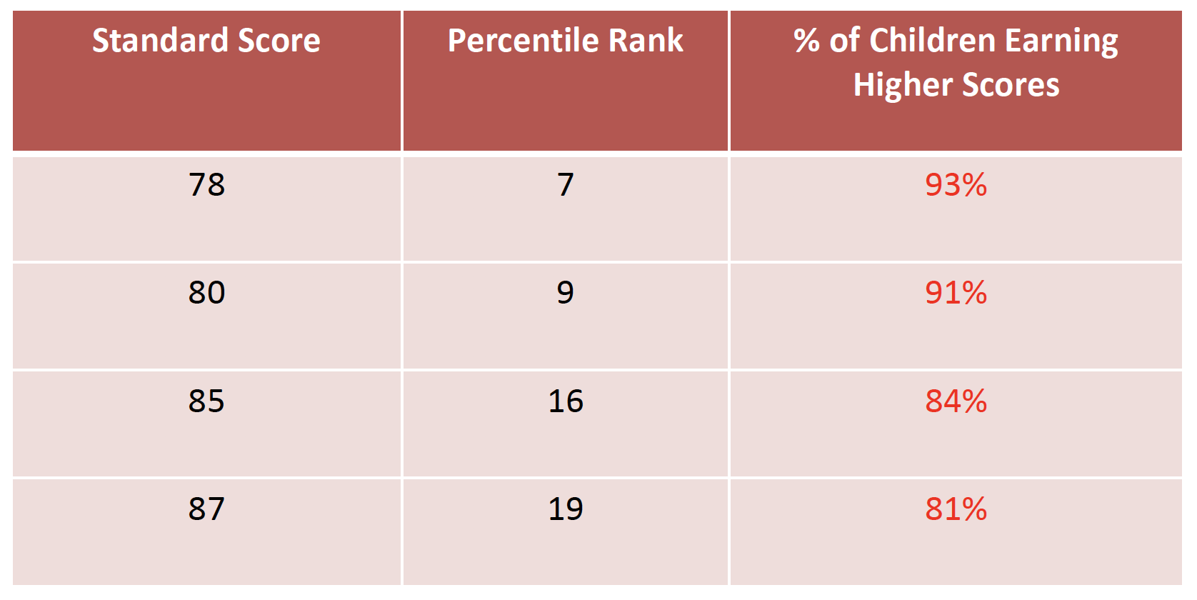
Eligibility versus Functional Impact

Slide 7
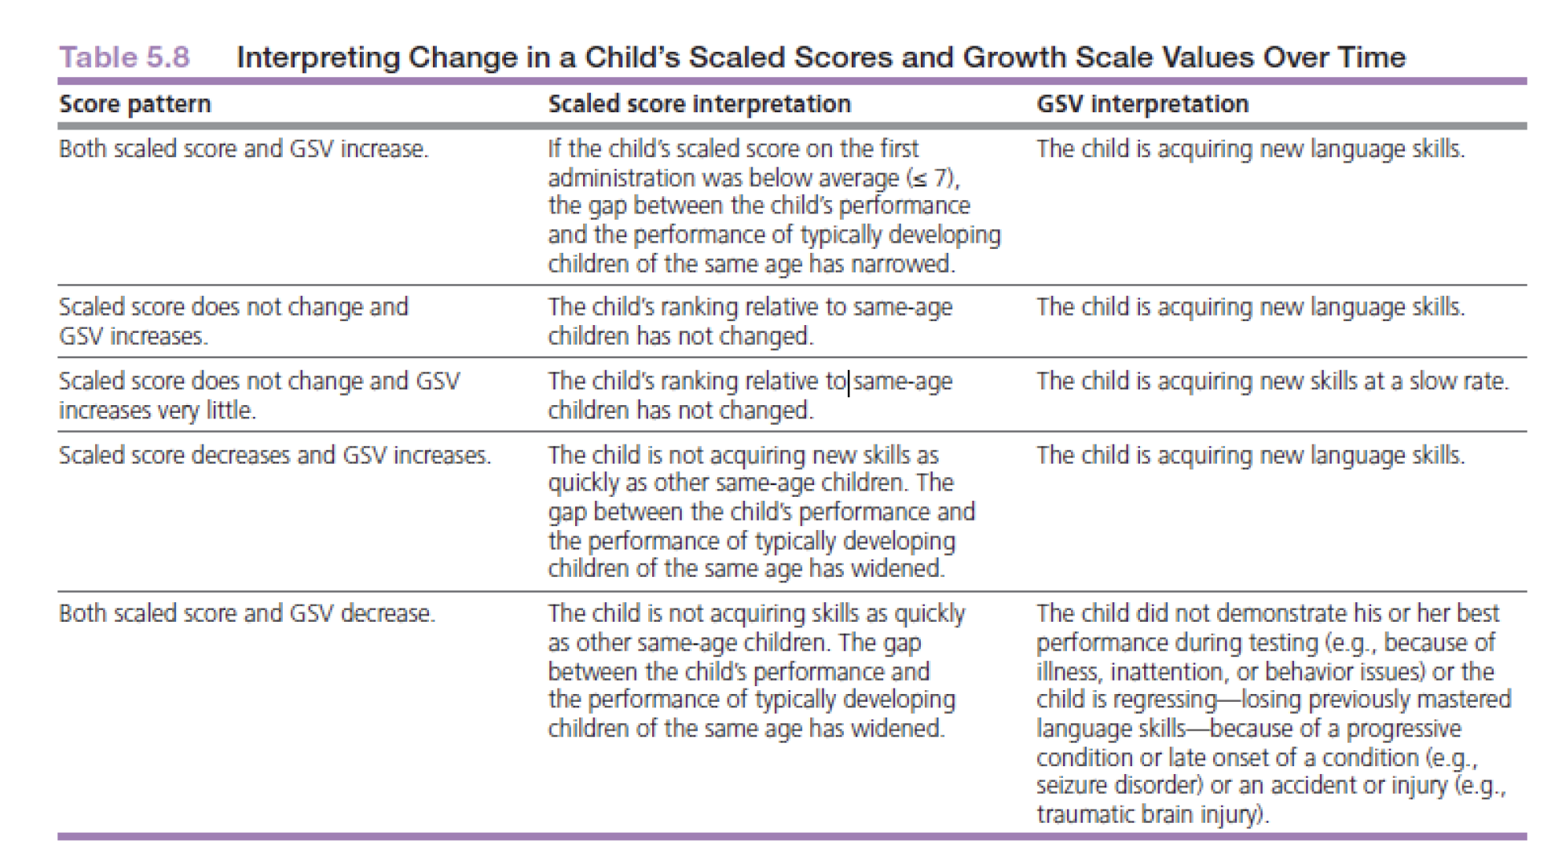
Example of SSs and GSVs on the CELF-P3

Slide 8
Age Equivalency
Average age in years and months typical for a given raw score.
DOES NOT provide information needed to determine if a child has a language impairment.
Although AE may be easier to understand for parents, it also can be misleading especially when discussing children with severe disabilities.

Slide 9
Clinical question | Measures
How significant is Matthew’s speech sound disorder? | DEAP (percentile from norm-referenced test)
How can we describe his speech sound disorder? What phonological patterns does he have in error? How intelligible is his speech? | DEAP (used descriptively- list of significant error patterns) Intelligibility (informal measure)
What kindergarten phonological awareness skills does he have? Does he know his letter sounds? Can he identify the first sound in words? Can he blend/segment words? | Letter Sound Probe (informal measure) Initial Sound ID Probe (informal measure) Blending/Segmenting Probes (informal measure)
What other factors may be contributing to his speech sound disorder? Hearing status? Oral motor skills? Overall Expressive Language Disorder Comprehension skills | Hearing Information (informal interview) Oral Motor Skills (clinical observation) Expressive language skills (clinical impression) CELF-P2 (percentile from a norm-referenced test)
What is the best treatment plan? What error patterns should be targeted first and what is Matthew’s baseline on those error patterns? What does the research say is the best approach for treating Matthew’s SSD? What are the family’s preferences concerning therapy? | Speech Sound Probes (informal measure) Research analysis (informal analysis) Family Preferences (informal interview)

Slide 10
Planning and Preparing for a Successful Evaluation Session
Consider:
what you will do prior to the assessment (Group 1 & 7)
how you will greet client on first meeting (Group 2)
how you will prepare the room and materials (Group 3 & 9)
how you will manage behaviors during testing (Group 4 & 8)
how you will document client’s communication (Group 5)
how you will end your first session (Group 6 & 10)
https://tinyurl.com/CDS431-Assessment-Planning

Slide 11
Case Study: Introduction to Assessment Activities
Matthew attended three assessment sessions
The first session was conducted by Sara Starlin, SLP
The second and third sessions were conducted by Heather Moore, SLP.
Matthew was very attentive and cooperative during all sessions.

Slide 12
The Interview as a Diagnostic Tool
The interview is an important diagnostic tool
Parent is expert on child’s development over time and in various contexts
Especially important for children who do not fit the standardization sample or cannot participate in a traditional standardized assessment.
When should the interview occur?
Before and/or during the assessment.
Follow-up on intake information.
Avoid asking questions that have already been provided in paperwork.
Ask open-ended questions or provide prompts
Tell me about your concerns.
How does your child let you know what s/he wants?
Is there anything else that you want to make sure I know?
Do you feel your child’s communication during the assessment today was typical of what you see at home?
Be an active listener, restate, and ask for clarification

Slide 13
Activity #4: Watch a language sample and form your initial clinical impressions Individual Activity- read through the questions first
Video title: SSD 1 Matthew DX1 Language Sample
Questions to consider:
Does his speech sound intelligible?
Do his utterances sound age appropriate?
How is his ability to comprehend questions?

Slide 14
Activity #4
Discuss questions in small groups
Identify a reporter for your group. Choose someone who hasn’t yet had a chance to be a reporter.
Number the questions 1-7. Start with the question assigned to your group and proceed through as many questions as you can in the given time.
Groups 1-3 start with question 1
Groups 4-6 start with question 3
Groups 7-10 start with question 5

Slide 15
Strategies for Eliciting a Language Sample
With children:
Staging environment
Open-ended questions
Motivating, interactive materials
Piece by piece
Sabotage
Turn-taking
With adults:
Open-ended questions
Personal narratives
Accounts
Scripts
https://tinyurl.com/CDS431-Sampling

