Slide 1
Big Picture
Assessment/Treatment Planning/Treatment Cycle
Referral, Intake, File Review
Assessment
Treatment Planning
Treatment
Session Planning
Data Collection
Differential Diagnosis
Ongoing Progress Monitoring
Programmatic Evidence
Service Delivery, Referral
Reviewing Empirical Evidence
Selecting a Treatment Approach
Determining Frequency, Duration, Service delivery
Goal Selection

Slide 2
Assessment
Referral, Intake, File Review
Assessment
Treatment Planning
Treatment
Differential Diagnosis
Ongoing Progress Monitoring
Programmatic Evidence

Slide 3
Initial Assessment Process
1. Referral, Intake, and Screening
2. Designing and Administering the Assessment Protocol
3. Interpreting Assessment Findings

Slide 4
Referral, Intake, and Screening
Referral
the initiation of services. Can be self-referred or by another professional
Intake
Gathering information to make decisions on whether client should be seen, and if so, what assessment/treatment needed (includes questionnaires, phone interview, reports from other agencies)
Screening
Brief assessment to determine if in-depth testing is warranted
Sensitivity
the ability of the assessment or procedure to correctly identify individuals with a speech/language problem
Specificity
the ability to correctly individuals without a speech/problem
Notes:
Sensitivity – the ability of the assessment or procedure to correctly identify individuals with a speech or language problem
Specificity – ability to identify individuals without a speech-language problem

Slide 5
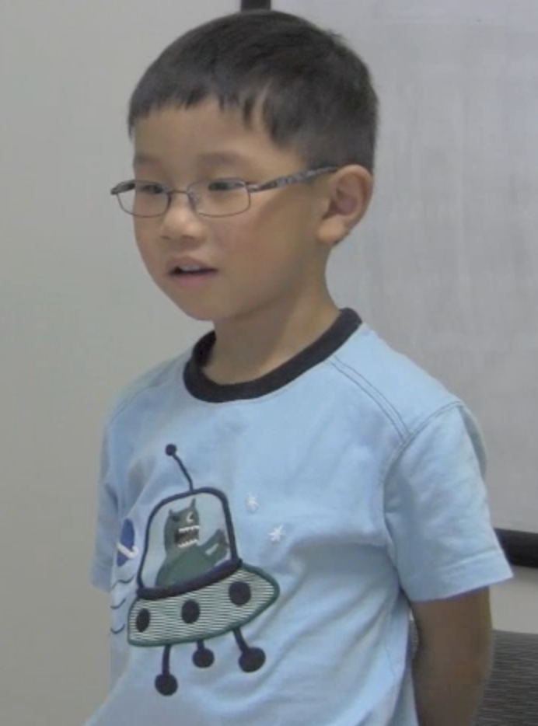
Meet Matthew

Slide 6
Case Study: Intake
Matthew’s mother, Kay, called the HEDCO clinic and told the receptionist that she wanted speech services for her son Matthew
The receptionist asked a few of questions
Age: 5 years old
Concerns: Speech production
The receptionist mailed Kay an intake packet, Kay completed it and returned it to the HEDCO clinic
HEDCO Child History Questionnaire
Sent in previous reports

Slide 7
Case Study: Screening
The clinic director reviewed the intake packet and determined that Matthew would benefit from an assessment
An assessment was scheduled with Dr. Heather Moore, CCC-SLP

Slide 8
Intake: File/Chart Review
Intake and Referral Information
Client Questionnaires
Developmental Histories
Medical Reports/Assessments
Educational Reports (EC-Cares)/Assessment
IEP (Individual Education Plan)
IFSP (Individual Family Service Plan)
504Plan
Previous Treatment Notes/Reports
Show parent interview while working on activity – Assessment > SSD 11 Parent interview
Notes:
IEP: Individual Education Plan for school age students with a disability requiring specially designed instruction.
IFSP: Individual Family Service Plan – preschool
Oregon: IFSP up to kindergarten
Other states: change to IEP at 3 years of age
504Plan: Accommodations or modifications that are needed by a student with a disability in order to be successful in the regular classroom. No specially designed instruction is needed.

Slide 9
Activity #1: Case Review Complete Independently
You will need the following documents located on Canvas
HEDCO Child History Questionnaire (completed by Kay)
Early Childhood CARES evaluations
20 month EI Evaluation
27 month Speech and Language Evaluation
3 year Developmental Evaluation
5 year IFSP
Notes:
May need to finish out of class

Slide 10
Child History Questionnaire
Follow-up questions for group discussion:
Matthew was adopted from China at 13 months. How does that information impact your decision-making?
What are the mother’s concerns?
Do you see evidence that this is an appropriate referral? If so, describe the evidence.
Why does the questionnaire include questions about favorite toys and games?
Why does the questionnaire include a question about the amount of television watching? Would you suggest any updates for this question?
What is your initial impression of the parents? How does your impression impact your services or decision-making?

Slide 11

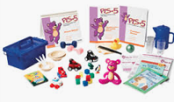

Preschool Assessments:
Assessment, Evaluation and Programming System for Birth to Three Years (AEPS)
Preschool Language Scale -5th Edition
Battelle Developmental Inventory – 2nd Edition
Notes:
AEPS: assessment and curriculum, Diane Bricker, update in 2020. 2 levels: Birth to 3 and 3-6
Battelle: Birth to 7-11
Gesell – unclear what measurement is being used, but the current Gesell Development Observation ages 2 ½ to 9. five strands: Developmental,
Letters/Numbers, Language/Comprehension, Visual/Spatial Discrimination, Social/Emotional/Adaptive

Slide 12
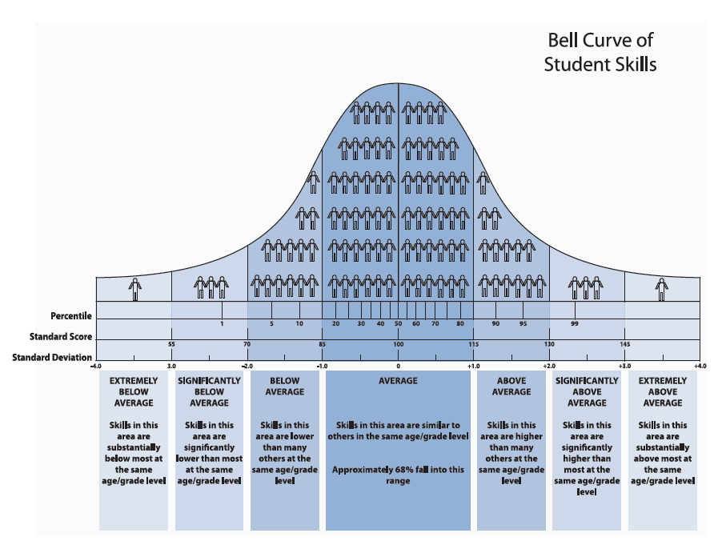

Slide 13
Mean Length of Utterance Norms
Miller & Chapman (1981) JSHR 24, 2, 154-161
MLU | Age Equivalent (within 1 month)
1.31 | 18
1.62 | 21
1.92 | 24
2.54 | 30
2.85 | 33
3.16 | 36
3.47 | 39
3.78 | 42
4.09 | 45
4.40 | 48
4.71 | 51
5.02 | 54
5.32 | 57
5.63 | 60

Slide 14
Speech Intelligibility Norms
Age | Intelligibility Level
19-24 months | 25 - 50%
2 – 3 years | 50 - 75%
4 – 5 years | 75 – 90%
5+ years | 90 – 100%

Slide 15
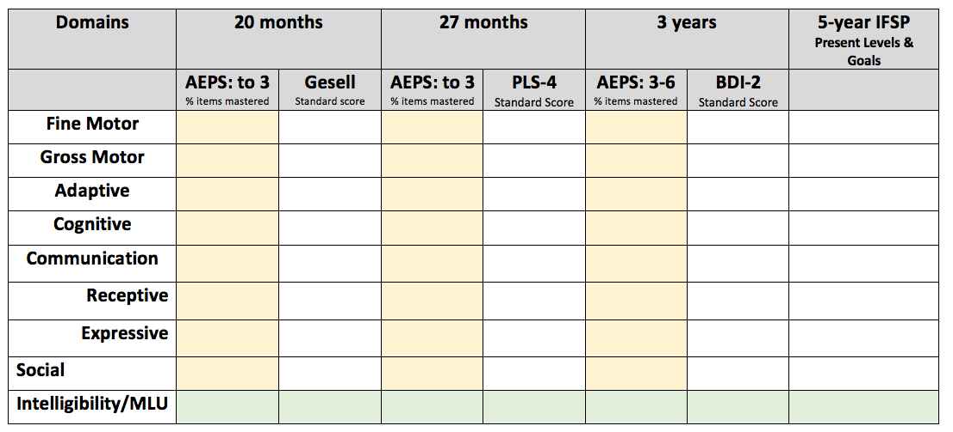
Complete the scoring section assigned to your group.
Is there information on hearing?
What are the recommendations? What is your impression?

Slide 16
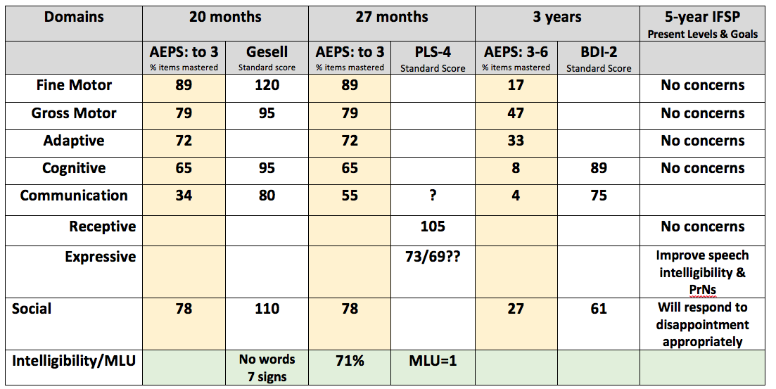

Slide 17
Initial Assessment Process
1. Referral, Intake, and Screening
2. Designing and Administering the Assessment Protocol
3. Interpreting Assessment Findings

Slide 18
Designing and Administering Assessment
General rules to remember…assessments should be designed to be
Sensitive
Comprehensive
Non-biased
Family-centered
Notes:
Designing
Sensitive: accurately identifies problem and characterizes the problem
Comprehensive: characterizes the problem on diverse aspects of the person’s life and skills, including how the problem affects daily living activities at home, school, and work
Non-biased: performance regardless of race, ethnicity, gender, SES, culture or language
Family-centered

Slide 19
Designing and Administering Assessment
Determine the purpose of the assessment
To identify the presence of a disorder, describe it, and determine the need for intervention
Differential diagnosis
Eligibility
To design intervention (programmatic assessment)
Develop goals
Identify intervention approach, strategies, and contexts
Establish baseline performance
To monitor progress over time
Notes:
Differential Diagnosis: the process of differentiating between two or more conditions which share similar signs or symptoms.
Eligibility: Meets regulations/rules/professional standard for services. In schools, having a speech-language delay or difference doesn’t ensure eligibility.
Programmatic assessment: Assessments to design intervention: determine goals, make decisions
Baseline performance: How well does client perform on skill prior to treatment

Slide 20
Activity #2: Specify Reasons for Assessment Large Group Activity
Diagnostic: __Make a (new) diagnosis __Determine whether a diagnosis is still present __Determine (ongoing) eligibility/need for service __ Other: | Programmatic: __Establish (new) goals __Determine (new) intervention approach __Establish a (new) baseline of performance __Document progress on current goals __Document progress in areas currently not targeted __Other:
Notes:
All of them!
I like to consider formal assessments for diagnostic purposes and informal/formal assessments for programmatic purposes

