Slide 1
Activity #2: Specify Reasons for Assessment Large Group Activity
Diagnostic: __Make a (new) diagnosis __Determine whether a diagnosis is still present __Determine (ongoing) eligibility/need for service __ Other: | Programmatic: __Establish (new) goals __Determine (new) intervention approach __Establish a (new) baseline of performance __Document progress on current goals __Document progress in areas currently not targeted __Other:
Notes:
Large group activity

Slide 2
Activity #3: Speech Sound Disorder Review Large Group Activity
Define Speech Sound Disorder (SSD)
Umbrella term referring to any difficulty or combination of difficulties with perception, motor production, or phonological representation of speech sounds.
32% of all communication disorders are speech sounds
2-6% of school age children have SSD

Slide 3
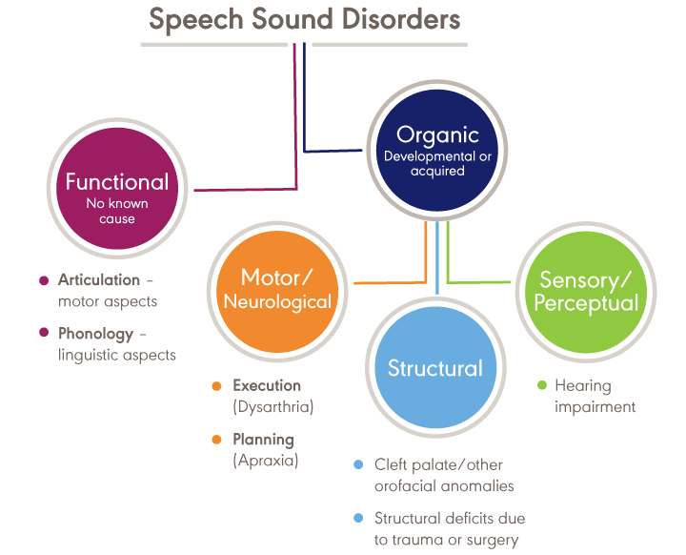
https://www.asha.org/Practice-Portal/Clinical-Topics/Articulation-and-Phonology/

Slide 4
Contrast the difference between Phonological Disorders and Articulation Disorders
Articulation: errors (distortions, substitutions) of individual speech sounds
Phonological: predictable, rule-based patterns that impact more than one sound.

Slide 5
How do SSDs relate to Language Development?
Language testing/screening is included in a comprehensive speech sound assessment because of the high incidence of co-occurring language problems.
35-50% of children with SSD have language problems
50-75% of children with SSD have long term academic problems
Children with SSD may also have difficulty with phonological awareness; phonological memory, phonological recoding in lexical access

Slide 6
How do SSDs relate to Reading Disorders?
Consider the findings of the National Reading Panel (2000) which identified effective methods for reading instruction, the Big Five:
Phonemic Awareness
Phonics
Fluency
Vocabulary
Reading Comprehension

Slide 7
What’s the relationship between SSDs and Hearing?
Hearing loss can affect speech perception and production to varying degrees depending on age of onset and severity.
Characteristics include:
consonant deletions (especially final consonants)
consonant substitutions
voiced/voiceless cognates
stops for fricatives and liquids
vowels tend to be neutralized
reduced speech intelligibility particularly as linguistic complexity increases
distorted resonance

Slide 8
List informal/formal assessment methods commonly used with children with SSD?

Slide 9
Review 3 Intervention Methodologies
for SSD
Minimal Pairs
Cycles
Metaphonological

Slide 10
Speech Sound Disorders

Slide 11
Components of Communication, Language and Speech
Communication: an exchange of meaning between a sender and a receiver
Language: a standardized set of symbols and the knowledge of how to use these symbols (manual sign language, written communication)
Spoken
Language
Speech: Respiration, phonation and articulation.
Notes:
Ask class for examples and provide some…
Communication
emails, written communication, conversations, signed conversations, gestures, nonverbal actions
Language
Different languages, manual sign language
Speech

Slide 12
Definitions: Speech Sound Disorders
A significant deficit in:
Speech Production
Speech Perception
Severity (Intelligibility)
Small number of errors
Significant errors
Etiology
Organic
Functional
Causes
Articulation
Phonological
Notes:
What is phonology?
Organic- attributable to physical conditions
Functional- no attributable physical cause

Slide 13
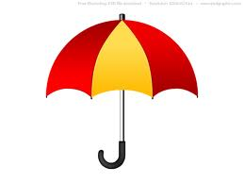
Speech Sound Disorders
Articulation Disorders
Phonological Disorders

Slide 14
Speaking the written word

Slide 15
Speaking the Heard Word

Slide 16
Definition: Articulation Disorders
Articulation Disorders
A deficiency at the phonetic level as a result of
neurological impairments (dysarthria, apraxia),
physical abnormalities (cleft palate)
deficits of motor learning
Characterized by:
Omissions
Substitutions
Additions
Distortions

Slide 17
Articulation Development
2 years p, h, n, b, k
3 years m, w, g, f, d
4 years t, “sh”, j (“y”)
5 years s, v, “ng”, r, l, “ch”, z
6 years “th”
7 years consonant blends and clusters

Slide 18
Factors associated (or not!) with Articulation
Dentition
Oral Mechanism
Nonspeech tasks

Slide 19
Definitions: Phonological Disorders
Phonological Disorders
Cognitive-linguistic
Speech sound representations
Perception and production
Characterized by:
Widespread patterns of errors
Limited speech sound repertoire
Limited syllable structures
Interactions of sounds and syllable structures

Slide 20
Factors Associated Phonological Disorders
Articulation
Language
Reading (a language based activity)
Dependent on Phonological Awareness (metaphonological abilities)
Rhyming
Identification of the beginning and end of words
Breaking words into syllables

Slide 21
Speech Sound Disorders
Articulation Disorders
Phonological Disorders

Slide 22
Factors Associated with Speech Sound Disorders
Speech Perception and Audition
Intelligence

Slide 23
Developmental Apraxia of Speech (DAS) Or Childhood Apraxia of speech (CAS)
Characteristics
Difficulty sequencing motor movements to produce speech sounds/syllables
Inconsistent errors
Less common errors
syllable omissions
consonant substitutions
vowel errors
Developmental, not due to known neurological impairment
Make very slow progress in therapy, tends to run in families
Controversial and Overdiagnosed!!!

Slide 24
Prevalence
4 in 100 children
More boys (4%) than girls (3%)
60% specific, 40% secondary to motor speech disorders or DD

Slide 25
Speech Sound Screening and Assessment
Screening
Case History and interview questions
Oral Mechanism Screening- Structure and Function
Lips
Teeth
Tongue
Hard Palate
Soft Palate
Hearing Screening
Language Screening

Slide 26
Speech Sound Assessment- Standardized Tests
Sound Inventory Tests: assess production in the initial, medial, and final positions of words
Goldman-Fristoe Test of Articulation-2
Phonological Pattern Tests: elicitation of phonological patterns
Khan-Lewis Phonological Analysis-2 (KLPA-2)
Phonological Awareness Tests
Pre-Reading Inventory of Phonological Awareness (PIPA)

Slide 27
Speech Sound Assessment: Sampling
Spontaneous Sample
Elicited Sample

Slide 28
Speech Sound Assessment: Sampling Analysis
Percent Consonants Correct
Total Number of correct consonants produced X 100 = Percent of
Total number of consonants produced Consonants
Correct
Intelligibility
Percent of = Number of Intelligible Words X 100
Intelligible words Total Number of Words

Slide 29
Speech Sound Assessment- Stimulability
Dynamic Assessment to determine whether a child can produce sounds in isolation, words, sentences with scaffolding
Auditory
Visual cues
Tactile cues

Slide 30
Intervention
Traditional Articulation Therapy
Appropriate for:
a small number of errors
No underlying deficits in phonology
Typically one sound is targeted at a time, in a specific position of a word (initial, medial, final).
Therapy doesn’t progress until a criteria is met (80% accuracy) – data driven

Slide 31
Traditional Articulation Therapy

Slide 32
5-minute Articulation Therapy

Slide 33
Phonological Therapy
Emphasis on changing the patterns of errors or underlying phonological knowledge
Appropriate for children who are highly unintelligible

Slide 34


Minimal Pair/ Contrast Approach
Word pairs contrast the target and the child’s error (bow-boat, take-cake)
Includes perception and production tasks
Notes:
Stopped here

Slide 35
Metaphonological Approach
Simultaneously targets
suppression of speech error patterns
development of phonological awareness at the phoneme level
letter-sound correspondences
Targeted skills are embedded in developmentally appropriate activities
Has been shown to be effective with preschoolers with SSD (Gillon, 2000, 2005; Hesketh, Adams, Nightingale, & Hall, 2000)

