Slide 1
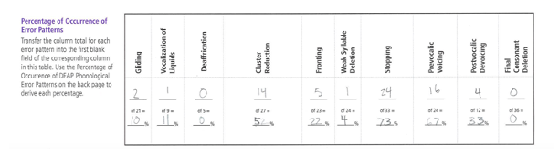
Activity #5: Norm-referenced Test: Diagnostic Assessment of Articulation and Phonology (DEAP) Read through the marked protocol as you watch the DEAP and then discuss the scores as a group.
Video title: SSD 7 Matthew DX1 DEAP
DEAP Percentage of Occurrence of Error Patterns

Slide 2
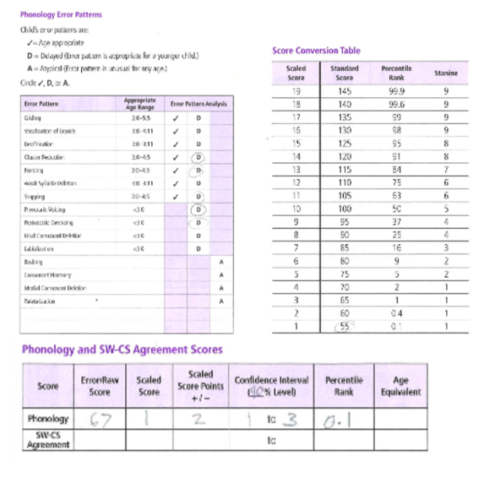
Discussion Questions:
1.) What scores did Matthew obtain?
2.) What phonological patterns were identified and how frequent were they?
3.) Clinician behavior discussion: balance of keeping child engaged while tracking responses accurately and consistently

Slide 3
Activity #6: Norm-Reference Test: Clinical Evaluation of Language Fundamentals- Preschool 2 (CELF-P2) Review the CELF-P2 scoring sheet as you watch the video. Then score using the manual.
Video Title: SSD 6 Matthew DX1 CELF-P2
Discussion questions:
What kind of task is this? Expressive or receptive?
How does Matthew appear to be doing on this subtest?
Activity 6 will focus on interpretation of expressive language subtest.
Notes:
GET SCORING SHEET!!!!!!!!
CELP-P:3. coming out this summer. Updated pictures– no more calculator, phone, newspaper. Digital version now - can use for telepractice.

Slide 4
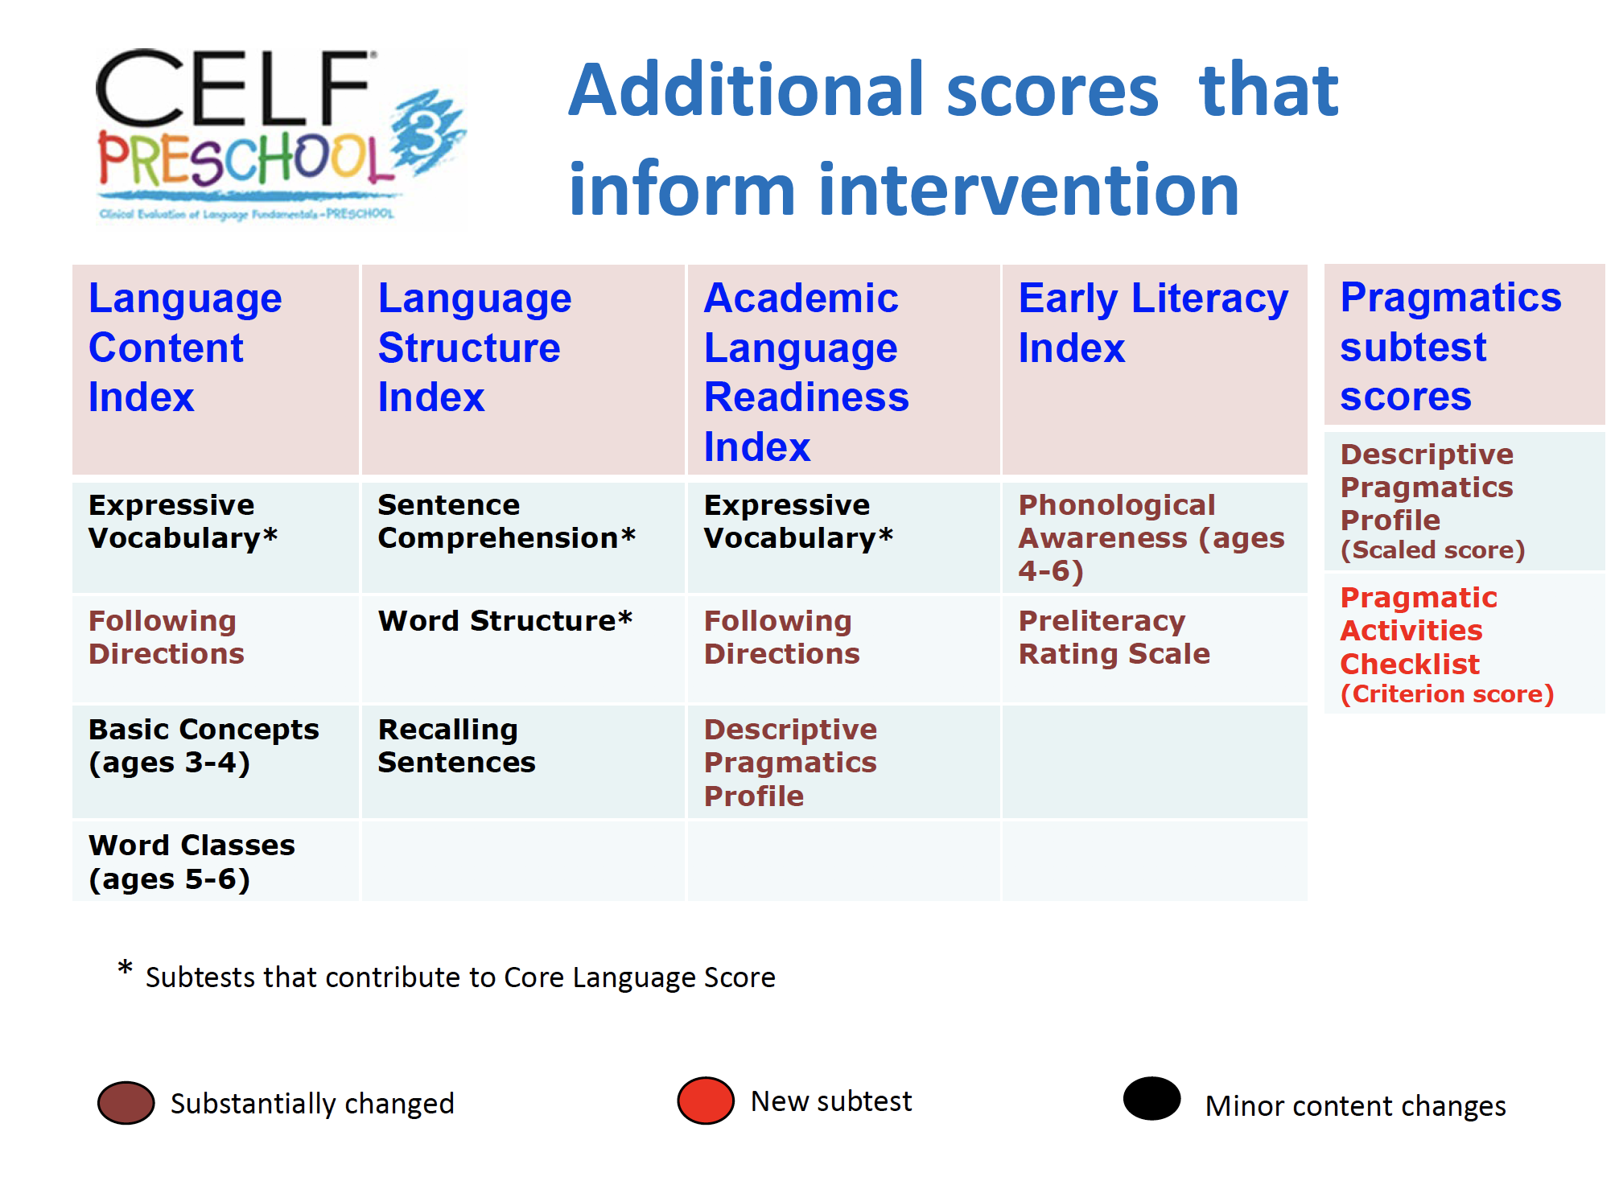
CELF Preschool -3 Updates

Slide 5
Speech- Sound Probes
After scoring the DEAP, the SLPs administered 5 informal speech error probes to learn more about Matthew’s speech error patterns and determine baseline functioning.
Due to time limitations, you will only be watching/scoring two speech error probes. The results of the other two probes are as follows:
Stopping probe: 0/28 correct (0%)
Initial s+stop and s+nasal probe: 0/35 correct (0%)
You will be watching the remaining two probes for:
pre-vocalic voicing (example: Matthew says “bear” when he should say “pear”)
final cluster stop + fricative (example: Matthew says “bat” when he should say “bats”).

Slide 6
Activity #7: Informal Measure: Pre-Vocalic Voicing Probe
Video Title: SSD Matthew DX1 Pre-Vocalic Voicing
Discussion question:
What is the clinician doing to prompt the target word?

Slide 7
Activity #8: Informal Measure: Final Cluster Stop + Fricative Probe
In this probe we were interested in determining whether Matthew could produce a stop + a fricative at the end of the word. For each target word, we are only interested in the final two sounds (stop+fricative).
If Matthew makes any stop consonant + a fricative count it as correct (even if it is the wrong stop or fricative) and leave the 1st or 3rd columns as is and score it as correct (1 point) in the 2nd or 4th columns.
If he doesn’t say a stop + fricative- in the 1st or 3rd columns cross out the incorrect letter and put what Matthew said above it OR just cross out the letter if he deletes that sound. In the 2nd or 4th columns, indicate that it was incorrect (0 points).
The first two are scored for you. (note: if he says it correctly at any time count it as correct even if he says it incorrectly another time)
Video Title: SSD Matthew DX2 Final cluster plus fricative
Discussion question: Why do we complete these deep informal probes if we’ve already administered the standardized DEAP?

Slide 8
Add more probe videos if there’s time:
Stopping probe: SSD 10
Initial s+stop and s+nasal probe: SSD 5
Notes:
Half way through

