Slide 1
Initial Assessment Process
1. Referral, Intake, and Screening
2. Designing and Administering the Assessment Protocol
3. Interpreting Assessment Findings

Slide 2
Designing and Administering Assessment
General rules to remember…assessments should be designed to be
Sensitive
Comprehensive
Non-biased
Family-centered
Notes:
Designing
Sensitive: accurately identifies problem and characterizes the problem
Comprehensive: characterizes the problem on diverse aspects of the person’s life and skills, including how the problem affects daiily living activities at home, school, and work
Non-biased: performance regardless of race, ethnicity, gender, SES, culture or language
Family-centered

Slide 3
Designing and Administering Assessment
Determine the purpose of the assessment
To identify the presence of a disorder, describe it, and determine the need for intervention
Differential diagnosis
Eligibility
To design intervention (programmatic assessment)
Develop goals
Identify intervention approach, strategies, and contexts
Establish baseline performance
To monitor progress over time
Notes:
Differential Diagnosis: the process of differentiating between two or more conditions which share similar signs or symptoms.
Eligibility: Meets regulations/rules/professional standard for services. In schools, having a speech-language delay or difference doesn’t ensure eligibility.

Slide 4
Activity #2: Specify Reasons for Assessment Large Group Activity
Diagnostic: __Make a (new) diagnosis __Determine whether a diagnosis is still present __Determine (ongoing) eligibility/need for service __ Other: | Programmatic: __Establish (new) goals __Determine (new) intervention approach __Establish a (new) baseline of performance __Document progress on current goals __Document progress in areas currently not targeted __Other:
Notes:
Large group activity

Slide 5
Activity #3: Speech Sound Disorder Review Large Group Activity
Define Speech Sound Disorder (SSD)
Umbrella term referring to any difficulty or combination of difficulties with perception, motor production, or phonological representation of speech sounds.
32% of all communication disorders are speech sounds
2-6% of school age children have SSD

Slide 6
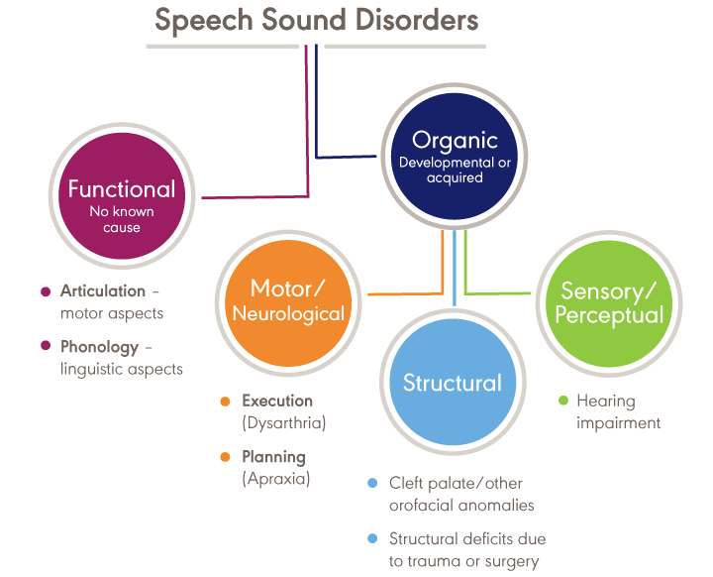
https://www.asha.org/Practice-Portal/Clinical-Topics/Articulation-and-Phonology/

Slide 7
Contrast the difference between Phonological Disorders and Articulation Disorders
Articulation: errors (distortions, substitutions) of individual speech sounds
Phonological: predictable, rule-based patterns that impact more than one sound.

Slide 8
How do SSDs relate to Language Development?
Language testing/screening is included in a comprehensive speech sound assessment because of the high incidence of co-occurring language problems.
35-50% of children with SSD have language problems
50-75% of children with SSD have long term academic problems
Children with SSD may also have difficulty with phonological awareness; phonological memory, phonological recoding in lexical access

Slide 9
How do SSDs relate to Reading Disorders?
Consider the findings of the National Reading Panel (2000) which identified effective methods for reading instruction, the Big Five:
Phonemic Awareness
Phonics
Fluency
Vocabulary
Reading Comprehension

Slide 10
What’s the relationship between SSDs and Hearing?
Hearing loss can affect speech perception and production to varying degrees depending on age of onset and severity.
Characteristics include:
consonant deletions (especially final consonants)
consonant substitutions
voiced/voiceless cognates
stops for fricatives and liquids
vowels tend to be neutralized
reduced speech intelligibility particularly as linguistic complexity increases
distorted resonance

Slide 11
List informal/formal assessment methods commonly used with children with SSD?

Slide 12
Review 3 Intervention Methodologies
for SSD
Minimal Pairs
Cycles
Metaphonological

