Slide 1
Big Picture
Assessment/Treatment Planning/Treatment Cycle
Referral, Intake, File Review
Assessment
Treatment Planning
Treatment
Session Planning
Data Collection
Differential Diagnosis
Ongoing Progress Monitoring
Programmatic Evidence
Service Delivery, Referral
Reviewing Empirical Evidence
Selecting a Treatment Approach
Determining Frequency, Duration, Service delivery
Goal Selection

Slide 2
Direct Services
The SLP provides direct intervention to the client.
Family
Service Provider
Settings and Contexts
Client

Slide 3
Consultation/ Coaching
An indirect, triadic service delivery model in which the consultant and the consultee work together to address an area of concern or common goal for change. The consultee/ coachee is the main provider of service.
Consultant/
Coach
Consultee/
Coachee
Settings and Contexts
Client

Slide 4
Coaching Example
SLP
Caregivers
Settings and Contexts
Client

Slide 5
Consultant Example
SLP
Preschool Teacher
Settings and Contexts
Child

Slide 6
Collaboration: Interdisciplinary
A direct service delivery model in which two or more service providers work collaboratively to address an area of concern or common goal for change. Each remains a provider of service.
Collaborator
Collaborator
Settings and Contexts
Client

Slide 7
Collaboration Example
Physical Therapist
Special Educator
SLP
Settings and Contexts
Client

Slide 8
Collaboration Example: Transdisciplinary
Assess and plan jointly. Blend professional boundaries; may have role release where responsibilities are shared across disciplines..
Physical Therapist
Home Health Care Nurse
SLP
Settings and Contexts
Client

Slide 9
Referral
Referring for outside services to benefit a client
Who do SLPs commonly refer to?
Who do we get referrals from?

Slide 10
Activity #28: Service Delivery Models and Referral Small Group Discussion
What type of service delivery model was used with Matthew? Who had what roles (e.g., consultant, collaborator, coachee)? Draw out a model.
Who referred Matthew to the HEDCO clinic?
Is there anyone Matthew should be referred to?
Matthew was assessed by an audiologist right after starting at the HEDCO clinic. Review the audiogram from this assessment (audiogram1) on Canvas. What does this audiogram tell us?
Why are his parent’s seeking a second opinion?

Slide 11
Activity #29: Watch the audiology assessment and answer the following questions
Audiology appointment video

Slide 12
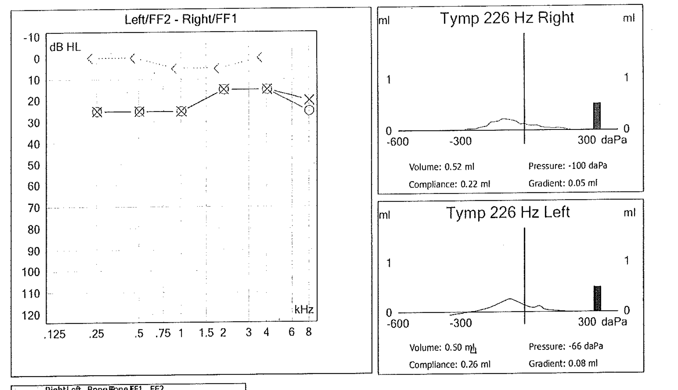
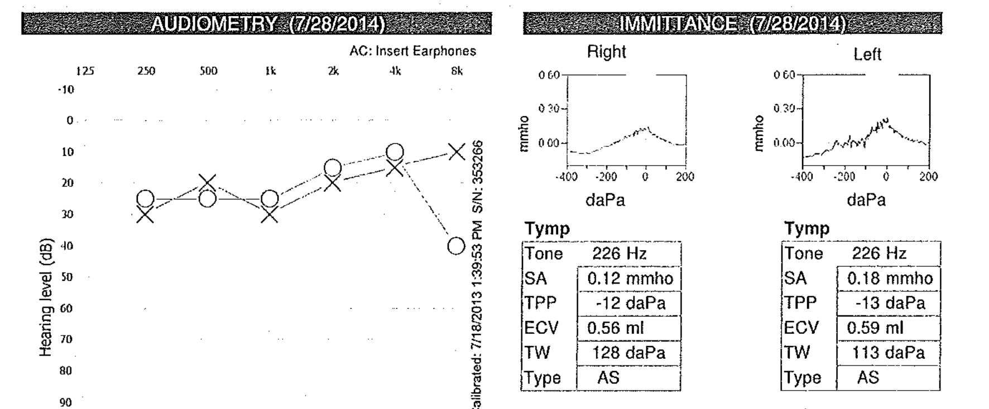
Review Activity 29

