Slide 1
Components of Communication, Language and Speech
Communication: an exchange of meaning between a sender and a receiver
Language: a standardized set of symbols and the knowledge of how to use these symbols (manual sign language, written communication)
Spoken
Language
Speech: Respiration, phonation and articulation.
Notes:
Ask class for examples and provide some…
Communication
emails, written communication, conversations, signed conversations, gestures, nonverbal actions
Language
Different languages, manual sign language
Speech

Slide 2
Speech Sound Disorder
Definition: Umbrella term referring to any difficulty or combination of difficulties with perception, motor production, or phonological representation of speech sounds.
32% of all communication disorders are speech sounds
2-6% of school age children have SSD

Slide 3
Prevalence
4 in 100 children
More boys (4%) than girls (3%)
60% specific, 40% secondary to motor speech disorders or DD

Slide 4
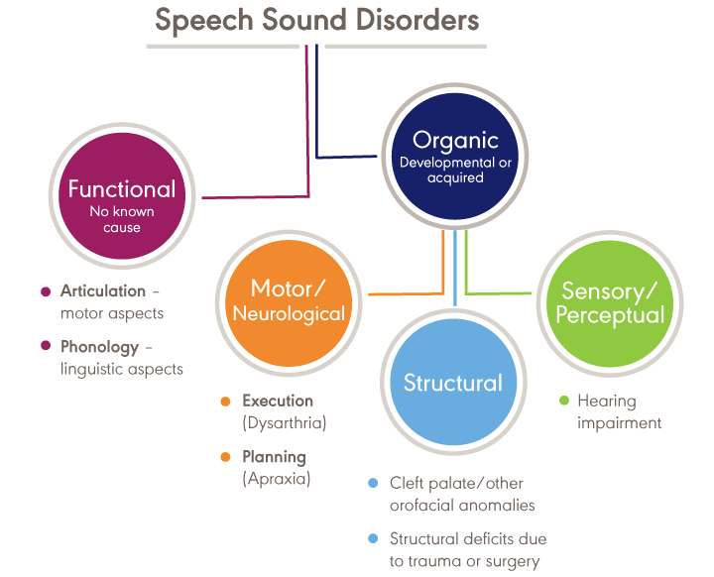
https://www.asha.org/Practice-Portal/Clinical-Topics/Articulation-and-Phonology/

Slide 5
Speaking the written word

Slide 6
Speaking the Heard Word

Slide 7
Developmental Apraxia of Speech (DAS) Or Childhood Apraxia of speech (CAS)
Characteristics
Difficulty sequencing motor movements to produce speech sounds/syllables
Inconsistent errors
Less common errors
syllable omissions
consonant substitutions
vowel errors
Developmental, not due to known neurological impairment
Make very slow progress in therapy, tends to run in families
Controversial and Overdiagnosed!!!

Slide 8
Definition: Articulation Disorders
Articulation Disorders
A deficiency at the phonetic level as a result of
neurological impairments (dysarthria, apraxia),
physical abnormalities (cleft palate)
deficits of motor learning
Characterized by:
Omissions
Substitutions
Additions
Distortions

Slide 9
Articulation Development
2 years p, h, n, b, k
3 years m, w, g, f, d
4 years t, “sh”, j (“y”)
5 years s, v, “ng”, r, l, “ch”, z
6 years “th”
7 years consonant blends and clusters
Notes:
5 and 6 year old sounds are considered the late 8!

Slide 10
Factors associated (or not!) with Articulation
Dentition
Malocclusion can affect speech sound quality
Tongue complications
Tongue tie
Tongue thrust
Important to complete comprehensive oral motor exam!

Slide 11
Definitions: Phonological Disorders
Phonological Disorders
Cognitive-linguistic
Speech sound representations
Perception and production
Characterized by:
Widespread patterns of errors
Limited speech sound repertoire
Limited syllable structures
Interactions of sounds and syllable structures

Slide 12
Factors Associated Phonological Disorders
Articulation
Language
Reading (a language based activity)
Dependent on Phonological Awareness (metaphonological abilities)
Rhyming
Identification of the beginning and end of words
Breaking words into syllables

Slide 13
Contrast the difference between Phonological Disorders and Articulation Disorders
Articulation: errors (distortions, substitutions) of individual speech sounds
Phonological: predictable, rule-based patterns that impact more than one sound.
Examples:
Stopping fricative sounds
Fronting velar stops
Gliding liquids

Slide 14
How do SSDs relate to Language Development?
Language testing/screening is included in a comprehensive speech sound assessment because of the high incidence of co-occurring language problems.
35-50% of children with SSD have language problems
50-75% of children with SSD have long term academic problems
Children with SSD may also have difficulty with phonological awareness; phonological memory, phonological recoding in lexical access
What do phonological awareness/memory/recoding relate to?
Notes:
Reading!!
Phonological awareness:
Segmenting, blending, identify words that rhyme, recognize alliteration, break down sentences into single words, break down single words into syllables – huge building block skill for reading

Slide 15
How do SSDs relate to Reading Disorders?
Consider the findings of the National Reading Panel (2000) which identified effective methods for reading instruction, the Big Five:
Phonemic Awareness
Phonics
Fluency
Vocabulary
Reading Comprehension
SSDs will significantly impact reading fluency
Consider connection between SSDs/language impairment to place individual at risk for falling behind in reading
Notes:
- Discussion on site word reading vs reading phonetically

Slide 16
What’s the relationship between SSDs and Hearing?
Hearing loss can affect speech perception and production to varying degrees depending on age of onset and severity.
Characteristics include:
consonant deletions (especially final consonants)
consonant substitutions
voiced/voiceless cognates
stops for fricatives and liquids
vowels tend to be neutralized
reduced speech intelligibility particularly as linguistic complexity increases
distorted resonance
Client HVOL from SCHAGE as example

Slide 17
Speech Sound Screening and Assessment
Screening
Case History and interview questions
Oral Mechanism Screening- Structure and Function
Lips
Teeth
Tongue
Hard Palate
Soft Palate
Hearing Screening
Language Screening

Slide 18
Speech Sound Assessment- Standardized Tests
Sound Inventory Tests: assess production in the initial, medial, and final positions of words
Goldman-Fristoe Test of Articulation-2
Phonological Pattern Tests: elicitation of phonological patterns
Khan-Lewis Phonological Analysis-2 (KLPA-2)
Phonological Awareness Tests
Pre-Reading Inventory of Phonological Awareness (PIPA)

Slide 19
Speech Sound Assessment: Sampling Analysis
Percent Consonants Correct
Total Number of correct consonants produced X 100 = Percent of
Total number of consonants produced Consonant Correct
Intelligibility
Percent of = Number of Intelligible Words X 100
Intelligible words Total Number of Words
Notes:
good ways to measure performance when collecting a spontaneous language sample
easier to measure percent correct when using an elicited list of targets

Slide 20
Speech Sound Assessment- Stimulability
Dynamic Assessment to determine whether a child can produce sounds in isolation, words, sentences with scaffolding
Auditory
Visual cues
Tactile cues
Snake sound cue on arm to represent all three types of cues

Slide 21
List informal/formal assessment methods commonly used with children with SSD?
Informal
Formal
Spontaneous vs elicited speech sample
Narrative sample
Deep probe
Word list to specifically target one sound or set of sounds (e.g., /r/, r-blends, vocalic-r
Goldman-Fristoe Test of Articulation 2 & 3 (GFTA)
Hodson Assessment of Phonological Processes-3 (HAPP)
The Arizona-3
Diagnostic Evaluation of Articulation and Phonology (DEAP)

Slide 22
Intervention
Traditional Articulation Therapy
Appropriate for:
a small number of errors
No underlying deficits in phonology
Typically one sound is targeted at a time, in a specific position of a word (initial, medial, final).
Therapy doesn’t progress until a criteria is met (80% accuracy) – data driven

Slide 23
5-minute Articulation Therapy
Similar to traditional approach but emphasis on shorter sessions with high frequency of targets
Drill and Kill

Slide 24
Phonological Therapy (Cycles Approach)
Emphasis on changing the patterns of errors or underlying phonological knowledge
Appropriate for children who are highly unintelligible
Goal is to identify all of the phonological error patterns present in the child’s speech and then “cycle” through each pattern, targeting one at a time for short periods of time

Slide 25


Minimal Pair/ Contrast Approach
Word pairs contrast the target and the child’s error (bow-boat, take-cake)
Includes perception and production tasks
Notes:
Stopped here

Slide 26
Metaphonological Approach
Simultaneously targets
suppression of speech error patterns
development of phonological awareness at the phoneme level
letter-sound correspondences
Targeted skills are embedded in developmentally appropriate activities
Has been shown to be effective with preschoolers with SSD (Gillon, 2000, 2005; Hesketh, Adams, Nightingale, & Hall, 2000)

Slide 27
Activity #3: Speech Sound Disorder Review Large Group Activity
If time available, consider showing Matthew assessment videos (e.g., SSD 8 and 9 initial sound ID and letter sound ID

