Slide 1
Big Picture
Assessment/Treatment Planning/Treatment Cycle
Referral, Intake, File Review
Assessment
Treatment Planning
Treatment
Session Planning
Data Collection
Differential Diagnosis
Ongoing Progress Monitoring
Programmatic Evidence
Service Delivery, Referral
Reviewing Empirical Evidence
Selecting a Treatment Approach
Determining Frequency, Duration, Service delivery
Goal Selection

Slide 2
EXTRAORDINARY CLAIMS REQUIRE EXTRAORDINARY EVIDENCE.
Carl Sagan

Slide 3
Check for personal biases when reviewing research

Slide 4
Evidence- Based SLP Practices
EBP: A process for clinical decision-making concerning assessment or treatment of a given condition/client.
3 Components: external evidence (systematic review of research), patient and contextual factors, clinician’s knowledge and experience
Patient/ Contextual Factors
EPB
Evidence
External & Internal
Clinician Knowledge and Experience
Clinical Expertise

Slide 5
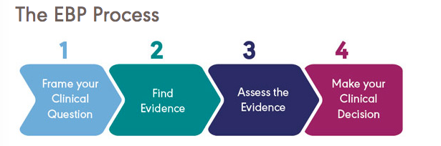
ASHA.org

Slide 6
Step 1: Generate a clinical question
PICO questions
Population and Problem
Intervention/Indicator
Comparison
Outcome
Quick Example: Do college students perform better on tests when they have slept well?

Slide 7
Activity #13: Framing PICO Questions Individual activity
Population | Intervention | Comparison | Outcome
Stroke patients | Early initiation of aphasia therapy | Aphasia treatment after initial spontaneous recovery time | Higher functional communication abilities
Toddlers with expressive language delay | Parent training to administer treatment at home | Direct treatment by therapist | Faster acquisition of functional vocabulary
Adolescents with TBI | Cognitive rehab | No cognitive rehab | Return to school/work faster
"Are patients with aphasia who received SLP services shortly after their stroke more or less likely to achieve functional communication abilities than stroke patients who received such treatments later?"
Write the next two PICO questions
Notes:
In groups, write questions for the other two.

Slide 8
Review 3 Intervention Methodologies
for SSD
Minimal Pairs
Cycles
Metaphonological

Slide 9
Activity #14: Framing and Writing Possible PICO Questions for the Research about the Best Intervention for Matthew Small group activity
Population | Intervention | Comparison | Outcome
Notes:
In groups, write questions for the other two.

Slide 10
Step 2: Find External Evidence for Treatment
Policy: A consistent guide to be followed under a given set of circumstances
Policy
Theory
Research

Slide 11
Theory
What is a theory?
Based on a hypothesis that is backed by evidence.
A group of linked ideas intended to explain something
Can be tested or challenged
What theories might apply to treatment of speech sound disorder?
Notes:
Discuss learning theories: Behaviorism, Cognitivism, Constructivism

Slide 12
How do these theories influence speech-language intervention?
Behavioral (Skinner): new behavior or changes occur through associations between stimuli and responses.
Cognitive (Piaget; Miller & Bruno): rather than just responding to stimuli, individuals process information and play an active role in learning. There are developmental stages.
Humanistic/Experiential (Maslow; Carl Rogers): hierarchy of needs; learning occurs when it is relevant, self-initiated, and there is low threat to self.
Social (Vygotsky): Cultural and social environments impact cognitive development. Language is central to development of thinking.
Notes:
iDiscuss learning theories: Behaviorism, Cognitivism, Constructivism

Slide 13
Search for the Research Evidence
UO Library Database: Communication and Mass Media
ASHA: http://www.asha.org
NIH: National Library of Medicine. http://www.nlm.nih.gov/
Speech Pathology Database for Best Intervention in Treatment Efficacy: http://www.speechbite.com
The Informed SLP: https://www.theinformedslp.com/. (membership fee)
Cochrane Collaboration: http://www.cochrane.org
Campbell Collaboration: http://campbellcollaboration.org
U.S. Department of Health and Human Services National Guideline Clearinghouse: http://guideline.gov
Notes:
Why not just Google it?

Slide 14
What Kind of Evidence?
Individual Studies
Peer-review
Publisher
Professional Organization Policies (ASHA)
http://www.asha.org/policy/
Position Statement
Professional Issues Statement (Guidelines)
Technical Reports
Evidence Maps (https://www2.asha.org/evidence-maps/)
Systematic Review (meta analysis)
Notes:
Position Statement: a statement that expresses the organization’s stance on an issue. It includes a concise summary statement and supporting documentation, analysis, and/or rationale, and recommendations.
Systematic reviews are documents that provide a comprehensive, unbiased synthesis of the scientific literature on a given topic.

Slide 15
Step 3: Assess the Evidence Consider the nature, credibility, and quality of the evidence.
Nature: feasibility, early/later efficacy, everyday clinical effectiveness
Quality: methodological rigor
Credibility: research design
The strongest level of evidence to guide practice decisions is systematic review of randomized controlled trials (RCT) and evidence-based practice guidelines.

Slide 16
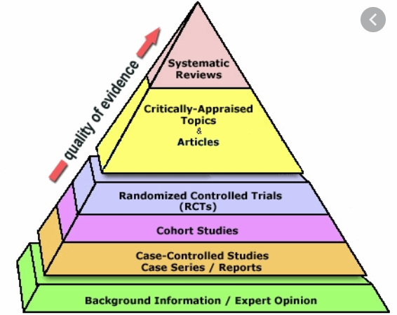
Levels of Evidence (Research Design)
https://cairns.health.qld.libguides.com/searching-evidence/levelsevidence

Slide 17
Step 4: Make Clinical Decision Take into account all points of EBP triangle Clinical Practice
Can the research be replicated in my practice?
What are my outcome measures or practice-based evidence?
Do I have a personal bias? “our strong preferences for what we already believe to be true makes us poor judges of whether it is actually true.” (Dollaghan, 2007)

Slide 18
Step 4: Make Clinical Decision Take into account all points of EBP triangle Client & Context
Consider the whole child/client not just the speech disability.
What are the client’s/family’s perceptions on communication deficits and desired outcomes of therapy?
Is it sufficient to target speech function alone and assume that it will automatically lead to improvements in other life domains?
May some children be more motivated if intervention includes words that they would like to say or their family deem improvement?

Slide 19
Use Your Time Wisely! Be Efficient and Effective in Reviewing the Literature
Brackenbury et al. (2008) reported that experienced and proficient researchers took from 3 to 7 hours to define a clinical question, search for evidence, read the evidence, and answer the question.
As a busy SLP, what can you do to speed up the process, but continue to make good EBP decisions?

Slide 21
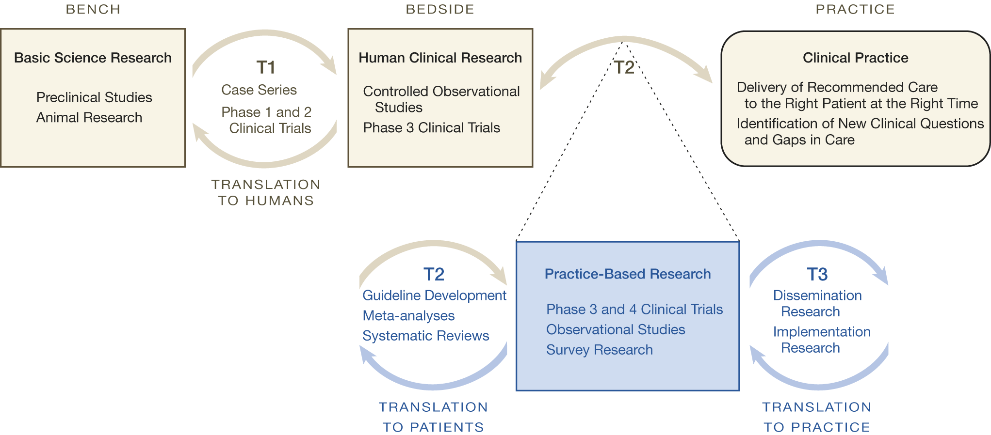

Slide 22
Dissemination vs. Implementation Research
The purpose of dissemination research is to understand how best to spread and sustain EBPs.
Implementation research improves participant outcomes and population health through strategical use of EBPs.

