Slide 1
cognitive assessments & Rehabilitation in the field
Amanda Thompson, M.S., CCC-SLP

Slide 2
Lecture Map
Examples of medical settings where cog rehab services would be commonly provided
Closer look at acute care, inpatient rehab/SNF, and outpatient rehab
Assessment
Treatment
Case application
Q&A

Slide 3
Settings
Acute Care (e.g., ED; ICU; Med/Surg)
Inpatient Rehabilitation
SNF
Outpatient/private practice
Home Health
Subacute

Slide 4
Rehab Settings: Criteria basics
Acute care: Patients with complex medical issues, deemed appropriate by MD
Inpatient Rehabilitation: Must tolerate 3 hours of therapy a day (PT/OT/SLP) at least 5 days per week
Subacute: Patient requires more intensive services than SNF, but less intensive than acute care. Unit is often housed within SNF (less often in hospital)
SNF: Patient requires skilled rehabilitative therapy(ies) for at least 60 minutes per day at least 5 days per week
Outpatient: Dependent on requirements set forth by the payer (if using insurance). Documentation must support the medical necessity of services
Home Health: Patient requires intermittent skilled therapy(ies) and/or nursing care, and doctor must certify that the patient is home bound
Notes:
Various facilities will have different names for units (e.g., inpatient rehab, acute rehab, etc.).
Acute: rehab not involved in process of determining criteria for admission (MD determines)
IPR: likely won’t meet criteria if unwilling to participate, poor rehab potential (at baseline), dementia, doesn't need help from at least 2 different disciplines, acute illness, still undergoing procedures or workups, severe behavior issues, unclear safe discharge plan. Needs achievable discharge plan and clear goals/motivation
SNF: Rehab needed for documented decline in functional status, must require skilled services at a frequency or duration that cannot be provided at home, must be anticipated to make improvements in a reasonable timeframe

Slide 5
Diagnoses Associated With Cognitive Deficits
Stroke (CVA)
Traumatic Brain Injury (TBI)
Anoxia
Heart failure
Infections (e.g., UTI)
Brain tumors
Cancers
Dementia
Parkinson’s Disease
Encephalopathy
Notes:
Heart failure: can directly impact cog (e.g., result in metabolic abnormalities, hypoxia from afib, strokes) or indirectly impact cog (e.g., depression and reduced nutrition)
Encephalopathy: umbrella term that encompasses any change in cognitive function due to complication of an underlying health problem. There are many different reasons for a general encephalopathy, such as from infection, medication induced, poor nutrition. It's important to determine the etiology, or the cause, of a cognitive impairment in our patients. We need to be sure that the diagnosis and the etiology warrant skilled therapy intervention, because with some of these encephalopathies, medical management is the only way to address the impairment

Slide 6
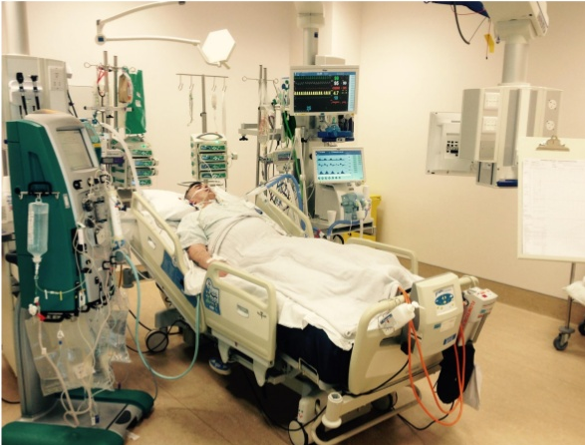
Acute Care Assessment & Treatment

Slide 7
Acute Care- SLP Goals of Care
Patient’s are often seen soon after admission (particularly for dysphagia) and are monitored closely throughout their admission as needed
Frequent assessments and re-assessments
Monitor for changes in status
Caregiver/ Family Education
Identify the acquired cognitive areas of deficit
Determine tentative prognosis
Collaborate with other medical professionals for best discharge plan
May focus on patient management rather than direct treatment

Slide 8
Acute Care: Assessment
Always start with a medical chart review!
Diagnosis
Imaging (CT scans, MRI)
Review MD notes (e.g., history and physical (H&P))
Review documentation (neurology, PT/OT, social work, nursing, etc.)
Contact nursing prior to entering room

Slide 9
Medication-Induce Cognitive Impairments
Psychoactive drugs
Antidepressants
Anticonvulsants
Histamine H2 receptor antagonists
Corticosteroids
NSAIDs (nonsteroidal anti-inflammatory agent)
Cardiac medications
Consider timing of your evaluation; check with nursing!
Shinohara & Yamada, 2016
Notes:
In ICU, often run into high dosages of pain medications and/or sedating medications for agitation.
Patients may also be weaning off high levels of pain meds they were taking at home (resulting in encephalopathy); also maybe not the best time to evaluate if patient is uncomfortable

Slide 10
Acute Care- Assessment
Mostly screen, not assess. This may include:
Scales of arousal and orientation (e.g., Glasgow Coma Scale; Galveston Orientation & Amnesia Test (GOAT))
Clinician created informal screener
Specific hospital created informal screener
Formal cognitive-communication screeners (e.g., MOCA, Slums examination, Mini-Metal Status Examination (MMSE), Cognitive-Linguistic Quick Test (CLQT))
Consider Rancho levels to describe patterns and stages of recovery following brain injury

Slide 11
Acute Care- ASSESSMENT
Initial observations:
Positioning in bed
Level of supervision: presence of restraints? 1:1 sitter?
Focused attention
Interactions with nursing and family
Engagement
Language

Slide 12
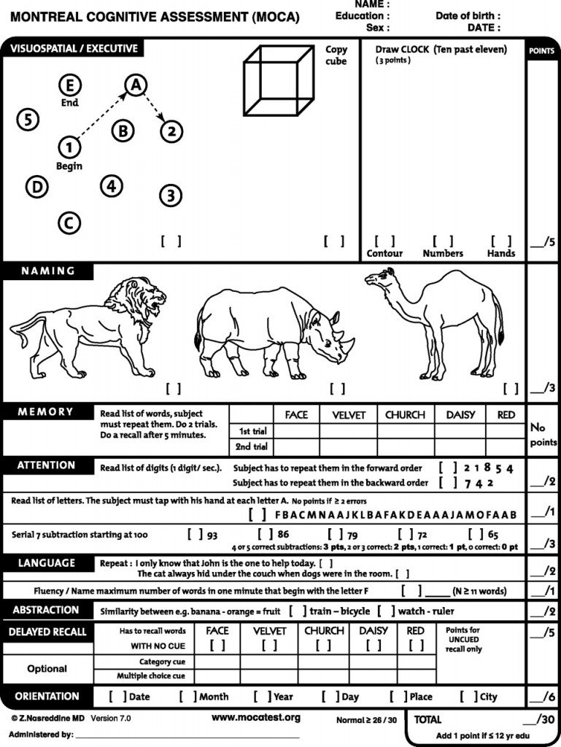
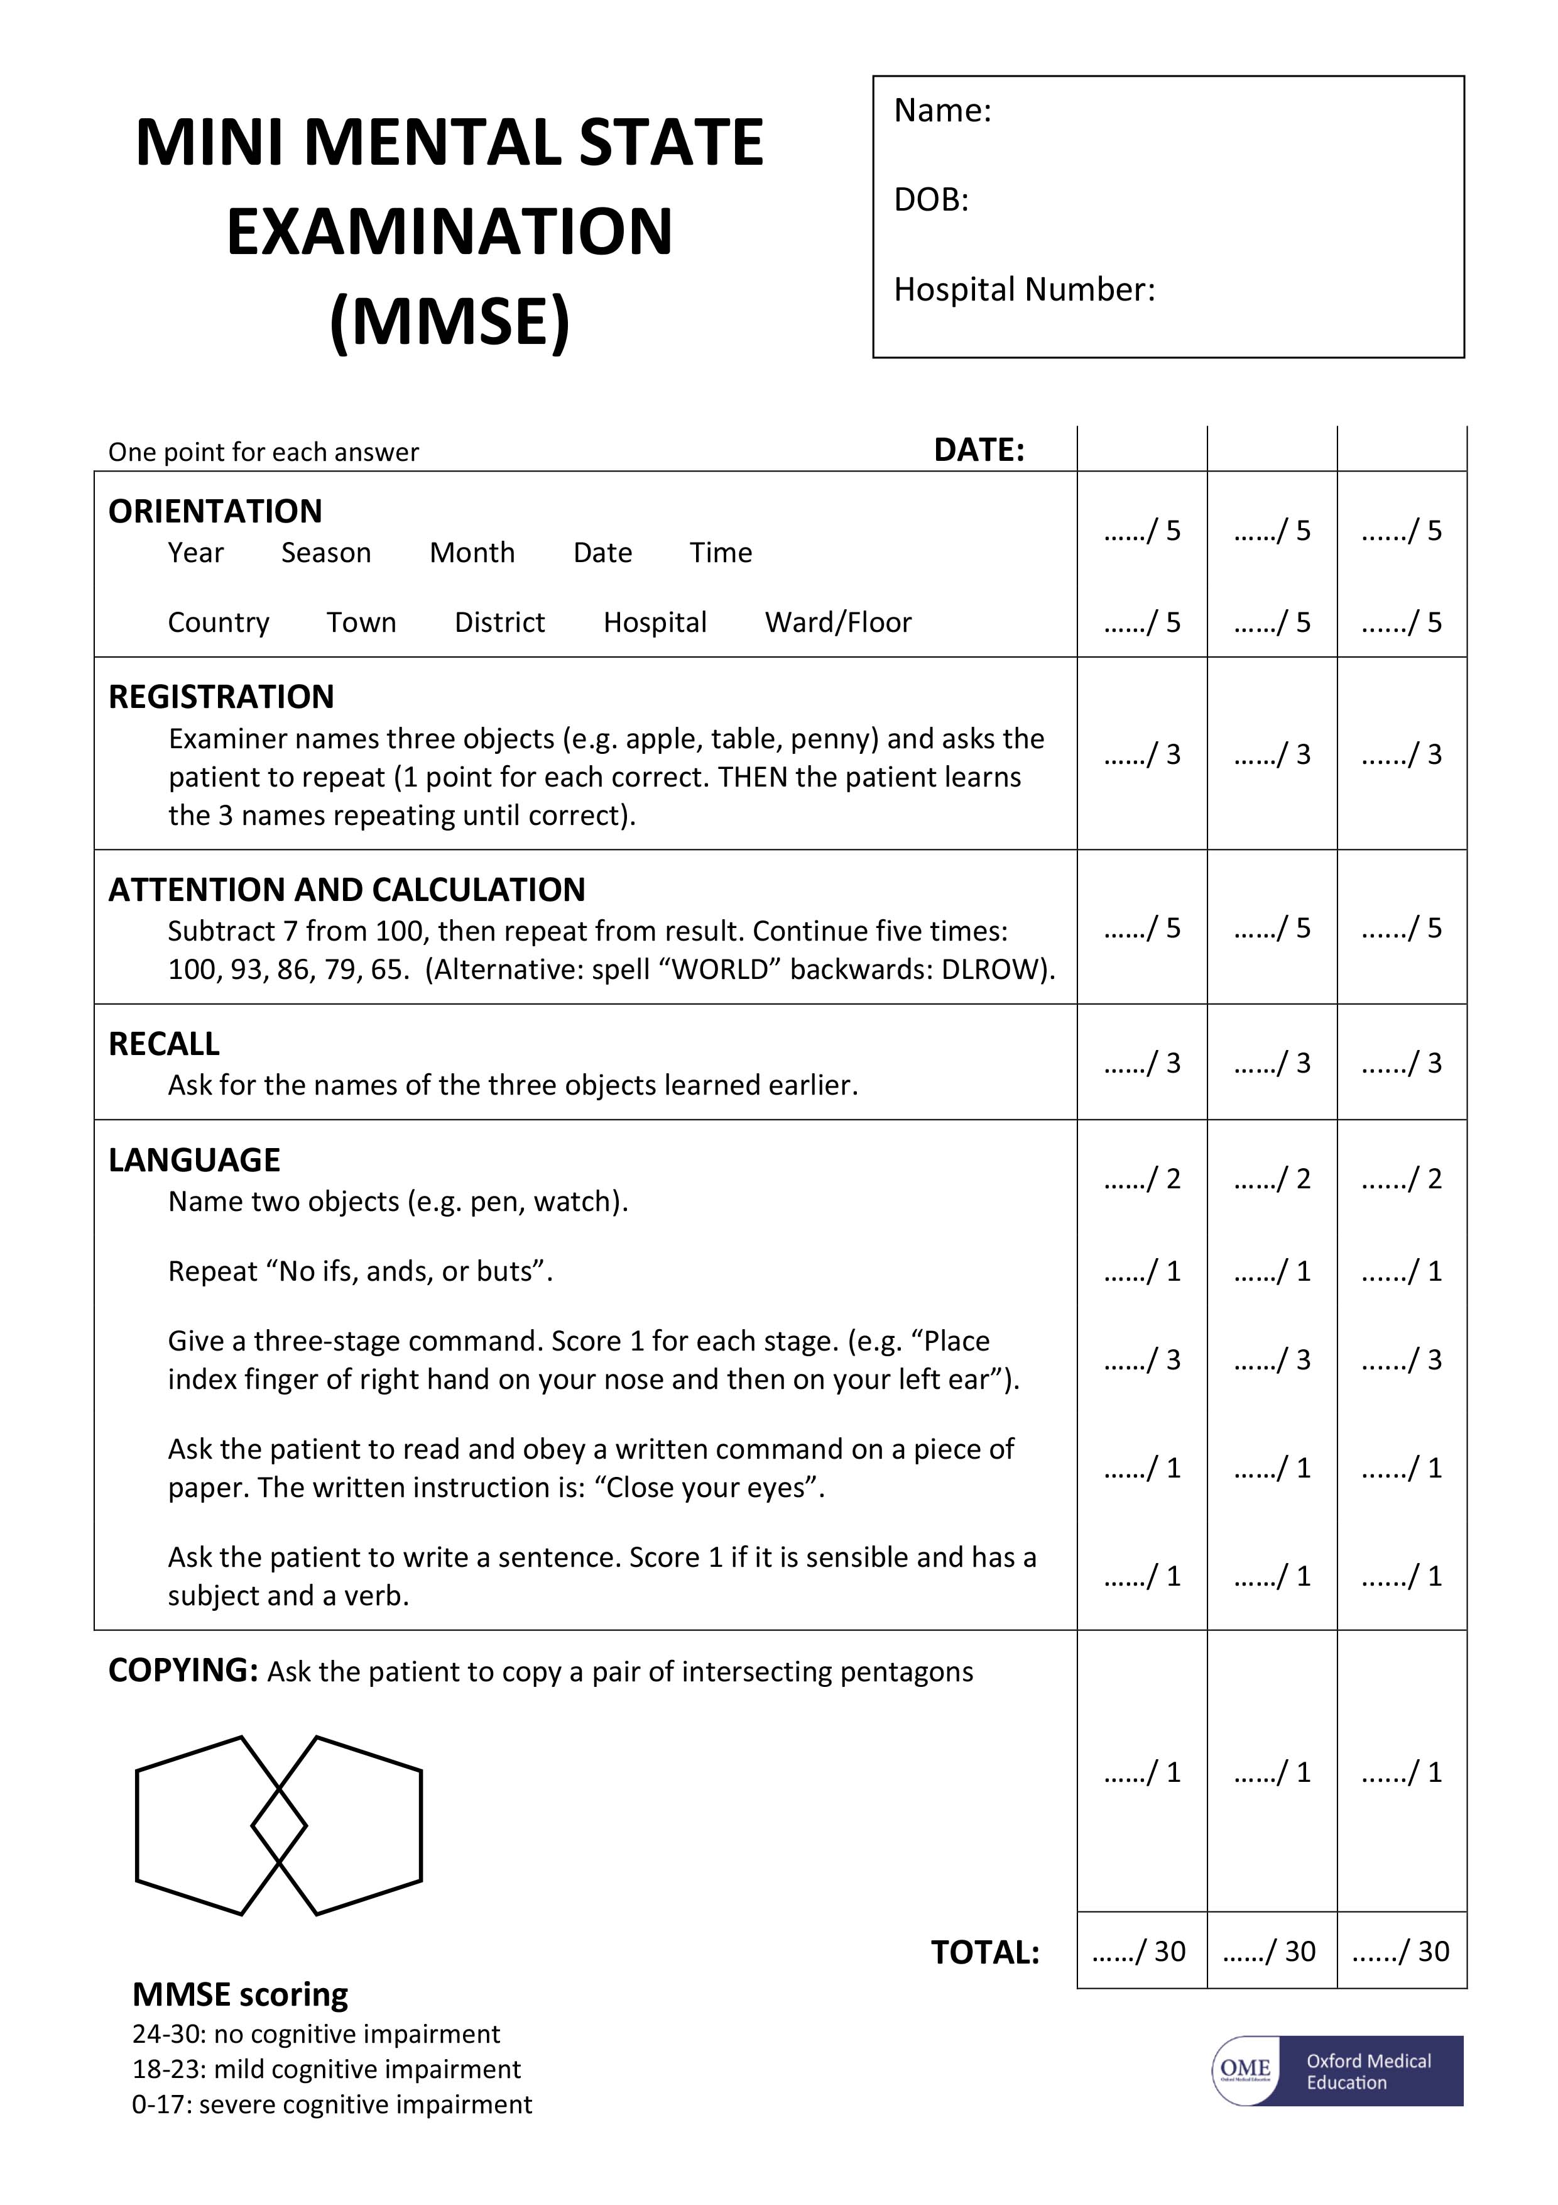

Slide 13
Acute Care: Assessment Components
Orientation/arousal
Attention
Functional problem solving (e.g., calculation, word problems, time-related problems, ability to carry out ADLs)
Sequencing
Initiation
Insight and safety awareness
Memory
Verbal reasoning (e.g., abstraction [similarities/differences])
Scanning
Pragmatics (e.g., turn taking, eye contact, appropriateness)
Language (expressive, receptive, written, etc.)
Notes:
Consider PLOF, d/c plan, & current level of functioning- if disoriented then may select easier assessment tasks.
Make it useful and relevant. Can you answer social workers questions re: d/c planning (e.g., safety awareness); can they recall the exercises PT gave them earlier today vs do they even know that they have a PT?
You will comment on these areas in your note, however, how you assess them will vary greatly depending on premorbid and current status.
Orientation- person, place, time, situation. Consider starting here to determine level of difficulty for remaining assessment tasks
Attention:
-basic focused attention: do they notice when you walk in the room?
-sustained attention: digit span forward, quiet environment
-Selective: attend in a noisy environment (ICU)
Memory:
-Immediate: tell information back to me
-Working memory: holding onto instruction set to execute task
-Short-term: recall info from earlier today (ensure you know the answer), or earlier on during assessment. If words are not recalled, can scaffold the cues.
-Long-term memory: simple biographical (remember to verify accuracy)
Initiation: during functional task or assessment task
Insight/safety awareness: can inquire about deficits, anything more difficult now than before you came to the hospital? Inquire from PT/OT. Keep in mind that the are still early on in illness and grieving is a process
Problem solving:
Verbal- simple addition/subtraction, time related questions. Difficulties can reveal reduced working memory
Reasoning: act of thinking about something in a logical, sensible way.
Abstraction- similarities/differences between items; categories. Could reveal rigidity of thought
Scanning: around room, while reading, while eating
Pragmatics- taking turns, eye contact, topic maintenance

Slide 14
Case Study: BC Initial Assessment
33 year old male “passed out” at work on 1/10/2019 resulting in facial and head trauma, x2 seizures witnessed by EMT en route to the hospital. GCS was 3 & intubated in ED
ST consult received following extubation on 1/11/2019. ST services held on 1/11/2019 & 1/12/19 due to somnolence
ST note in ICU 1/13/19 (Rancho IV- Confused/agitated: Maximal assist)
Family at bedside, in ICU
Oriented to person only
Problem solving/safety: restraints, 1:1 sitter, attempting to pull at IV. Requiring intermittent sedation
Assessment limited due to inability to cooperate with treatment efforts
Plan: return for formal assessment when appropriate
Recommendations: Low stimulation environment, 1:1 supervision
Ideas for SLP intervention at this stage?:
Notes:
GCS: Severe Head Injury----GCS score of 8 or less. Scores based on eye opening, verbal response, motor response
Family education, environmental organization
Recommendations: Tell the person where he is and reassure him that he is safe. • Bring in family pictures and personal items from home, to make him feel more comfortable. • Allow him as much movement as is safe. • Take him for rides in his wheelchair, with permission from nursing. • Experiment to find familiar activities that are calming to him such as listening to music, eating, etc. • Do not force him to do things. Instead, listen to what he wants to do and follow his lead, within safety limits. • Since he often becomes distracted, restless, or agitated, you may need to give him breaks and change activities frequently. • Keep the room quiet and calm. For example, turn off the TV and radio, don't talk too much and use a calm voice. • Limit the number of visitors to 2-3 people at a time.

Slide 15
Case Study: BC Re-assessment
Subjective: Asleep but easily arousable. Impulsive. Tele-sitter in place, no restraints. Rancho V per PT/OT note earlier today. Transferred from ICU to neurology unit, no longer receiving sedating medications.
Prior level of function (PLOF): gas station attendant (pumps fuel, works as a cashier). Lives with wife, manages finances for household.
Patient goals: unable to state. Suspect return to prior level of function (PLOF)
Administered cognitive/communication screen (i.e., Addenbrooke’s Cognitive Examination- ACE-R). Subtests include orientation, registration, attention/concentration; memory; fluency; language; visuospatial
Informal observations:
Off topic responses
Required verbal cues to attend to assessment tasks; easily distracted by external stimuli.
Impulsive
Inconsistently identified errors following cues to self-correct
Findings: significant cognitive/communication impairments including anterograde memory, visuospatial abilities, and attention.
Plan: ongoing assessment. Initiate therapy.
Notes:
Level V - Confused, Inappropriate Non-Agitated: Maximal Assistance
Alert, disoriented, may become agitated with lack of structure.

Slide 16
Case Study: BC Treatment plan
Family education (re-orient patient (tell, don’t quiz); keep comments and questions short and simple; bring in pictures and personal items from home; low stimulation environment)
Patient will tolerate mechanical soft textures and thin liquid by discharge without signs or symptoms of aspiration with independent utilization of safe swallow strategies.
Patient will write simple biographical information with 100% accy given min cues to check work for accuracy
Pt will implement basic self-monitoring strategies (e.g., evaluate situation/generate plan; initiate task; check for accuracy) with mod cues during functional tasks (e.g., feeding, writing, reading, etc.)
Pt will complete basic money management tasks with 75% accy with min assist
Patient will utilize external aids (e.g., memory log) for orientation information and recall of recent events with mod assist
Patient will utilize nurse call button during 75% of opportunities per RN report (consider errorless learning for method of intervention)
Notes:
Rancho V: • Repeat things as needed. Don't assume that he will remember what you tell him. • Tell him the day, date, name and location of the hospital, and why he is in the hospital when you first arrive and before you leave. • Keep comments and questions short and simple. • Help him organize and get started on an activity. • Bring in family pictures and personal items from home. • Limit the number of visitors to 2-3 at a time. • Give him frequent rest periods when he has problems paying attention.

Slide 17
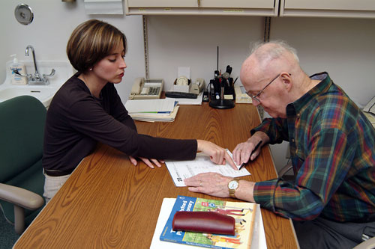
Inpatient Rehabilitation subacute/skilled nursing Assessment & Treatment

Slide 18
Rehab-SLP Goals of Care
Refine cognitive/communication and swallowing diagnoses
Monitor change
Focus on intensive treatment (for IPR)
Interdisciplinary collaboration (e.g., PT, OT, MD, dietician, psychologist, etc.), meetings, and co-treating
Patient and family education with goal of understanding the evolution and course of disorders
Planning for transition to the next phrase of care with consideration of contextual factors (environment, social, psychological, vocational)
Notes:
SNF: Cog sessions typically focus on whatever their need is to get home (i.e. finance management, bus route coordination, medication management, etc).

Slide 19
Rehabilitation: Services/Documentation
Initial evaluations could include:
Standardized assessments (Assessment of Neuropsychological Status Update (RBANS); Scales of Cognitive and Communicative Ability for Neurorehabilitation (SCCAN)) – depending on availability!
Informal assessments (e.g., facility created and/or clinician created)
Subsequent progress documentation on at least a weekly basis
A discharge summary assists with continuity of patient care as the patient transitions to the next level of care (e.g., outpatient treatment, home health services).
Notes:
For cog rehab in SNFs: materials are typically quite limited (e.g., an aphasia battery and/or the CLQT)

Slide 20
Rehabilitation: Treatment
Goals/treatment plan based on:
Transition to next level of care
Prior level of function (PLOF) to create functional goals
Complimenting and supporting goals from other members of the treatment team (e.g., OT, PT, dietary, etc.)
Patient/family education
Turkstra (2013) Commentary: is it time for a change?
Notes:
Establish therapeutic alliance with patients and families, so they identify SLPs as an ongoing post-discharge resource
Help patients and families to observe and understand the cognitive recovery process to interpret observed bx and progress
Provide patients and families with tools to help manage cognitive impairments within the hospital, home and community environments
Minimize bad habits that can develop during the early post-injury period when patients have normal implicit learning, but impaired declarative memory and reasoning
Help patients and families be advocates for their own need post-discharge and educated consumers of cognitive-related resources

Slide 21
IPR Case Study: CH
19 y/o male who sustained an anoxic brain injury
Admitted to IPR for comprehensive rehabilitation ~6 weeks post-injury following complicated acute hospital stay
Prior level of functioning (PLOF): College student, athletic (skier)
Supports: Involved mother, currently local
Patient goals: goal of eating
Family goals: continued gains overall
Notes:
**Important areas to obtain during clinical interview/chart review are on this slide!

Slide 22
IPR Case Study: CH Assessment
Oral motor exam
Informal voice/motor speech assessment
Modified barium swallow study (MBSS)
Hearing screen
“Craig Hospital Initial Cognitive Communication Screen”; language assessments (Boston Naming Test (BNT); portions of WAB & BDAE)
Subjective observations
Social interaction
Attention
Processing speed
Orientation
Verbal memory/learning
Safety judgement
Problem solving/executive functioning
Notes:
Red = assessment specific to cognition
Found to have global cognitive impairments across areas tested, reliant on procedural/errorless learning
High levels of distractibility by internal and external stimuli
Safety judgement: 1:1 sitter, impulsive, high fall risk with profoundly impaired memory to recall why safety precautions are in place
Problem solving: unable to recognize a problem with absent awareness of current circumstances or deficits. Profoundly impaired.

Slide 23
IPR Case Study: CH Treatment Plan
Plan of Care (POC): 60 minute individual treatment sessions 5x/week. ~4 week stay.
Problem solving: Procedural learning for care routines including transfer
Dysarthria: compensatory strategies (slow rate) at the word level
Swallowing: Advance to general textured diet w/ thin liquids
Safety judgement: decreasing level of assist during short and simple tasks
Expressive language: responding to questions one time with 90% accuracy
Orientation: using errorless learning for basic orientation information
Visual & verbal learning: use of procedural and errorless learning in a highly structured environment
Notes:
Procedural learning: acquisition and memory are demonstrated through task performance. Completing complex task repetitively until it is automatic

Slide 24
IPR Case Study: CH Discharge Assessment
Goals: “return home with brothers”
Assessment:
Informal motor speech tests; voice
“Craig Hospital Initial Cognitive Communication Screen”; Boston Naming test; WAB
Progress:
Spontaneous improvement in voice
Notable gains appreciated in mixed dysarthria
Swallow: Now WFL (general/thin)
Continues to require structured and predictable care routines with structured down time and 24 hour supervision for both cognition and language
Family education provided for discharge home with mom
Notes:
Red = assessment specific to cognition

Slide 25
Outpatient services Assessment
Clinical interview (remember motivational interviewing/OARS!)
Involve family/caregivers if available and appropriate
Assessments (formal and/or informal) (e.g., RBANS, CLQ)
Standardized, self-report measure (e.g., BREF A, LaTrobe Communication Questionnaire)
Collaborative goal setting
Motivational interviewing, including open-ended questions
Consider GAS
Find a ‘low hanging fruit’ at the end of session that addresses an area of concern
MacLennan & Sohlberg, 2018 presentation
Notes:
Often initiated by an MD referral. May self-refer, particularly if paying out of pocket
Outpatient services may be initiated directly following discharge from a facility, and/or further along in the patient’s recovery process if deficits persist
Frequency/duration: often determined by the payer.
Collaboration with other providers will depend on your facility
Beyond Workbooks: Functional Cognitive Rehabilitation for Traumatic Brain Injuries. Don MacLennan, MA, CCC-SLP; McKay Moore Sohlberg, PhD, CCC-SLP

Slide 26
Outpatient Rehabilitation Treatment
Therapy approaches/strategies:
Personalized education (always!)
Cognitive strategy training
Direct training of cognitive impairments
Selection and training the use of assistive technology
Training specific tasks
Environmental management
(Selected based on patient preference; hx of previous treatment; timelines for treatment; specific needs of the person with BI, research evidence)
MacLennan & Sohlberg, 2018 presentation
Notes:
Cognitive strategy training: Can be general/implemented across a range of tasks or situations or specific to a task or situation; internal (self-talk) or external (smart pen for notes)
Direct training of cognitive processes: APT, goal management training
Training specific task: not expected to generalize. Riding bus, cooking.
Environmental management: setting up desired workspace, lighting, etc.

Slide 27
Revisit case study: CH assessment
Interview with patient’s mother
Interview with client
Informal observations (orientation, attention, conversational ability, self-awareness, etc.)
Attempted RBANS (suspected results invalid due to interference of memory impairment)
Recommendations: Focus on cognitive rehabilitation and development of learning strategies for completion of functional tasks

Slide 28
CH case study cont. Initial treatment plan
Examples of target areas:
Caregiver training
Increase ability to complete ADLs (e.g., heating food in microwave) by utilizing external aids (Google Calendar, smart phone apps)
Responding during interactions with unfamiliar listeners (e.g., ordering a beverage) by independently answering questions with verbal utterances or gestures
Accurately filling out biographical information (either spontaneously or by using smart phone) to fill out paperwork with no more than one verbal cue

Slide 29

Any questions??

Slide 30
References
Cornis-Pop, M. (n.d.). Responding to the Demand. Retrieved February 25, 2020, from https://www.asha.org/uploadedFiles/slp/CornisPop.pdf
Getting Started in Acute Care Hospitals. (n.d.). Retrieved February 19, 2020, from www.ASHA.org
Getting Started in Acute Inpatient Rehabilitation. (n.d.). Retrieved February 19, 2020, from www.ASHA.org
Jacobson, B. (2018, October 5). Medical Speech-Language Pathology – Best Practice and Resources . Retrieved from https://ksha.org/docs/SLP10_Medical_SLP_Best_Practices.pdf
Mechler, L. (2018, April). Assessment of Cognitive-Linguistic Skills: The SLP's Role in Acute Care. SpeechPathology.com, Article 19580. Retrieved from www.speechpathology.com.
MacLennan, D., & Sohlberg, M. (2018, October 11). Beyond Workbooks: Functional Cognitive Rehabilitation for Traumatic Brain Injuries. ASHA. Retrieved from https://apps.asha.org/
Shinohara, M., & Yamada, M. (2016). Drug-induced Cognitive Impairment. Brain and Nerve. Retrieved from http://europepmc.org/article/med/27056860

