Slide 1
Lecture Part B
Discussion of SIMUCASE
Deficits of awareness
Left neglect

Slide 2
SIMUCASE
Caution/Limitations of CQLT
Lack of ecological validity and predictive ability
Norming sample/psychometrics
Wide age norms, weak test-retest reliability, limited evaluation of validity, sampling limited particularly on neurogenic populations
Possible confounds with motor, visual and auditory functioning
Over-diagnoses language impairments

Slide 3
Treatment of Awareness Deficits & Hemispatial Neglect

Slide 4
Why is Self-Awareness Important?

Slide 5
Self-awareness allows for us to…
View ourselves objectively
Appropriately monitor, analyze, and modify our behaviors
See ourselves from the perspective of others
Use feedback from others as we develop our personalities and decisions

Slide 6
We use self-awareness when we…
Interact socially with others
Decide what situations or information to share
Make judgements about ourselves
Act in ways that ensure our personal safety
Other ideas??

Slide 7
Impact of Brain Injury
Can result in a denial of deficits
Limits or slows recovery
Less likely to follow in therapy recommendations
Less likely to participate in supportive efforts
More likely to demonstrate risky/dangerous bx
Poor employment outcomes
Poor academic outcomes
Caregivers report greater levels of stress

Slide 8
Sources of Deficits in Self-Awareness
Direct injury to the brain structures responsible for awareness
Direct injury to the structures responsible for think processes
Psychological denial
No opportunities to experience changes

Slide 9
Direct injury to the brain structures responsible for awareness
Frontal lobes house our primary awareness centers and are highly susceptible to injury (EF systems)
Injuries can significantly contribute to deficits of insight and poor judgement
A person might acknowledge an injury, but do not appreciate the impact it has on their life

Slide 10
Direct injury to the structures responsible for think processes
Brain damage to areas impacting memory, reasoning or problem solving
If a person cannot remember information or does not fully understand it, then that information cannot be used effectively
A person with poor reasoning may not fully understand the demands of a given task

Slide 11
Psychological denial
Denial occurs when a person knows they have difficulties, but suppresses that information
May soften or outright deny evidence that reveals limitations
Psychological issue, not resulting from BI
Psychological denial is an emotional defense mechanism
To some degree it can be normal

Slide 12
No opportunities to experience changes
A person may think they are functioning well until an experience uncovers breakdowns in their ability to execute a task safely, effectively and efficiently
Awareness deficits may become apparent as the person gradually returns to routine activities
Driving

Slide 13
Three Trajectories
Hyper-aware
Hypo-aware
Combination

Slide 14
Self-Awareness of Deficits Interview (SADI)
Sections
1. Knowledge of impairments, deficits and changes that have occurred since the injury
2. Awareness of the functional consequences of the impairments (e.g., their impact on work, social relationships)
3. Correspondence between the patient’s level of functioning and future plans, goals and expectations
Semi-structured interview -> you rate awareness
20-30 min administration time
Advantages: commonly used, measures change
Limitations: time, requires verbal and recall skills

Slide 15
Treatment
Goal of tx is to increase a person’s understanding of their abilities and limitations in a way that preserves self-esteem
Establishment of a trusting therapeutic rapport
Align with the individual and avoid power struggles
Use positive restatements
Compromise
Find strengths and points of agreement
Psychoeducation
Environmental supports
Feedback –orient to to aspects of performance that are not accurately perceived
Direct
Indirect

Slide 16
Agnosia
The acquired inability to recognize key sensory information, including objects, faces, voices or places
Usually affects a single neural pathway
Types of agnosia:
Visual: Prosopagnosia (face blindness), Achromatopsia (color blindness), Agnosic alexia (pure alexia), Akinetopsia (motion blindness)
Auditory: Phonagnosia (recognize familiar sounds)
Tactile: Autotopagnosia (visually orient or recognize the parts of your own body)
https://www.youtube.com/watch?v=f1Zjq1M75gc

Slide 17
Hemispatial Neglect
Reduced tendency to respond to and search for objects on the side contralateral to the side with the lesion (contralesional side)
Other terms: unilateral neglect, hemi-inattention
Most commonly occurs following right hemisphere damage (RHD) and is referred to as LEFT NEGLECT or LEFT INATTENTION
Neglect is one of the strongest predictors of general functional recovery post stroke

Slide 18
Examples
https://www.youtube.com/watch?v=_MuG31viTno

Slide 19
Cause: Anatomy
Infarction within the territory of the middle cerebral artery
Most often on the inferior parietal cortex

Slide 20
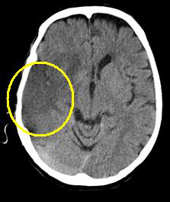

Slide 21
Theories
Hemispheric specialization:
RH is specialized for attn to left and right hemispace; LH is specialized only for attention to right hemispace
Damage to right side leads to losing main control over left sided attention
Disengagement Theory
People with unilateral neglect find it difficult to disengage from attention on the right
Interhemispheric Inhibition
RH works “against” the left
Right sided damage would lead to increased activity in the LH; RH is no longer inhibiting LH

Slide 22
Incidence & Impact Hemispatial Neglect
Significant number of patients present with left neglect in the acute stage and then it improves over time
(17% of RHD & 5% of LHD 3 mos post onset)
Chronic neglect does occur and can significantly impact independence and safety

Slide 23
Co-morbidities
Neglect in the auditory and tactile domains
Apraxia
Visual spatial deficits
Hemianopsis (blindness of ½ the visual field)
Unawareness (anosognosia)
Agnosia
Limb spasticity

Slide 24
Difference between Neglect and Hemianopia
Both may lead patients to miss information on the left
Neglect reflects an attentional deficit usually caused by cortical lesion
Hemianopia reflects a cut in the visual field that is caused by lesion to pathways from retina to occipital lobe
Neglect usually accompanied by unawareness or apathy about neglect
Double simultaneous stimulation can differentiate them.

Slide 25


Slide 26


Healthy Individual
Left Homonymous Hemianopsia
“Cluttered” Neglect
“Uncluttered” Neglect

Slide 27
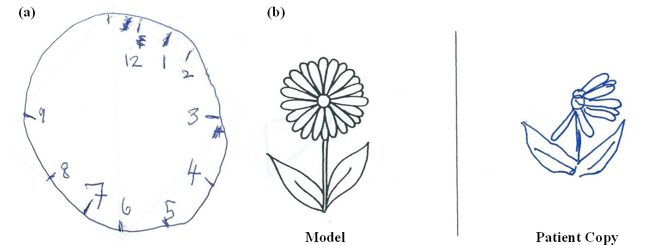
Assessment
Paper pencil: star cancellation, line bisection, free drawing, shape copying; clock drawing

Slide 28
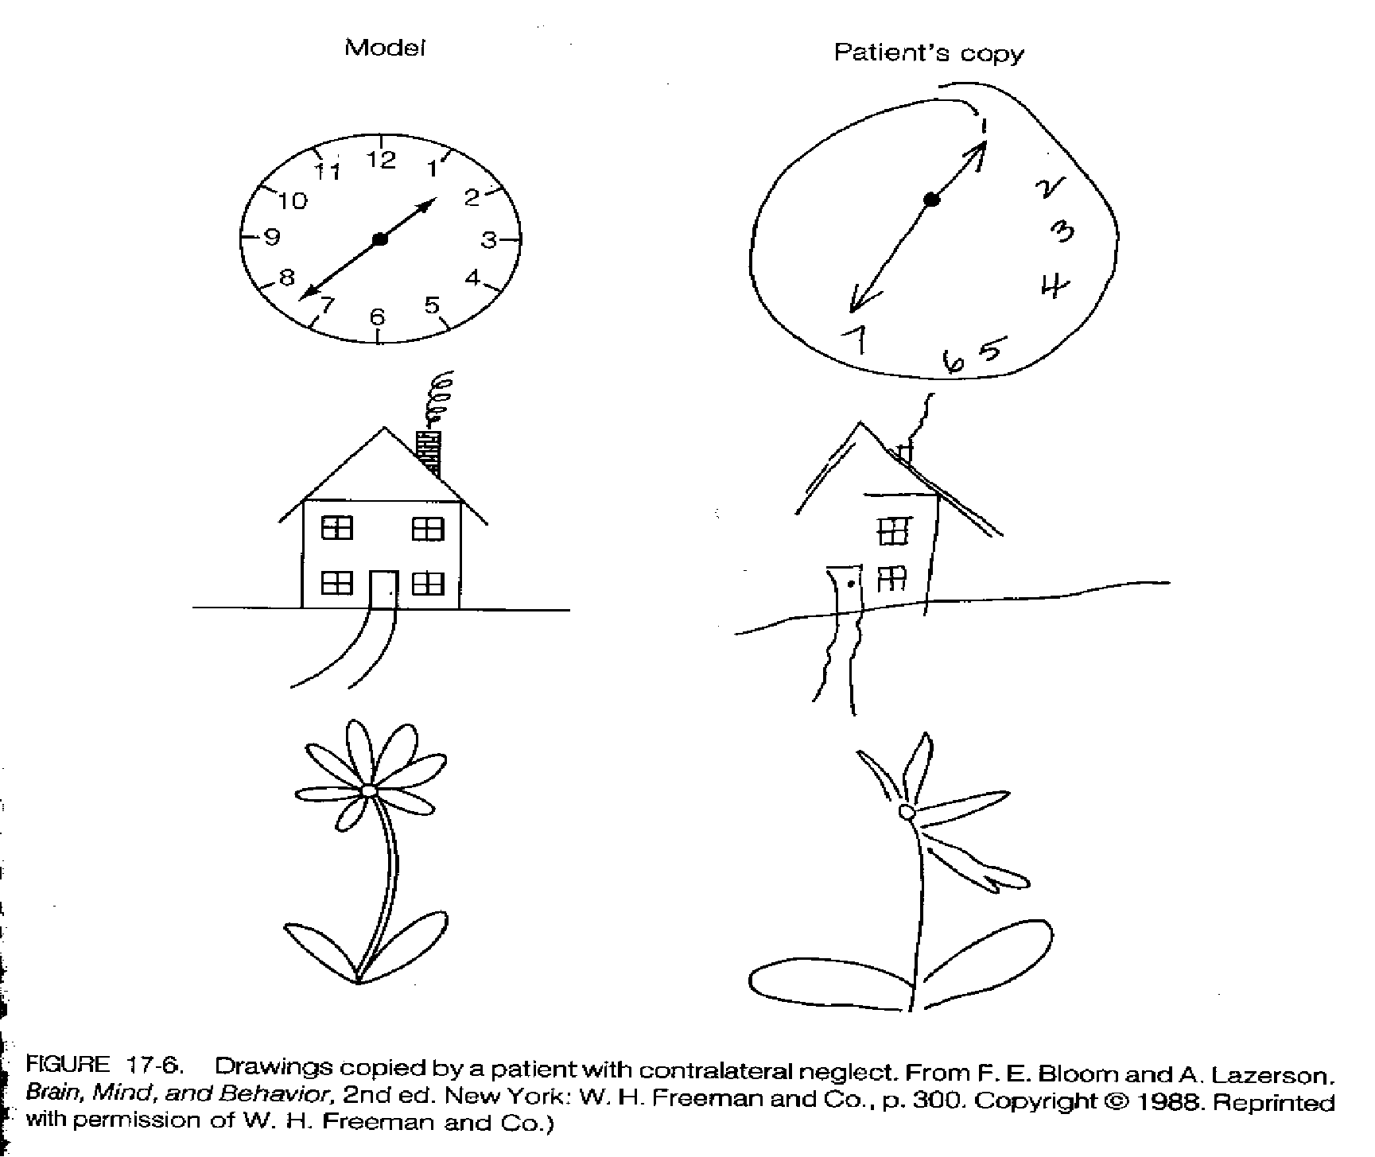

Slide 29
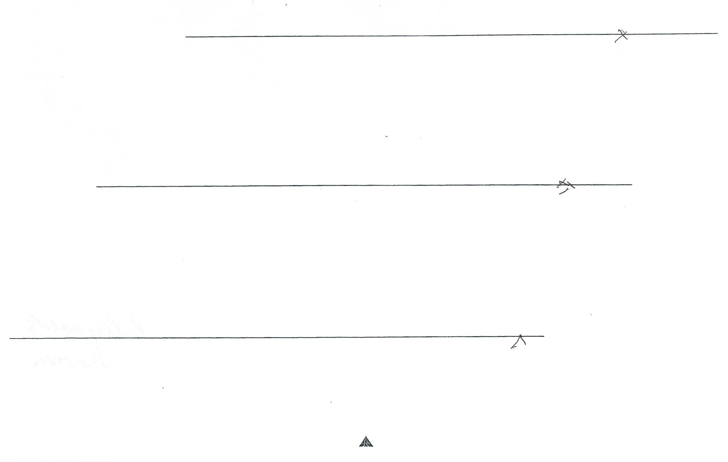
Line-Bisection Task

Slide 30
Paper Pencil Assessment
Don’t always map to problems encountered in daily living thus may use functional tasks such as menu and article reading; map navigation etc.

Slide 32
Treatment
Behavioral Compensation: Visual Scanning Therapy (VST)
Time consuming (approximately 40 hours of therapy)
Only targets visual aspects of neglect
Hard to generalize
May be paired with alert—e.g., contralesional stimulation of neck muscles
Device
Prism adaptation: lenses shift visual field to the right
Transcranial magnetic stimulation: Pulses applied to intact hemisphere disrupt the neural activity and reduce ipsilesional bias
Eye patching: ipsilesional visual field is patched which prevents visual info from reaching intact hemisphere in order to “release” visual processes in damaged hemisphere and restore neglect

Slide 33
Therapy Sequence for VST
Increase awareness and understanding of neglect
Gather and prepare materials
Training beginning w/single stimulus visual cancellation
Increase on hierarchy of treatment
Reduce cueing
Considerations (e.g., placement of stimulus, anchoring, etc.)
Train to criteria
MEASURE GENERALIZATION

Slide 34
Summary
Hemispatial neglect is a common attentional disorder following unilateral brain damage
Neglect is one of the strongest predictors of general functional recovery from stroke
Identification of patients with neglect is important, as it can alert clinicians to comorbid conditions and aid staff with day-to-day patient care
Potentially effective treatments are in development but these lack large-scale, trials validation.

