Slide 1
Our Cognitive Rehab Journey
Fundamentals: etiologies; types of impairments; treatment frameworks; assessment frameworks
Cognitive Domains/Therapy Approaches
All Domains/Training ATC using principles of systematic instruction
Attention/Training Direct Cognitive Processes (DAT)
Memory/Task Specific Training + (Spaced Retrieval)
Executive Functions/Cognitive Strategy Training using principles of systematic instruction

Slide 2
Memory: Theory, Assessment and Treatment
Winter 2020

Slide 3
Big Picture: Learning & Memory
Engage a wide range of brain regions
There are both modality & material-specific channels for information encoding, storage & even retrieval
Information is not represented statically in the brain--(e.g., attention, emotion, hormonal levels) influence, modify and rearrange our knowledge

Slide 4
Stages for remembering & neuroanatomical correlates
Attention/Initial registration (reticular activating system/corresponding sensory cortex)
Encoding (corresponding sensory cortex/basal ganglia/diencephalon)
Working Memory (prefrontal/parietal structures)
Consolidation/Storage (medial temporal lobes/limbic systems/hippocampi)
Retrieval (frontal structures)
[medial temporal lobes, diencephalon (thalamus), basal forebrain (hippocampus), neocortex of frontal lobes and temporal lobes]

Slide 5
Types of Memory time-dependent forms
Short term (includes working memory-an active construct)
Long term

Slide 6
Types of memory content-dependent forms (all longterm memory)
LONG TERM MEMORY
Declarative
Nondeclarative

Slide 7
Memory
Declarative
Memory
NonDeclarative
Memory
Facts
Events
Skills/
Procedures
Habits
World
Knowledge
Vocabulary
Simple
Classical
Conditioning
Priming

Slide 8
Valitchka & Turkstra (2013)
Spoiler Alert:
The clinical relevance of this dichotomy to the interactions observed in the acute care setting will be very important.

Slide 9
Declarative Memory Semantic vs. Episodic
Semantic Memory
Episodic Memory
dic memory
General knowledge about the world
Mental thesaurus
The residue of many episodes
People with amnesia usually have trouble building up new semantic knowledge and they don’t have access to episodic memories
It is the what when where part of memory
Relies on links between the hippocampus, thalamus and cortex—patients with damage to this system are often amnestic

Slide 10
Types of memory Everyday memory
Prospective memory
Remembering to carry out intended action in the absence of explicit reminder to do so
Event-based vs. Time based prospective memory
Metamemory
(What are these; what brain systems do you think they might be dependent upon?)

Slide 11
Prospective Memory Intervention
Shum and colleagues evaluated several approaches for treating prospective memory impairments what were they?
Your turn:
In five minutes clap your hands (5 min time based pm task)
When you return to your seat after the break, compliment someone at your table (event based task)

Slide 12
Amnesia Terms
Anterograde amnesia
Problem with encoding, storing or retrieving information that can be used in the future
Retrograde amnesia
Loss of access to events that happened in the past, typically before the onset of the disease
Can occur on a gradient “shrinking RA”
Often co-occurs with anterograde amnesia

Slide 13
Posttraumatic amnesia
Difficulty forming new memories
Tends to gradually improve

Slide 14
Why is memory theory important?
We want to strengthen encoding, consolidation and storage.
What does the O’Neil-Pirozzi et al. article offer that builds on this concept?
Instructional techniques can emphasize procedural memory pathways in those whose declarative memory pathways are damaged.
Sohlberg & Turkstra text provides map to do this

Slide 15
Learning is enhanced when…
Deeper levels of processing are activated
Material is elaborated
This increases the number of potential routes to retrieval..

Slide 16
What Makes Memories Last?
Self-relevance
Reactivation pattern
Cognitive significance
Sensory diversity
Distinctiveness
Exposure duration
Motivational significance
Emotional significance
Predictability

Slide 17
Instruction Should be Based on Client’s Profile
What parts of memory are preserved versus impaired
Will client need a highly structured, error free learning regimen?
What other considerations should drive the design of instruction?
Cognitive-linguistic function
Physical sensory abilities
Psychosocial function
Social connection

Slide 18
Applying Memory Theory
Client’s primary issue is with encoding because working memory is reduced
➔ administer direct attention training
Client’s primary issue is with consolidation and storage
➔ circumvent using procedural learning and SI
Client’s primary issue is with retrieval
➔ circumvent by teaching recall strategies

Slide 19
Assessment of Memory
Episodic memory
Semantic memory
Working (short term/attentional) memory
Perceptual (agnosias)
Procedural
Priming
Emotional/motivational

Slide 20
Assessment Questions
Is there a memory impairment?
If so, how severe?
What memory systems & domains are affected?
Prognosis & prediction?
How do/will memory problems affect everyday functioning?
What will help?

Slide 21
Contributions to Clinical Memory Assessment
Patient symptoms
Perspective of carers/family
Diary based observations
Memory tests

Slide 22
Testing (Informal/Formal-Unstandardized)
Clinical Interview (spontaneous account, symptoms, impact, agreement)
Questionnaires/rating scales for acute (e.g., GOAT)
Questionnaires/rating scales for post acute (Memory Questionnaire; Cognitive Symptoms Checklist (Ohara, et al., 1993)
Diaries/charts (formal to informal)

Slide 23
Testing (Formal-Standardized)
Wechsler Memory Scales (six primary subtests--episodic, working/recognition, recall, learning)
RBMT (episodic, prospective/recognition, recall, learning
CVLT (episodic/recognition, recall, learning)
Pyramid & Palm Trees (semantic/recognition)

Slide 24
Testing (Formal-Standardized)
Consider task stimuli (pictorial, verbal), response modality (auditory, visual), mode of response (recall, cued, recognition), focus (new learning, retention)
Consider psychometrics: construct validity, face validity, reliability, norming, floor & ceiling effects, ecological validity
Dynamic assessment by altering: distraction, practice, rehearsal, simplification of instructions, external incentives, external aids etc.

Slide 25
Six Possible Memory Intervention Approaches
Impairment based
Drills (no evidence to support; Shum et al., 2011)
VS
Domain specific/Task Specific/Compensatory
Environmental management*
Functional Skills or Facts Training*
External Aids/Assistive Technology*
Cognitive strategies to enhance memory*
Personalized Education
*Depend upon effective instruction—Use PIE framework

Slide 26
Spaced Retrieval
Used to primarily train concepts and facts
“Active rehearsal”
Repeated and spaced retrieval facilitates learning
Minimizes errors but does not eliminate them
Been demonstrated to enhance memory performance on a range of tasks (face-name association, object recall, use of memory aids)
Most of the data in the dementia population with some in the ABI literature

Slide 27
Errorless Learning used in SR
Basic principle is: Error reduction by minimizing guessing
Errorless learning is an instructional technique part of a number of different approaches

Slide 28
Overview
Identify Goals: ask client and caregivers
Develop Verbal Prompt and Response using client’s own words
Practice phrasing before beginning to train

Slide 29
An example…
“If you want to know what activities we have planned today, you can come over here and read this schedule.
Prompt: Where can you look to find out what is planned for the day?”
Response:“I can go here to read this schedule.”

Slide 30
Another example…
“ When you get up in the morning, please go to the refrigerator and read the message I left for you.
Prompt: What should you do when you get up in the morning?”
Response: “I go to the refrigerator and read the message.”

Slide 31
Training procedure
Prompt:
What do you do when you finish your cereal?
Correct response:
I take something out of the freezer for dinner.
= Immediate Repetition
Next prompt in 30 sec.
Interval doubles with each correct response.
Incorrect response: Immediate repetition of correct response then interval reduces by half.

Slide 32
Theoretical rationale
Relies on implicit or nondeclarative memory
Exploits residual but impaired declarative memory
Look at Valitchka & Turkstra (2013). Take one of their examples where the careprovider used declarative questions and turn it into a spaced retrieval target.

Slide 33
Sample SR Training Session (30 min)
Hello, are you ready to start?
Prompt: “what is your telephone number?
Response: “my telephone number is 123-4567”
That’s right. How have you been? Anything new happening in your life?
30 sec later: Now I need to ask you, “what is your telephone number?
Response: “my telephone number is 123-4567”
Good, you were telling me…..
1 min later: Again, I need to ask you, “what is your telephone number
“my telephone number is 123-4567”
Keeps repeating at 2 min, 4 min, 8 min, 16 min.

Slide 34
What to do or say during intervals?
General conversation: how have you been, what’s new with you?
Different activity: another therapy goal, reading, puzzles, games
Future goal discussion: identify other problems to address; plan external aids
DO NOT discuss current goal

Slide 35
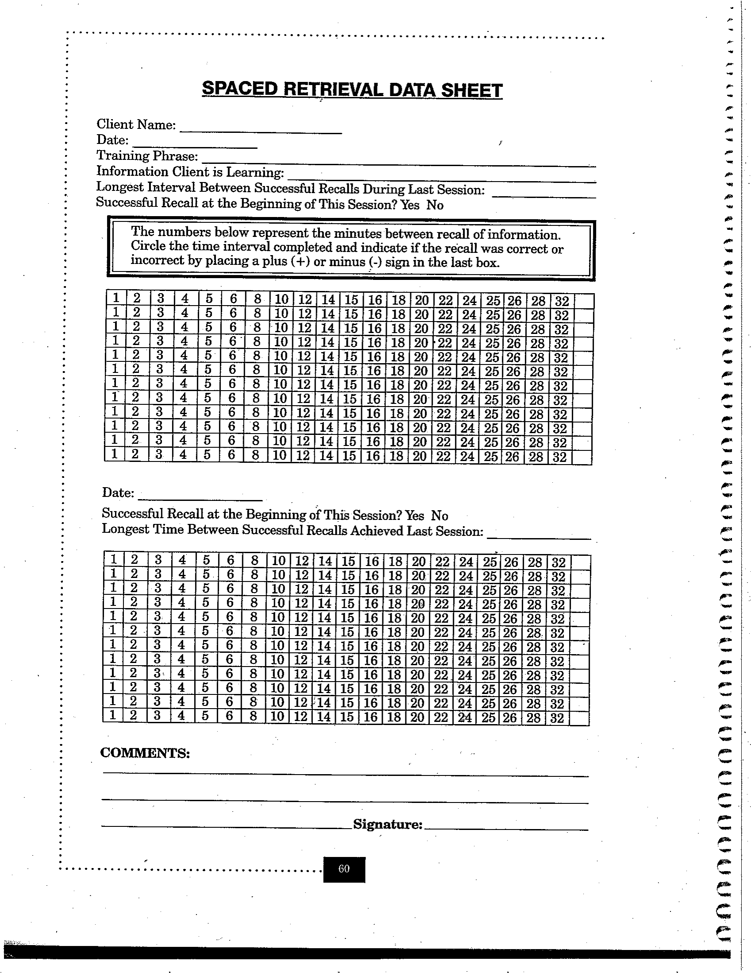
Clinician records
Longest interval between successful recalls achieved during last session
Successful recall at beginning of session
Charting recall intervals during session

Slide 36
SR Session Data
Used to record progress when teaching the use of a strategy
Data taken on the phone

Slide 37
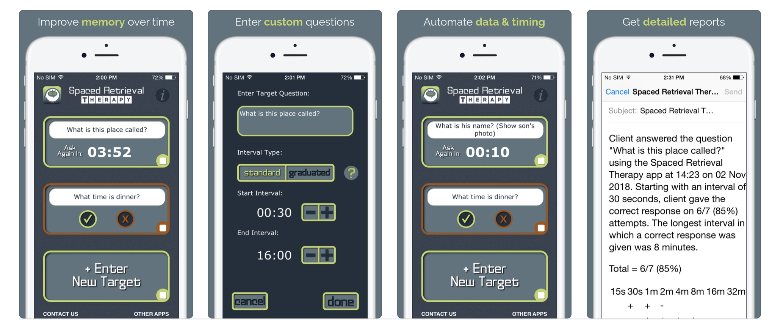
Spaced Retrieval App
Spaced Retrieval Therapy 4+ Memory Training for Dementia
Tactus Therapy Solutions Ltd.

Slide 38
Examples of SR Goals
Type of Goal Diagnosis Source
*Using a calendar to remember AD Camp et al., 1996
daily tasks
*Remembering to redeem a AD McKitrick, Camp, & Black, 1992
coupon
*Object naming AD (Vascular) Abrahams & Camp, 1993
*Remember to eat HAD Neundorfer et al., 2004
*Describe an item if you CVA Brush & Camp, 1998b
cannot name it
*Room number Dementia Brush & Camp, 1998b
*Speak into a voice CVA/Dysarthria Brush & Camp, 1998b
amplifier when talking
*Take a sip of liquid after Dementia Brush & Camp, 1998c
eating a bite of food
*Face-name association AD Clare et al., 2002;
Loewenstein et al., 2004
*Use a notebook to find AD (Vascular) Bird & Kinsella, 1996
answers to questions
*Address “paranoid AD Bird, 2001
delusions” & violence
*Obsessive toileting Hypoxia Bird, 2001
*Anger management TBI Melton & Bourgeois, 2005

Slide 39
Types of Instructional Targets
Metacognitive strategies
Task specific strategies
General strategies
External aids/Tools or Multistep Tasks
Smartphone apps
Facts/Information; Simple routines*
Names/addressess
Vocabulary
Dressing or swallowing routines
*BEST FOR SPACED RETRIEVAL

Slide 40
SR promotes rote learning
Does not encourage self monitoring, reflection, or other metacognitive skills
Relies on establishing automaticity so generalization is limited
MOST of our instruction will encourage both implicit and explicit memory
Metacognitive components that rely on declarative memory
Error reduction, chaining, repetition that promote automaticity and rely primarily on implicit memory

Slide 41
Sample Multiple Choice Question
Think about the tripartite (3 pronged) RTSS model classifying treatment. Which of the following would be true if you applied it to Direct Attention Training as described in class?
Active ingredients would include drills targeting specific attention impairments, strategies to increase or compensate for attention deficits, and client engagement components like self monitoring.
Active ingredients would only include attention drills
Targets might include improved sustained attention
Mechanism of action might refer to sustained attention
Mechanism of action might refer to improved cognitive processing
A, C, & E

Slide 42
What would be important considerations during the “E” phase of the PIE model if a clinician were planning on using assistive technology for cognition as an therapy approach:
Identify a standardized test that meets the SMARTED criteria in order to assess impact of ATC.
Use multidimensional measures that assess ability to use the device or tool AND impact of tool usage on the corresponding functional goal
Develop session measures for evaluating learning of tool that probe steps recalled for using the tool
None of the above
B & C

