Slide 1



Dementia: Approaches for SLPs
Heidi Iwashita, M.S., CCC-SLP Winter 2021

Slide 2

Dementia
Characterized by significant decline in cognitive function across one or more domains
Also impacting:
Thought
Behavior
Mood
Interferes with daily life activities
Not explained by delirium or other disorder
“Umbrella” term covers a wide range of conditions
1st most common:
Alzheimer’s Disease dementia
400+ types of dementia, some extremely rare
2nd most common:
vascular dementia
More than one type often co-occurs in same person

Slide 3

Causes
Irreversible
Reversible:
Alzheimer’s Disease
Huntington’s Disease
Parkinson’s Disease
Lewy-body dementia
Etc.
Bayles & Tomoeda (2007) overview primary causes of dementia as divided into irreversible or reversible causes
Certain infections
Medication side effects
Excess alcohol use
Thyroid disease
Vitamin deficiency
Correlates somewhat with distinction between “dementia” and “delirium”

Slide 4
Diagnostic criteria in DSM-V (2013) Major Neurocognitive Disorder
Significant decline from previous performance in one or more of these cognitive domains:
Complex attention (sustained attention, divided attention, selective attention)
Executive function
Learning and memory
Language (object naming, word finding, fluency, grammar and syntax, receptive language)
Perceptual-motor function
Social cognition
Sufficient to interfere with independence in ADLs
Not attributable to other mental disorder

Slide 5
Subclassification of Types of Dementia
1. Cortical Dementia: primarily affecting the cortex
Examples: Alzheimer’s disease, frontotemporal degeneration
Motor deficits later
Less awareness of cognitive deficits
2. Subcortical Dementia: primarily affecting the subcortical components of the brain.
Motor deficits earlier
More aware of deficits – may contribute to depression
Examples: Parkinson’s, Huntington’s Disease, vascular dementia
3. Mixed Dementia: affecting both cortical and subcortical regions of the brain.
Examples: dementia with Lewy bodies, Creutzfeldt-Jakob disease

Slide 6
Mild cognitive impairment (MCI) Minor Neurocognitive Disorder
Subtle cognitive changes
Up to 9 years prior to dementia diagnosis
Intermediate stage of cognitive impairment
Does not always progress to dementia
Early identification of MCI might allow cognitive interventions that slow the progression of decline
Does not interfere with independence in everyday activities
https://www.asha.org/Practice-Portal/Clinical-Topics/Dementia/#Mild_Cognitive_Impairment

Slide 7
Diagnosis
“The diagnosis of dementia is made by a medical team. The role of the SLP is to assess cognitive-communication deficits related to dementia (e.g., memory problems; disorientation to time, place, and person; difficulty with language comprehension and expression) and to identify cultural, linguistic, and environmental influences that have an impact on functioning.”
Source: ASHA.org
https://www.asha.org/PRPSpecificTopic.aspx?folderid=8589935289&section=Assessment

Slide 8
Alzheimer’s Disease
A type of cortical dementia
Memory difficulties are often the first sign
Most common form of dementia
About 50 to 70% of all progressive dementias
Approximately 4.5 million currently in the U.S.
Expected to almost quadruple by 2050

Slide 9
Risk factors for dementia
Nonmodifiable
Modifiable
Less than high school education
Hearing loss
Obesity
Hypertension
Smoking
Depression
Physical inactivity
Social isolation
Diabetes
Age
Every 5 years after age 65, the number of individuals with Alzheimer’s disease doubles (National Institute on Aging, 2017).
Heredity

Slide 10
Cognitive Reserve
Same amount of brain pathology does not always mean same degree of disruption in functioning
“Cognitive reserve” is a theory to account for this difference
More cognitive reserve – less functional impairment, even with same degree of structural brain damage
Factors thought to increase cognitive reserve:
Higher education
Bilingualism
Physical activity
Intellectual stimulation
Social involvement

Slide 11
Roles of the SLp
Assist in identification, screening
Assessment – cognition, communication, swallowing
Intervention – cognition, communication, dysphagia
Counseling
Collaboration
Education
Advocacy
Research

Slide 12
Interdisciplinary collaboration
SLPs frequently coordinate care with many other disciplines, including:
Nursing
Social worker
Neuropsychologist
OT
Home safety
Medication management
ADLs
Driving evaluation
PT
Fall prevention
Home safety
Activity director

Slide 13
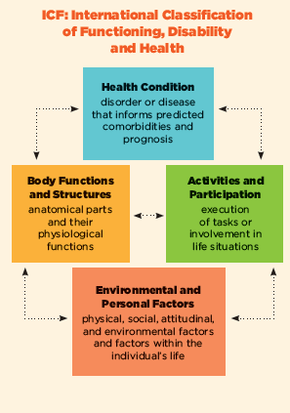
Icf Framework
Environment plays a crucial role in performance
Communication
Cognition
Set up supports in environment to ensure success
Activities and participation
Continuing valued roles
Continuing social involvement
Continuing preferred activities
Continuing sense of purpose –helping, contributing

Slide 14
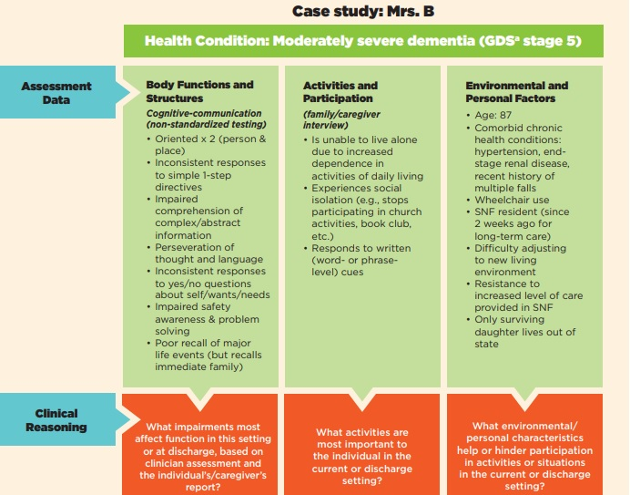

Slide 15
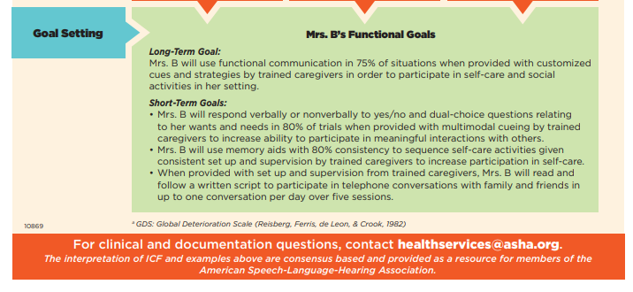

Slide 16
Clinical considerations mod to severe dementia
Clinical Presentation
Clinical Tips
Confusion, Agitation
Not knowing what to do
Not knowing where they are
Paranoia, delusions, hallucinations
Confabulation
Receptive language deficits
Impaired attention
Impacted learning and memory
Social withdrawal
Personality changes
Keep it simple
Create pleasant, calm, familiar environment
One activity at a time
Clear away clutter and distractors
Write down key words, directions
Tell, don’t quiz
Reduce opportunities for confabulation
Avoid asking fact-based questions
Set up environment to show expectations
Keep conversation about the present
Be in the moment with them

Slide 17
Dementia Assessment
What are your clinical questions? What are your hypotheses?
Current level of function
Family and caregiver support
Stage of dementia
Level of independence
Safety concerns

Slide 18

Interview and informal assessment
Consider
Client
Caregivers
Disorder
Environment
Collect Information
Medical history
Personal history
Education
Vocation
Hobbies
Daily activities

Slide 19
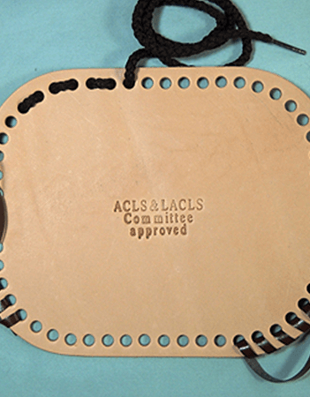
formal assessments
Screens: MMSE, SLUMS, MOCA
Allen Cognitive Levels
Arizona Battery Communication Disorder of Dementia (ABCD)
The Brief Cognitive Assessment Tool (BCAT)
Dementia Severity Rating Scale
Functional Linguistic Cognitive Inventory (FLCI)

Slide 20
Formal assessments, continued
Skills assessment inventory (Klein and Hahn, 2007)
Asks patients/caregivers to rate the patients’ ability to do various tasks of basic living skills and social, leisure, and work activities.
Assessment of Language-Related Functional Activities (ALFA)
Uses activities such as telling time and using the telephone to assess cognitive linguistic function (Baines, Martin, & McMartin-Heeringa, 1999).

Slide 21
Formal assessments, continued
Arizona Battery for Communication Disorders of Dementia (Bayles & Tomoeda, 1991).
14 subtests that assess communicative components of judgment, objection identification, and direction following.
Communicative Activities of Daily Living-Second Edition (CADL-2; Holland, Frattali, & Fromm, 1999).
Evaluates skills needed for everyday activities, e.g. reading menus, making phone calls, making plans
Evaluates verbal and nonverbal behaviors

Slide 22
Global Deterioration Scale (see handout)
Seven stages, with Level 1 representing “no cognitive impairment”
Individuals with progressive dementia will progress through all 7 stages
Average durations:
Stage 3: 7 years before onset of dementia
Stage 4: 2 years
Stage 5: 1.5 years
Stage 6: 2.5 years
Stage 7: 2.5 years

Slide 23
Non-pharmacological Treatment approaches for dementia

Slide 24
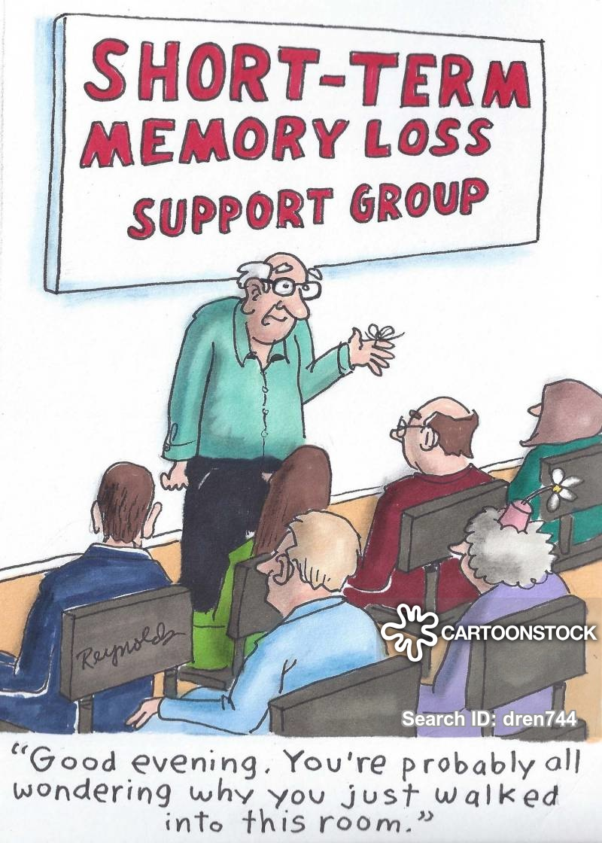
Why can’t we just train memory?

Slide 25
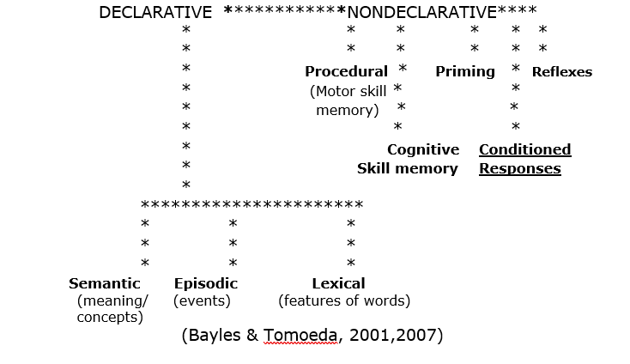
Declarative vs nondeclarative memory
Declarative memory: memory for facts, events
Nondeclarative memory: “non-fact” memories
Procedural: memory for motor skills/sequences
Cognitive Skill Memory: cognitive procedures that occur without conscious awareness, i.e. being able to read in reverse in a mirrored image
Priming: Prior experience improves performance; prior exposure makes a response more likely
Conditioned responses: associations & habits that are formed through classical and operant conditioning.
Reflexes

Slide 26
Internal memory strategies vs. External Memory aids
Internal
External
Appropriate for MILD memory difficulties
Or to enhance memory performance in people without memory deficits
Ex.: visualization, association, acronyms, mnemonics, chunking, elaborative encoding, memory palace
May be helpful for swallowing strategies, safety strategies
Need to be able to remember when to use it, how to use it
Appropriate for mod-severe memory decline, dementia
Relies on written/visual reminders
Signs and labels for home
Memory wallet/book
Procedural checklists
List of names, passwords, etc.
May require caregiver support

Slide 27
Consider Candidacy, Not Convenience
Approach | Candidacy Issues | Key References
Internal memory strategies | Not supported by evidence for dementia/degenerative diseases Requires awareness & remembering to use May be helpful for clients with ABI, MCI, or other stable condition | Piras et al., 2011
AAC (e.g. memory wallets and books, may be electronic) | Suitable for moderate and severe memory deficits May require caregiver support | May, Dada, & Murray, 2019
Environmental modification | Suitable for individuals with severe memory deficits May require caregiver support | Brush et al, 2011

Slide 28
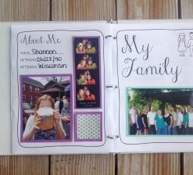
Assistive Technology (AAC) for Dementia
Memory wallets, memory books
No-tech, low-tech (talking picture album)
Requires caregiver training, caregiver support
Considerations:
Simple & easy to use
Photos, simple labels
Label photos with names
Important life events, facts
Image source: https://speechymusings.com/
2013/09/24/memory-and-orientation-books/

Slide 29
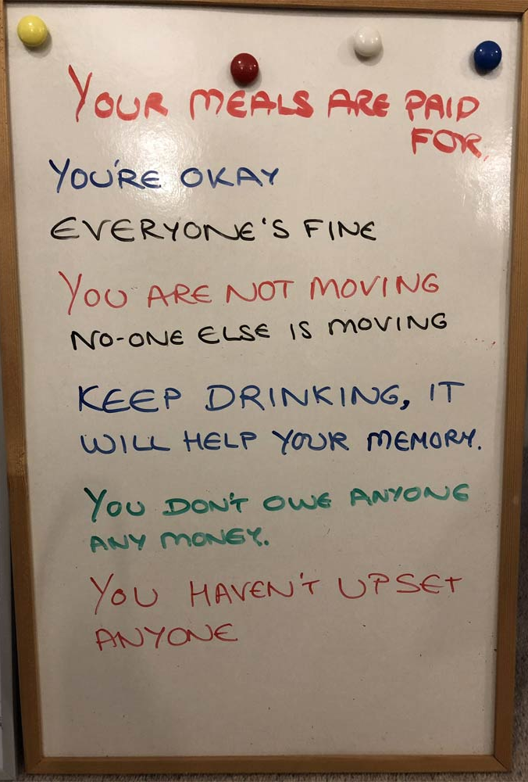
Environmental Modification
Aim to support safe, independent routines
Signs, whiteboards
Large print, high contrast
Reassuring worries, fears
Labels, arrows
Make landmarks more salient
Image source: https://www.dailymail.co.uk/femail/article-6640593/White-boards-used-help-dementia-sufferers.html

Slide 30
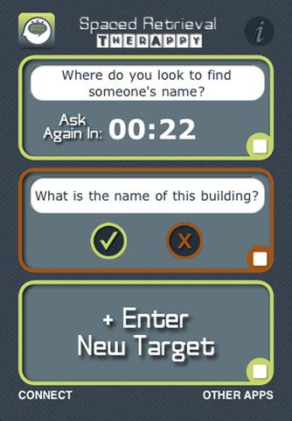
Spaced retrieval
When to use:
Need or desire to retain one concrete fact or strategy
Screen for candidacy first:
Can they execute the strategy?
Can they retain a fact for a short period (i.e. 30 sec?)
Purpose: to train one fact/strategy that will enhance the person’s safety, independence, or QOL

Slide 31
Spaced retrieval examplE
“If you want to know what activities we have planned today, you can come over here and read this schedule.”
Prompt: Where can you look to find out what is planned for the day?”
Response:“I can go here to read this schedule.”

Slide 32
Training procedure
Prompt:
What is your daughter’s name?
Correct response:
Her name is Mary.
= Immediate Repetition
Next prompt in 30 sec.
Interval doubles with each correct response.
Incorrect response: Immediate repetition of correct response then interval reduces by half.

Slide 33
SR promotes rote learning
Does not encourage self monitoring, reflection, or other metacognitive skills
Relies on establishing automaticity so generalization is limited
MOST of our instruction will encourage both implicit and explicit memory
Metacognitive components that rely on declarative memory
Error reduction, chaining, repetition that promotes automaticity and relies primarily on implicit memory

Slide 34
Sample SR Training Session (30 min)
Hello, are you ready to start?
Prompt: “where do you find today’s date?
Response: “the calendar on my desk”
That’s right. How have you been? Anything new happening in your life?
30 sec later: Now I need to ask you, “where do you find today’s date?
Response: “the calendar on my desk”
Good, you were telling me…..
1 min later: Again, I need to ask you, “where do you find today’s date?”
“the calendar on my desk”
Keeps repeating at 2 min, 4 min, 8 min, 16 min.

Slide 35
What to do or say during intervals?
General conversation: how have you been, what’s new with you?
Different activity: another therapy goal, reading, puzzles, games
Future goal discussion: identify other problems to address; plan external aids
DO NOT discuss current goal

Slide 36
More info on Spaced retrieval: Tutorials
https://www.youtube.com/watch?v=FiLzX1r8RVI
https://eatspeakthink.com/how-to-use-spaced-retrieval-with-errorless-learning-to-improve-memory/#question-response
https://tactustherapy.com/spaced-retrieval-training-memory/

Slide 37
Retained Abilities in Alzheimer’s Dementia (see handout)
Memory - strengths
Procedures, habits
Long-ago memories
Response to cues
Reading - strengths
Oral reading of short phrases, words
Can read aloud recipes, instructions, titles
Social language - strengths
grammar, syntax, greetings, automatic phrases

Slide 38

Reminiscence: ‘‘the process of remembering long-forgotten experiences and events that are worth remembering for the person”
Started in early 1960s –reevaluation of reminiscence as positive
Became widespread in 1980s
Research continues to show benefits
Can be group or individual
Most common in SNF setting

Slide 39
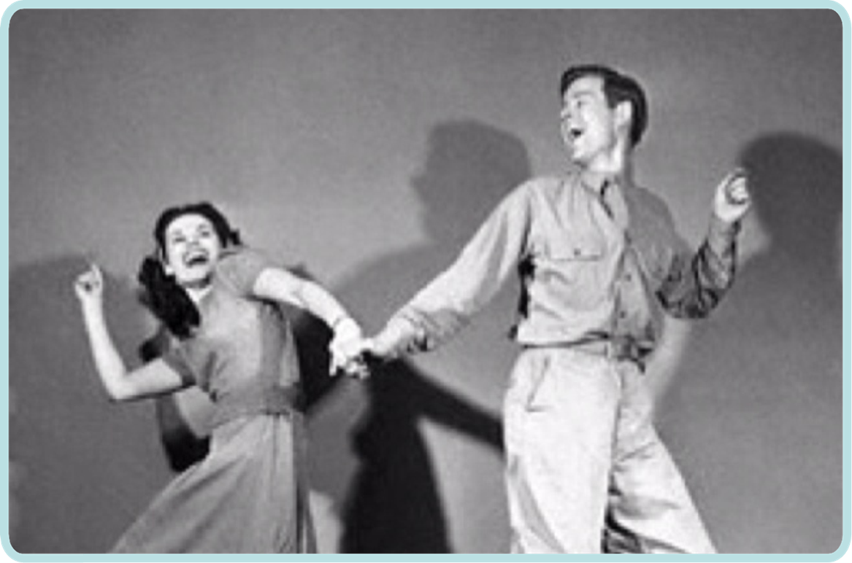
Benefits of Reminiscing
Self-expression
Social interaction and connection
Promotes self-esteem, self-worth
Alleviates depression, boredom, isolation
Sense of belonging
Connect with the past, explore memories
Finding meaning, purpose
Pass along stories and memories

Slide 40
Theory
Strengths-based approach
“Reminiscence bump” for the period of early adulthood
Fosters social interaction and connection
Reduces isolation, loneliness
Age-appropriate: elders want to tell their stories
Reflecting back on one’s life, making it meaningful
Erikson’s Stage 8: Looking back on life with satisfaction (Integrity vs. Despair)

Slide 41
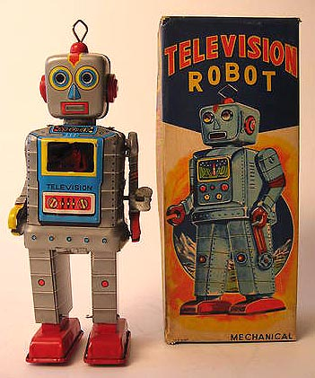
Reminiscence outcomes
Cognitive benefits
Improvement on global cognitive measures
MMSE scores
Increased # of utterances, decreased problem behavior
Mental health benefits
Reduction in depression
Increase in Quality of Life measures
Asiret, G.D. & Kapucu, S. (2016).
Swan et al., (2018)

Slide 42
Reminiscence Video Examples
The Think Life Organization
https://www.youtube.com/watch?v=DAlrkb2XIe4
The Cardinals Reminiscence League
https://www.youtube.com/watch?v=GrnQHpzLtz0

Slide 43
Guidelines for Planning a Reminiscence Group Session
Group together members with similar cognitive/communicative ability if possible
No more than 5 individuals with dementia per staff person
Groups of 6-10 members total are ideal
Group facilitators should be familiar with dementia and have group leadership skills
Focus each session around a theme, and use relevant multisensory props/stimuli
Use personally relevant props if possible (e.g. members’ own photos, keepsakes, etc.)
Frequency: at least weekly
(Kim et al., 2006; Asirit & Kapucu, 2016)

Slide 44
Suggested reminiscence topics
Use multisensory materials that evoke positive memories
Each session should have a specific theme/topic
Examples:
Cooking -Gardening
Travel -Dancing
Sewing -Sports
Music -Toys, dolls
Fashion -Games
TV, film -Cars
Weddings -Hobbies, collecting

Slide 45
Tips for Leading Reminiscence Groups
Pass around
objects and photos, let members handle them
Large
and clear font for printed materials e.g. recipes, song lyrics
Speak
slowly and clearly; use simple sentences
Validate
all opinions (“I think your right Tom (restate his point)… and Linda, I think you also have a good point about…”)
Share
your own memories when relevant
Give
all members a chance to speak
Keep
sessions low pressure, relaxing and fun
Focus on
positive memories (avoid topics that could trigger bad memories for some people like wartime, babies, marriage, hospitals…)
Don’t correct
facts; instead, affirm the feeling behind the statement.

Slide 46
Montessori Method
Developed for educating children
Adapted for people with dementia
For dementia, has been successful in improving social interactions (Camp & Mattern, 1999) and engagement (Judge, Camp, & Orsulic-Jeras, 2000).
Characterized by:
Use of real materials
Breaking down activity into simple steps
Increasing complexity
Create functional activities
Promote independence
Provide a scaffolding
Provide a safe, stimulating environment

Slide 47

Montessori Method
Activities
Person’s interests
Previous life roles
Engage the senses
Safe environment
Independent
With scaffolding
Example:
Person who likes to bake
Materials:
cupcakes
icing
Plates
Task: finish icing the cupcakes

Slide 48
Alzheimers and dementia resources for families
Local caregiver support groups and early-stage Alzheimer’s support groups
https://www.alz.org/media/oregon/documents/support%20group%20listings/190212_SGs_Cascade-Coast-listing-flyer.pdf
https://www.sheltercare.org/what-we-do/uhlhorn-day-services/
Podcasts (https://player.fm/podcasts/Dementia)
Websites (e.g. alz.org)
Books for caregivers (helpful content may include communication strategies, learning to be at peace with diagnosis, preventing caregiving burnout through self-compassion, etc.)

Slide 49
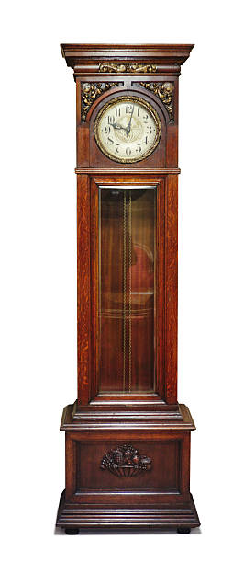
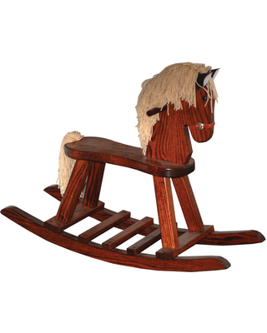
Summary
Assessment
Informal assessments: interview, questionnaire
Client, caregiver, disorder, environment
Standardized assessments,
e.g. ABCD
Collaborative goalsetting
Safety
Quality of life
Treatment
Reminiscence therapy
Caregiver training
Memory aids/books
Errorless learning
Spaced retrieval
Montessori method
Contact: heidii@uoregon.edu

Slide 50
references
American Speech-Language Hearing Association. Person Centered Focus: Dementia. Retrieved from: https://www.asha.org/uploadedFiles/ICF-Dementia.pdf
Asiret, G.D. & Kapucu, S. (2016). The effect of reminiscence therapy on cognition, depression, and activities of daily living for patience with Alzheimer disease. Journal of Geriatric Psychiatry and Neurology, 29(1), 31-37.
Bayles, K. & Tomoeda, C. (2007). Cognitive-Communication Disorders of Dementia. San Diego, CA: Plural Publishing.
Brush, J., Sanford, J., Fleder, H., Bruce, C., & Calkins, M. (2011). Evaluating and Modifying the Communication Environment for People with Dementia. Perspectives on Gernontology, 16(2) 32-40
Folkerts, A., Roheger, M., Franklin, J., Middelstadt, J., & Kabe, E. (2017). Cognitive interventions in patients with dementia living in long-term care facilities: Systematic review and meta-analysis. Archives of Gerontology and Geriatrics, 73, 204-221
Kim, E. S., Cleary, S. J., et al. (2006). Evidence-based practice recommendations for working with individuals with dementia: group reminiscence therapy. Journal of Medical Speech-Language Pathology, 14(3), xxiii-xxxiv.
Korytkowska, M., & Obler, L., K. (2016). Speech-language pathologists (SLP) treatment approaches for Alzheimer’s dementia. Perspectives of the ASHA Special Interest Groups, Sig 2, Vol 1(3).

Slide 51
references
May, A. A., Dada, S., & Murray, J. (2019). Review of AAC interventions in persons with dementia. International Journal of Communication Disorders, 54 (6)857-874.
Piras, F., Inoccia, C., Borella, E., & Carlesimo, G. A. (2011). Evidence-based practice recommendations for memory rehabilitation. European Journal of Physical and Rehabilitation Medicine, 47: 149-75.
Swan, K., Hopper, M., Wenke, R., Jackson, C., Till, T., & Conway, E. (2018). Speech-language pathologist interventions for communication in moderate-severe dementia: A systematic review. American Journal of Speech-Language Pathology, 27, 836-852
Knopman, D.S., Boeve, B.F., & Petersen, R.C. (2003). Essentials of the proper diagnoses of mild cognitive impairment, dementia, and major subtypes of dementia. Mayo Clinic Proceedings, 78(10),1290-308.
Stern, Y. (2012). Cognitive reserve in ageing and Alzheimer’s disease. Lancet Neurology, 11(11), 1006-1012

