Slide 1
Systematic Instruction Applied to Selecting (Today) and Training the Use of ATC (Thursday)

Slide 2
Why Emphasize Instruction?
After all, I’m a therapist not an educator
Instruction encompasses the processes involved in teaching facts, procedures, skills, or strategies to another person
Cognitive impairments hamper learning and require instruction to be exemplary if the client is really going to learn, retain and utilize the targets that are taught
Is our instruction exemplary?

Slide 3
Consider the Range of Instructional Targets…
Motor sequence…safe swallowing techniques
Facts and concepts…orientation
Procedures to use assistive technology for cognition…smart phone app to help with memory and scheduling
Steps to use a cognitive or social communication strategy…problem solving strategy to increase vocational performance

Slide 4
A Further Case For SLPS Becoming Master Instructors
SLPs receive very little training in the design and delivery of instruction
Research suggests we are not very good instructors
But…we have the tools, experience, drive and talent to become instructors par excellence

Slide 5
The Good News
There’s a whole science of instruction upon which we can draw:
Systematic Instruction is an instructional theory and package of training techniques that are backed by much evidence across different populations

Slide 6
What is Systematic Instruction?
Basic Theory:
Learners benefit from explicit models of discrete skills, minimization of errors during initial acquisition and guided practice to enhance mastery, maintenance, and generalization across contexts
Techniques have been applied to training individuals with acquired cognitive impairments

Slide 7
Compare and Contrast:
What is Systematic Instruction?
Systematic Instruction | Conventional Instruction
Limited range of instructional targets (e.g., only calendar app at first) | Broad range of instructional targets (train multiple apps)
Multiple training examples | Few training examples
Mastery emphasized | Mastery not emphasized
Exploration discouraged/error minimization | Exploration encouraged
Step-by-step models, carefully faded support | Whole-task models
High rates of correct, distributed practice and review per target | Few practice opportunities per target
Immediate corrective feedback | Feedback after task completion
Training in different environments | Training primarily in clinic setting

Slide 8
A Familiar Context:
Consider Your Own Learning to Drive Experience
Systematic Instruction | Conventional Instruction
Programmed, hierarchy of driving skills introduced as mastery achieved on previous skill | Get behind the wheel and start driving as anxious parent gives you constant corrective feedback until eventually you sort it out
Example: Step-by-step models, carefully faded support —learning breaking only without gas pedal | Whole task: Just drive in parking lot, then on quiet road and then on freeway
Example: Exploration discouraged No driving on the road till prerequisite “ready set”, smooth breaking, gas, and signaling have been mastered | Exploration encouraged: See where the problems are then frantically tell them what they are doing wrong
Example: Error minimization Pre-correct lane change tendency to veer when looking over shoulder | Corrective feedback given as mistakes made usually with loud, tense voice

Slide 9
Multiple Fields have Supported SI for Compromised Learners
Cognitive psychology
Special Education
Neuropsychology

Slide 10
Efficacy Study
METHODS
FINDINGS
Compared systematic instruction with conventional instruction (trial & error) for teaching use of PDA
RCT; double blind; pre- post-test
N=29; ABI
Moderate-severe cognitive impairments
No significant difference in post testing on measures of accuracy & fluency
Systematic instruction resulted in generalization
Systematic instruction more powerful at 30 day follow up
Powell et al., (2012) Systematic instruction for individuals with ABI: A randomized controlled clinical trial. Neuropsych Rehab, 22(1)

Slide 11
3 Reasons for Failed Adoption of Rehabilitation Targets
Lack of instruction
Lack of effective instruction
Lack of instruction targeting generalization and/or maintenance
(Powell et al., 2012)

Slide 12
The Larger Instructional Framework PIE Process
PLANNING (Who, What, Where, When, Why?)
Conduct individualized needs assessment (learner characteristics, select device, identify outcome, develop training plan
IMPLEMENTATION
Train use of device (acquisition, mastery/generalization & maintenance)
EVALUATION

Slide 13
PERSON
PROGRAM
PLAN
EVALUATE
IMPLEMENT
ENVIRONMENT

Slide 14
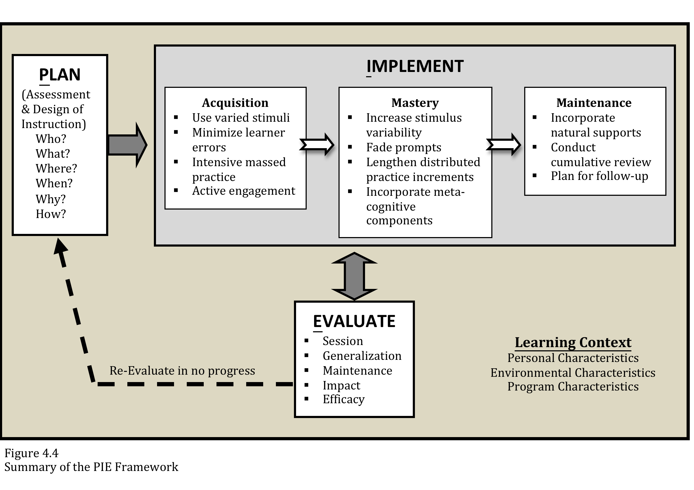

Slide 15
Let’s Talk About Planning
If you do some thinking and planning before entering the therapy room, your chances for lasting impact are greatly enhanced.
Effective planning requires knowing range of tools, strategies or therapy options to assist the client with primary areas of concern

Slide 16
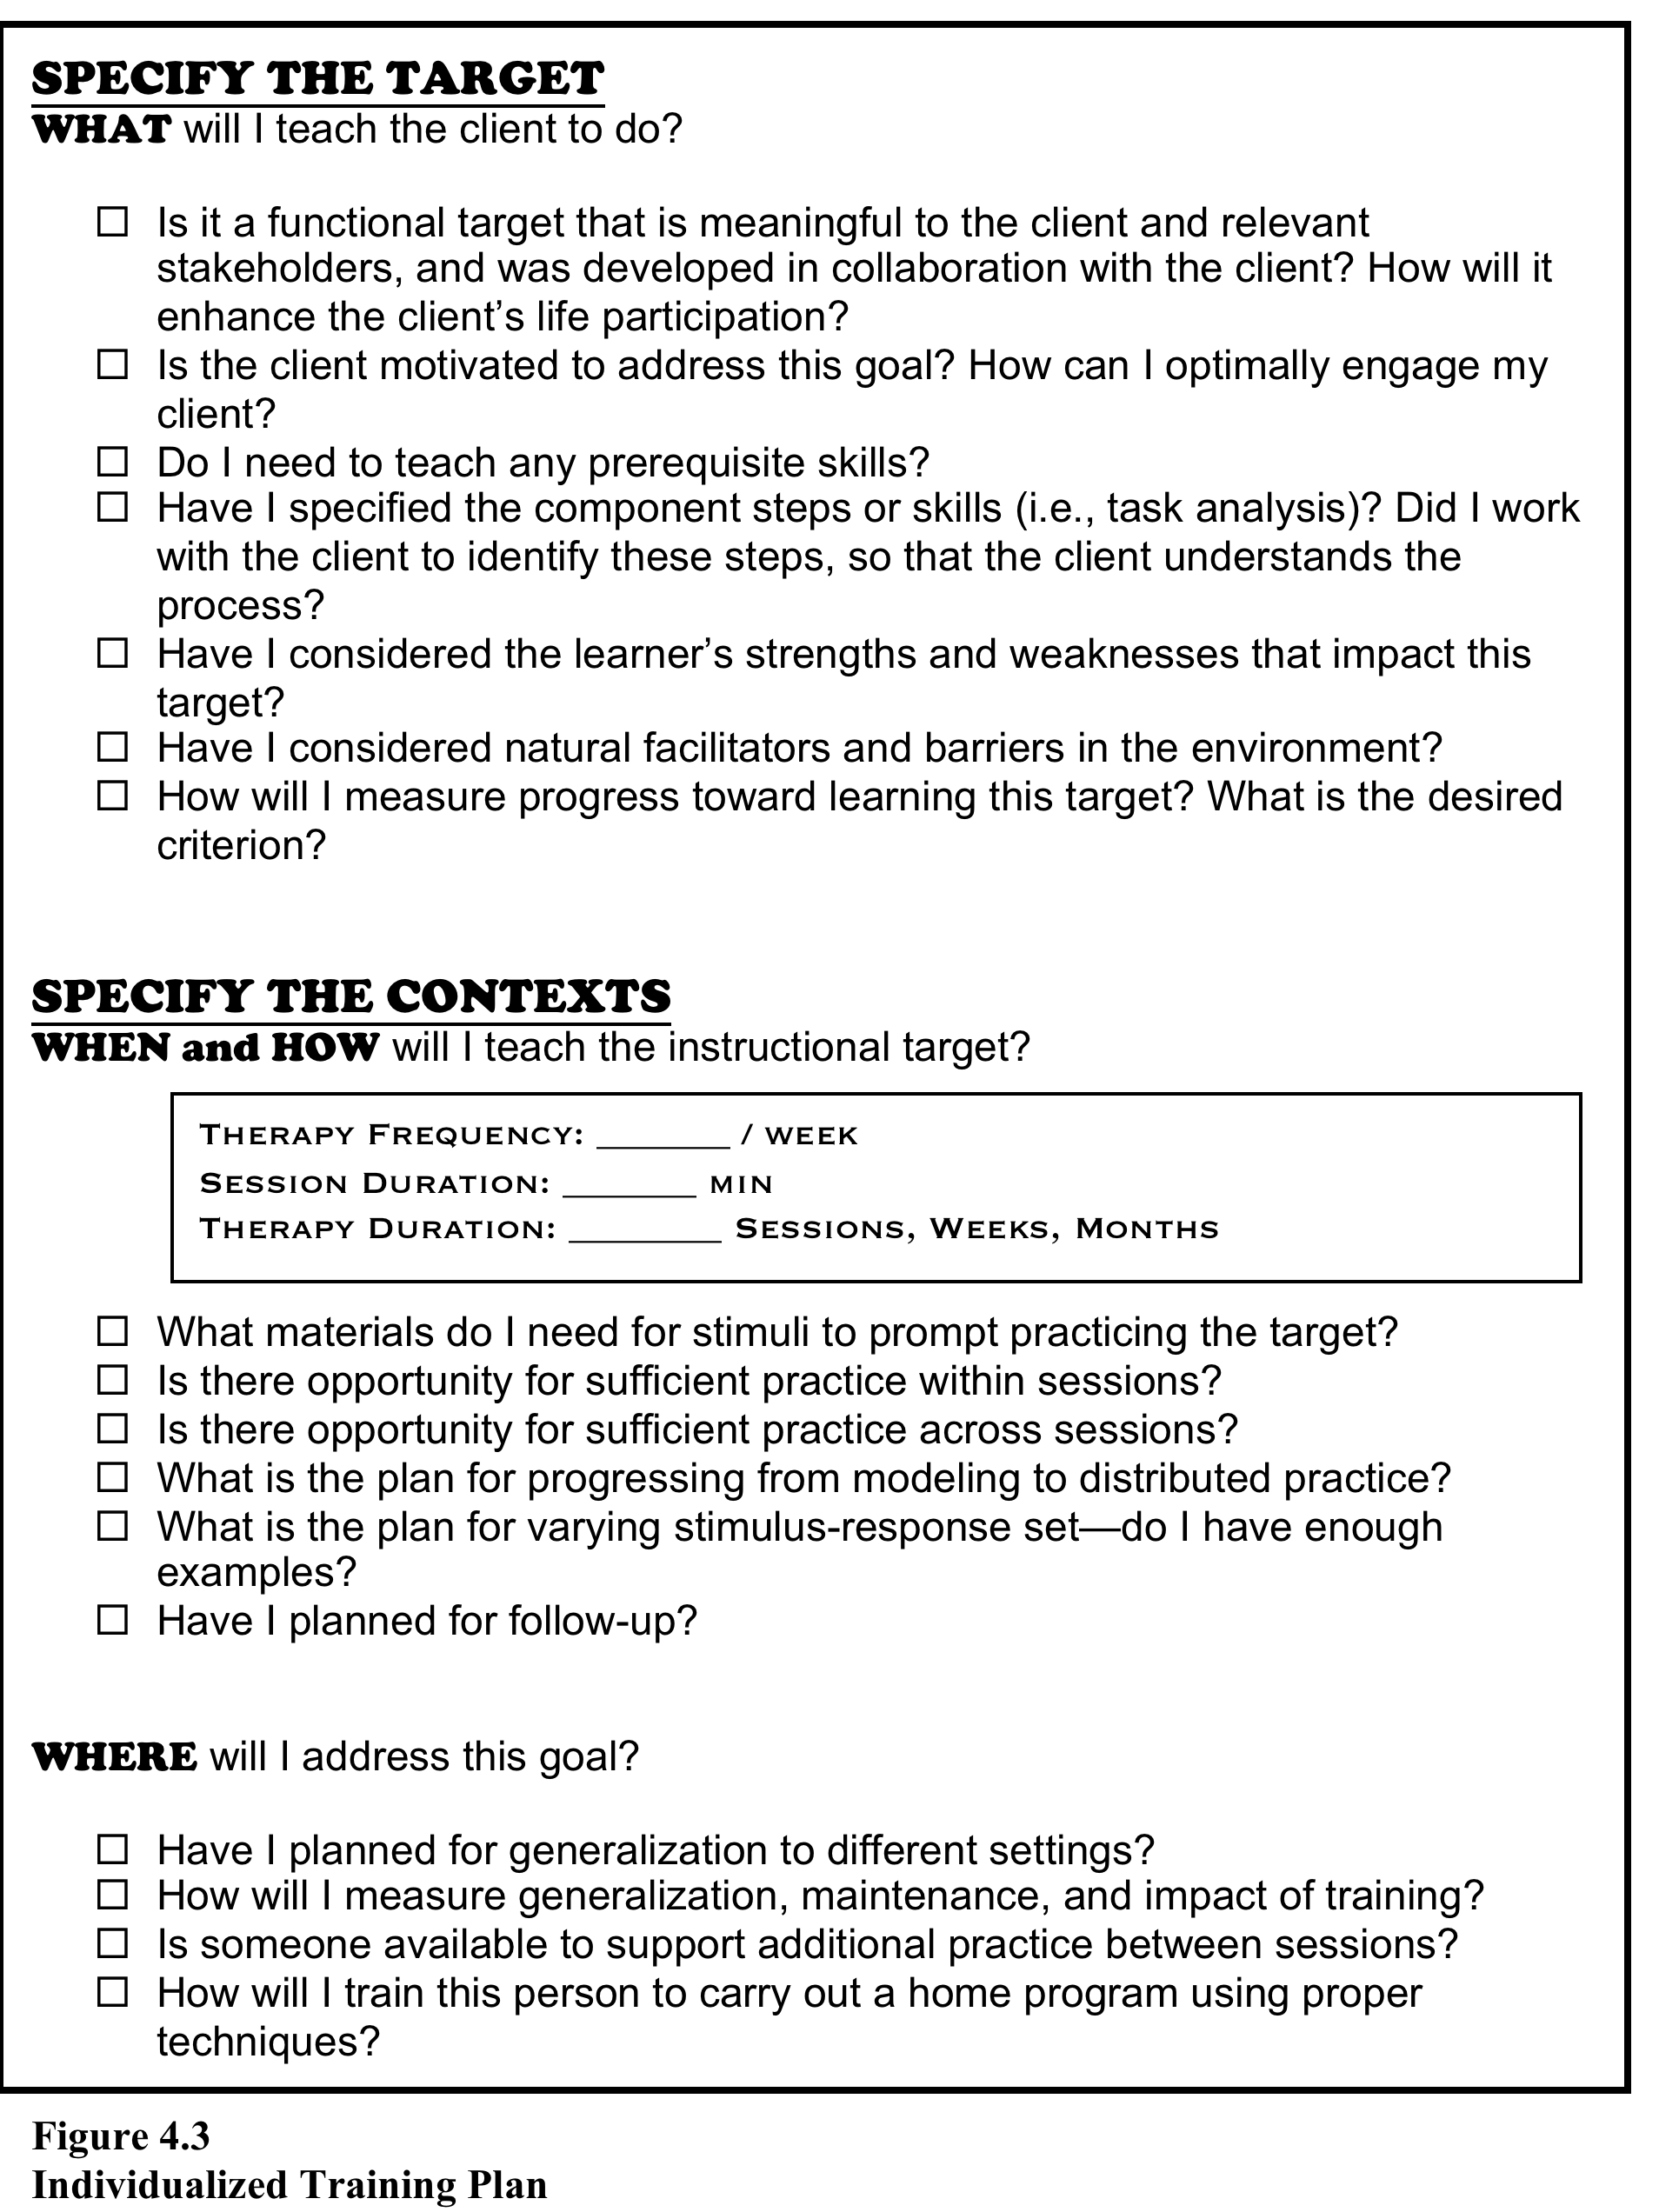

Slide 17
Selecting the Target Collaborative Interview
Always embed selection in collaborative interview process
Principles of Motivational Interviewing are very helpful
Open ended questions
Affirmations
Reflections
Summaries
Helps identify issues, strengths, and treatment approaches that match client profile

Slide 19
Thursday’s Session: Needs Assessment for Assistive Technology

Slide 20
Summary of Planning Phase
Conduct a Needs Assessment to Determine:
Training target meaningful to client
Contextual Variables
Learning Needs to inform instructional design
Requires Clinician to
Know options for strategies, tools, procedures
Be skilled in collaborative interview

Slide 21
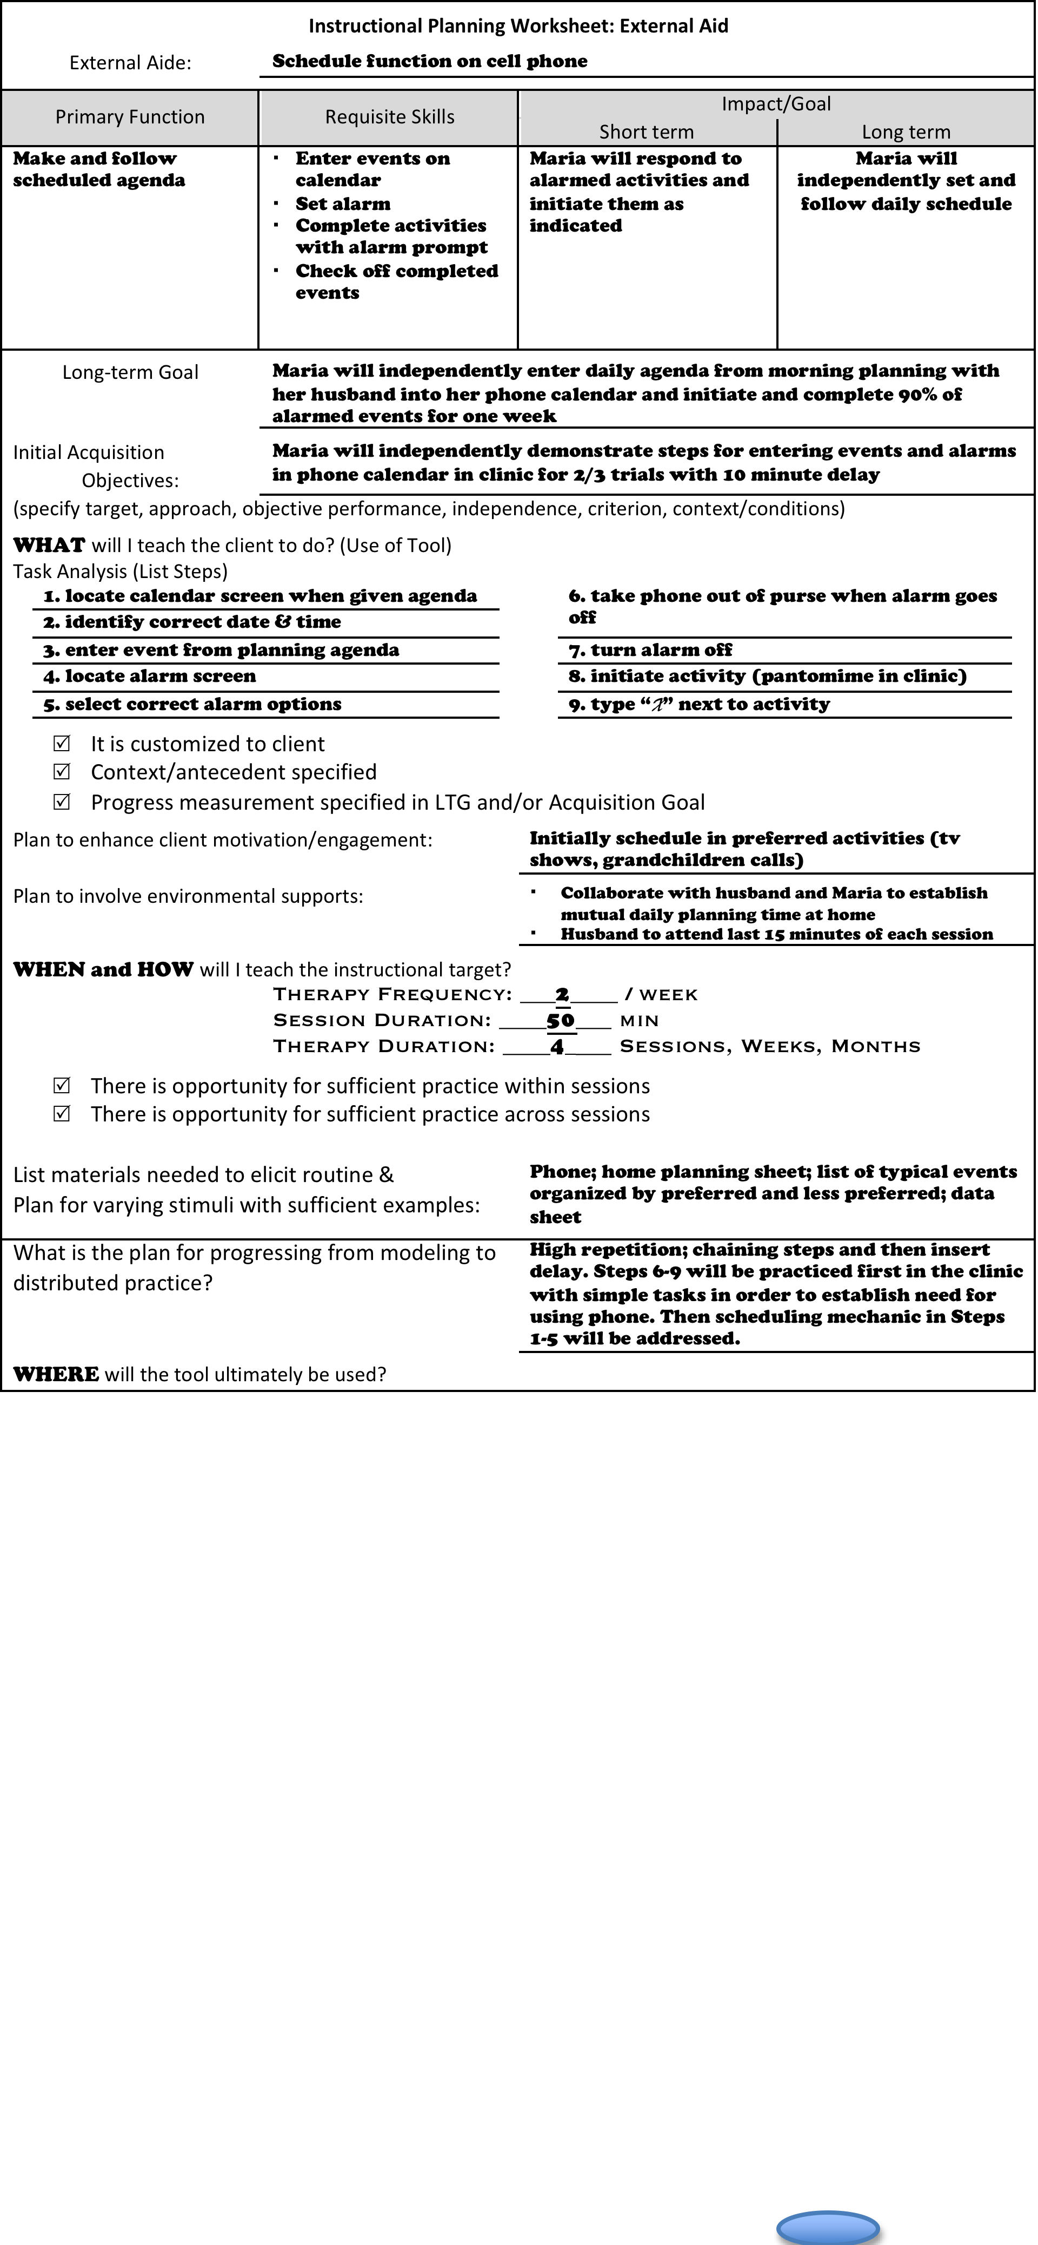

Slide 23
Principles of Acquisition Training
Task analysis
Minimize learner’s errors
Modeling
Graduated cueing
Isolating errors and providing massed practice on that error
Move from massed to a distributed practice schedule
Provide sufficient practice
Chain steps together

Slide 24
Begin with ACQUISITION
Initial Instructional Objectives
(Acquisition Training)
Systematically teach and chain steps of the task analysis with the procedures for using the tool
∗Isolate steps that are difficult and provide mass practice
∗Use distributed practice to solidify procedures
Client with cognitive to learn Client using tool
Client needs to learn procedures
Begin with MASTERY &
GENERALIZATION
Initial Instructional Objectives
(Mastery/Generalization Training)
of supplemental steps that may facilitate use of the tool (e.g., setting alarm)
Client familiar with tool; learns the procedures quickly; or tool very simple/intuitive
Client familiar with
Tool or strategy

Slide 26
Initial Session
Using Task Analysis and Error Minimization:
Provide Model
Facilitate Mass Practice
Distribute Practice over time
Sample script:
“When your husband gives you the day’s agenda, you will touch calendar icon, like this…Agenda…touch calendar. Now you try it. Agenda..touch calendar…”
“You’ve got it. I’m going to distract you and then give you the agenda cue and you remember to touch calendar icon”

Slide 27
Initial Session
Chain Steps by having learner execute last step that has been learned and follow it with new step:
“I see you have steps 1-3 firm; now let’s add the alarm. You put in “take dinner out of fridge”, now you touch alarm icon” Watch me again. I put in “call sister” and touch the alarm icon” You try—enter agenda item, then touch alarm icon”

Slide 28
Progress Monitoring
Conduct Session Probe at the beginning of each session
This determines retention and tells you what step to begin training in that session

Slide 31
Session Data
Probe determines where to start. What did participant retain?
Session data documents learning within the session
Clinician uses that data to know when to move forward and chain the next step; back up and provide mass practice and/or distribute practice

Slide 33
Review of Instructional Sequence
Initial Probe at beginning of session using the task analysis to see what step to begin on.
Training (session data)
o Minimizing learner errors during practice (clinician demonstration; fading of prompts)
o High repetition with intensive massed practice to establish the skill
o Chaining newly learned steps with previously learned steps
o Distributing or spacing practice as the steps are learned

Slide 34
Let’s Look at an Example
Instructional Target: Independently entering activities on Google Calendar
Session Format: Begin with Probe to see where to start training
Task Analysis: (1) get activity sheet; (2) phone on; (3) swipe to unlock; (4) tap calendar; (5) select desired hour
SI Techniques: Isolate error—model and practice that step; chain it back to previous step
https://www.youtube.com/watch?v=_xxNDcVdAL0&feature=youtu.be

Slide 35
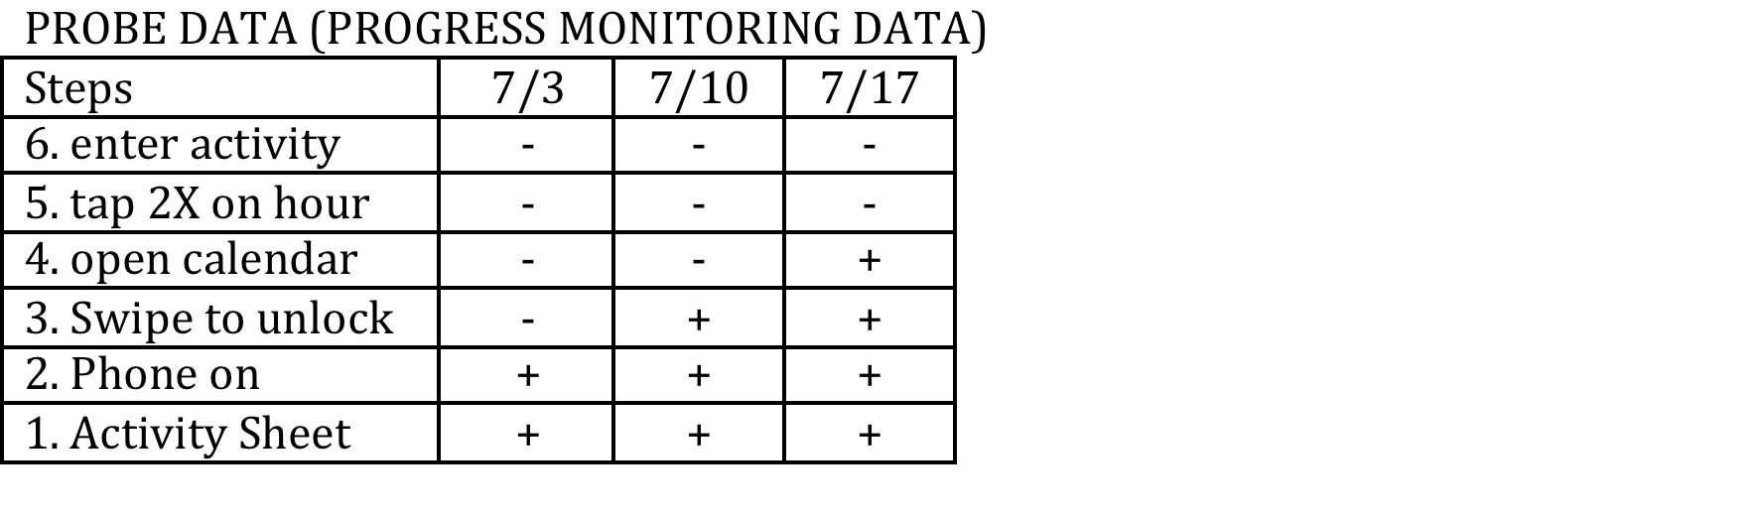
Progress Monitoring Form

Slide 36
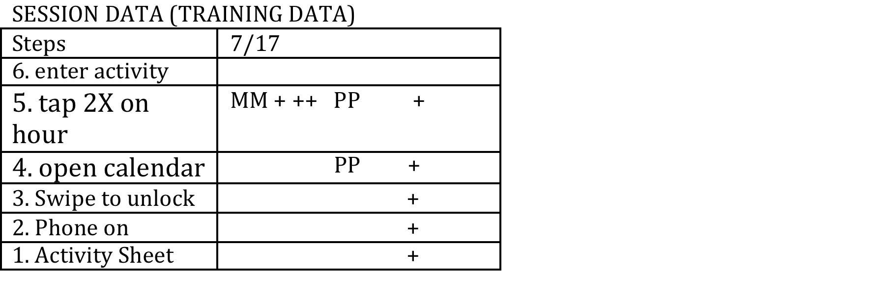
Training Trials

Slide 37
Sample Data
Steps | Session Data Ex 1 (2min) | Questions:
1 | + + | What happened when there was an error?
2 | + + | Where is the massed vs. distributed practice
3 | + + | How many steps were added so far in this session?
4 | M + + + + + + | What would you do next?
5 | M - MMM + + + + + M + ++ +++
6 | M + +

Slide 38
Negative Examples (not systematic instruction)
Steps | Session Data Example 1 | Session Data Example 2
1 | + + + | + +
2 | + + + | + +
3 | + + + | + +
4 | M + + | M -
5 | M - M | M M + + - M M
6 | M - - | M M + + + M M

Slide 39
Learner Engagement is Critical
Sample strategies to promote Engagement
Investing in progress—Setting personal goal; comparing performance; taking data
Predicting and summarizing
Lots of doing and not much listening
Promoting self evaluation and reinforcement

Slide 40
Mastery/Generalization Key Principles
Lengthen the distributed practice
Continue to quickly correct errors & provide additional repeated practice on target step
Introduce natural supports into the training
Vary alerting prompts
involving the support people
Train in natural environment
Facilitate opportunity & reinforcement

Slide 41
Maintenance: Best Insurance
Select a target that is meaningful to client
Train systematically and carefully
Set up ongoing reinforcement and support in real world contexts
Plan for ongoing support
(spread out therapy sessions? schedule follow up visit to promote generalization and make any needed adjustments to the usage plan? Write a review handout? Train a spouse? )

Slide 42
Evaluation
Session data
Probe
Session data
Generalization
Use of tool or information
Perceptions around feasibility and usefulness
Outcome data
Disability rating scales; Functional scales
Goal Attainment Scaling: Identify levels of progress in real world context that would be expected to change if client learned target

Slide 43
SI Assignment Review Due 2/18/21

Slide 44
Overview
PIE Process: Planning, Implementation, Evaluation
Planning: Needs Assessment embedded in collaborative Interview
Implementation: Acquisition vs. Mastery; Instructional principles
Evaluation: Multilevel evaluation to assess understanding, use, and impact

Slide 45
An Example of Needs Assessment from Assistive Technology
Assistive Technology Outcomes Measure (ATOM)
Matching Person to Technology - consider:
Person
Environment
Technology
Outcomes - measure:
Clinical use, comfort, & satisfaction
Functional impact / QOL
Cost & time
(Scherer, 2002, 2004)

Slide 46
Needs Assessment: Person
Team-driven assessment of personal factors:
Physical needs (gross + fine motor, speech)
Sensory needs (vision, hearing)
Cognitive needs (insight, attention, memory, executive)
Cultural values & expectations
Perceptions of tool or strategy
Pre-injury familiarity with technology or other approach
Motivation to…
Improve in daily tasks
Use assistive devices

Slide 47
Needs Assessment: Environment
Type of Supports
What is already in place?
Are natural supports in place?
Who is available for technical support?
What is the need?
Frequency
How often is support needed?
How often do opportunities to use device occur?
Physical Environment
Distractions
Lighting
Cueing

Slide 48
Needs Assessment: Characteristics of Strategy or Device
Cognitive Demands:
Memory load
Number of steps
Complexity of decision trees
Physical Demands:
Access (button, stylus, touch screen)
Size, complexity, sensitivity
Prompting
Sensory/Language Demands:
Symbols (text, pictures, both)
Size & layout

Slide 49
Week Calendar vs. Calendar
http://id4theweb.com/appreviews/
Demo

Slide 50
Barriers to App Selection: App Overload
Can’t know ALL of the apps
Over 1,000,000 apps in the
App Store

Slide 51
No Need for Specialized Apps
In our experience, people with TBI benefit from the same
kinds of apps that we use ourselves – Priority Matrix for
organizing tasks, Pomodoro for sustained attention,
Fantastical Calendar and MinimaList to integrate
calendar and tasks to my Apple watch

Slide 52
ATC App Categories
Remember things people tell you
Journals
Track phone numbers/addresses
Contacts
Keep track of appointments
Calendars
Track birthdays / anniversaries
Calendars
Remembering shopping items
Groceries
Learn new things like procedures at work
Learning
Keep track of things you need to do
Tasks
Keep track of where my money goes
Money
Follow a daily schedule
Calendars
Take medications
Medications

Slide 53
Executive Functions
Self Monitoring / Self-Evaluation
Initiating
Planning / Prioritizing
Goal Setting
(features)
(features)
Habits Pro
Outliner
Attention
Working Memory
Retrospective Memory
Break Time
Prospective Memory
Pomodoro
Events
Daily Notes
Events
Alarmed
Learning
Minimalist
Priority Matrix (archive)
Tasks
Information
Cheatsheet
Tasks
Minimalist
Priority Matrix
Conversations
Daily Notes

Slide 54
Features to Support Specific Cognitive Challenges
Attention
Learning
Alarms
Recurring alarms to maintain focus
Rehearsal
Periodic alarms to take breaks
Distributed practice
Checklists / Tasklists to stay on task
Executive Functions
Categorize tasks, events
Prospective Memory
pre-alarms for time management
Prioritize tasks, events
Subtasks, checklists, notes
Snooze, nag alarms for people who lose
intention quickly
Set goals, monitor progress
Repeating events, tasks – for people who
need cues for routine
Fluidity of Strategy
Siri compatible
Retrospective Memory
Speech-to-text
Content
Look up
Supports natural language
Notes
Key word
Syncs to other apps or devices or functions – e.g. Facebook
Pictures
Calendar date
Voice recording
Quick fire entries
Geotracking

Slide 55
Calendar App Features
Events
Adjunct capability for tasks, notes
Reminders, notifications, badge alerts
Rolling to do / to do carryover
Input: speech-to text
Supports natural language
Universal application: iPhone, iPad, Apple Watch
Recurring events
Multiple views: Day, Week Month, 3-month, Year, Agenda
Multiple Calendars: Family, Work etc
File Sharing: Family, Work
Share events via email
Passcode protection
Wallpaper image
Customize events: holidays, birthdays, sick days
Synch: native calendar, Google calendar
Full text search

Slide 56
Task App Features – organized by category
Alarms
Sharing support
Variable loudness, duration
mail
Snooze, nag alarms
Air drop
pre-alarms
File sharing with family, work
Pop-up notifications, badges
Sync
Custom reminders with repeat feature
Native reminder app
Location reminders
Universal application: iPhone,
iPad, Apple Watch
Input
Speech-to-text
Synch to calendar
Siri compatible
Facebook
Supports natural language
Organization
Information Access
Quick fire scheduling
Categorize tasks
Prioritize tasks
Repeat
Subtasks, checklists, notes
Customizable, multi-day, month by day/date, yearly

Slide 57
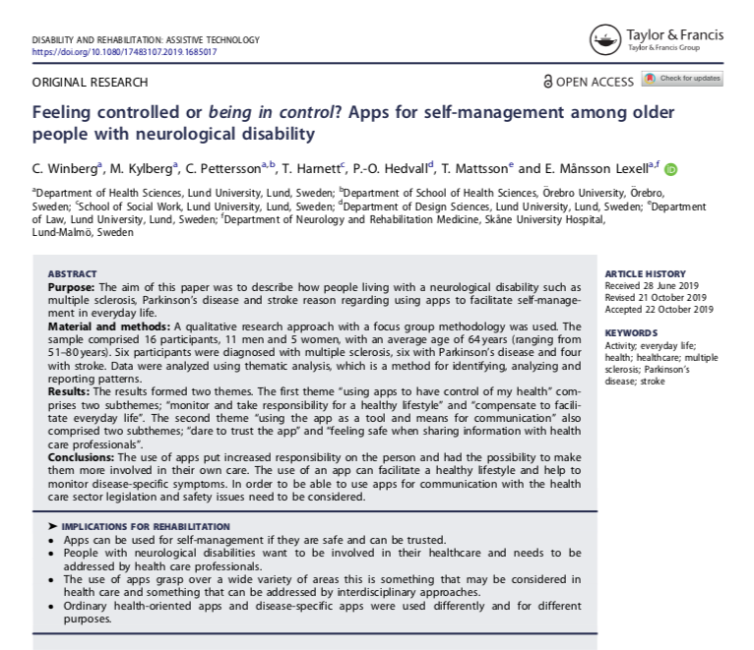

Slide 58
Overview
PIE Process: Planning, Implementation, Evaluation
Planning: Needs Assessment embedded in collaborative Interview
Implementation: Acquisition vs. Mastery; Instructional principles
Evaluation: Multilevel evaluation to assess understanding, use, and impact

Slide 59
Summary of Planning Phase
Conduct a Needs Assessment to Determine:
Training target meaningful to client
Contextual Variables
Learning Needs to inform instructional design
Requires Clinician to
Know options for strategies, tools, procedures
Be skilled in collaborative interview

Slide 60
Svoboda & Richards (2009)
How does the article’s training program map on to the PIE model?
What aspects of the Acquisition phase of Systematic Training Instruction are included in the intervention article:
Task analysis
Minimize learner’s errors (modeling, cueing, prompting)
Move from massed to a distributed practice schedule
Provide sufficient practice
Chain steps together

