Slide 1
Topic: IP Address Classification using Federated Learning Frameworks
Jim

Slide 2
Description
The goal of this work is to explore possibilities of collaborative learning for an IP address classification.

Slide 3
Progress
Data Preprocessing
Split the Attributes column in the Flowmon dataset
Label the IP in the blacklist, delete the event whose IP is in the blacklist, but Type is not BLACKLIST.
Encode the categorical columns for training
Extra step
Normalize the data
Clustering ( DBSCAN )
XGboost implementation & Federated learning implementation

Slide 4
Data Preprocessing

Slide 5
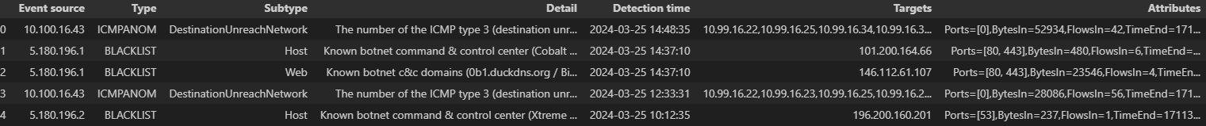
Split Attributes
Split the “Attributes” in the original dataset into several smaller fields.

Slide 6
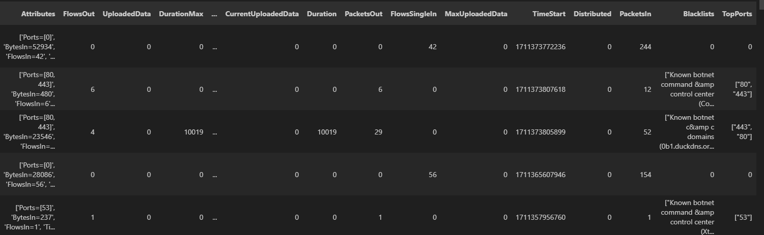

Slide 7
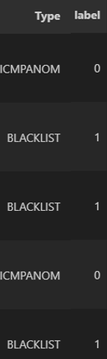
Label the IP
IP in the blacklist -> 1
IP Not in the blacklist -> 0

Slide 8
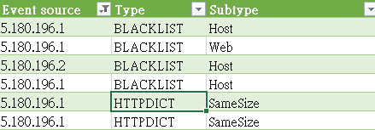
Delete some events
For example : IP ‘5.180.196.1” is in blacklist, but it also appears in other event whose type is not blacklist.
Should be deleted

Slide 9
Encode the columns ( 1 )
Data that has numbers or can be counted are numerical data, whereas data that involves words or vocabulary are non-numerical data.
There are 7 non-numerical columns in the dataset after splitting, so it is very important to choose the encoding method.
Here are some problems when encoding some columns, let’s take ‘Ports’ for example

Slide 10

Encode the columns ( 2 )
1. One-Hot Encoding ? Easy but too many features.
Port_1 ~ Port_65535
2. Frequency Encoding ? There are multiple port in one event
It will be like 80-> 1000 443-> 500 53-> 800
3. Hash Encoding ? A better choice so far
Feature Hasher

Slide 11
Key points about Feature Hasher
It converts categorical features into a sparse matrix.
Uses a hash function to map features to indices.
Suitable for high-dimensional and large-scale data.
Helps avoid the memory overhead of storing feature names.

Slide 12
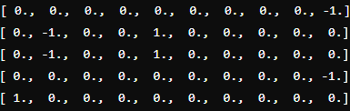
It will be like

Slide 13
XGBoost implementation

Slide 14
Experiment setup
Dataset：FL-Event-Filtered.csv
Classifier : xgboost

Slide 15
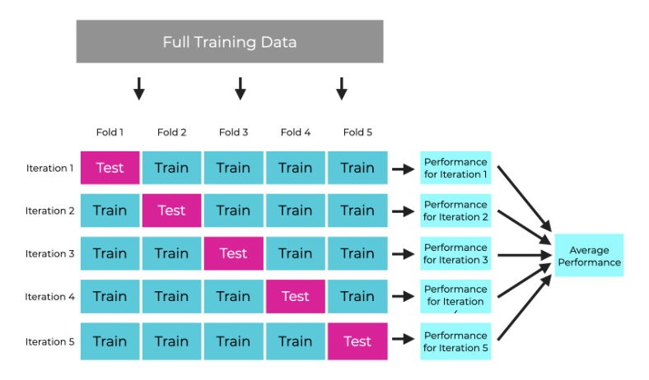
I used 5-fold cross validation to find the best classifier and observe its feature importance.

Slide 16
Result of the XGBoost ( 1 )
 | 1 | 2 | 3 | 4 | 5 | mean
Accuracy | 1.0 | 1.0 | 0.9984 | 1.0 | 1.0 | 0.9996

Slide 17
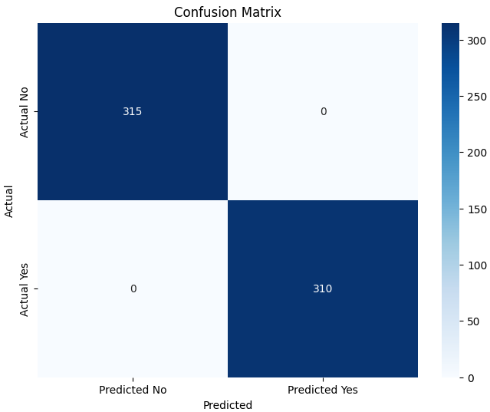
Result of the XGBoost ( 2 )

Slide 18
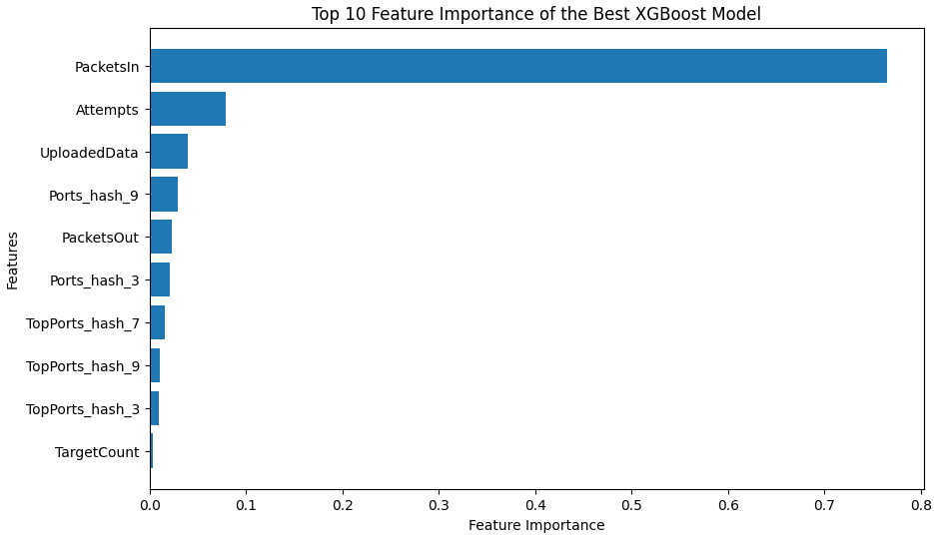
Feature Importance
I noticed the model relies too heavily on these two features.

Slide 19
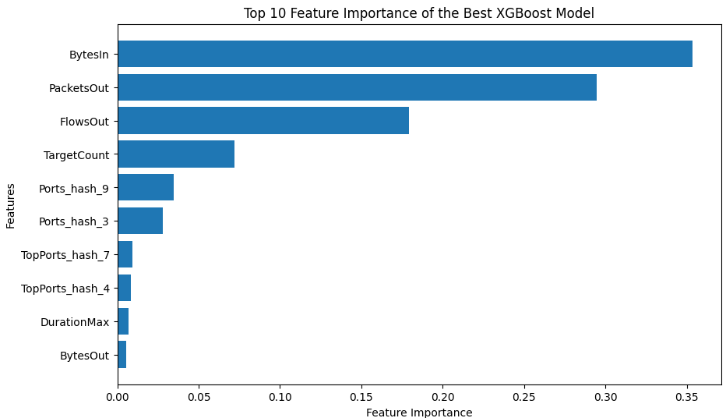
Feature Importance – Removed

Slide 20
Federated Learning

Slide 21

Federated learning framework : Flower

Slide 22
Experiment setup
Dataset：FL-Event-Filtered.csv
Horizontal Splitting -> Client1.csv 、 Client2.csv 、 Client3.csv
Classifier : Simple MLP

Slide 23
FedAVG
10 rounds
Client
Model
Train
3 Epochs
Get
Weights
Broadcast
Model updates
Pass
Weight
Pass
Weights
Server
Global
Weights
Aggregation

Slide 24
Result of Federated learning
Flower | 1 | 2 | 3 | 4 | 5 | mean
Accuracy | 0.987 | 0.980 | 0.968 | 0.977 | 0.993 | 0.987
Here I split the original dataset randomly for 5 times.
XGboost | 1 | 2 | 3 | 4 | 5 | mean
Accuracy | 1.0 | 1.0 | 0.998 | 1.0 | 1.0 | 0.999

Slide 25

Federated learning framework : Our Lab
Source : https://www.pokemon.com/us

Slide 26
FedAVG
10 rounds
Client
Local
Model
Train
3 Epochs
Get
Weights
Broadcast
Model updates
Pass
Weight
Pass
Weights
Server
Global
Model
Global
Weights
Aggregation
We have global model

Slide 27
Experiment setup
Dataset：FL-Event-Filtered.csv
Horizontal Splitting -> Client1.csv 、 Client2.csv 、 Client3.csv
Classifier : Simple MLP

Slide 28
Result of Federated learning
Our Lab | 1 | 2 | 3 | 4 | 5 | mean
Accuracy | 0.976 | 0.984 | 0.980 | 0.967 | 0.971 | 0.975
Here I split the original dataset randomly for 5 times.
Flower | 1 | 2 | 3 | 4 | 5 | mean
Accuracy | 0.987 | 0.980 | 0.968 | 0.977 | 0.993 | 0.987
XGboost | 1 | 2 | 3 | 4 | 5 | mean
Accuracy | 1.0 | 1.0 | 0.998 | 1.0 | 1.0 | 0.999

Slide 29
Comparison

Slide 30
 | Centralized Learning | Federated Learning
Data storage | In a central server or database | distributed across multiple devices or nodes
Data privacy and Security | Data needs to be collected and transferred to the central server, posing potential privacy risks. | Data remains on local devices, reducing the risk of data privacy breaches
Model updates | Training and updating are completed centrally. | Each device train a local model, server aggregate the model parameters and send back to devices
Accuracy | Better | Worse
Execution time | Less | more

Slide 31
Conclusion

Slide 32
Conclusion
Although federated learning runs slower in experiments, it ensures the privacy of client data while maintaining minimal loss in accuracy.

Slide 33
Future Work

Slide 34
Future work
Try on more federated learning frameworks, such as tensorflow federated, pysyft … and so on.
Use Bigger dataset.
Federated Learning may be vulnerable to a 'gradient leakage attack’, still need to improve the architecture

Slide 35
Reference
https://xgboost.readthedocs.io/en/stable/
https://www.sharpsightlabs.com/blog/cross-validation-explained/
https://scikit-learn.org/stable/modules/generated/sklearn.feature_extraction.FeatureHasher.html
https://scikit-learn.org/stable/modules/generated/sklearn.cluster.DBSCAN.html
https://flower.ai/

Slide 36
Thank you for listening

