Slide 1
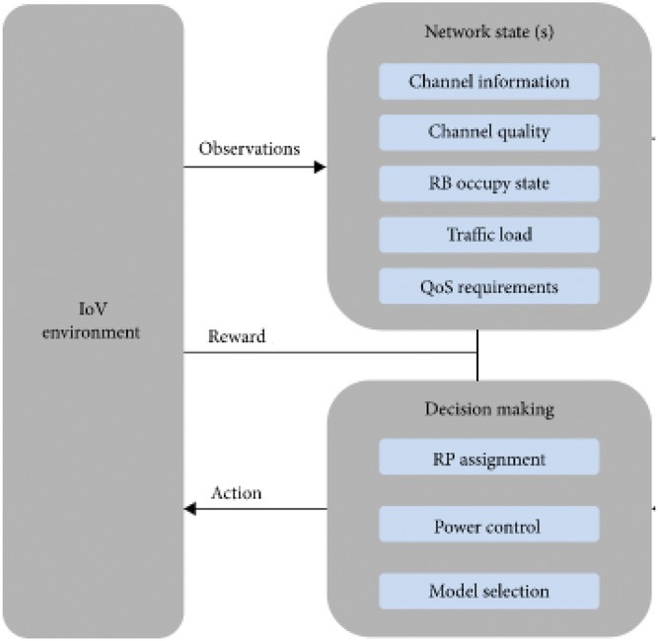
Internet of vehicle's resource management in 5G networks using AI technologies: Current status and trends
IET Communications, Volume: 16, Issue: 5, Pages: 400-420, First published: 30 December 2021, DOI: (10.1049/cmu2.12315)
Notes:
IoV resource management based AI
IF THIS IMAGE HAS BEEN PROVIDED BY OR IS OWNED BY A THIRD PARTY, AS INDICATED IN THE CAPTION LINE, THEN FURTHER PERMISSION MAY BE NEEDED BEFORE ANY FURTHER USE. PLEASE CONTACT WILEY'S PERMISSIONS DEPARTMENT ON PERMISSIONS@WILEY.COM OR USE THE RIGHTSLINK SERVICE BY CLICKING ON THE 'REQUEST PERMISSIONS' LINK ACCOMPANYING THIS ARTICLE. WILEY OR AUTHOR OWNED IMAGES MAY BE USED FOR NON-COMMERCIAL PURPOSES, SUBJECT TO PROPER CITATION OF THE ARTICLE, AUTHOR, AND PUBLISHER.

