Slide 1
Data Sub-setting
Getting you just the data values you need
Notes:
In this lesson, we're going to cover one of the most important elements of data analysis: how to work with tablular data to extract just the bits of it that you need. We'll cover the two main applications: selecting columns and filtering rows, and show how to use both to get the subsets of data you need for your work.

Slide 2

Imagine a scenario:
Hi,
Here’s the data you’ll need for the research project.
Working with the data was tricky, but I think I’ve we should be ok!
FYI the team told me this is just a first cut of the data; we’re going to get more next week.
Thanks so much for helping out, I owe you one!
Notes:
So you’re working on a research project
Your collaborator/team sends across the data,
Not quite what you asked for
Just a sample, the full data will be much larger

Slide 3
Imagine a scenario:
Columns you’re not interested in
Rows you don’t care about
Notes:
You’ve received lots of data, a lot of which isn’t useful to you.
There are
Columns you’re not interested in (e.g. because the measurements aren’t relevant to your study)
Rows you don’t care about (e.g. because of the values in them mean that information isn’t useful to you)
The net result is, you need to get to just the data you’re interested in.
You need to subset, based on the rows and columns of your data!

Slide 4



Your options
Manually extract the data you want
Ask your collaborator for help
Write some R code to extract what you need
❗
Notes:
Is not great – there’s going to be more data next week, and you’d have to do this all over again
Might be hard – they already said that getting the data were tricky
Will require some of your effort, but that’s why you’re in this class!
You need to subset
This is one of the most common, and therefore most useful data transformation steps

Slide 5


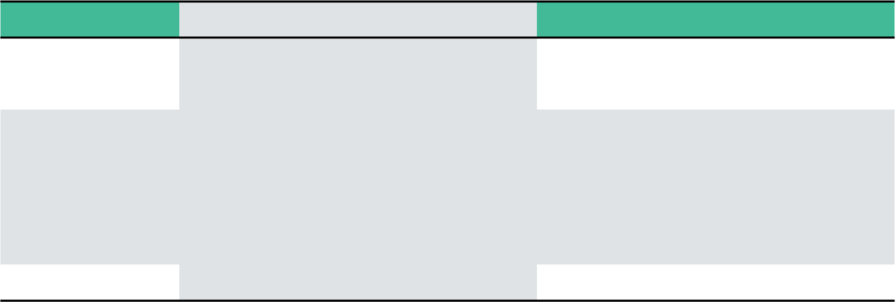
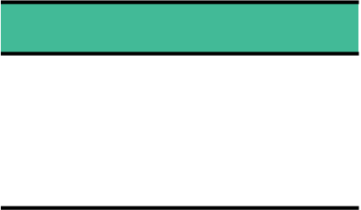
Sub-setting with functions
You’re going to learn two functions from the dplyr package
Input
Output
function_name(some_data, a_subset)
function_name(
some_data,
a_subset)
some_data
subset_data
The name of the function
The data to subset
The subset you want to keep
subset_data <- function_name(some_data, a_subset)
Notes:
dplyr is a fantastic package for working with data
All of it’s functions work in the same way:
They have a name (just like the functions you’re already familiar with like mean() or sum() )
The first argument, the first ”thing” is the data you want to subset – i.e. the full data
The extra argument(s) is/are the subset you want to keep
All of them return more data – they don’t modify the existing data – so you must assign the output to something to retain it!
We’re interested in sub-setting both rows and columns, and there are two function – can someone suggest/think what each function does?
One is rows, one is columns

Slide 6
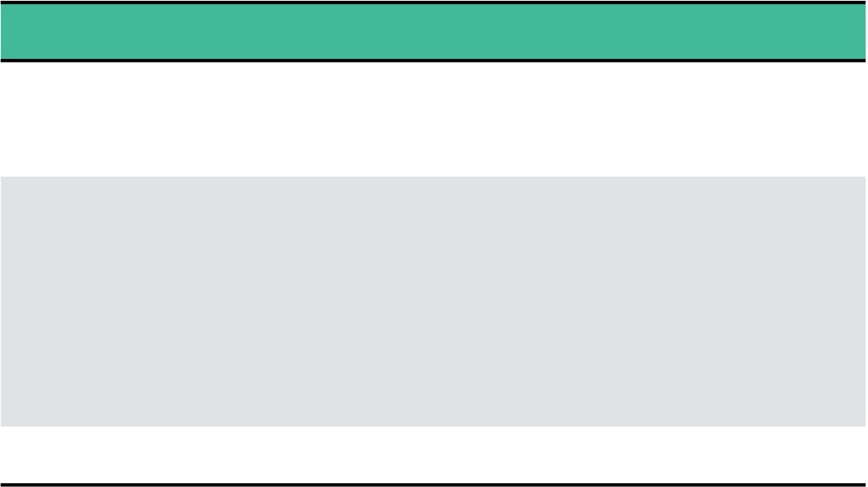
Sub-setting columns:
select()
What goes here?
What if we want more columns?
select(some_data, )
select(some_data, colA, colB)
select(some_data, colA)
comma-separated
An example
select(some_data, colA, colB, colC)
some_data
subset_data
Notes:
The first function we’re going to use is select – used to get just the columns we want.
What do we think goes in the gap, remembering the mental model of:
Function_name
Data to subset (full data)
The subset we want
The answer is a column name (here we imagine the columns are called col1A, colB, colC, etc)
But what if we want more than 1 column?
We just add them, separated by columns
Until we have (potentially) multiple columns, comma-separated
And we get the same function sig. we had before: name, data, subset
Let’s see a couple of quick examples

Slide 7
Sub-setting columns:
select() quiz
You have data, some_data, and want to take and keep a subset of 3 columns: colA, colB, and colC. Which line is correct? Why?
select(colA, colB, colC, some_data)
new_data <- select(some_data, colA, colB, colC)
select(some_data, colA, colB, colC)
Notes:
Let’s do some exercises to try and cement that in your brain. First off let’s do this quiz.
The correct answer is 2 – but why?
1 is wrong – the data we want to subset need to come first
3 is wrong – we don’t modify the data, we get new data back, so we need to save the results of our function to a new variable.

Slide 8
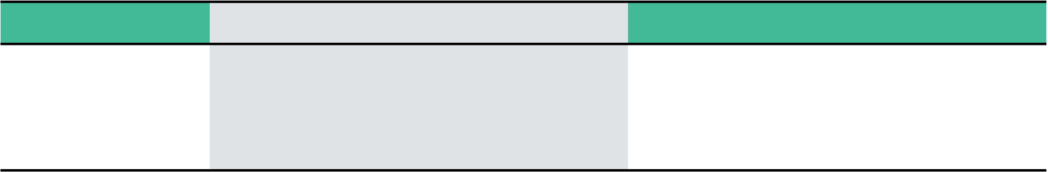
Sub-setting rows:
filter()
What goes here?
filter(some_data, colD > 65)
filter(some_data, )
filter(some_data, colD > 65, colE == “P”)
What if we want extra conditions?
comma-separated
filter(some_data, colD > 65, colE == “P”)
some_data
subset_data
Notes:
The other function we’re going to use is filter – used to get just the rows we want.
What do we think goes in the gap, remembering the mental model of name, data, subset?
The answer is a condition – use >, <, ==, >=, <=, etc.
But what if we want more than 1?
We just add them, separated by columns
Until we have (potentially) multiple conditions, comma-separated
And we get the same function sig. we had before: name, data, subset
Let’s see a couple of quick examples

Slide 9
Sub-setting columns:
filter() quiz
You have data, some_data, and want to take and keep a subset where colD is over 65 and colE is exactly 1. Put the following code snippets together to do this.
,colE == 1)
new_data <-
,colD > 65
filter(some_data
new_data <- filter(some_data, colD > 65, colE == 1)
Notes:
Let’s do some exercises to try and cement that in your brain. First off let’s do this quiz.
The correct answer is 3 – but why?
1 is wrong – the data we want to subset need to come first, and we have the condition the wrong way around
2 is wrong – we need filter() not select()

Slide 10
Imagine a scenario:
Columns you’re interested in – get with select()
Rows you care about – get them with filter()
Notes:
Let’s do some exercises – go to the RStudio cloud project, and open up the subsetting.Rmd exercise
Work through them
So now you have learned how to:
Get the rows you care about using filter()
Get the columns you care about using select()

Slide 11
Putting both together...
Using pipes %>%

Slide 12
Mental Model:
Is often called
Based on the
Getting (only) the data you need
Subsetting
Rows
+
Columns
Of
Data
Is a
Fundamental, primary activity
Using functions
So it’s
Separated with
Really useful!
Signature
Used across
function_name(.data, .thing1, .thing2)
commas ,
Part of
Both from
For rows
For columns
dplyr
One or more
One or more
The function
The function
filter()
+
conditions
select()
+
names
tidyverse
Later content
To get
…
Combine with
Less Data

