Slide 1
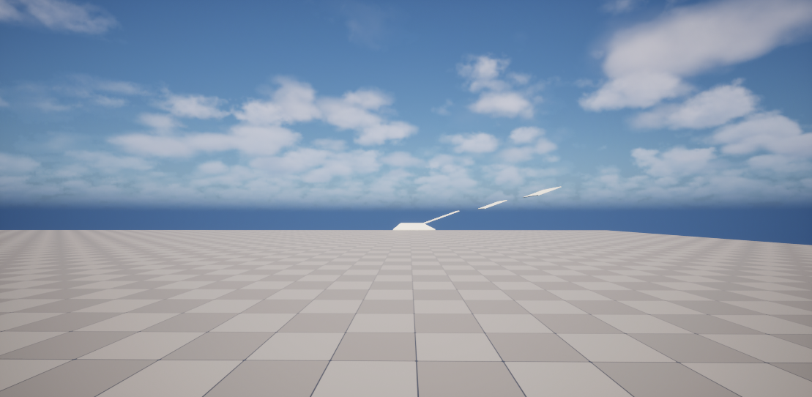
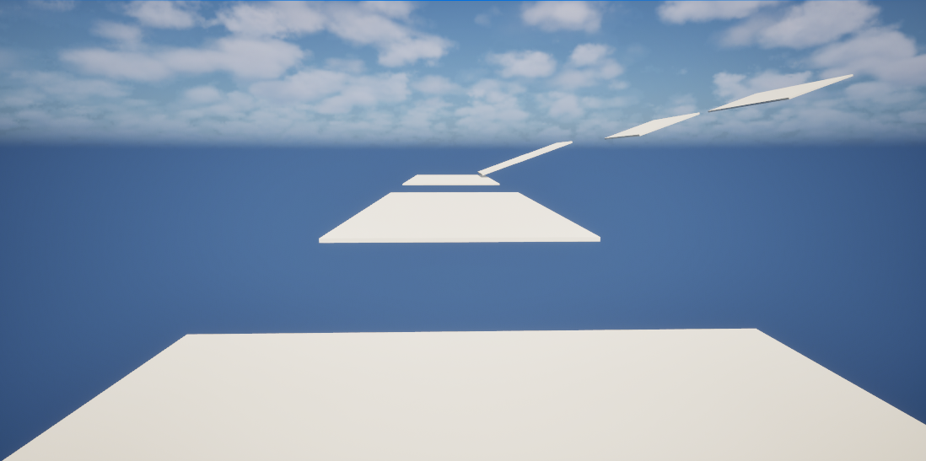
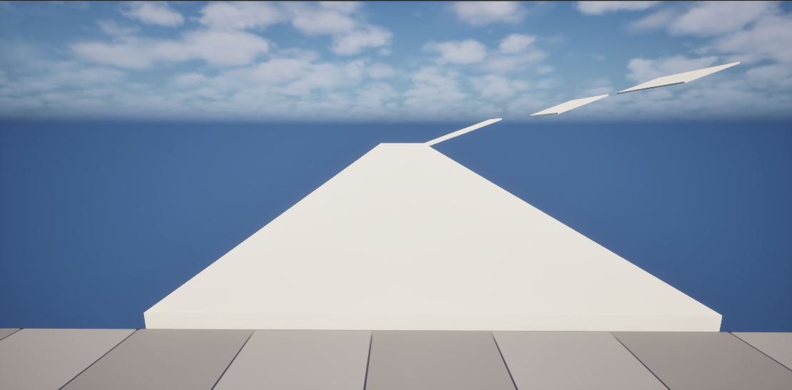
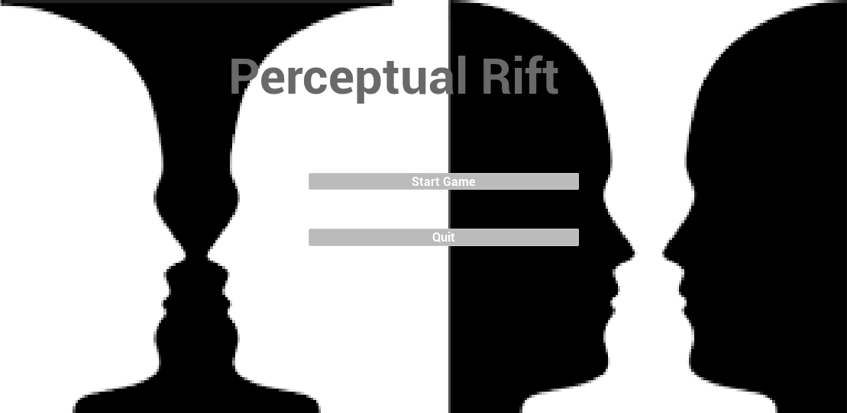
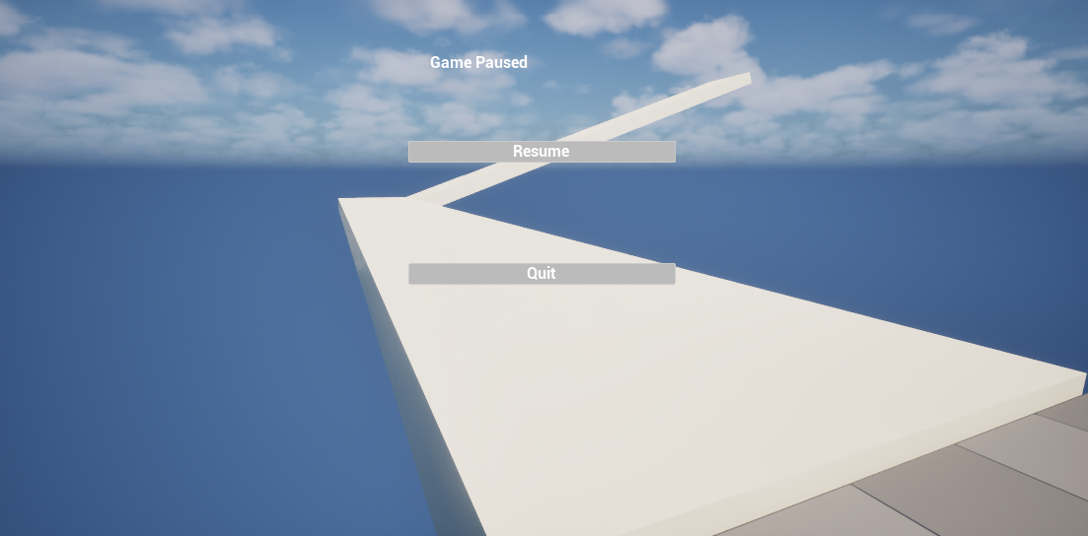
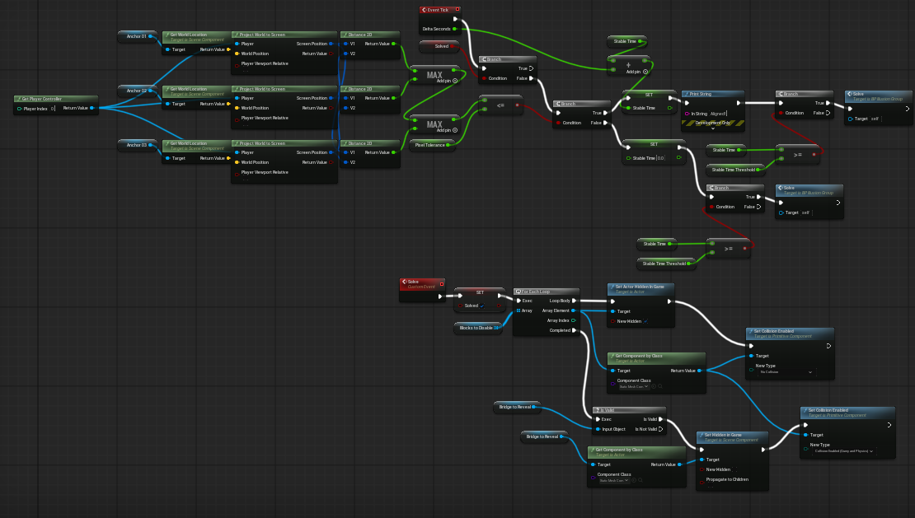

Perceptual Rift: A Perspective-Based Optical Illusion Puzzle Game
Jim Almonte
Project Description
Perceptual Rift is a single-player puzzle game built in Unreal Engine 5.6 that challenges players to solve perspective-based optical illusion puzzles. Players align illusion elements from a specific viewpoint. When alignment is held, illusion blocks disappear and a solid bridge is revealed.
Project Description
Perceptual Rift is a single-player puzzle game built in Unreal Engine 5.6 that challenges players to solve perspective-based optical illusion puzzles. Players align illusion elements from a specific viewpoint. When alignment is held, illusion blocks disappear and a solid bridge is revealed.
Project Justification
Perspective-based mechanics provide strong cognitive engagement but are rarely explored in modern games. This project demonstrates how visual perception concepts can be implemented using structured software engineering practices.
Before Solving
After Solving
Core Features
- Perspective-based alignment puzzles
- Stable-hold solve confirmation
- Dynamic bridge reveal
- Collision-safe traversal
Technologies Used
Unreal Engine 5.6
Blueprint Visual Scripting
Windows PC Development
Main Menu
Pause Menu
Testing Summary
Component, unit, requirements, and system testing were executed. All implemented features passed required test cases with no blocking defects.
Design Process
Requirements Definition
System Design
Implementation
Testing and Validation
Iteration and Refinement
BP_IllusionGroup Logic

