Slide 1
Mental Health in tech
Connor McCall
Jim Carson
Lou Canjar
Natasia McLean

Slide 2
Data Overview
Mental health survey that measures attitudes towards mental health and frequency of mental health disorders in the tech workplace.
Questions:
What are the predictors of mental health issues?
How does the percentage of respondents in treatment vary by total survey population, remote workers and self-employed workers?
What is the relationship between age and gender when seeking treatment?

Slide 3
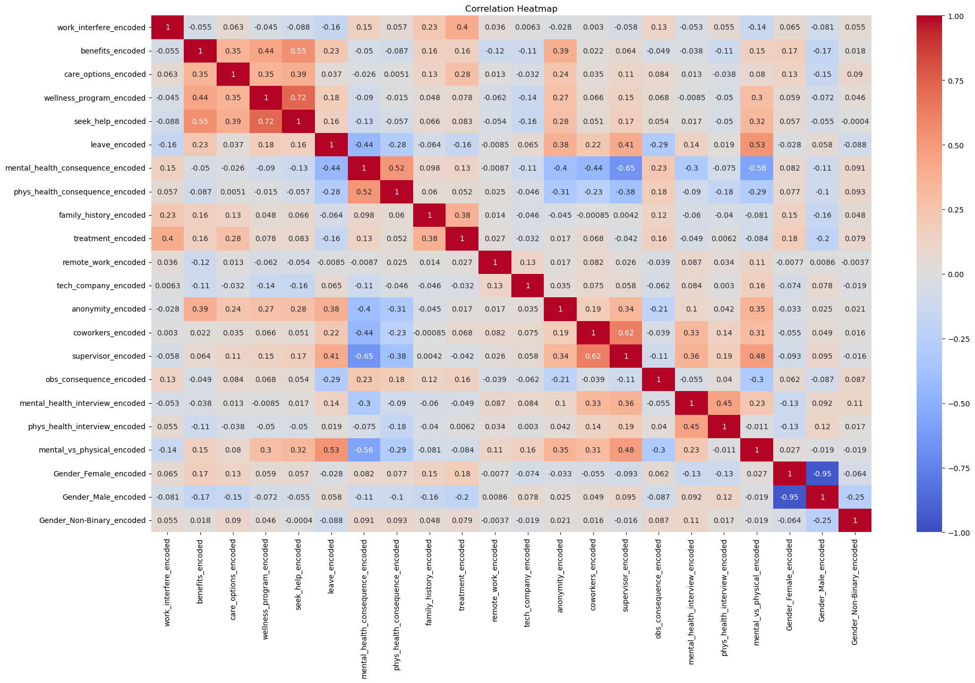
What are the predictors of mental health issues?

Slide 4
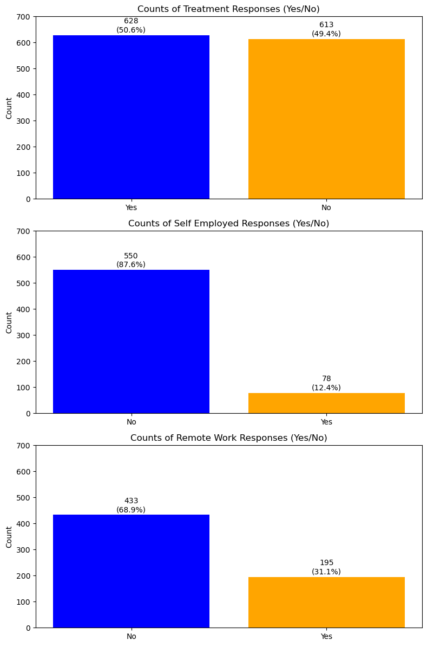
How does % of respondents in treatment vary by total population, remote workers and self-employed?
A negligible correlation with treatment:
Self-employment @ .021
Remote @ .027
2) That said, it was worth understanding the variance between total population, self employed population, and remote workers
3) Although no causation / correlation, it does infer that remote workers and those self-employed tend to either be less predisposed to counseling or less in need of counseling3

Slide 5
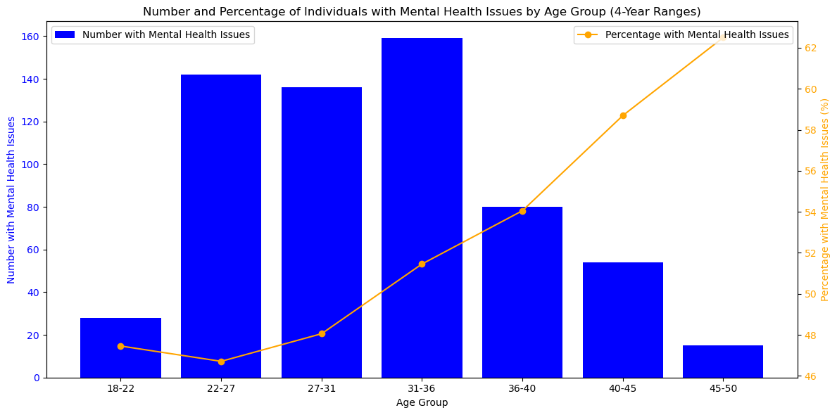
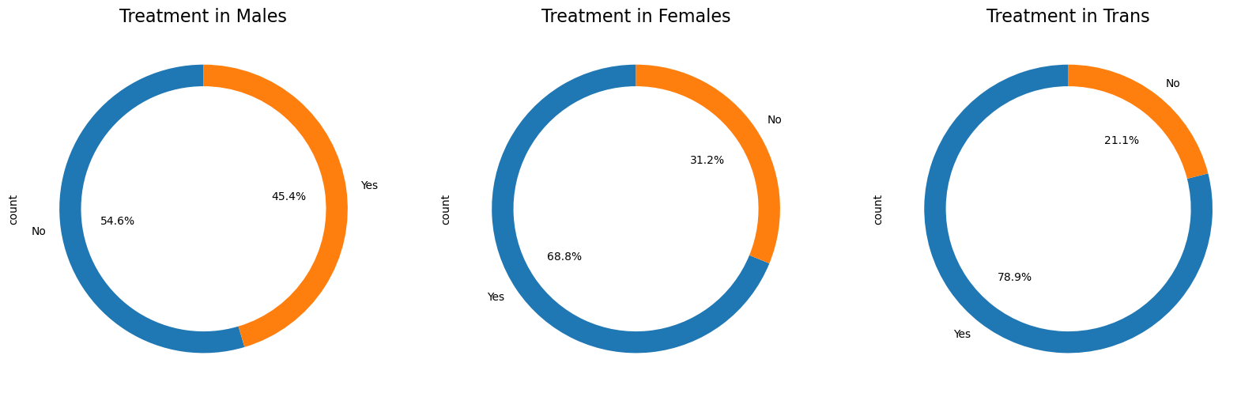
What is the relationship between age and gender when seeking treatment?
We don't see much differences between the age groups. Majority of individuals experiencing mental health issues fall within the age range of 25 to 35. They are all around 46-60 percents of seeking help so it can be stated ages between 34 to 47 tend to seek help a bit more than others but it's not so distinguished.
Those identifying as Trans and Females exhibit a higher tendency to seek treatment for mental health issues in comparison to Males.

Slide 6
Questions?

