Slide 1

COVID-19 Starter Kit: Infection Relevance
By Jim Chen

Slide 2
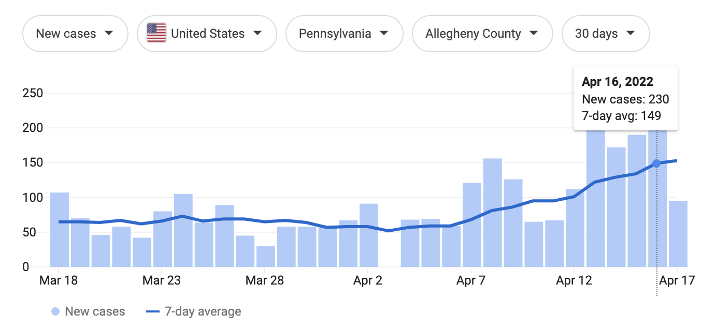
COVID-19 is relevant

Slide 3
Research Question
How much is Patient A’s infection due to Patient B’s infection?
Could we quantify the relevance?

Slide 4
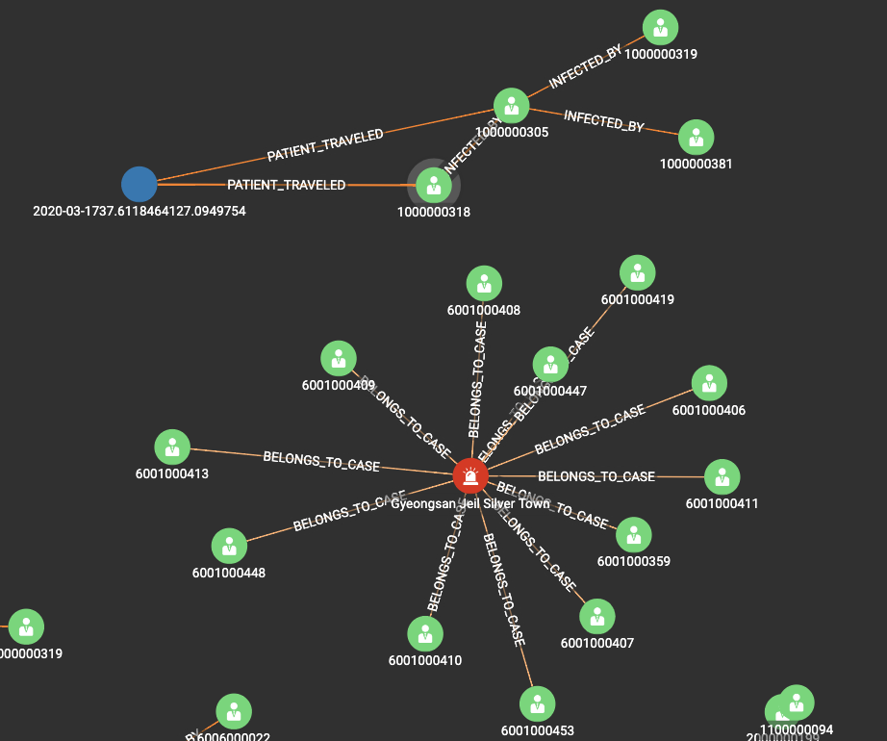
Dataset
Korean Center of Disease Control
~30,000 Patients
Direct/Indirect Infection
Example Data:

Slide 5
Relevance Model
same_case_relevance = a
close_contact_relevance = b
infected_by_relevance = c
0 < a < b < c < 1

Slide 6
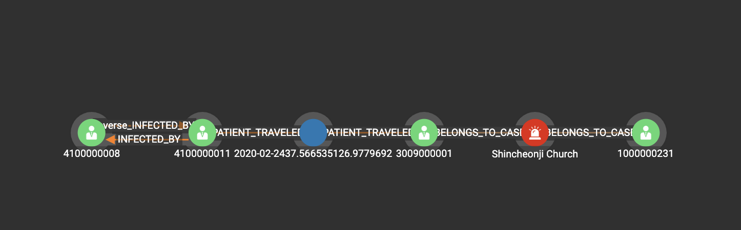
Problem I:
What about indirect relevance?
A
a = 0.99
B
b = 0.6
C
c = 0.2
D

Slide 7
Problem I:
What about indirect relevance?
Multiply them!
Relevance: 0.1188
A
a = 0.99
B
b = 0.6
C
c = 0.2
D
Takeaway: The product of relevance on a path from any Patient A To any Patient B can be an indicator of relevance

Slide 8
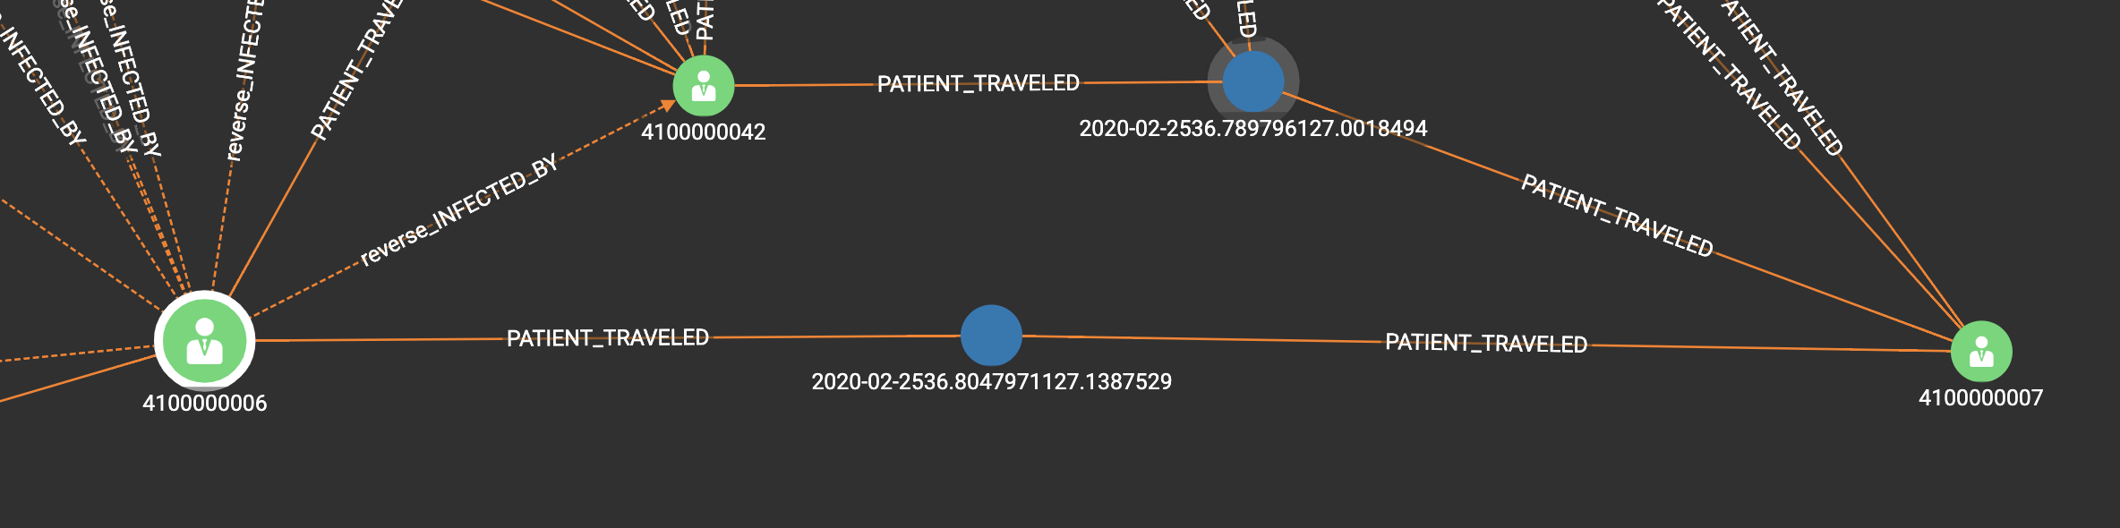
Problem II:
What about multiple path?
B
b = 0.6
A
a = 0.99
B
b = 0.6
C
c = 0.2
D
a = 0.99
b = 0.6
A
C

Slide 9
Problem II:
What about multiple path?
Highest Relevance Path!
B
b = 0.6
A
a = 0.99
B
b = 0.6
C
c = 0.2
D
a = 0.99
b = 0.6
Relevance: 0.6
A
C
Takeaway: The path from any Patient A To any Patient B with the highest product of relevance can be a good indicator of relevance

Slide 10
Problem III:
How to implement this?
B
b = 0.6
a = 0.99
b = 0.6
A
a = 0.99
B
b = 0.6
C
c = 0.2
D
A
Some relevance on edge, some on vertex
Shortest path algorithms find lowest sum

Slide 11
Problem III:
How to implement this?
1. Split the relevance from vertex to edge
b’ = sqrt(b)
B
a = 0.99
b’ = sqrt(0.6)
b = 0.6
A
a = 0.99
B
b = 0.6
C
c = 0.2
D
b’ = sqrt(b)
b’ = sqrt(b)
A
Now, we can multiply only edge values on paths!

Slide 12
Problem III:
How to implement this?
2. Map edge value x to –ln(x) as edge distance
w_b’ = -ln(sqrt(b))
B
w_a = -ln(a)
w_b’ = -ln(sqrt(b))
b = 0.6
A
a = 0.99
B
b = 0.6
C
c = 0.2
D
w_b’ = -ln(sqrt(b))
w_b’ = -ln(sqrt(b))
A
Now, we claim the shortest path corresponds to the path with highest product of relevance

Slide 13
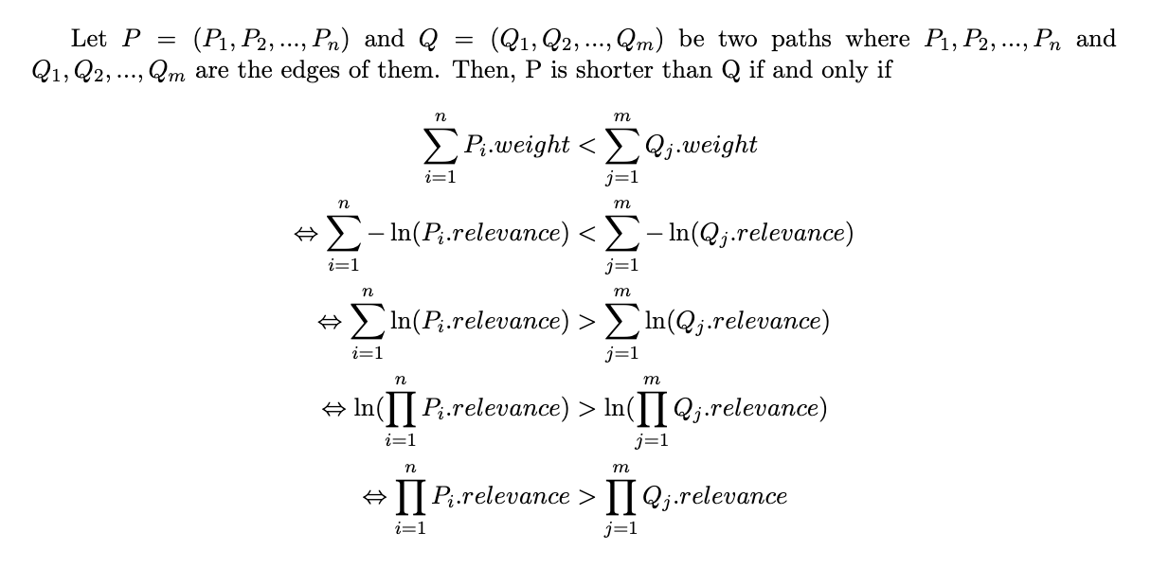
Prove the claim:
Want to show: a path is shorter its product of relevance is higher
Now, we claim the shortest path corresponds to the path with highest product of relevance

Slide 14
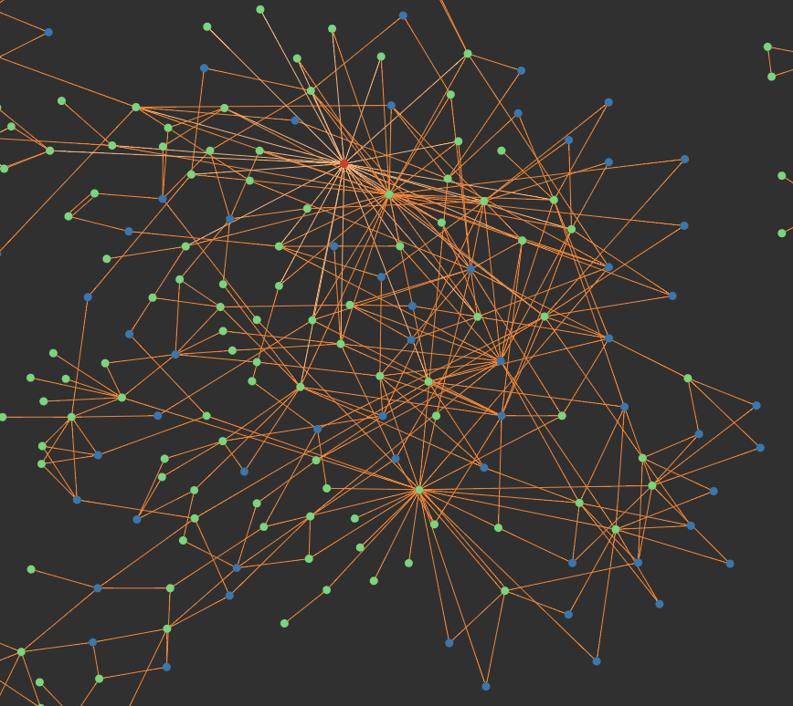
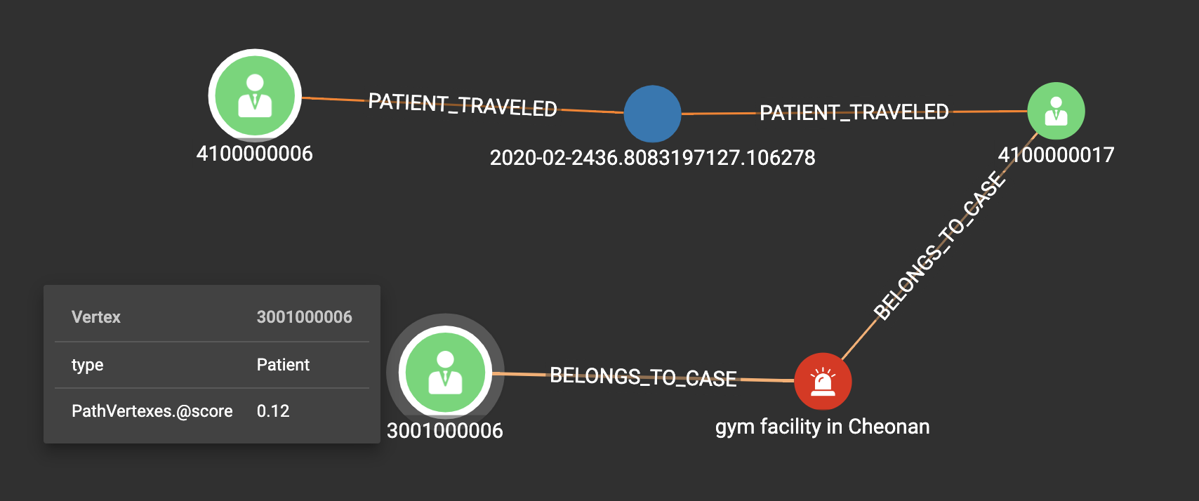
Result

Slide 15
Conclusion
We propose a model to quantify the relevance of patients’ infection.
We code an implementation of the solution.
GitHub: https://github.com/JimChen2002/TigerGraphDemo.git

