Slide 1

Notes:
https://www.vis4.net/blog/2011/10/mapping-internet-and-population/

Slide 2
Plan for this week
Tuesday:
Focal Operations
Thursday:
Focal Operations (Cont.)
Slope
Aspect

Slide 3
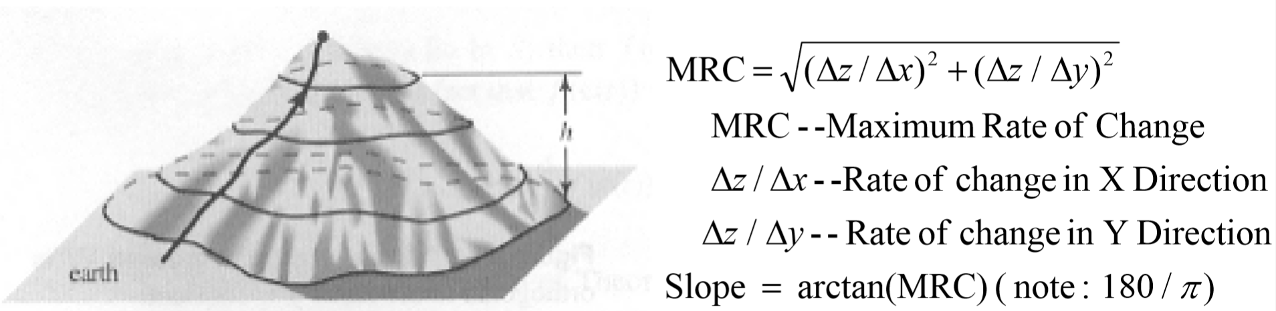
Slope/Aspect Calculations
What do they mean?
Slope: Maximum rate of change
Aspect: The direction of that change

Slide 4
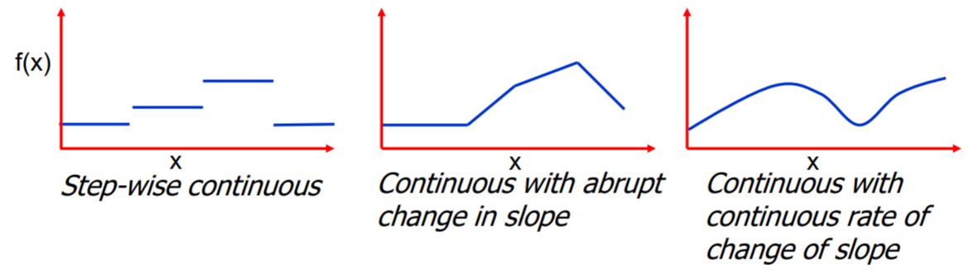
Terrain/Modeling surface
Continuity – A value is implied at every point
Falls on a continuum, and where that surface falls can dictate the mathematical functions we can perform on it.
These definitions are meaningful, although f(x) is defined everywhere, f’(x) may not be

Slide 5
Definitions: Slope
Slope is formally described by a plane tangent to the surface
Slope therefore has two components
Gradient: The maximum rate of change of the plane
Aspect: the direction of the plane with respect to some arbitrary 0 (usually north)
Note that slope is a vector, we (the GIS people) generally conflate slope and gradient. See paper.
http://desktop.arcgis.com/en/arcmap/latest/tools/spatial-analyst-toolbox/how-slope-works.htm

Slide 6
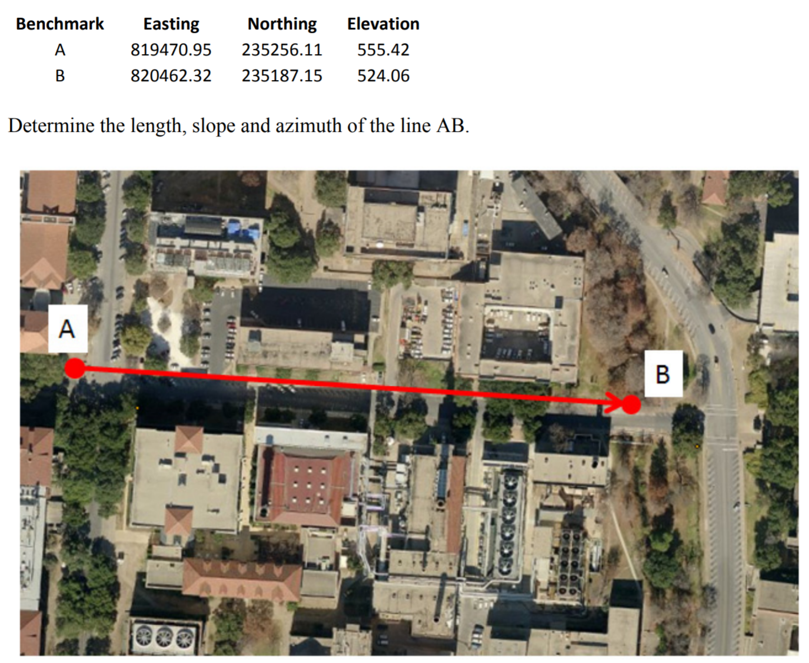

Slide 7
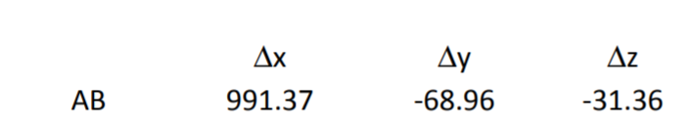

$Slope=\frac{Rise}{Run}$
$Azimuth=\frac{180}{π}\tan^{−1}{\frac{∆x}{∆y}}$
$∆x=820462.32−819470.95=991.37$

Slide 8
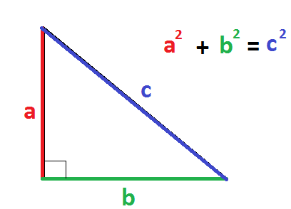
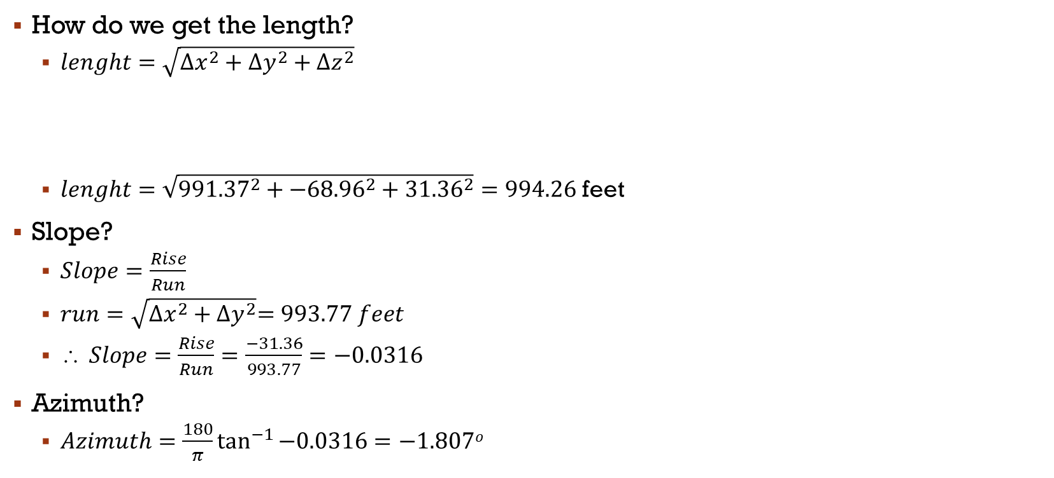
How do we get the length?
$lenght=\sqrt{{∆x}^{2}+{∆y}^{2}+{∆z}^{2}}$
$lenght=\sqrt{{991.37}^{2}+{−68.96}^{2}+{31.36}^{2}}=994.26$ feet
Slope?
$Slope=\frac{Rise}{Run}$
$run=\sqrt{{∆x}^{2}+{∆y}^{2}}=993.77 feet$
$\text{} Slope=\frac{Rise}{Run}=\frac{−31.36}{993.77}=−0.0316$
Azimuth?
$Azimuth=\frac{180}{π}\tan^{−1}{−0.0316}=−1.807o$

Slide 9
Flow Types
http://hydrology.usu.edu/dtarb/
http://hydrology.usu.edu/taudem/taudem5/help/D8FlowDirections.html
ArcMap
http://desktop.arcgis.com/en/arcmap/latest/tools/spatial-analyst-toolbox/how-slope-works.htm
In class exercise

