Slide 1
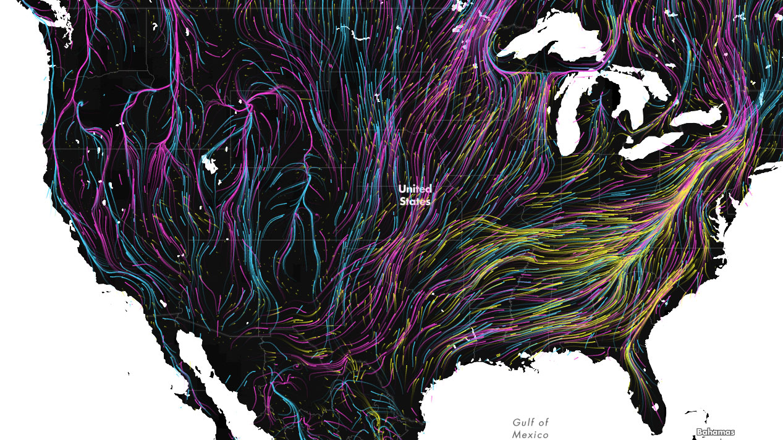
Notes:
https://blog.nature.org/science/2016/08/19/migration-in-motion-visualizing-species-movements-due-to-climate-change/

Slide 2
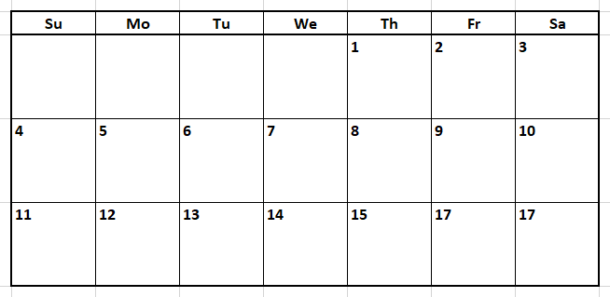
Plan
Review &
Euclidian
Distance
Geoprocessing
Cost Distance
Site Suitability
Review Exam

Slide 3
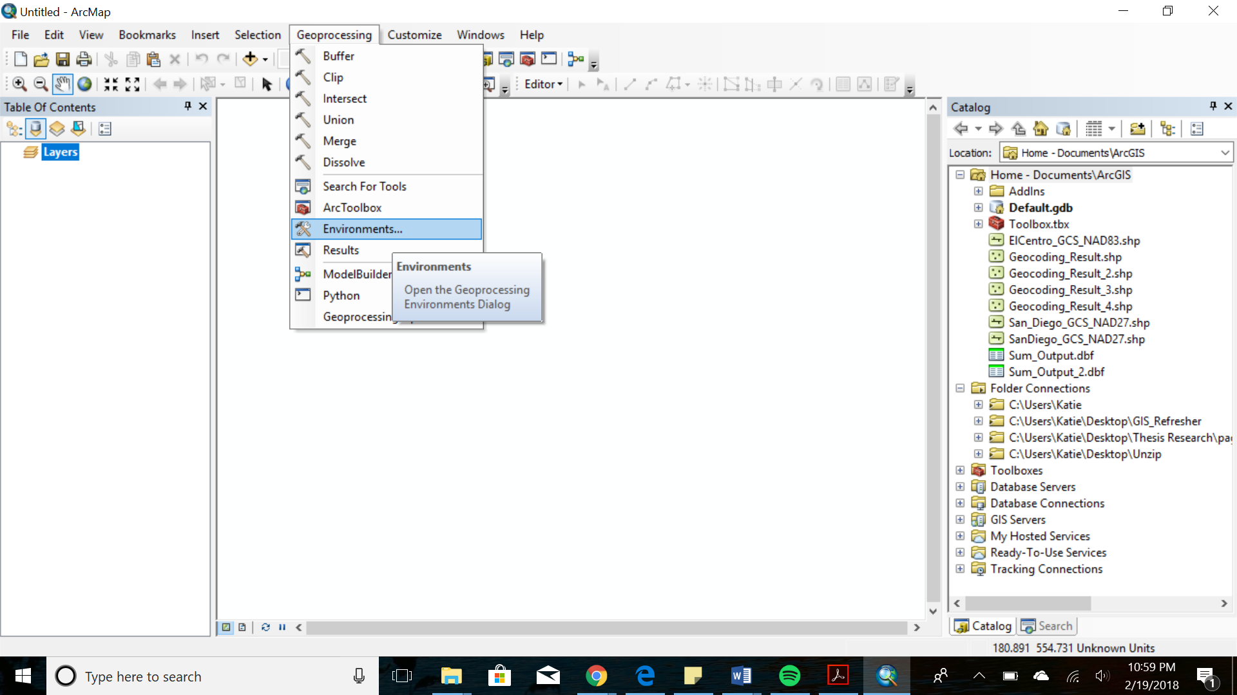

Slide 4
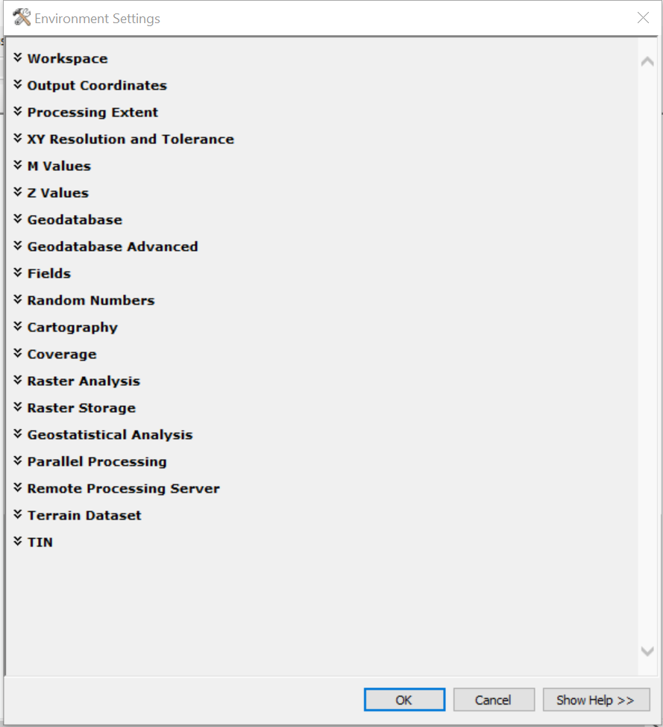

Slide 5
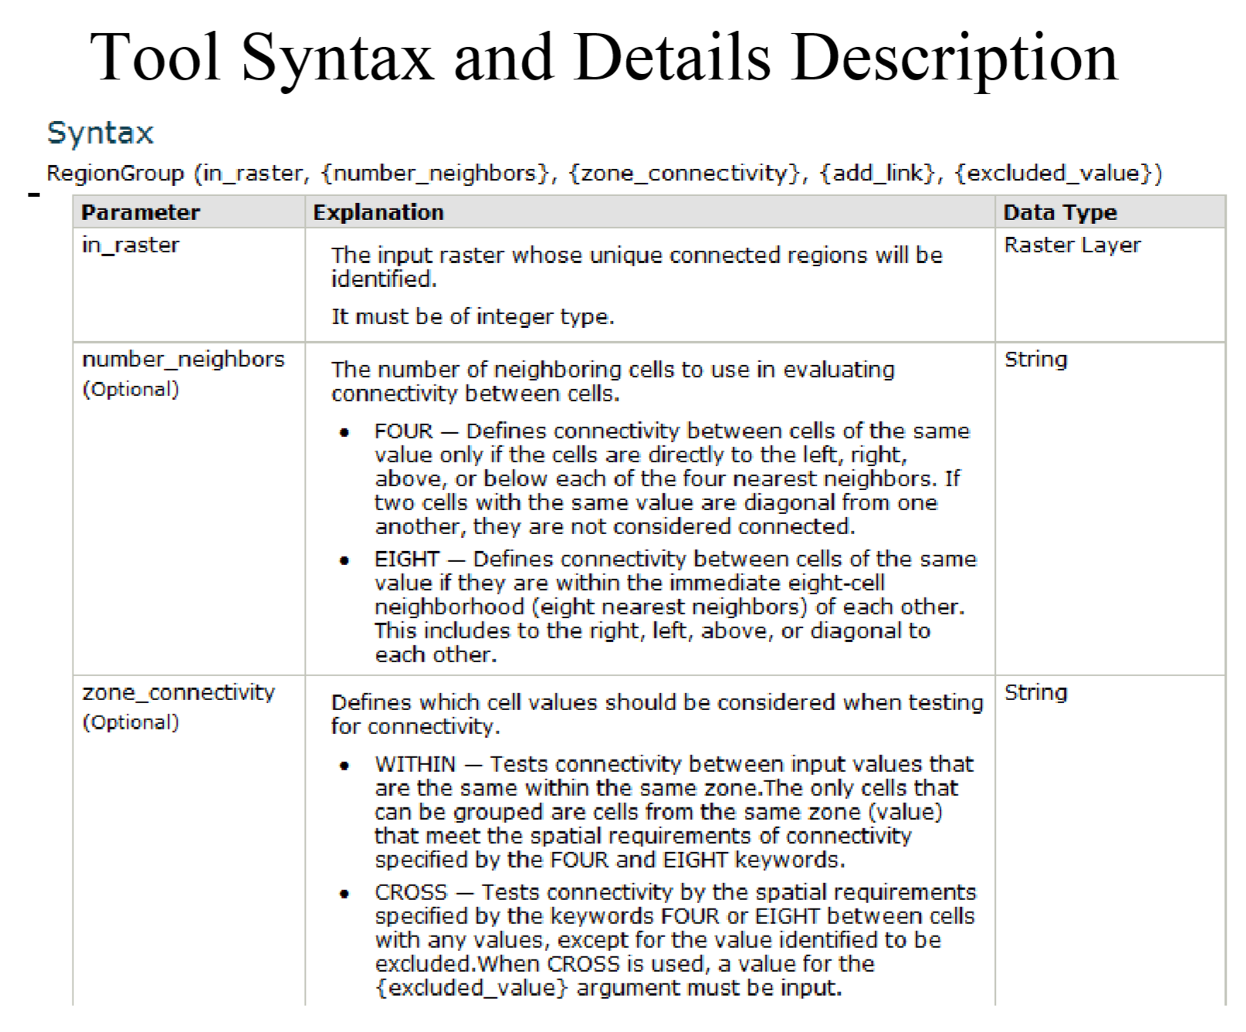

Slide 6
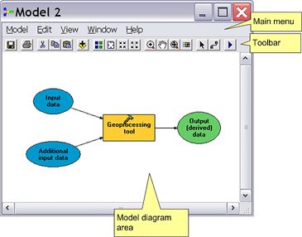

Slide 7
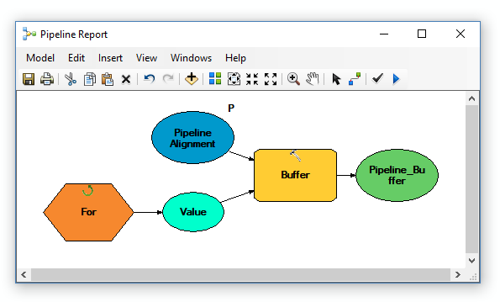

Slide 8
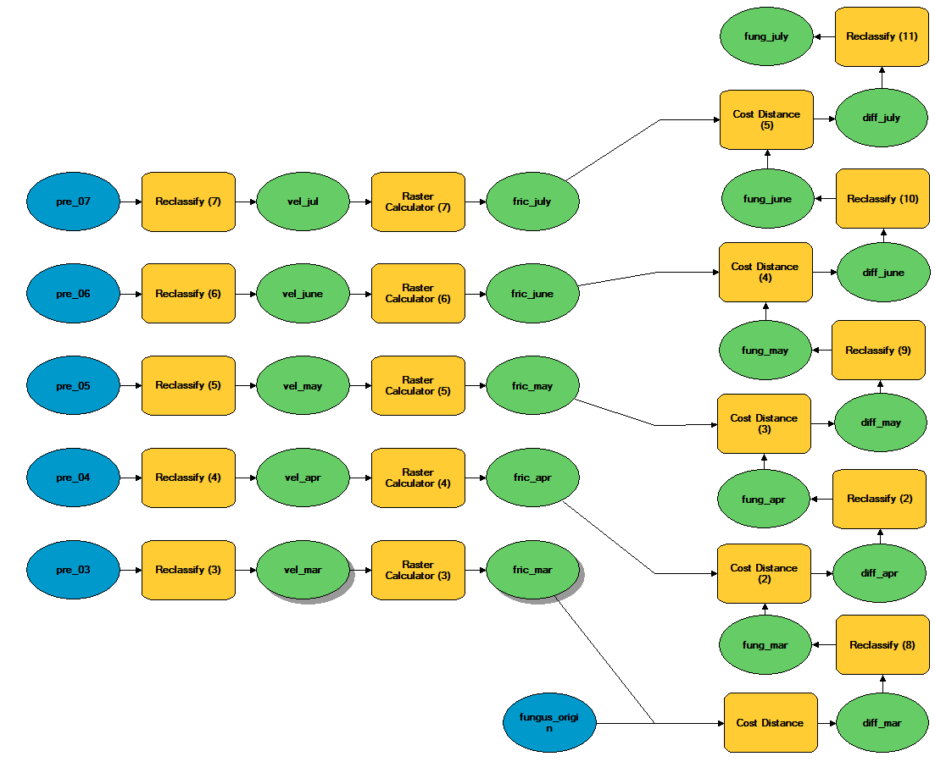

Slide 9
Spatial Analysis in Raster Data Model
Spatialize point calculations/operations
Mapping (or performing) ‘calculations’ in space
Link data by location
At the same location or within a neighborhood
Characterize fundamental spatial relationships
Spatial connectivity
Region group
Distance
Basis for define neighborhoods (distance & direction)

Slide 10
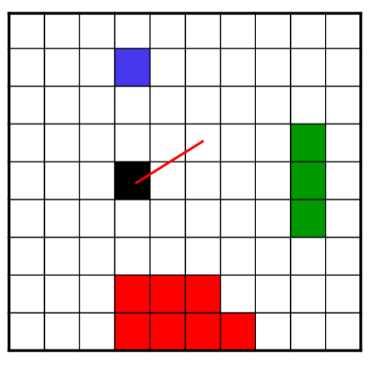
Distance Operations in Raster Data Model
Characterize the relationships between each cell and some feature cells (source cells) in space
Nearest feature cell
Distance to nearest feature cell
Direction to nearest feature cell

Slide 11
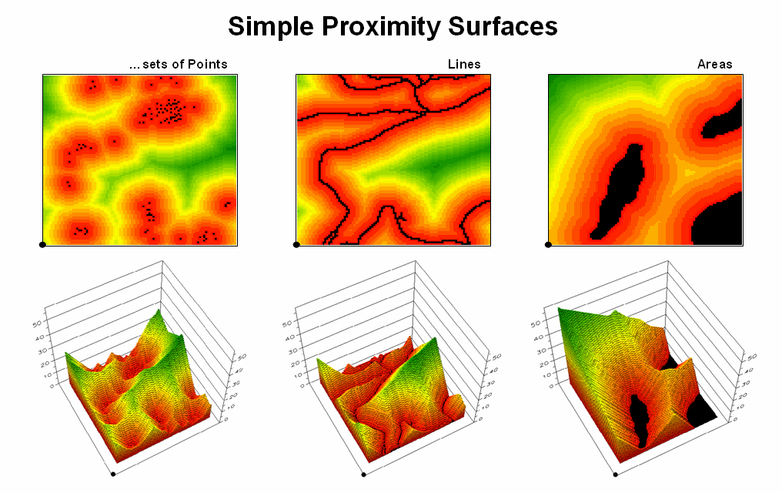
Notes:
http://www.innovativegis.com/basis/mapanalysis/topic25/Topic25_files/image007.png

Slide 12
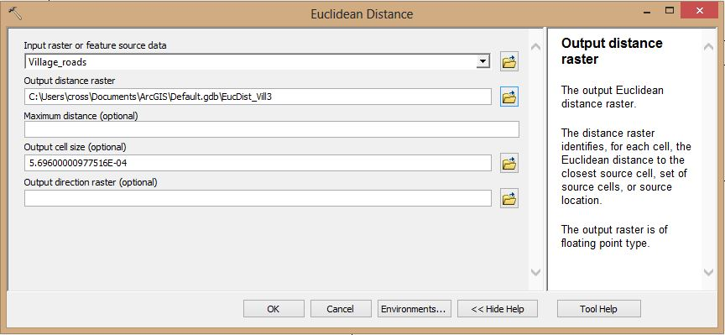
Euclidean Distance
EucDistance(in ArcGIS) operation calculates the shortest distance from each cell to source cells.
Pythagorean theorem: distance between the center of a cell and the center of a source cell.

Slide 13
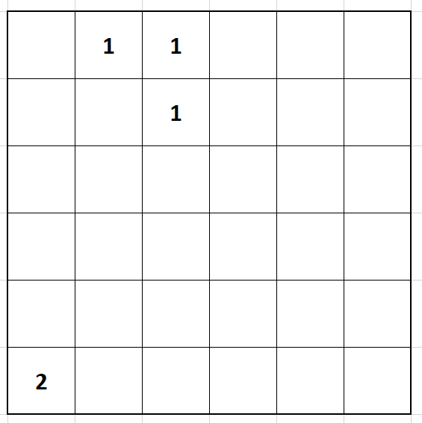

Slide 14
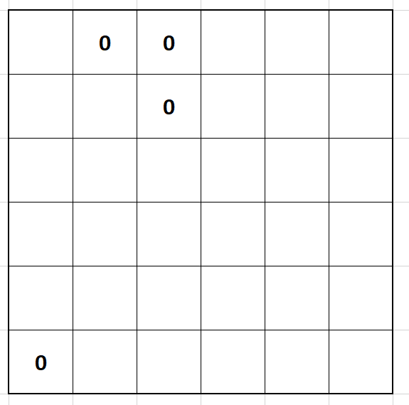

Slide 16
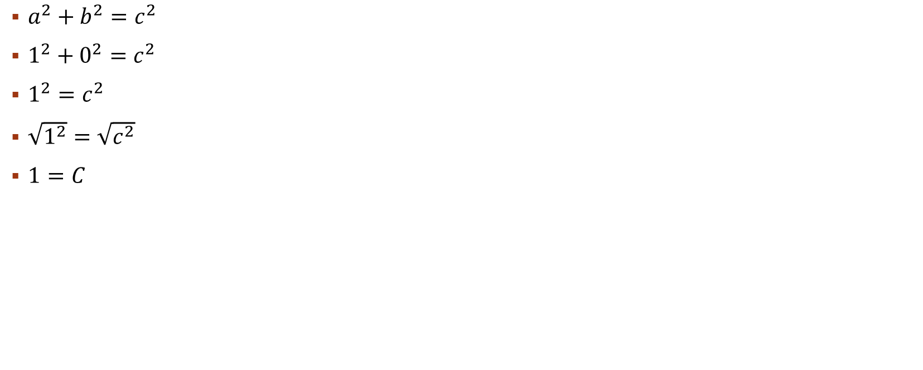
$a^{2}+b^{2}=c^{2}$
$1^{2}+0^{2}=c^{2}$
$1^{2}=c^{2}$
$\sqrt{1^{2}}=\sqrt{c^{2}}$
$1=C$

Slide 17
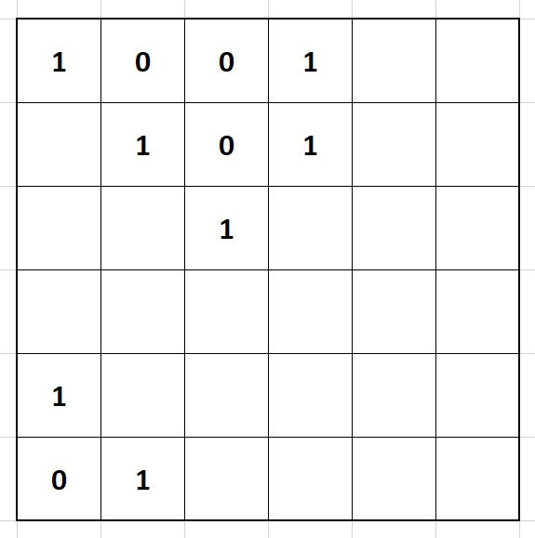

Slide 20

C
A
$a^{2}+b^{2}=c^{2}$
$1^{2}+1^{2}=c^{2}$
$1+1=c^{2}$
$\sqrt{2}=\sqrt{c^{2}}$
$1.4=C$
B

Slide 21
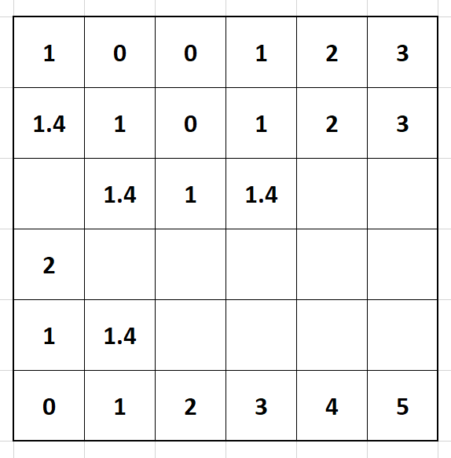

Triangle 1
$a^{2}+b^{2}=c^{2}$
$3^{2}+1^{2}=c^{2}$
$9+1=c^{2}$
$\sqrt{10}=\sqrt{c^{2}}$
$3.16=C$
Triangle 2
$a^{2}+b^{2}=c^{2}$
$2^{2}+2^{2}=c^{2}$
$4+4=c^{2}$
$\sqrt{8}=\sqrt{c^{2}}$
$\text{2.8}=C$
“Triangle” 3
2…
C1
C2
A1
A2
B2
B1

Slide 23
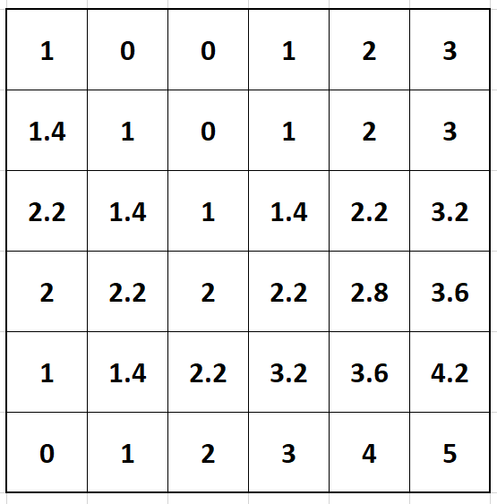

Slide 24
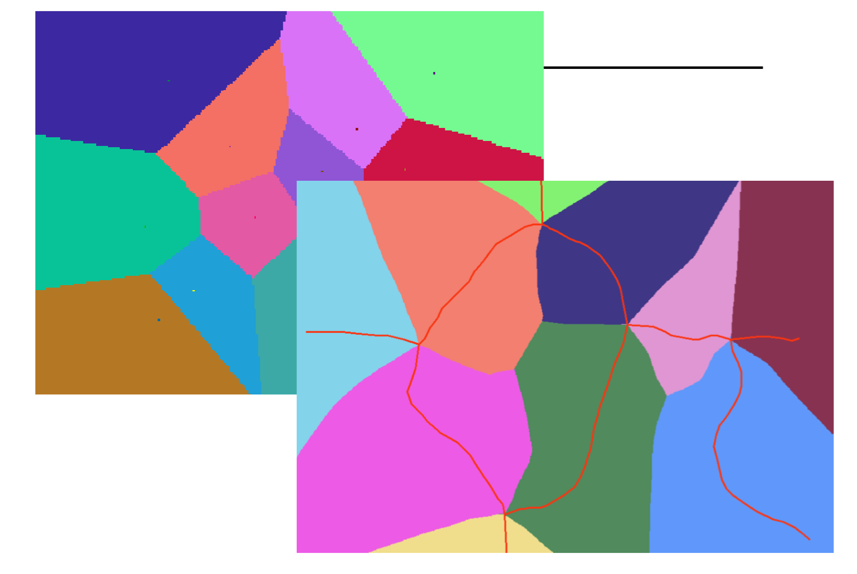
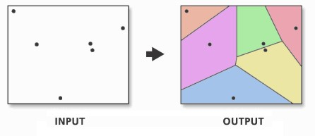
EucAllocation: Proximal regions
Assigns each cell the value of the nearest source cell

Slide 25
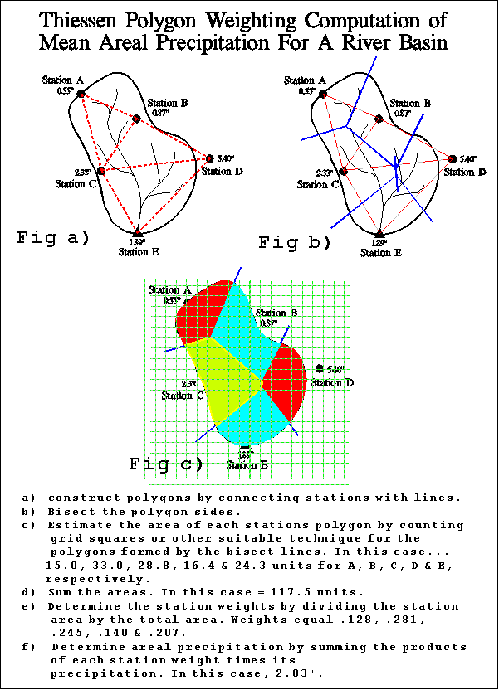

Slide 27
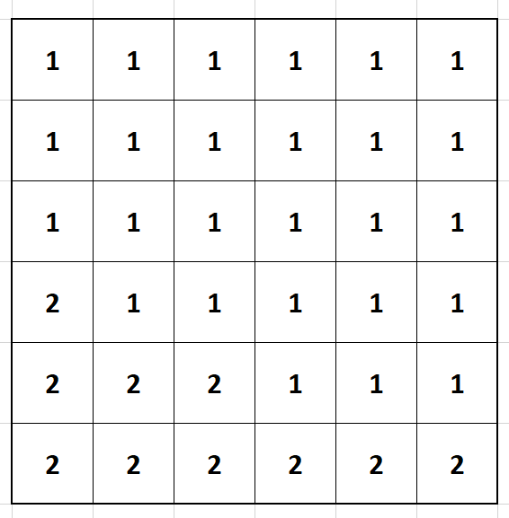

Slide 28
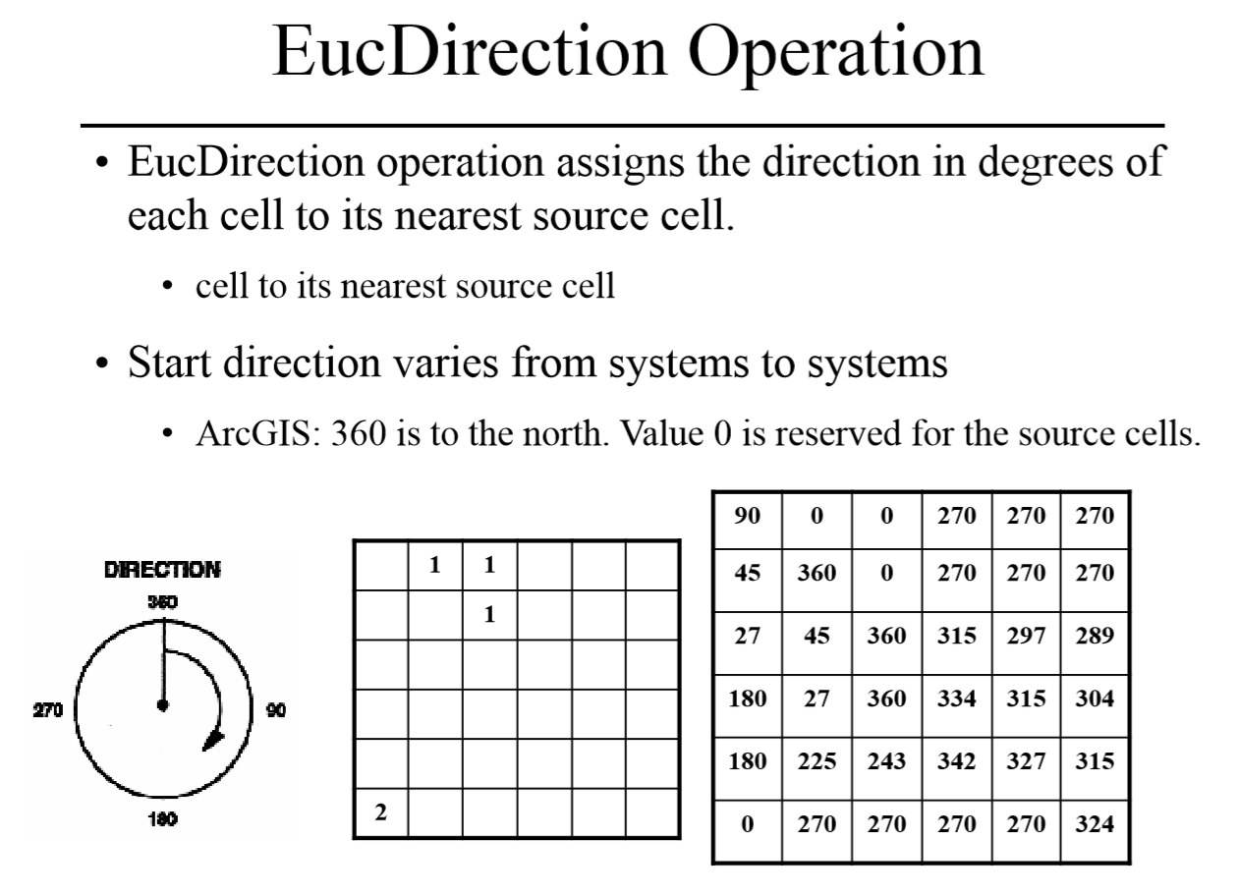

Slide 30
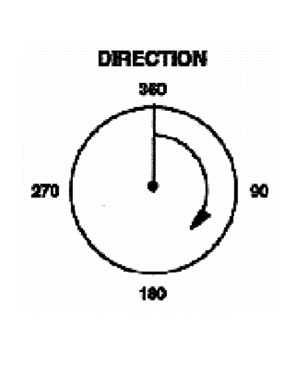

Slide 31
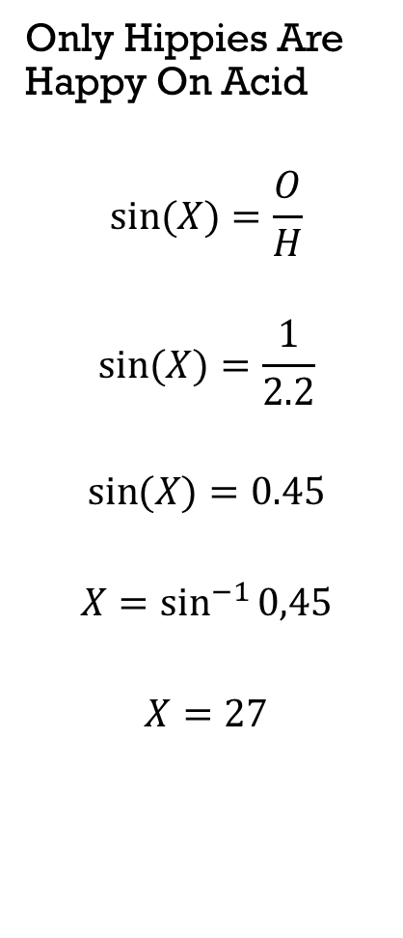

Only Hippies Are Happy On Acid
$$\sin{(X)=\frac{O}{H}}$$
$$\sin{(X)=\frac{1}{2.2}}$$
$$\sin{(X)=0.45}$$
$$X=\sin^{−1}{0,45}$$
$$X=27$$
1
2
2.2

Slide 32
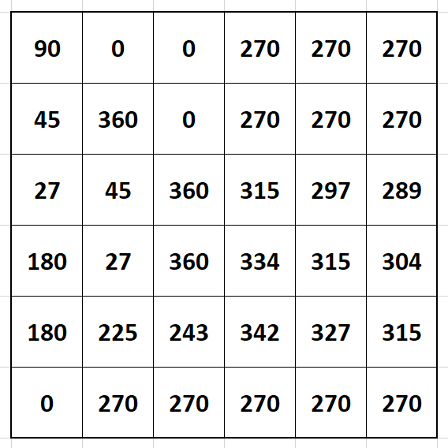

Slide 33
Next Week
An alternative means of calculating distance in raster format.

