Slide 1
Debugging Rust with Visual Studio Code
Jim Fawcett
https://JimFawcett.github.io

Slide 2
Contents
Add Visual Studio Code Plugins: Rust, CodeLLDB
Create new Rust library package
Populate package with a small amount of Rust code
lib.rs, test1.rs, test2.rs
Start debug session: Run -> start with debugging
Dismiss no launch popup, Yes to create launch popup
Look at launch.json content
Start debugging

Slide 3
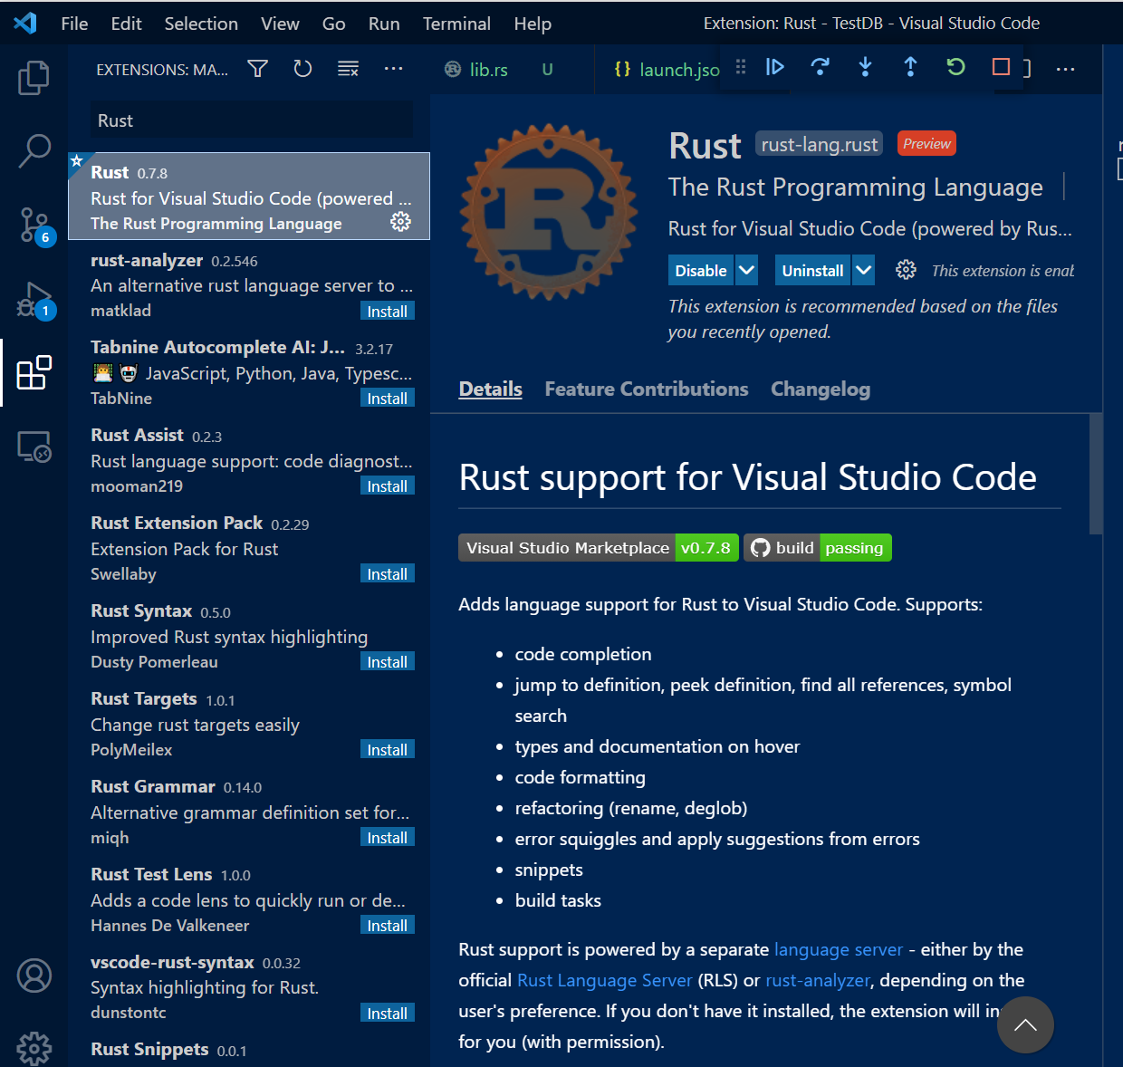
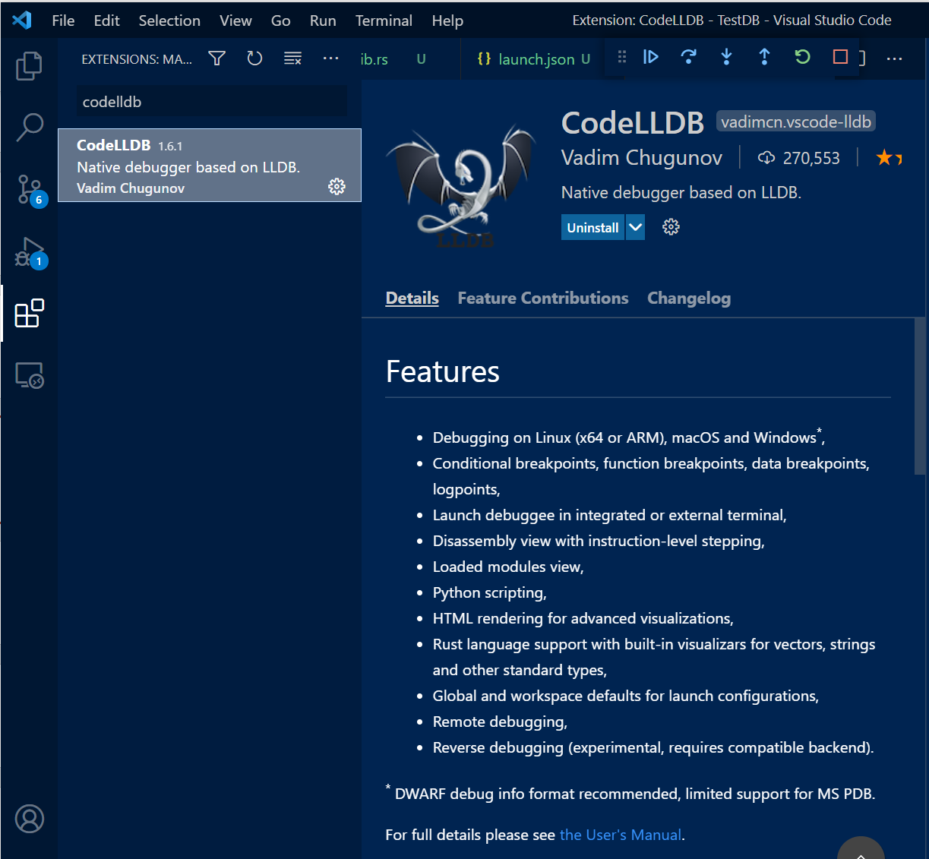
Add Plugins to Visual Studio Code

Slide 4
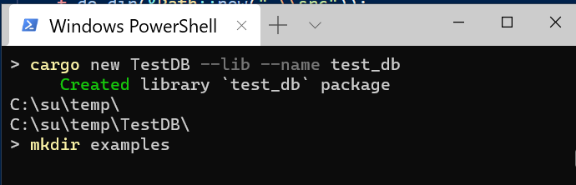
Create new Rust package
Create lib
Create examples subdirectory
Add test1.rs and test2.rs
Add a new type in the library
Add a unit test
There is no .vs directory since we have not opened in VS Code.

Slide 5
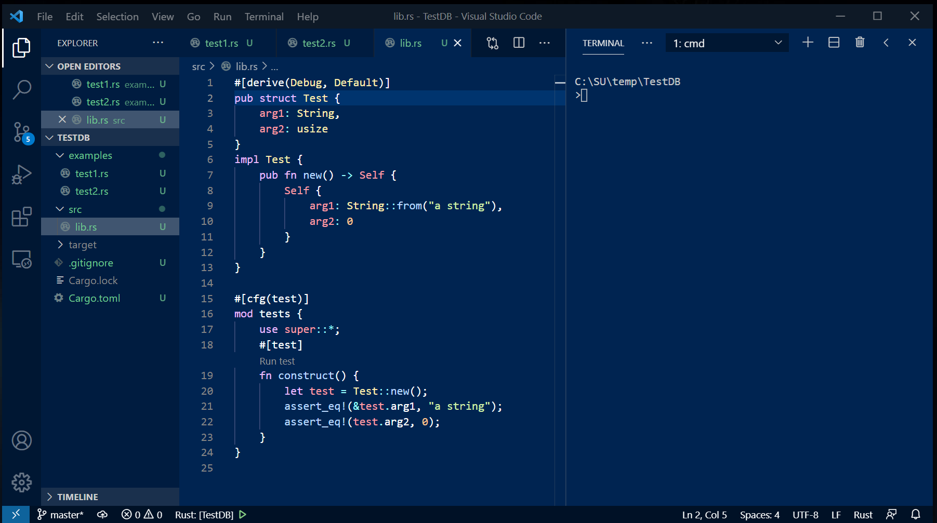
Project State before starting debug session
Almost all of this code developer enters.
Wizard only generates a basic test hook.

Slide 6
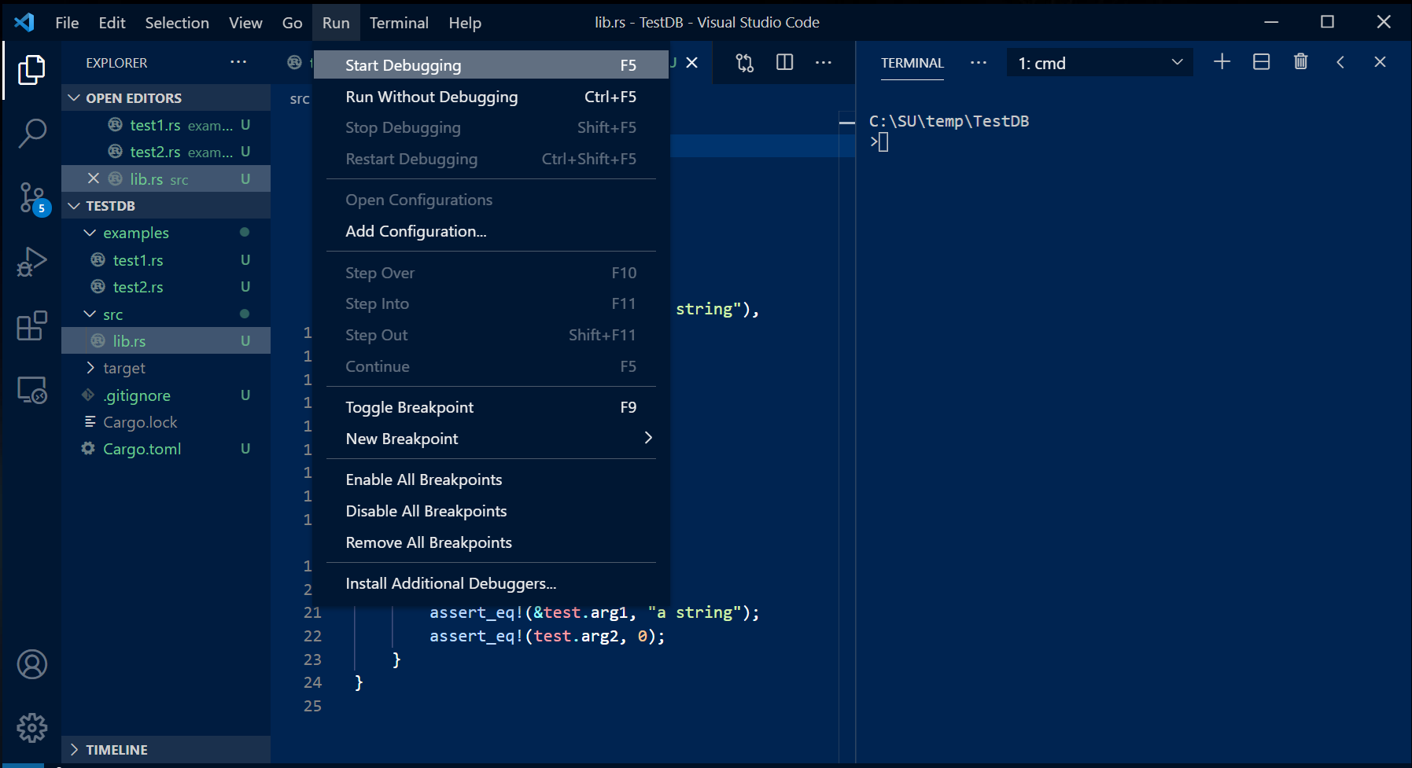
Start First Debug Session

Slide 7
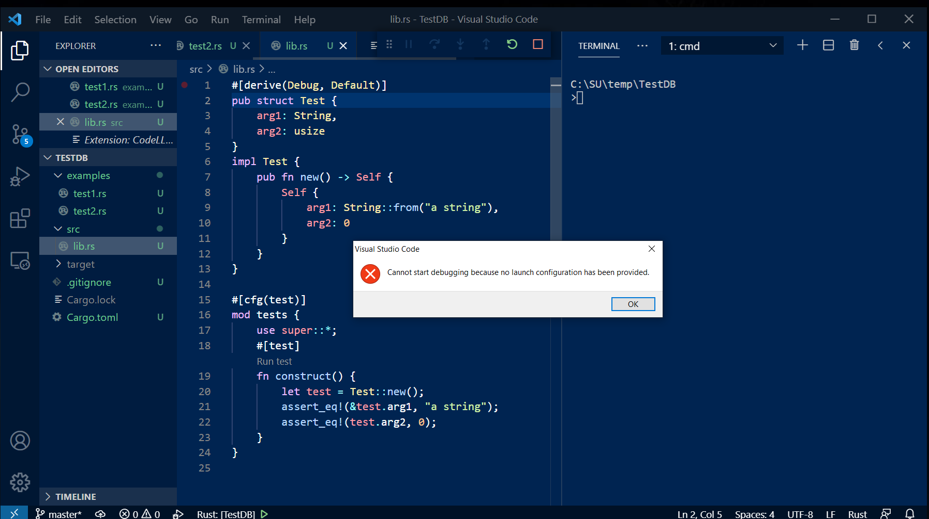
There is no launch.json so can’t start

Slide 8
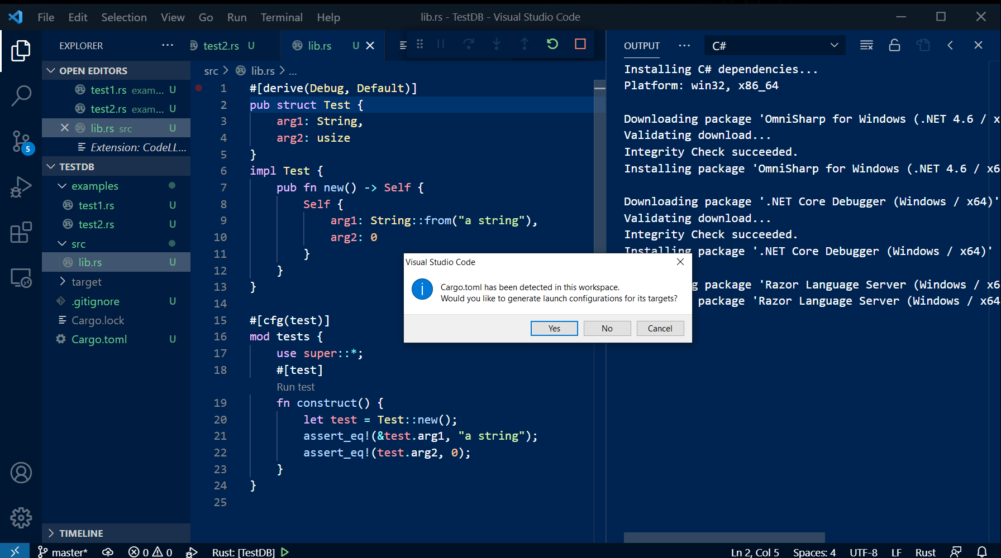
After clicking ok a new prompt appears

Slide 9
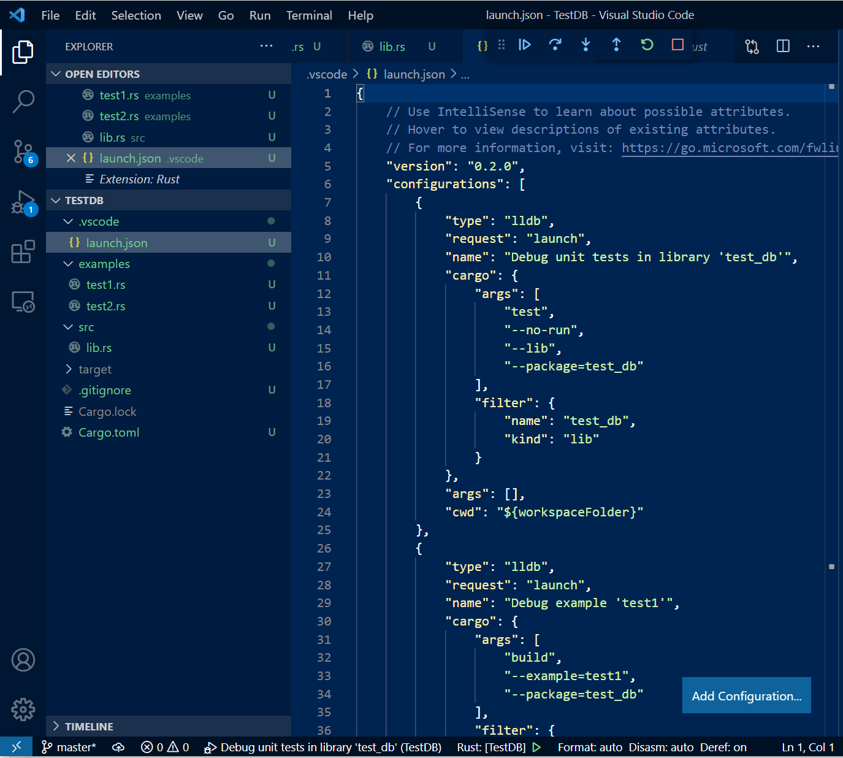
Clicking yes creates a launch.json
The Rust and CodeLLDB plugins conspire to populate the launch configurations from contents of the project directories.
Now, debugging works “out of the box”.
You may need to add command line arguments.

Slide 10
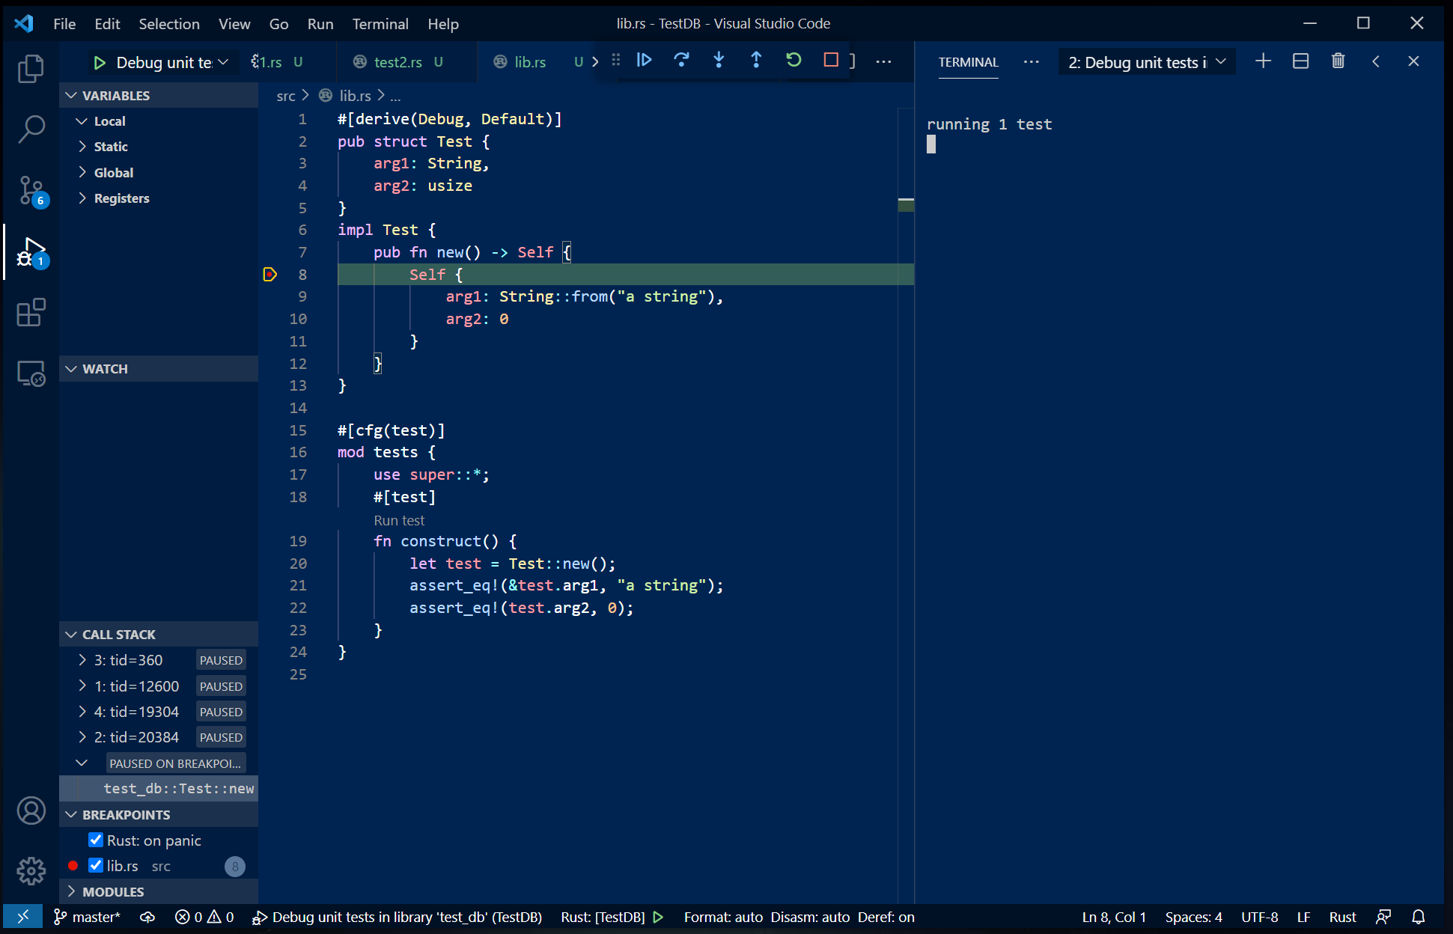
Now Debugging Works!
You can set breakpoints
Step: over, into, out of
Restart
Run to completion

Slide 11
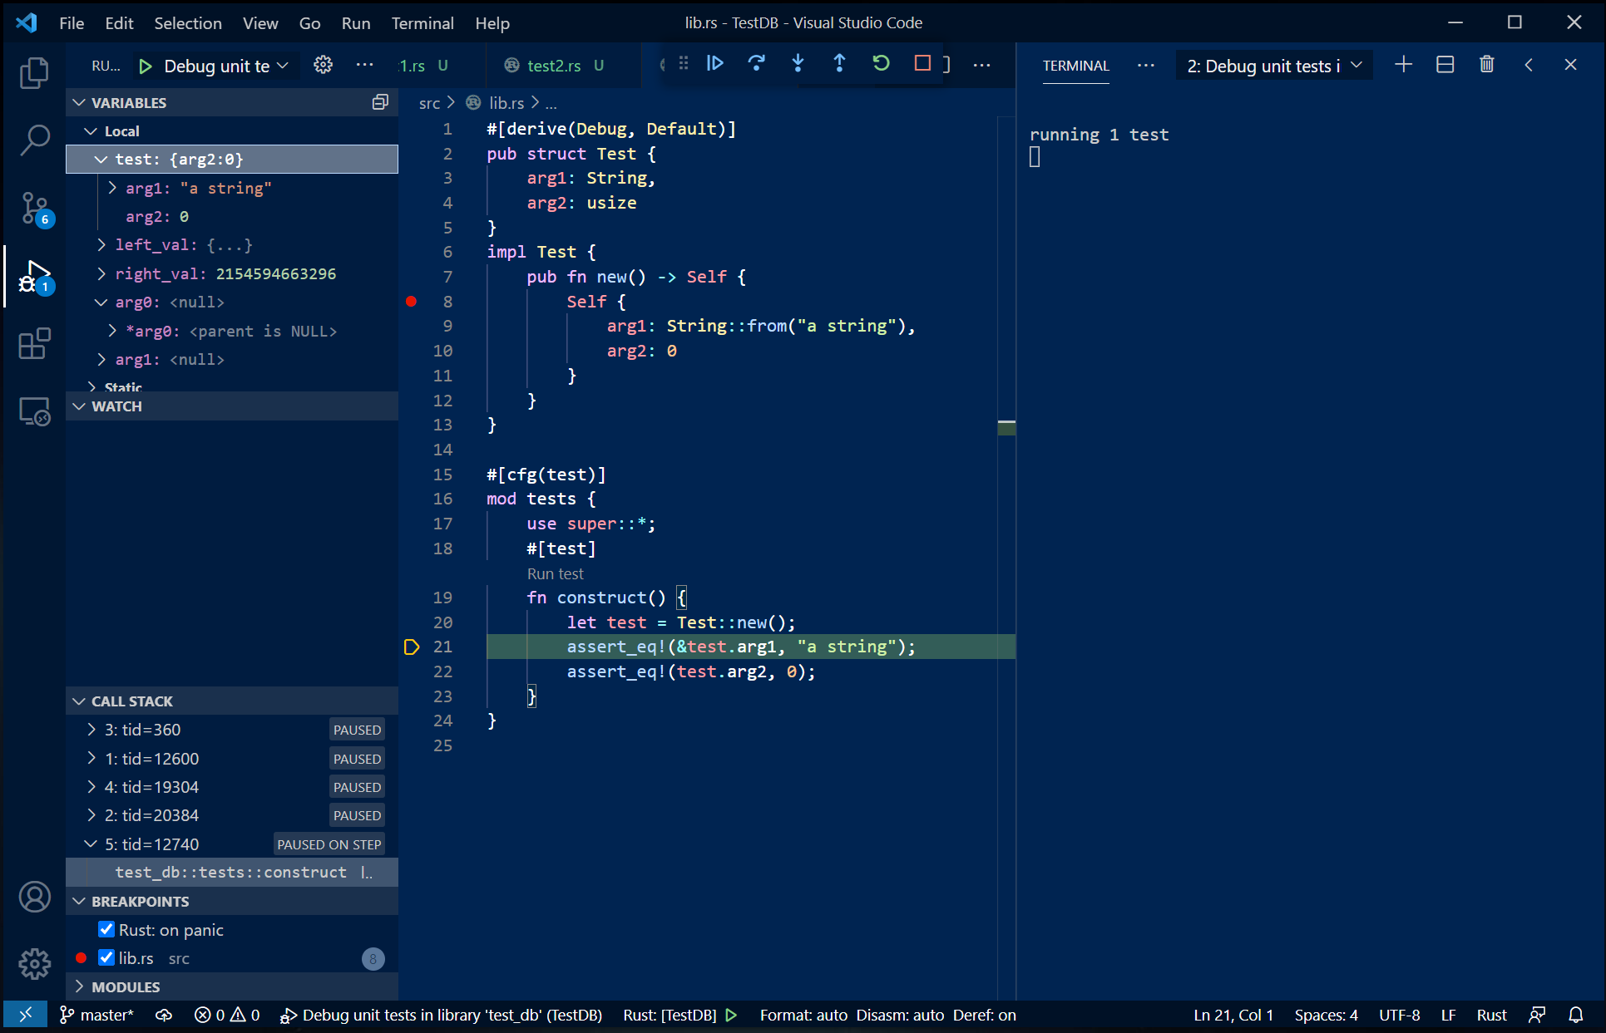
Data Visualizers – you will need to experiment

Slide 12
That’s all Folks!

