Slide 1
Consuming Rust bite by byte Bite 1 - Data
Jim Fawcett
https://JimFawcett.github.io
Intro
UDB

Slide 2
Bite #1 – Rust Data
Our goal is to understand the terms:
Bind – associate an identifier with a value
Copy – bind to a copy of a Copy type
Move – transfer ownership of a value
Clone – make a clone of a !Copy type
But first, a message from our sponsor

Slide 3
Why Rust?
Memory and Data Race safety
Enforced data ownership rules insure Memory and Data Race safety.
Error Handling
Any function that can fail returns a result indicating success or failure. Code has to handle errors in well defined ways.
Performance
Rust compiles to native code and does not need garbage collection, so it is as fast as C and C++.
Simple Value Behavior
Rust supports value behavior without the need to define copy and move constructors and assignment operators.
Extraordinarily effective tool chain

Slide 4
What is this?
This is the first in a series of bites - brief presentations - about the Rust programming language:
Each presentation will be brief – a few slides
Each will focus on one part of the Rust language
The series will build in bite sized chunks: easy to grasp, quick to consume.
Now, on with the show!

Slide 5
Bite #1 – Binding to a value
Bind – associate an identifier with a memory location
Every identifier has a type:
let k : i32 = 42;
let signifies a binding is being created
i32 is the type of a 32 bit integer
42 is a value placed in the memory location associated with k
A type is a set of legal values with associated operations.
Type inference:
let k = 42;
This binding is legal and has the same meaning as the previous binding.
In lieu of other information, Rust will assign the type i32 to any unadorned integral value that can be correctly written to a 32 bit location.

Slide 6
Bite #1 – Binding to an identifier
Binding to an identifier has several forms:
let j:i32 = k; // makes copy because k is blittable
let l = &k; // l makes reference to k, called a borrow
let s:String = “a string”.into_string();
let t = s; // moves s into t, e.g., transfers ownership // because s is not blittable
Blittable
A blittable type occupies a single contiguous block of memory, and so can be correctly copied to a new location with a single memcpy.
Non-blittable types occupy more than one memory location, usually one contiguous block on the stack and one or more blocks on the heap.
Non-blittable types cannot be successfully copied with a single memcpy operation.

Slide 7
Bite #1 - Ownership
Ownership in Rust is an interesting concept.
In Rust, data has one, and only one owner.
Ownership can be borrowed or transferred.
There are rules about ownership that we discuss in Bite #3.
Following Rust’s ownership rules makes Rust code memory-safe.
Enforced by rustc, the Rust compiler
The rules also make Rust code free from data races
Rust will not compile code that is shared between threads unless it is guarded by a lock.
That, combined with single-ownership, ensures ordered access to shared data, one thread at a time.

Slide 8
Copies, Moves
Copy
Data resides in one contiguous block of memory (blittable)
let x = 3.5;
let y = x;
y gets copy of x’s value ==> two separate locations holding the same value.
Copy binding creates new owner of new data.
Move
Data resides in two or more blocks, usually one in stack, one in heap.
let s = String::from(“a string”);
let t = s;
s value moved to t, s becomes invalid
Move binding transfers ownership

Slide 9
Bite #1 – Copy and Borrow
A copy operation can occur only for values that satisfy the Copy trait.
A trait is, like an interface, a specification of a contract. Copy contract requires Rust code, when binding, to copy data with that trait.
To satisfy Copy, the data must be blittable.
Copies happen implicitly when an identifier is bound to a Copy type.
let i = 3; let j = i; // copy
Borrows - binding references to other identifiers
A reference is a safe pointer to the bound memory location.
let r = &i;

Slide 10
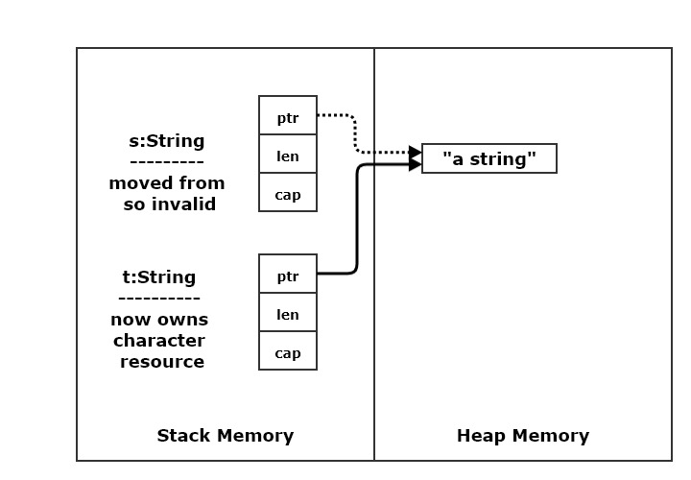
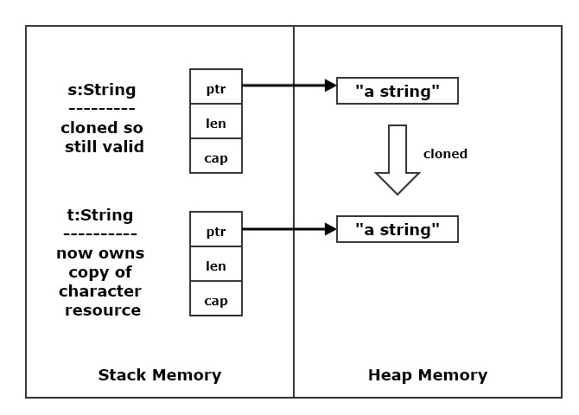
Bite #1 – Move and Clone
A move transfers a Move type’s heap resources to another instance of that type
The string, s, shown in the top diagram is moved to t with the statement:
let t = s;
Move transfers ownership of resources.
A clone copies a Move type’s heap resources to a new instance of that type.
The string s, shown in the bottom diagram is cloned with the statement:
let t = s.clone();
Clone operation copies resources to target.
Move
Clone

Slide 11
Exercises
Create an instance of a blittable type and show when it is copied.
Can you prove that it was copied?
Create an instance of a non-blittable type and show when it is moved.
Can you prove that it was moved?
Repeat the second exercise but clone the non-blittable type before moving it. Show that the clone is valid while the move source is not valid.
Hint:
Integral types, chars, and floating-point types are blittable
Strings, Vecs, VecDeques, and Maps are non-blittable.

Slide 12
References
Link | Description
ConsumingRustBite2 - UDB | Undefined behavior – example from C++ code
Rust Story - Data | Expanded discussion in Rust Story

Slide 13
That’s all until Bite #2
Bite #2 illustrates undefined behavior with C++ code, showing us why we need Rust.

