Slide 1
Rust Models
Jim Fawcett
https://JimFawcett.github.io
https://jimfawcett.github.io/Resources/RustModels.pdf

Slide 2
Model
“A model of a system or process is a theoretical description that can help you understand how the system or process works, or how it might work.” - collinsdictionary.com
Models help us understand important features
Use language effectively
Accelerate learning process

Slide 3
Models Prologue
https://JimFawcett.github.io/RustStory_Models.html
Rust is an interesting and ambitious language.
We will consider Rust Models for:
Type Safety
Ownership
Objects
User-Defined Types
Generics
Code Structure, Compilation, and Execution
Chapter 1 of the Rust Story
https://jimfawcett.github.io/RustStory_Prologue.html

Slide 4
Why Rust?
Memory Safety
No dangling pointers or null references
No reading or writing to unowned memory
Rust’s type system enforces sane ownership policies.
No Data Races
The same ownership policies applied to thread interactions ensures data race free operation
Performance
As fast as C and C++
Abstraction without Overhead
Traits and Trait objects
In the same ballpark as C++

Slide 5
Hello Rust World!
This section assumes you have no experience with Rust.
Getting started:
Install Rust - https://www.rust-lang.org/tools/install
This takes just a few minutes
Puts cargo, Rust’s package manager, builder, executer on your path
Install Visual Studio Code - https://code.visualstudio.com/download
Now we’re ready for a hello world ++ experiment.
Create a temporary directory and navigate to that in a command prompt.
Issue command: cargo new hello
Issue command: cd hello
Issue command: code . [opens Visual Studio Code in hello directory]

Slide 6
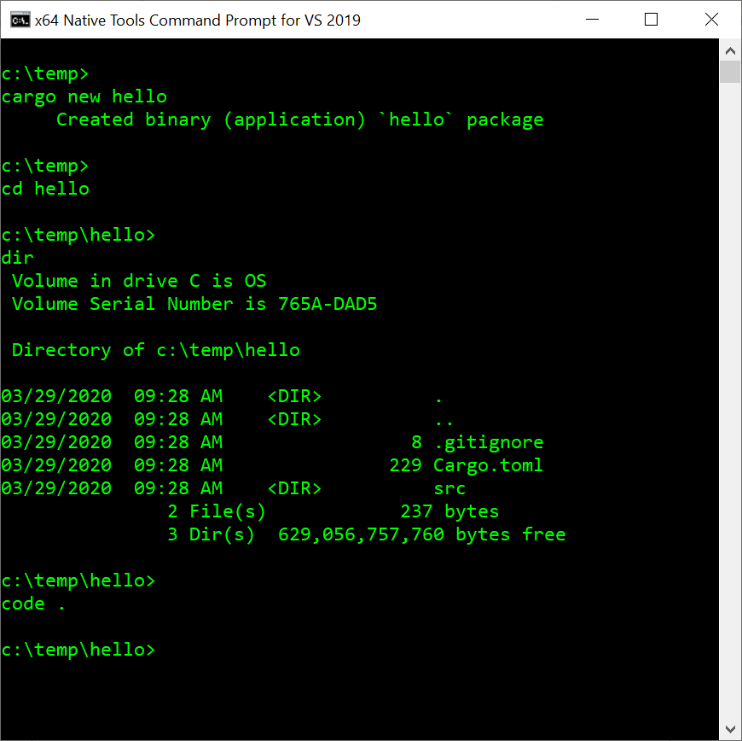
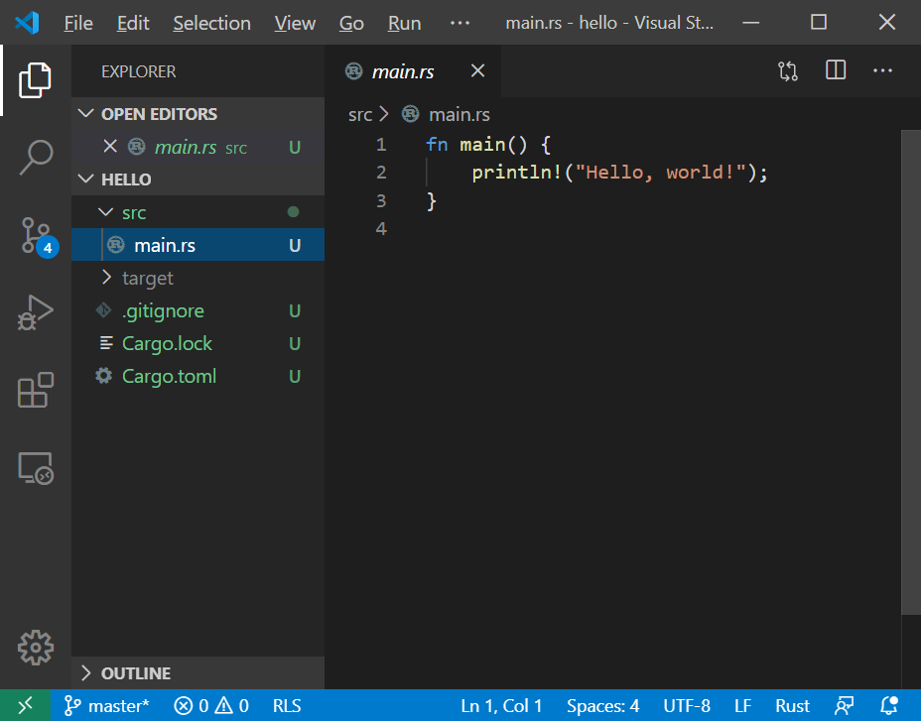
Hello World

Slide 7
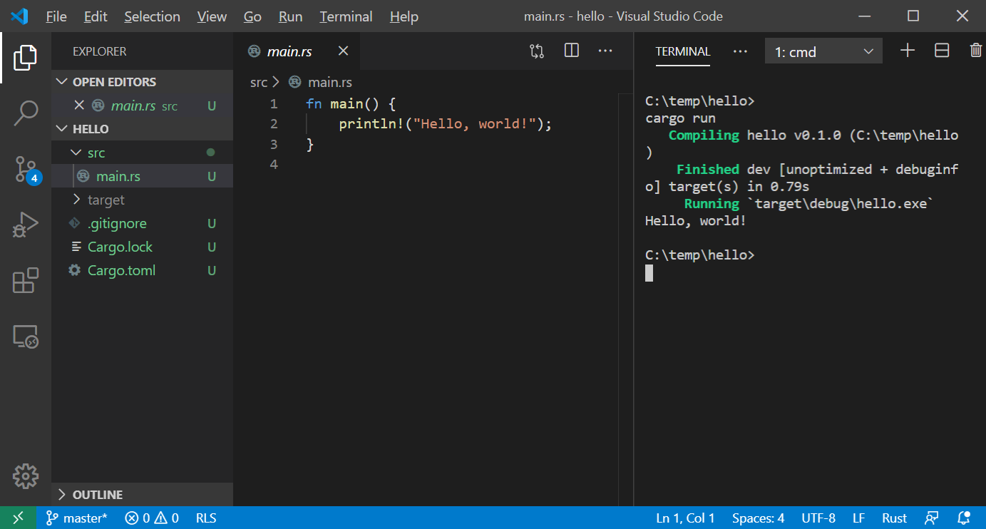
Building and Running with Cargo

Slide 8
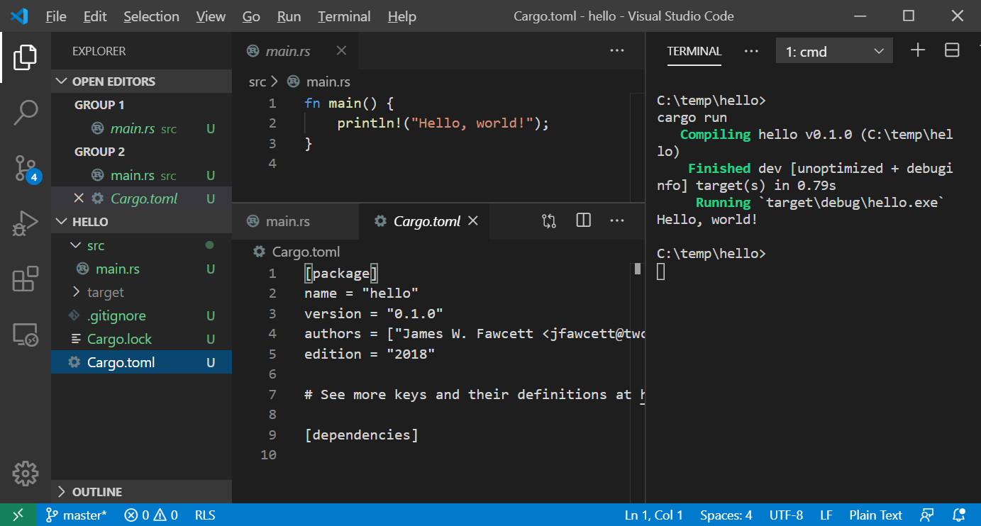
Cargo.toml – defines package

Slide 9
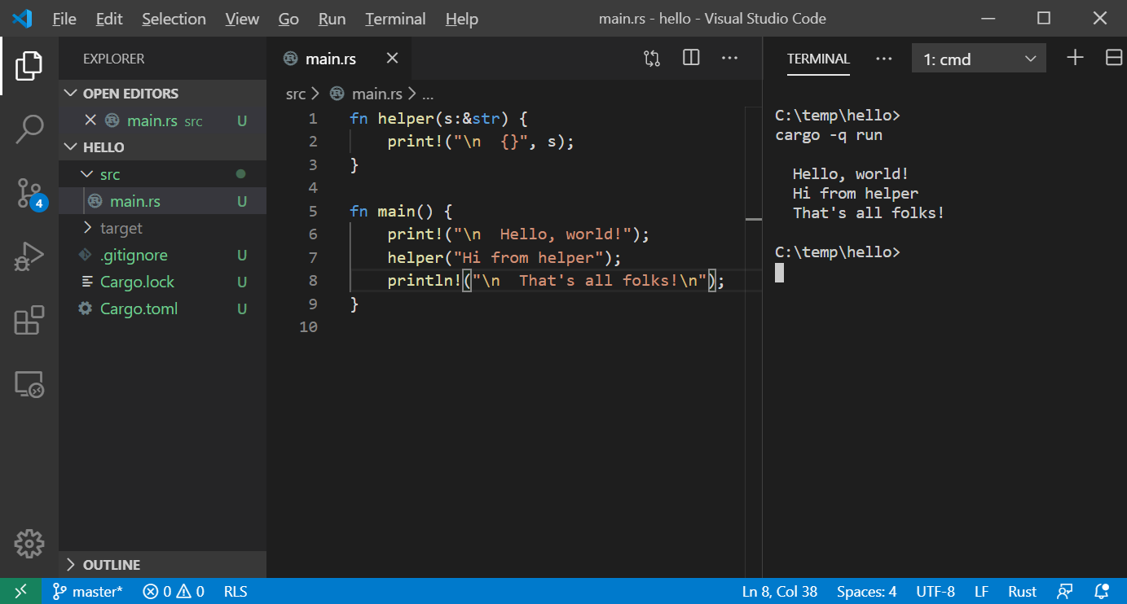
Add another function

Slide 10
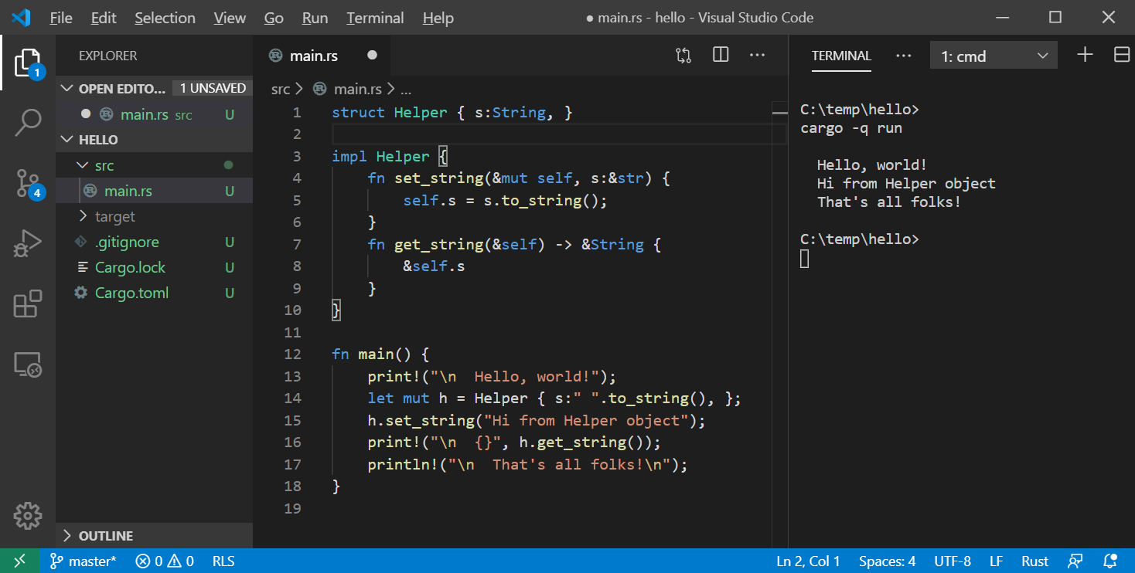
Modify to use “object”

Slide 11
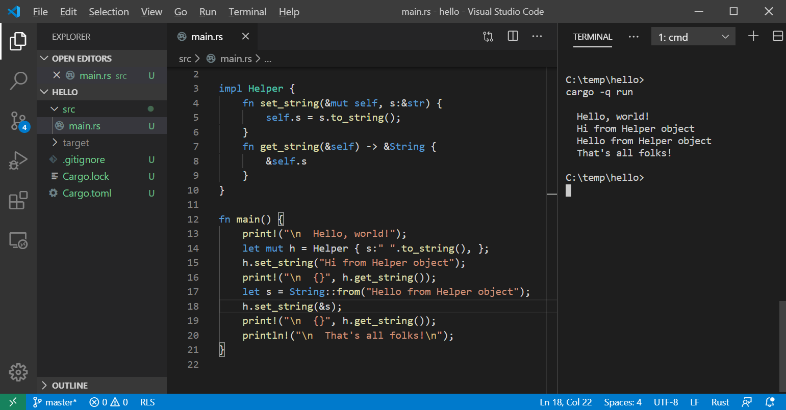
More string handling – see lines 17-18

Slide 12
Why Rust?
Memory Safety
No dangling pointers or null references
No reading or writing to unowned memory
Rust’s type system enforces sane ownership policies.
No Data Races
The same ownership policies applied to thread interactions ensures data race free operation
Performance
As fast as C and C++
Abstraction without Overhead
Traits and Trait objects
In the same ballpark as C++

Slide 13
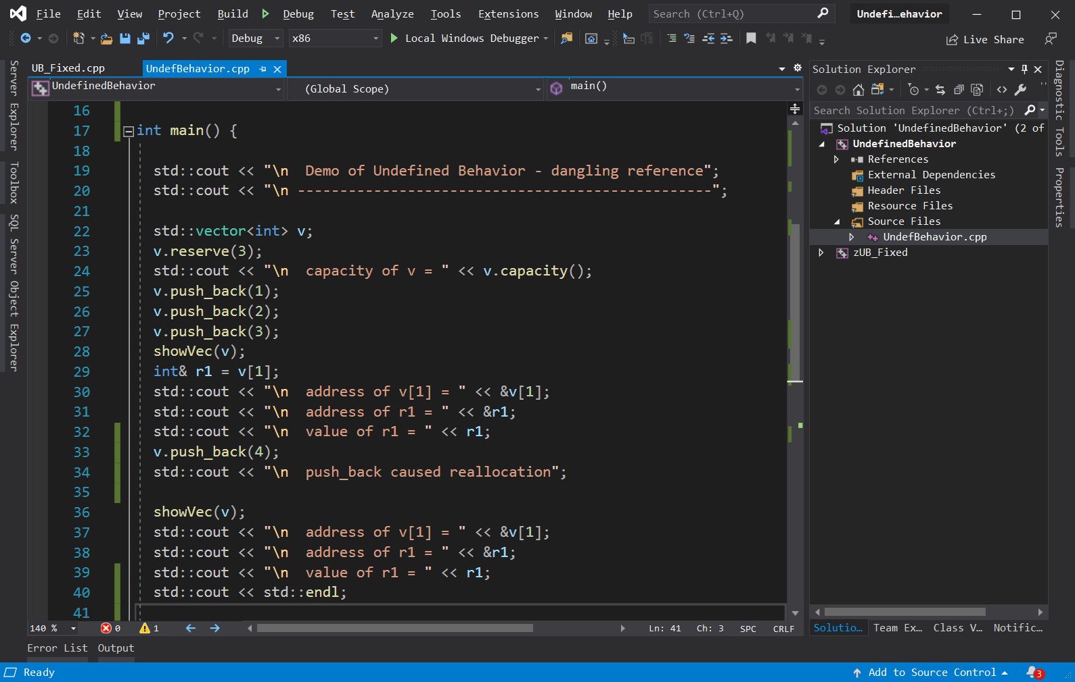
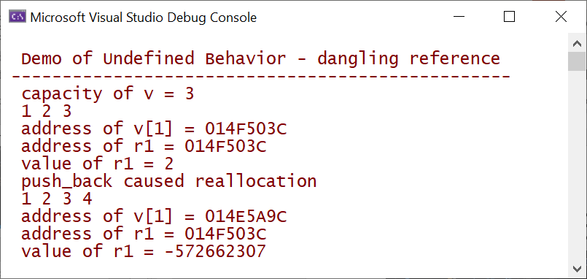
Undefined Behavior – C++ dangling reference

Slide 14
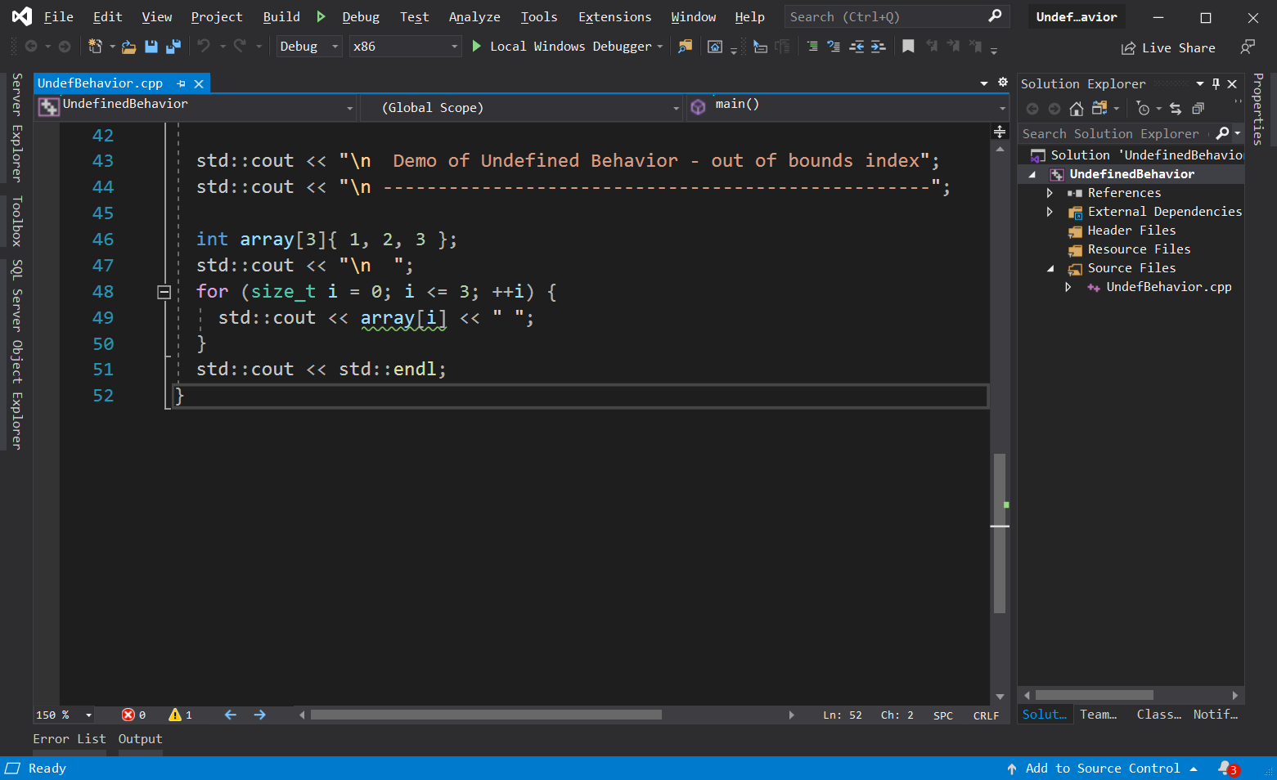
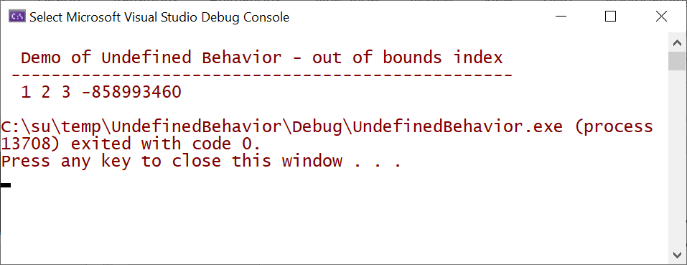
Undefined Behavior – C++ index out of bounds

Slide 15
In defense of C++ - Dangling Reference
If we had used an iterator:
auto iter1 = ++v.begin();
v.push_back(4);
Std::cout << *iter1; // throws exception – no undefined behavior
It is standard practice to access containers with iterators, so well-crafted C++ will not exhibit undefined behavior.
The difference:
With Rust you can’t get undefined behavior (UB) – most often programs fail to compile if they would have UB.
C++ code has to be well-crafted to avoid UB, errors are discovered at run-time, not compile-time.

Slide 16
In defense of C++ - Index out of Bounds
If we had used a range-based for loop:
for(auto item : array) { std::cout << item << “ “; }
there is no chance of out-of-bounds indexing
It is standard practice to traverse containers with range-based for loops, so well-crafted C++ will not exhibit undefined behavior.
The difference:
With Rust you can’t get undefined behavior (UB) – out of bounds index causes panic (exit) with no chance to access unowned memory.
C++ code has to be well-crafted, using standard idioms, to avoid UB.

Slide 17
Ownership Model
https://jimfawcett.github.io/RustStory_Models.html#ownership

Slide 18
Rust Ownership
Ownership rules are, in principle, quite simple:
Rust enforces Read-Write-Locks on data access at compile-time.
Any number of readers may access value simultaneously.
Writers get exclusive access to value – no other readers or writers.
What are readers and writers?
Any variable bound to a value with no mut qualifier is a reader.
Original owner: let s = String::from(“a string”);
References to the data: let r = &s;
Any variable bound to a value with mut qualifier is a writer:
Original owner: let mut s = String::from(“another string”);
References to the data: let mut r = &s;

Slide 19
Copies, Moves
Copy
Data resides in one contiguous block of memory (blittable)
let x = 3.5;
let y = x;
y gets copy of x’s value ==> two separate locations holding the same value.
Copy binding creates new owner of new data.
Move
Data resides in two or more blocks, usually one in stack, one in heap.
let s = String::from(“a string”);
let t = s;
s value moved to t, s becomes invalid
Move binding transfers ownership

Slide 20
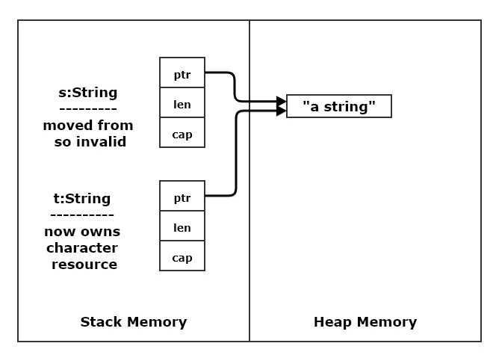
Rust Move versus Copy
Rust will copy any value contained in a single contiguous block of memory (blittable)
let x = 2;
let y = x; // copy
Any value requiring separate parts, like the string shown in the right panel will be moved.
let s = String::from(“a string”);
let t = s; // value moved from s
// t owns string, s invalid

Slide 21
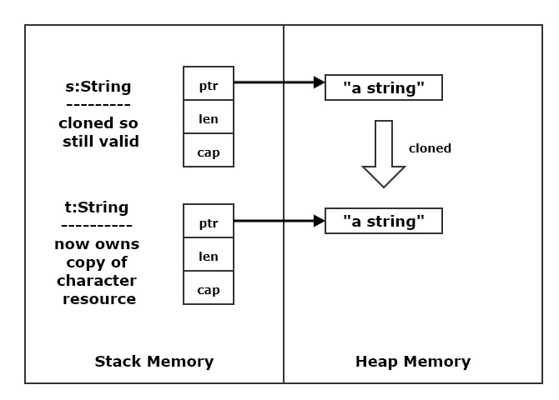
Rust Clone
Often a type satisfies clone trait (if not you can add that).
This allows moves to be avoided by explicitly calling clone() to make a copy.
let t = s.clone(); // s still valid
Clone must always be called explicitly. Rust wants you to know when you invoke an expensive operation.

Slide 22
References and RwLocking
Non-mutable Vec and references - all readers:
let v = vec![1,2,3];
let r1 = &v; let r2 = &v; // each has view of v’s data
Mutable Vec, non-mutable references – creating reference inhibits Vec mutation:
let mut v = vec![1,2,3];
let r1 = &v; let r2 = &v; // each has view of v’s data
r1 and r2 borrow v’s data // v cannot mutate while borrows are active
Borrows end when they go out of scope or are dropped, drop(r1);
Mutable data, mutable reference – writer v’s ability to write borrowed
let mut v = vec![1,2,3];
let mut r = &v; // r has borrowed v’s ability to mutate
v cannot mutate until borrow ends

Slide 23
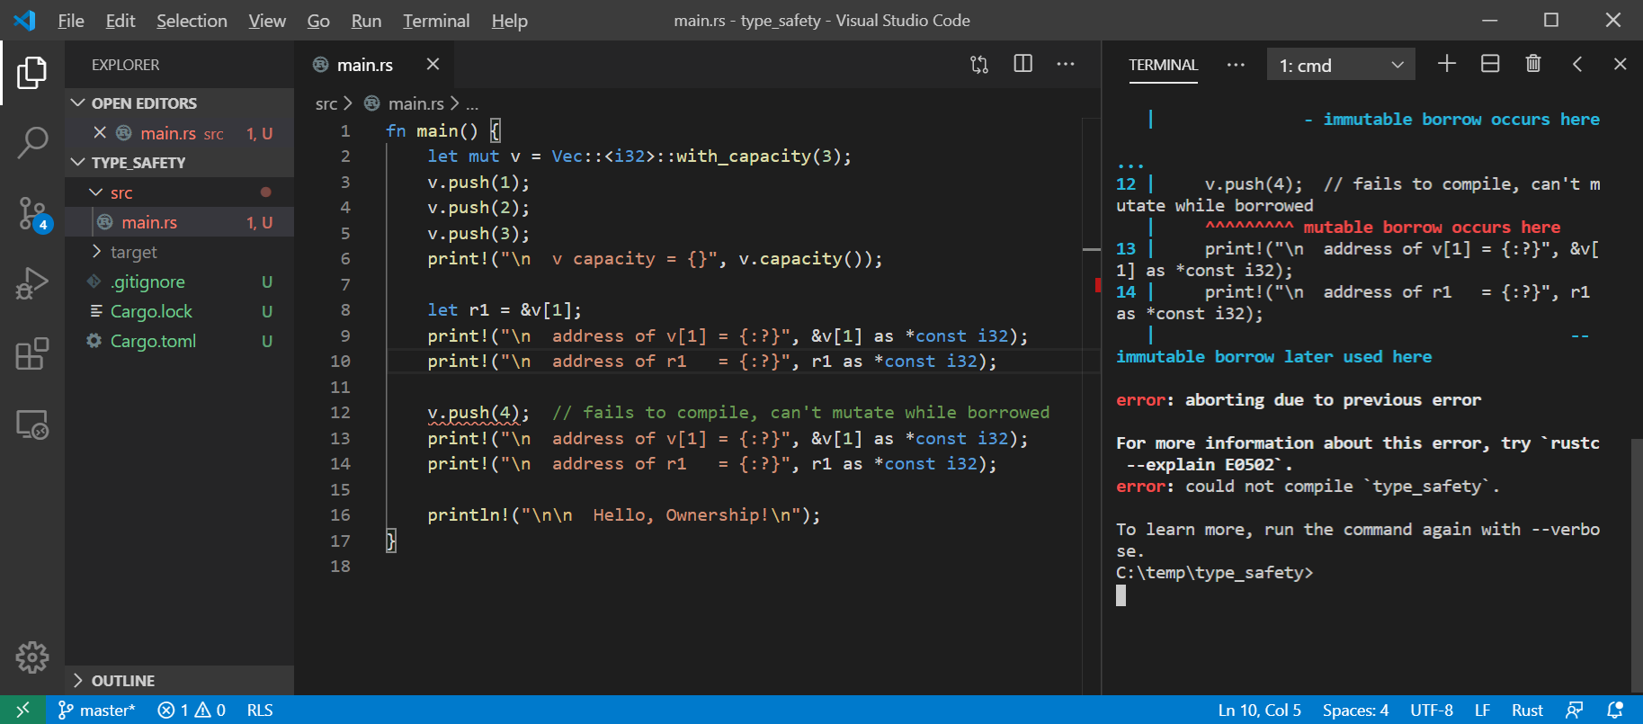
Rust won’t allow mutation with an active reference

Slide 24
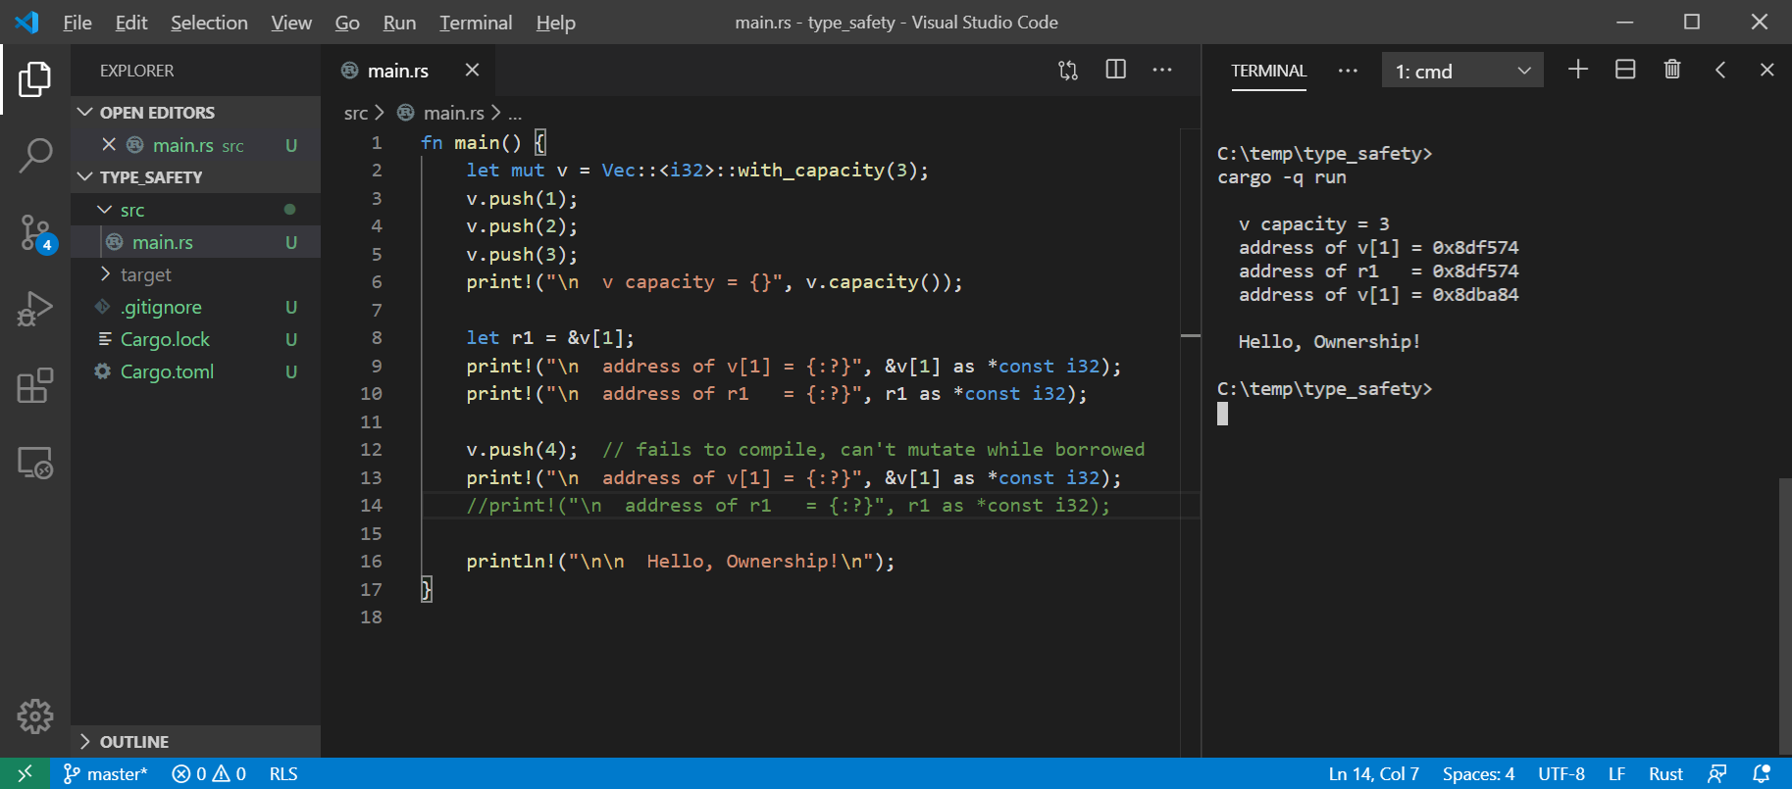
Rust allows mutation if we don’t use the reference

Slide 25
Hello Ownership!
Rust’s ownership policies:
Every value has one and only one owner
Ownership can be transferred with a move
Ownership can be borrowed with a reference
References hold a view into value
Original value’s owner can’t mutate value while borrowed
Immutable references can be shared
Mutable references are exclusive
Borrowing ends when reference goes out of scope or is dropped
This fits very well with pass by reference function arguments
Values are, by default, immutable, but can be made mutable
let x = 3; // x is immutable
let mut y = 3; // y is mutable

Slide 26
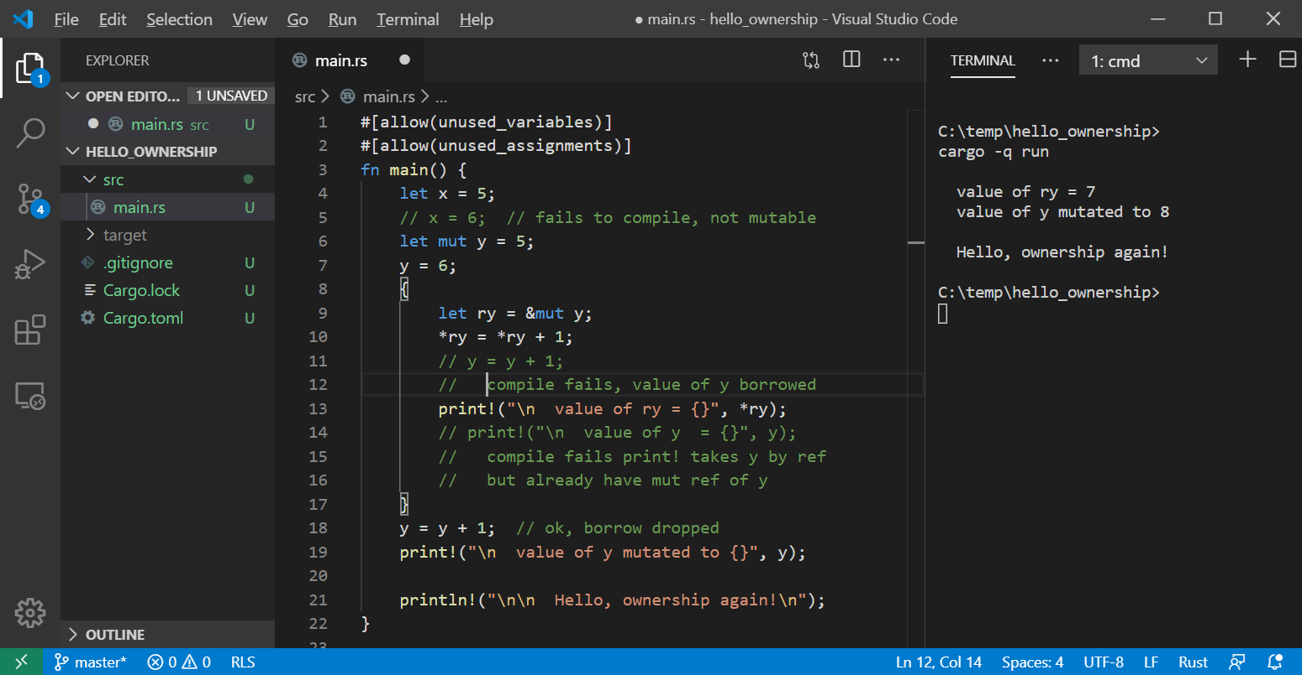
Hello Rust Ownership

Slide 27
Immutable References
Any number of immutable references may be declared for a value:
let mut s = String::from(“a string”);
let r1 = &s;
let r2 = &s;
The original owner can not mutate until all active references are dropped or go out of scope:
fn show(s:&String) { … }
let mut t = String::from(“another string”);
show(&t);
t.push_str(“ with more stuff”); // mutation ok, &t when out of scope

Slide 28
Mutable References
Only one mutable reference may be declared for a value:
let mut s = String::from(“a string”);
let r1: &mut String = &mut s;
// let r2: &mut String = &mut s; // won’t compile
// let r3 = &s; // won’t compile
The original owner can not mutate until active reference is dropped or goes out of scope (same as before):
fn show(s:&String) { … }
let mut t = String::from(“another string”);
show(&t); // copies reference to show stack frame, e.g., a borrow
t.push_str(“ with more stuff”); // mutation ok, &mut t went out of scope

Slide 29
Ownership summary
These simple rules provide memory safety:
let x = y ==> copy if blittable, otherwise move ==> transfer of ownership
Can’t use y if moved from
let r1 = &x; let r2 = &x; ==> may have any number of immutable references
x may not be mutated while there are active references
let mut z = …
Let r3 = &mut z; ==> may only have one mutable reference
References become inactive when they go out of scope or are dropped:
drop(r3);
Prefer use of references for pass by reference functions and methods

Slide 30
Rust Type System
https://jimfawcett.github.io/RustStory_Models.html#types

Slide 31
Type Safety
A program is well defined if no execution can exhibit undefined behavior.
A language is type safe if its type system ensures that every program is well defined.
A non-type safe language may introduce undefined behavior with:
Integer overflow, e.g., wrap-around
Buffer overflow – out of bounds access
Use after free – access unowned memory
Double free – corrupt memory manager
Race conditions – mutation without exclusive ownership

Slide 32
Unsafe Type System – C++ and C
Allows dangling references
std::vector<int> v { 1, 2, 3 };
int& ri = v[1];
v.push_back(4);
push_back may cause reallocation of vector memory, leaving ri dangling.
Allows out of bounds indexing
int j = v[4];
Program continues to run, results in undefined behavior
Mitigations:
Use C++ references only for passing arguments to functions.
Prefer passing by const refence to avoid side-affects.
Don’t use arrays; use std::vector.
Use range-based for loop when iterating through collections like vector.

Slide 33
Safe Type System - Rust
Rust is a type safe language, avoiding undefined behavior.
Rust’s type system prevents data races in multi-threaded programs.
Rust’s type system ensures this behavior by:
Preventing mutation combined with aliasing
Ensure memory safety
Preventing mutation, aliasing, and lack of access ordering
Avoid data races

Slide 34
Safe Type System - Rust
Prevent dangling references:
let mut v = Vec::<f64>::new();
v.push(1.0); v.push(2.0), v.push(3.0);
let r1 = &v[1];
// v.push(4.0); // fails to compile
Print!(“\n r1 = {?:}”, r1);
drop(r1);
v.push(4.0); // ok
v owns vector
r1 borrows ownership
v can’t mutate until r1 is dropped or goes out of scope
Going out of scope calls drop implicitly

Slide 35
Safe Type System - Rust
Prevent access to unowned memory:
let mut v = Vec::<f64>::new();
v.push(1.0), …
for x in v { print!(“\n {}”, x) }
for i in 0…3 { print!(“\n {}”, v[i]); }
If bound 3 is incorrect, will panic, not allowing access to unowned memory.
Rust knows the size of almost all values, and uses that in for loops like the first.
We can cause access to unowned memory, but that results in aborting the program without allowing access to unowned memory.

Slide 36
Safe Type System - Rust
Rust is a type safe language, avoiding undefined behavior.
Rust’s type system prevents data races in multi-threaded programs, based on its ownership model.
We won’t discuss data races further in these notes.
It provides level of performance and access to machine resources needed for system programming.

Slide 37
Rust Object Model
https://jimfawcett.github.io/RustStory_Models.html#objmodel

Slide 38
Rust Object Model
Rust does not have classes but structs are used in a way very similar to the way classes are used in C++.
Structs have:
Composed members, may be instances of language or user defined types.
Aggregated members, using the Box<T> construct:
Box<T> acts like a std::unique_ptr<T> in C++.
Methods - functions that accept &self which is a reference to the instance invoking the function.
&self is similar to the C++ pointer this.
Traits - implemented by a struct, similar to Java or C# interfaces.
Access control - uses the keyword pub.
Anything not decorated with pub is private but accessible in the local crate.

Slide 39
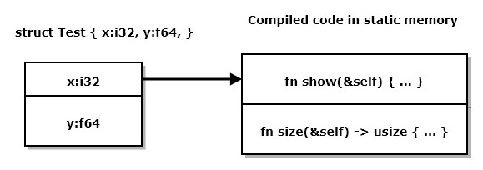
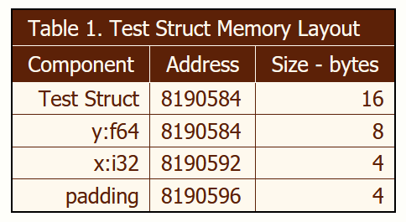
Rust Object Model – Static Binding
trait Show : Debug { … }
trait Size { … }
struct Test { x:i32, y:f64, }
impl Show for Test { … }
impl Size for Test { … }
impl Test { … }

Slide 40
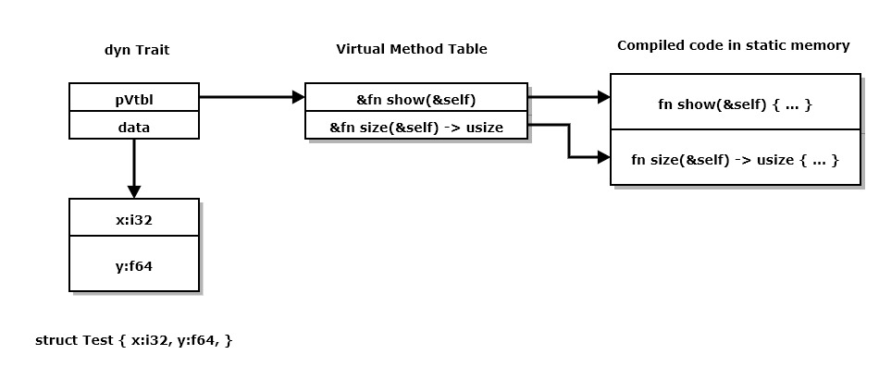
Rust Object Model – Dynamic Binding
trait Show : Debug { … }
trait Size { … }
struct Test { x:i32, y:f64, }
impl Show for Test { … }
impl Size for Test { … }
impl Test { … }
fn size_is(o:&dyn Size) ->usize {
o.size()
}
let mut t = Test { x:42, y:1.5, };
print!( "size of t = {:?}", size_is(&t)
);
Size_is doesn’t know anything about Test. It does know Size::size

Slide 41
Implementing Traits and Methods
trait Size { fn size(&self) -> usize; }
trait Show : Debug { fn show(&self) { print!(“\n {:?}”, &self); } }
pub struct Test { x:i32, y:f64, }
impl Size for Test { fn size(&self) -> usize { std::mem::size_of::<Test>() } }
impl Show : Debug { fn show(&self) { print!(“\n {:?}”, &self); } }
impl Test { pub fn new() -> Self { Self { x:42, y:1.5, } } }

Slide 42
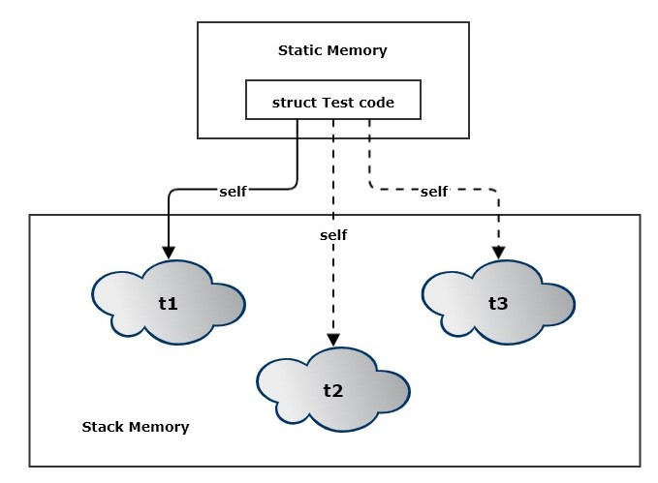
Copy and Move Types
Copy types have instances that can be copied and assigned.
let t = Test::new();
let u = t; // copy
t = u; // assign
Value types implement Copy and Clone traits
Move types have instances that are moved instead of copied. Any type that does not implement Copy is a move type.
Moveable types can implement the Clone trait.
Test is a value type.
trait Size { fn size(&self) -> usize; }
trait Show : Debug { fn show(&self) { print!(“\n {:?}”, &self); } }
pub struct Test { x:i32, y:f64, }
impl Size for Test { fn size(&self) -> usize { std::mem::size_of::<Test>() } }
impl Show : Debug { fn show(&self) { print!(“\n {:?}”, &self); } }
impl Test { pub fn new() -> Self { Self { x:42, y:1.5, } } }

Slide 43
Comparison with C++
C++ object model provides:
Composition
Aggregation
Inheritance
Most classes can be value types:
Copy constructors
Assignment operator overloads
Destructors
Many are value types by default
Members are primitive types or STL containers
Rust object model provides:
Composition
Aggregation
Traits
Provide functions but no data
Some structs are Copy, but many must be Move.
No overloads, so no overloaded assignment operators
Move types can implement clone() but that is never called implicitly

Slide 44
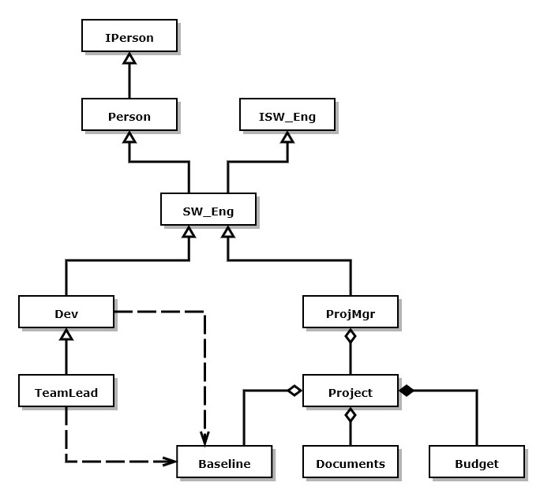
C++ Person Class Hierarchy Example – from C++ Models
The class structure shown on the right represents a software development organization.
Software Engineers inherit the person type and implement the ISW_Eng interface. SW_Eng is an abstract base class for all software engineers.
Any function that accepts a pointer to SW_Eng will also accept pointers to Devs, TeamLeads, and ProjMgrs.
If ISW_Eng defines a pure virtual method, say doWork(), any derived class can override that method.
Devs doWork that devs do
TeamLeads doWork that team leads do
ProjMgrs doWork that project managers do
So the doWork() method binds to code based on the type of object bound to an ISW_Eng pointer.

Slide 45
Rust Generics
https://jimfawcett.github.io/RustStory_Models.html#generics

Slide 46
Rust Generics
Rust Generics define constraints that limit the types that will compile.
Rust generics do not support specializations that broaden the number of types that can be used.
Generic functions:
fn demo_ref<T>(t:&T) where T:Debug { show_type(t); show_value(t); }
fn show_type<T: Debug>(_value:&T) { let name = std::any::type_name::<T>(); print!( “\n TypeId: {:?}, size: {:?}”, name, size_of::<T>() ) }
Generic structs:
#[derive(Debug)] struct Point<T> { x:T, y:T, z:T }

Slide 47
Traits
trait Show : Debug {
fn show(&self) {
print!("\n {:?}", &self);
}
}
trait Size {
fn size(&self) -> usize;
}
fn size_is(o:&dyn Size) ->usize {
o.size()
}
#[derive(Debug, Copy, Clone)]
pub struct Point<T>{ // public type
x:T, y:T, z:T, // private data
}
impl<T> Show for Point<T> where T:Debug {} // using default impl
impl<T> Size for Point<T> { // must provide impl
fn size(&self) -> usize {
std::mem::size_of::<Point<T>>()
}
}
let mut t = Point { x:0.0, y:1.0, z:0.5, };
t.show();
print!( "\n size of t = {:?}", size_is(&t) );

Slide 48
Code Structure
https://jimfawcett.github.io/RustStory_Models.html#structure

Slide 49
Code Structure
Source code is written in files
For many software systems file structures become large and hard to understand.
To support readability and maintenance, we create packages that consist of a few files with a single purpose and document the purpose and design in comments.
Source files are units of construction
Binaries - /src/main.rs – has main function, builds to an executable
Libraries - /src/lib.rs – builds to library
Modules - /src/*.rs – loaded when building binaries and libraries
A Crate is a unit of translation
Crates start as a set of source files in the /src directory and compile to a single file:
Binaries - /target/debug/[package_name].exe on windows
Libraries - /target/debug/lib[package_name].rlib

Slide 50
Crate
The source form of a crate is composed of:
A crate root, main.rs or lib.rs, and a set of zero or more supporting source files called modules, all found in the /src folder.
The crate root loads any modules identified with the keyword mod at the top of its source.
mod some_module ➔ loads some_module.rs
Each module may also load other modules.
The crate may specify dependencies on other crates and import their definitions into the root or any of its modules.
The translation form of a crate is a single compiled file, e.g., one of:
/target/debug/[package_name].exe
/target/debug/lib[package_name].rlib

Slide 51
Packages
A Package is a collection of directories and files that are the basis for builds
Cargo.toml – specifies package metadata, dependencies, and optional directives
/src – directory containing a binary or library source crate
/target – directory containing translated binaries or libraries
/examples – directory containing example code that exercises the package library
The Rust build system is transitive
Builds start with the package root cargo.toml
Parse it to find dependencies
Load the depending library and parse its cargo.toml
…
Build the local crate along with its dependencies

Slide 52
Library Crate Construction Co-Tests
For anything other than trivial example code it’s very useful to test as we build code:
A library crate is created with the command cargo new --lib [package-name].
That builds a lib.rs containing a single configured test that asserts 2 + 2 = 4.
This is simply a demonstration of how to build test cases for a library.
Each test passes if, and only if, there are no failed assertions.
Every time we add a few lines of code in the lib.rs file we add small tests, each in a configured test block and then build and execute with the command: cargo test in a terminal window located in the crate root folder.
This “co-test” process allows us to very quickly find errors. If a test fails, the problem is almost certain to be in the few lines of code we entered after the last test.

Slide 53
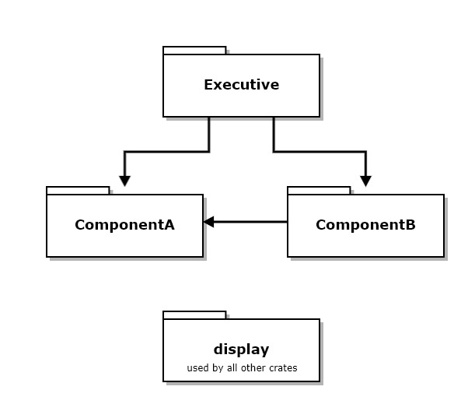
Example – Crates and Packages
The diagram at the right shows a set of crates that work together to implement some functionality.
The diagram shows dependency relationships between crates.
The ComponentA crate provides an interface and object factory to allow ComponentB and Executive to use it without binding to its implementation details.
The Executive package consists of all three of these crates.
Code for this example: https://github.com/JimFawcett/RustBasicDemos/ in code_structure_demo

Slide 54
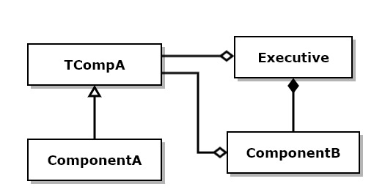
Example – Traits and Structs
This diagram shows structs that are defined in each of the files from the previous slide.
TCompA is an interface¹ trait for ComponentA
ComponentA implements the trait to provide exported services
ComponentB doesn’t provide an interface
ComponentB uses ComponentA through its interface trait and factory²
Executive composes ComponentB and uses ComponentA through its trait and factory
Rust does not have an interface construct. We use traits with virtual functions for that purpose.
ComponentA’s factory is implemented with a function, declared and implemented in ComponentA.

Slide 55
Use of Interfaces and Factories
If you look at interface trait TCompA you will see it has no implementation detail.
pub Trait TCompA {
fn do_work(&self);
fn get_msg(&self) -> String;
fn set_msg(&mut self, m:&str);
}
pub fn get_instance() -> Box<dyn TCompA> {
Box::new(ComponentA::new())
}
Executive and ComponentB use ComponentA’s factory function, get_instance to avoid binding to the concrete ComponentA type.
That means that Executive and ComponentB have no source dependencies on ComponentA. ComponentA can change any of its implementation without affecting Executive or ComponentB as long as the interface, TCompA, and factory function signature, get_instance, don’t change.

Slide 56
Build Process
https://jimfawcett.github.io/RustStory_Models.html#build

Slide 57
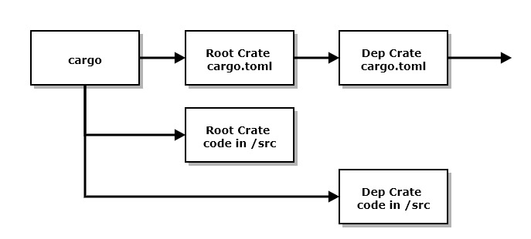
Compilation Model
Rust compilation is a transitive depth first search process.
The cargo build tool starts by parsing the package’s cargo.toml file, looking for dependencies and build attribute specifications.
For each dependency cargo parses its dependencies transitively until it reaches a cargo.toml with no dependencies.
It then builds that crate root with its loaded modules, then returns to the previous crate in the dependency tree.
When it returns to the build package it builds the files in /src and deposits its results in /target.
If any of the dependencies have current builds, that library in /target is used and files in /src are not built.
Note that cargo.toml files may list zero or more dependencies, so the dependency structure is a tree, not a list.

Slide 58
Execution Model
https://jimfawcett.github.io/RustStory_Models.html#execution

Slide 59
Program Execution
There are three ways to execute code in a fully formed crate, using cargo:
Execution of binaries: If the crate root is a binary, e.g., main.rs, the command cargo run will execute the program
Testing libraries: If the crate root is a library, e.g., lib.rs, the command cargo test will run any tests configured at the end of the library. Tests pass if there are no assertions in the test code, and fail if there are.
Running examples: For library crates, if you create a /examples folder and put demonstration modules there, then the command cargo run –example an_example will run the code in an_example.rs, assuming that you’ve supplied a main function for that module. The user expects that this code will demonstrate use of library functionality.

Slide 60
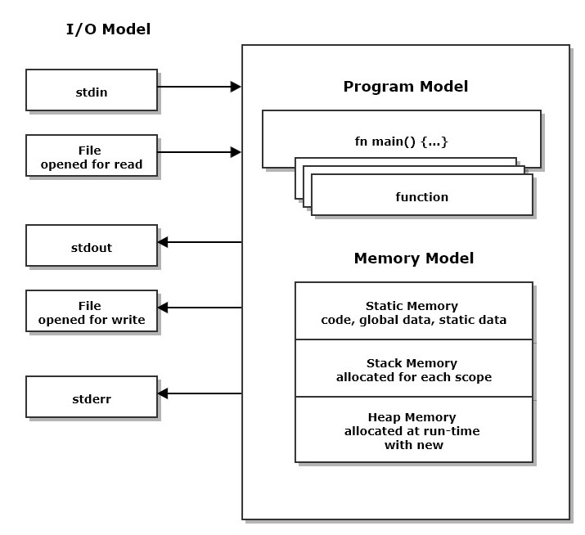
Program Execution
When the executable for a program is loaded:
Initialization code provided by the compiler executes
Then the function main is entered.
main is just a function that is defined to the linker as the entry point for processing.
Any function may call other functions within the executable.

Slide 61
Use of program memory
When the thread of execution enters a function an allocation of stack memory is used to store function parameters and any local data defined in the function.
The same thing happens for every scope, defined by a matching pair of braces, { and }. For example, an if statement, using braces, allocates stack memory to hold data local to its scope.
A program may place any of its entities, e.g., an instance of a user-defined type, into static memory, stack memory, or heap memory.
We will discuss consequences of that later in the next slide.

Slide 62
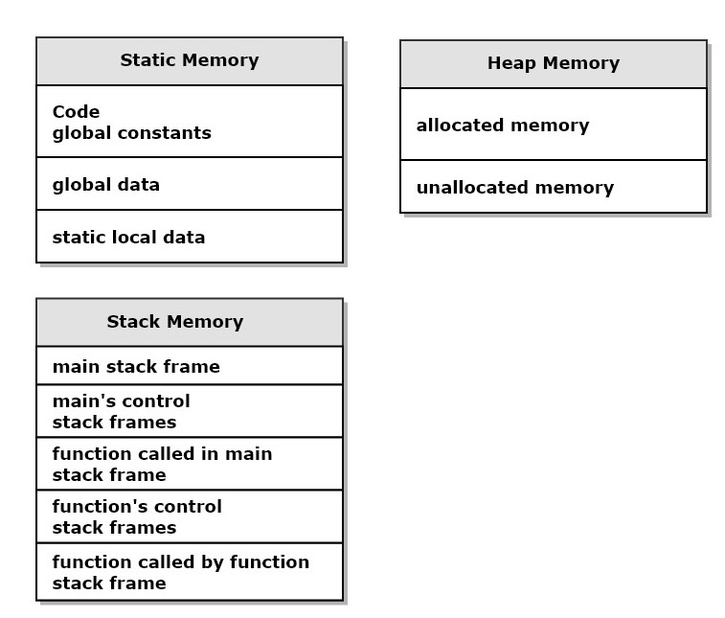
Memory Model
Static memory is used to store code and entities that live for the entire program execution
Stack memory is used as scratch-pad to store information needed in each scope, e.g., local data. It becomes invalid when the thread of execution leaves the scope.
Heap memory is used to store entities that live from the time the program creates them with a call to new until the program discards them with a call to delete

Slide 63
Control of entity placement in memory
The compiler places all code and global data in static memory.
A program can place an entity instance in static memory by qualifying its declaration with the keyword static. Rust statics should be immutable.
Rust code also places entities in stack memory by calling a function, placing function parameters and local data in its stack frame.
Also, every local scope, defined by braces, { and }, creates a new allocation of stack memory to hold data local to that scope.
An entity instance is placed in heap memory by declaring Box::new(Point { x: 1.0, y:2.0, z:3.5 }). The heap allocation is returned when the Box instance goes out of scope.

Slide 64
Interaction with the Execution Environment
There are two primary ways for a Rust program to observe and use its execution environment:
Use a stream object like std::stdin or std::stdout.
Types for streams are provided by the standard library, via import statements: use std::io::prelude::{*}, use std::fs::File, …
The program may use services of its platform API by using std::ffi (Foreign Function Interface) in an unsafe block or by using a crate that wraps that:
https://github.com/retep998/winapi-rs

Slide 65
Epilog
https://jimfawcett.github.io/RustStory_Models.html#epilogue

Slide 66
Conclusions
If you understand the 7 models, we’ve covered, I think you will find Rust syntax and semantics to be convenient and sensible.
Some particular parts of the language discussed in the Rust Story but not here are intricate and require some study to master:
String syntax and semantics because the only character type Rust recognizes in its native strings is utf-8, which uses multi-byte characters of varying sizes.
Life-time annotation needed for some scenarios using generics.
Many crates in https://crates.io are used routinely by knowledgeable Rust developers, but some take significant amounts of time and effort to use effectively.
Rust avoids undefined behavior by incorporating a safe type system. That is based on the ownership rules we’ve discussed. It takes a while to get use to the rules, but compiler error messages are usually very good.

Slide 67
Presentation Resources
The ideas discussed in this presentation are drawn from a web page: https://jimfawcett.github.io/RustStory_Models.html which is part of the Rust Story: https://jimfawcett.github.io/RustStory_Prologue.html
And code examples for the story are documented here: https://jimfawcett.github.io/RustBasicDemos.html
These slides are available here: https://jimfawcett.github.io/Resources/RustModels.pdf

Slide 68
Background
The material for this presentation comes from the github website:
https://JimFawcett.github.io, https://jimfawcett.github.io/Resources/RustModels.pdf
The site provides a curated selection of code developed for graduate software design courses at Syracuse University
It also contains tutorial and reference materials related to that code.
Some of that is presented in the form of “stories”
Rust Models is the title of the first chapter of a “Rust Story”
The story is a detailed walk-through of the Rust programming language. It provides reference material for a set of repositories that hold source code for utilities, tools, components, and demonstrations.

Slide 69
Ownership Model
https://jimfawcett.github.io/RustStory_Models.html#ownership

Slide 70
Rust Ownership
Values in Rust have only one owner, defined by a let statement:
let x = 3;
let y = x; // initialized with copy of x so x is still valid
let u = String::from(“a string”);
let v = u; // u’s value moved to v, u is no longer valid
What’s the difference here?
x is an i32 (integer), is blittable, so is copy-able
u is a String, is not blittable (String chars are stored in heap), so is moved.
A move transfers ownership to the target and invalidates the source.
Blittable values can be copied, non-blittable values can only be moved. A value is blittable if it can be copied with memcpy.

Slide 71
Move
let s = String::from(“a string”);
s consists of a control block in stack memory and a character array in the heap.
let t = s;
s’s control block is blitted to t
That preserves the pointer to the heap character array.
So now t owns the string and s is marked as invalid.
This is fast. Characters are not copied, only the small control block is copied.

