Slide 1
Publishing Source Code for Reuse and Maintenance
Jim Fawcett
11 October 2019

Slide 2
Application Domains
Academic Research: 5 – 10 code developers
Code life-time: 3 – 5 years
Example: Natural Language Processing (NLP)
Open Source Development: 5 – 1000 active developers, many casual contributors
Code life-time: 10 - 20 years
Example: Linux
Industrial Development: 5 – 10 developers
Code life-time: 5 – 20 years
Example: Machine Tool Control
Commercial Products: 10 – 30 developers
Code life-time: 20 – 30 years
Example: Microsoft Word
Aerospace Programs: 5 – 200 developers
Code life-time: 20 – 30 years
Example: Submarine control, Area surveillance, ..

Slide 3
Open-Source Domain Parts flow in, a product flows out
Open-source projects like Linux
Locally developed code flows to the cloud
Local contributors push to remote development branch
A single large system flows from the cloud to local users
Download a distro
Open-source applications like node.js
Developed by small group of contributors
Users download and install system with additional imports
Open-source libraries like jQuery.js
Developed by small group of contributors
Users bind remote library to webpages with Content Delivery Network (CDN) links
This domain already has a publishing model that has different goals than ours

Slide 4
Other Domains Components installed, flow out to users
Users search for a component to fill a current implementation need
Repository needs to be large, i.e., hold many components so there is a fairly good change to find something useful
So search and interpretation need to be effective
For repositories with hundreds of components that is not trivial
The main issues are:
Developing a useful search process that is intuitive and quick
Helping users interpret a found component
What does it do?
How is it designed?
How to integrate with existing code?

Slide 5
Goal – Support Salvage and Reuse
Software Components
Software package that has a single purpose, few dependencies, and is useful for building software systems – example: blocking queue
Salvage
Using an existing component with minor modifications
That creates another component that must be configured and managed
Reuse
Reuse an existing component with no modification
Used by composing, using as template argument, or using as base for derived classes

Slide 6
Publishing Code for (Re)use
Publishing some code artifact is the act of making it available, in useable form.
Five main facets:
Containment
Delivery
Location
Interpretation
Quality Control

Slide 7
The Issues
Source code containment and delivery are solved problems
Cloud-based facilities like github do that very well
The issues are finding and understanding code relevant to a need
We want most code repositories to be large – to support broad reuse
How do we find, in a large repository, code that fills some need?
Website documentation, collocated with source code, is a good option
To support both salvage and reuse documentation needs to provide information about the component’s concept, design, and typical use
Notes:
The code base for commercial and industrial projects have hundreds, perhaps thousands of files.
If we find code, how do we use it?
What are its dependencies?
How does it work?

Slide 8
Website for Publishing Reusable Components
A site for publishing source code will need:
A structure for holding organized collections of code
Documentation for each component
Concept, Design, Useage, Status
Additional resources to help users understand relevant technologies
Language and platform references
Brief code snapshots with commentary, provided as webpages
Related blogs and opinion pieces
Code standards

Slide 9
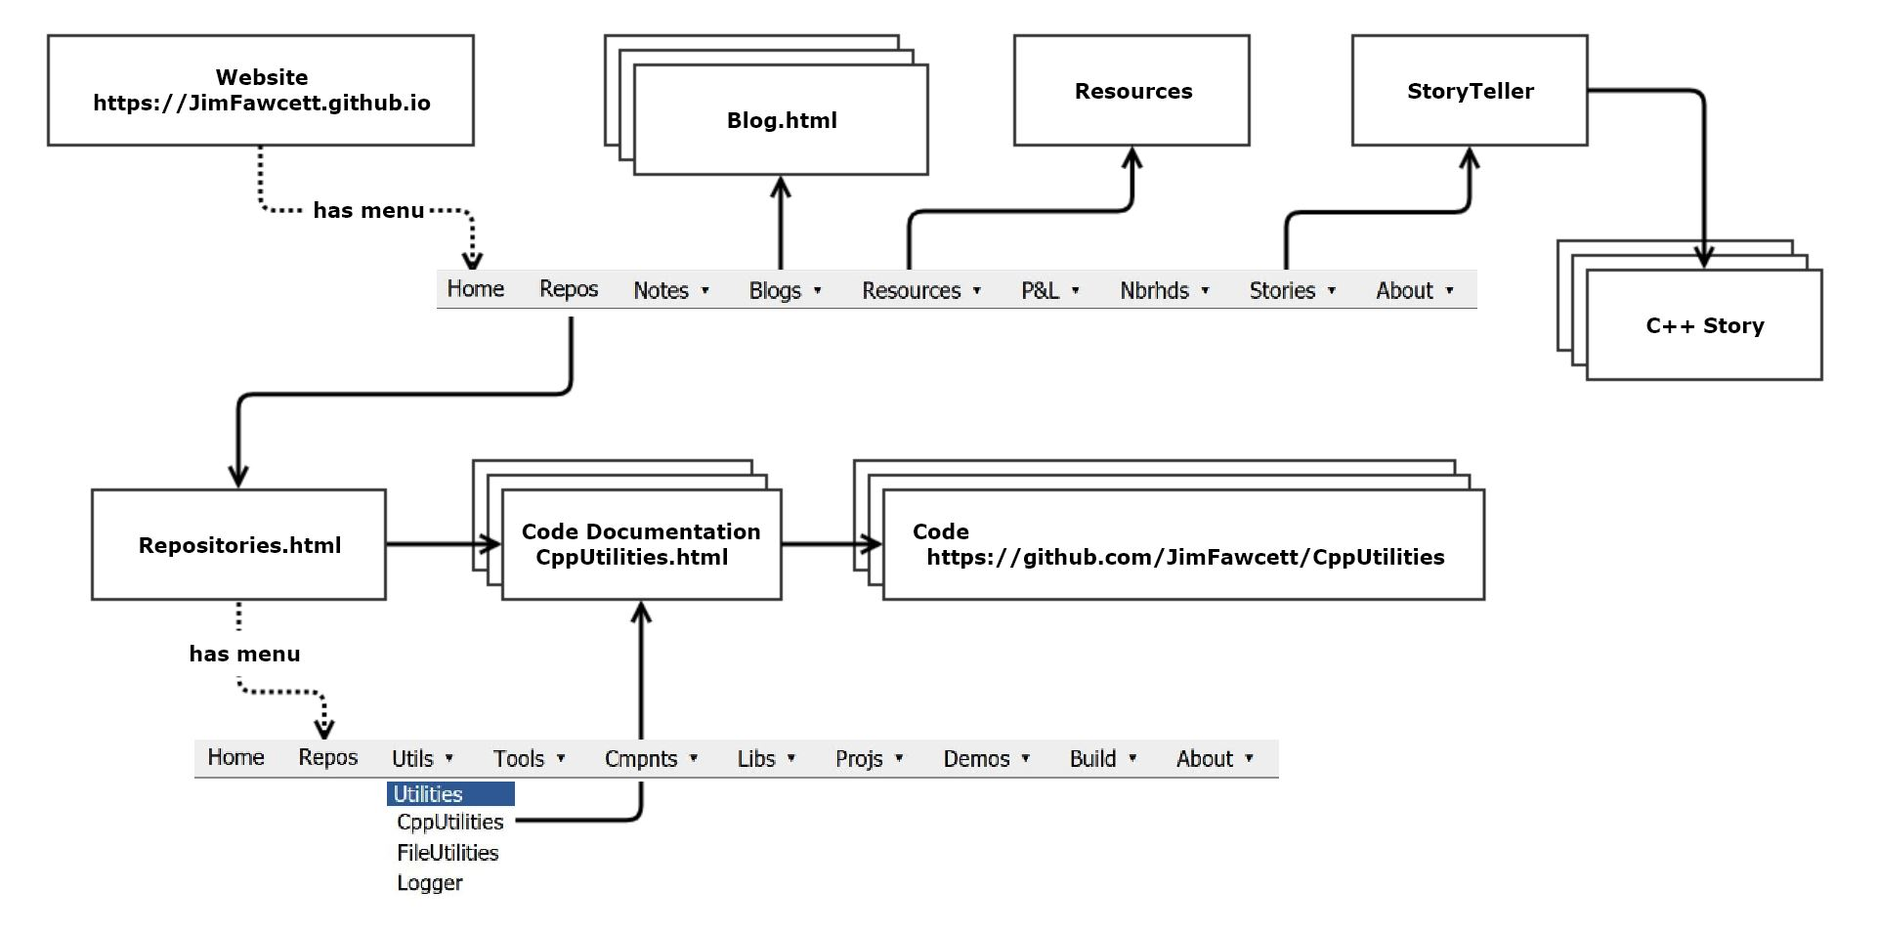
Site Structure

Slide 10
Academic Research Domain
Academic Research: 5 – 10 code developers
Code life-time: 3 – 5 years
Example: Natural Language Processing (NLP)
An academic researcher may have 2 or 3 doctoral candidates working on related parts of a research project.
She may collaborate with two or three colleagues, perhaps at different universities.
Each of those colleagues may have a similar team working on related projects.
There usually is continuing work on the same or related research projects for many years.
It is quite common that this work develops software tools for gathering and analyzing data. Sometimes software is part of the end product, e.g., compilers for a new language, an architecture for streaming or classifying content, …
These software developments are rarely maintained well. Often documentation is nothing but poorly written code.
Software exchange is often ad-hoc.

Slide 11
Open Source Domain
Open Source Development: 5 – 1000 active developers, many casual contributors
Code life-time: 10 - 20 years
Examples: Linux, Node.js, MongoDB
Following an initial period of development, a project often settles into a maintenance mode:
Maintain the same mission and design.
Add new features and port to new platforms.
Occasionally revise most of the code and support new missions.
Documentation varies from poor to outstanding.
Some projects focus on api level documentation – how to use the code.
Some focus on maintenance – what are the parts, how are they related, code standards, …

Slide 12
Domain
Open Source Development: 5 – 10 active developers, many casual contributors
Code life-time: 10 - 20 years
Example: Linux
Industrial Development: 5 – 10 developers
Code life-time: 5 – 20 years
Example: Machine Tool Control
Commercial Products:
Code life-time: 20 – 30 years
Example: Microsoft Word
Aerospace Programs: 5 – 200 developers
Code life-time: 20 – 30 years
Example: Submarine control, Area surveillance, ..

