Slide 1
Publishing Source Code for Reuse and Maintenance https://JimFawcett.github.io/Resources/PublishingSourceCode.pdf
Jim Fawcett
11 October 2019

Slide 2
Publishing Code Topics
Software Salvage and Reuse
Publishing Code Components
Repository Structure
Quality Control
Experiments
Conclusions
Alternate View – briefer and denser - Site Story from StoryTeller: https://JimFawcett.github.io/StoryTeller.html

Slide 3
Software Salvage and Reuse
Software Components
Software package that has a single purpose, few dependencies, and is useful for building software systems – example: blocking queue
Salvage (good)
Use existing components with minor modifications
That creates new components that must be configured and managed
Reuse (better)
Reuse existing components with no modification
Use by composing, use as template argument, or use as base for derived classes
Purpose
Improve productivity by building fewer lines of code
Avoid introducing new defects and performance issues

Slide 4
Software Reuse – Good news and bad news
Reusing code from compiler libraries has been spectacularly successful
Each language defines a set of libraries that support building projects
Updated with each new standardization of the language.
Software reuse in the academic, industrial, and commercial domains has often been disappointing
Typical use is:
Grab the last relevant project(s)
Attempt to throw away unneeded parts
Sometimes we keep unneeded parts because too much breaks if we remove
That causes maintenance problems
Merge and add needed new parts
Spend a lot of time fixing breakage

Slide 5
Application Domain Targets – Candidates for Support?
Academic Research: 5 – 10 code developers
Code life-time: 3 – 5 years
Example: Natural Language Processing (NLP)
Open Source Development: 5 – 1000 active developers, many casual contributors
Code life-time: 10 - 20 years
Example: Linux
Industrial Development: 5 – 10 developers
Code life-time: 5 – 20 years
Example: Machine Tool Control
Commercial Products: 10 – 30 developers
Code life-time: 20 – 30 years
Example: Microsoft Word
Aerospace Programs: 5 – 200 developers
Code life-time: 20 – 30 years
Example: Submarine control, Area surveillance, ..

Slide 6
Supporting Software Reuse
Purpose: to provide for application domain specific code the same advantages attained from compiler libraries
For reuse a software component should be designed so that reusing in a new project is quicker and easier than creating from scratch
There are many good examples, e.g., the C++ Standard Template Library and Apache HttpComponents.
How to do that is a topic for another story.
Components must be available
That implies some cloud-based repository
Components need to be documented
Concept, use statement, use examples, design, status

Slide 7
Website Story Prologue
This is a presentation of goals and features of a website designed to publish source code in support of software reuse.
https://JimFawcett.github.io Take a quick tour
The site is a second-generation facility based on experience with an academic website:
https://ecs.syr.edu/faculty/fawcett/handouts/Webpages/fawcettHome.htm
I used that site for graduate software design courses taught at Syracuse University for many years.
Published lecture content
Provided access to code components students used for class projects

Slide 8
Publishing Code Components for (Re)use
The goal of this site is to improve that first site’s process by publishing code in an effective way
Publishing some code artifact is the act of making it available, in usable form.
Five main facets of publication:
Containment
Delivery
Location
Interpretation
Quality Control

Slide 9
The Issues
Source code containment and delivery are solved problems
Cloud-based facilities like github do that very well
The issues are finding and understanding code relevant to a need
We want most code repository collections to be large – support broad reuse
How do we find, in a large repository collection, code that fills some need?
A good option - website documentation, colocated with source code
To support both salvage and reuse, documentation needs to provide information about the component’s concept, design, and typical use
Notes:
The code base for commercial and industrial projects have hundreds, perhaps thousands of files.
If we find code, how do we use it?
What are its dependencies?
How does it work?

Slide 10
Website for Publishing Reusable Components
A site for publishing source code will need:
A structure for holding organized collections of code
An intuitive navigation process to find specific code and resources
Documentation for each component
Concept, Design, Usage, Status
Additional resources to help users understand relevant technologies
Language and platform references
Brief code snapshots with commentary, provided as webpages
Related blogs and opinion pieces
Code standards
Stories and Videos
Discussions, each focused on a single theme

Slide 11
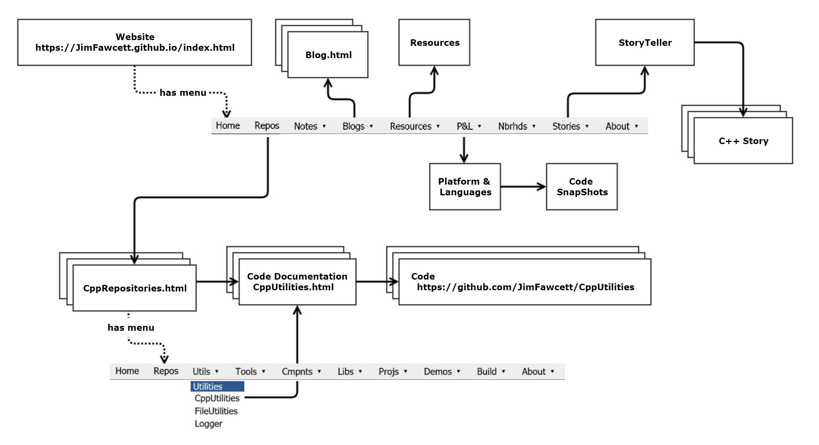
Site Structure – https://JimFawcett.github.io

Slide 12
Definitions - Repository
“A software repository, colloquially known as a "repo" for short, is a storage location from which software packages may be retrieved and installed on a computer. These repositories often house metadata about the packages stored in the repository.” – Wikipedia software Repository
“A repository is like a folder for your project. Your project's repository contains all of your project's files and stores each file's revision history. You can also discuss and manage your project's work within the repository.” - GitHub Help
Common use of the Repository name often implies the totality of all components served from one site. We follow github with a narrower definition, i.e., a place to hold one project from a site that may make many projects available.

Slide 13
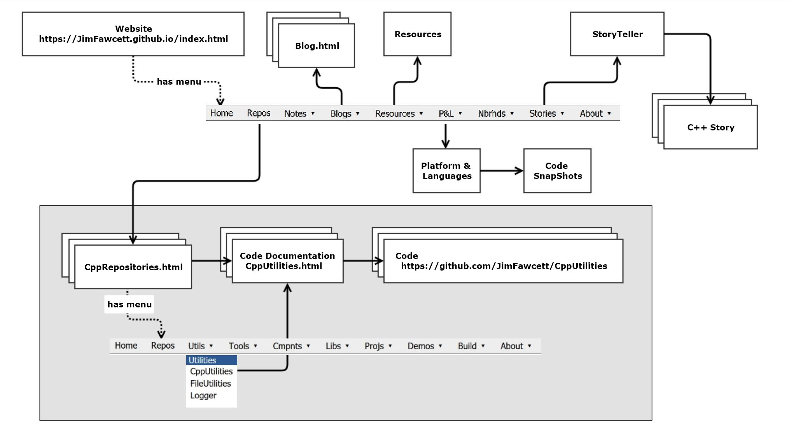
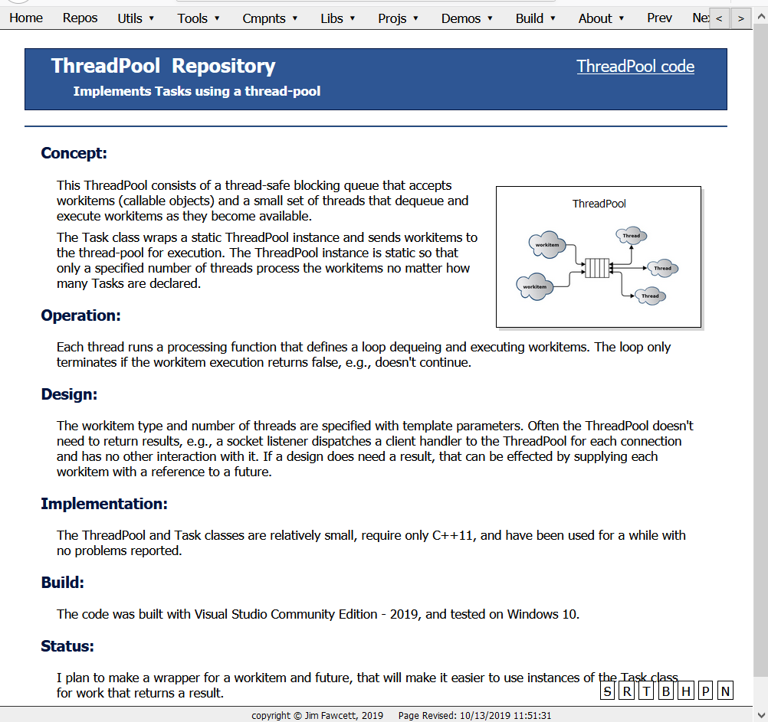
Site Structure - Code Repos https://JimFawcett.github.io/Repositories.html
Code Repositories are the most important part
Goal is to have large collections to promote broad reuse
Navigation is an issue. Solution:
Link from Home menu
Factor into (language or product specific) collections
Factor each collection into individual repositories (utilities, tools, … )
Link first to documentation which then links to code folder

Slide 14
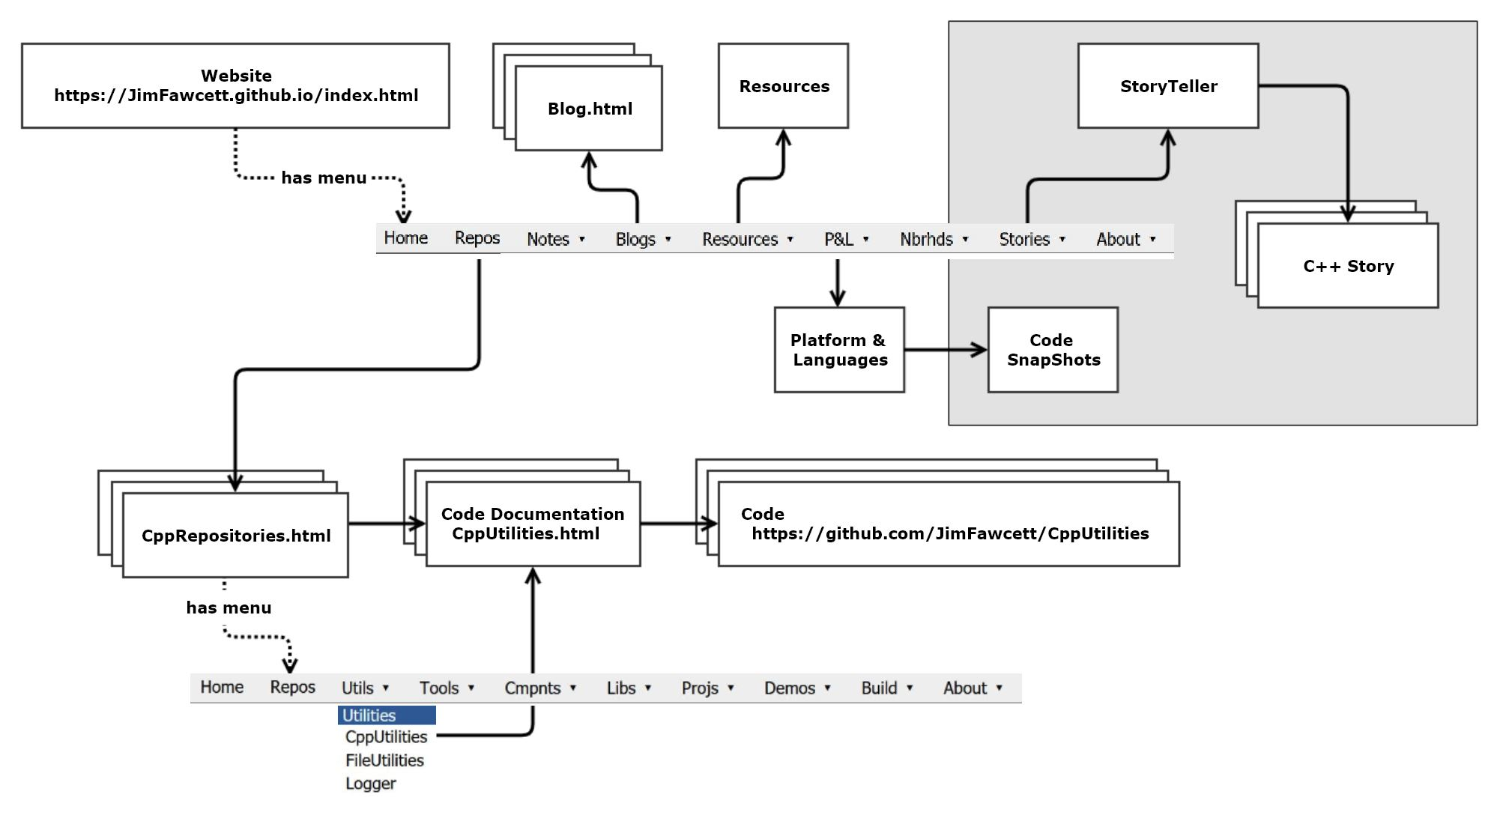
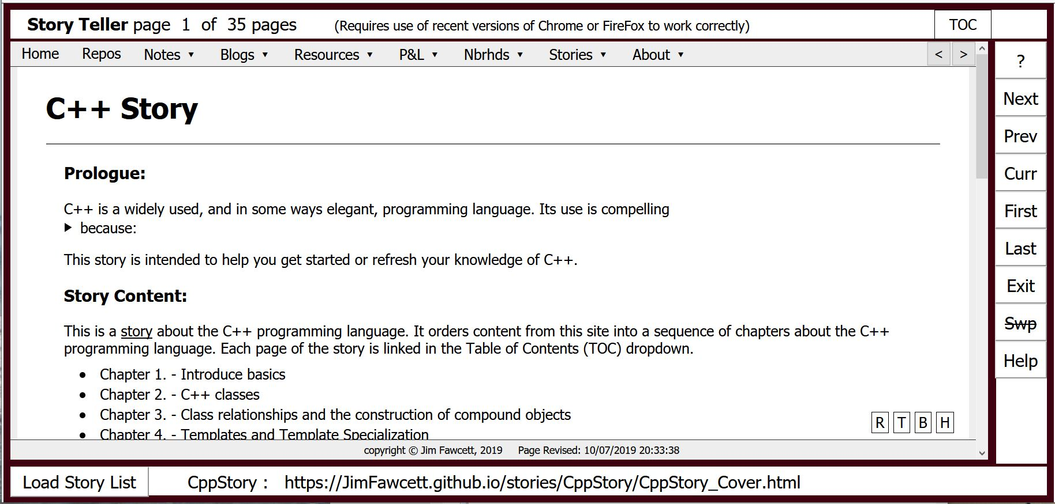
Site Structure – Stories https://JimFawcett.github.io/StoryTeller.html
Stories are organized collections of pages from the site that all focus on a single theme
Intent is to help users grapple with site content
Examples are:
C++ story – tutorial material
SiteStory – description of this site
MLiPS – guest story about ML
Image to the left is StoryTeller interface

Slide 15
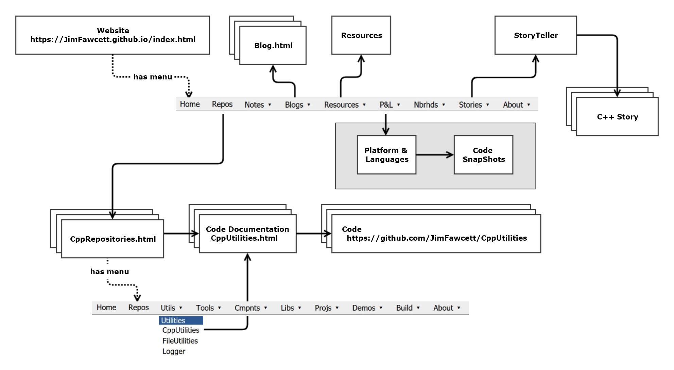
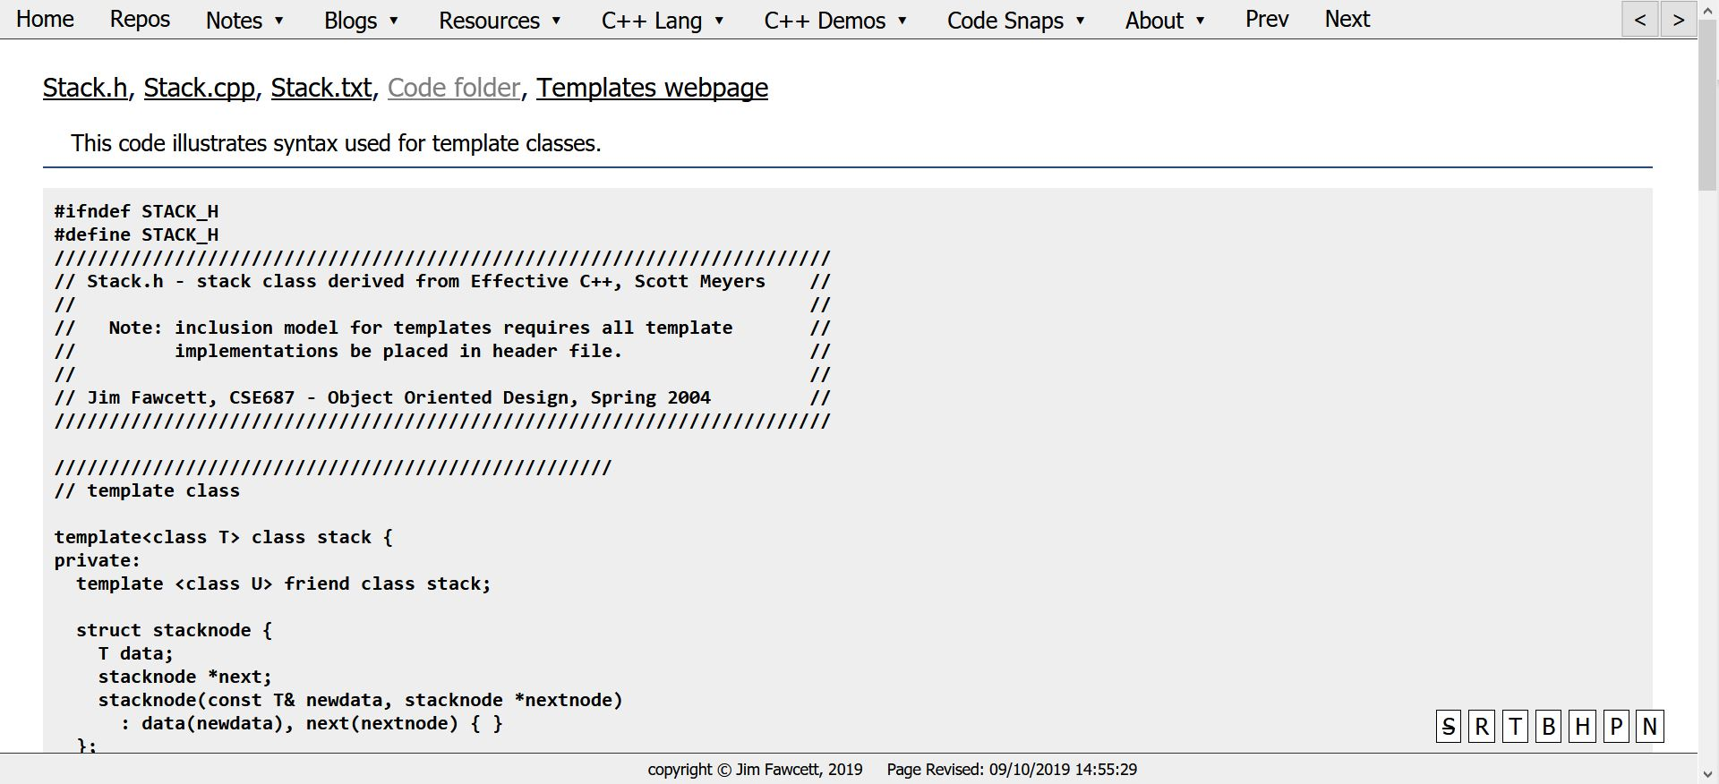
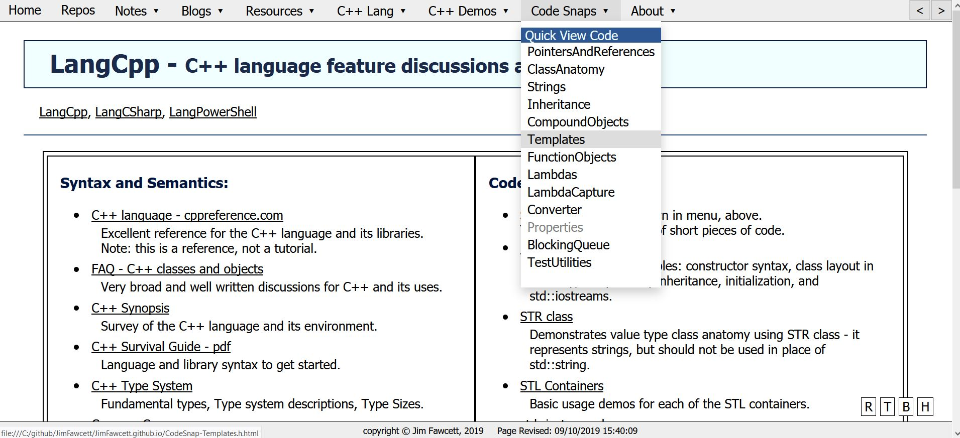
Site Structure – Code Snaps https://JimFawcett.github.io/LangCpp.html
CodeSnaps
Source code converted to HTML page
Provides quick access to views of important code fragments
No need to download from repository to explore

Slide 16
Quality Control
Without quality control it’s easy for repositories to become a sea of flotsam[1] and jetsam[2]
Some good content, but a lot of content that isn’t ready for reuse
To avoid that destination two things are necessary:
An effective structure for disclosing the contents of a repository
This site provides a candidate
Willingness of the site sponsor to invest in review and improvement
Standards – brief statements - components must meet to become candidates
Knowledgeable and productive person(s) to evaluate a component against the standards and admit or reject
Continuing background review activity – is this component still valuable?
Note that github provides tools to help, e.g., wikis, charts, …
[1] Flotsam - cargo that surfaces from a sunken ship
[2] Jetsam – cargo that is intentionally cast from a ship in distress.

Slide 17
Experiments https://JimFawcett.github.io/Tests.html - Main menu > Resources > UI Widget Tests https://JimFawcett.github.io/SiteStory_4.html - Main menu > stories > SiteStory
Experiments to make the site’s publishing process more effective are continuing:
Developing UI widgets to use webpage real estate effectively
User driven diagram resizer
Slide-in panels
Slide show
Code blocks for presentation
Photo styling
Navigation schemes
Dropdown menus
Page sequences (defined by hidden links)
Navigation buttons and key presses
Continuing to think about site organization schemes

Slide 18
Status and Conclusions
Status - https://JimFawcett.github.io:
Most of the structure described is in place
More than 40 repositories of mostly C++ code are published
Several stories are published
Other resources and CodeSnaps are available from the site
Plans
Install more code repositories
Install starter site
Start to add videos
Conclusions:
Static sites seem like a good tool for publishing
Main issue is text or keyword searches not available with static sites
Can be addressed with local mirror and tools for synchronizing and local searching
Required effort is reasonable for the expected payoff
This site went from zero to current status in four months of my time
However, I’ve built a site like this before.

Slide 19
Appendix - Domains

Slide 20
Application Domain Targets – Candidates for Support?
Academic Research: 5 – 10 code developers
Code life-time: 3 – 5 years
Example: Natural Language Processing (NLP)
Open Source Development: 5 – 1000 active developers, many casual contributors
Code life-time: 10 - 20 years
Example: Linux
Industrial Development: 5 – 10 developers
Code life-time: 5 – 20 years
Example: Machine Tool Control
Commercial Products: 10 – 30 developers
Code life-time: 20 – 30 years
Example: Microsoft Word
Aerospace Programs: 5 – 200 developers
Code life-time: 20 – 30 years
Example: Submarine control, Area surveillance, ..

Slide 21
Open-Source Domain Parts flow in, a product flows out
Open-source projects like Linux
Locally developed code flows to the cloud
Local contributors push to remote development branch
A single large system flows from the cloud to local users
Download a distro
Open-source applications like node.js
Developed by small group of contributors
Users download and install system with additional imports
Open-source libraries like jQuery.js
Developed by small group of contributors
Users bind remote library to webpages with Content Delivery Network (CDN) links
This domain already has a publishing model that has different goals than ours

Slide 22
Other Domains Components installed, flow out to users
Users search for a component to fill a current implementation need
Repository needs to be large, i.e., hold many components so there is a fairly good change to find something useful
So search and interpretation need to be effective
For repositories with hundreds of components, that is not trivial
The main issues are:
Developing a useful search process that is intuitive and quick
Helping users interpret a found component
What does it do?
How is it designed?
How to integrate with existing code?
These domains appear to be good candidates for the publication process proposed here

Slide 23
Academic Research Domain
Academic Research: 5 – 10 code developers
Code life-time: 3 – 5 years
Example: Natural Language Processing (NLP)
An academic researcher may have 2 or 3 doctoral candidates working on related parts of a research project.
She may collaborate with two or three colleagues, perhaps at different universities.
Each of those colleagues may have a similar team working on related projects.
There usually is continuing work on the same or related research projects for many years.
It is quite common that this work develops software tools for gathering and analyzing data. Sometimes software is part of the end product, e.g., compilers for a new language, an architecture for streaming or classifying content, …
These software developments are rarely maintained well. Often documentation is nothing but code and the papers that describe research results and mention the software as an aside.
Our methods are applicable.

Slide 24
Open Source Domain
Open Source Development: 5 – 1000 active developers, many casual contributors
Code life-time: 10 - 20 years
Examples: Linux, Node.js, MongoDB
Following an initial period of development, a project often settles into a maintenance mode:
Maintain the same mission and design.
Add new features and port to new platforms.
Occasionally revise most of the code and support new missions.
Documentation varies from poor to outstanding.
Linux documentation is one of the outstanding ones:
https://www.kernel.org/doc/html/v4.10/index.html
Some projects focus on api level documentation – how to use the code.
Some focus on maintenance – what are the parts, how are they related, code standards, …
Their goal is different than ours – our methods may not apply.

Slide 25
Industrial Development Domain
Industrial Development: 5 – 10 developers
Code life-time: 5 – 20 years
Example: Machine Tool Control
Code base starts with an initial product
New products start from that initial code
Has a common code baseline been defined?
Code reviews are held during development
At product completion is code reviewed and refactored into reusable parts and product specific code?
Is the organization willing to provide overhead effort to evolve the common code base?
Our methods are applicable. A scaled down version is probably appropriate.

Slide 26
Commercial Domain
Commercial Products:
Code life-time: 20 – 30 years
Example: Microsoft Word
Product may start with code framework, standards, and a specification
For Microsoft Office and many other products, the framework has been the Microsoft Component Object Model (COM) – technology was specifically designed for reuse
It appears that, moving forward, COM will be hidden with a wrapper technology - Windows RunTime (WinRT): https://en.wikipedia.org/wiki/Windows_Runtime
Specification is developed by a Program Manager and reviewed by the development team
Microsoft has spent a lot of resources on documentation, with mixed results
Executing a search in MSDN for WinRT results in 6,180,000 results.
That isn’t a useful query – in fairness, the results are prioritized
It’s quite common that when you arrive at a useful documentation page you get partial results with the remainder often linked to many pages scattered over the vast reaches of MSDN
There are many Microsoft technologies each with its own products, APIs, code examples.
Some, like the .Net framework have outstanding organization and documentation.

Slide 27
Aerospace Domain
Aerospace Programs: 5 – 200 developers
Code life-time: 20 – 30 years
Example: Submarine control, Area surveillance, ..
Development is product oriented, starting with an initial contract, and continuing for possibly many years of enhancements and new contracts that build on the existing product technology
An example is the development of area surveillance radar systems
Typical lifetime of a radar system is 20 years
The code has to be maintained over that lifetime, sometimes by the manufacturer, sometimes by the customer.
Once an initial contract has been successfully completed it is common for many contracts to be awarded for new versions.
Usually a large part of a new product is based on an existing one and will share a large fraction of its code
In most cases the new contract requires new features and enhancements – the customer looks at the original and decides how to embellish
The Capability Maturity Model was developed beginning when the Air Force funded a study with the Software Engineering Institute. Its intent is to encourage DoD contractors to develop and maintain a consistent process for creation of software.
https://en.wikipedia.org/wiki/Capability_Maturity_Model
CMM provides guidelines, but it is a model and a yardstick for assessing capability of contractors
It does not provide specifics for tools and techniques that support reuse
Our methods apply for individual product teams. Unknown how that would scale to corporation level.

Slide 28
That’s all Folks!

