Slide 1
Rust BuildOn #5
Jim Fawcett
https://JimFawcett.github.io
April 9, 2021

Slide 2
Build-On
Learn Rust in small steps
Start with a simple Rust demo
Text Finder
Build on that in interesting ways, e.g., for Text Finder:
Add capability – command line parsing, directory tree walking, …
Use generics – plugin components
Use threads – parallel text searches, thread pool based dir traversal
Use library components
Discord server
Q&A
Comments

Slide 3
BuildOn Timeline: Bi-Weekly Sessions
Session #1 – BuildOn Introduction & Rust Preview
Session #2 – Project Introduction & Some Rust details
Session #2 – Step #1: TextSearch -> Functional package with demo
Session #3 – Step #2: DirNav -> “
Session #4 – Step #3: CmdlnParser -> “
Session #5 – Step #4: Executive, Display -> Functional project
Session #6 – RegEx Extension ?
Session #7 – Parallel Text Searh ?

Slide 4
BuildOn Session #5 Topics
Focus: CmdlnParser & Exec Packages
Focus: Macros & Debugging in VSCode
Step #3 – CmdlnParser
Solution Code
Step #4 – Executive, Display -> full solution
Executive’s parts and startup actions
Goals of Display
Continuous output
Options
Project Structure
Diagram next slide
Design Bites – look at cargo.toml dependencies
BuildOn – click on BuildOn code
Macros
Debugging Rust in Visual Studio Code
RustBites
Questions?

Slide 5
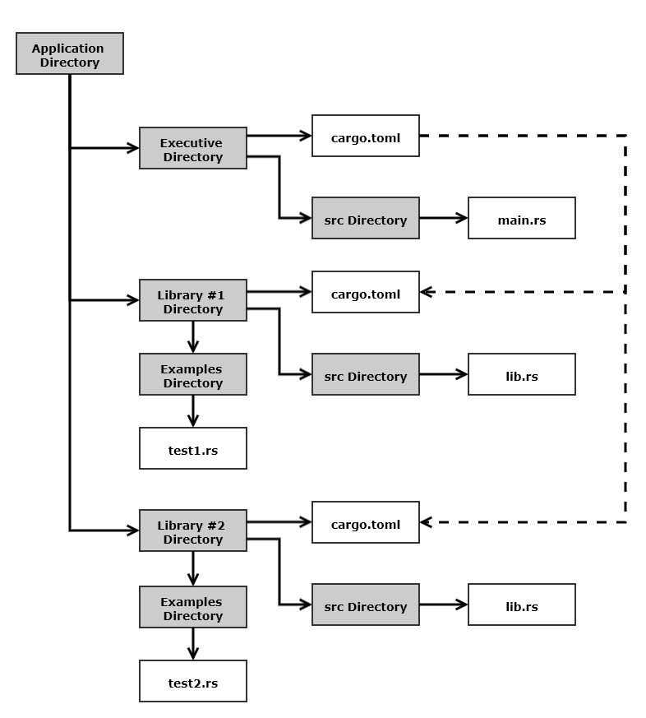
Rust Project Structure for TextFinder
All components on same level
Makes dependency metadata simpler
Each component has at least one testN.rs file with a main.
Use for testing and demonstrations
Traits are defined in the caller’s package if you use DIP.
Otherwise they usually go in the called package.

Slide 6
BuildOn
Session #3
DirNav
Session #4
CmdlnParser
Session #5
Executive & Display
Session #6 ?
RegEx Search
Session #7 ?
Parallel Text Search

Slide 7
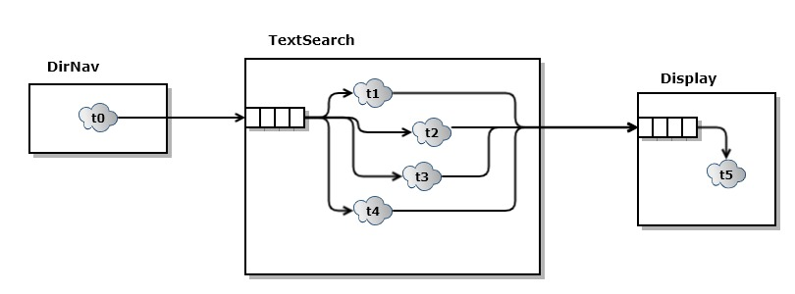
Parallel Text Search

Slide 8
That’s All Folks!

Slide 9
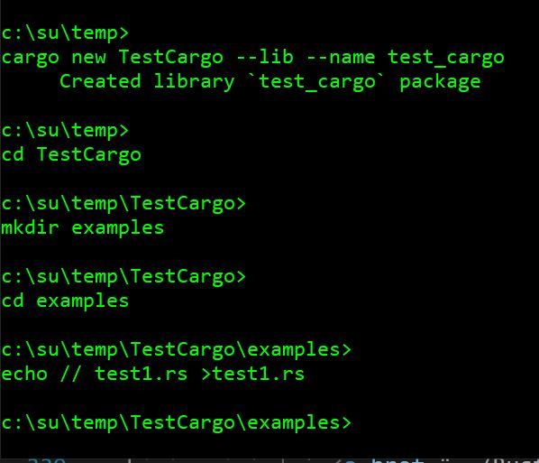
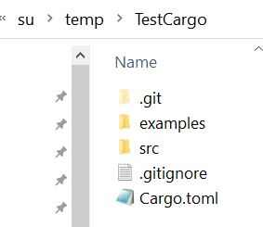
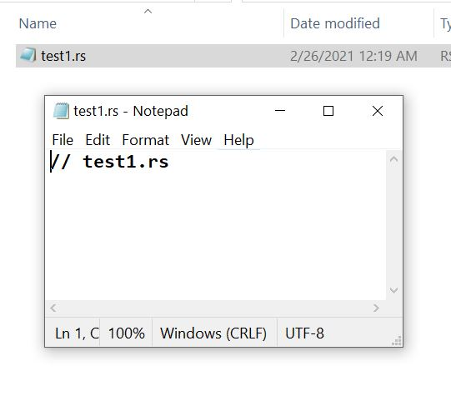
Building Rust Library Package (Crate)
Windows cmd (terminal)
Windows Explorer File Manager

Slide 10
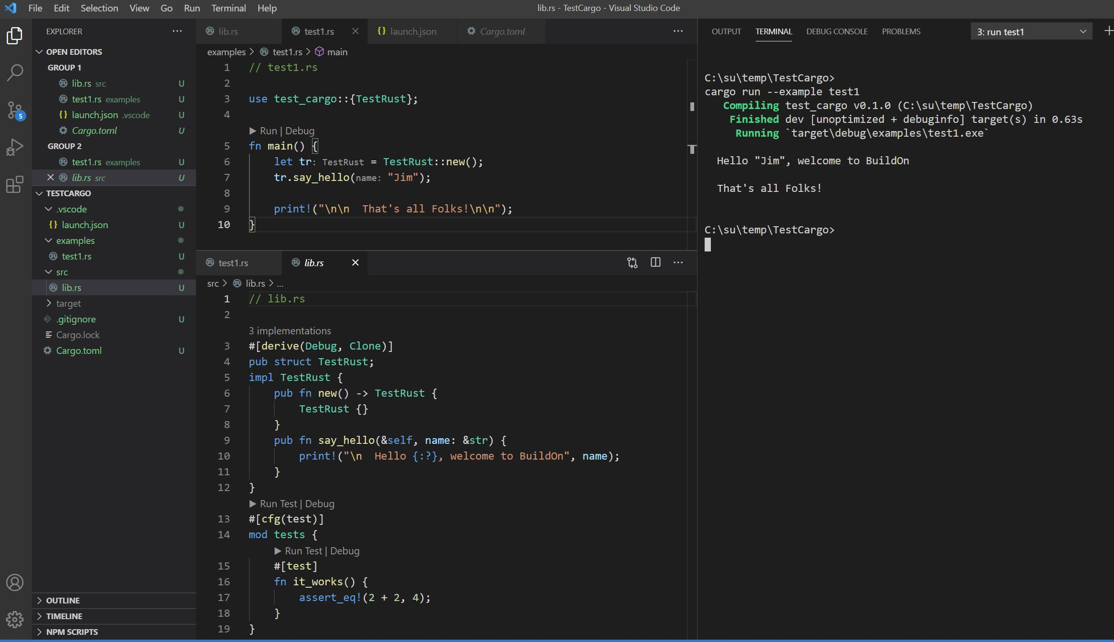

Slide 11
How would I use Rust at work?
Migrate parts of a large project to Rust using its foreign function interface:
Piece-meal improvement: performance, safety of existing code-base
https://locka99.gitbooks.io/a-guide-to-porting-c-to-rust/content/
std::ffi
Use Rust generated WebAssembly to speed JavaScript processing
https://rustwasm.github.io/book/
Start new projects in Rust
Create fast, sound code with lots of help from compiler messages
Great tooling: RustBites_Tooling, works on Windows, Linux, macOS
Resources: e-books, active user forum, https://crates.io

Slide 12
Build-On Motivation
Participate in a developer community interested in learning Rust
Stay in contact with SU Computer Engineering and Computer Science alumni
Support conversations about Rust and other interesting tech topics
Encourage both active learners and curious browsers
Rust is a very clever language supporting development of secure, high performance code (same ballpark as C++ without undefined behavior)
Rust website lists 138 companies using Rust in production
Tiobe lists rust as 25th in their language popularity index (Oct 2020).

Slide 13
Build-On Process
Zoom meeting that:
Briefly describes motives for using Rust and Rust basic ideas
Provides two or three references
identifies a problem and refers to starter code
Q&A
Subsequent meetings
Briefly describes my solution
Others may discuss their solutions and/or problems
Pose next extension to problem
Q&A

