Slide 1
Rust BuildOn #2
Jim Fawcett
https://JimFawcett.github.io
February 26, 2021

Slide 2
Build-On
Learn Rust in small steps
Start with a simple Rust demo
Text Finder
Build on that in interesting ways, e.g., for Text Finder:
Add capability – command line parsing, directory tree walking, …
Use generics – plugin components
Use threads – parallel text searches, thread pool based dir traversal
Use library components
Discord server
Q&A
Comments

Slide 3
How would I use Rust at work?
Migrate parts of a large project to Rust using its foreign function interface:
Piece-meal improvement: performance, safety of existing code-base
https://locka99.gitbooks.io/a-guide-to-porting-c-to-rust/content/
std::ffi
Use Rust generated WebAssembly to speed JavaScript processing
https://rustwasm.github.io/book/
Start new projects in Rust
Create fast, sound code with lots of help from compiler messages
Great tooling: RustBites_Tooling, works on Windows, Linux, macOS
Resources: e-books, active user forum, https://crates.io

Slide 4
BuildOn Timeline: Bi-Weekly Sessions
Session #1 – BuildOn Introduction & Rust Preview
Session #2 – Project Introduction & Some Rust details
Session #2 – Step #1: TextSearch -> Functional package with demo
Session #3 – Step #2: DirNav -> “
Session #4 – Step #3: CmdlnParser -> “
Session #5 – Step #4: Executive, Display -> Functional project
Session #6 – RegEx Extension ?
Session #7 – Parallel Text Searh ?

Slide 5
BuildOn Session #2 Topics
Focus: TextSearch Package
Focus: Rust
Step #0
Run TextFinder
DesignBites_Intro
TestCargo
Step #1 - TextSearch
Starter Code
Tooling
Functions, Structs
RustStory_Libraries.html#fs
std:fs
BuildOn
RustBite_Data
Safety
Anim_Features
Rust Bites
Rust Story
Code Experiments
Questions?

Slide 6
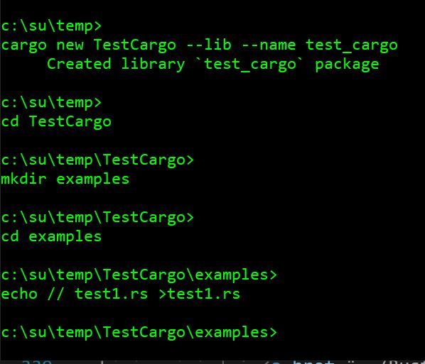
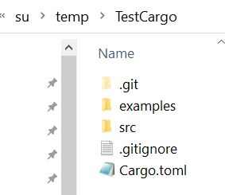
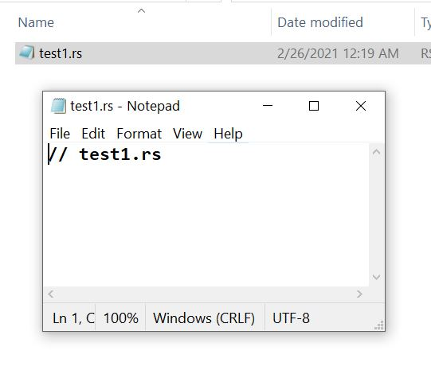
Building Rust Library Package (Crate)
Windows cmd (terminal)
Windows Explorer File Manager

Slide 7
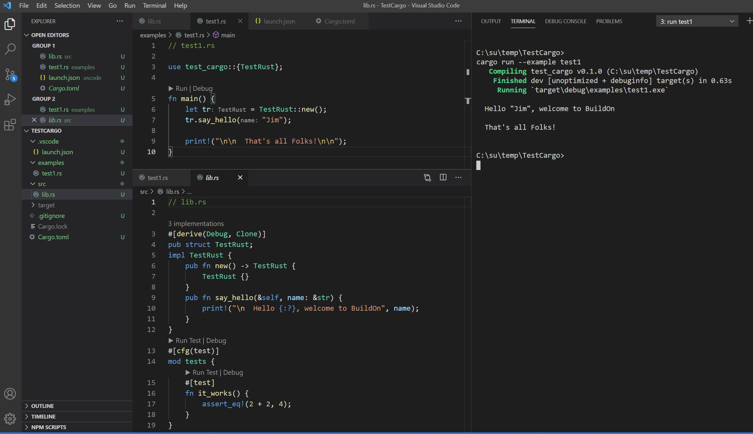

Slide 8
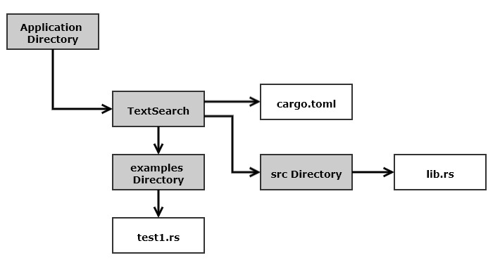
Rust Project Structure for TextSearch

Slide 9
BuildOn Session #2 Topics
Focus: TextSearch Package
Focus: Rust
Step #0
Run TextFinder
DesignBites_Intro
TestCargo
Step #1 - TextSearch
Starter Code
Tooling
Functions, Structs
RustStory_Libraries.html#fs
std:fs
BuildOn
RustBite_Data
Safety
Anim_Features
Rust Bites
Rust Story
Code Experiments
Questions?

Slide 10
Next BuildOn – Session #3 – DirNav
Project Packages
Rust
Step #1 – Quick Review
Text Search package
Posted solution
Step #2 - DirNav
DirNav package spec
Look at Starter Code
Enumerations
Error Handling
Conversions
Generics &Traits
Answer Questions

Slide 11
BuildOn – Session #3 – DirNav
Project
Rust
Code review: Step #1 - TxtSrch
Code will be posted
Step #2 – DirNav
Specification
Starter code
Structs
Rust Libs
Rust std::fs
Answer Questions

Slide 12
BuildOn
Session #3
DirNav
Session #4
CmdlnParser
Session #5
Executive & Display
Session #6 ?
RegEx Search
Session #7 ?
Parallel Text Search

Slide 13
That’s All Folks!

Slide 14
Build-On Motivation
Participate in a developer community interested in learning Rust
Stay in contact with SU Computer Engineering and Computer Science alumni
Support conversations about Rust and other interesting tech topics
Encourage both active learners and curious browsers
Rust is a very clever language supporting development of secure, high performance code (same ballpark as C++ without undefined behavior)
Rust website lists 138 companies using Rust in production
Tiobe lists rust as 25th in their language popularity index (Oct 2020).

Slide 15
Build-On Process
Zoom meeting that:
Briefly describes motives for using Rust and Rust basic ideas
Provides two or three references
identifies a problem and refers to starter code
Q&A
Subsequent meetings
Briefly describes my solution
Others may discuss their solutions and/or problems
Pose next extension to problem
Q&A

