Slide 1
Segments
Introduction: slides 2-7 10 minutes
Basic ideas: slides 8-12 10 minutes
Architecture: slides 13-22 20 minutes
Service code: slides 23-27 20 minutes
Finale: slides:28, 29, 37 5 minutes
Slides 30-36 hidden and won’t be presented

Slide 2
Windows Communication Foundation
Jim Fawcett
CSE681 – Software Modeling and Analysis
Fall 2017

Slide 3
Primary Code References
www.ecs.syr.edu/faculty/Fawcett/handouts/CSE681-OnLine/code/WCF_Examples
Start with these references and use object browser and MSDN docs via F1 key

Slide 4
Tutorials
Tutorials on WCF, WPF, and more
Getting Started - MSDN

Slide 5
Distributed Computer Communication
1964 – Dartmouth Time Sharing System
1969 – First link of ARPANET installed
1974 – First TCP specification
1978 – TCP/IP specification
1980 – Ethernet
1983 – Berkely sockets released with BSD
1990 – CORBA 1.0
1991 – OLE
Early 90’s - DCE/RPC
1993 – COM
1994 – CORBA 2.0
1996 – ActiveX, DCOM
1997 – Java RMI (Sun jdk 1.1, Java 2.0)
2002 – .Net Remoting
2006 – WCF (.Net 3.0)

Slide 6
What is WCF?
Provides software services on machines, networks, and across the internet
Unified programming model for all of these
Supported natively on Windows 8, 7 and Vista
Requires installation on XP
Not available on other platforms
Mono?
DotGnu?
Mac OSX ?

Slide 7
Integration into .Net Facilities
One model for distributed systems decomposes into presentation layer, application logic layer, and data layer, all bound together with communication.
Presentation: WPF
Data: LINQ – retrieves data
Communic: WCF – local, network, internet
Applic Logic: Custom designs

Slide 8
WCF Design Principles
Boundaries are explicit
No attempt to hide communication
Services are intended to be autonomous
Deployed, managed, and versioned independently
Services share contracts and schemas, not types
Contracts define behavior, schemas define data
Client needs a reference to contract not to service implementation
Compatibility is policy-based
Policy supports separation of behavior from access constraints

Slide 9
Essential Pieces of WCF
Contracts for services, data, and messages
A contract is simply an interface declaration
Service, Data, and Message definitions
Class implementations of the contracts
Configurations defined programmatically or declaratively
.Net class instances versus config files.
A host process (can be self hosted)
IIS, Windows Executable, Windows Service, or WAS
.Net Framework Classes provide support for all of the above.

Slide 10
Examples
All code samples for WCF must be run in Visual Studio with administrator privileges. That’s because Windows requires administrative priviledges to start and stop services.
You can do that in at least two different ways:
Create a link to Visual Studio (devenv.exe) and right-click, selecting run as administrator.
Search on Visual Studio and right-click on the desktop app and select run as administrator.
If you forget to do that you will get a crash dialog with lots of text.

Slide 11
Examples
These examples are important. They show you how to build services and proxies that can be self-hosted. The WCF wizard (there is only one) builds an IIS hosted service and that is not what we need for projects.
BasicHTTP Service – Declarative
BasicHTTP Service – Programmatic
WSHttp Service – Declarative
WSHttp Service – Programmatic
You will find these in the code folder in WCF Examples.

Slide 12
Look and Feel of WCF
Convergence of programming models
Just like web services
Similar to .Net Remoting
Sockets on steriods
Hosting for local, network, and web
Communication models
Remote Procedure Call (RPC) with optional data models
Message passing
One way, request and (callback) reply, synchronous call (wait for return)

Slide 13
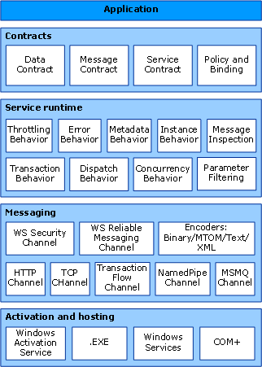
WCF Architecture
https://docs.microsoft.com/en-us/dotnet/framework/wcf/architecture

Slide 14
ServiceModel Namespace
Bindings, Channels, Endpoints, Messages, Serialization
Activation, Concurrency, Hosting, Security, Sessions
Queuing, Transactions
Exceptions

Slide 15
Principle Parts of a WCF Service
Contract
An interface defining services rendered
Service, Data, Message
Endpoints
Address: http://localhost/Calculator/service
Binding: WSHttpBinding
Contract: ICalculator
Implementation
One or more classes that implement the contract interfaces. May also include hosting code.

Slide 16
WCF Service Files
IService.cs
Interface(s) that define a service, data, or message contract
Service.cs
Implement the service’s functionality
Service.svc
Markup file (with one line) used for services hosted in IIS
Configuration files that declare service attributes, endpoints, and policy
App.config (self hosted) contains service model markup
Web.config (hosted in IIS) has web server policy markup plus service model markup, as in App.config

Slide 17
Service serviceModel Markup
<system.serviceModel> <services> <service name=“mySvcName” behaviorConfiguration=“…”> <endpoint address=“” binding=“wsHttpBinding” contract=“myNamespace.myInterface” /> <!-- can expose additional endpoints here --> <endpoint address=“mex” binding=“mexHttpBinding” contract=“IMetadataExchange” /> </service> </services> <behaviors> <serviceBehaviors> <behavior name=“myNamespace.mySvcNameBehavior”> <serviceMetaData httpGetEnabled=“true” /> <serviceDebug includeExceptionDetailInFaults=“false” /> </behavior> </serviceBehaviors> </behaviors> </system.serviceModel>

Slide 18
Channels
Channels are the vehicles that transport messages. They provide:
Transport protocols via bindings
Http, WSHttp, Tcp, MSMQ, named pipes
Encoding and Encryption
Reliable sessions
Communication modes
Simplex, duplex, send and wait
Security modes

Slide 19
WCF Bindings
Binding | Interoperability | Mode of Security (Default) | Session (Default) | Transactions | Duplex
BasicHttpBinding | Basic Profile 1.1 | (None), Transport, Message, Mixed | None, (None) | (None) | n/a
WSHttpBinding | WS | None, Transport, (Message), Mixed | (None), Transport, Reliable Session | (None), Yes | n/a
WS2007HttpBinding | WS-Security, WS-Trust, WS-SecureConversation, WS-SecurityPolicy | None, Transport, (Message), Mixed | (None), Transport, Reliable Session | (None), Yes | n/a
WSDualHttpBinding | WS | None, (Message) | (Reliable Session) | (None), Yes | Yes
WSFederationHttpBinding | WS-Federation | None, (Message), Mixed | (None), Reliable Session | (None), Yes | No
WS2007FederationHttpBinding | WS-Federation | None, (Message), Mixed | (None), Reliable Session | (None), Yes | No
NetTcpBinding | .NET | None, (Transport), Message, Mixed | Reliable Session, (Transport) | (None), Yes | Yes
NetNamedPipeBinding | .NET | None, (Transport) | None, (Transport) | (None), Yes | Yes
NetMsmqBinding | .NET | None, Message, (Transport), Both | (None) | (None), Yes | No
NetPeerTcpBinding | Peer | None, Message, (Transport), Mixed | (None) | (None) | Yes
MsmqIntegrationBinding | MSMQ | None, (Transport) | (None) | (None), Yes | n/a

Slide 20
Interoperability
Channel protocols determine interoperability with other platforms:
BasicHttpBinding ➔ universal interoperability
WSHttpBinding ➔ platforms that use ws extensions
NetTcpBinding ➔ .Net on both ends
MSMQ ➔ WCF to pre WCF windows platforms

Slide 21
Service Behaviors
Instancing:
Singleton: one instance for all clients
Per call: one instance per service call
Private session: one instance per client session
Shared session: one instance per session shared between clients
Concurrency models for instances:
Single: one thread at a time accesses instance
Multiple: more than one thread may enter instance
Reentrant: threads make recursive calls without deadlock

Slide 22
Other Service Behaviors
Throttling:
Limits on number of messages, instances, and threads a service can process simultaneously
Error handling:
Options to handle, let framework handle, and report to client
Metadata:
Services can be self-describing, providing MEX endpoints
Lifetime:
Can specify session duration, service operations to initiate sessions and others to terminate sessions
Security:
Can specify message confidentiality, integrity, authentication, authorization, auditing, and replay detection.

Slide 23
Structuring Service Code
Service | Class | Attribute
Service contract | interface | [ServiceContract]
Service operation | method | [OperationContract]
Implementation | class | [ServiceBehavior] Derive from contract interface
Implementation | method | [OperationBehavior]
Data Contract | class | [DataContract] class [DataMember] member
Message Contract | interface | [MessageContract] interface [MessageHeader] member [MessageBody] member

Slide 24
Building Clients
There are three ways to build a client’s proxy:
Hand craft a proxy using ClientBase<ServiceType> as we did in BasicService-Declarative
Create a proxy programmatically with the ChannelFactory<ServiceContract>, as we did in SelfHosted_StringsService
Create a proxy with SrvcUtil. It also uses ClientBase<ServiceType> but adds a lot of other stuff as well.

Slide 25
Building Clients
Build proxy with svcutil
Visual Studio will do that if you add a service or web reference
Proxy code is in a subdirectory under the project.
Add proxy code to project
Add “using System.ServiceModel” to client code
Build and run

Slide 26
Generating Proxies
SvcUtil.exe generates code:
from a mex endpoint: svcutil http://localhost/myService
from WSDL or XSD files: svcutil myService.wsdl
SvcUtil.exe generates WSDL and XSD files from a service library:
svcutil myService.dll

Slide 27
Building Proxy Programmatically
WSHttpBinding binding = new WSHttpBinding();
Uri address = http://Odysseus:4040/ICommService;
ICommService proxy = ChannelFactory<IContract>.CreateChannel(binding, address);
Message msg = new Message();
msg.text = “a message”;
proxy.PostMessage(msg);

Slide 28
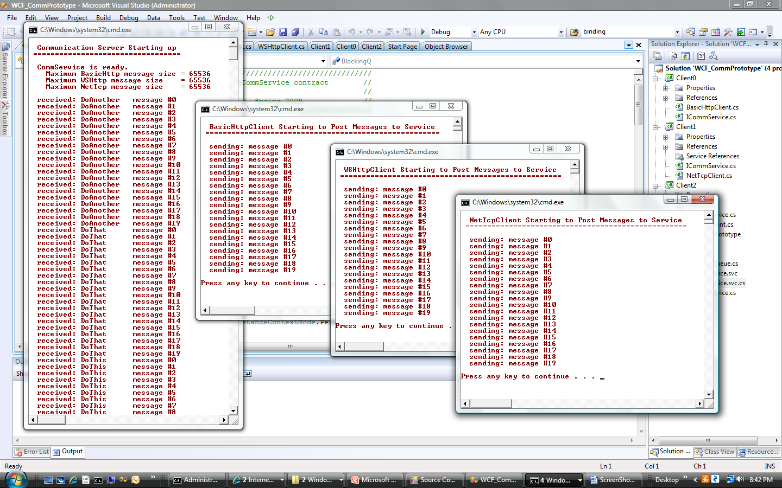
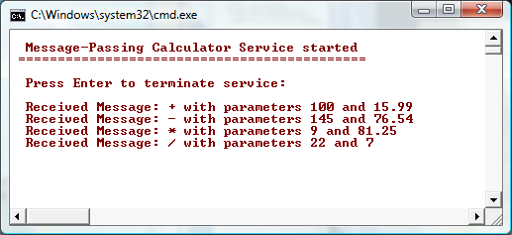
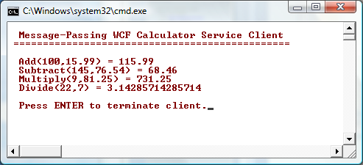

Slide 29
References
Setting up Reference Code
Web References
Tutorials

Slide 30
Microsoft WCF Samples are useful, but NOTE !!!
WCF Samples won’t run unless you:
Install a digital certificate (can be self-signed), part of setup
Run Visual Studio as Administrator (in Win8, Win7, Vista)
Setup steps
One-Time Setup for WCF
IIS7 doesn’t include a folder of scripts used by setup so you have to add IIS6 compatibility which creates the script folder
There are a number of Windows features you need to turn on to make the samples work – see next slide.

Slide 31
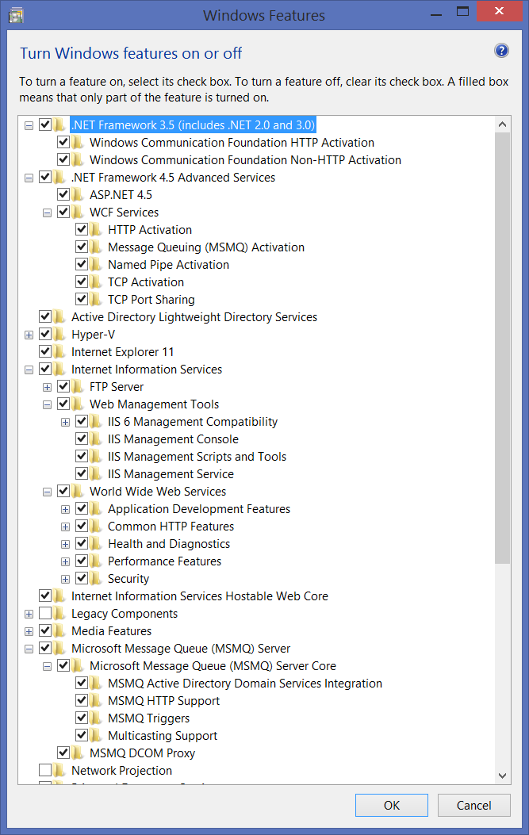
Check all features in .Net Framework 3.5 and 4.5
Check all features in Internet Information Services
Check all features in MSMQ

Slide 32
Primary Book References
Pro C# 6.0 and the .Net 4.6 Platform, Andrew Troelsen, Apress,
Excellent introduction
Programming WCF Services, 2nd Edition, Juval Lowy, O’Reilly, 2009
More up-to-date details than many of the others
Inside Windows Communication Foundation, Justin Smith, Microsoft Press, 2007
Covers some of the plumbing, e.g., messaging and service host details
Microsoft Windows Communication Foundation, Step by Step, John Sharp, Microsoft Press, 2007
Practical discussion with examples for securing communication

Slide 33
Primary Web References
MSDN WCF Root Page
WCF Feature Details
MSDN WCF Architecture Overview
Microsoft WCF Samples Setup
Self-signed certificates, finding keys, ... Petar Vucetin blog
Makecert - Certificate Creation Tool
Distributed .NET Learn ABCs Of Programming WCF
Service Station Serialization in Windows Communication Foundation
Service Station WCF Messaging Fundamentals
Windows Communication Foundation Glossary
Windows Communication Foundation Tools
Tutorials on WCF, WPF, and more
A Performance Comparison
Security in WCF

Slide 34
References – Activation & Channels
How to Access WCF Services with One-Way and Request-Reply Contracts
How to Access Services with a Duplex Contract
Sessions, Instancing, and Concurrency
WCF Essentials Instance Management
WCF Essentials One-Way Calls, Callbacks, Events

Slide 35
References – Web Model
How to Create a Basic Web-Style Service
WCF Web Programming Model Overview
Web Programming Model
WCF Web Programming Object Model
WCF Syndication HTTP Programming with WCF and the .NET Framework 3.5
Creating WCF AJAX Services without ASP.NET
Creating WCF Services for ASP.NET AJAX

Slide 36
References – Building Clients
Accessing Services Using a Client
Clients
Client Architecture
Client Configuration
Call WCF Service Operations Asynchronously
A Performance Comparison
Security in WCF
File-streaming with a few comments about file chunking

Slide 37
End of Presentation

