Slide 1
Segments
Introduction: slides 2-11 15 minutes
Features: slides 12-20 10 minutes
Basic Architectue: Slides 21-24 10 minutes
Dependencies: Slides 25-34 20 minutes
Special features: slides 35-39 10 minutes

Slide 2
Windows Presentation Foundation
Jim Fawcett
CSE681 – Software Modeling and Analysis
Fall 2017

Slide 3
References
Pro C# 5 and the .Net 4.5 Platform, Andrew Troelsen, Apress, 2012
Programming WPF, 2nd Edition, Sells & Griffiths, O’Reilly, 2007
Windows Presentation Foundation Unleashed, Adam Nathan, SAMS, 2007
Essential Windows Presentation Foundation, Chris Anderson, Addison-Wesley, 2007
http://msdn2.microsoft.com/en-us/library/aa970268.aspx
http://msdn2.microsoft.com/en-us/library/ms754130.aspx

Slide 4
WPF Blogs
Josh Smith Blog
WPFpedia
Mike Taulty's Blog

Slide 5
Introduction
What is WPF?
A Graphical User Interface Technology
Desktop
Little brother Silverlight is used for web applications
Uses Markup and Code
Together or separately, much like ASP.Net
Easy to produce different styles
Web browser like navigation and placement
Traditional forms
Animated Graphics

Slide 6
Markup
XAML
eXtensible Application Markup Language
Tags are names of .Net 3.5 classes
Attributes are class properties and events
<Grid> <Ellipse Fill=“blue” /> <TextBlock> Name: <TextBlock Text=“{Binding Name}” /> </TextBlock> </Grid>

Slide 7
Code Behind
Often, code provides processing for control events, bound in XAML, like this:
XAML in Window.Xaml
<Button x:Name=“button” Width=“200” Height=“25” Click=“button_Click”>Submit</Button>
C# code in Window.Xaml.cs
Void button_Click(object sender, RoutedEventsArgs e) { MessageBox.Show(…) }

Slide 8
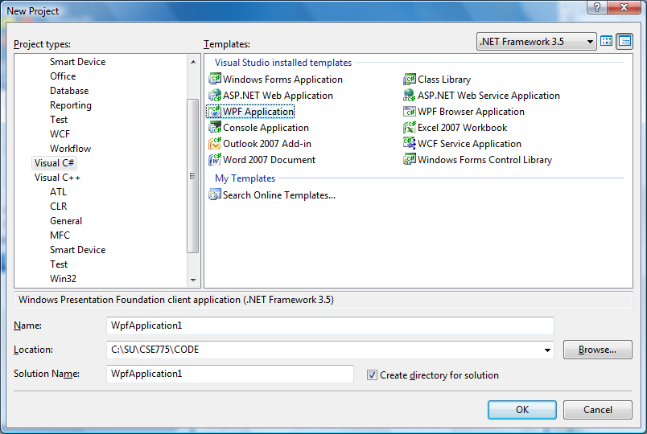
C# Wizard

Slide 9
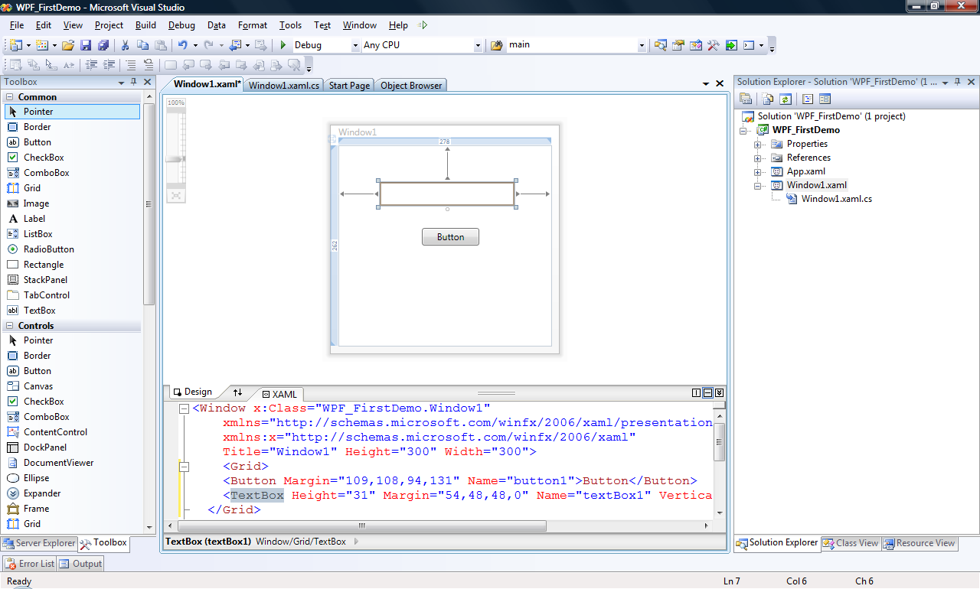
Default Grid Panel

Slide 10
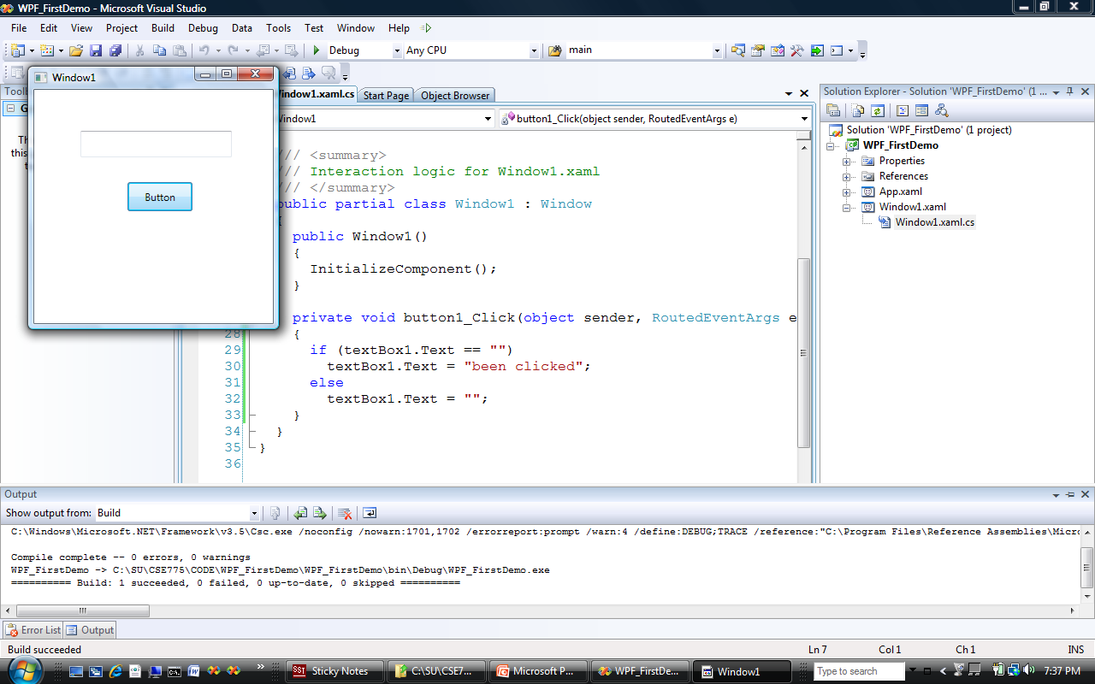
Like WinForms, But …

Slide 11
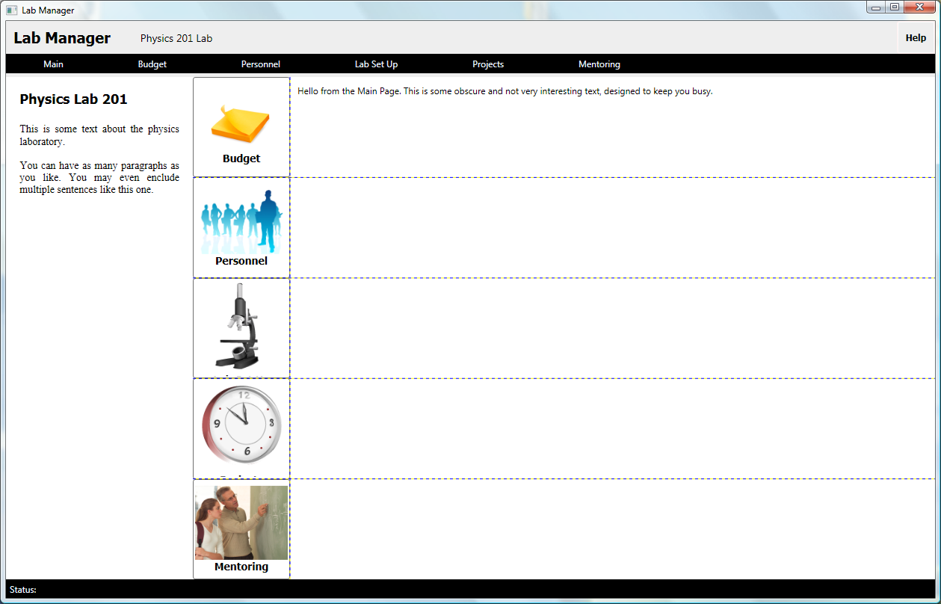
It’s Easy to do more interesting things

Slide 12
Panels
Layouts, like the previous page can use:
Canvas
Simplest, placement relative to two edges
StackPanel
Horizontal or vertical stacking
Grid
Uses rows and columns
Unsized elements fill Grid cells
DockPanel
Dock to top, right, bottom, left, and all else fills remaining space
WrapPanel
Horizontal stacking with wrap on overflow
All of these can be nested, any one in another

Slide 13
Vector Graphics
In WPF there is only (usually) one window
Controls are not windows!
No handles – really, no handles
A button is a shape with border, fill, text, animation, and events, like click.
There is a Button class, but it is not a .Net control in the traditional sense nor an ActiveX control.
Just markup, lines, fills, and events.

Slide 14
Parse Tree
XAML gets rendered into a parse tree, just like XML – it is XML
Inherited properties are based on parent child relationships in the markup tree
Events bubble based on those relationships as well
You have direct and simple control over that structure
The world is yours!

Slide 15
What Makes WPF Unique?
Vector Graphics with Parse Tree Structure derived from markup
Routed Events bubble up the parse tree
Pervasive Publish and Subscribe Model
Data Binding
Dependency Properties
Layered on top of DirectX
Strong 2D and 3D graphics
Animation
Layout and styles model similar to the best of the web

Slide 16
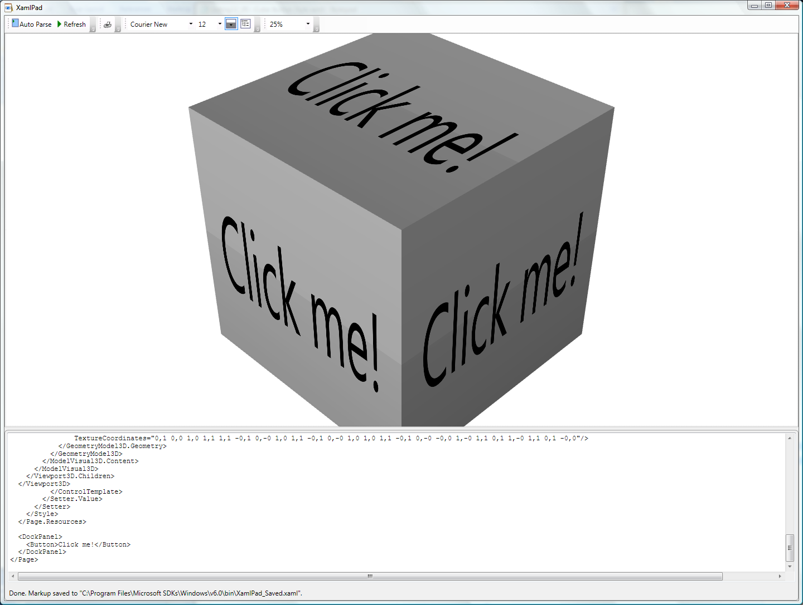

Slide 17
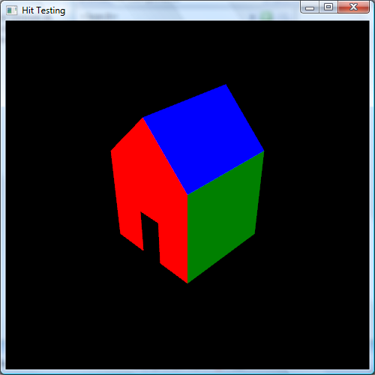
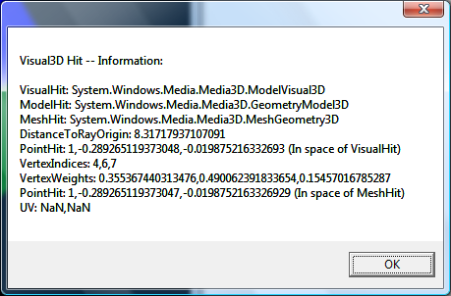
3D Hit Testing

Slide 18
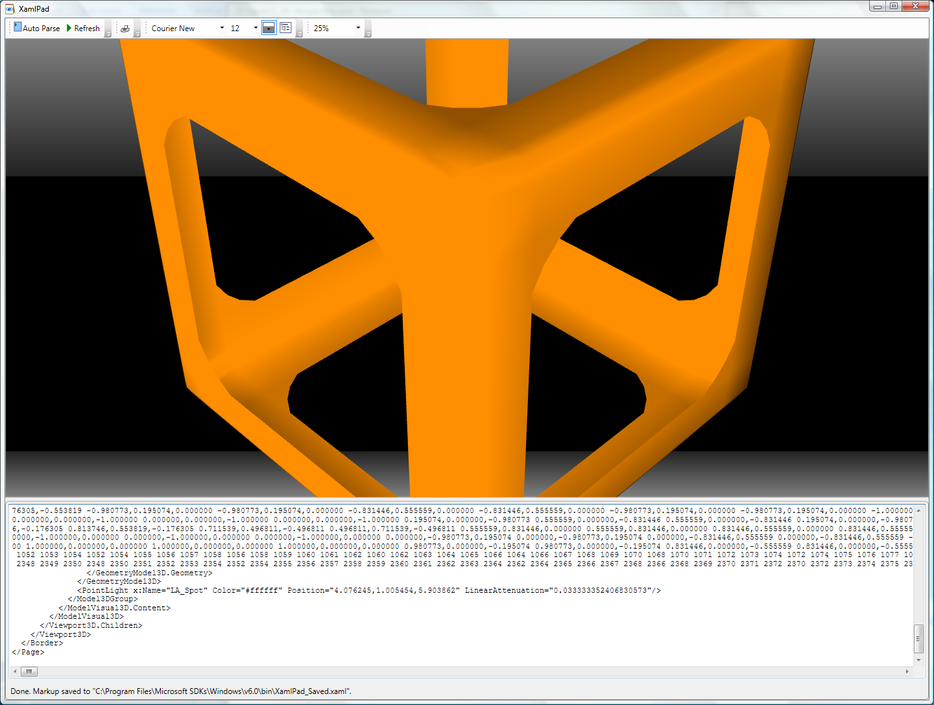
3D Perspective Camera

Slide 19
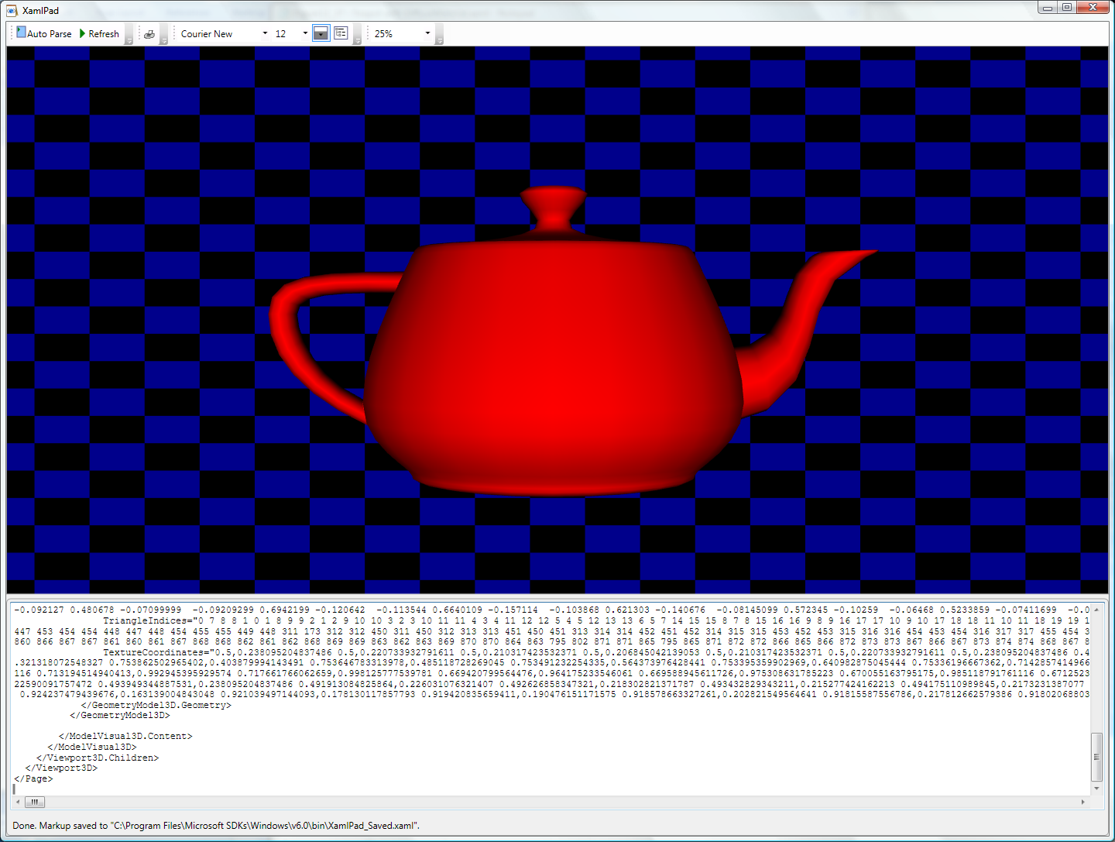
Famous Teapot

Slide 20
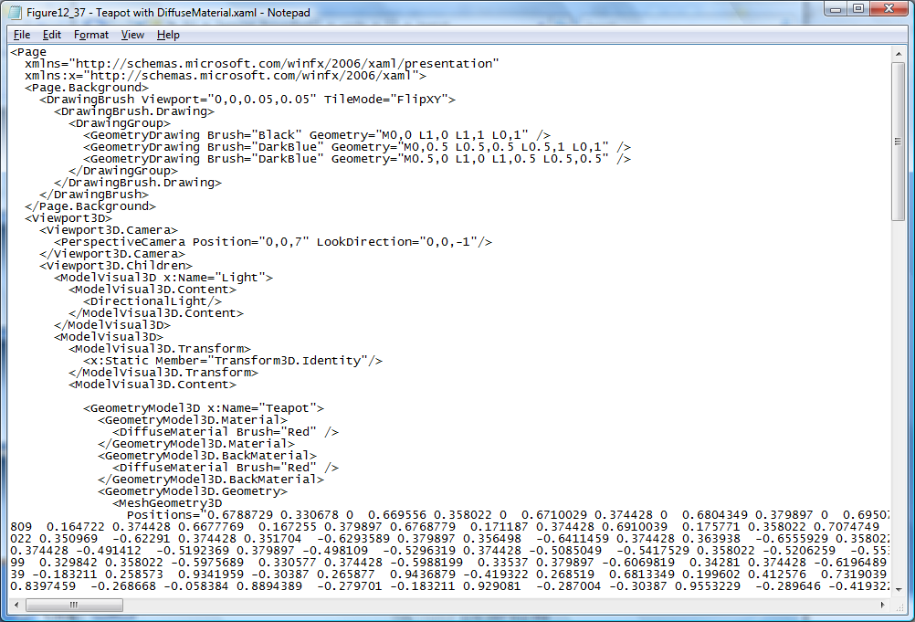

Slide 21
Routed Events
WPF maps markup elements to UIElements, which derive from ContentControl
That means that almost everything can hold content – only one thing unless it’s a panel.
How does a mouse click event on any one of a control’s content elements get routed to the control?
By walking the XAML parse tree until it finds a parent that handles that event.

Slide 22
Adding Event Handlers
You will find that property sheets show events as well as properties
click on the lightning bolt to see the event sheet.
You subscribe by clicking on an event entry.
You can also add event handlers quickly in XAML:
Go to the XAML, type a space after the tag for the element you want to handle the event
That gets you a context menu (via intellisense) and you just double click on the desired event, which adds an event attribute

Slide 23
Attached Properties
Buttons, ListBoxes, Images, etc., do not have Dock properties.
However, when you place one of these in a DockPanel, you find that it has had Dock properties attached. <Image Source="./help.png" DockPanel.Dock="Top" Height="213" ImageFailed="Image_ImageFailed" />

Slide 24
DependencyObject Class
Attached properties work because all WPF controls derive from the DependencyObject class.
DependencyObject class supports adding an arbitrary number of dependency properties.

Slide 25
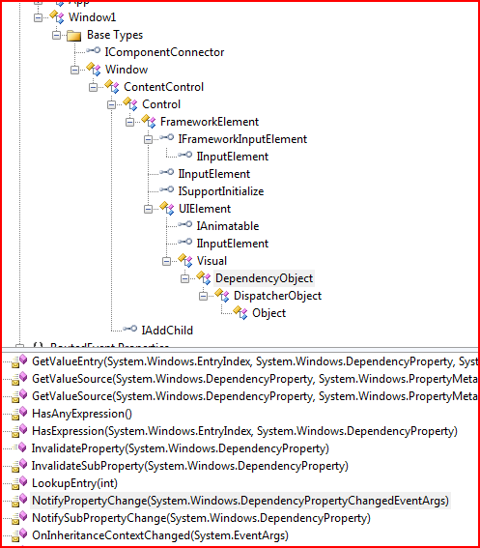

Slide 26
Dependency Properties
A Dependency Property is a property that is registered with the WPF Dependency property system. Two uses:
Backing an object property with a dependency property, provides support for databinding, styling, and animation. Examples include Background and Fontsize properties
Creating attached properties. Attached properties are properties that can be set on ANY DependencyObject types. An example is the Dock property.
You can find an example of the definition and use of a custom Dependency Property here.
Dependency Properties are a Publish and Subscribe system.

Slide 27
Dependency Property Links
Josh Smith's Blog
Switch on the Code Blog
Learn WPF site

Slide 28
Property Syntax
Two syntax forms:
XAML attribute: <button ToolTip=“Button Tip />
Property Element Syntax: <Button> <Button.Background> <SolidColorBrush Color=“#FF4444FF” /> </Button.Background> Some Button Text </Button>

Slide 29
Markup Extensions
Sometimes you need to assign a property from some source at run-time. For that you use Markup Extensions: <Button Foreground=“{x:static SystemColors.ActiveCaptionBrush}” > Some text </Button>

Slide 30
Inline Styles
Collections of property values:
<Button.Style> <Style> <Setter Property=“Button.FontSize” Value=“32pt” /> <Setter Property=“Button.FontWeight” Value=“Bold” /> </Style> </Button.Style>

Slide 31
Named Styles
Collections of property values:
<Window.Resources> <Style x:Key=“myStyle” TargetType=“{x:Type Control}”> <Setter Property=“FontSize” Value=“32pt” /> <Setter Property=“FontWeight” Value=“Bold” /> </Style> </Window>

Slide 32
Binding
Binding infrastructure allows you to set up a one-way or two-way updating of property values that happens when the source changes.
This requires two things:
A dependency object
Has its own dispatcher thread
Support for INotifyPropertyChanged interface

Slide 33
Binding
Objects that implement INotifyPropertyChanged interface raise events when the property has changed.
Data binding is the process of registering two properties with the data binding engine and letting the engine keep them synchronized.
You will find an example in the Wpf_AttachedProperties demo code.

Slide 34
Binding Links
MSDN Article by John Papa
CodeProject article by Josh Smith (part of a tutorial series)
Bea (Costa) Stollnitz

Slide 35
Control Templates
With Control Templates you can change the look and feel of existing controls and support making your own controls:
<Button.Template> <ControlTemplate> <Grid><Rectangle /></Grid> </ControlTemplate> </Button.Template>

Slide 36
Navigation
You can use instances of the Page and Frame classes to set up a navigation structure resembling web applications.
Pages go in NavigationWindow instances and Frames go in Windows and Pages.
This is a good alternative to tabbed displays.

Slide 37
Special Classes
ContentControl
All UIElements derive from this.
Content can be text, a tree of elements, or a .Net object which can be displayed using a data template
Dependency Object
Derives from Dispatcher Object
Supports data binding, styling, animation, property inheritance, and property change notifications
WindowsFormsHost
Supports hosting controls based on HWNDs

Slide 38
Special UIElements
ViewBox
Resizes content to fit available space
UserControl
Way to build custom controls as collections of elements on a panel
Animatable
Provides hooks for DirectX to change elements properties over time, e.g., position, size, color, …
FlowDocument
FlowDocumentScrollViewer
FlowDocumentPageViewer
MediaElement
Play media on load or on request, e.g., wma, wmv, mp3, …

Slide 39
End of Presentation

