Slide 1

The Networking TS in Practice
Testable, Composable Asynchronous I/O in C++
Robert Leahy
Software Engineer
rleahy@rleahy.ca

Slide 2

Networking TS
Asynchronous model & standardized networking for ISO C++
Adapted subset of Boost.Asio
Reconciliation with Executors TS ongoing
Boost.Asio ≥1.64.0 forward compatible with Networking TS
Provides conceptual framework for asynchronous operations

Slide 3
Problem: Testability & Rigidity
I/O code written against concrete types/global state:
File descriptors
Timers (e.g. nanosleep)
Testing requires:
An actual network connection
Passage of actual time
Rewrite/-factor required to:
Change transport (e.g. TCP to TLS)

Slide 4
Problem: Patterns & Guarantees
[W]riting asynchronous code in a clean style which uses all the modern idioms of Asio and Net.TS is quite a difficult endeavor, as evidenced by the distinct lack of open source libraries built on Asio which follow best practices (despite Asio having been available for over a decade).
–Vinnie Falco (P1100R0)
Boost.Asio often hidden as implementation detail
Flexibility is lost
Customization difficult or impossible

Slide 5
Synchronous vs. Proactor 1/2
 | Synchronous | Asynchronous (Proactor)
Initiation | Function call | Function call (initiating function)
Input/Output | Blocks calling thread | Proceeds in background (initiating function returns immediately)
Completion | Control of thread returned to caller, returned value(s) transmit result | Completion handler (callable object) invoked, parameter(s) transmit result

Slide 6
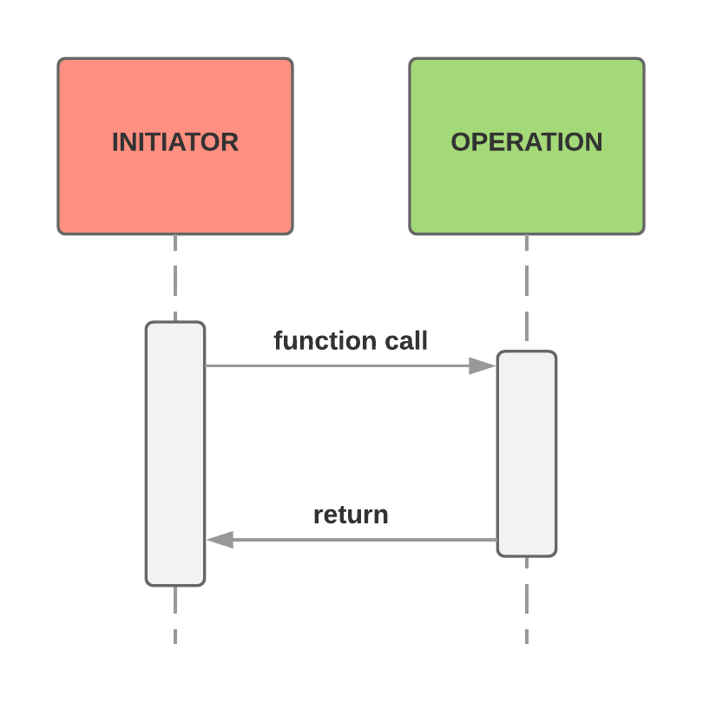
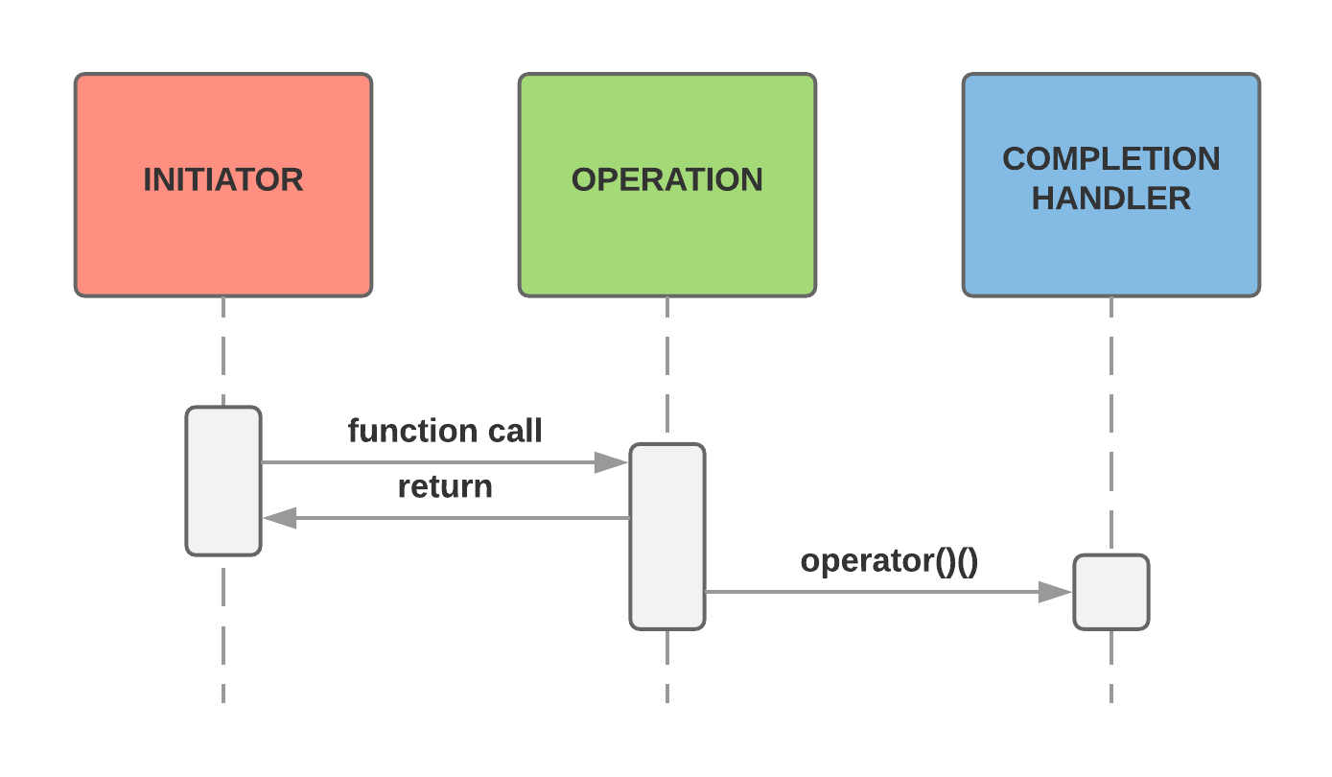
Synchronous vs. Proactor 2/2
Synchronous
Asynchronous (Proactor)

Slide 7
Heartbeat Example 1/3
struct heartbeat { std::net::system_timer& timer_; std::net::ip::tcp::socket& socket_; const std::byte* buffer_; std::size_t size_; void initiate(); void operator()(std::error_code ec, std::size_t written); };

Slide 8
Heartbeat Example 2/3
void heartbeat::initiate() { async_wait_then_write(timer_, socket_, std::chrono::seconds(5),
std::net::buffer(buffer_, size_), std::move(*this)); } void heartbeat::operator()(std::error_code ec, std::size_t written) { if (ec) throw std::system_error(ec); initiate(); }

Slide 9
Heartbeat Example 3/3
const std::byte write_buffer[/* ... */]; std::net::io_context ctx; std::net::ip::tcp::socket socket(ctx); std::net::system_timer timer(ctx); // ... heartbeat{timer, socket, write_buffer,
sizeof(write_buffer)}.initiate();

Slide 10
Composed Async Operations
When asynchronous algorithms are constructed from calls to other initiating functions, the result is called a composed operation. [...] Layers of composition may be added to arbitrary degree, permitting algorithms of significant complexity to be developed.
–Vinnie Falco (P1100R0)
Patterns from Networking TS enable composition
Consumption of such operations simplifies development

Slide 11
std::net::async_write
template<class AsyncWriteStream,
class ConstBufferSequence,
class CompletionToken>
DEDUCED async_write(AsyncWriteStream& stream,
const ConstBufferSequence& buffers,
CompletionToken&& token);
[...]
Initiates an asynchronous operation to write data to the buffer-oriented asynchronous write stream object stream by performing zero or more asynchronous operations on the stream using the stream’s async_write_some member function [...]
–Networking TS §17.8 [buffer.async.write]

Slide 12
async_wait_then_write
template<typename ConstBufferSequence, typename Handler> void async_wait_then_write(std::net::system_timer& timer, std::net::ip::tcp::socket& sock,
std::net::system_timer::duration dur, ConstBufferSequence bufs, Handler&& h) { timer.expires_after(dur); auto f = [&sock, bufs = std::move(bufs), h = std::forward<Handler>(h)]
(std::error_code ec) mutable { if (ec) h(ec, 0); else std::net::async_write(sock, std::move(bufs), std::move(h)); }; timer.async_wait(std::move(f)); }

Slide 13
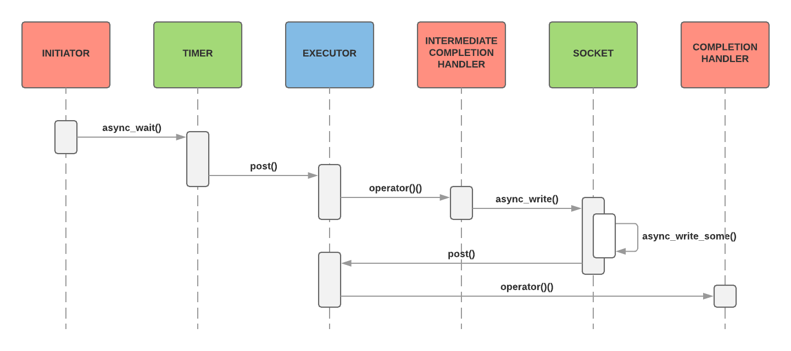
async_wait_then_write

Slide 14
Executors
Every piece of every program executes somehow and somewhere.
–Executors Design Document (P0761R2)
An executor is a handle to an execution context in which code may be executed upon execution resources via execution agents

Slide 15
Operations on Executors
Networking TS defines three operations on executors:
dispatch invokes a function object within the associated execution context
defer extends dispatch by requesting that the call not block on the completion of submitted work
post extends defer by making the request a requirement

Slide 16
Testability
References to std::net::ip::tcp::socket and std::net::system_timer impede testing:
Actual connection required
Time must actually pass
Reformulate operation in terms of concepts
Mock models of concepts for testing
Code becomes more reusable:
Could replace TCP socket with TLS stream

Slide 17
AsyncWriteStream Concept
Operation | Type | Semantics
a.get_executor() | A type satisfying the Executor requirements | Returns the associated I/O executor.
a.async_write_some(cb,t) | The return type is determined according to the requirements for an asynchronous operation | Meets the requirements for a write operation and an asynchronous operation with completion signature void(error_code ec, size_t n). If buffer_size(cb) > 0, initiates an asynchronous operation to write one or more bytes of data to the stream a from the buffer sequence cb. If successful, ec is set such that !ec is true, and n is the number of bytes written. If an error occurred, ec is set such that !!ec is true, and n is 0. If buffer_size(cb) == 0, the operation completes immediately. ec is set such that !ec is true, and n is 0.

Slide 18
Mock AsyncWriteStream 1/2
struct mock_async_write_stream { std::net::io_context::executor_type ex_; std::byte* ptr_; std::size_t size_; io_context::executor_type get_executor() noexcept { return ex_; } template<class ConstBufferSequence, class Handler> void async_write_some(ConstBufferSequence cb, Handler&& h); };

Slide 19
Mock AsyncWriteStream 2/2
template<class ConstBufferSequence, class Handler> void mock_async_write_stream::async_write_some(ConstBufferSequence cb, Handler&& h) { std::error_code ec; std::size_t bytes = 0; if (std::net::buffer_size(cb)) { bytes = std::net::buffer_copy(std::net::buffer(ptr_, size_), std::move(cb)); size_ -= bytes; ptr_ += bytes; if (!bytes) { ec = make_error_code(std::net::stream_errc::eof); } } std::net::post(std::net::bind_executor(ex_, std::bind(
std::forward<Handler>(h), ec, bytes))); }

Slide 20
Initiating Functions & Recursion
If an asynchronous operation completes immediately (that is, within the thread of execution calling the initiating function, and before the initiating function returns), the completion handler shall be submitted for execution as if by performing ex2.post(std::move(f), alloc2).
–NetTS §13.2.7.12 [async.reqmts.async.completion]
Arbitrary number of asynchronous operations may be chained without risk of stack overflow
Asynchronous “loop” has no risk of infinite call depth

Slide 21
Testable Example
template<typename WaitableTimer, typename AsyncWriteStream, typename ConstBufferSequence,
typename Handler> void async_wait_then_write(WaitableTimer& timer, AsyncWriteStream& s,
typename WaitableTimer::duration dur, ConstBufferSequence bufs, Handler&& h) { timer.expires_after(dur); auto f = [&s, bufs = std::move(bufs), h = std::forward<Handler>(h)] (std::error_code ec) mutable
{
if (ec) h(ec, 0); else std::net::async_write(s, std::move(bufs), std::move(h));
}; timer.async_wait(std::move(f)); }

Slide 22
Test 1/2
std::byte out[1024]; std::string_view in("GET / HTTP/1.1\r\n\r\n"); std::net::io_context ctx; mock_waitable_timer timer{ctx.get_executor()}; mock_async_write_stream stream{ctx.get_executor(), out, sizeof(out)}; bool i = false; std::error_code ec; std::size_t bytes = 0; async_wait_then_write(timer, stream, std::chrono::milliseconds(1000),
std::net::buffer(in), [&] (auto e, auto b) { i = true; ec = e; bytes = b; }); assert(!i);

Slide 23
Test 2/2
std::size_t handlers = ctx.poll(); // Allow pending handlers to run assert(!handlers); // Returned value is number of handlers that ran timer.expire(); ctx.restart(); // Prepare io_context for another run handlers = ctx.poll(); assert(handlers); assert(i); assert(!ec); assert(bytes == in.size()); std::size_t written(sizeof(out) - stream.size_); assert(written == in.size()); assert(std::equal(reinterpret_cast<const char*>(out),
reinterpret_cast<const char*>(out) + written, in.begin(), in.end()));

Slide 24
Concurrency & Parallelism
Asynchronous operations are:
Divided into pieces (i.e. concurrent)
Agnostic as to whether pieces executed simultaneously (i.e. in parallel)
Parallelism property of execution context
Intra-operation synchronization natural as initiation happens-before completion
Inter-operation synchronization remains problematic

Slide 25
Thread Safe? 1/3
struct process { std::net::ip::tcp::socket& socket_; std::byte* buffer_; std::size_t size_; void initiate(); void operator()(std::error_code ec, std::size_t bytes); };

Slide 26
Thread Safe? 2/3
void process::initiate() { socket_.async_read_some(std::net::buffer(buffer_, size_),
std::move(*this)); } void process::operator()(std::error_code ec, std::size_t bytes) { if (ec) throw std::system_error(ec); // ... initiate(); }

Slide 27
Thread Safe? 3/3
const std::byte write_buffer[/* ... */]; std::byte read_buffer[/* ... */]; std::net::io_context ctx; std::net::ip::tcp::socket socket(ctx); std::net::system_timer timer(ctx); // ... heartbeat{timer, socket, write_buffer,
sizeof(write_buffer)}.initiate(); process{socket, read_buffer, sizeof(read_buffer)}.initiate();
// ...

Slide 28
Data Races
Potential data race calling members of std::net::ip::tcp:: socket:
async_write_some (in std::net::async_write)
async_read_some (in process::initiate)
Data race only if completion handlers can be invoked in parallel
Problematic access can occur in intermediate completion handler

Slide 29
Implicit Strand Example
const std::byte write_buffer[/* ... */]; std::byte read_buffer[/* ... */]; std::net::io_context ctx; std::net::ip::tcp::socket socket(ctx); std::net::system_timer timer(ctx); // ... heartbeat{timer, socket, write_buffer,
sizeof(write_buffer)}.initiate(); process{socket, read_buffer, sizeof(read_buffer)}.initiate();
// std::thread t([&] () { ctx.run(); }); ctx.run();

Slide 30
Associated Executor 1/2
Executor customization to ensure data race free program
namespace std::net { template<class T, class Executor = system_executor> struct associated_executor { using type = see below; static type get(const T& t, const Executor& e = Executor()) noexcept; }; }
type is associated executor type for completion handler type T with fallback executor type Executor

Slide 31
Associated Executor 2/2
Tedious to specialize for each intermediate completion handler type
Unspecialized associated_executor has convenient behavior:
using type = see below;
Type: T::executor_type if the qualified-id T::executor_type is valid and denotes a type. Otherwise Executor.
type get(const T& t, const Executor& e = Executor()) noexcept;
Returns: t.get_executor() if the qualified-id T::executor_type is valid and denotes a type. Otherwise e.

Slide 32
Associated Executor Example 1/2
template<class WaitableTimer, class AsyncWriteStream, class ConstBufferSequence, class Handler> struct write_op { WaitableTimer& timer_; AsyncWriteStream& sock_; ConstBufferSequence cb_; Handler h_; void operator()(std::error_code ec) { if (ec) h_(ec, 0); else std::net::async_write(sock_, std::move(cb_), std::move(h_)); } using executor_type = std::net::associated_executor_t<Handler,
decltype(std::declval<WaitableTimer>().get_executor())>; auto get_executor() const noexcept { return std::net::get_associated_executor(h_, timer_.get_executor()); } };

Slide 33
Associated Executor Example 2/2
template<typename WaitableTimer, typename AsyncWriteStream,
typename ConstBufferSequence, typename Handler> void async_wait_then_write(WaitableTimer& timer, AsyncWriteStream& s, typename WaitableTimer::duration dur, ConstBufferSequence bufs, Handler&& h) { timer.expires_after(dur); write_op<WaitableTimer, AsyncWriteStream, ConstBufferSequence, std::decay_t<Handler>> op{
timer, s, std::move(bufs), std::forward<Handler>(h)}; timer.async_wait(std::move(op)); }

Slide 34
Explicit Strand Example 1/2
template<typename Executor> struct heartbeat { using executor_type = Executor; auto get_executor() const noexcept { return ex_; } Executor ex_; // ... }; template<typename Executor> struct process { using executor_type = Executor; auto get_executor() const noexcept { return ex_; } Executor ex_; // ... };

Slide 35
Explicit Strand Example 2/2
const std::byte write_buffer[/* ... */]; std::byte read_buffer[/* ... */]; std::net::io_context ctx; using strand_type = std::net::strand<std::net::io_context::executor_type>; strand_type strand(ctx.get_executor()); // ... heartbeat<strand_type>{strand, timer, socket, write_buffer,
sizeof(write_buffer)}.initiate(); process<strand_type>{strand, socket, read_buffer, sizeof(read_buffer)}.initiate(); std::thread t([&] () { ctx.run(); }); ctx.run();

Slide 36
Promise & Future?
const std::byte buffer[/* ... */]; std::net::io_context ctx; std::net::ip::tcp::socket socket(ctx); std::net::system_timer timer(ctx); // ... std::future<std::size_t> f = async_wait_then_write(timer, socket, std::chrono::seconds(5), std::net::buffer(buffer, sizeof(buffer)), std::net::use_future); ctx.run(); std::cout << "Wrote " << f.get() << " bytes" << std::endl;

Slide 37
Universal Asynchronous Model
With the universal asynchronous model [...] we have the ability to select an asynchronous approach that is appropriate to each use case.
–Christopher Kohlhoff (N3747)
Alternate completion notification mechanism may be desired
Initiating function accepts completion token and produces completion handler and return value using std::net:: async_result

Slide 38
async_result
// Networking TS §13.3 [async.async.result] namespace std::net { template<class CompletionToken, class Signature> class async_result { public: using completion_handler_type = CompletionToken; using return_type = void; explicit async_result(completion_handler_type&) {} async_result(const async_result&) = delete; async_result& operator=(const async_result&) = delete; return_type get() {} }; }

Slide 39
async_result Example
template<class WaitableTimer, class AsyncWriteStream, class ConstBufferSequence, class Token> decltype(auto) async_wait_then_write(WaitableTimer& timer, AsyncWriteStream& s, typename WaitableTimer::duration dur, ConstBufferSequence bufs, Token&& t) { using signature_type = void(std::error_code, std::size_t)>;
using result_type = std::net::async_result<std::decay_t<Token>, signature_type>; using handler_type = typename result_type::completion_handler_type; handler_type h(std::forward<Token>(t)); result_type r(h); write_op<WaitableTimer, AsyncWriteStream, ConstBufferSequence, handler_type> op{
timer, s, std::move(bufs), std::move(h)}; timer.expires_after(dur); timer.async_wait(std::move(op)); return r.get(); }

Slide 40
Summary
Concepts for testability and reusability
Non-recursive initiating functions to prevent stack overflows
Parallelism-agnosticism:
Assume strand
Maintain and honor executor association
Resolve completion tokens to completion handlers
Compose operations adding functionality in layers

Slide 41
Questions

Slide 42
References & Further Reading
Networking TS:
http://cplusplus.github.io/networking-ts/draft.pdf
Executors TS:
https://github.com/executors/executors/blob/master/explanatory.md
https://github.com/executors/executors/blob/master/wording.md
Networking TS vis-à-vis Executors TS:
http://www.open-std.org/jtc1/sc22/wg21/docs/papers/2018/p0958r0.html
Miscellaneous:
http://www.open-std.org/jtc1/sc22/wg21/docs/papers/2013/n3747.pdf
http://www.open-std.org/jtc1/sc22/wg21/docs/papers/2018/p1100r0.html

