Slide 1
Rust Error Handling
Jim Fawcett
https://JimFawcett.github.io

Slide 2
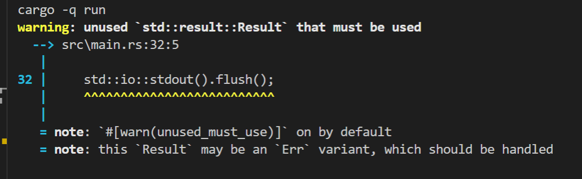
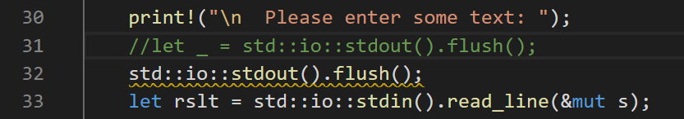
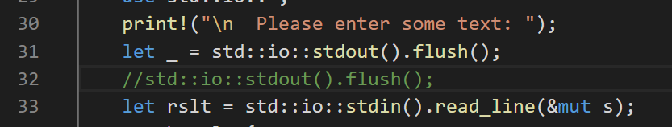
What’s Unique about Rust Error Handling?
Rust encourages developers to handle every case were errors may occur.
You have to opt out of handling an error case.
Rust has support for bubbling errors up the call chain, creating new custom errors, and returning errors from main.

Slide 3
Errors
Indexing out of bounds
Divide by zero
Integer overflow
Console and file I/O failures to open or read/write
Initializing String from non-utf8 byte array
System and User-defined errors
Users supply unexpected or malicious inputs
Server not available
Unexpected content format

Slide 4
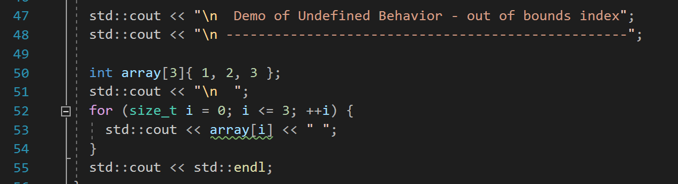
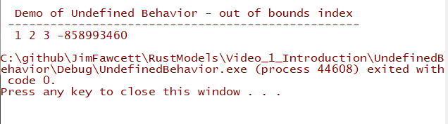
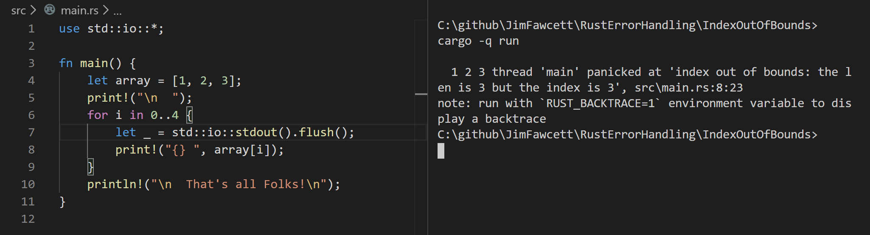
Avoiding Undefined Behavior with Panic
C++ Code
Unowned memory can be accessed. Process ends normally.
Rust Code
Panic terminates before memory can be accessed

Slide 5
Rust Panics
A panic is a program exit that attempts to unwind the stack, dropping each object residing in the stack.
Panics can be trapped and handled to avoid program exit
Should a panic occur while unwinding the stack from an earlier panic the program will immediately abort.
Multiple panic aborts cannot be trapped, so stopping in this case is inevitable
Panics are intended program actions that avoid undefined behavior due to program errors.
Indexing out of bounds
So panics are the lowest level of error handling mechanisms.

Slide 6
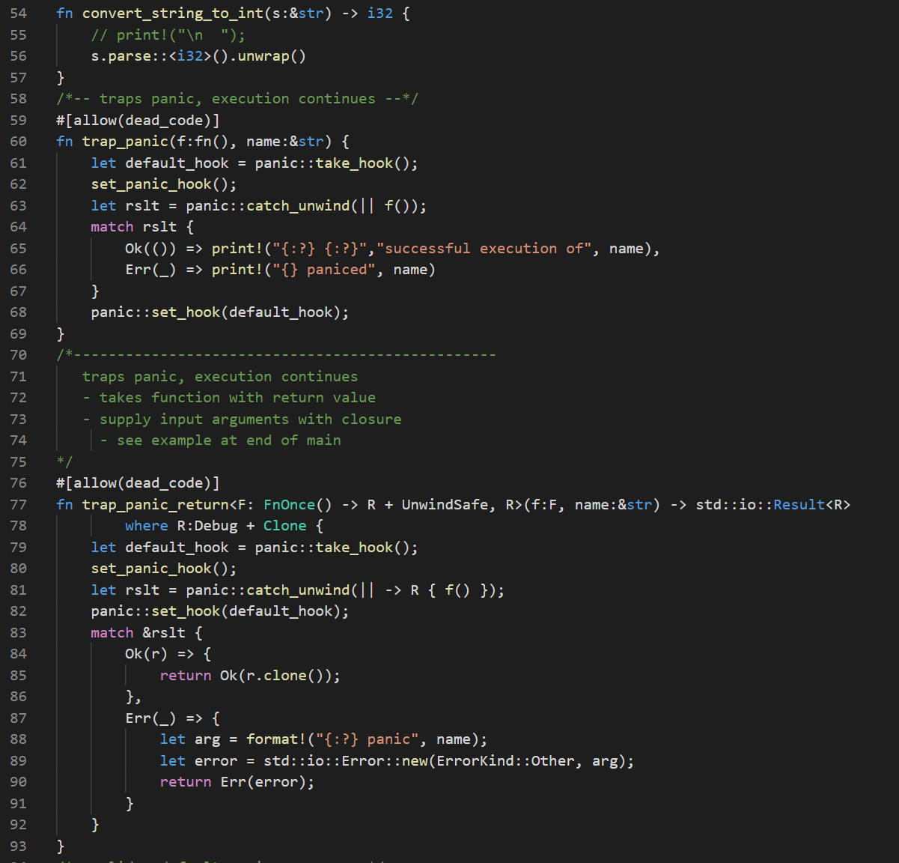
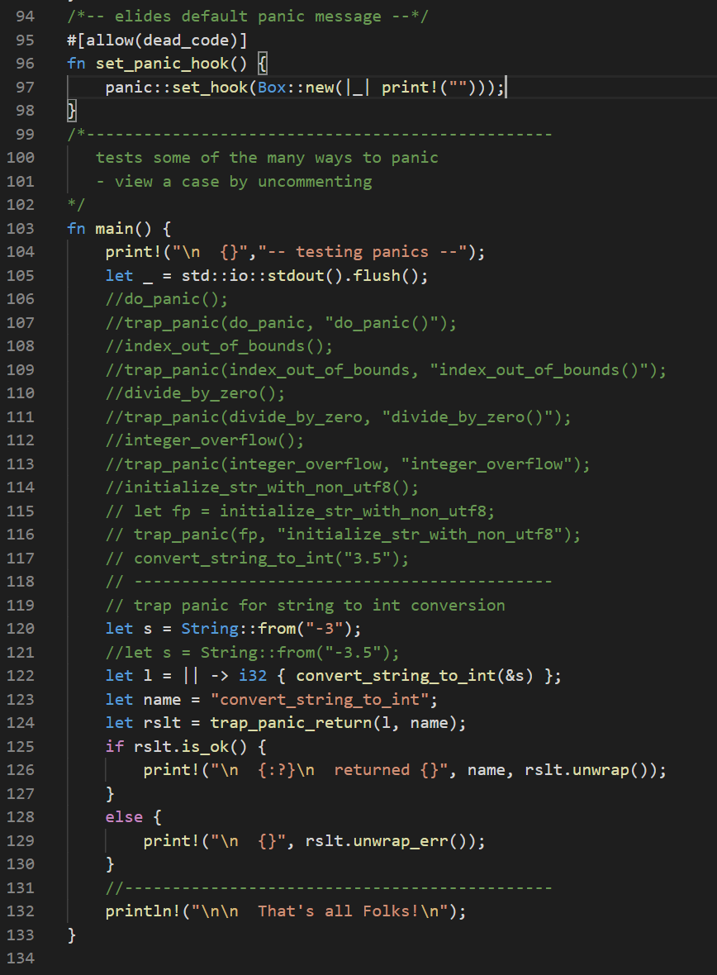
Trapping Panics

Slide 7
Rust Error Handling Types
Enum Result<T,E> { Ok(T), Err(E) }
#[must_use]
std crate import
pub fn is_ok(&self) -> bool
pub fn is_Err(&self) -> bool
pub fn unwrap(self) -> T
panics if not Ok
Pub fn unwrap_err(self) -> E
Panics if not Err

Slide 8
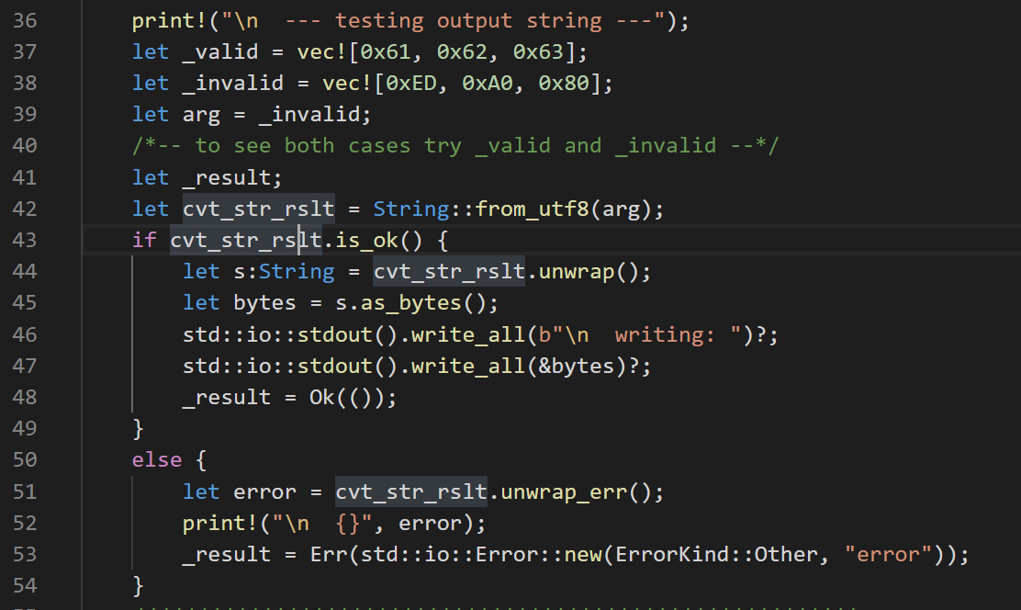
Using Result<T,E> with is_ok()
Illustrates accepting Result<String, FromUtf8Error>,
testing, and returning
Result<(), CustomError>

Slide 9
Error Types
Std Error
type Result<T> = Result<T,std::io::Error>;
std::io crate import
Custom Error
Use std::io::{Error, ErrorKind};
Let custom_error = Error::new(ErrorKind::Other, some_useful_value);

Slide 10
Error Handling that Avoids Panics
Each function that can fail should return a std::result::Result<T, E>
fn f<T, E>() -> Result<T, E> { /* code that can fail */ }
std library functions do this and so should user-defined functions
Result is an enumeration
Enum Result<T, E> { Ok(T), Err(E), }
Returned Result instance is either Ok(t:T) or Err(e:E)
t is the computed value of f()
e is the instance of error encountered, either from Error enumeration or user-defined
Testing Result
let rslt = f();
if rslt.is_ok() { let t:T = rslt.unwrap(); /* do something with t */ }
if rslt.is_err() { let e:E = rslt.unwrap_err(); /* do something with e */ }

Slide 11
Evaluating Result by Matching
let rslt = f();
match rslt { Ok(t) => { /* do something with t */ }, Err(e) => { /* do something with e */ }, }
match is required to define actions for both possible results
if let uses matching operator =
if let Ok(t) = rslt { /* do something with t = rslt.unwrap() */ } else { /* do something with e = rslt.unwrap_err() */ }

Slide 12
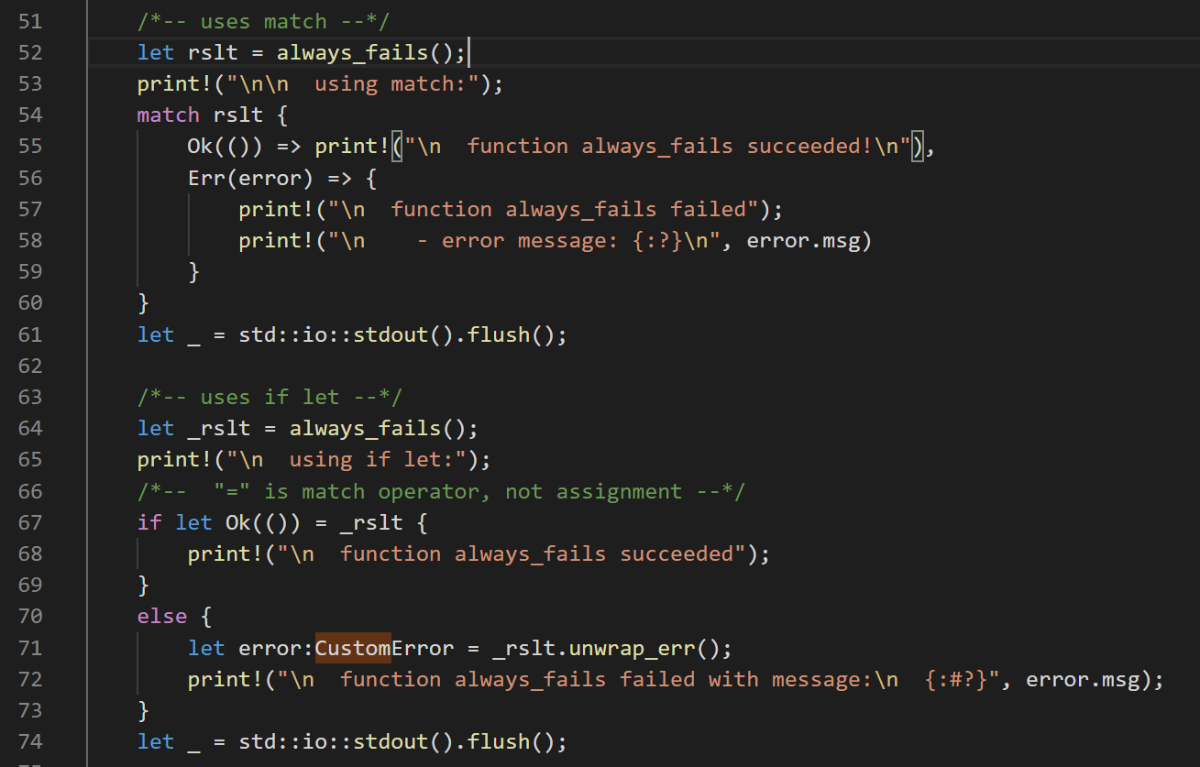
Demonstration code using match and let if
match requires testing both cases, Ok and Err
if let doesn’t require handling both cases, but the code may do so, as shown

Slide 13
Bubbling Errors up Call Chain
Fn g<T, E>() -> Result<T, E>
Fn f<T, E>() -> Result<T, E> { // code elided let t:T = g()? // code using t elided }
If g() returns an error the try operator ? returns from f(), passing out the Result object, Err(e:E).
Otherwise, the ? operator unwraps the result, t:T and binds to t.

Slide 14
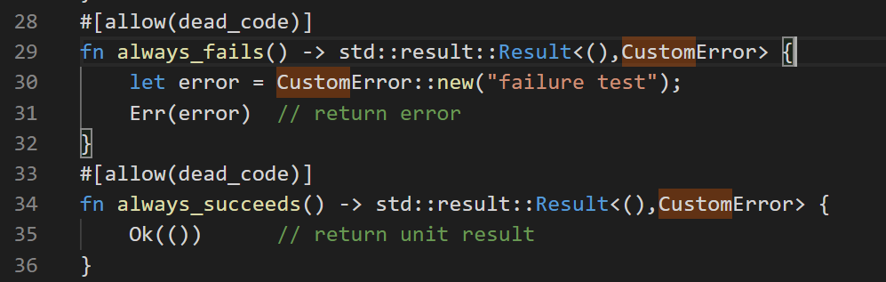
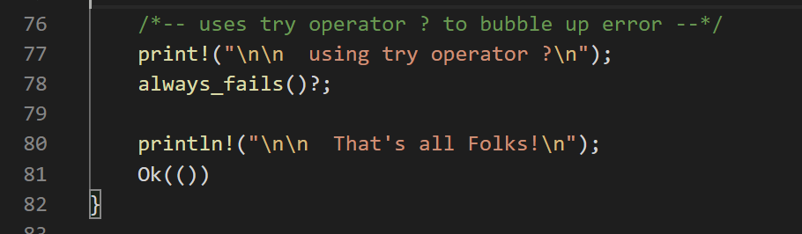
Bubbling Errors up the Call Chain
f<T>() -> Result<T, E>
if Result<T, E> contains Ok(t:T) after evaluating f()
then f()? Evaluates as t = f().unwrap();
if Result<T, E> contains Err(error)
then f()? Returns Result<T, E> to caller

Slide 15
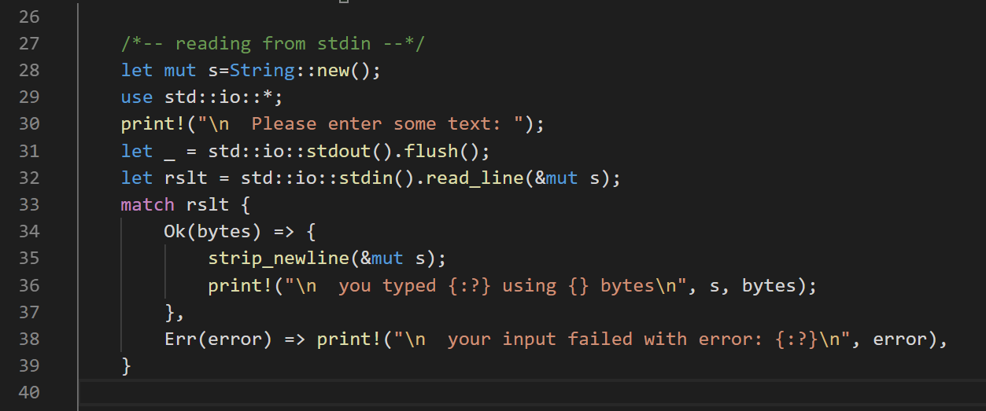
Console I/O – std::io::stdin()

Slide 16
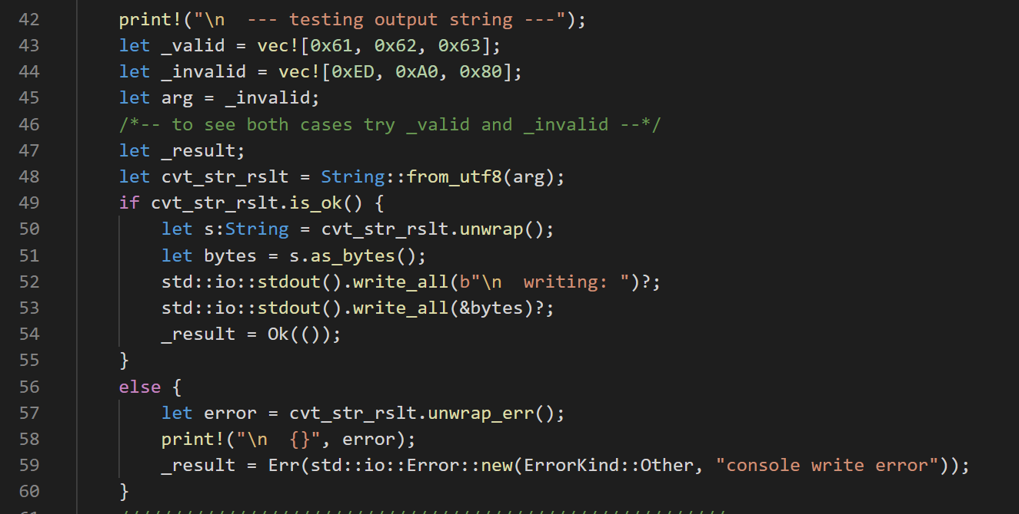

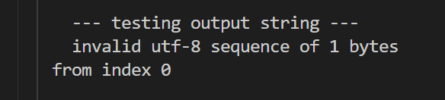
Console I/O – std::io::stdout()
arg = _valid
arg = _invalid

Slide 17
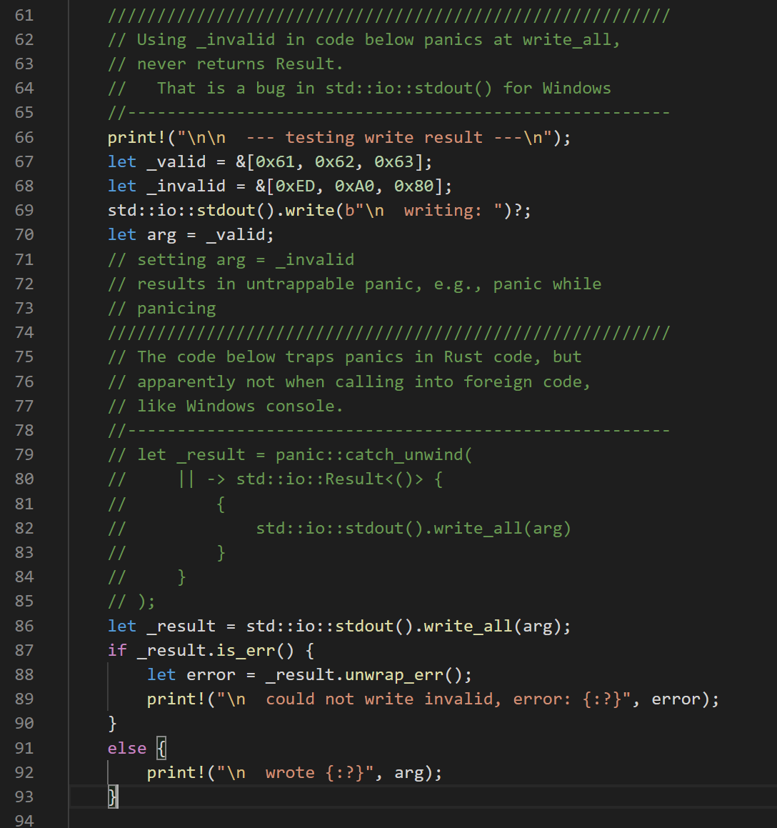
std::io::stdout()
Stdout() on Windows platform does not work well with non-utf8 characters. If you pass a buffer containing non-utf8 byte sequence(s) the program will panic.
Moreover, that panic cannot be trapped because the stack unwinding process results in a second active panic which always calls an immediate abort.
Note that you can always avoid this problem by building a String from the byte sequence. That does reliably fail with a Result if any of the bytes can’t be represented as part of a utf-8 sequence.
If it doesn’t fail, you can safely pass the String, as bytes, to the stdout().write or write_all methods.

Slide 18
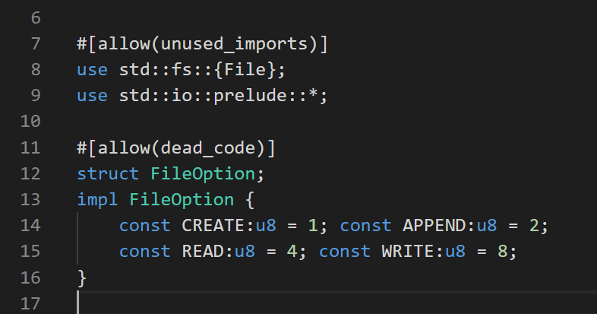
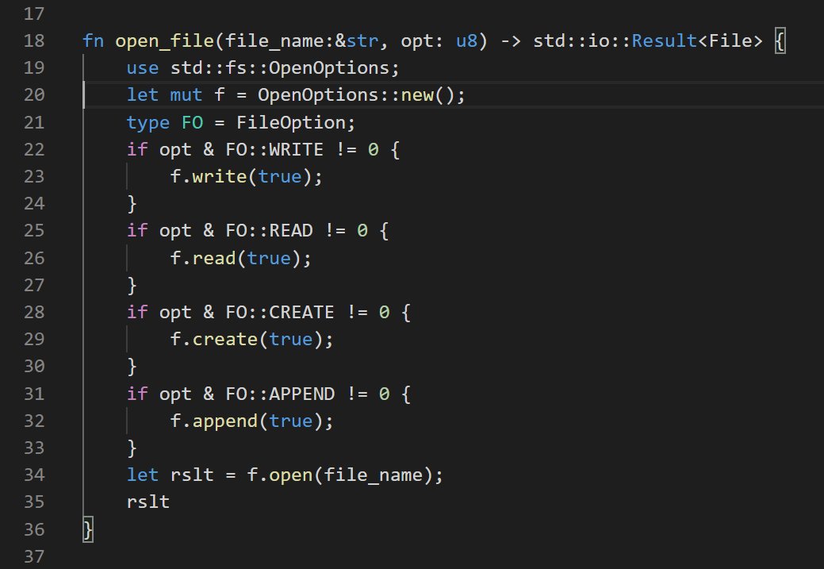
Flexible File Open
Syntax of the Rust language does not support bit-masking on enums (which you can do in C++). The reason is that Rust enums may have any associated type, not just integers (like C++). This code illustrates one way to accomplish bit masking on options.

Slide 19
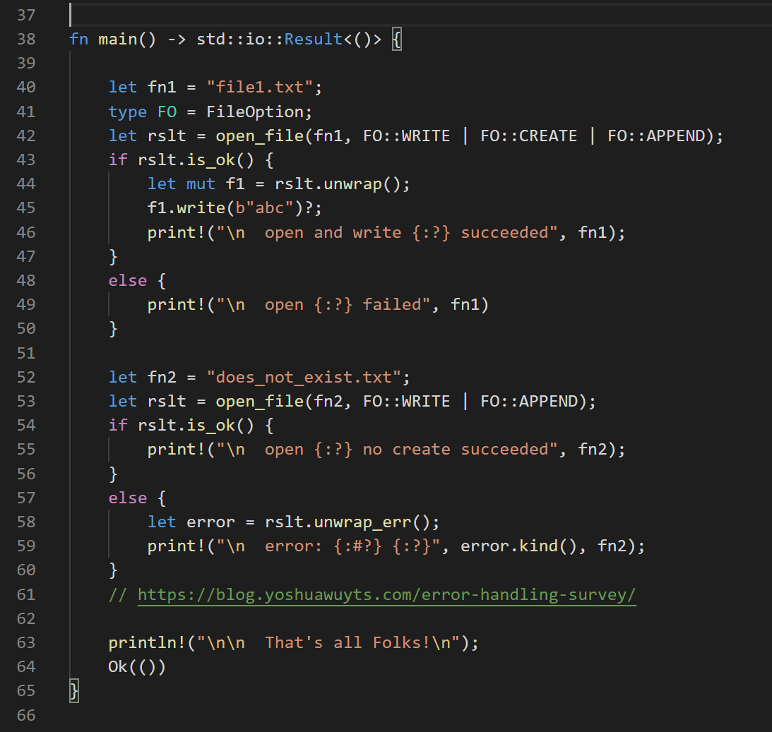
File Error Handling
Two cases are presented here. The first attempts to open a file, and, if it does not exist, will create and open it.
The second case does not attempt to create the file if it does not exist, so will fail if it doesn’t exist.
Open errors are managed by examining the open_file function’s result. Write failures are handled by bubbling up to the caller – main in this case, so a write error terminates the program with an error message.

Slide 20
Summary
Rust error handling uses:
panics
Trapping panics has behavior similar to C++ exception handling
std::Result<T,E>
Must handle both Ok(t:T) and Err(e:E)
Matching
Equivalent to manually handling Result, but often less code
call-chain error event bubbling
Supports chaining calls, e.g., anInstance.f1()?.f2()?.f3()?;
Chaining requires each function to return self or &self
Rust tries to prevent developers from ignoring errors or forgetting to manage them.

