Slide 1
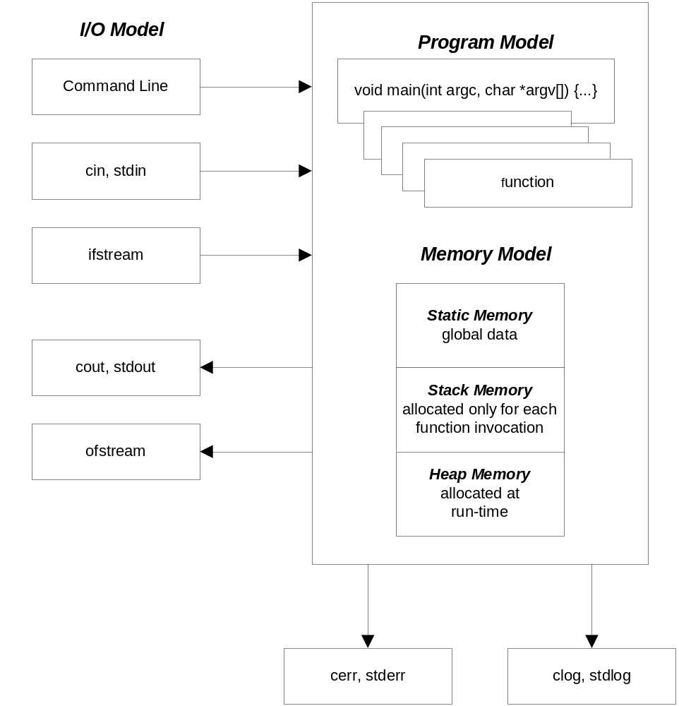
C/C++ Computational Model

Slide 2
C/C++ Memory Model
Static memory: - available for the lifetime of the program
public global functions
and data
defined outside any function (globals) and initial- ized before main is entered.
global data and functions are made private by
qualifying as static, otherwise they are public
memory allocations local to a function, but quali-
fied as static
private global functions
and data
local static data
Stack memory: - temporary scratch pad
main stack frame
- defined only while computational thread passes
through a function.
- holds input parameters, local data, and return
values, used as scratch-pad memory
- guaranteed to be valid during the evaluation of
a containing expression, won’t be valid after
- expression evaluation starts with function eval-
uation first, then expression evaluation as alge-
braic combination of terms
- stack frame is destroyed when expression eval-
uation is complete
function called by main
stack frame
more stack frames
:
current function
stack frame
heap memory: - valid from the time of allocation to deallocation
allocated heap memory
- allocated/deallocated at run time by invoking
operators new /delete (or functions malloc/free)
- memory is available to anyone with a pointer
to the allocated memory from the time of
allocation until deallocated.
free heap memory
free memory

