Slide 1
Rust Error Handling
Jim Fawcett
https://JimFawcett.github.io

Slide 2
What is Rust?
A modern programming language that emphasizes:
Compiler verified freedom from undefined behavior.
Support for writing data race free code in multi-threaded environments.
Performance comparable to C and C++.
Rust builds on experience with C and C++ to provide a system programming language that:
Closes vulnerabilities by construction.
Does not pay run-time performance penalty for safety.
Enables abstractions needed to build large maintainable code bases.
Rust compiles to native code and provides clever mechanisms to ensure freedom from dangling references and resource leaks.

Slide 3
Safe and Productive System Programming
Rust incorporates a number of interesting ideas that support system programming:
Compiler-checked single ownership policy with transfer and borrowing operations.
Heap storage only through smart pointers that use scope-based data management, so no resource leaks.
Traits that define contracts for static and dynamic polymorphism, using generics and trait inheritance, essential for building flexible code that adapts to changing requirements.
Error handling: functions return Result<T, E> { Ok(t:T), Err(e:E) } enumerations.
Dependency management through metadata supported transitive builds.
Effective tools for building (cargo), checking code quality (clippy), formatting (rustfmt), and documentation (rustdoc).

Slide 4
Error Handling
This presentation focuses on Rust error handling.
Role of panics in preventing undefined behavior
Returning results from functions that may fail
Matching return enumerations with appropriate operations
Error event bubbling up call chain
We will demonstrate these with discussions and code. You can find all code presented here in this Error Handling Code Rerpository.
You will find more details about ownership, objects, generics, and the Rust build process in a series of podcasts that are being published by CSIAC and also made available here.
More details about Rust are provided in a Rust Story from my github site.

Slide 5
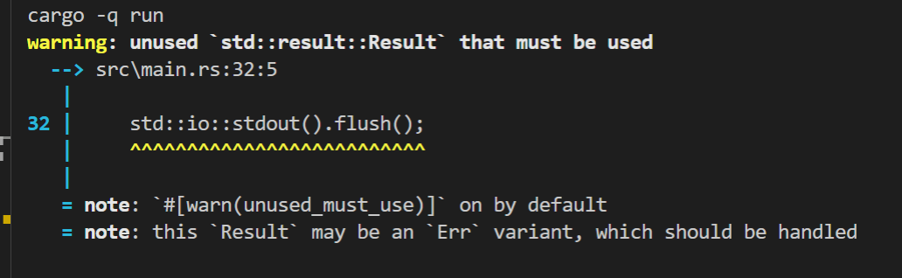
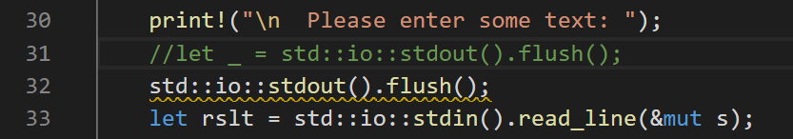
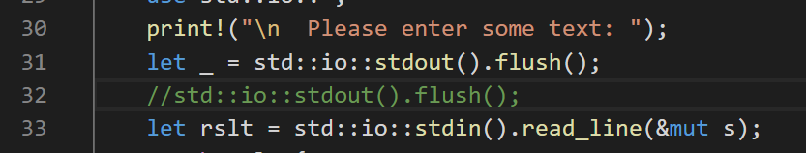
What’s Unique about Rust Error Handling?
Rust encourages developers to handle every case were errors may occur.
You have to opt out if you don’t need to handle an error case.
Rust has support for bubbling errors up the call chain, creating new custom errors, and returning errors from main.

Slide 6
Errors
Indexing out of bounds
Divide by zero
Integer overflow
Console and file I/O failures to open or read/write
Initializing String from non-utf8 byte array
System and User-defined errors
Users supply unexpected or malicious inputs
Server not available
Unexpected content format

Slide 7
Rust Panics
A panic is a program exit that attempts to unwind the stack, dropping each object residing in the stack.
Panics can be trapped and handled to avoid program exit
Should a panic occur while unwinding the stack from an earlier panic the program will immediately abort.
Multiple panic aborts cannot be trapped, so stopping in this case is inevitable
Panics are intended program actions that avoid undefined behavior due to program errors.
Indexing out of bounds
So panics are the lowest level of error handling mechanisms.

Slide 8
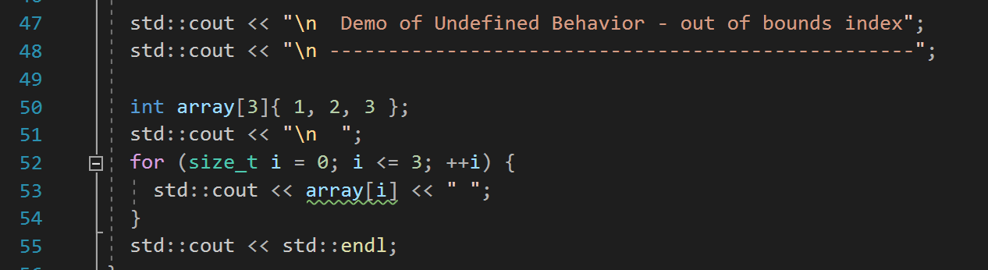
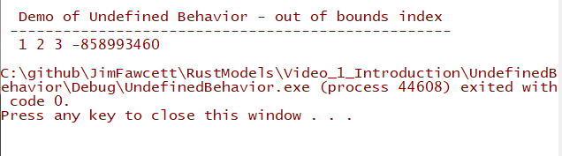
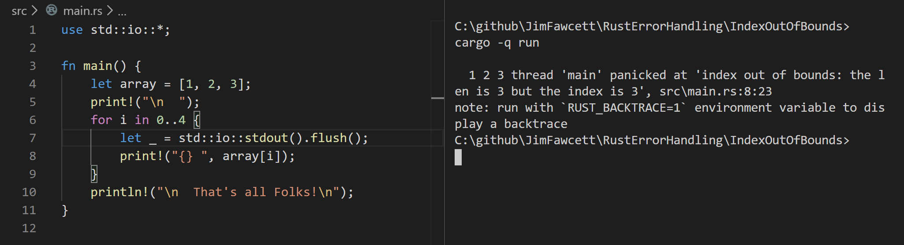
Avoiding Undefined Behavior with Panic
C++ Code
Unowned memory can be accessed. Process ends normally.
Rust Code
Panic terminates before memory can be accessed

Slide 9
Avoiding Panics
If your program affects user health, wealth, or safety, then don’t panic.
Thank you, Douglas Adams
Abruptly terminating operation of a Boeing 797 flight navigation system is not a good idea.
The route to panic-free behavior is handling results of all functions that may fail.
Rust makes that obvious, using the return type Result<T, E> for functions that may fail.
Rust vigorously reminds you to add any missing error handling for those functions – see slide #2.

Slide 10
Rust Error Handling Types
Enum Result<T,E> { Ok(T), Err(E) }
#[must_use]
std crate import
pub fn is_ok(&self) -> bool
pub fn is_Err(&self) -> bool
pub fn unwrap(self) -> T
panics if not Ok
Pub fn unwrap_err(self) -> E
Panics if not Err

Slide 11
Error Types
Std Error
type Result<T> = Result<T,std::io::Error>;
std::io crate import
Custom Error
Use std::io::{Error, ErrorKind};
Let custom_error = Error::new(ErrorKind::Other, some_useful_value);

Slide 12
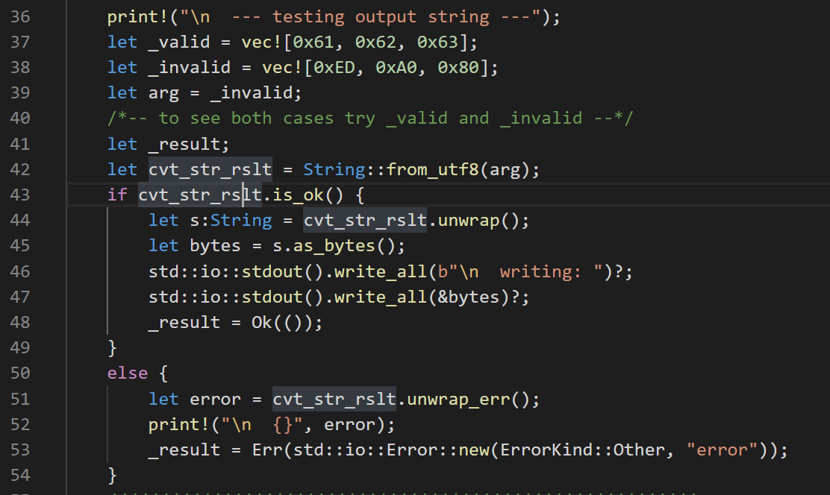
Using Result<T, E> with is_ok()
Illustrates accepting Result<String, FromUtf8Error>,
Testing, with Result::is_ok(), and returning a new Result type: Result<(), CustomError>

Slide 13
Trapping Panics
If you need to use code that doesn’t reliably avoid panics you may attempt to trap them:
trap_panic(unreliable_function, description_str) -> Result;
Definition in next slide
Traps are not guaranteed to succeed.
A panic unwinds the call stack, returning resources to the process with drop.
If a drop also panics, the system will immediately abort.
If that happens before leaving trap_panic the trap will fail.

Slide 14
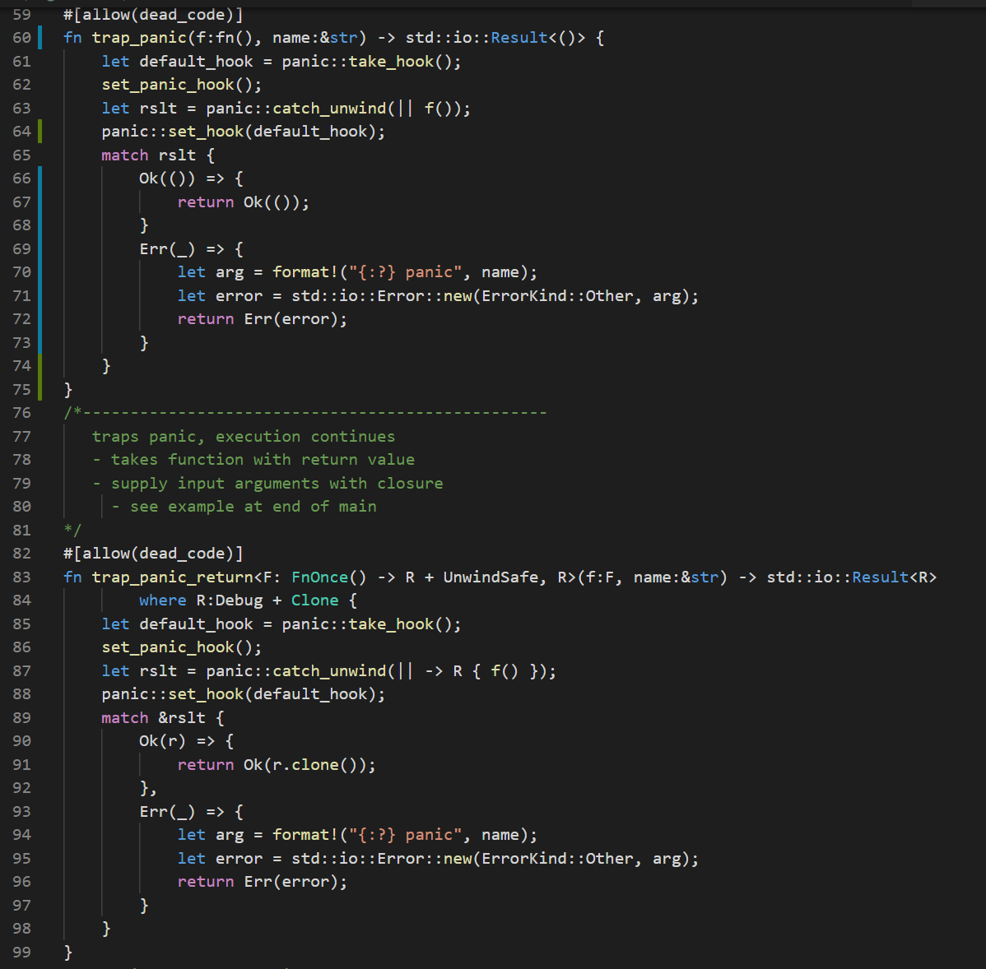
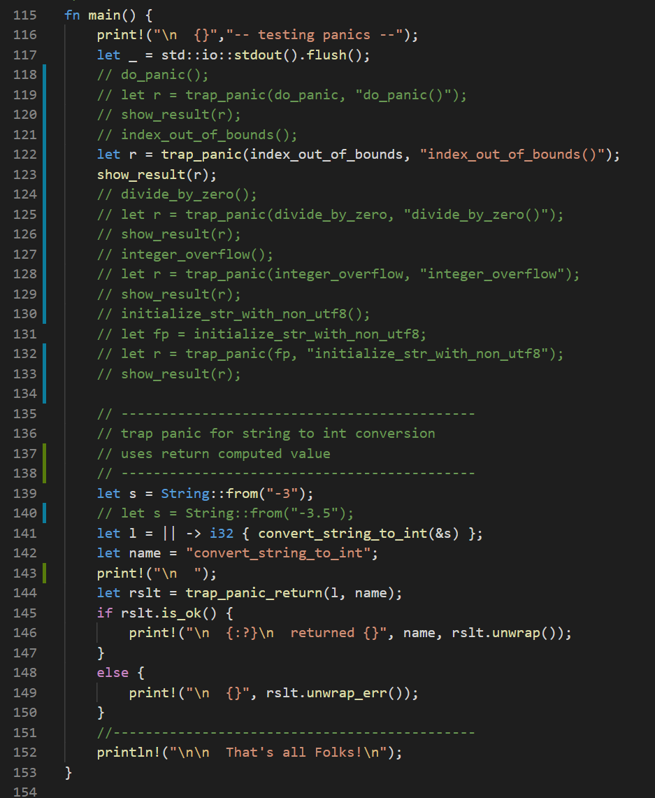
Trapping Panics

Slide 15
Error Handling that Avoids Panics
Each function that can fail should return a std::result::Result<T, E>
fn f<T, E>() -> Result<T, E> { /* code that can fail */ }
std library functions do this and so should user-defined functions
Result is an enumeration
Enum Result<T, E> { Ok(T), Err(E), }
Returned Result instance is either Ok(t:T) or Err(e:E)
t is the computed value of f() or unit, (), if no such value is computed
e is the instance of error encountered, either from Error enumeration or user-defined
Testing Result
let rslt = f();
if rslt.is_ok() { let t:T = rslt.unwrap(); /* do something with t */ }
if rslt.is_err() { let e:E = rslt.unwrap_err(); /* do something with e */ }

Slide 16
Evaluating Result by Matching
let rslt = f();
match rslt { Ok(t) => { /* do something with t */ }, Err(e) => { /* do something with e */ }, }
match is required to define actions for both possible results
“if let” uses matching operator =
if let Ok(t) = rslt { /* do something with t = rslt.unwrap() */ } else { /* do something with e = rslt.unwrap_err() */ }

Slide 17
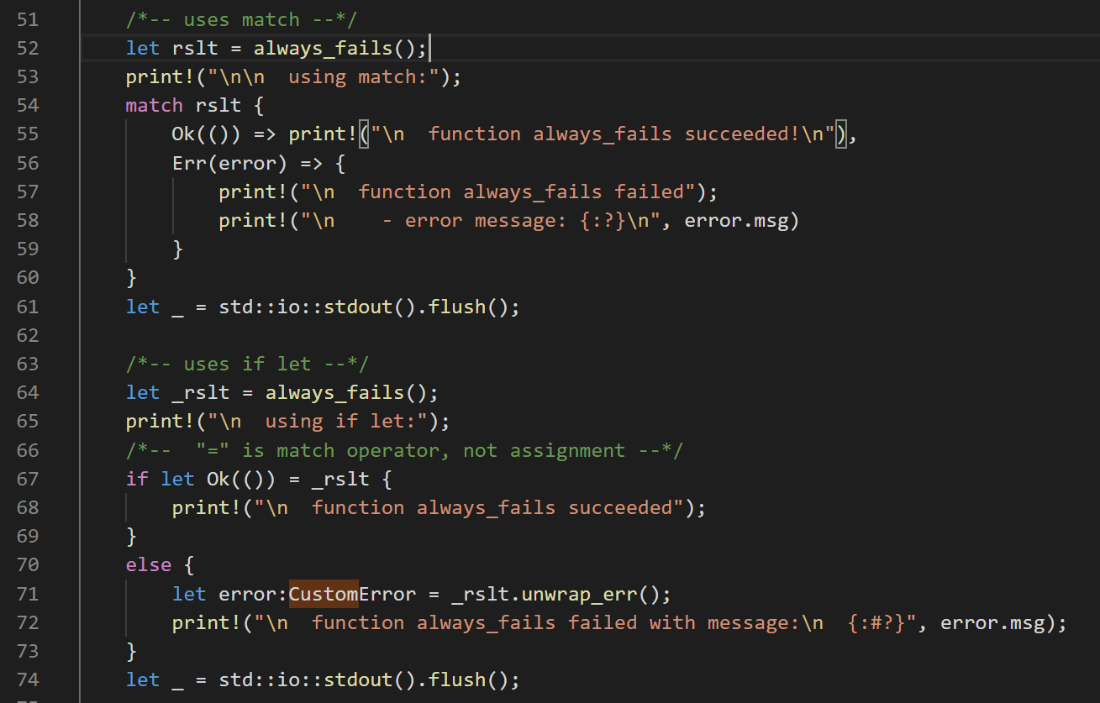
Demonstration code using match and if let
match requires testing both cases, Ok and Err
if let doesn’t require handling both cases, but the code may do so, as shown

Slide 18
Bubbling Errors up Call Chain
fn g<T, E>() -> Result<T, E>
fn f<T, E>() -> Result<T, E> { // code elided let t:T = g()? // code using t elided }
If g() returns an error the try operator ? returns from f(), passing out the Result object, Err(e:E).
Otherwise, the ? operator unwraps the result, t:T and binds to t.

Slide 19
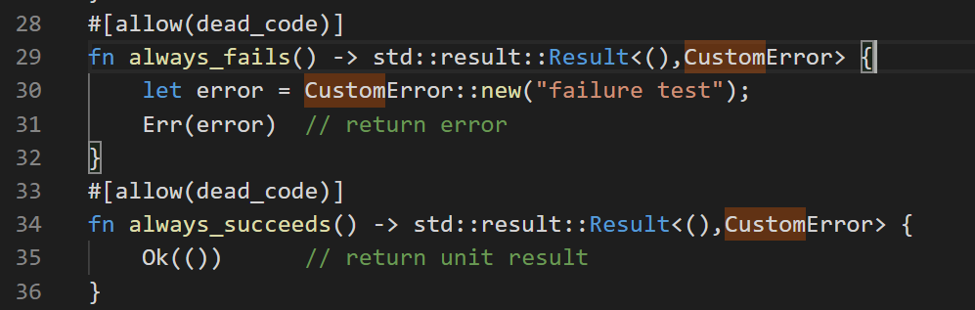
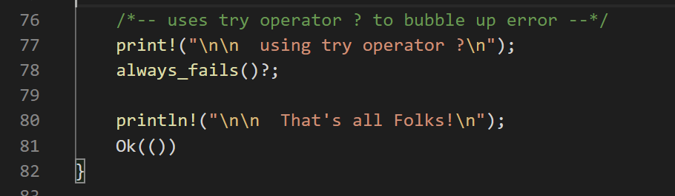
Bubbling Errors up the Call Chain
f<T>() -> Result<T, E>
if Result<T, E> contains Ok(t:T) after evaluating f()
then f()? Evaluates as t = f().unwrap();
if Result<T, E> contains Err(error)
then f()? Returns Result<T, E> to caller

Slide 20
Examples of Common Error Handling
Console I/O
File I/O
TCP communication processing
Inter-process communication with pipes
We will briefly discuss the first two in this presentation

Slide 21
Console I/O
std::io::stdin() -> Stdin
Stdin functions:
fn read_line(&self, buf:&mut String) -> Result<usize>
fn read_to_string(&mut self, buf:&mut String) -> Result<usize>
Many more here: https://doc.rust-lang.org/1.4.0/std/io/struct.Stdin.html
std::io::stdout() -> Stdout
Stdout functions
fn write(&mut self, buf: &[u8]) -> Result<usize>
fn write_all(&mut self, buf: &[u8]) -> Result<usize>
fn flush(&mut self) -> Result<()>
Many more here: https://doc.rust-lang.org/1.4.0/std/io/struct.Stdout.html

Slide 22
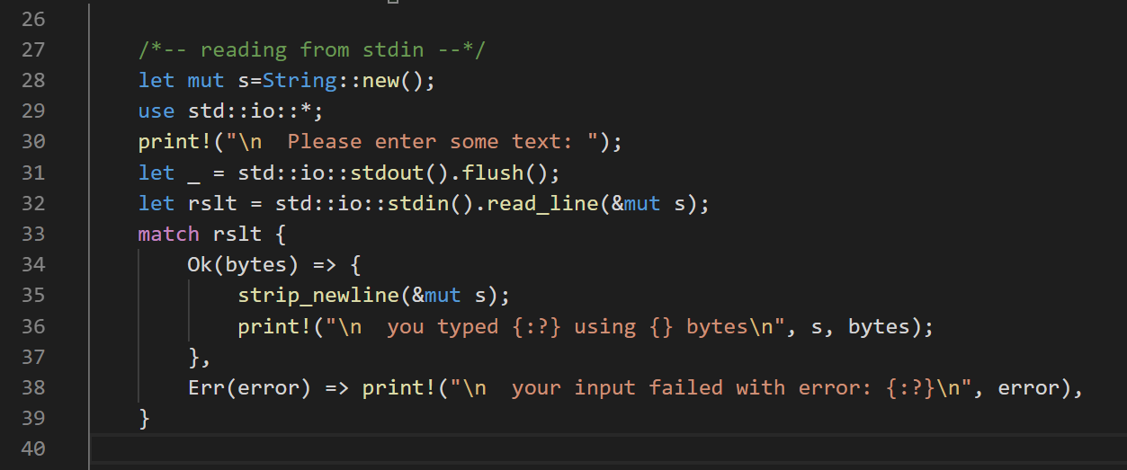
Console I/O – std::io::stdin()

Slide 23
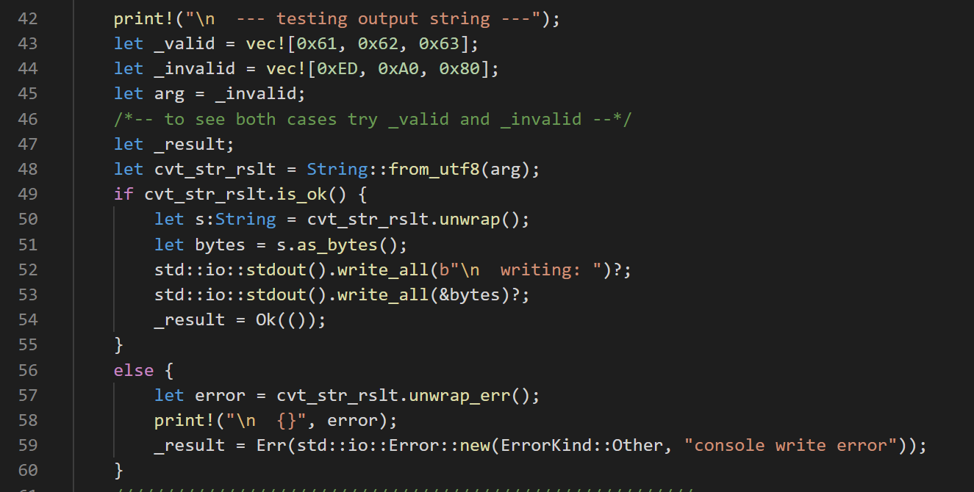

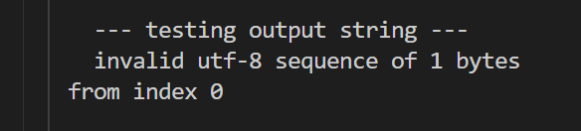
Console I/O – std::io::stdout()
arg = _valid
arg = _invalid

Slide 24
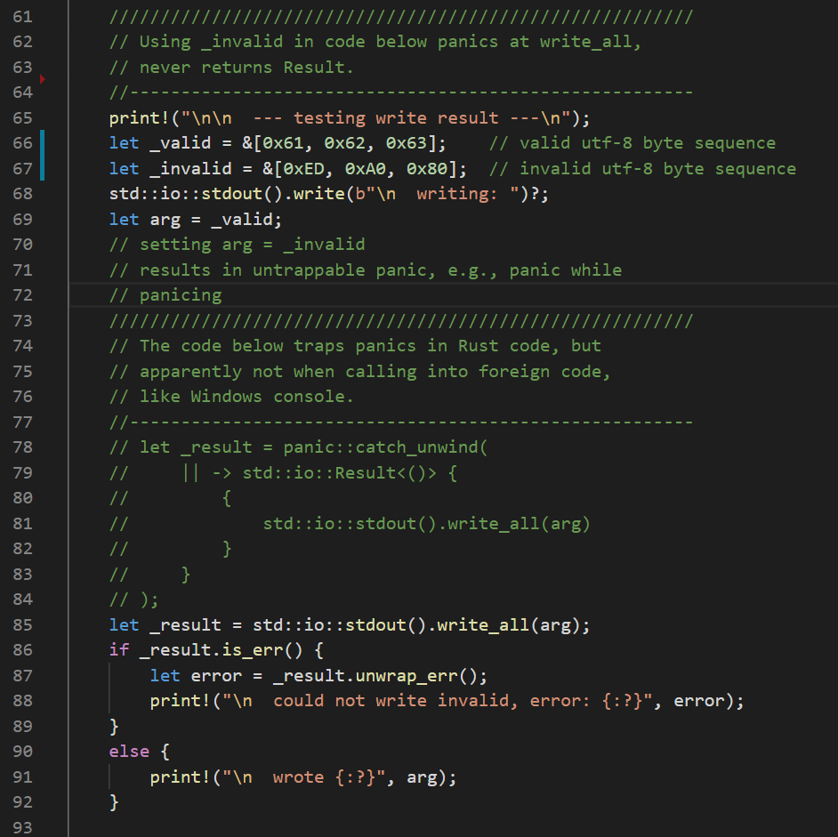
std::io::stdout()
Stdout() on Windows platform does not work well with non-utf8 characters. If you pass a buffer containing non-utf8 byte sequence(s) the program will panic.
Moreover, that panic cannot be trapped because the stack unwinding process results in a second active panic which always calls an immediate abort.
Note that you can always avoid this problem by building a String from the byte sequence, as shown in the previous slide. That does reliably fail with a Result if any of the bytes can’t be represented as part of a utf-8 sequence.
If it doesn’t fail, you can safely pass the String, as bytes, to the stdout().write or write_all methods.

Slide 25
File I/O
std::fs::File
File functions:
fn open<P: AsRef<Path>>(path: P) -> Result<File> // opens read-only
fn create<P: AsRef<Path>>(path: P) -> Result<File> // opens write-only
fn with_options() -> OpenOptions
Many more here: https://doc.rust-lang.org/std/fs/struct.File.html

Slide 26
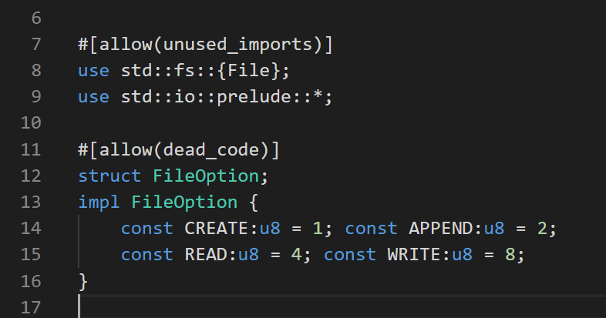
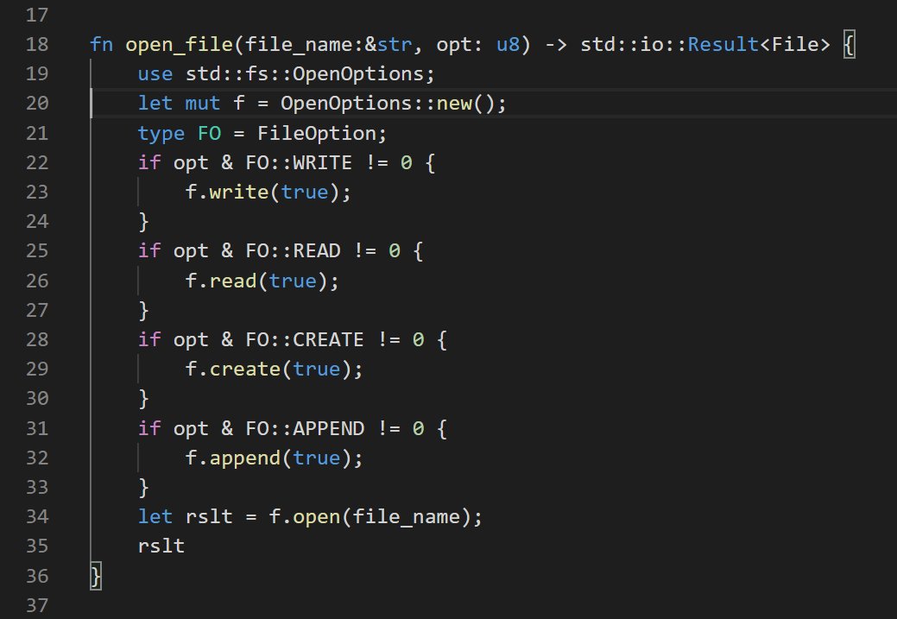
Flexible File Open
Syntax of the Rust language does not support bit-masking on enums (which you can do in C++). The reason is that Rust enums may have any associated type, not just integers (like C++). This code illustrates one way to accomplish bit masking on options.

Slide 27
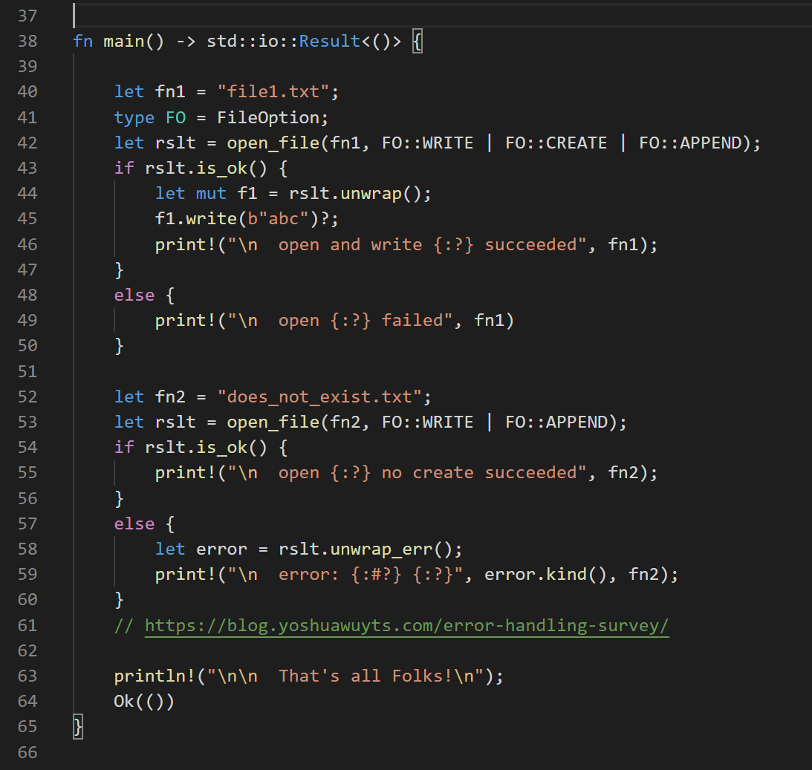
File Error Handling
Two cases are presented here. The first attempts to open a file, and, if it does not exist, will create and open it.
The second case does not attempt to create the file if it does not exist, so will fail if it doesn’t exist.
Open errors are managed by examining the open_file function’s result. Write failures are handled by bubbling up to the caller – main in this case, so a write error terminates the program with an error message.

Slide 28
Summary
Rust error handling uses:
panics
Trapping panics has behavior similar to C++ exception handling
std::Result<T,E>
Must handle both Ok(t:T) and Err(e:E)
Matching
Equivalent to manually handling Result, but often less code
call-chain error event bubbling
Supports chaining calls, e.g., anInstance.f1()?.f2()?.f3()?;
Chaining requires each function to return self or &self
Rust tries to prevent developers from ignoring errors or forgetting to manage them.

Slide 29
References
Link | Contents
Rust Error Handling Code | Demonstration code for this presentation
Rust Book | Covers most of the language clearly
Gentle Introduction to Rust | Well written, fewer topics than Rust Book, very clear
Half Hour to Learn Rust | Stroll throught most of the common constructs
Rust Standard Library | The official documentation for the std library

Slide 30
That’s all Folks!
Thanks for listening/reading

