Slide 1
Consuming Rust bite by byte Bite 2 – Undefined Behavior
Jim Fawcett
https://JimFawcett.github.io
Bite #1
Bite #3

Slide 2
Bite #2 – Undefined Behavior
Our goal is to observe undefined behavior in C++, and understand why that won’t happen in Rust code:
Invalid references
Indexing out of bounds
C++ safe by convention
Rust safe by construction

Slide 3
Type Safety
A program is well defined if no execution can exhibit undefined behavior.
A language is type safe if its type system ensures that every program is well defined.
A non-type safe language may introduce undefined behavior with:
Reference invalidation
Integer overflow, e.g., wrap-around
Buffer overflow – out of bounds access
Use after free – access unowned memory
Double free – corrupt memory manager
Race conditions – mutation without exclusive ownership

Slide 4
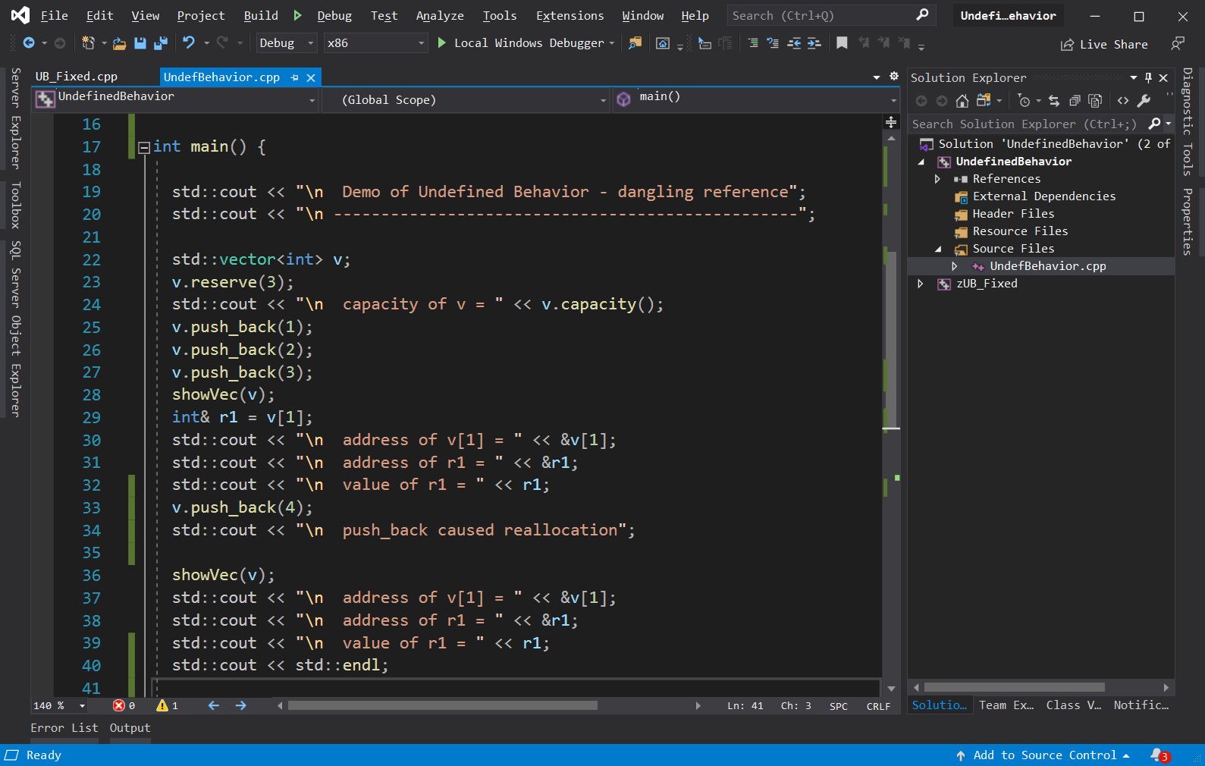
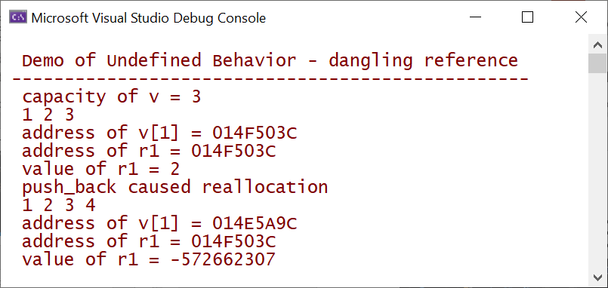
Undefined Behavior – C++ dangling reference

Slide 5
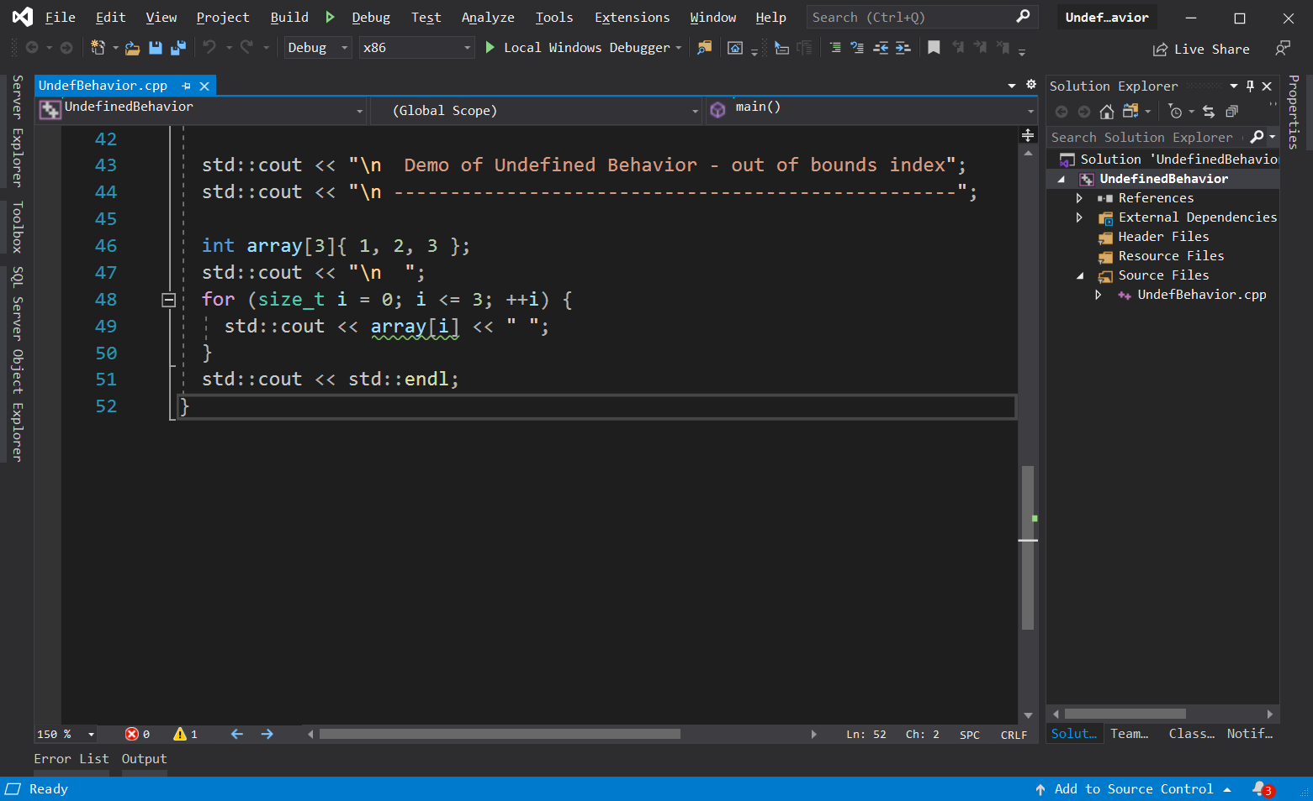
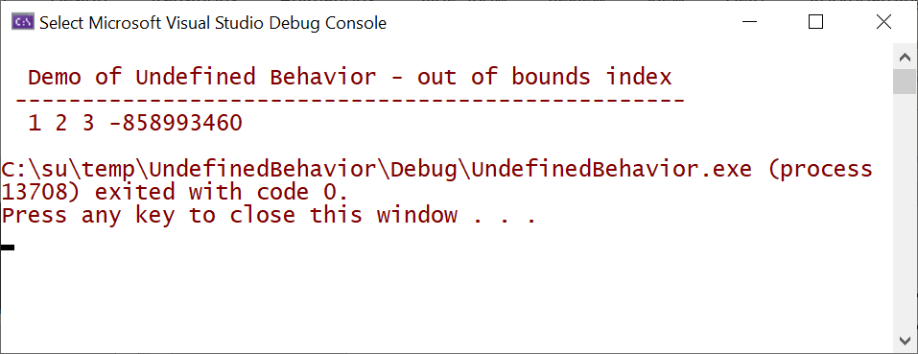
Undefined Behavior – C++ index out of bounds

Slide 6
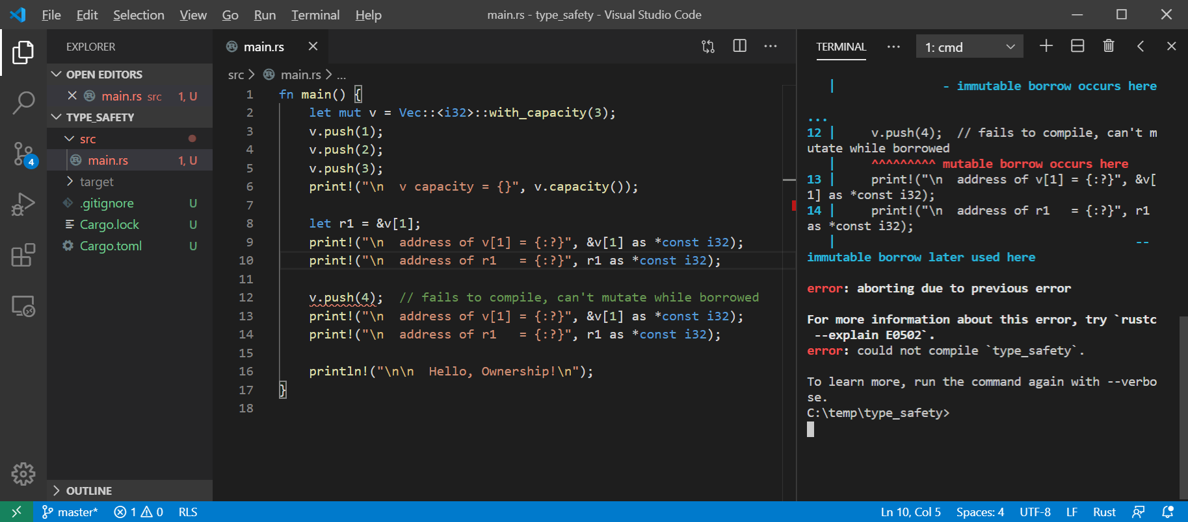
Rust won’t allow mutation with an active reference

Slide 7
In defense of C++ - Dangling Reference
If we had used an iterator:
auto iter1 = ++v.begin();
v.push_back(4);
Std::cout << *iter1; // throws exception – no undefined behavior
It is standard practice to access containers with iterators, so well-crafted C++ will not exhibit undefined behavior.
The difference:
With Rust you can’t get undefined behavior (UB) – most often programs fail to compile if they would have UB.
C++ code has to be well-crafted to avoid UB, errors are discovered at run-time, not compile-time.

Slide 8
In defense of C++ - Index out of Bounds
If we had used a range-based for loop:
for(auto item : array) { std::cout << item << “ “; }
there is no chance of out-of-bounds indexing
It is standard practice to traverse containers with range-based for loops, so well-crafted C++ will not exhibit undefined behavior.
The difference:
With Rust you can’t get undefined behavior (UB) – out of bounds index causes panic (exit) with no chance to access unowned memory.
C++ code has to be well-crafted, using standard idioms, to avoid UB.

Slide 9
Why Rust?
Memory Safety
No dangling pointers or null references
No reading or writing to unowned memory
Rust’s type system enforces sane ownership policies.
No Data Races
The same ownership policies applied to thread interactions ensures data race free operation
Performance
As fast as C and C++
Abstraction without Overhead
Traits and Trait objects
In the same ballpark as C++

Slide 10
Exercises
Create a Rust array of integers – attempt to index out of bounds.
What is the advantage of Rust panic over C++ allowed access?
Explain the difference between references in C++ and Rust?
Distinguish between references and pointers.
Consult Dr. Google to discover what you can and cannot do with pointers in safe Rust code.

Slide 11
References
Link | Description
ConsumingRustBite1 - Data | Bind, Copy, Move, and Clone
ConsumingRustBite3 - Ownership | Single owner, borrow
Rust Models | Expanded discussion in Rust Models presentation

Slide 12
That’s all until Bite #3
Bite #3 introduces Rust’s ownership model. That’s what makes Rust a safe language.

