Slide 1
Consuming Rust bite by byte Bite 3 – Ownership
Jim Fawcett
https://JimFawcett.github.io
Bite #2
Bite #4

Slide 2
Bite #3 – Ownership
Our goal is to understand:
Mutability
Single ownership
Borrow
RwLock model

Slide 3
Rust Ownership
Ownership rules are, in principle, quite simple:
Rust enforces Read-Write-Locks on data access at compile-time.
Any number of readers may access a value simultaneously.
Writers get exclusive access to a value – no other readers or writers.
What are readers and writers?
Any variable bound to a value with no mut qualifier is a reader.
Original owner: let s = String::from(“a string”);
References to the data: let r = &s;
Any variable bound to a value with mut qualifier is a writer:
Original owner: let mut s = String::from(“another string”);
References to the data: let mut r = &s;

Slide 4
Examples of References and RwLocking
Non-mutable Vec and references - all readers:
let v = vec![1,2,3];
let r1 = &v; let r2 = &v; // each has view of v’s data
Creation of reference inhibits owner’s ability to mutate
Mutable Vec, non-mutable references:
let mut v = vec![1,2,3];
let r1 = &v; let r2 = &v; // each has view of v’s data
r1 and r2 borrow v’s data // v cannot mutate while borrows are active
Borrows end when they go out of scope or are dropped, drop(r1);
Mutable data, mutable reference – writer v’s ability to write borrowed
let mut v = vec![1,2,3];
let mut r = &v; // r has borrowed v’s ability to mutate
v cannot mutate until borrow ends

Slide 5
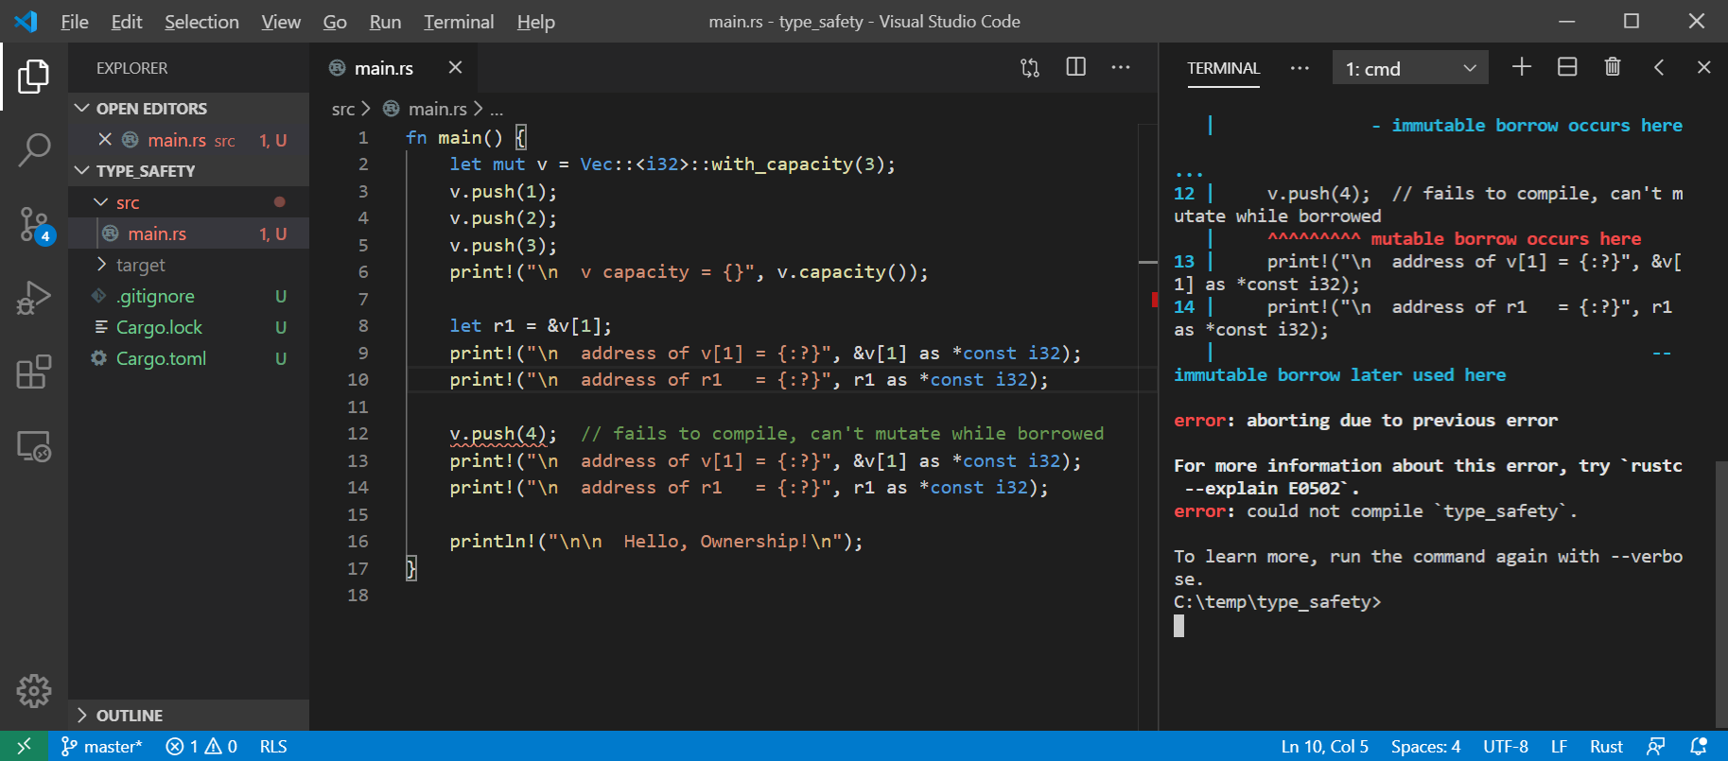
Rust won’t allow mutation with an active reference

Slide 6
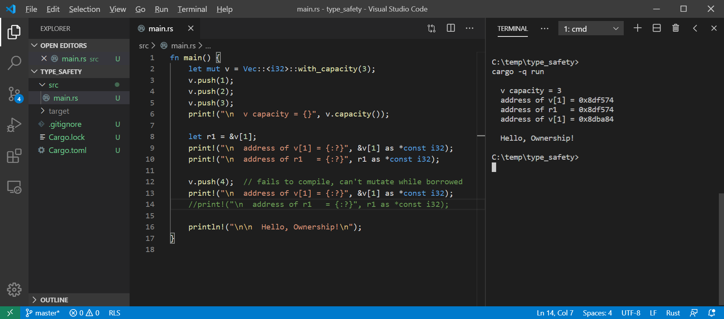
Rust allows mutation if we don’t use the reference

Slide 7
Hello Ownership!
Rust’s ownership policies:
Every value has one and only one owner
Owner disposes resource when it goes out of scope or is dropped
Ownership can be transferred with a move
Ownership can be borrowed with a reference
References hold a view into value
Original value’s owner can’t mutate value while borrowed
Immutable references can be shared. Mutable references are exclusive
Borrowing ends when reference goes out of scope or is dropped
This fits very well with pass by reference for function arguments
Values are, by default, immutable, but can be made mutable
let x = 3; // x is immutable
let mut y = 3; // y is mutable

Slide 8
Immutable References
Any number of immutable references may be declared for a value:
let mut s = String::from(“a string”);
let r1 = &s;
let r2 = &s;
The original owner can not mutate until all active references are dropped or go out of scope:
fn show(s:&String) { … }
let mut t = String::from(“another string”);
show(&t);
t.push_str(“ with more stuff”); // mutation ok, left &t’s scope, e.g. show function exit

Slide 9
Mutable References
Only one mutable reference may be declared for a value:
let mut s = String::from(“a string”);
let mut r1: &String = &s;
// let mut r2: &String = &s; // won’t compile
// let r3 = &s; // won’t compile
The original owner can not mutate until active reference is dropped or goes out of scope (same as before):
fn show(s:&String) { … }
let mut t = String::from(“another string”);
show(&t); // copies reference to show stack frame, e.g., a borrow
t.push_str(“ with more stuff”); // mutation ok, &mut t went out of scope

Slide 10
Copies, Moves
Copy
Data resides in one contiguous block of memory (blittable)
let x = 3.5;
let y = x;
y gets copy of x’s value ==> two separate locations holding the same value.
Copy binding creates new owner of new data.
Move
Data resides in two or more blocks, usually one in stack, one in heap.
let s = String::from(“a string”);
let t = s;
s value moved to t, s becomes invalid
Move binding transfers ownership

Slide 11
Ownership summary
These simple rules provide memory safety:
let x = y ==> copy if blittable, otherwise move ==> transfer of ownership
Can’t use y if moved from
let r1 = &x; let r2 = &x; ==> may have any number of immutable references
x may not be mutated while there are active references
let mut z = …
Let mut r3 = &z; ==> may only have one mutable reference
Z may not be mutated while there is an active reference
References become inactive when they go out of scope or are dropped:
drop(r3);

Slide 12
Exercises
Create a function that accepts a mutable reference. Attempt to display the reference with print!. Why does this fail to compile?
How can you display the function’s argument?
What do Copy and Move operations have to do with ownership?
How can you avoid transfer of ownership when binding to a non-blittable value?
Why is an owner not allowed to mutate when there are active references to its value?

Slide 13
References
Link | Description
ConsumingRustBite2 - Undefined Behavior | Lack of memory safety
ConsumingRustBite4 - Interior mutability | Checking ownership rules at run-time
Rust Story - Ownership | Expanded discussion in Rust Story

Slide 14
That’s all until Bite #4
Bite #4 discusses interior mutability. The defers ownership rule checking to run-time.

