Slide 1
Rust Models
Jim Fawcett
https://JimFawcett.github.io

Slide 2
Model
“A model of a system or process is a theoretical description that can help you understand how the system or process works, or how it might work.” - collinsdictionary.com
“A system or thing used as an example to follow or imitate.” - Merriam-Webster Dictionary

Slide 3
Rust Models – Chapter 1 of Rust Story
Part 1.
Code Structure
Build Model
Execution Model
Ownership model
Object Model
User Defined Types
Generics

Slide 4
Background
The material for this presentation comes from the github website:
https://JimFawcett.github.io, https://JimFawcett.github.io/Resources/RustModel.pdf
The site provides a curated selection of code developed for graduate software design courses at Syracuse University
It also contains tutorial and reference materials related to that code.
Some of that is presented in the form of “stories”
Rust Models is the title of the first chapter of a “Rust Story”
The story is a detailed walk-through of the Rust programming language. It provides reference material for a set of repositories that hold source code for utilities, tools, components, and demonstrations.

Slide 5
Prologue
Rust is an interesting and ambitious language.
Models help us understand important features of the language
Show the language’s internal consistency
Help us understand and use it effectively
We will consider:
Code Structure, Compilation, and Execution
Ownership – a key feature of Rust
Structs and the Rust object model
Generics

Slide 6
Rust Models Model 1 – Code Structure
Jim Fawcett
https://JimFawcett.github.io

Slide 7
1. Code Structure https://jimfawcett.github.io/RustStory_Models.html#structure
Source code is written in files
For many software systems file structures become large and hard to understand.
To support readability and maintenance, we create packages that consist of a few files with a single purpose and document the purpose and design in comments.
Source files are units of construction
Binaries - /src/main.rs – has main function, builds to an executable
Libraries - /src/lib.rs – builds to library
Modules - /src/*.rs – loaded when building binaries and libraries
A Crate is a unit of translation
Crates start as a set of source files in the /src directory and compile to a single file:
Binaries - /target/debug/[package_name].exe on windows
Libraries - /target/debug/lib[package_name].rlib

Slide 8
Crate
The source form of a crate is composed of:
A crate root, main.rs or lib.rs, and a set of zero or more supporting source files called modules, all found in the /src folder.
The crate root loads any modules identified with the keyword mod at the top of its source.
mod some_module ➔ loads some_module.rs
Each module may also load other modules.
So the source form of a crate is the crate root and a tree of modules
The translation form of a crate is a single compiled file, e.g., one of:
/target/debug/[package_name].exe
/target/debug/lib[package_name].rlib

Slide 9
Packages
A Package is a collection of directories and files that are the basis for builds
Cargo.toml – specifies package metadata, dependencies, and optional directives
/src – directory containing a binary or library source crate
/target – directory containing translated binaries or libraries
/examples – directory containing example code that exercises the package library
The Rust build system is transitive
Builds start with the package root cargo.toml
Parse it to find dependencies
Load the depending library and parse its cargo.toml
…
Build the local crate along with its dependencies

Slide 10
Crate Library Construction Co-Tests
For anything other than trivial example code it’s very useful to test as we build code:
A library crate is created with the command cargo new --lib [package-name].
That builds a lib.rs containing a single configured test that asserts 2 + 2 = 4.
This is simply a demonstration of how to build test cases for a library.
Each test passes if, and only if, there are no failed assertions.
Every time we add a few lines of code in the lib.rs file we add small tests, each in a configured test block and then build and execute with the command: cargo test in a terminal window located in the crate root folder.
This “co-test” process allows us to very quickly find errors. If a test fails, the problem is almost certain to be in the few lines of code we entered after the last test.

Slide 11
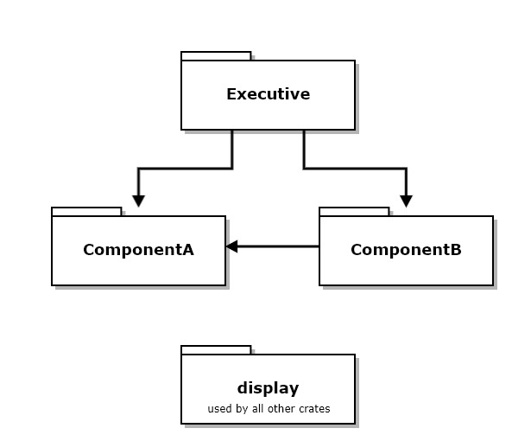
Example – Crates and Packages
The diagram at the right shows a set of crates that work together to implement some functionality.
The diagram shows dependency relationships between crates.
The ComponentA crate provides an interface and object factory to allow ComponentB and Executive to use it without binding to its implementation details.
The Executive package consists of all three of these crates.
Code for this example: https://github.com/JimFawcett/RustBasicDemos/ in code_structure_demo

Slide 12
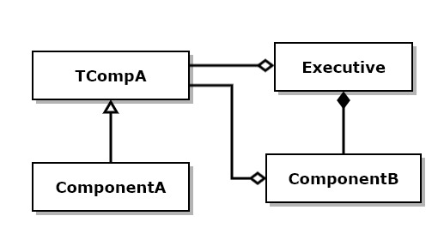
Example - Structs
This diagram shows structs that are defined in each of the files from the previous slide.
TCompA is an interface¹ trait for ComponentA
ComponentA implements the trait to provide exported services
ComponentB doesn’t provide an interface
ComponentB uses ComponentA through its interface trait and factory²
Executive composes ComponentB and uses ComponentA through its trait and factory
Rust does not have an interface construct. We use traits with virtual functions for that purpose.
ComponentA’s factory is implemented with a function, declared and implemented in ComponentA.

Slide 13
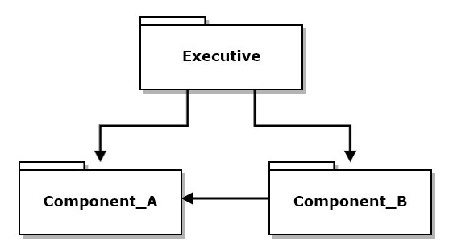
Use of Interfaces and Factories
pub fn get_instance() -> Box<dyn TCompA> { let a = ComponentA::new(); Box::new(a) }
pub fn get_instance() -> Box<dyn TCompA> { let a = ComponentA::new(); Box::new(a) }
If you look at interface trait TCompA you will see it has no implementation detail.
pub Trait TCompA {
fn do_work(&self);
fn get_msg(&self) -> String;
fn set_msg(&mut self, m:&str);
}
pub fn get_instance() -> Box<dyn TCompA> {
Box::new(ComponentA::new())
}
That means that Executive and Component_B have no build dependencies on Component_A. Component_A can change any of its implementation without affecting Executive or Component_B as long as the interface, IComponent_A and factory function signature don’t change.

Slide 14
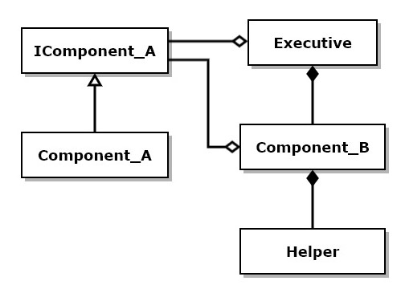
Object Factories
There are two kinds of object factories:
Factories that return a smart pointer referring to a newly created instance of a component in the native heap. std::unique_ptr<IComponent> createComponent() { … }
Singleton factories that return a reference to a static component. IComponent& getComponentInstance() { … }
You can find examples of both in the Logger repository: https://JimFawcett.github.io/Logger.html in files ITestLogger.h and IQTestLogger.h

Slide 15
C++ Models Model 2 - Compilation
Jim Fawcett
https://JimFawcett.github.io

Slide 16
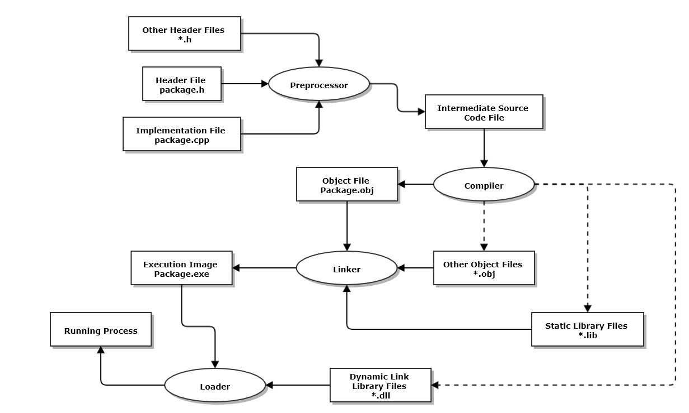
2. Compilation Model https://jimfawcett.github.io/CppStory_Models.html#compil
The C++ build process translates each *.cpp file independently.
We say that a *.cpp file and all its include files are a translation unit.
Translation begins by inserting the contents of each included *.h file into the *.cpp file at the site of the include.
That is then compiled into an object file, *.obj.
That process is repeated for all cpp files in the current build.
The linker then binds the obj files into an executable.

Slide 17
Compilation Model
One consequence of this build process is the definition first rule.
The C++ language was designed to support one-pass compilation.
The compiler can’t layout code for an instance until it knows the instance’s size.
That comes from seeing the class, struct, or enum declaration.
You can create a pointer to an incomplete type, e.g., forward declaration like class A; but you can’t use it until after the type is completed with a declaration.
Definition First Rule
Instances of classes, structs, and enums can be created only after those entities are declared.
If you think of a cpp file as an ocean of syntax and its include files as syntax tributaries filling the ocean, then the entity declarations must be upstream from the point of entity creation. Here, upstream simply means compiler scan order.

Slide 18
C++ Models Model 3 - Execution
Jim Fawcett
https://JimFawcett.github.io

Slide 19
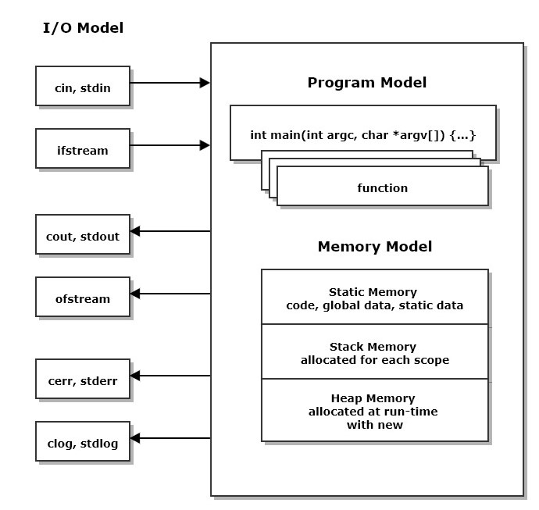
3. Program Execution https://jimfawcett.github.io/CppStory_Models.html#execute
When the executable for a program is loaded:
Initialization code provided by the compiler executes
Then the function main is entered.
main is just a function that is defined to the linker as the entry point for processing.
Some project types will use other names, e.g., WinMain
Any function may call other functions within the executable.

Slide 20
Use of program memory
When the thread of execution enters a function an allocation of stack memory is used to store function parameters and any local data defined in the function.
The same thing happens for every scope, defined by a matching pair of braces, { and }. For example, an if statement, using braces, allocates stack memory to hold data local to its scope.
A program may place any of its entities, e.g., an instance of a user-defined class, into static memory, stack memory, or heap memory.
We will discuss the consequences of that in the next section.

Slide 21
Interaction with the Execution Environment
There are two primary ways for a C++ program to observe and use its execution environment:
Use a stream object like std::cout or std::cin.
Classes for streams are provided by the standard library, via include statements: #include<iostream>, #include<fstream>, …
The std::iostream library defines global objects: std::cout, std::cin, std::cerr, std::clog that are always accessible to a program.
The program may use services of its platform API by including certain header files specific to each platform, e.g., windows, linux, …

Slide 22
C++ Models Model 4 - Memory
Jim Fawcett
https://JimFawcett.github.io

Slide 23
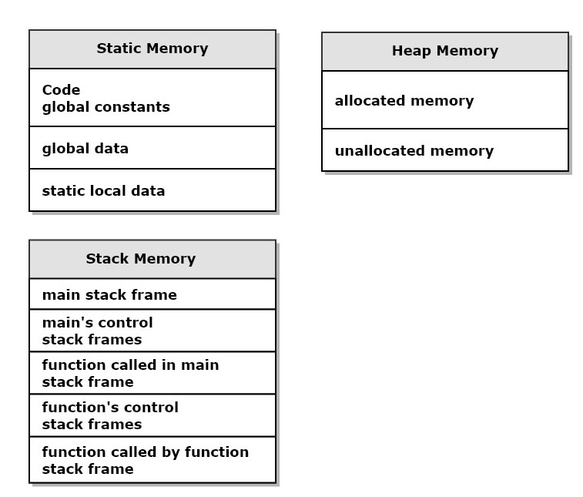
4. Memory Model https://JimFawcett.github.io/CppStory_Models.html#memory
Static memory is used to store code and entities that live for the entire program execution
Stack memory is used as scratch-pad to store information needed in each scope, e.g., local data. It becomes invalid when the thread of execution leaves the scope.
Heap memory is used to store entities that live from the time the program creates them with a call to new until the program discards them with a call to delete

Slide 24
Control of entity placement in memory
The compiler places all code and global data in static memory.
A program can place an entity instance in static memory by qualifying its declaration with the keyword static.
C++ code also places entities in stack memory by calling a function, placing function parameters and local data in its stack frame.
Also, every local scope, defined by braces, { and }, creates a new allocation of stack memory to hold data local to that scope.
An entity instance is placed in heap memory by a call to new and removed with a call to delete.

Slide 25
C++ Models Model 5 - Classes
Jim Fawcett
https://JimFawcett.github.io

Slide 26
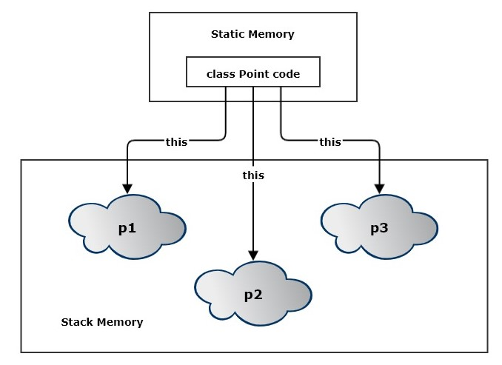
5. Classes https://jimfawcett.github.io/CppStory_Models.html#class
Classes are units of data management.
A class is a “cookie cutter” for stamping out class instances in memory.
Each instance has member data that has been initialized by a class constructor.
When an instance method is invoked, say p1.name(“p1”), the code in static memory needs to know which instance invoked its name method. Each call of a non-static method sends its address to its code in static memory in an implicit argument called “this”. The code may then mutate p1’s state as defined by the method using this pointer.

Slide 27
Point Class
A class designed to represent points in some space might be declared as shown on the right.
The space might represent physical space-time, so the coordinates might be physical x, y, z, t values representing width, depth, height, and time.
If we declare an instance of Point locally in some function, the member data of the class will be stored in stack memory.
However, the std::vector<double> stores its contents, the coordinates in this case, in the native heap.
Strings do the same thing. All string characters are also stored in the heap.
The size of this object, used by the compiler to set up allocation for the function’s stack frame, is just the static memory consumed by each data member. It does not include heap allocations, because that is allocated at run time, not by the compiler. This is what the sizeof operator measures.
class Point {
public:
using iterator = std::vector<double>::iterator;
using const_iterator = std::vector<double>::const_iterator;
Point(size_t N, const std::string& name = "none");
Point(std::initializer_list<double> il);
void name(const std::string& name);
std::string name() const;
double& operator[](size_t i);
double operator[](size_t i) const;
size_t size() const;
iterator begin();
iterator end();
const_iterator begin() const;
const_iterator end() const;
private:
std::string name_ = "unspecified";
std::vector<double> coordinates_;
};

Slide 28
C++ Models Model 6 – Object Model
Jim Fawcett
https://JimFawcett.github.io

Slide 29
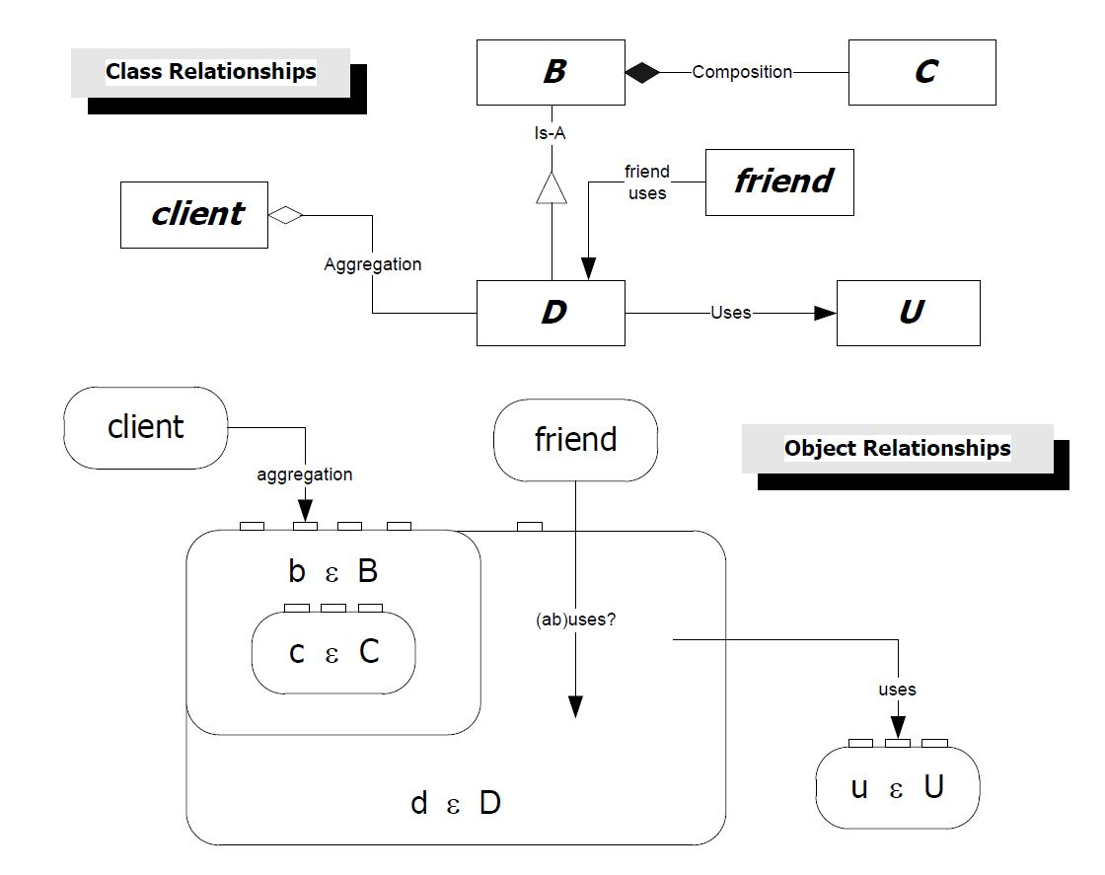
6. C++ Object Model https://jimfawcett.github.io/CppStory_Models.html#objmodel
The C++ object model is concerned with how compound objects are laid out in memory.
Structs and classes support five relationships that bind objects together to build compound objects: inheritance, composition, aggregation, using, and friend-ship.
Inheritance causes base class instances to be encapsulated within the memory footprint of instances of classes that derive from them.
Composition does the same thing. A composing class instance contains an instance of each class it composes.
These are strong owning relationships. Weak ownership – aggregation, and non-owning relationships - using, and friend-ship - do not cause this encapsulation.

Slide 30
Object Construction
When B is constructed its C component is constructed in its memory footprint. That means that C is constructed as part of B’s construction.
When D is constructed its base B is constructed in its memory footprint. So B is constructed as part of D’s construction.
These are required events that affect the syntax of the constructors we write.
We use an initialization sequence for B to determine how C is to be constructed.
Similarly, D uses an initialization sequence to determine how B is constructed.
Code for this example: https://github.com/JimFawcett/CppStory in Chapter1-Classes
Documented in: https://JimFawcett.github.io/CppStoryRepo.html
Point::Point(size_t N, const std::string& name) : name_(name)
{
coordinates_.reserve(N);
}
Initialization sequence

Slide 31
Value Types
Value types have instances that can be copied and assigned.
C++ has been designed from the beginning to support creation of user-define value types.
If class member data and base member data have correct copy and assignment semantics, copies are made by copying each of the class and base members, and for assignment the process is the same. Examples are classes with only fundamental types and STL containers as data members.
If class members do not have correct copy and assignment semantics C++ supports the definition of copy constructors and assignment operators that the developer designs to provide correct copy and assignment operations. Examples are classes that contain pointer data members.
Point is a value type.
class Point {
public:
using iterator = std::vector<double>::iterator;
using const_iterator = std::vector<double>::const_iterator;
Point(size_t N, const std::string& name = "none");
Point(std::initializer_list<double> il);
void name(const std::string& name);
std::string name() const;
double& operator[](size_t i);
double operator[](size_t i) const;
size_t size() const;
iterator begin();
iterator end();
const_iterator begin() const;
const_iterator end() const;
private:
std::string name_ = "unspecified";
std::vector<double> coordinates_;
};

Slide 32
C++ Models Model 7 – Polymorphism
Jim Fawcett
https://JimFawcett.github.io

Slide 33
7. Polymorphism
When a class D derives from some class B it inherits all of the methods and data of B. class D : public B { … };
If there are multiple derived classes: D1, D2, … a base class pointer or reference can be bound to any one of them: B* pB = &D1 B& br = D2;
Functions that accept a base pointer will accept a base pointer bound to any derived class: fun(pB) This allows fun to process any of the derived objects using syntax specified by the base class.
Inheritance supports two features:
Inheritance of implementation, e.g., all of the methods of a base class
Substitution of derived instances in functions that are typed to accept base pointers or references.
Of these two features, substitutability is the more important. It allows us to build very flexible code.
If we need to add a new derived class, all the functions that accept base pointers or references don’t change. They simply use the base class language, inherited by every derived class, to interact with that input.

Slide 34
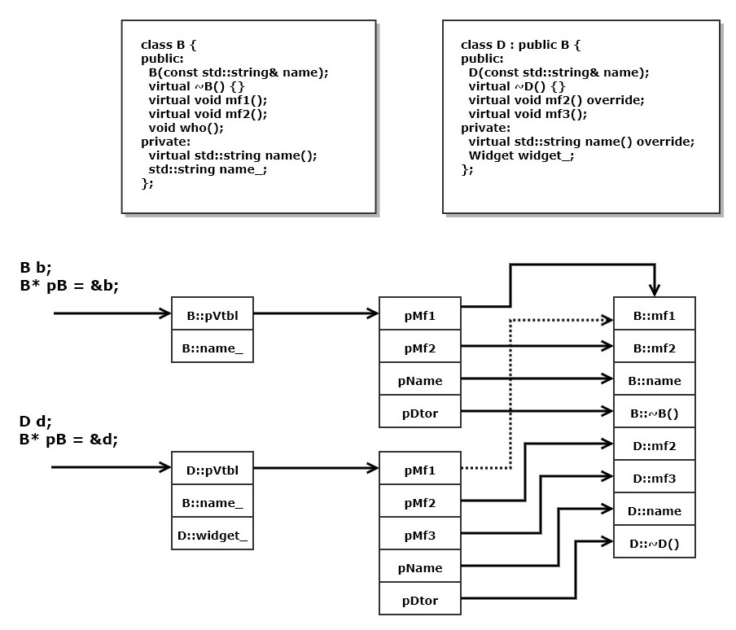
Virtual Function Dispatching
Every class that includes one or more virtual functions has a Virtual function pointer Table (VTBL)
The class B defines three virtual functions and for each of those its VTBL has a pointer bound to the code defined for that function.
Class D, derived from B, has a VTBL with pointers to code for each of its functions.
pMf1 points to B:Mf1 because D did not override that method
pMf2 points to D:Mf2 because D did override that method.
pMf3 points to code for a new virtual function defined in D but not in B.
When we invoke a method on a derived instance using a base pointer, the code invoked is reached through one of the VTBL pointers.

Slide 35
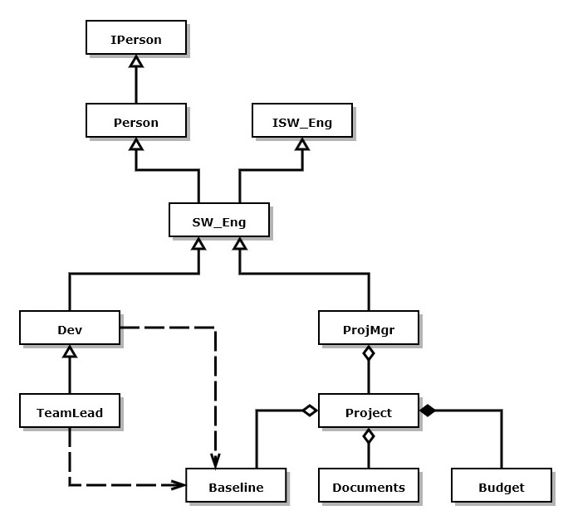
Person Class Hierarchy Example
The class structure shown on the right represents a software development organization.
Software Engineers inherit the person type and implement the ISW_Eng interface. SW_Eng is an abstract base class for all software engineers.
Any function that accepts a pointer to SW_Eng will also accept pointers to Devs, TeamLeads, and ProjMgrs.
If ISW_Eng defines a pure virtual method, say doWork(), any derived class can override that method.
Devs doWork that devs do
TeamLeads doWork that team leads do
ProjMgrs doWork that project managers do
So the doWork() method binds to code based on the type of object bound to an ISW_Eng pointer.

Slide 36
C++ Models Model 8 – Templates
Jim Fawcett
https://JimFawcett.github.io

Slide 37
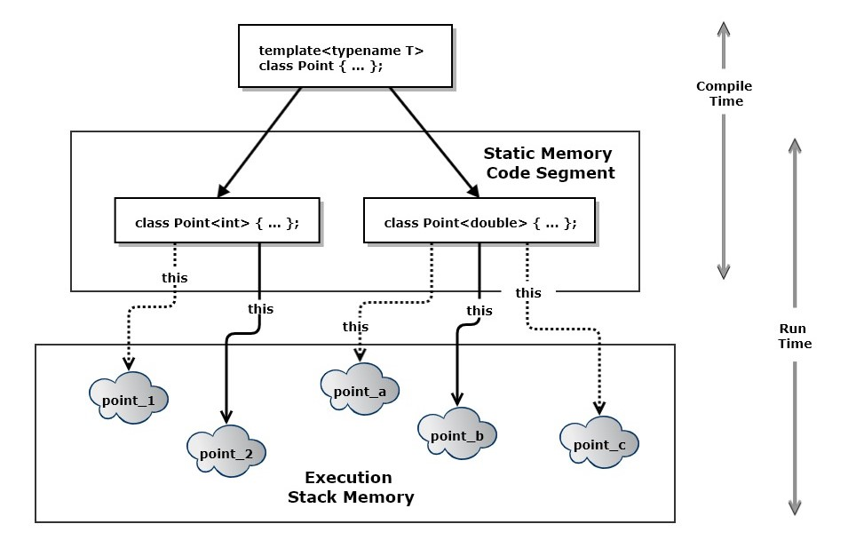
8. Templates https://jimfawcett.github.io/CppStory_Models.html#templ
Function and class templates are code generators that create functions or classes from parameterized patterns.
Function templates generate concrete functions and class templates generate concrete classes when supplied, in application code, with specific types.
The class template, shown top right, generates a point class for each T specified in application code. Here, the using code has instantiated it with two types, int and double, resulting in Point<int> and Point<double>, two distinct classes.

Slide 38
Template Class Example
template<typename T>
Point<T>::Point(size_t N, const std::string& name) : name_(name)
{
coordinates_.reserve(N);
}
template<typename T>
Point<T>::Point(std::initializer_list<T> li) : name_("none") {
for (auto item : li)
coordinates_.push_back(item);
}
template<typename T>
std::string Point<T>::name() const { return name_; }
template<typename T>
void Point<T>::name(const std::string& name) { name_ = name; }
template<typename T>
T& Point<T>::operator[](size_t i) {
if (i < 0 && coordinates_.size() <= i)
throw(std::exception());
return coordinates_[i];
}
// remaining method implementations elided
template<typename T>
class Point {
public:
using iterator = typename std::vector<T>::iterator;
using const_iterator = typename std::vector<T>::const_iterator;
Point(size_t N, const std::string& name = "none");
Point(std::initializer_list<T> il);
void name(const std::string& name);
std::string name() const;
T& operator[](size_t i);
T operator[](size_t i) const;
size_t size() const;
iterator begin();
iterator end();
const_iterator begin() const;
const_iterator end() const;
private:
std::string name_ = "unspecified";
std::vector<T> coordinates_;
};

Slide 39
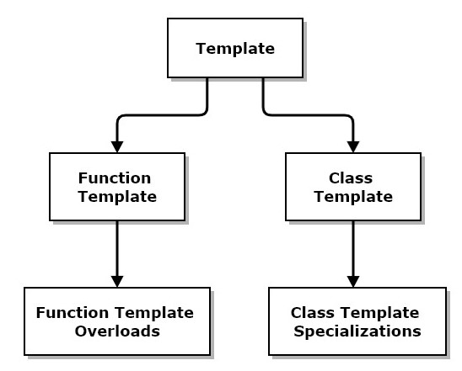
Template overloads and Specialization
Template specification provides a pattern for generating specific code for a function or class.
That gets instantiated by something close to substitution, subject to type deduction for classes or overload resolution for functions.
That may work well for most of the types an application uses but may fail for one or more specific types.
In that case, a function may be defined for specific type(s) that has modified code. C++ guarantees that the overload will be chosen if the application supplied type matches the overload.
Similarly, a class may be defined for specific type(s) that has modified code. The language guarantees that the specialization will be chosen, instead of the generic class, if the application type matches the specialization, using template type deduction.
A designer may provide any number of overloads and specializations as needed by the application.

Slide 40
C++ Models Conclusions
Jim Fawcett
https://JimFawcett.github.io

Slide 41
Conclusions
If you understand the 8 models, we’ve covered, I think you will find C++ syntax and semantics to be consistent and sensible.
Some particular parts of the language discussed in the C++ Story but not here are intricate and require some study to master:
Template type deduction
Function overload resolution
Template metaprogramming
But template type deduction and template function resolution just seem to work without deep analysis most of the time.
Template metaprogramming is used largely by library developers, but is getting easier to use with each new version of the C++ standard.

Slide 42
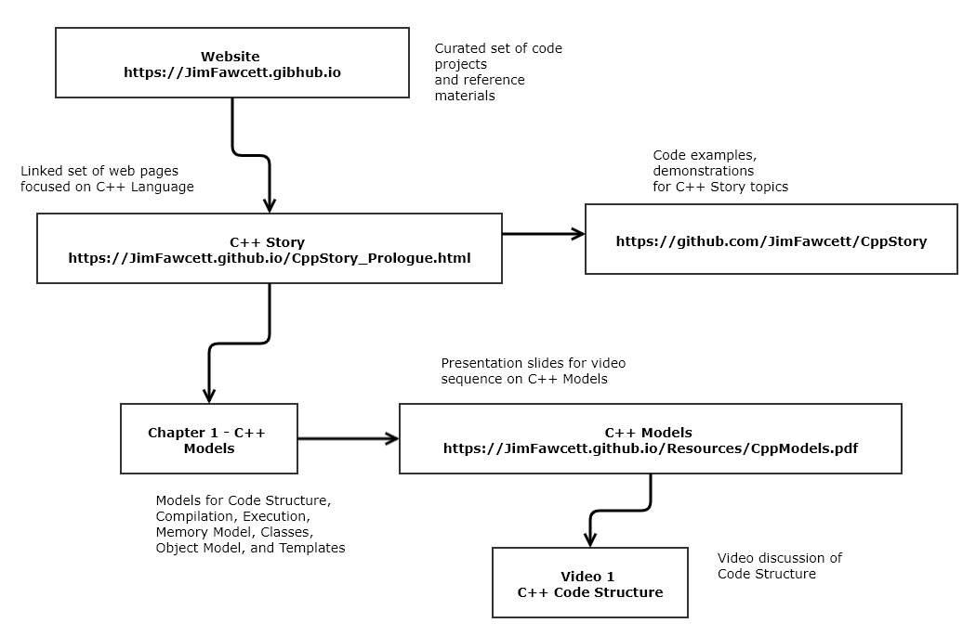
Location of Resources

Slide 43
Presentation Resources
The ideas discussed in this presentation are drawn from a web page: https://JimFawcett.github.io/CppStory_Models.html which is part of the CppStory: https://JimFawcett.github.io/CppStory_Prologue.html
And code examples for the story are documented here: https://JimFawcett.github.io/CppStoryRepo.html
These slides are available here: https://JimFawcett.github.io/Resources/CppModels.pdf

Slide 44
Epilogue
In this presentation we’ve discussed models for:
Code Structure
Compilation
Program Execution
Program use of Memory
Classes
C++ Objects
Polymorphism
Templates
We’ve focused on models and ideas, not the details of design and syntax.
You can find an extended discussion of C++ in the CppStory: https://JimFawcett.github.io/CppStory_Prologue
There is a lot of sample code for the CppStory: https://github.com/JimFawcett/CppStory
With documentation: https://JimFawcett.github.io/CppStoryRepo.html

